Slide 1
Operating Systems Lecture 1 Introduction

Slide 2
Course Description
This course covers concepts related to modern existing operating systems.
It focuses on principles, structures, policies and mechanisms of current open-source and closed-source systems.
It includes an overview of operating systems, Process Management, Memory Management, Deadlocks, Storage and Device Management.

Slide 3
Text Book
Operating Systems Concepts: Essentials - 10th Edition
By: Silberschatz, Galvin, and Gagne
Modern Operating Systems – 4thEdition
By: Tanenbaum, A.S. and Bos, H.

Slide 4
What is an Operating System (1)?
A modern computer consists of:
One or more processors
Main memory
Disks
Printers
Various input/output devices.
Managing all these varied components requires a layer of software – the Operating System (OS).

Slide 5
What is an Operating System (2)?
An operating system (OS) is a software that manages computer hardware and software resources and provides common services for computer programs.
It acts as an intermediary between the computer's hardware and the applications running on it, facilitating the execution of programs and providing a user interface.

Slide 6
What is an Operating System (2)?
An OS is a program that acts as an intermediary between a user and the computer hardware.
OS goals :
Control/execute user/application programs.
Make the computer system convenient to use.
Ease the solving of user problems.
Use the computer hardware in an efficient manner

Slide 7
What is an Operating System (2)?
An OS is a program that acts as an intermediary between a user and the computer hardware.
Common examples of operating systems include:
Microsoft Windows
macOS
Linux
Unix
Android

Slide 8
Computer System Structure
Computer system can be divided into four components:
Hardware – provides basic computing resources
CPU, memory, I/O devices
Operating system
Controls and coordinates use of hardware among various applications and users
Application programs – define the ways in which the system resources are used to solve the computing problems of the users
Word processors, compilers, web browsers, database systems, video games
Users
People, machines, other computers

Slide 9
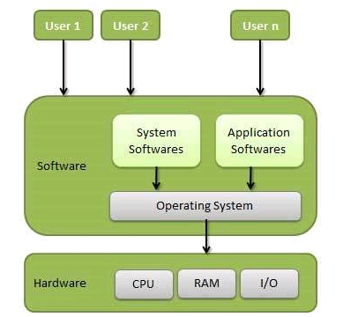
Static View of System Components
An operating system is a program that acts as an interface between the user and the computer hardware and controls the execution of all kinds of programs.

Slide 10
What Operating Systems Do
Depends on the point of view
Users want convenience, ease of use and good performance
Don’t care about resource utilization
But shared computer such as mainframe must keep all users happy (How?).
operating system is designed to maximize resource utilization to assure that all available CPU time, memory, and I/O are used efficiently and that no individual user takes more than her fair share.
Users of workstations have used local resources but frequently use shared resources from servers (printer)
The operating system is designed to evaluate the individual usability and resource utilization.
Handheld (ex: smartphones) computers are resource poor, optimized for usability and battery life.
Some computers have little or no user interface, such as embedded computers in devices.

Slide 11
Operating System Definition
System View
OS is a resource allocator
Manages all resources
Decides between conflicting requests for efficient and fair resource use
OS is a control program
Controls execution of programs to prevent errors and incorrect use of the computer

Slide 12
The OS consists three-main components
Kernel: The kernel is the core component of an operating system. It acts as a bridge between software applications and the underlying hardware.
File Management System: Organizes and manages files.
User Interface: The user interface (UI) is the component that allows users to interact with the operating system and its applications.

Slide 13
OS Kernel Functions
The Kernel provides basic-level control over all of the computer hardware devices. Main roles include reading data from memory and writing data to memory, processing execution orders, determining how data is received and sent by I/O devices such as the monitor and keyboard.
Create and remove processes
Process interrupt requests
Schedule processes
Send processes
Provide communication and synchronization between processes
Support file system
Manage main memory addresses

Slide 14
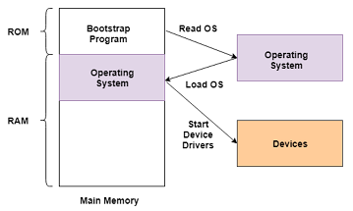
Computer Startup
bootstrap program is loaded at power-up or reboot
Typically stored in ROM or EPROM, generally known as firmware
Initializes all aspects of system
Loads operating system kernel and starts execution
ROM : read-only memory
EPROM : erasable programmable read-only memory
Bootstrapping Process

Slide 15
Types of OS According to users/tasks
Single user, single task
i.e., MS-DOS
Single user, multitasking
i.e., Windows, Mac OS, Unix, Linux
Multi-user multitasking
i.e., Unix, OS/390 (Mainframe)

Slide 16
Types of OS
Time Sharing OS
Real Time OS
Networking OS
Multiprocessor OS

Slide 17
Time-Sharing Operating Systems
Each task has given some time to execute, so that all the tasks work smoothly.
Each user gets time of CPU as they use single system.
Each user has at least one separate program in memory.
The task can be from single user or from different users also.

Slide 18
Real-Time Operating System
These systems are characterized by having time as a key parameter.
The time interval required to process and respond to inputs is very small.
Example: missile systems, air traffic control systems, robots etc

Slide 19
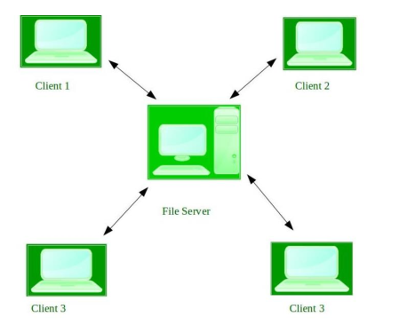
Network Operating System
This system runs on a server and provides the capability to manage data, users, groups, security, applications, and other networking functions.
It allows shared access of files, printers, security, applications, and other networking functions over a small private network

Slide 20
Multiprocessor Operating System
Multiprocessor Operating System refers to the use of two or more central processing units (CPU) within a single computer system.
These types of systems are used when very high speed is required to process a large volume of data.
They are generally used in environment like satellite control, weather forecasting etc.

Slide 21
Multiprocessor Operating System
Also known as parallel systems
Advantages include:
Increased throughput
Economy of scale
Increased reliability
Two types:
Asymmetric Multiprocessing – each processor is assigned a specie task.
Symmetric Multiprocessing – each processor performs all tasks

Slide 22
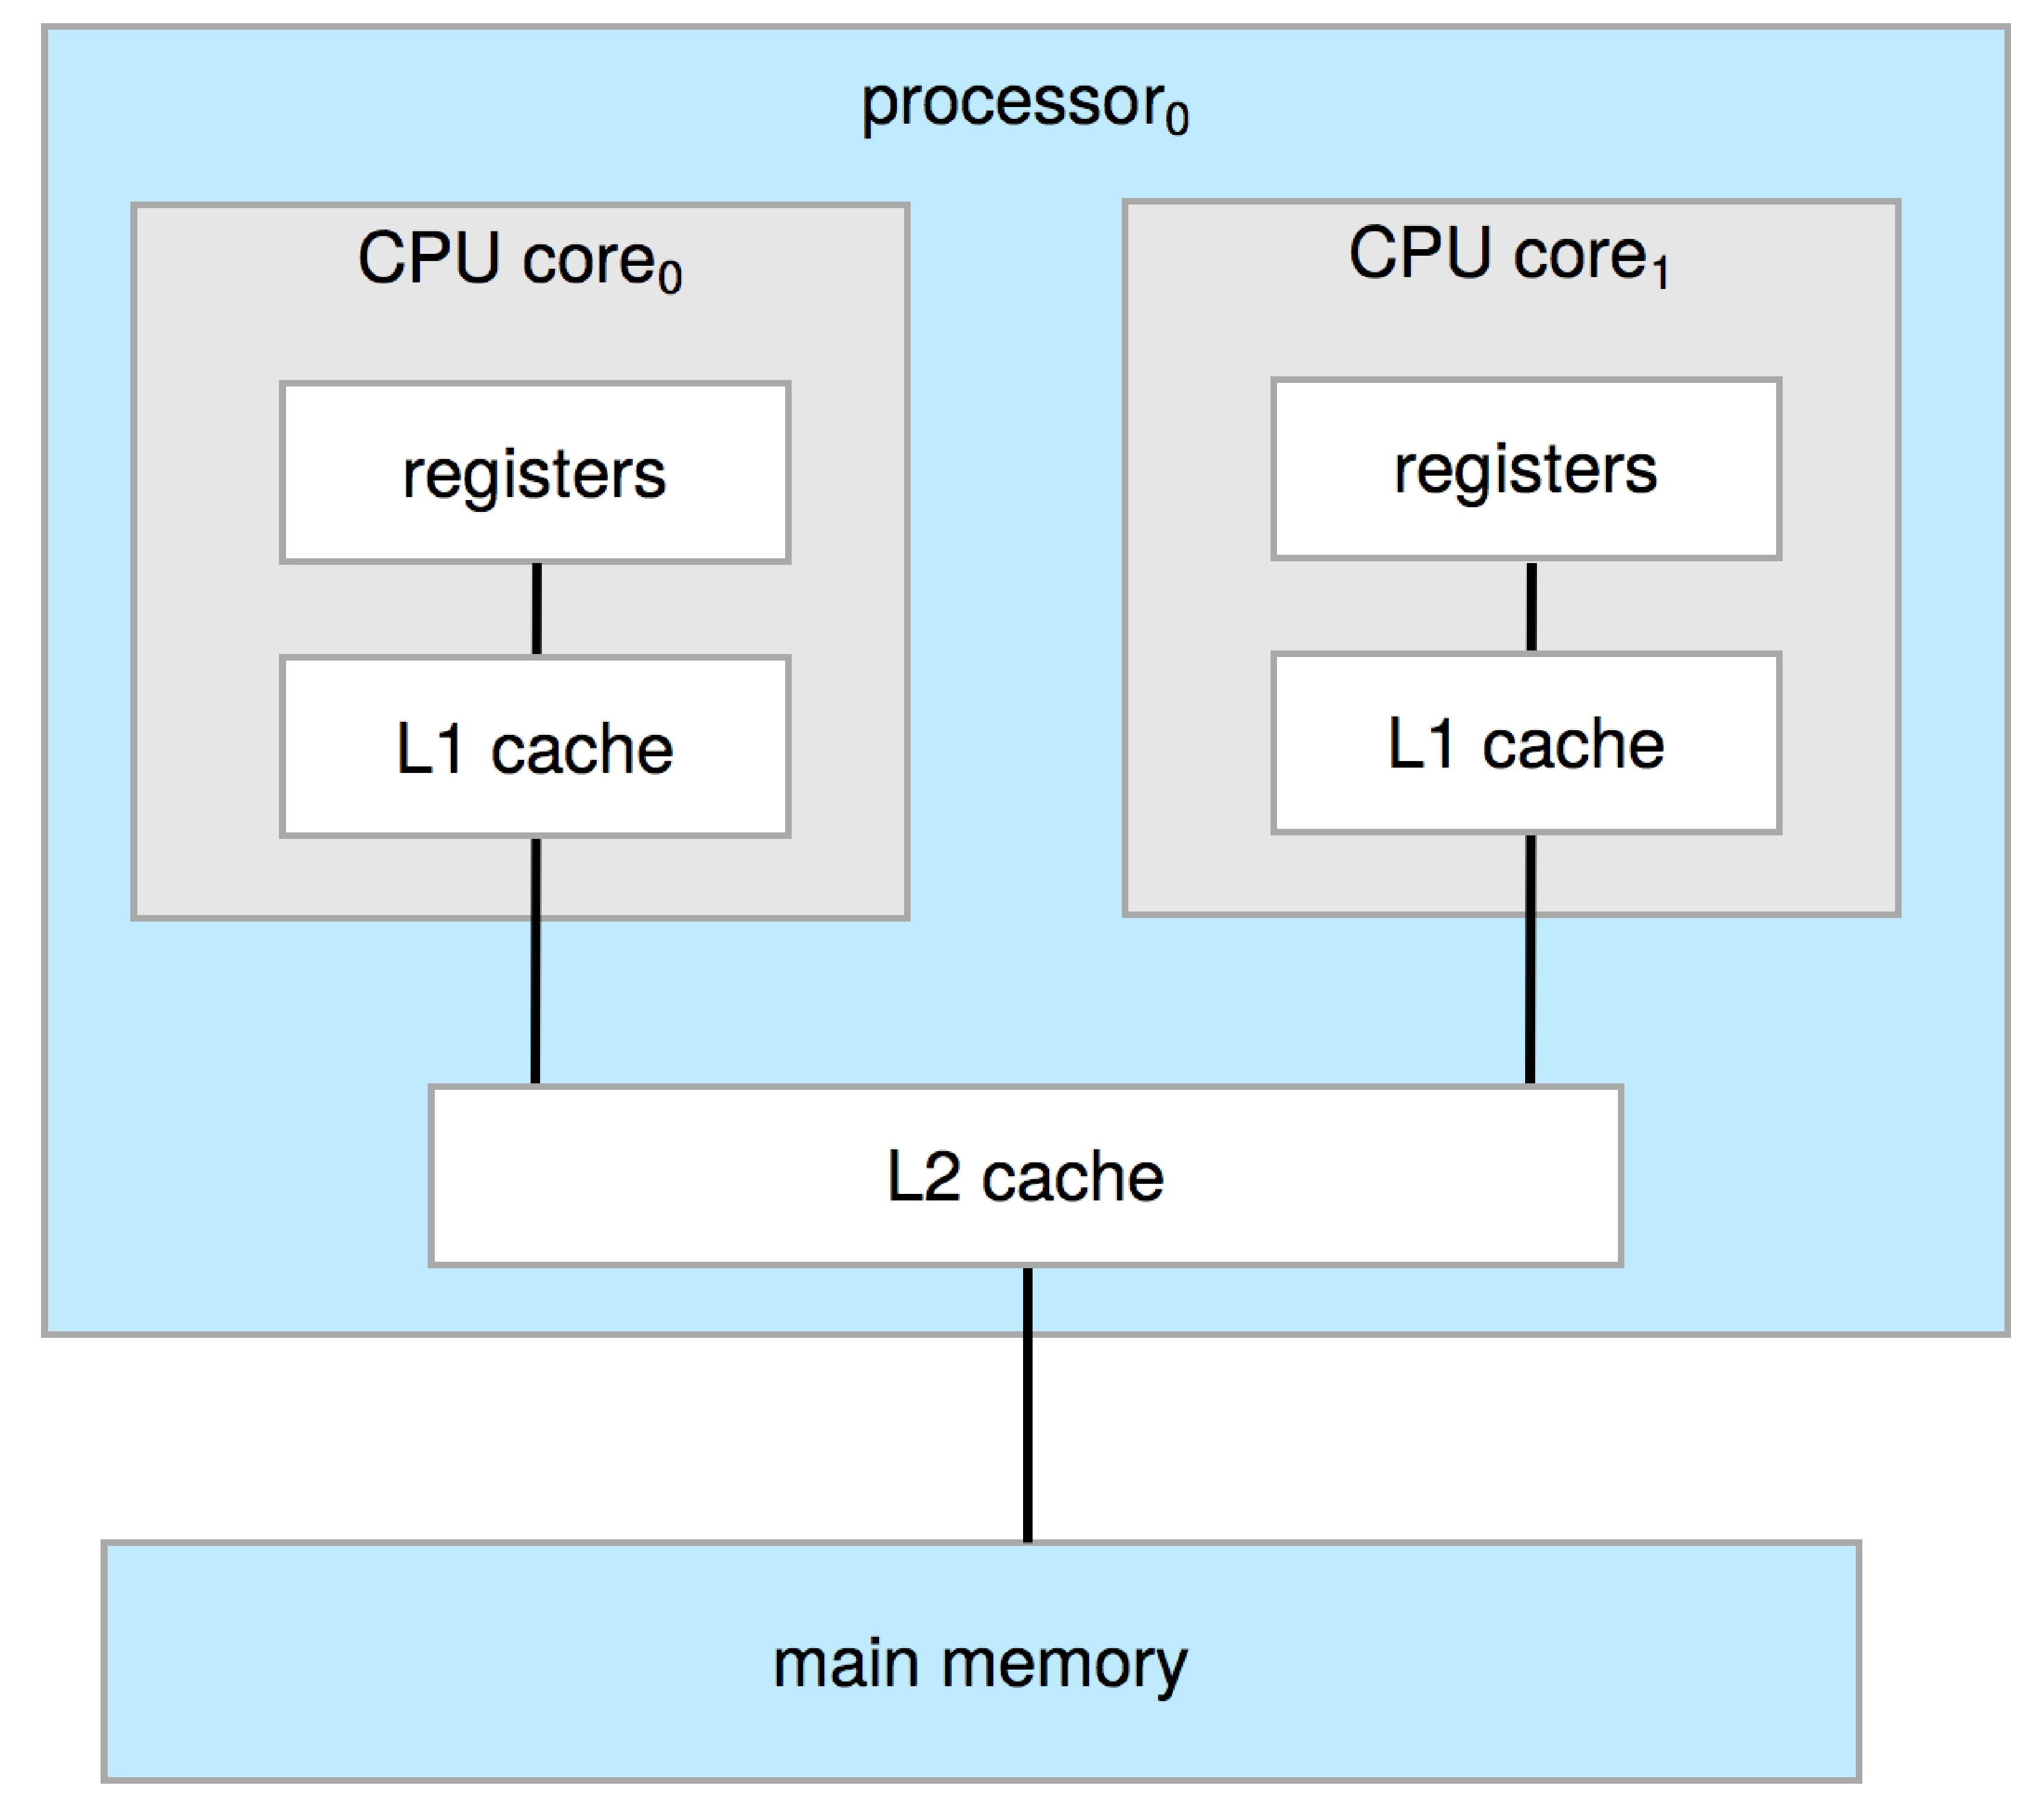
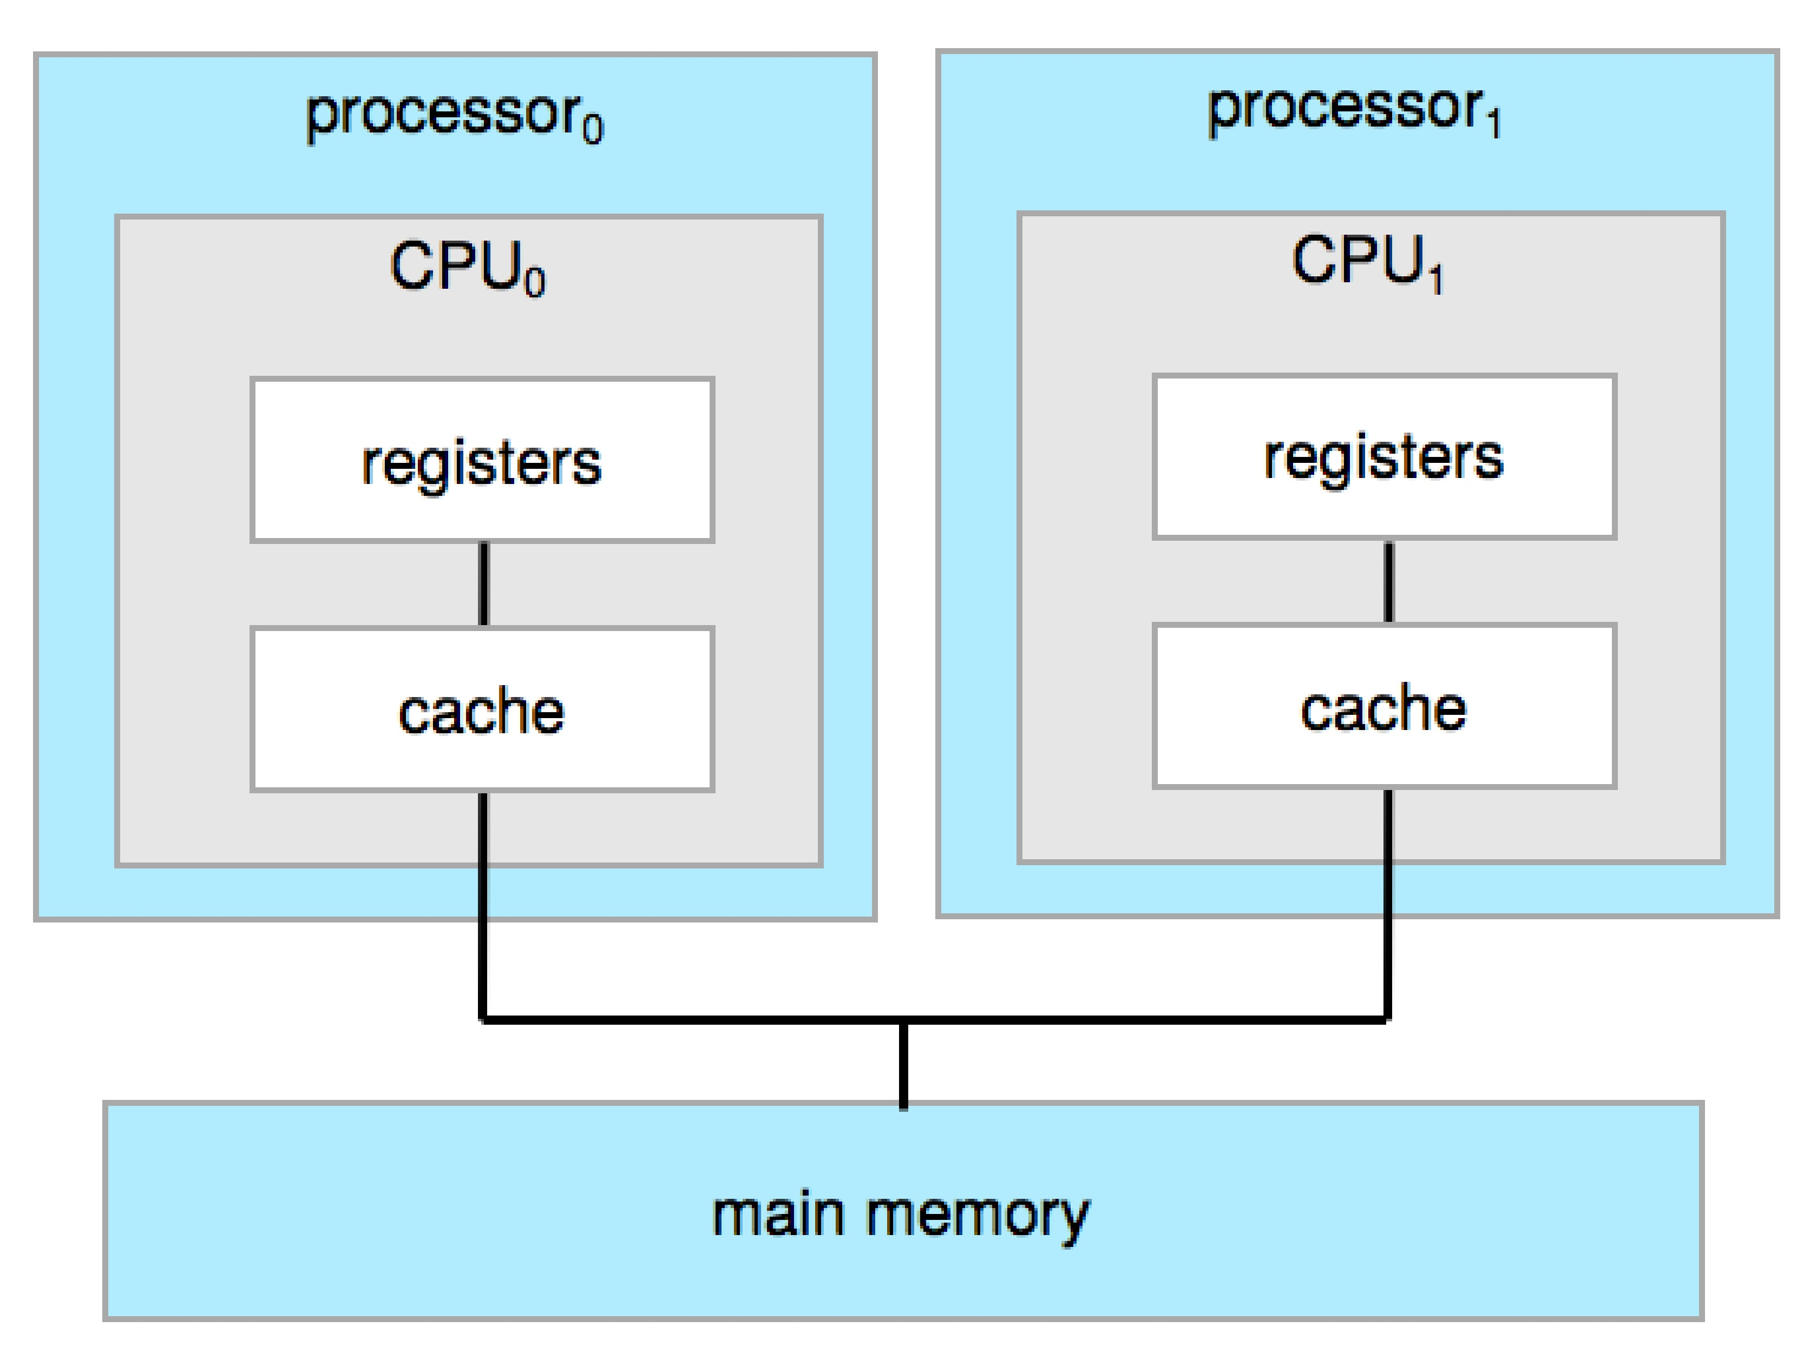
Multiprocessor Systems
two cores on the same chip (multicore)
Symmetric multiprocessing architecture

Slide 23
Cluster
Cluster is a set of connected computers that work together so that, in many respects, they can be viewed as a single system
Like multiprocessor systems, but multiple systems working together
Usually sharing storage via a storage-area network (SAN)
Provides a high-availability service which survives failures
Asymmetric clustering has one machine in hot-standby mode.
If that server fails, the hot-standby host becomes the active server.
Symmetric clustering has multiple nodes running applications, monitoring each other
Some clusters are for high-performance computing (HPC)
Applications must be written to use parallelization

Slide 24
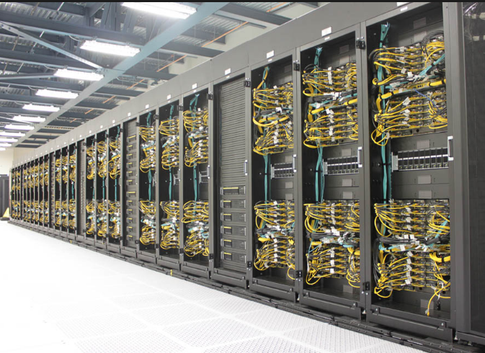
Clustered Systems

Slide 25
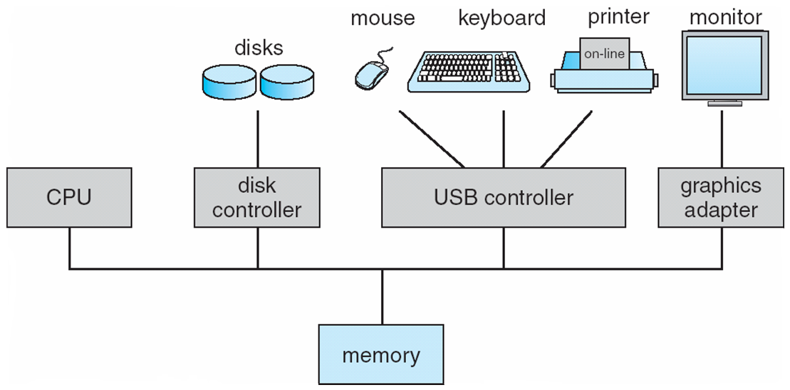
Computer System Organization
Computer-system operation
One or more CPUs, device controllers connect through common bus providing access to shared memory
Concurrent execution of CPUs and devices competing for memory cycles

Slide 26
Storage Definitions and Notation Review
The basic unit of computer storage is the bit. A bit can contain one of two values, 0 and 1. All other storage in a computer is based on collections of bits. Given enough bits, it is amazing how many things a computer can represent: numbers, letters, images, movies, sounds, documents, and programs, to name a few. A byte is 8 bits, and on most computers it is the smallest convenient chunk of storage. For example, most computers don’t have an instruction to move a bit but do have one to move a byte. A less common term is word, which is a given computer architecture’s native unit of data. A word is made up of one or more bytes. For example, a computer that has 64-bit registers and 64-bit memory addressing typically has 64-bit (8-byte) words. A computer executes many operations in its native word size rather than a byte at a time.
Computer storage, along with most computer throughput, is generally measured and manipulated in bytes and collections of bytes.
A kilobyte, or KB, is 1,024 bytes
a megabyte, or MB, is 1,024² bytes
a gigabyte, or GB, is 1,024³ bytes
a terabyte, or TB, is 1,024⁴ bytes
a petabyte, or PB, is 1,024⁵ bytes
Computer manufacturers often round off these numbers and say that a megabyte is 1 million bytes and a gigabyte is 1 billion bytes. Networking measurements are an exception to this general rule; they are given in bits (because networks move data a bit at a time).

Slide 27
Storage Structure
Main memory – only large storage media that the CPU can access directly
Random access
Typically volatile
Secondary storage – extension of main memory that provides large nonvolatile storage capacity
Hard disks – rigid metal or glass platters covered with magnetic recording material
Disk surface is logically divided into tracks, which are subdivided into sectors
The disk controller determines the logical interaction between the device and the computer
Solid-state disks – faster than hard disks, nonvolatile
Various technologies
Becoming more popular

Slide 28
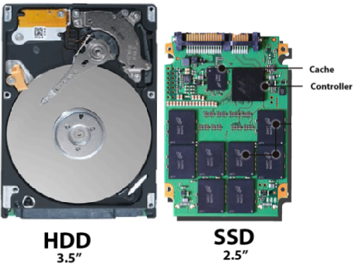
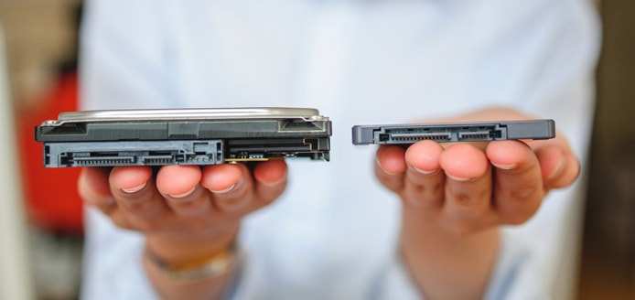
Storage Structure
Hard disk drives (left) typically come in standard sizes, while the appearance of solid-state drives can vary slightly.

Slide 29
Storage Hierarchy
Storage systems organized in hierarchy
Speed
Cost
Volatility
Caching – copying information into faster storage system; main memory can be viewed as a cache for secondary storage
Device Driver for each device controller to manage I/O
Provides uniform interface between controller and kernel

Slide 30
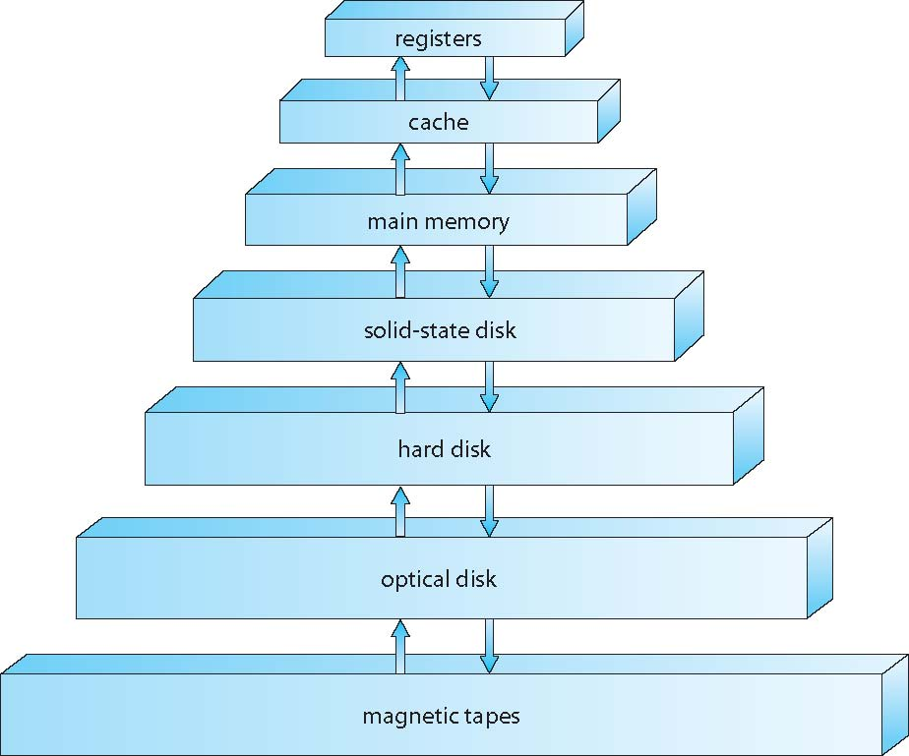
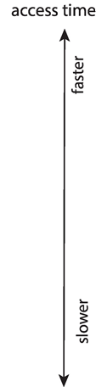
Storage-Device Hierarchy

Slide 31
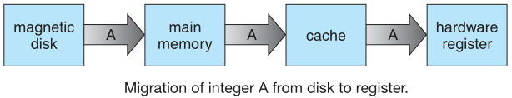
Caching
Important principle, performed at many levels in a computer (in hardware, operating system, software)
Usually, if information is used, then it copied from slower to faster storage temporarily (ex: from main memory to cache).
How it works?
Faster storage (cache) checked first to determine if information is there
If it is, information used directly from the cache (fast)
If not, data copied to cache and used there
Main memory can be viewed as a fast cache for secondary storage (How?)

