Slide 1
Operating Systems Operating System services Lecture 2

Slide 2
Operating-System Structures
Outlines
Operating System Services
User Operating System Interface
System Calls
Types of System Calls
System Programs

Slide 3
Operating-System Structures
An operating system provides the environment within which programs are executed.
Operating System provides services to programs and to the users of those programs.
Different operating systems may have different services provided.
Following are a few common services provided by an operating system for users:
User interface
Program execution
I/O operations
File-system manipulation
Communications
Error detection

Slide 4
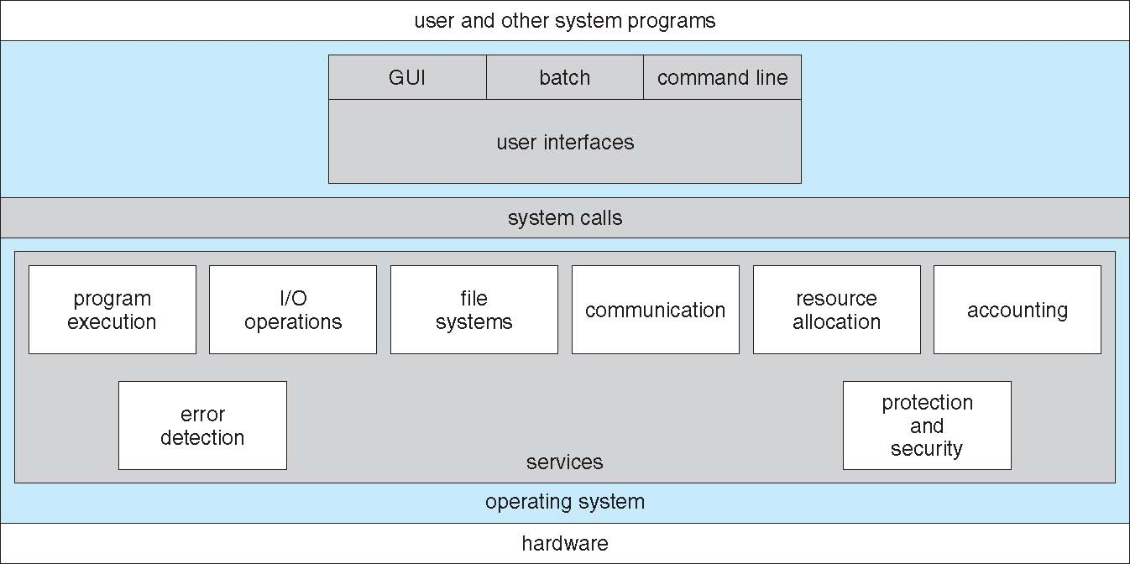
A View of Operating System Services

Slide 5
Operating System services
Common services provided by an operating system for users:
User interface
Program
I/O operations
File-system manipulation
Communications
Error detection

Slide 6
Operating System services
common services provided by an operating system for users:
User interface - Almost all operating systems have a user interface (UI).
Varies between:
Graphics User Interface (GUI) :
User-friendly desktop metaphor interface
Usually mouse, keyboard, and monitor
Icons represent files, programs, actions, etc
Command-Line (CLI) : uses text commands
Batch Interface: commands are entered into files, and those files are executed.
Program execution - The system must be able to load a program into memory and to run that program, end execution, either normally or abnormally/forcefully (indicating error).

Slide 7
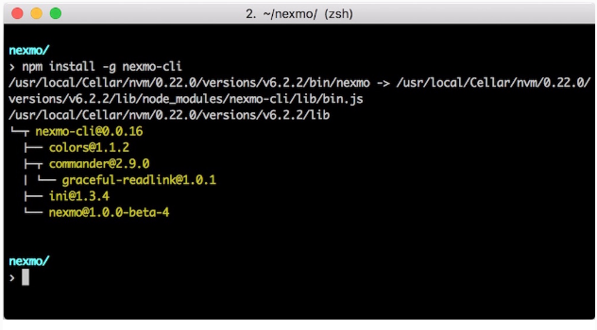
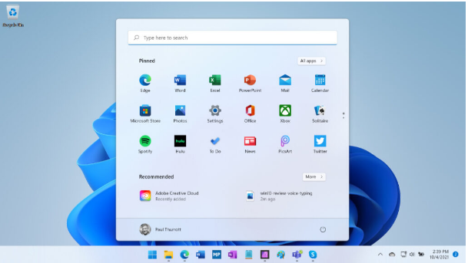
GUI vs CLI

Slide 8
Operating System services con’td
3. I/O operations -
An OS controls the communication between the operators and device drivers.
A running program may require I/O (ex: CD/DVD, Screen).
For efficiency and protection, users usually cannot control I/O devices directly.
4. File-system manipulation –
operating system allows users to create and delete files by specific name along with extension, search for a given file and / or list file information.

Slide 9
Operating System services con’td
5. Communications – Processes may exchange information, on the same computer or between computers over a network
Communications may be via shared memory or through message passing (packets moved by the OS)
6. Error detection – Errors may occur within CPU, memory hardware, I/O devices and in the user program. For each type of error, the OS takes right action for ensuring correct and consistent computing.

Slide 10
Operating System services con’td
Another set of OS functions exists for ensuring the efficient operation of the system itself via resource sharing
1) Resource allocation - Many types of resources - CPU cycles, main memory, file storage, I/O devices.
2) Accounting - To keep track of which users use how much and what kinds of computer resources.
3) Protection and security –
Protection involves ensuring that all access to system resources is controlled
Security of the system from outsiders requires user authentication, extends to defending external I/O devices from invalid access attempts. Usually by using a password, to gain access to system resources

Slide 11
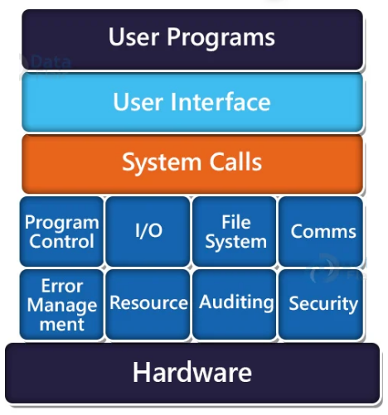
System Calls
A system call is a method that allows a program to request services from the kernel.
System call provides an interface between user programs and operating systems.
The services are provided via API (Application Programming Interface).
System Calls
System Call

Slide 12
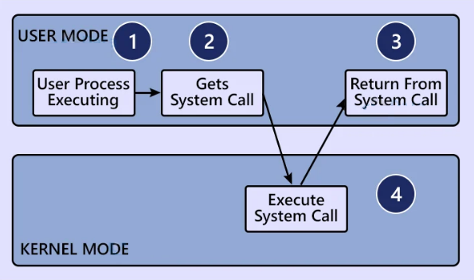
Workings of a System Call in OS
Following are the steps on how a System Call works: Step 1: The processor executes a process in the user mode until a system call interrupts it. Step 2: Then on a priority basis, the system call is executed in the kernel mode. Step 3: After the completion of system call execution, control returns to user mode., Step 4: The execution resumes in Kernel mode.
steps for System Call

Slide 13
Need for System Calls
Following are the reasons we need system calls:
To read and write from files.
To create or delete files.
To create and manage new processes.
To send and receive packets, through network connections.
To access hardware devices.

Slide 14
System Calls
How are system calls made?
System Calls typically written in a high-level language (C or C++)
Mostly accessed by programs via a high-level Application Programming Interface (API) rather than direct system call use
Three most common APIs are Win32 API for Windows, POSIX API for POSIX-based systems (including virtually all versions of UNIX and Linux), and Java API for the Java virtual machine (JVM)

Slide 15
System Calls - Example
Example, the UNIX cp command:
This command copies the input file in.txt to the output file out.txt.
this approach will require a sequence of system calls:
first to write a message on the screen
read from the keyboard the characters that define the two files.
open the input file and create and open the output file.
loop that reads from the input file (a system call) and writes to the output file (another system call)
… etc
cp in.txt out.txt

Slide 16
System Calls - Example
System call sequence to copy the contents of one file to another file
source file
destination file
The process …..
Get input file name
Write to screen
Accept input
Get output file name
Write to screen
Accept input
Open the input file
if file doesn't exist, abort
Create output file
if file exists, abort
Loop
Read from input file
Write to output file
Until read fails
Close output file
Write completion message to screen
Terminate normally
Example of how system calls are used

Slide 17
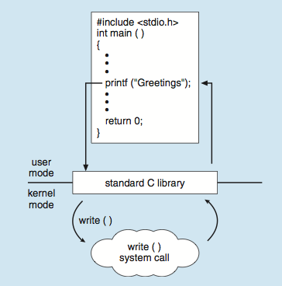
Standard C Library Example
C program invoking printf() library call, which calls write() system call

Slide 18
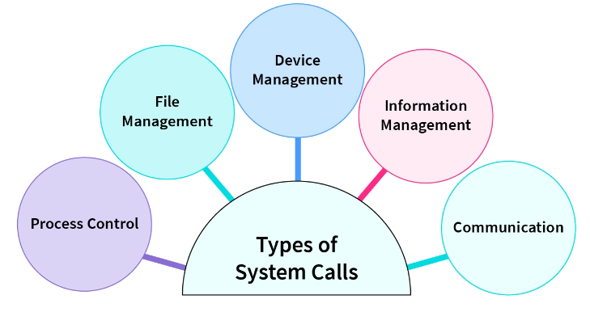
Types of System Calls
There are mainly 5 types of system calls available.
Process control
File management
Device management
Information maintenance
Communications

Slide 19
Types of System Calls
Process control
create process, terminate process, abort
load, execute
get process attributes, set process attributes
wait for time
allocate and free memory
Dump memory if error
Locks for managing access to shared data between processes

Slide 20
Types of System Calls
File management
create file, delete file
open, close file
read, write, reposition
get and set file attributes
Device management
request device, release device
get device attributes, set device attributes

Slide 21
Types of System Calls (Cont.)
Information maintenance
Information about the amount of time that the program execute
get and set process attributes
Communications
create, delete communication connection
There are two common models of inter process communication:
1) Message-passing model
2) Shared-memory model

Slide 22
Next Topic
“Processes”

