Slide 1
Operating Systems Lecture 3 Processes

Slide 2
Processes
Outlines
Process Concept
Process Scheduling
Process Management
Communication

Slide 3
Introduction to Process
A program is a set of instructions or code stored in a file, typically on disk. It represents a passive entity in the sense that it is a static representation of the software.
On the other hand, a process is an active instance of a program that is being executed by the operating system.

Slide 4
Introduction to Process
A process can be defined as an instance of a program that is currently being executed by the operating system.

Slide 5
Process Concept (Cont.)
The OS helps you to create, schedule, and terminates the processes which is used by CPU.
Program becomes process when executable file loaded into memory.
Execution of program started via GUI mouse clicks, command line entry of its name, etc
One program can be several processes
Consider multiple users executing the same program

Slide 6
Introduction to Process
Typically system has many processes, some user, some operating system running concurrently on one or more CPUs
Single-threaded process has one program counter specifying location of next instruction to execute
Process executes instructions sequentially, one at a time, until completion
Multi-threaded process has one program counter per thread

Slide 7
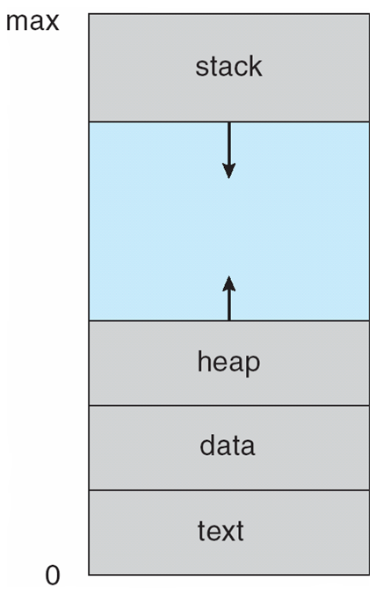
Process in Memory
When a process is executed by the operating system, it is loaded into the computer's memory (RAM).
The memory space allocated to a process is referred to as its "process memory" or "address space.“
The process memory typically consists of several sections, including:
Stack
Heap
Data
Text

Slide 8
Process in Memory
The memory layout of a process is typically divided into multiple sections:
S.N. | Component & Description
1 | Stack section The process Stack contains the temporary data such as method/function parameters, return address and local variables.
2 | Heap section It used for dynamically allocating memory during runtime.
3 | Data section This section contains the global and static variables.
4 | Text section (Code Section) The executable code or the compiled program code (instructions are here)
Process in Memory
Note: a process needs this memory content to run

Slide 9
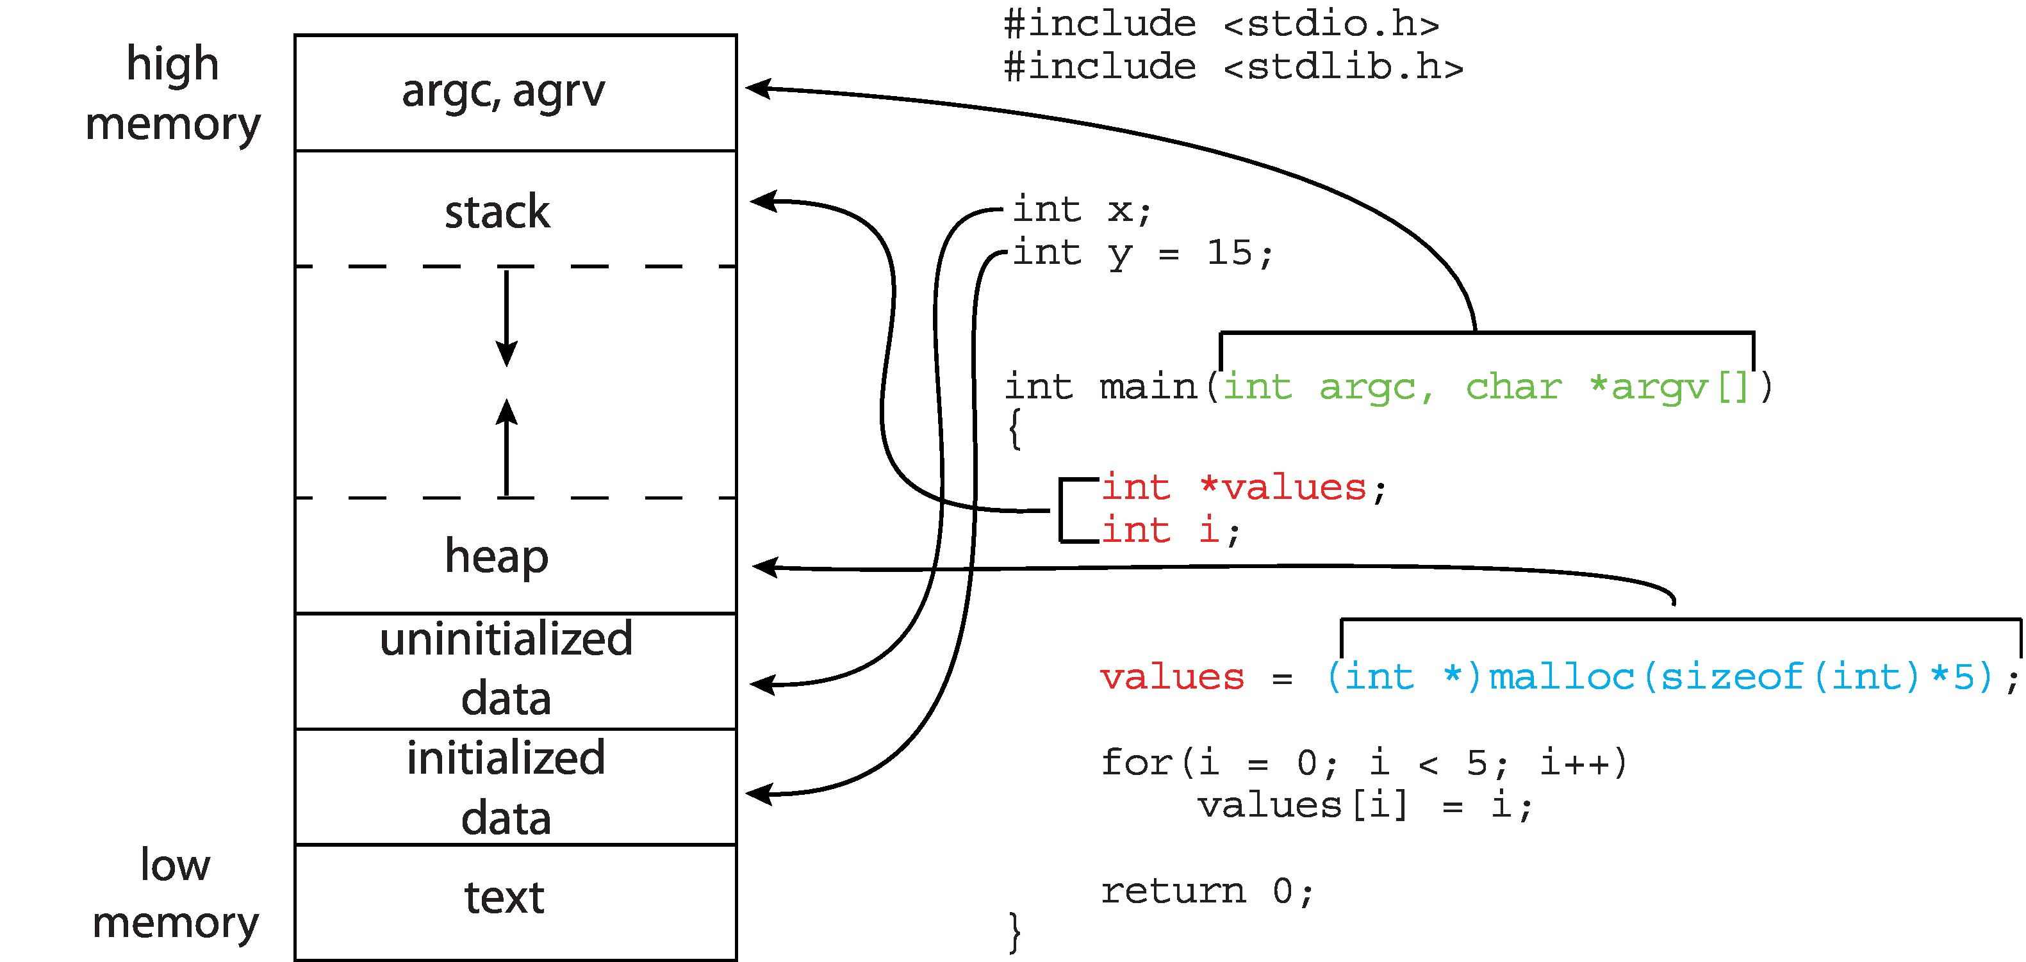
Memory Layout of a C Program
Data section

Slide 10
Program vs Process
Program vs Process
A computer program is a collection of instructions that performs a specific task when executed by a computer.
A process is a program in execution.
For example, when we write a program in C or C++ and compile it, the compiler creates binary code. The original code and binary code are both programs.
When we actually run the binary code, it becomes a process.

Slide 11
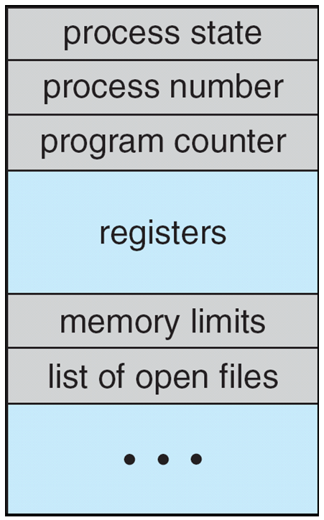
Process Control Block (PCB)
Process Control Block (PCB) is a data structure used by a computer operating system to store all the information about a running process.
Each process in the system has its own PCB, which is created and maintained by the operating system.
PCB also called a task control block.
Process control block (PCB)
Note: The architecture of a PCB is completely dependent on Operating System and may contain different information in different operating systems

Slide 12
Process Control Block (PCB)
PCB Contains :
Process state – The current state of the process i.e., whether it is ready, running, waiting, or whatever.
Program counter – the address of the next instruction to be executed for this process.
Process ID- Unique identification for each of the process in the operating system, and also the parent process ID is stored.
CPU registers - it needed to be saved and restored when swapping processes in and out of the CPU.
CPU scheduling information- priorities, scheduling queue pointers
Memory-management information – memory allocated to the process
I/O status information – I/O devices allocated to process, list of open files

Slide 13
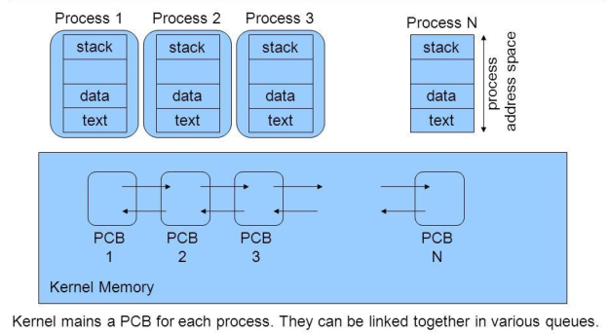
Process Control Block (PCB)
stack
data
text
Note: The PCB is maintained for a process throughout its lifetime, and is deleted once the process terminates.

Slide 14
Threads
Process has a thread of execution.
A thread is a single sequential flow of execution of tasks of a process.
Consider having multiple program counters per process
Multiple locations can execute at once
Multiple threads of control -> threads
The information of Threads is needed to start, or restart, a process.
The information is stored in - process control block (PCB)

Slide 15
Threads
Threads within a process can be thought of as parallel paths of execution.
They can execute different parts of the program simultaneously, performing multiple tasks concurrently.

Slide 16
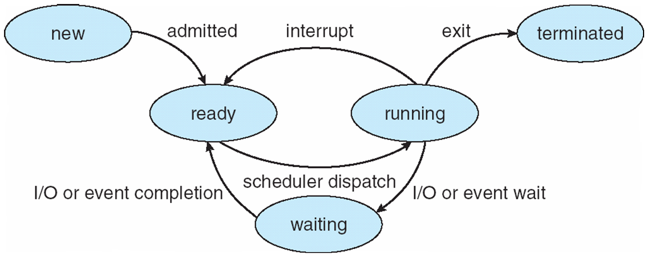
Process State (Process Life Cycle)
As a process executes, it changes state
new: The process is being created
ready: The process is waiting to be assigned to a processor
running: Instructions are being executed by CPU.
waiting: Process moves into the waiting state if it needs to wait for a resource, such as waiting for user input, or waiting for a file to become available.
terminated: The process has finished execution.
Diagram of Process State

Slide 17
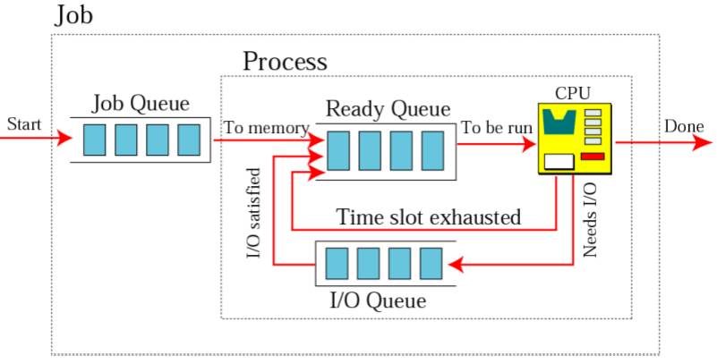
Queues for process management
In a single-CPU system, only ONE process may be in running state; many processes may be in ready and blocked/waiting states

Slide 18
Process Scheduling
The objective of multiprogramming is to have some process running at all times, to maximize CPU utilization.
Maximize CPU use, quickly switch processes onto CPU for time sharing
Process scheduler selects among available processes for next execution on CPU
Process Scheduling Queues
Job queue – set of all processes in the system
Ready queue – A new process is initially put in the ready queue. The processes residing in main memory, ready and waiting to execute on CPU.
Device queues – set of processes waiting for an I/O device

Slide 19
Context Switch
Context Switch: switching of the CPU from one process or task to another.
A context switch is the mechanism to store and restore the state or context of a CPU in Process Control block.
so that a process execution can be resumed from the same point at a later time.
When the scheduler switches the CPU from executing one process to execute another, the state from the current running process is stored into the process control block. After this, the state for the process to run next is loaded from its own PCB and used to set the PC, registers, etc. At that point, the second process can start executing.

Slide 20
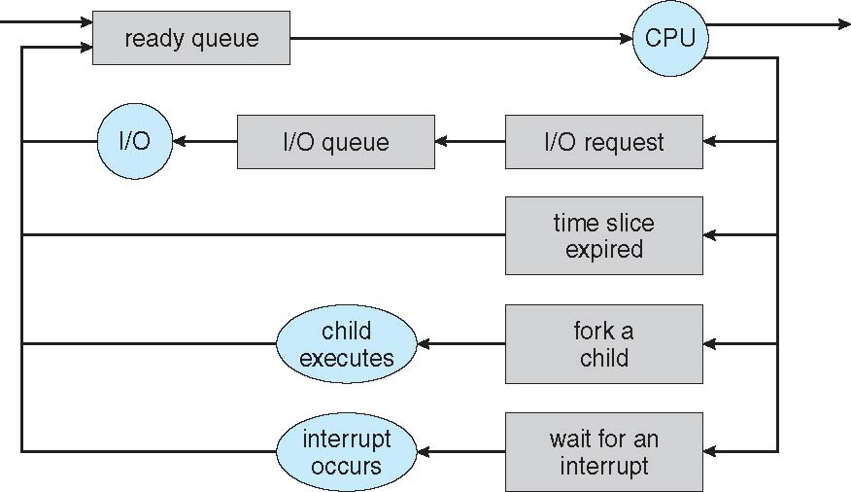
Context Switch
the most common reasons for a context switch

Slide 21
Process Management
Process management involves various tasks like:
Creation of processes
Scheduling of process
Termination of processes
Dead lock

Slide 22
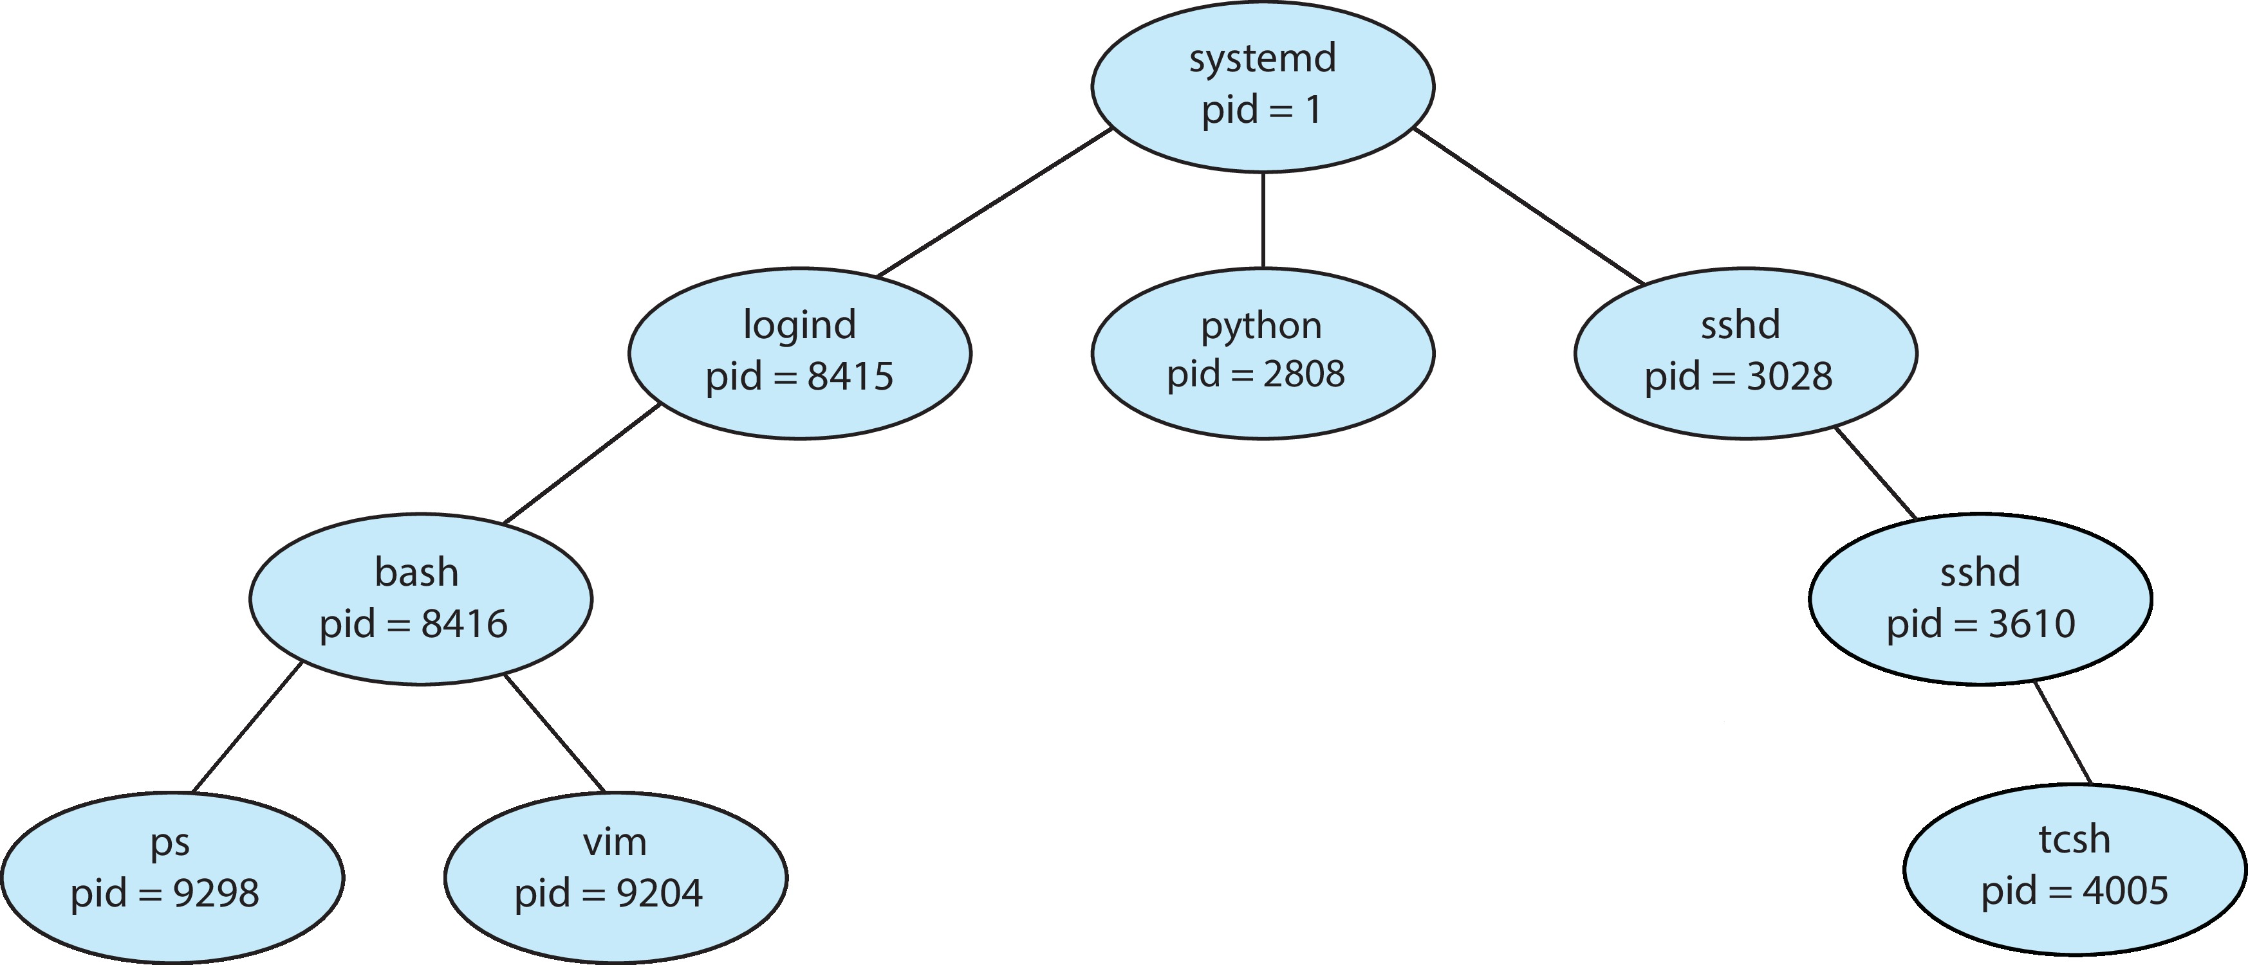
Process Creation
Parent process create children processes, which, in turn create other processes, forming a tree of processes.
Process creation is achieved through the fork() system call.
Generally, process identified and managed via a process identifier (pid)
Execution options
Parent and children execute concurrently
Parent waits until children terminate
A Tree of Processes
in Linux

Slide 23
Process Termination
Process executes last statement and then asks the operating system to delete it using the exit() system call.
Parent may terminate the execution of children processes using the abort() system call. Some reasons for doing that:
Child has exceeded allocated resources.
For example - A process can be terminated for trying to write into a read only file.
Task assigned to child is no longer required
The parent is exiting and the operating systems does not allow a child to continue if its parent terminates

Slide 24
Process Termination
Some operating systems do not allow child to exists if its parent has terminated. If a process terminates, then all its children must also be terminated.
It called “cascading termination”.
The termination is done by the operating system.

Slide 25
Process Termination
A parent process may wait for the termination of a child process by using the wait() system call.
Zombie state: If a process exits and its parent has not yet waited for it, the process enters a kind of suspended state called the zombie state—the living dead. When the parent finally waits for it, the process terminates.
if a parent did not invoke wait() and instead terminated, thereby leaving its child processes as orphans.
UNIX systems addressed this scenario by assigning the process as the new parent to orphan processes then it invokes wait() to release it.

Slide 26
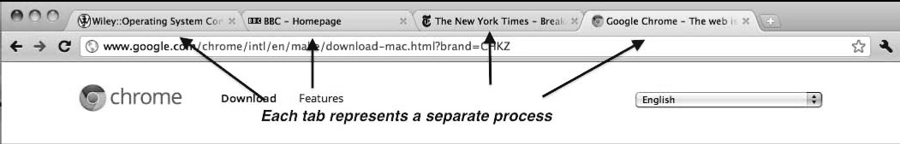
Multiprocess Architecture – Chrome Browser
Many web browsers ran as single process (some still do)
If one web site causes trouble, entire browser can hang or crash
Google Chrome Browser is multiprocess with 3 different types of processes:
Browser process manages user interface, disk and network I/O
Renderer process renders web pages, deals with HTML, Javascript. A new renderer created for each website opened
Plug-in : (such as Flash or QuickTime)
Note: If one website crashes, only its renderer process is affected (the advantage of Multiprocess)

Slide 27
Interprocess Communication
Processes within a system may be independent or cooperating
Cooperating process can affect or be affected by other processes, including sharing data
Reasons for cooperating processes:
Information sharing
Computation speedup
Cooperating processes need interprocess communication (IPC)
Two models of IPC
Shared memory
Message passing

Slide 28
Communications Models
(a) Message passing (b) shared memory

Slide 29
Questions
What do you mean by a process?
What does a process look like in memory?
What are the different states of a process?
What is the difference between process and program?
What are the main reasons for process termination?
What is cascading termination?
What are the most common reasons for a context switch?
What is the purpose of the stack in the process memory?

Slide 30
More Question
What are the advantages of a multiprocessor system?
What is kernel?
What are real-time systems?

