Slide 1
Operating Systems Lecture 4 Threads

Slide 2
Threads
A thread is a flow of execution through the process code
a process is a program that performs a single thread of execution. For example, when a process is running a word-processor program, a single thread of instructions is being executed.
The single thread of control allows the process to perform only one task at one time.
Many modern OS allow a process to have multiple threads of execution and thus to perform more than one task at a time.

Slide 3
Threads
it comprises
a thread ID
a program counter ( PC )
a register set
a stack.
It shares with other threads belonging to the same process:
its code section
data section
other operating-system resources, such as open files.

Slide 4
Single and Multithreaded Processes
(process with
single thread)
(process with
three threads)
Note: no thread can exist outside a process.

Slide 5
Process vs Thread
N | Process | Thread
1 | Processes use more resource (heavy weight) | Threads share resources (light weight)
2 | Communication between processes is slower. | Communication between threads is faster.
3 | Context Switching in processes is slower. | Context switching in threads is faster.
4 | Creation and termination times of processes are slower. | Creation and termination times of threads are faster compared to processes.
5 | Process means a program is in execution | Thread means a segment of a process

Slide 6
Motivation
Most modern applications are multithreaded
Threads run within application
Multiple tasks with the application can be implemented by separate threads
Example:
Update display
Fetch data
Spell checking
Answer a network request
Process creation is heavy-weight while thread creation is light-weight
Can simplify code, increase efficiency
Kernels are generally multithreaded

Slide 7
Benefits
Responsiveness – may allow continued execution if part of process is blocked, especially important for user interfaces
Resource Sharing – threads share resources of parent process, easier than using shared memory or message passing for communication.
Economy – cheaper than process creation, thread switching lower overhead than context switching - thread share most of process’s PCB.
Scalability – process can take advantage of multiprocessor architectures. Threads can run in parallel on different processing cores.
Efficient communication

Slide 8
Multicore Programming
Multicore or multiprocessor systems putting pressure on programmers, OS designers must write CPU scheduling algorithms that use multiple cores.
Parallelism implies a system can perform more than one task at the same time (simultaneously)
Concurrency supports more than one task by allowing all the tasks to make progress.

Slide 9
Concurrency vs. Parallelism
Parallelism on a multi-core system:
Concurrent execution on single-core system:

Slide 10
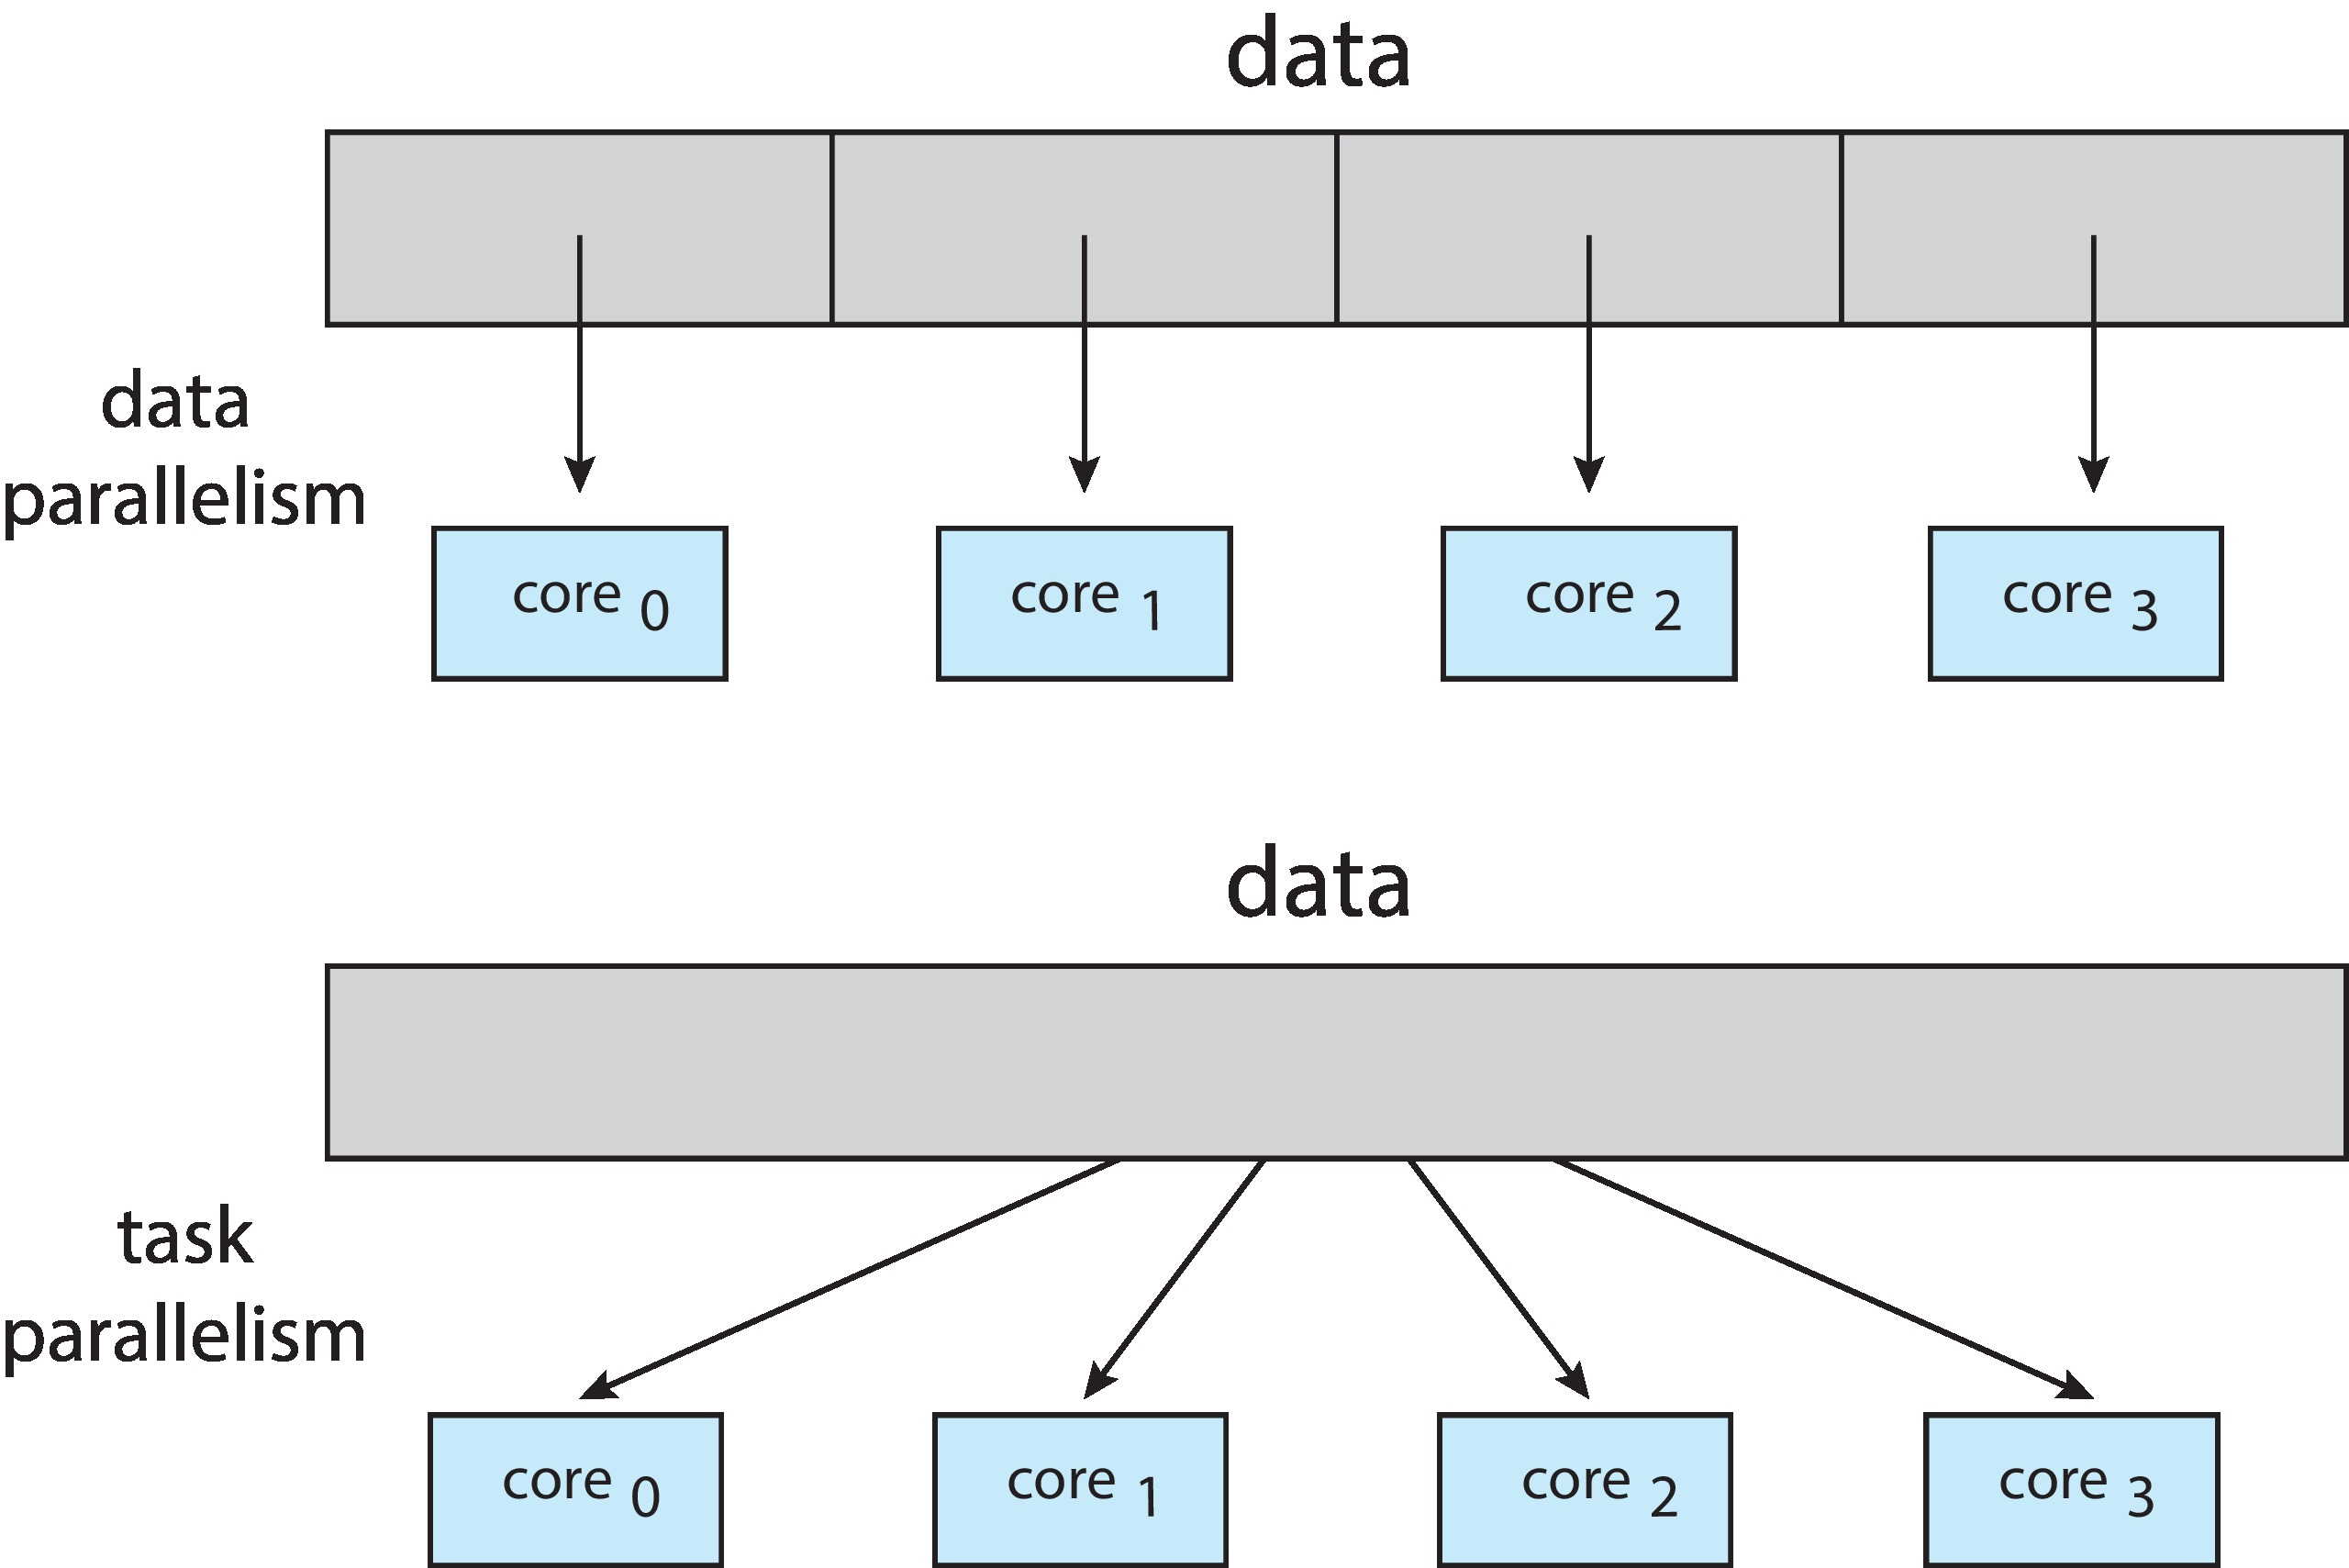
Multicore Programming
Types of parallelism
Data parallelism – distributes subsets of the same data across multiple cores, same operation on each
Ex: summing elements of a length-N array
Task parallelism – distributing threads across cores, each thread performing unique operation
Ex: Task 1: sorting a length-N array
Task 2: average a length-N array

Slide 11
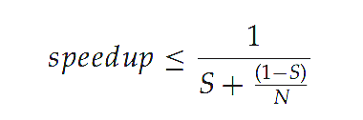
Amdahl’s Law
It is used in parallel computing to predict the theoretical maximum speedup using multiple processors.
Identifies performance gains from adding additional cores to an application that has both serial and parallel components.
S is serial portion
N processing cores
That is, if application is 75% parallel / 25% serial, moving from 1 to 2 cores results in speedup of 1.6 times
As N approaches infinity, speedup approaches 1 / S

Slide 12
Types of Thread
Threads are implemented in following two ways −
User Level Threads − User managed threads.
Kernel Level Threads − Operating System managed threads acting on kernel, an operating system core.

Slide 13
User Threads and Kernel Threads
User threads -A user thread is an entity used by programmers to handle multiple flows of controls within a program.
management done by user-level threads library. Supports thread programming: creating and managing program threads

Slide 14
User Threads and Kernel Threads
Kernel threads - In this case, thread management is done by the Kernel. There is no thread management code in the application area. Kernel threads are supported directly by the operating system.
including:
Windows, Solaris, Linux, Tru64 UNIX and Mac OS X.
Recall: The kernel is the central part of an operating system (OS). It is the part of the operating system that loads first, and it remains in main memory..

Slide 15
Multithreading Models
A relationship must exist between user threads and kernel threads
such as:
Many-to-One
One-to-One
Many-to-Many

Slide 16
Many-to-One
Many user-level threads mapped to single kernel thread
One thread blocking causes all to block
Multiple threads may not run in parallel on multicore system because only one may be in kernel at a time
Few systems currently use this model
Examples:
Solaris Green Threads

Slide 17
One-to-One
Each user-level thread maps to kernel thread
Creating a user-level thread creates a kernel thread
More concurrency than many-to-one - in case a thread has blocked
Number of threads per process sometimes restricted due to overhead
allows multiple threads to run in parallel on multiple CPU systems
Examples
Windows
Linux
Solaris 9 and later

Slide 18
Many-to-Many Model
Allows many user level threads to be mapped to many kernel threads
Allows the operating system to create a sufficient number of kernel threads
Ex: Windows with the ThreadFiber package

Slide 19
Two-level Model
Similar to M:M, except that it allows a user thread to be bound to kernel thread
Examples
Tru64 UNIX

Slide 20
Thread Libraries
Thread library provides programmer with API for creating and managing threads
Two primary ways of implementing
Library in user space
Codes and data structures for thread library are available to the user
Thread library functions are not system-calls
Kernel-level library supported by the OS
Codes and data structures for thread library are not available to the user
Thread library functions are system-calls to the kernel
Three main thread libraries are in use today: POSIX Pthreads, Windows, and Java.

Slide 21
Windows Threads
Operating System Examples
Windows implements the Windows API – primary API for Win 98, Win NT, Win 2000, Win XP, and Win 7
Implements the one-to-one mapping
App run as separate processes, each process may contain many threads
Each thread contains
A thread id
Register set representing state of processor
Separate user and kernel stacks for when thread runs in user mode or kernel mode
Private data storage area

Slide 22
End

