Slide 1
PHP Laravel VIEW

Slide 2
Blade is a powerful templating engine that comes bundled with Laravel.
It provides a simple and expressive syntax for creating views and
allows you to write clean and maintainable template files.
the blade templating engine provides its own structure such as conditional statements and loops

Slide 3
features Blade
1. Blade Syntax:
Blade uses the {{ }} syntax to echo out variables or the results of expressions. For example, {{ $name }} will output the value of the $name variable.
2. Blade layout
Blade allows you to define reusable layout templates that can be extended or included by other views..

Slide 4
To design layout, we will follow the steps :
Create main page which contained other pages (main.blade.php)
html tags will been added in main.blade.php only
In other pages, @section keyword used to add the content to main page
In main page, @yield keyword used to get content of child views
@extends keyword used to include main page inside other pages

Slide 5
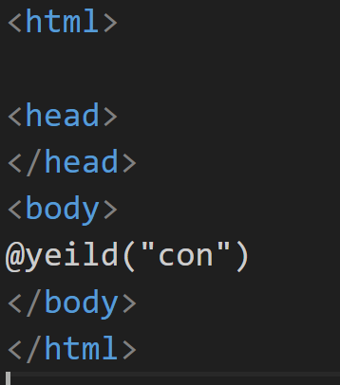
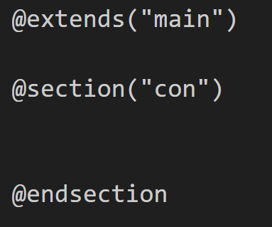
main.blade.php
Other pages

Slide 6
Advantage of Blade Layout
Constant layout will implement in main.blade.php only such as header , footer
Other pages have shown in body of main.blade.php

Slide 7
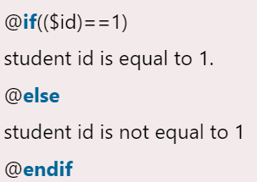
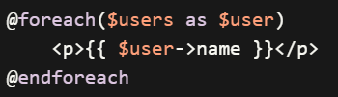
3. Blade Directives
Some commonly used directives include:
@if, @else, @elseif, @endif for conditional statements.
@foreach, @endforeach for looping over arrays or collections.

Slide 8
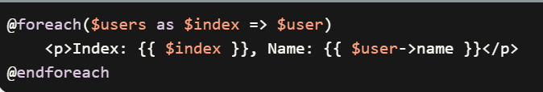
4. Blade print
{{ }} used to print contents in browser such as
{{$variable}}

Slide 9
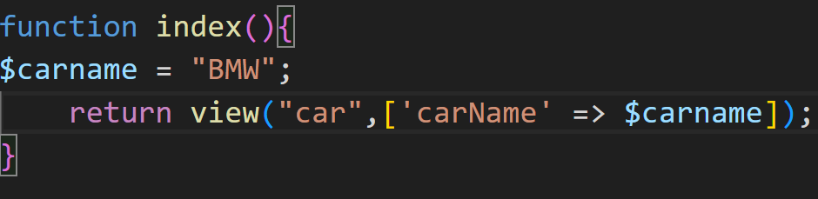
Pass data from controller to view
Here are some of the ways we can pass data to the view
view()
We can directly pass the data in the ‘view()’ helper function by using the second parameter in the function which takes an array as key and value pair.
Example :

Slide 10
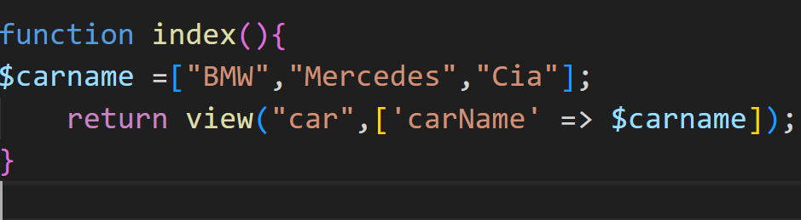
@
To display carname, we can use {{$carname}} directly because singular data
Example 2:
Pass multiple data to view ,so to display data in view , we must use @foreach

Slide 11
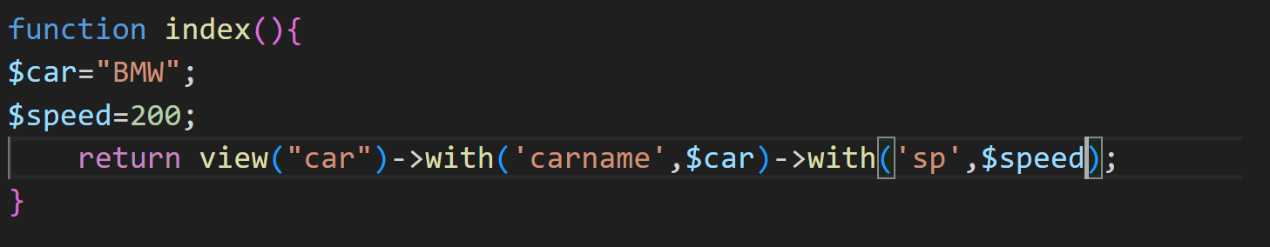
2. with()’ is a method to pass individual form of data
To display data in view , we can not use @foreach because with() send individual values not array

Slide 12
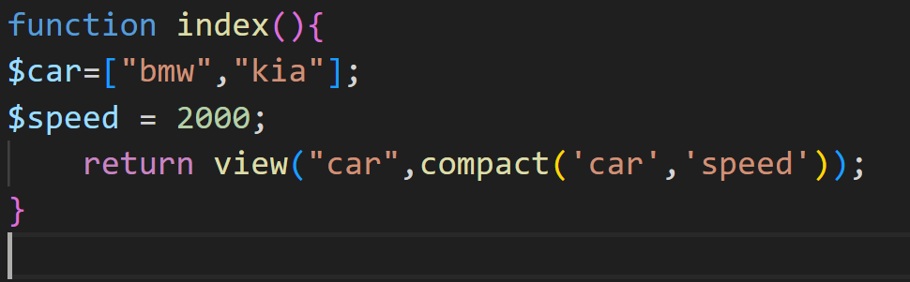
3 compact()’ is a PHP function that can be used for creating an array with variable and their value. Here the name on the variable is the key and the variable content is the value.
To display data in view ????????

