Slide 1
PHP LARAVEL

Slide 2
Laravel is a powerful PHP web application framework that streamlines web application development through an MVC (Model-View-Controller) architecture.
Laravel has gained immense popularity due to its simplicity and ease of use, making it a top choice for web developers worldwide.

Slide 3
Laravel is open framework used to build fast websites and more security
Laravel has several version such as 4 ,5,5,5 …..9,10
Main website of Laravel framework is Laravel.com which contains many tutorial and details for each version of Laravel

Slide 4
Laravel uses concept MVC
M:Model , V: view , C:controller
Model is responsible to deal with database
View: user interface used Blade engine (html inside php)
Controller is intermediate between Model and view , and used to control project fully

Slide 5
Advantages of Using Laravel
1. Rapid Development Process
Laravel provides intuitive syntax, built-in tools, and extensive documentation, enabling developers to create web applications quickly and efficiently, significantly reducing development time.

Slide 6
2. Readable and Maintainable Code
Laravel promotes clean and well-structured code, making it easier to read and maintain. This is particularly beneficial when working in a team or on large projects, as it helps ensure consistency and code quality.

Slide 7
3. Strong Community and Support
Laravel has a large and active community of developers who contribute to its growth and provide support through forums, blogs, and social media. This makes it easy to find help and resources when needed

Slide 8
4. Built-In Tools and Libraries
Laravel comes with many built-in tools and libraries, such as Eloquent ORM, Blade templating engine, and Artisan command-line tool, which simplify the development process and reduce the need for external dependencies.

Slide 9
MVC
The Model-View-Controller (MVC) framework is an architectural/design pattern that separates an application into three main logical components Model, View, and Controller
Components of MVC :
1. Controller
2. Model
3. View
.

Slide 10
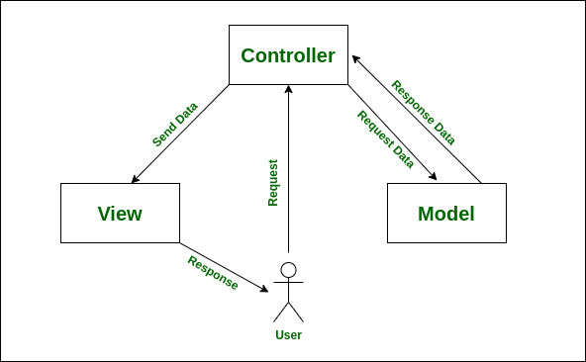

Slide 11
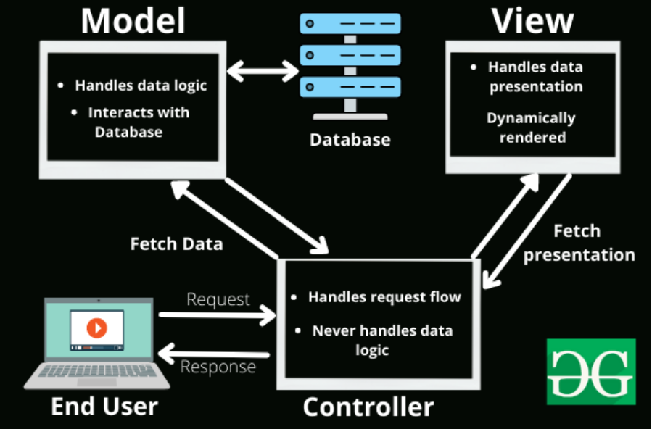

Slide 12
Install php Laravel
Install XAMPP (to install PHP and MySQL)
Install Composer
Verify Composer installation
Install Laravel using Composer
Verify Laravel Installation
Start the server
Run the project in your browser

Slide 13
Command to install laravel
Composer create-project Laravel/Laravel app_name
This will automatically download all the relevant Laravel files to create a new project.

Slide 14
Command to Start server
Php artisan serve

