Slide 1
Laravel Pages

Slide 2
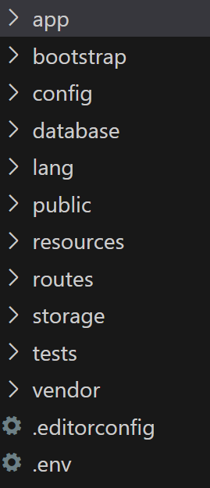
Project Sructure
Laravel project contains several folders as following :
App: folder includes core Laravel codes such as controller , Models
Public : used to images, css, javascript,fonts
config : used to configure all project such as configure database , mail ,session
resource : contains view folder
routes : folder has two main file , web.php and api.php
Web.php used to create routes for project’pages
Api.php used to create routes for project’api

Slide 3
MVC
Model-view-controller is pattern used to organize the project’codes
Controller is exist in app/Http/Controller
Controller is php files which contains class inheritance from base controller class like this
Base controller class is Controller
Example :
Class HomeController extends Controller{
}

Slide 4
Controller
To create new controller ,this command used in cmd :
php artisan make: controller Homecontroller
HomeController is controller name that inheritance automatically from controller class
Function index: function must be implemented inside controller to show view to user
Example:
function index(){
Return view(“login”) // login is login.blade.php
}
We can change function’name from index to any name

Slide 5
View
View is user interface existing in resource folder
Each view in project has blade engine
Blade engine is engine used to combined php and html together ,so we can write html codes inside php using blade engine
Format view file in Laravel is login.blade.php

Slide 6
Routes
Inside Routes folder , open web.php file
Route is class used to open pages in Laravel
Route::get(“route name”,”HomeController@index”);
Route: class which contains several functions such as get,post,put,delete
Get: used to retrieve and show pages
Route name: any name chosen ,which will display in browser

Slide 7
Routes
Example :
Route::get(“home”,”HomeController@index”)
Browser link : localhost:8080/login
HomeController: controller name
Index: function inside controller used to display view to user

Slide 8
What is meaning page in Laravel
Each page in Laravel has controller , view , routes and model if thee is database
For example : create page in Laravel called login
So steps of solution are :
1. create view inside resource called login.blade.php
2. Create controller called loginController using command in cmd , with function index
3. Create route in routes folder inside web.php like this
Route::get(“log”,” loginController@index”)

Slide 9
Run the Project
Command to run : php artisan serve
In browser , write localhost/login
how to Laravel open login page ?

