Slide 1
Laravel Routing

Slide 2
Route is a URL pattern that maps to a specific action or logic in your application. It defines how incoming HTTP requests should be handled and which code should be executed to generate the appropriate response.
Routes in Laravel are defined in the routes/web.php or routes/api.php files
depending on whether they are intended for web or API routes .
These files serve as the entry points for defining your application's routes .

Slide 3
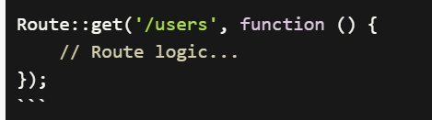
Route components
HTTP Verb/Method:
The HTTP verb or method specifies the type of request that the route should respond to.
Laravel supports all standard HTTP methods such as GET, POST, PUT, PATCH, DELETE, etc

Slide 4
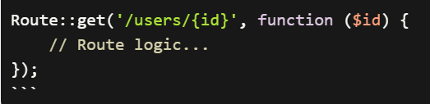
2. URL/URI Pattern:
The URL or URI pattern defines the specific URL that the route should match. It can include dynamic segments enclosed in curly braces {} to represent route parameters

Slide 5
Routes can be defined to handle various types of requests, such as retrieving resources, submitting forms, displaying views, or executing specific actions. Depending on the route, you can associate it with a closure function or a controller method to handle the request and generate the appropriate response.

Slide 6
Types of routes
1. Basic Routes
Basic routing is meants to route the request to an appropriate controller
Route::get("log","logincontroller@index");
2. Routing parameters
Parameters passed with URL, for example localhost/user/120
User: route name
120 : parameter

Slide 7
There are two types of routing parameters:
A . Required parameter
B. Optional parameter :
A. Required parameter
These parameters must be present in URL,if parameter is not exist ,browser displays message “page is not exist”
Bracket {} used to required parameter

Slide 8
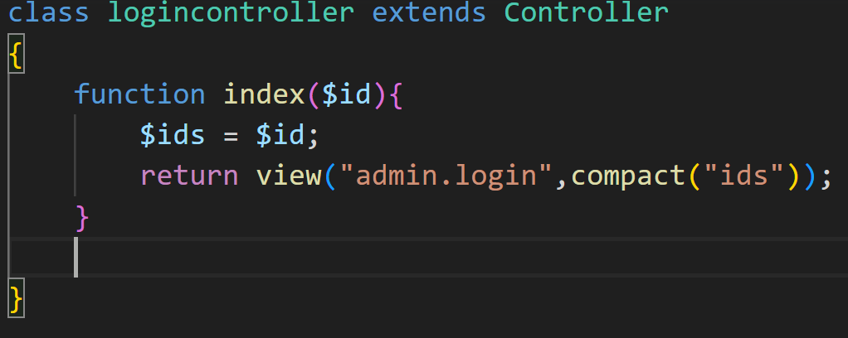
Route::get("log/{id}","logincontroller@index");
We can capture id from browser link to show in view as following :
Inside function index existing in controller, add id as parameters

Slide 9
Compact : function used to transform data from controller to view
2. In view : print content of id by using double brackets {{ }}
To print id,write {{ $id }}

Slide 10
B. Optional parameters
There are some parameters which may or may not present in URL
Optional parameters are indicated by “?” after the name of parameter
Route::get("log/{ id? }", "logincontroller@index");

Slide 11
3. Named routing
A Property is added to route to allow access router from inside project such as access router by click button or hyperlink,
Named routing does not accessed by URL
Property called name must be added to end router for example :
Route::get("log", "logincontroller@index")->name(“log”);
How hyper link can access router ?
<a href = “{{route(‘log’)}}”> Open Login page </a>
v

Slide 12
Parameter Constrains
Parameter Constrains applied to parameters in router to limit the function of parameters such as parameter id only allowed number from 1-5 parameter age only allowed age from 20-40
Parameter used keyword where at end of route
Route::get("log/{id}", "logincontroller@index")->where(‘id’,’[1-5]’);
Only allow id 1,2,3,4,5
Route::get("log/{id}", "logincontroller@index")->where(‘id’,’[1-5]+’);
Only allow id 1,2,3,4,5 and mixture of these numbers (121 ,434, 554)

Slide 13
Route::get("log/{name}", "loginController@index")->where(‘name’,’[a-z]’);
Allow only characters from a to z

Slide 14
Http methods in routing
1. Get : used to show view or retrieve data from Mysql database
Route::get("log","logincontroller@index");
2. Post : used to send data to mysql database , most used with form
tag in view
3. PUT : update the data
4. delete: delete the data
5. Resource : general http used to create CRUD operation
automatically by generate all functions of CRUD
Route::resource("log","logincontroller");

Slide 15
Route group
In Laravel, a route group allows you to group related routes together and apply common attributes or middleware to them. This helps in organizing and managing your routes more efficiently. To define a route group in Laravel, you can use the Route::group() method.

Slide 16
Route::group(['prefix' => 'example', 'middleware' => 'auth'], function () {
Route::get('/', 'ExampleController@index');
Route::post('/store', 'ExampleController@store');
Route::put('/update/{id}', 'ExampleController@update');
// ... more routes
});

Slide 17
prefix: This attribute allows you to specify a common URL prefix for all routes within the group. For example, if you set 'prefix' => 'example', all routes within the group will have /example prepended to their URLs.
Within the route group, you can define your routes using the various HTTP verb methods such as get(), post(), put(), and so on

