Slide 1
Laravel Database

Slide 2
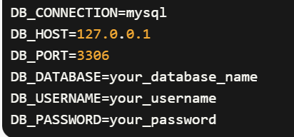
In Laravel, you can easily connect and interact with a MySQL database. Laravel provides a clean and expressive syntax for working with MySQL using either Eloquent ORM or the Query Builder.
To connect your Laravel application to a MySQL database, you need to configure the database connection settings in the .env file located in the root directory of your Laravel project

Slide 3
Laravel offers several powerful features and tools for working with databases, including a database abstraction layer, an ORM (Object-Relational Mapping) called Eloquent, a Query Builder, migrations, and more.

Slide 4
Query Builder
the Query Builder is a component that provides a fluent and expressive syntax for constructing database queries. It allows you to interact with your database using PHP code
How to use the Query Builder in Laravel:
To use the Query Builder, you need to import the DB facade or use the fully qualified class name \Illuminate\Support\Facades\DB
Selecting Data
To retrieve data from a table, you can use the table method to specify the table name, and then chain methods to construct the query

Slide 5

You can also specify the columns you want to select using the select method
3. Filtering Data:
You can add conditions to your queries using the where method.

Slide 6
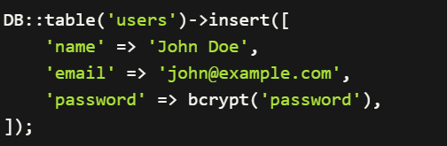
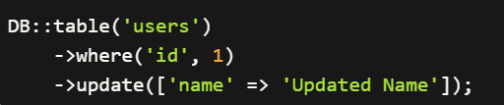
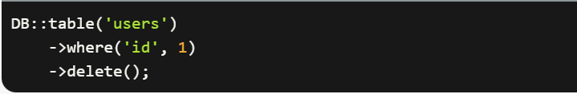
Inserting Data:
Updating Data:
Deleting Data:

Slide 7
Laravel Eloquent (ORM)
Laravel, Eloquent is the default Object-Relational Mapping (ORM) system.
It is mapping database tables to model classes
Eloquent simplifies database operations and provides features like querying, creating, updating, and deleting records, as well as handling relationships between tables.

Slide 8
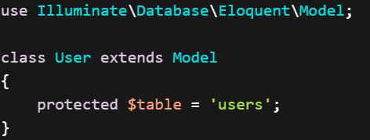
Overview of how to use Eloquent in Laravel:
Define a Model:
To use Eloquent, you need to define a model class that represents a database table. A model class extends the Illuminate\Database\Eloquent\Model class
Create model
php artisan make:Model model_name

Slide 9
There is relation between model and table in database :
Table is plural and model is singular
Example : table (users) model (user)
Retrieving Records: You can use the model to perform database queries. Eloquent provides various methods for retrieving records. For example, to retrieve all users:

Slide 10

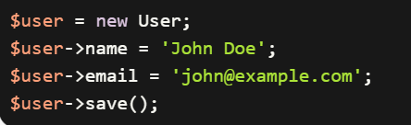
To retrieve a single user by their ID:
Creating Records: To create a new record, you can instantiate a model object and set its attributes, then call the save method

Slide 11

Deleting Records: To delete a record, you can call delete function

Slide 12
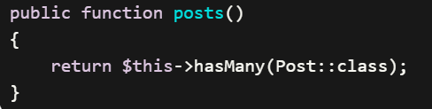
Relationships
Eloquent simplifies working with relationships between tables. You can define relationships in your model classes, such as one-to-one, one-to-many, many-to-one, and many-to-many.
Eloquent provides methods like belongsTo, hasMany, hasOne, and belongsToMany to define these relationships and retrieve related records.
For example, if a User has many Posts, you can define the relationship in the User model:

Slide 13

Then, you can retrieve a user's posts using the relationship:

