Slide 1

Sales and Profit Analysis Report
Presented by: Omer Metwally
Last Updated: 17th October 2025

Slide 2
Table of Contents
Sales and Profit Analysis Report
Increase profit by understanding which products, regions, and time periods drive the most and least sales.
Data source
Data cleaning summary
The story with data.
Conclusion
Potential Marketing Focus Areas

Slide 3
What are we talking about?

Slide 4
Objective
analyze sales performance and profitability across products, regions, and time periods to identify key factors driving profit and recommend actionable strategies to increase overall business growth and efficiency.

Slide 5
Data source

Slide 6
Data set
The dataset used in this analysis comes from the Superstore Data Set — available on Kaggle License: Open dataset provided for educational and analytical purposes. The data has been used strictly for learning and non-commercial analysis.
Data License: © Motivate International Inc. | Public data used for educational purposes only.

Slide 7
Data cleaning summary

Slide 8
Data cleaning
Removed duplicates to avoid counting the same order multiple times.
Removed rows with missing or invalid values (e.g., null times, negative sales)
Checked for missing values in key columns (Sales, Profit, Region, Dates) and handled them appropriately.
Standardized date formats (Order Date, Ship Date) to DD/MM/YYYY.
Cleaned currency symbols and spaces in Sales and Profit columns for numerical calculations.

Slide 9
Data cleaning
Validated relationships between fields (e.g., no negative sales or incorrect dates).
Ensured consistent text formatting (e.g., product names, region names).
Created new calculated columns:
Ship Days : Difference between Ship Date and Order Date
Shipping Speed : Slow, Average, Fast on Ship Days
Year, Quarter, Month extracted from Order Date
Avg Profit Margin = Profit / Sales
Sales Category = Profitable / Loss based on Profit value
✅ Result:
Clean and structured dataset ready for analysis and dashboard creation.

Slide 10
Present data

Slide 11

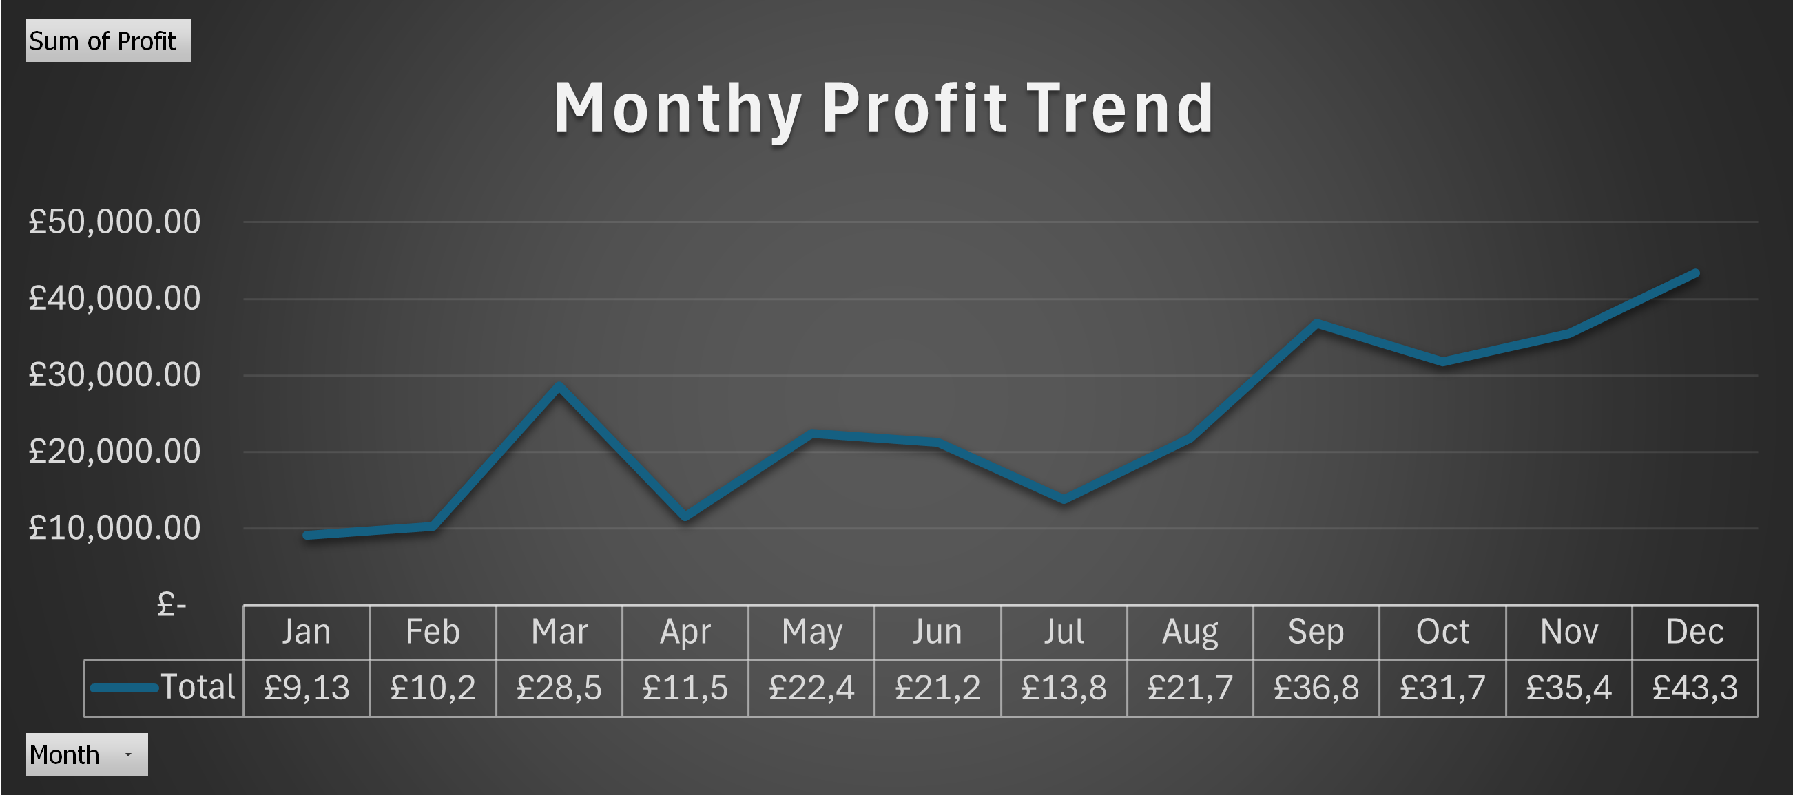
Monthly Profit Trend
When do we make the most profit?
Jan and Feb Profits are very low showing
a post-holiday slump
Profits from May to August remain steady
Nearly 40% of annual profit comes from Q4 indicating heavy reliance on holiday-season sales

Slide 12

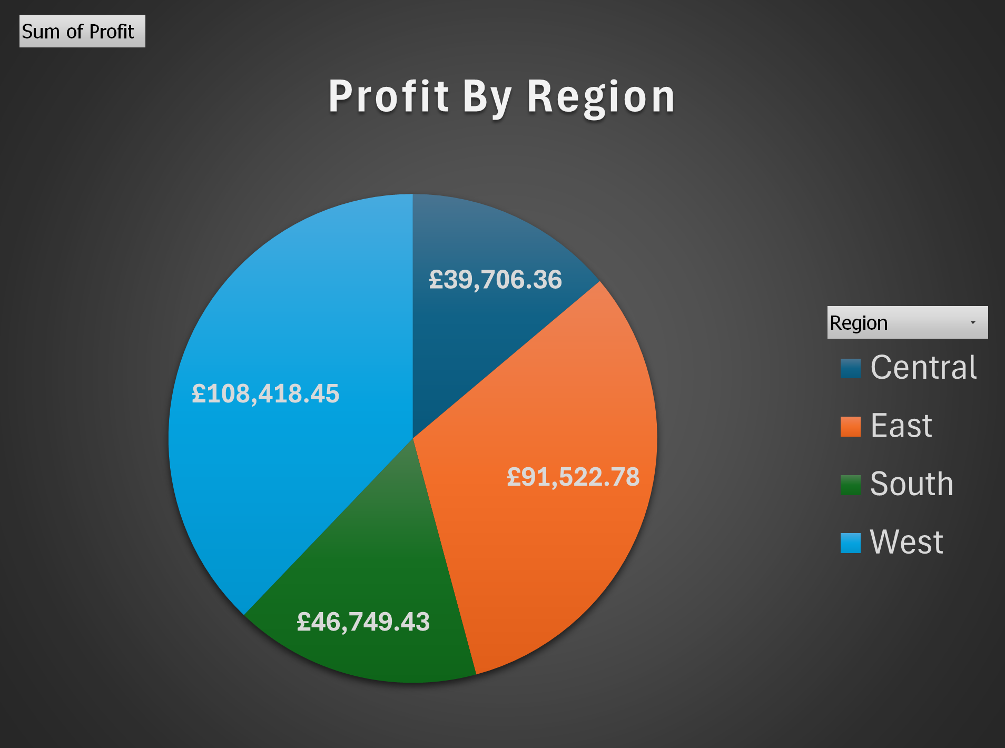
Profit by Region
Where do we make or lose the most?
Over 70% of profits come from the West and East, highlighting strong performance in these markets.
Central and South lag behind, signaling opportunities to grow through targeted promotions.
Focusing on these underperforming regions could meaningfully boost overall revenue

Slide 13

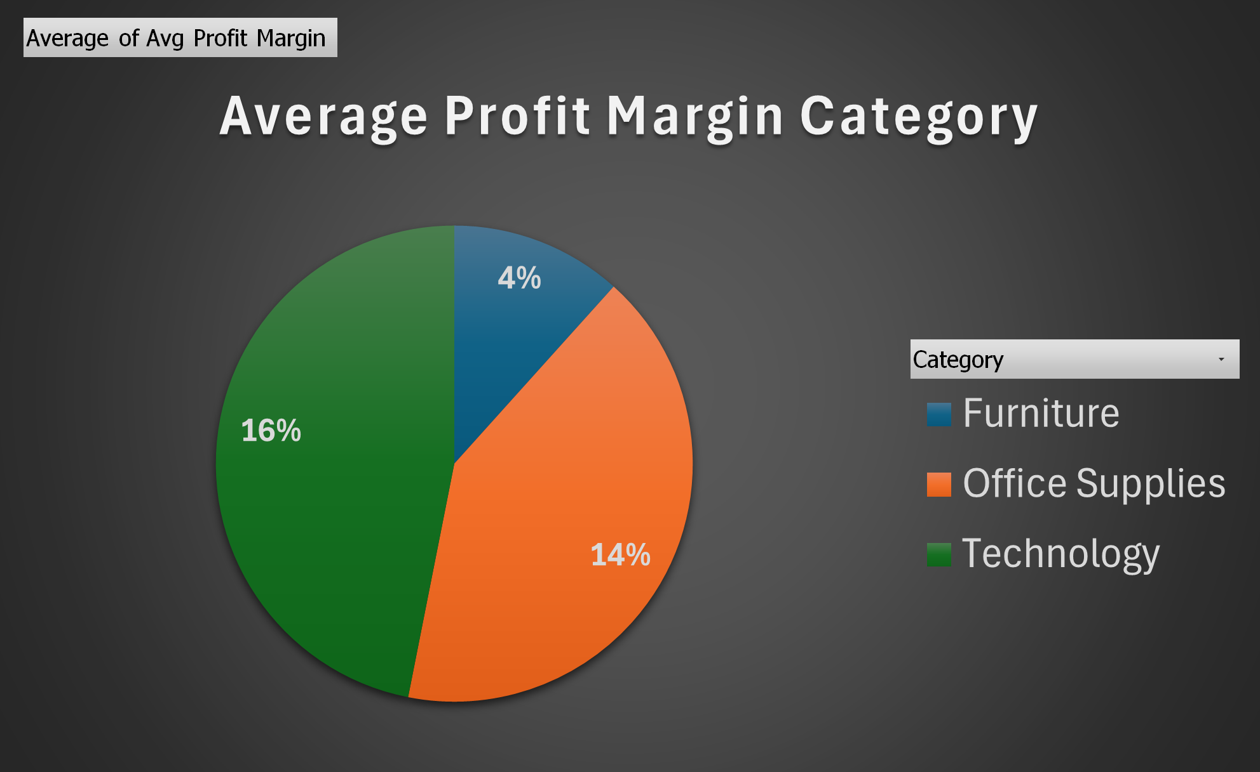
Average Profit Margin by Category
Which category drive the most profit?
Technology and Office Supplies drive strong profitability with margins of 16% and 14%
whereas Furniture’s 4% margin is significantly underperforming. This indicates that Furniture is eroding overall profitability
So, strategies like cost optimization, premium pricing, or product mix adjustments are needed to improve returns in this category.

Slide 14
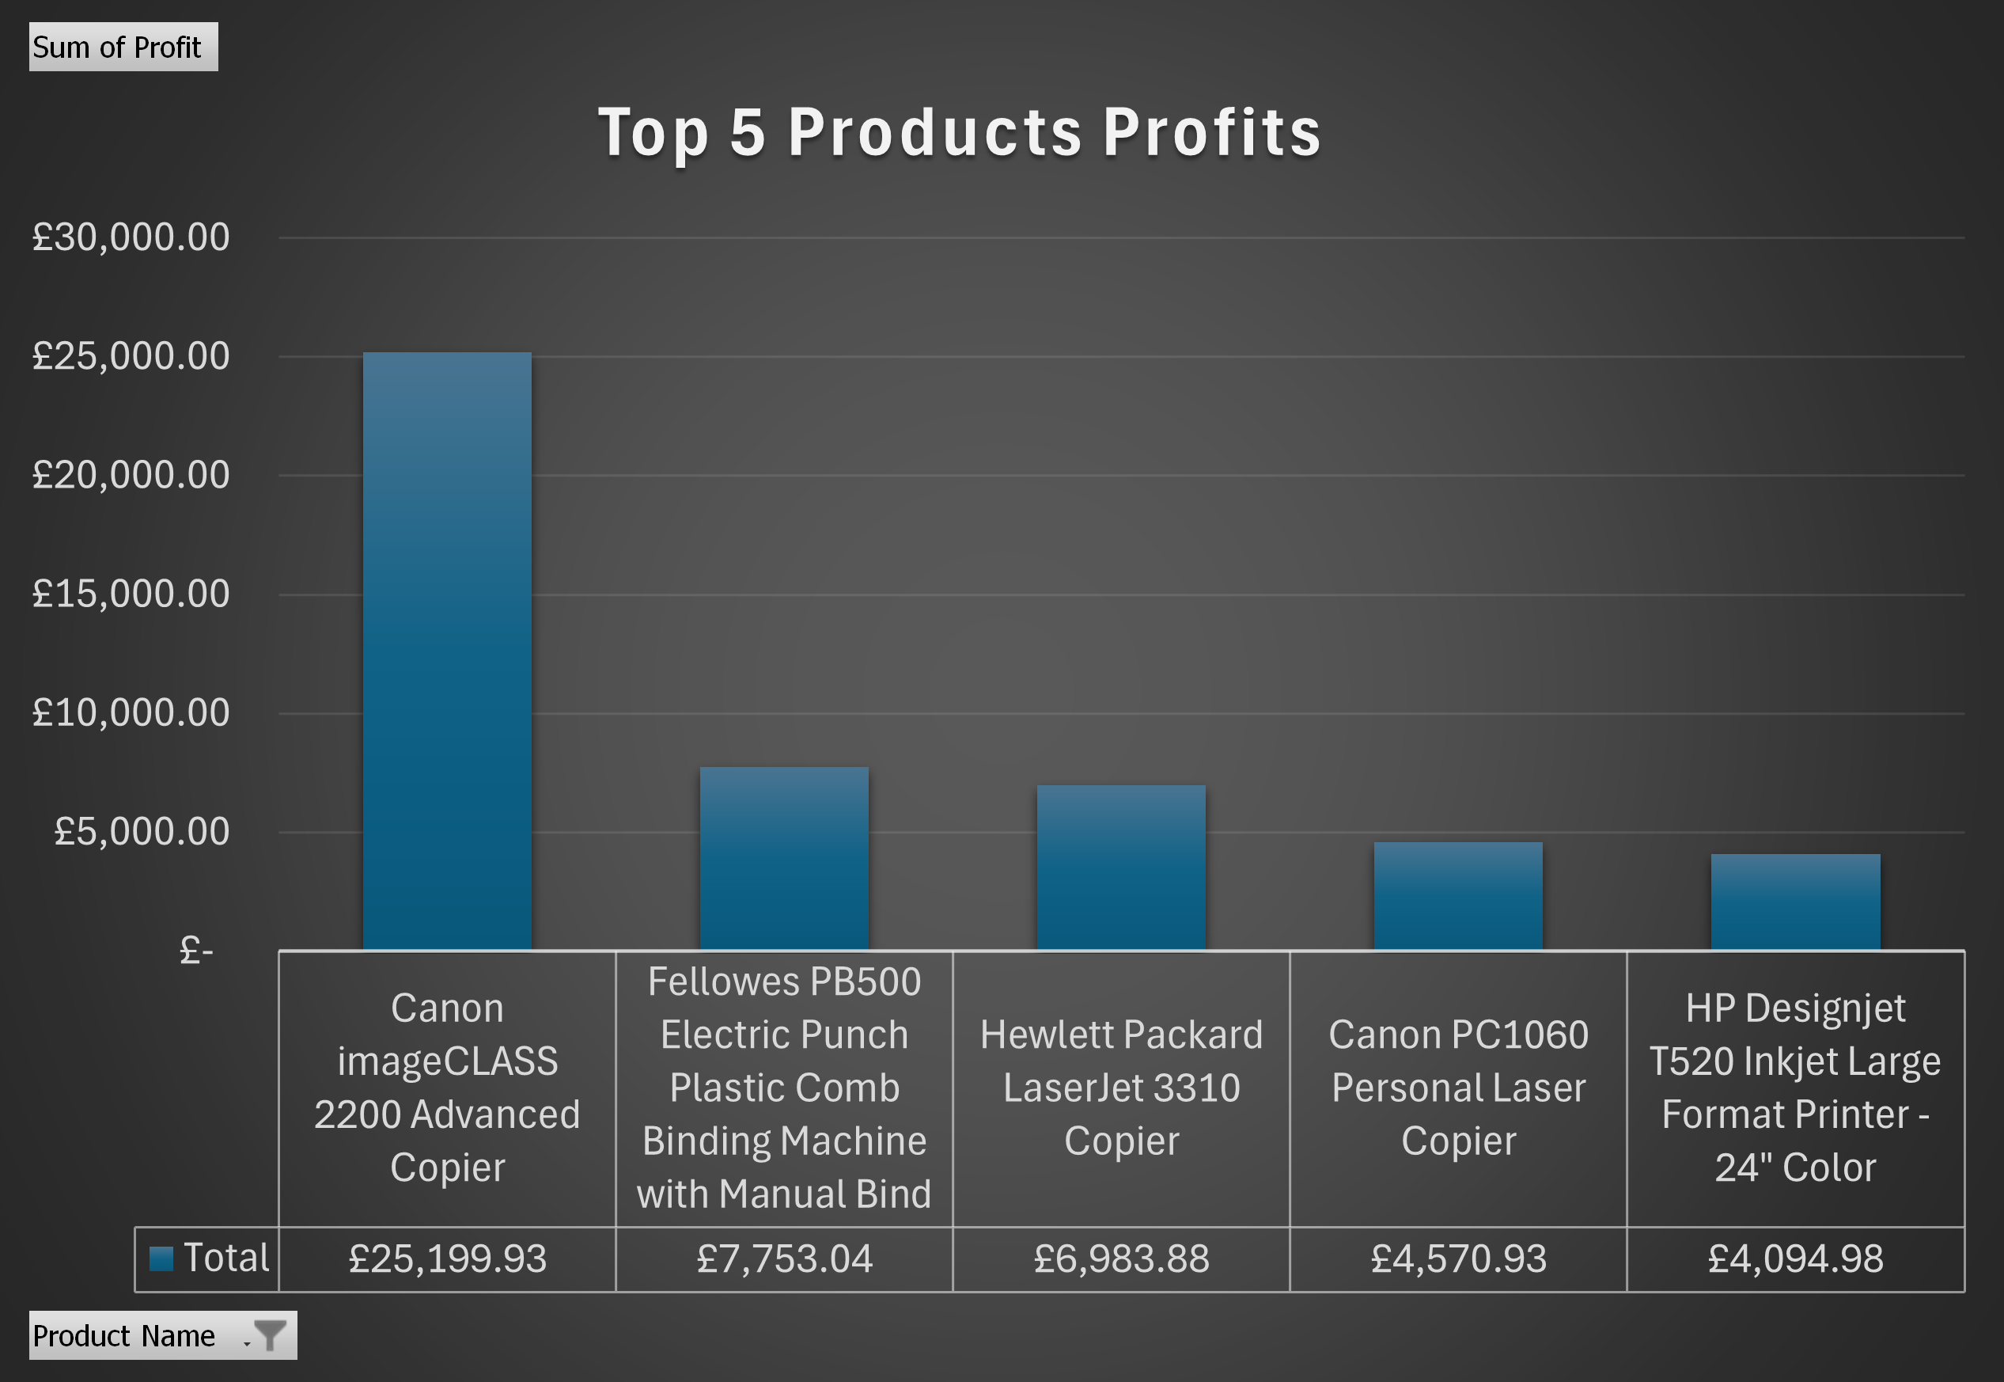
Top 5 Products by Profit
Which products drive the most profit?
Over half of profits come from the Canon, showing heavy reliance on a single top performer.
Other products contribute modestly, highlighting opportunities to boost sales of lower-performing items.
Diversifying revenue across multiple products could reduce risk and stabilize overall profit.

Slide 15

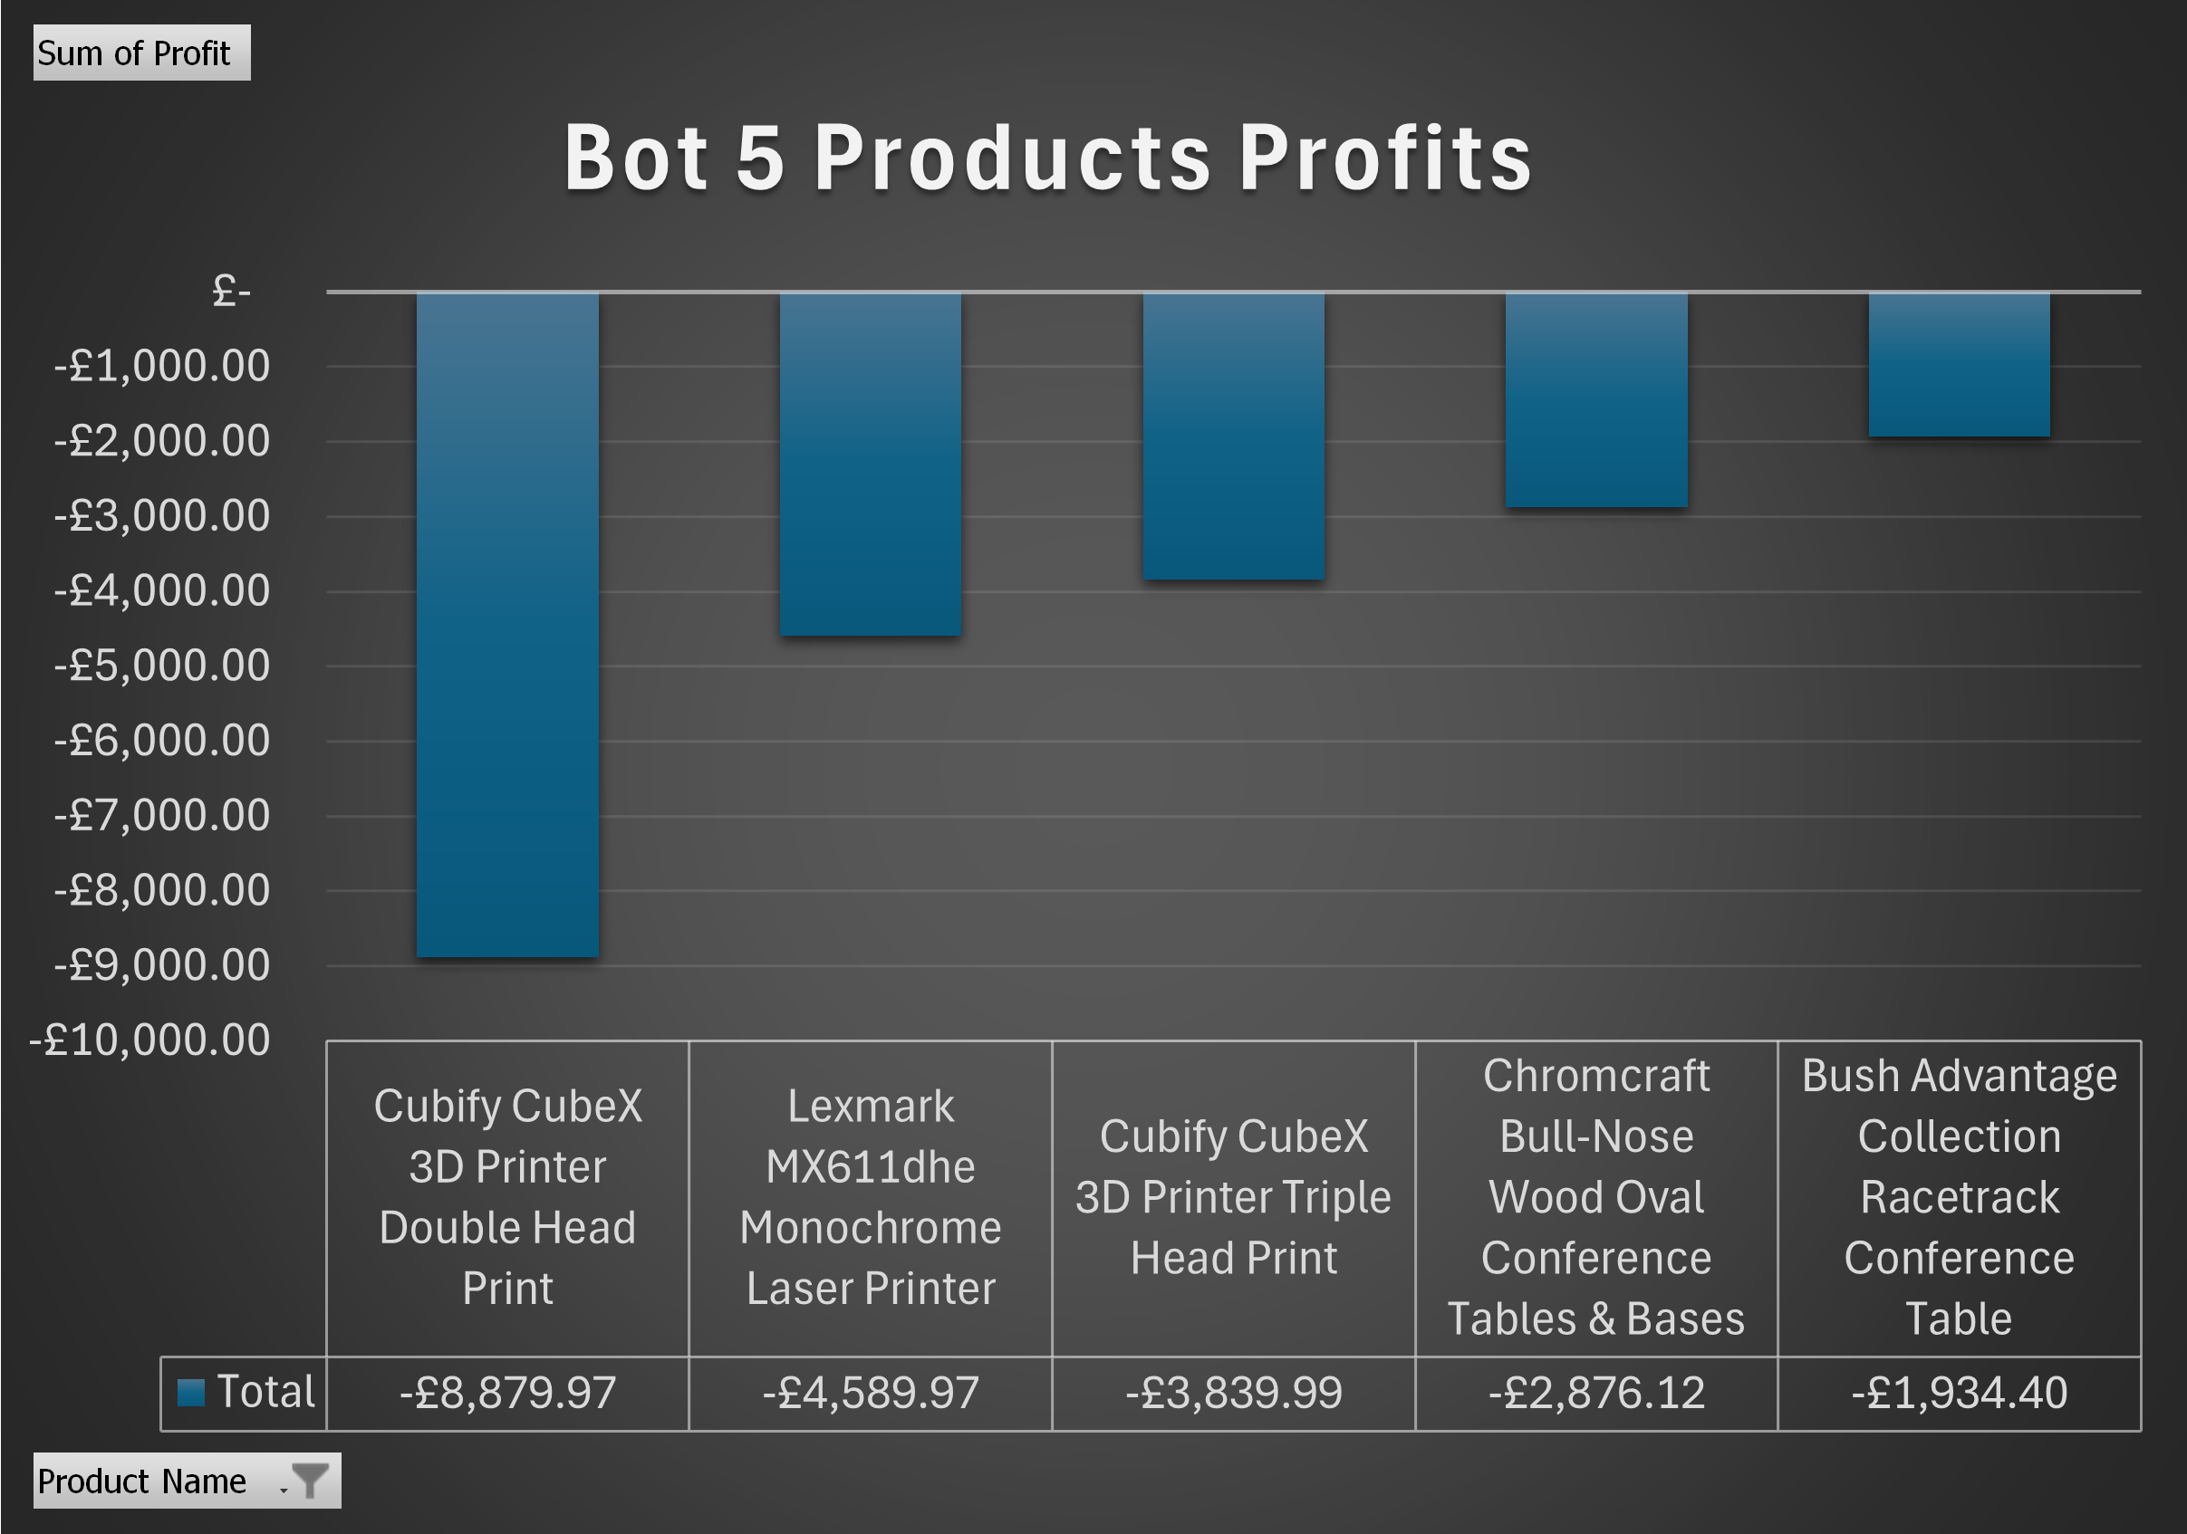
Bottom 5 Products by Profit
Which products cause losses or low profit?
The top five loss-making products total £22,120 in losses, led by Cubify CubeX.
High costs or low demand are driving these negative results. Reviewing pricing, cutting costs, or discontinuing underperforming items is critical to protect overall profitability.

Slide 16
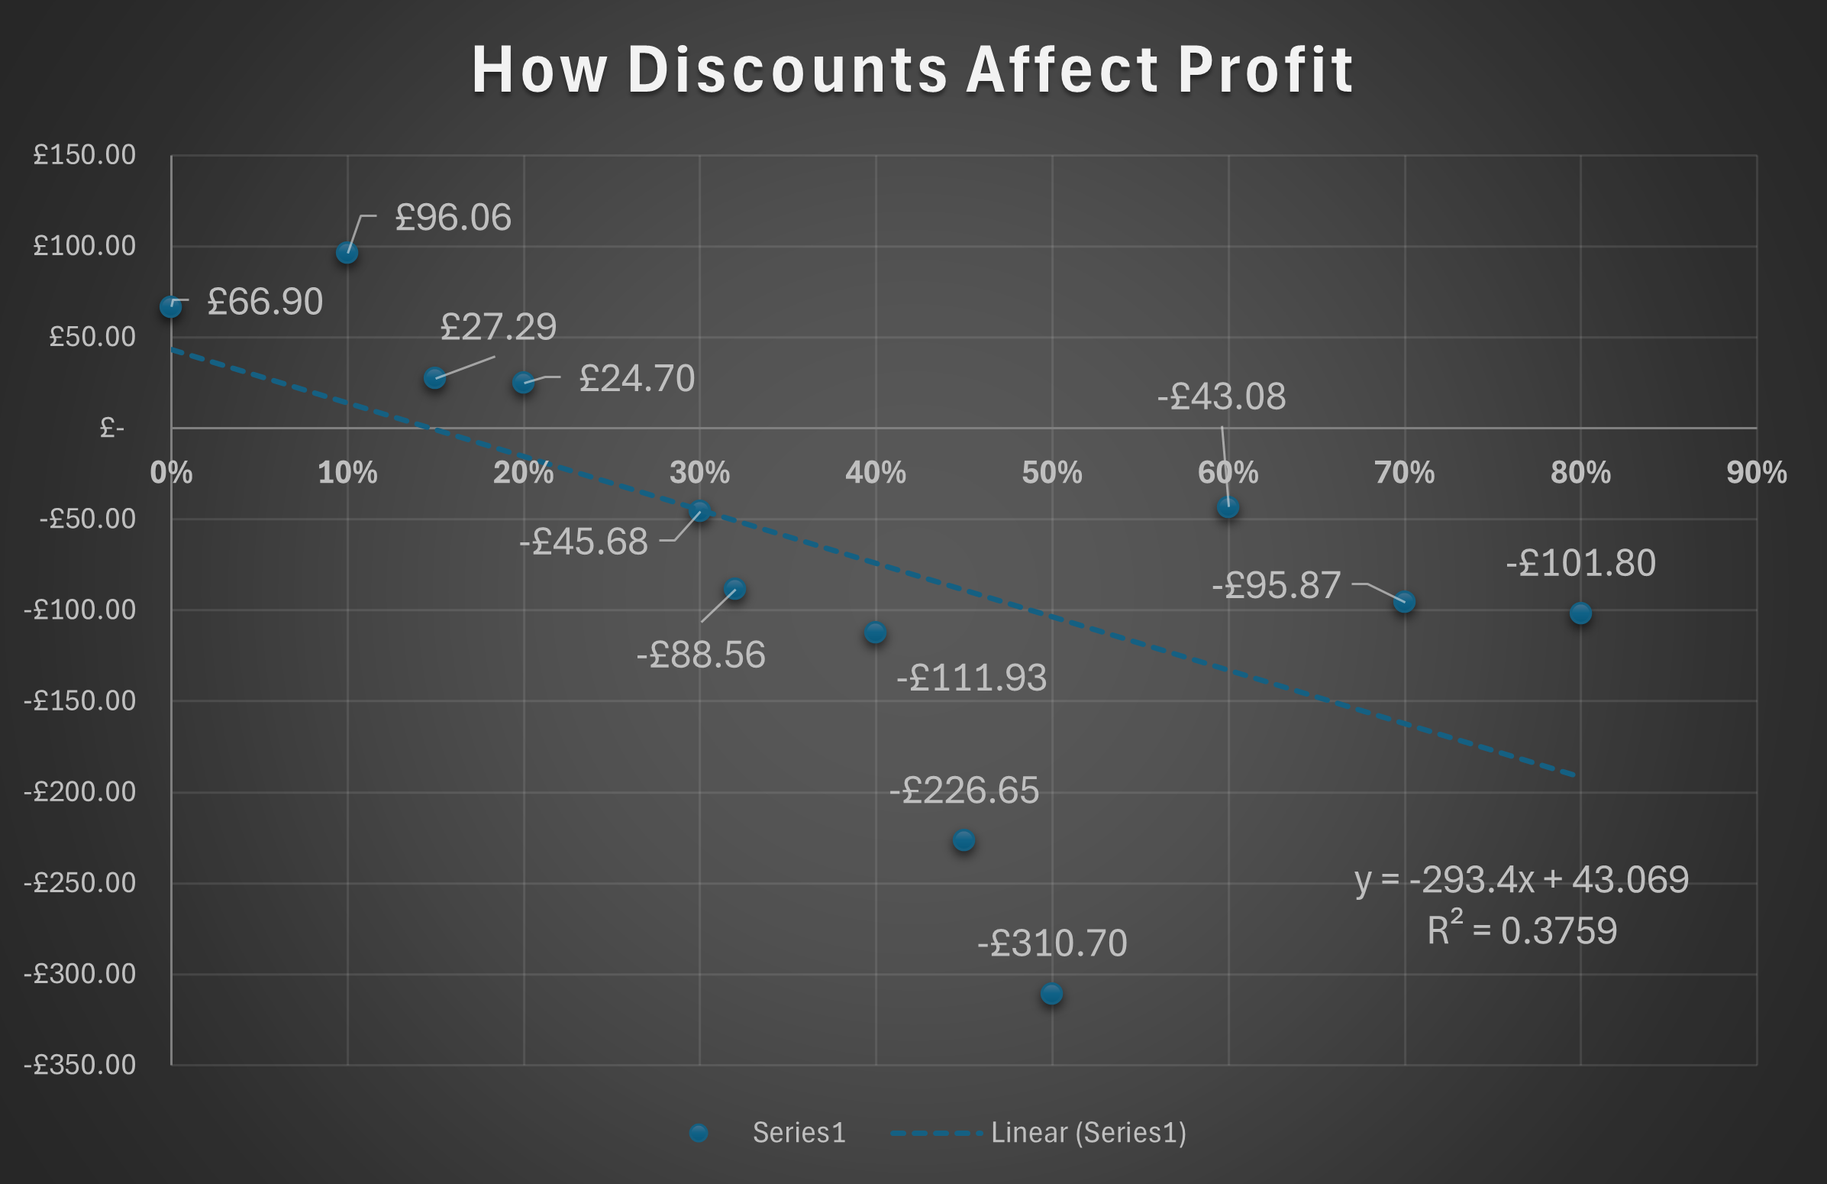
How Discounts Affect Profit
Do discounts actually help or hurt profit?
The scatter plot shows a clear negative relationship between discount and profit.
Higher discount rates above 30% lead to significant profit losses.
To increase profitability, limit high discounts or apply them only to low-demand products.

Slide 17

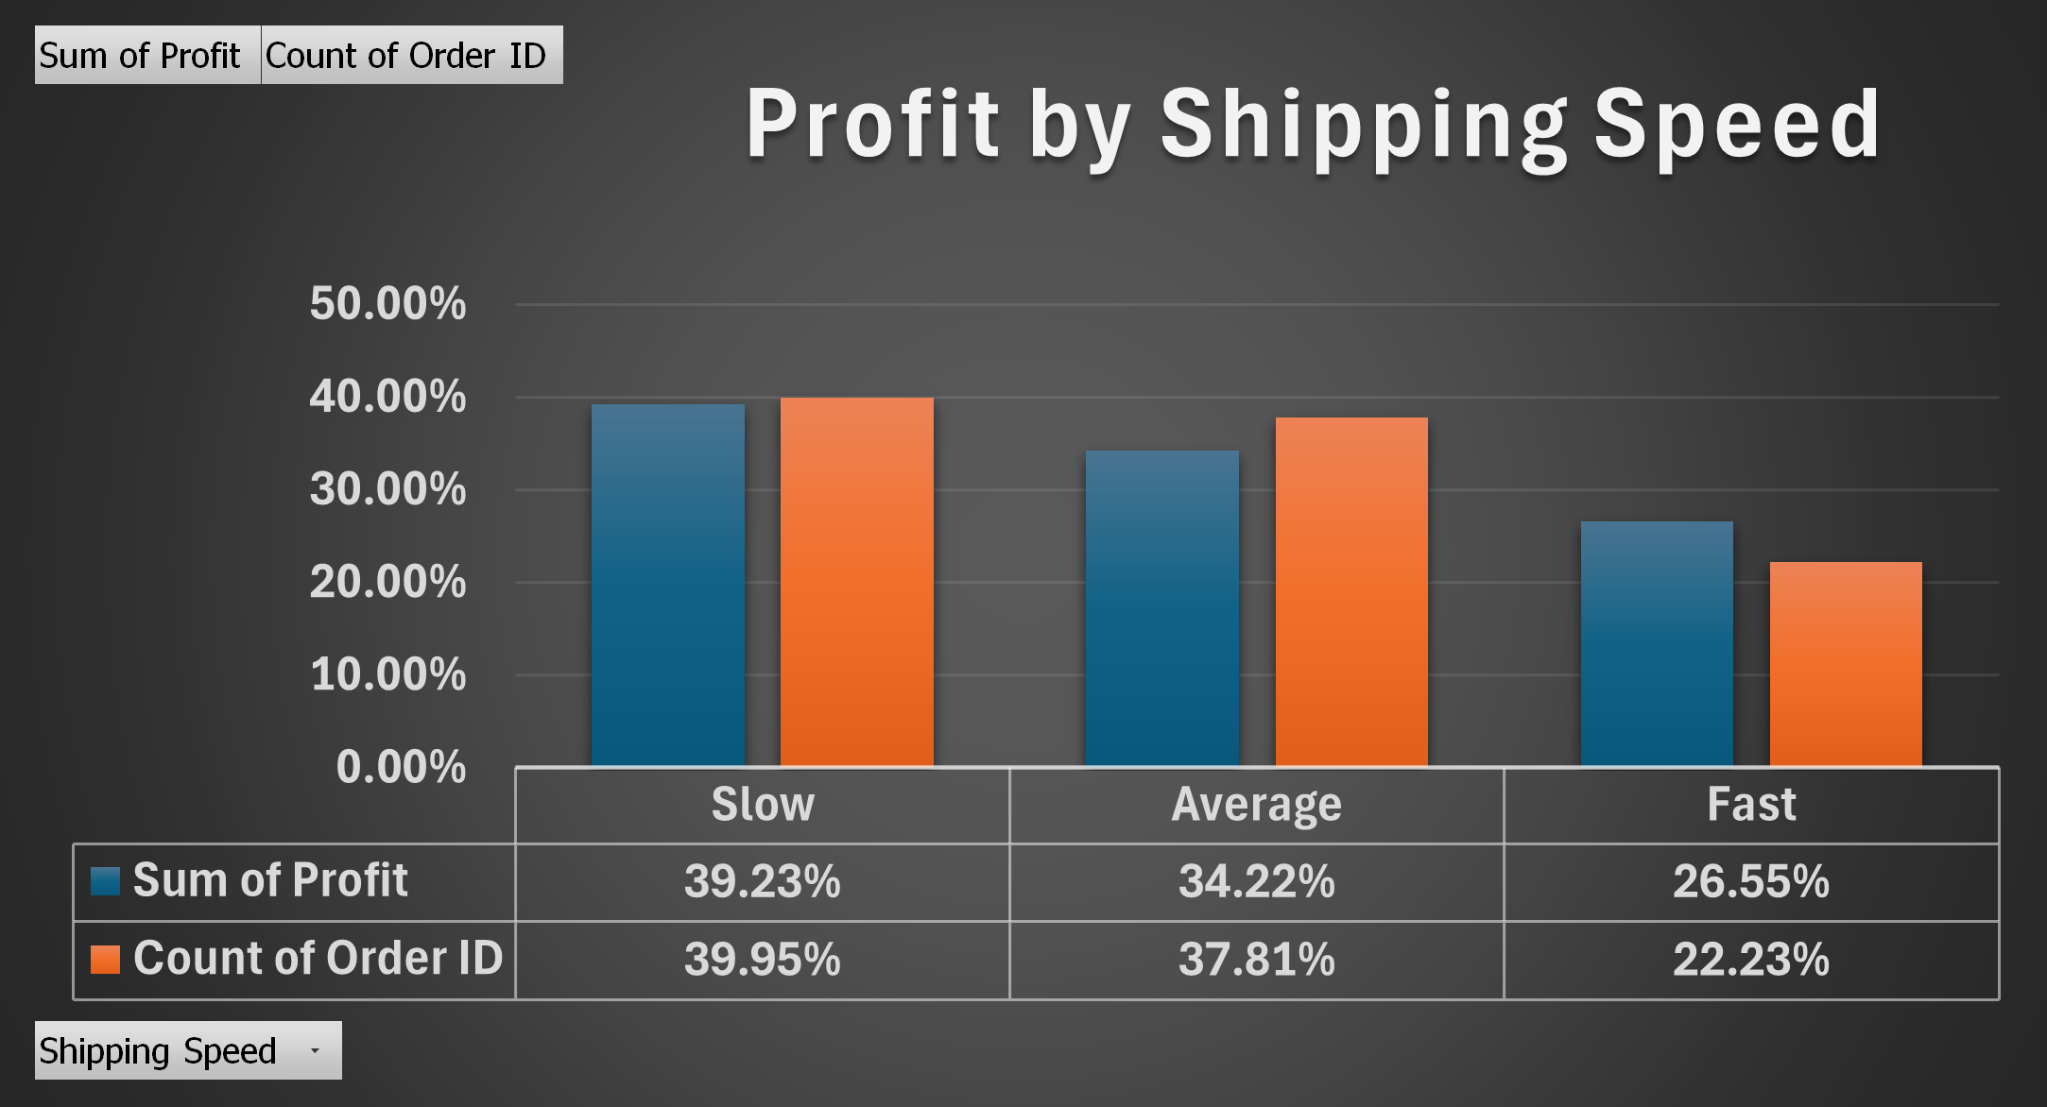
Profit by Shipping Speed
Does faster delivery increase or reduce profitability?
Slow shipping drives the highest profit 39% and order volume 40%.
Fast shipping contributes the least. This indicates slower shipments are linked to higher-value orders.
Optimizing shipping strategies could balance speed with profitability to improve margins.

Slide 18
Conclusion

Slide 19
Sales and Profits Summary
Gender distribution is similar for both groups, but overall usage is male-dominated.
Profit shows strong seasonality, with Q4 contributing nearly 40% of annual revenue.
Profit shows strong seasonality, with Q4 contributing nearly 40% of annual revenue.
Certain regions (West and East) and products (Canon imageCLASS 2200) dominate profits, while others lag significantly.
Low-margin categories (Furniture) and loss-making products (Cubify 3D printers) are dragging overall profitability.
1
2
3

Slide 20
Gender distribution is similar for both groups, but overall usage is male-dominated.
Profit shows strong seasonality, with Q4 contributing nearly 40% of annual revenue.
High-margin products (Technology, Office Supplies) and top sellers drive most profits
The business relies heavily on a few top products and regions for profit, creating risk if demand shifts
Shipping speed data suggests slower shipments are linked to higher-value orders, presenting an opportunity to optimize logistics.
4
5
6

Slide 21
Potential Marketing Focus Areas

Slide 22
Potential Marketing Focus Areas
Gender distribution is similar for both groups, but overall usage is male-dominated.
Profit shows strong seasonality, with Q4 contributing nearly 40% of annual revenue.
Boost Early-Year Sales: Target January–March with promotions or campaigns to reduce post-holiday slump.
Regional Growth: Focus on underperforming regions (Central and South) through localized advertising, events, or promotions.
Seasonal Campaigns: Leverage Q4 trends with pre-holiday marketing to maximize peak-season profits.
1
2
3

Slide 23
Gender distribution is similar for both groups, but overall usage is male-dominated.
Profit shows strong seasonality, with Q4 contributing nearly 40% of annual revenue.
Cross-Selling & Bundling: Use insights from shipping patterns and popular products to bundle items, encourage higher-value purchases, and optimize delivery options for profitability.
Product Mix Optimization: Promote high-margin products (Technology, Office Supplies) and top performers (Canon imageCLASS 2200) while reviewing pricing/costs for low-margin or loss-making items.
4
5

Slide 24

Thank You!
Omer Metwally | Aspiring Data Analyst
Tools: Excel, PivotTables, Charts
Last Updated: 17th October 2025

