Slide 1
Introduction to Conditional Probability through Games
24/07/2024
Omer Eryilmaz

Slide 2




Game 1: Finding the Pirate’s Treasure
Story: You have a map with an 8x8 grid. One grid square contains the treasure. You have captured a pirate who knows which grid square has the treasure. You can only search one grid square, and you have limited time. If the crew realizes that one pirate is missing, they will change the location of the treasure.

Slide 3
Game 1: Finding the Pirate’s Treasure
The pirate offers you a game. You can inquire about each column or row by asking, "Is the treasure in this row/column?" Then, throw a die. Each time, the pirate will keep a number in his mind, and you will throw the die. When you roll that number, the pirate will give the correct answer about your inquiry. How would you play this game optimally to find the treasure?
Column
row

Slide 4
Game 1: Finding the Pirate’s Treasure
How would you play this game optimally to find the treasure?
Play the game with your friends.
Note how many questions you asked.
Did you find the treasure?
What is your optimal strategy? Explain it to me.
Column
row

Slide 5
Game 2: The Three Glasses Game
In this game your friend will show you three glasses; one has a die, and the other two are empty. Your friend knows which glass contains the die. Once you make a choice, he will reveal one empty glass and ask if you want to change your choice.

Slide 6
Game 2: The Three Glasses Game
Play this game 10 times, sticking with one strategy (e.g., change).
Record how many times you won.
Play the game 10 times with the other strategy (e.g., stay with your first choice). Record how many times you won.
Compare your results with other groups.
Which strategy is the winning one, and why?
Can you explain it?

Slide 7
Game 2: The Three Glasses Game
Play this game 10 times, sticking with one strategy (e.g., change).
Record how many times you won.
Play the game 10 times with the other strategy (e.g., stay with your first choice). Record how many times you won.
Compare your results with other groups.
Which strategy is the winning one, and why?
Can you explain it?
* This problem is famously known as the Monty Hall problem. You might also remember it from the movie 21.

Slide 8
Probability
Imagine the Real Madrid football team plays against a local high school football team. Which option is more probable?
A) Real Madrid wins.
B) Real Madrid wins and scores more than once.

Slide 9
Conditional Probability
What is the probability of seeing the Northern Lights given that your location is Birmingham?
What is the probability of seeing the Northern Lights given that your location is Norway?
What is the probability of having a rainy day given that you are in the UK?
What is the probability of having snow given that your location is Nigeria? (Or Siberia).

Slide 10
Back to the Game 1
What is the probability of finding the treasure on the map in one try?
What is the probability of finding the treasure in a given column or row?
What is the probability of receiving a truthful answer from the pirate?
What is the probability of receiving a false answer?
You asked the question, and the pirate's answer is yes or no. Given a yes answer, what is the probability of having the treasure on that row or column?

Slide 11
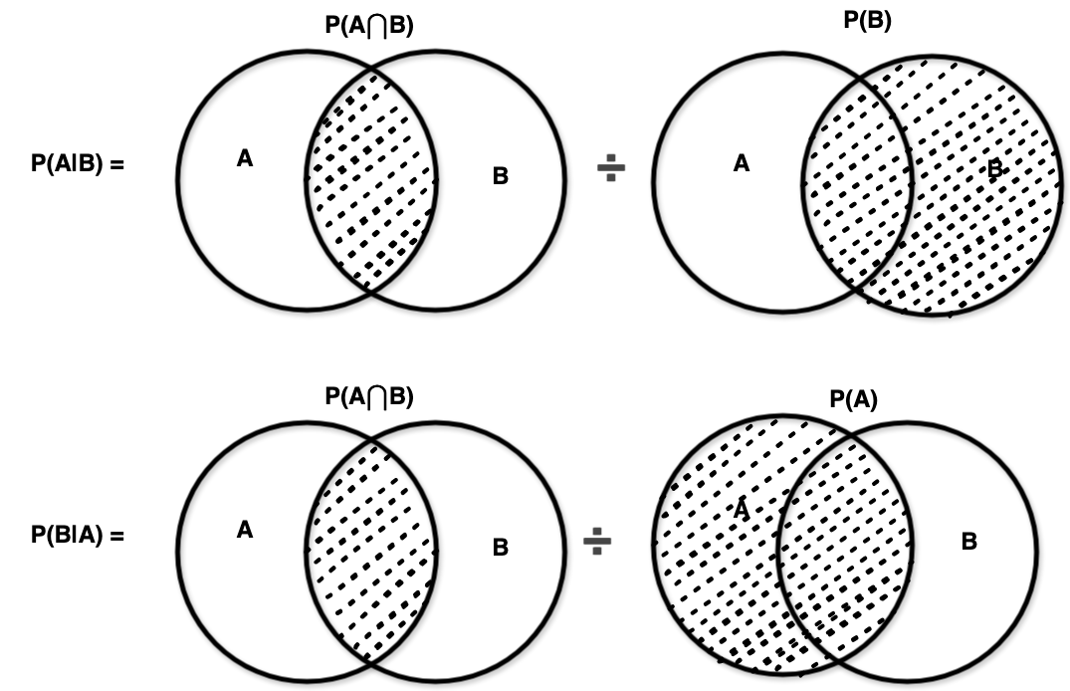
Back to the Game 1
A = Treasure (Yes, No). B = Answer (Yes, No)

Slide 13

https://github.com/Omer1Eryilmaz/In2STEM_outreachActivity

Slide 14

Thank you! Any feedback?

