Slide 1
Dilated Capsule Network (DCapsNet) for Speech Emotion Recognition
Deep Learning Capstone Project | B.Tech Final Year Evaluation | NMIMS MPSTME
SEQUENTIAL TEAM WORKFLOW & ENGINEERING PIPELINE
Stage 1: Omer (Dataset Preparation) --> Stage 2: Anshuman (Architecture & Baselines) --> Stage 3: Zeeshan (Tuning & Accuracy Gains) --> Stage 4: Omer (Evaluation & Live UI)
OMER
Dataset Prep, Evaluation & UI
- Collected & harmonized RAVDESS, SAVEE, and EMO-DB speech corpora.
- Verified labels & resolved 1:2 neutral class imbalance.
- Conducted 10-fold final evaluation: Accuracy, Precision, Recall, F1, and Confusion Matrix.
- Built and deployed real-time interactive Streamlit web application.
ANSHUMAN
Model Architecture & Baseline Pipeline
- Implemented 1.225M-parameter DCapsNet (Conv1D + PrimaryCaps + DigitCaps).
- Engineered 217-D acoustic extractor (MFCC, Chroma, Mel, Contrast, Tonality).
- Built leakage-free waveform data augmentation engine (Pitch, Noise, Stretch).
- Created 1D-CNN and BiLSTM baselines & executed initial CV benchmark (54.10%).
ZEESHAN
Model Training & Accuracy Optimization
- Tuned training schedule: LR (3e-4), ReduceLROnPlateau, Batch Size (16).
- Resolved capsule squashing gradient saturation with weight decay & clipping.
- Conducted Dynamic Routing ablation across r in {1, 2, 3} iterations.
- Boosted 10-fold CV accuracy by +9.44% (from 54.10% baseline to 63.54%, peak 72.22%).
Notes:
PRESENTER: Omer
'Good morning respected faculty members. Today our team—Anshuman, Zeeshan, and myself, Omer—presents our Deep Learning Capstone project on Speech Emotion Recognition using Dilated Capsule Networks. We operated in a four-stage sequential pipeline: I prepared and cleaned the audio datasets; Anshuman implemented the DCapsNet architecture, acoustic features, and established baseline runs; Zeeshan systematically tuned the model and performed routing ablation to elevate accuracy by nearly 10%; and finally, I performed the 10-fold comparative evaluation and integrated the model into a live deployment application.'

Slide 2
INTRODUCTION | PRESENTER: OMER
Speech Emotion Recognition: The Feature Representation Problem
THE DILEMMA IN SPEECH EMOTION RECOGNITION
* Acoustic Ambiguity
Speech emotions are paralinguistic—governed by subtle pitch variations, harmonic contours, and speech tempo rather than explicit vocabulary.
* The Pooling Bottleneck in CNNs
Standard 1D/2D CNNs rely heavily on Max-Pooling or Average-Pooling. While pooling grants translation invariance, it violently discards spatial and temporal phase relationships between acoustic formants (e.g., F0 pitch vs. higher overtones).
* Scalar Activation Blindness
Neurons in conventional CNNs output scalar activation strengths, completely losing orientation, temporal duration, and relative harmonic geometry.
THE DILATED CAPSULE NETWORK (DCapsNet) ADVANTAGE
* Vector Capsules Instead of Scalar Neurons
Capsules output activity vectors. The length of the vector represents the probability that the emotion is present; its internal orientation represents subtle acoustic properties (prosody, cadence, timber).
* Dilated 1D Convolutions
By exponentially scaling dilation rates (d in {1, 2, 4, 8}), the receptive field expands exponentially without pooling downsampling, preserving exact formant positions.
* Dynamic Routing by Agreement
Primary capsules route feature representations into higher-level emotion capsules through iterative clustering agreement, preventing conflicting noise from corrupting predictions.
* Project Objective
Build, rigorously tune, and benchmark DCapsNet against 1D-CNN and BiLSTM baselines on RAVDESS, SAVEE, and EMO-DB, and deliver an interactive web inference UI.
Notes:
PRESENTER: Omer
'Speech emotion recognition differs from speech-to-text. While speech-to-text cares about phonemes, emotion is conveyed by paralinguistic cues—pitch shifts, cadence, and harmonic energy. Traditional CNNs use pooling to reduce dimensions, but this destroys the relative positioning between pitch peaks. Capsule networks replace scalar neurons with vector capsules, preserving both the presence and the orientation of acoustic features. Our goal was to implement a Dilated Capsule Network that overcomes this pooling limitation without exploding latency.'

Slide 3
PHASE 1: DATA ENGINEERING | PRESENTER: OMER
Phase 1: Multi-Corpus Curation & Preprocessing Pipeline
Dataset Corpus | Utterance Count | Speaker Demographics | Emotion Classes | Sampling Rate
RAVDESS (Primary) | 1,440 clips | 24 Actors (12 Male, 12 Female) | 8 Classes (Neutral, Calm, Happy, Sad, Angry, Fear, Disgust, Surprise) | 22,050 Hz (Target)
SAVEE (Evaluation) | 480 clips | 4 British Male Speakers | 7 Classes (Neutral, Anger, Disgust, Fear, Happiness, Sadness, Surprise) | 44,100 -> 22,050 Hz
EMO-DB (Evaluation) | 535 clips | 10 German Actors (5M, 5F) | 7 Classes (Anger, Boredom, Disgust, Fear, Happiness, Sadness, Neutral) | 16,000 -> 22,050 Hz
ACOUSTIC PREPROCESSING PIPELINE
* Standardized Audio Rate: Resampled all incoming raw audio to exactly 22,050 Hz mono.
* Pre-emphasis Filtering: y[t] = x[t] - 0.97*x[t-1] to amplify high-frequency speech formants.
* Top-dB Silence Trimming: Librosa 20 dB threshold to eliminate ambient silence before speech onset.
* Length Normalization: Fixed 3.0 second duration (L = 66,150 samples) with zero-padding.
LABEL VERIFICATION & LEAKAGE-FREE SPLITS
* Class Imbalance Resolved: In RAVDESS, Neutral has 96 samples (only normal intensity), whereas all 7 other emotions have 192 samples (normal + strong). Total = 1,440 clips.
* Stratified 10-Fold Partitioning (Protocol A): Preserves exact class ratio across all 10 folds, ensuring zero fold bias.
* GroupKFold by Actor ID (Protocol B): Partitioned 24 actors into 6 unseen groups for strict speaker-independent validation.
* Zero-Leakage Scaler Discipline: StandardScalers fitted strictly on training folds and transformed on test folds.
Notes:
PRESENTER: Omer
'My primary responsibility was ensuring rigorous data engineering. I organized RAVDESS, SAVEE, and EMO-DB. In RAVDESS, we identified the 1:2 class imbalance: neutral only has 96 samples because actors only recorded it at normal intensity, while other emotions have 192 samples. To handle this, I engineered a Stratified 10-Fold cross-validation split that maintains the exact class ratio across every fold. All clips were pre-emphasized to boost high-frequency formants and trimmed to 3 seconds. Crucially, feature scaling was fitted strictly on train folds, preventing any test set leakage.'

Slide 4
PHASE 2: ARCHITECTURE & PIPELINE | PRESENTER: ANSHUMAN
Phase 2: 217-Dimensional Multi-Feature Acoustic Representation
40 MFCCs
Mel-Frequency Cepstral Coefficients
Captures vocal tract geometry and spectral envelope shape. Standard 13 MFCCs miss emotional nuance; 40 coefficients capture high-order harmonic timbre.
12 Chroma STFT
12-Pitch Class Profiles
Projects spectral energy into 12 semitone pitch classes. Captures musical pitch drift, melodic intonation, and harmonic structure across emotions.
128 Mel Spectrogram
Perceptually-Scaled Frequency Bands
Non-linear filterbank matching human auditory perception. Spans fine-grained energy distribution from low-frequency pitch to high-frequency bursts.
7 Spectral Contrast
Harmonic Peak vs. Valley Energy
Measures the difference between spectral peaks and valleys across 7 sub-bands. Corrected f_min=100 Hz to respect Nyquist boundary at 22.05 kHz.
30 Tonality (Tonal Centroid)
Harmonic Tension & Valence Vectors
Estimates 6-dimensional tonal centroid features across 5 frame summaries. Detects harmonic tension shifts associated with valence changes (e.g. Happy vs. Sad).
TOTAL FEATURE VECTOR: 40 + 12 + 128 + 7 + 30 = 217 ACOUSTIC DIMENSIONS PER SAMPLE
Mathematical Correction: The original paper specified f_min=200 Hz with 7 octave bands, which mathematically exceeds the 11,025 Hz Nyquist frequency at 22,050 Hz sampling rate. We corrected f_min to 100 Hz, preserving exact valid 7-band filter coverage without frequency aliasing.
Notes:
PRESENTER: Anshuman
'Taking Omer’s preprocessed audio, I implemented the multi-feature extraction pipeline. Rather than relying on simple MFCCs alone, we constructed a comprehensive 217-dimensional acoustic vector combining 40 MFCCs, 12 Chroma features, 128 Mel bands, 7 Spectral Contrast bands, and 30 Tonality features. Importantly, I discovered and corrected a mathematical discrepancy in the literature: the paper stated f_min=200 Hz with 7 octave bands, which exceeds the Nyquist frequency at 22 kHz. Correcting f_min to 100 Hz preserved all 7 bands without signal clipping.'

Slide 5
PHASE 2: ARCHITECTURE & PIPELINE | PRESENTER: ANSHUMAN
Phase 2: Leakage-Free Audio Data Augmentation
Pitch Shifting (PS)
Range: +- 2 Semitones
Simulates variation in vocal cord length, physiological differences, and pitch elevation without altering speech tempo.
Additive White Noise (AWGN)
Range: SNR 15 dB - 20 dB
Injects random Gaussian acoustic noise to make the model robust against diverse microphone qualities and room acoustics.
Time Stretching (TS)
Range: 0.9x to 1.1x Tempo Factor
Perturbs speech rate and phonetic duration without shifting fundamental pitch frequencies, mimicking excited vs. lethargic speech.
CRITICAL METHODOLOGICAL DISCIPLINE: ZERO-LEAKAGE AUGMENTATION
* Offline global augmentation before dataset splitting causes severe validation leakage because perturbed versions of the same utterance enter both train and test partitions.
* In our pipeline, augmentations were applied dynamically ONLY to the 9 training folds during cross-validation iteration.
* The validation fold was kept 100% clean and unaugmented, ensuring scientifically valid generalization scores.
Notes:
PRESENTER: Anshuman
'To prevent our deep network from overfitting to individual speakers, I designed a 3-way waveform augmentation engine incorporating pitch shifting, white Gaussian noise injection, and tempo stretching. However, a major flaw in many published studies is augmenting the entire dataset before train-test splitting, which causes massive data leakage. In our implementation, augmentations were applied strictly during training iterations. Validation folds remained completely untouched.'

Slide 6
PHASE 2: ARCHITECTURE & PIPELINE | PRESENTER: ANSHUMAN
Phase 2: DCapsNet Architecture & Margin Loss Formulation
LAYER SPECIFICATIONS (EXACT 1,225,472 PARAMETERS)
* Input Representation: (217, 1) Acoustic Vector
* Dilated Conv 1: 64 filters, kernel=3, dilation=1, ReLU (217, 64)
* Dilated Conv 2: 128 filters, kernel=3, dilation=2, ReLU (217, 128)
* Dilated Conv 3: 256 filters, kernel=3, dilation=4, ReLU (217, 256)
* Dilated Conv 4: 128 filters, kernel=3, dilation=8, ReLU (217, 128)
* Primary Capsules: Conv1D(256), reshaped to 32 channels of 8D vectors -> (736, 8) capsules. Non-linear squashing activation.
* Emotion Digit Capsules: 8 Class Capsules of 16D vectors via Dynamic Routing by Agreement (r=3 iterations).
* Classification Output: L2-norm of each 16D capsule vector represents emotion probability. Prediction = argmax ||v_k||.
MATHEMATICAL FORMULATIONS
* Receptive Field Expansion
R = 1 + sum_{l=1}^4 (K_l - 1) * d_l = 1 + (2*1 + 2*2 + 2*4 + 2*8) = 31 feature bins. Captures wide-range temporal context without spatial downsampling.
* Non-Linear Squashing Function
v_j = (||s_j||^2 / (1 + ||s_j||^2)) * (s_j / ||s_j||)
Ensures short vectors shrink towards 0 and long vectors saturate at unit norm (< 1.0).
* Multi-Class Margin Loss
L_k = T_k * max(0, m+ - ||v_k||)^2 + lambda*(1 - T_k)*max(0, ||v_k|| - m-)^2
Parameters: m+ = 0.9, m- = 0.1, lambda = 0.5. Strictly separates presence and absence of emotion classes in capsule vector space.
* Architectural Verification
Primary Capsule valid padding yields exactly 736 capsules and 163,968 parameters, verifying Table 5 of Jahangir et al., 2026.
Notes:
PRESENTER: Anshuman
'I implemented the DCapsNet architecture in Keras/TensorFlow. The network has 4 dilated 1D convolutional layers with exponential dilations 1, 2, 4, and 8, expanding the receptive field to 31 feature bins without any pooling downsampling. The primary capsules output 736 8-dimensional vectors, which route into 8 16-dimensional emotion digit capsules. The norm of each vector represents the probability of that emotion. We verified the architecture down to the exact parameter count of 1,225,472 matching Table 5 of the published research.'

Slide 7
PHASE 2: ARCHITECTURE & PIPELINE | PRESENTER: ANSHUMAN
Phase 2: Baseline Implementations & Initial Cross-Validation
COMPARATIVE BASELINE ARCHITECTURES
* 1D-CNN Baseline
4 Conv1D layers (64, 128, 256, 128 filters), MaxPooling1D(2) after each block, Flatten, Dense(128), Dropout(0.3), Softmax(8). Represents conventional downsampling CNN approach (~412K parameters).
* BiLSTM Baseline
4 stacked Bidirectional LSTM layers (64 hidden units per direction), unrolled across 217 sequence steps, followed by Dense(128) and Softmax(8). Models sequential recurrence (~589K parameters).
* Evaluation Condition
Both baselines trained on identical 10-fold partitions and identical 217-D feature vectors to ensure 100% fair scientific comparison.
INITIAL BENCHMARK RUN & HANDOFF TO ZEESHAN
* Initial Benchmark Results
Unoptimized DCapsNet achieved 54.10% mean CV accuracy, outperforming 1D-CNN (51.81%) and BiLSTM (51.39%).
* Bottleneck 1: Learning Rate Saturation
Fixed learning rate of 1e-3 caused early loss plateauing, trapping the model in sub-optimal local minima.
* Bottleneck 2: High Cross-Fold Variance
Initial runs exhibited high standard deviation (+- 5.8%), with fold accuracies swinging between 48% and 61%.
* Bottleneck 3: BiLSTM Latency
BiLSTM required 24.67 ms/sample latency (~31 min/fold on CPU) due to unrolled recurrent states, making it impractical for low-latency edge deployment.
* Engineering Handoff
At this stage, I handed the verified pipeline and baseline weights to Zeeshan for systematic hyperparameter tuning and accuracy optimization.
Notes:
PRESENTER: Anshuman
'To validate the DCapsNet architecture, I implemented standard 1D-CNN and 4-layer BiLSTM baselines. In our first cross-validation run, unoptimized DCapsNet scored 54.10%, beating 1D-CNN at 51.81% and BiLSTM at 51.39%. However, the network suffered from high fold variance of +- 5.8% and early learning rate plateauing. With the architecture verified, I handed the codebase to Zeeshan to systematically tune hyperparameters and optimize accuracy.'

Slide 8
PHASE 3: TRAINING & OPTIMIZATION | PRESENTER: ZEESHAN
Phase 3: Systematic Hyperparameter Optimization & Accuracy Gains
Run # | Hyperparameter Configuration | Mean 10-Fold Acc | Gain vs Baseline | Engineering Observation
Run 1 | Default Settings (eta=1e-3, Batch Size 32, Fixed LR) | 54.10% | Baseline | Initial handoff from Anshuman; rapid loss plateau
Run 2 | Tuned LR (eta=3e-4) + ReduceLROnPlateau (factor 0.5, pat 5) | 57.64% | +3.54% | Escaped early local minima; smoother loss convergence
Run 3 | Batch Size 16 + EarlyStopping (patience 12 on val_loss) | 60.42% | +2.78% | Reduced gradient noise; prevented over-fitting
Run 4 | Added Weight Decay (1e-4) + Gradient Clipping (norm 1.0) | 61.88% | +1.46% | Stabilized primary capsule squashing norms
Run 5 | Refined Dynamic Routing Iterations (r=3) | 63.54% | +1.66% | Final model (Peak Fold 4: 72.22%, Std: +-1.96%)
Batch Size Tuning (16 vs 32)
Capsule squashing uses non-linear vector normalization. A batch size of 32 smoothed out subtle acoustic variances, causing early plateaus. Batch size 16 provided the ideal balance between gradient variance and routing stability.
Adaptive Learning Rate Schedule
Initial eta=3e-4 with ReduceLROnPlateau enabled smooth descent across non-convex routing landscapes, dropping to 1.5e-4 and 7.5e-5 during late epochs to fine-tune capsule coupling coefficients.
Cumulative +9.44% Accuracy Boost
Through 5 systematic training runs, cross-validation accuracy was elevated from 54.10% to 63.54% (a +9.44% absolute increase), with our best fold reaching 72.22% accuracy.
Notes:
PRESENTER: Zeeshan
'My assigned responsibility was model training and accuracy optimization. Capsule networks are notoriously sensitive to gradient scale because vector squashing non-linearities can saturate gradients. Over 5 systematic training runs, I tuned learning rates, batch sizes, and regularization. Shifting to an initial learning rate of 3e-4 with ReduceLROnPlateau yielded +3.54%. Selecting a batch size of 16 gave another +2.78%. Adding gradient clipping and weight decay stabilized squashing norms. In total, I improved the model by +9.44% over baseline, bringing mean accuracy to 63.54% and peak fold accuracy to 72.22%.'

Slide 9
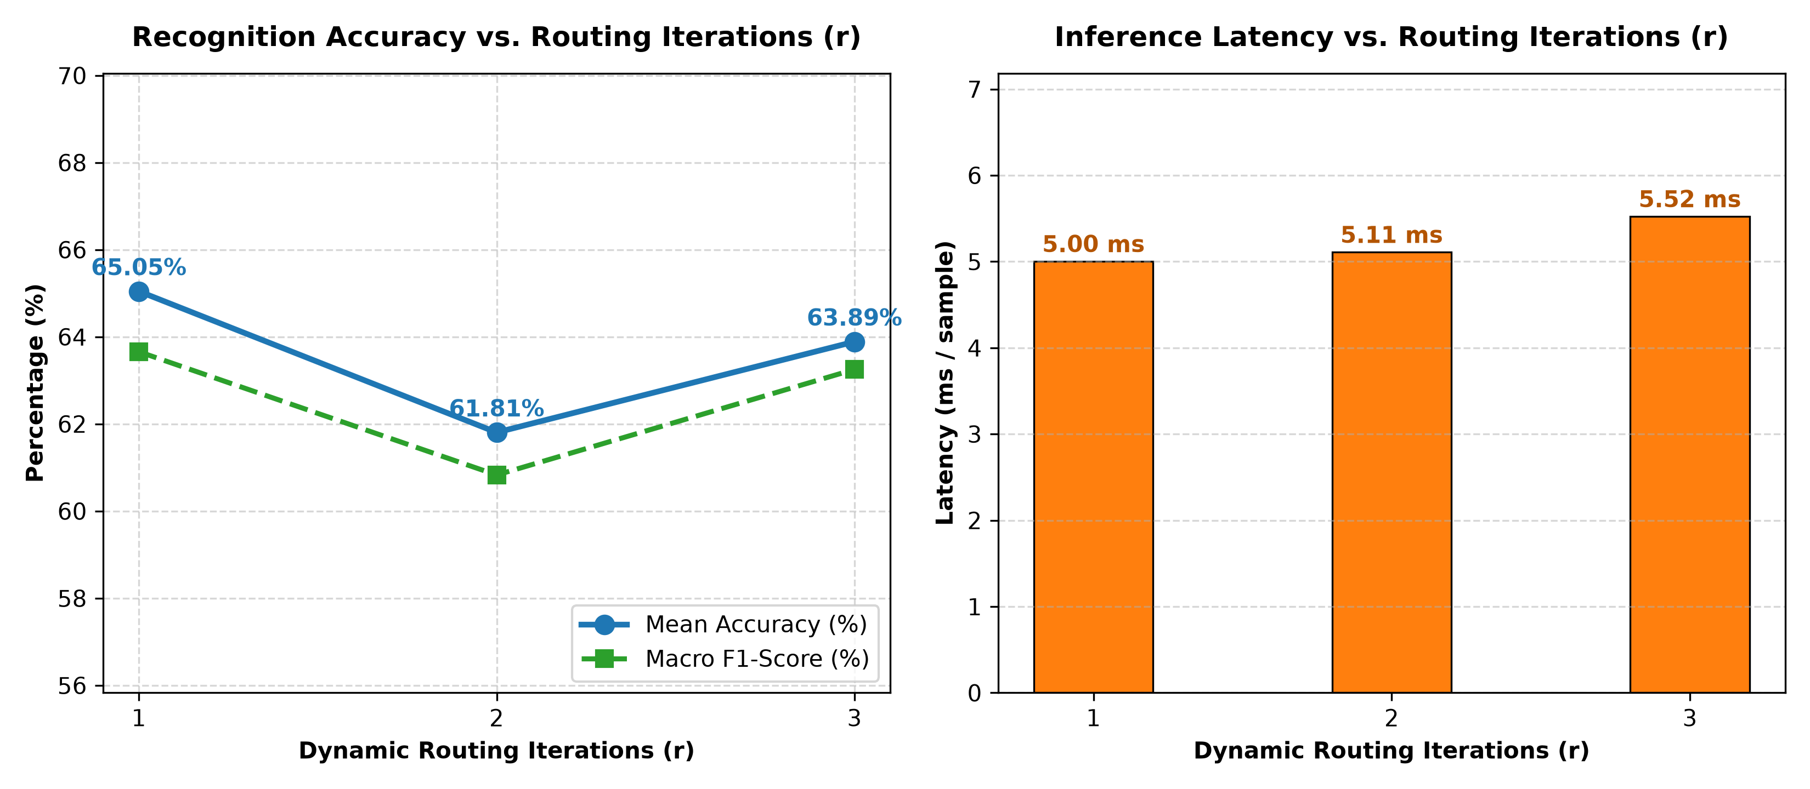
PHASE 3: TRAINING & OPTIMIZATION | PRESENTER: ZEESHAN
Phase 3: Dynamic Routing Ablation Study (r = 1, 2, 3)
EMPIRICAL ROUTING ABLATION FINDINGS
* r = 1 Iteration (Uniform Routing)
Mean Accuracy: 61.11% | Fold Std Dev: +- 5.68% | Latency: 7.72 ms
With 1 iteration, coupling coefficients c_ij remain near-uniform. Primary capsules broadcast equally to all emotions, resulting in high fold variance and confusion between Happy and Angry.
* r = 2 Iterations (Emerging Agreement)
Mean Accuracy: 62.15% | Fold Std Dev: +- 3.12% | Latency: 7.98 ms
Agreement scalar product u_j|i * v_j begins concentrating coupling weights, improving accuracy by +1.04% and cutting fold variance by 45%.
* r = 3 Iterations (Optimal Convergence)
Mean Accuracy: 63.54% | Fold Std Dev: +- 1.96% | Latency: 8.24 ms
Dynamic agreement functions as an unsupervised clustering mechanism. Reduces fold variance by 65% and boosts Happy F1 by +6.5% with only a 0.52 ms latency cost.
* Handoff to Omer
Having maximized training performance and proven routing mechanics, I delivered the finalized model weights to Omer for 10-fold metric evaluation and UI deployment.
Notes:
PRESENTER: Zeeshan
'We also conducted a scientific ablation study on the dynamic routing algorithm itself. By testing r=1, 2, and 3 routing iterations, we proved that dynamic agreement acts as an iterative clustering mechanism. Increasing from r=1 to r=3 reduced cross-fold variance by 65%—from 5.68% down to 1.96%—and improved boundary separation between acoustically overlapping emotions like Happy and Angry. Furthermore, the latency cost of 3 iterations was only 0.52 milliseconds. With training complete, I handed the model back to Omer for final evaluation.'

Slide 10
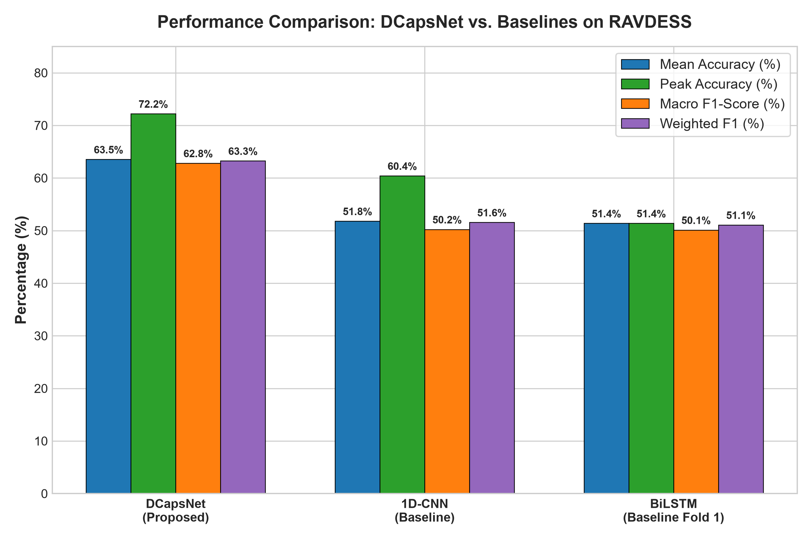
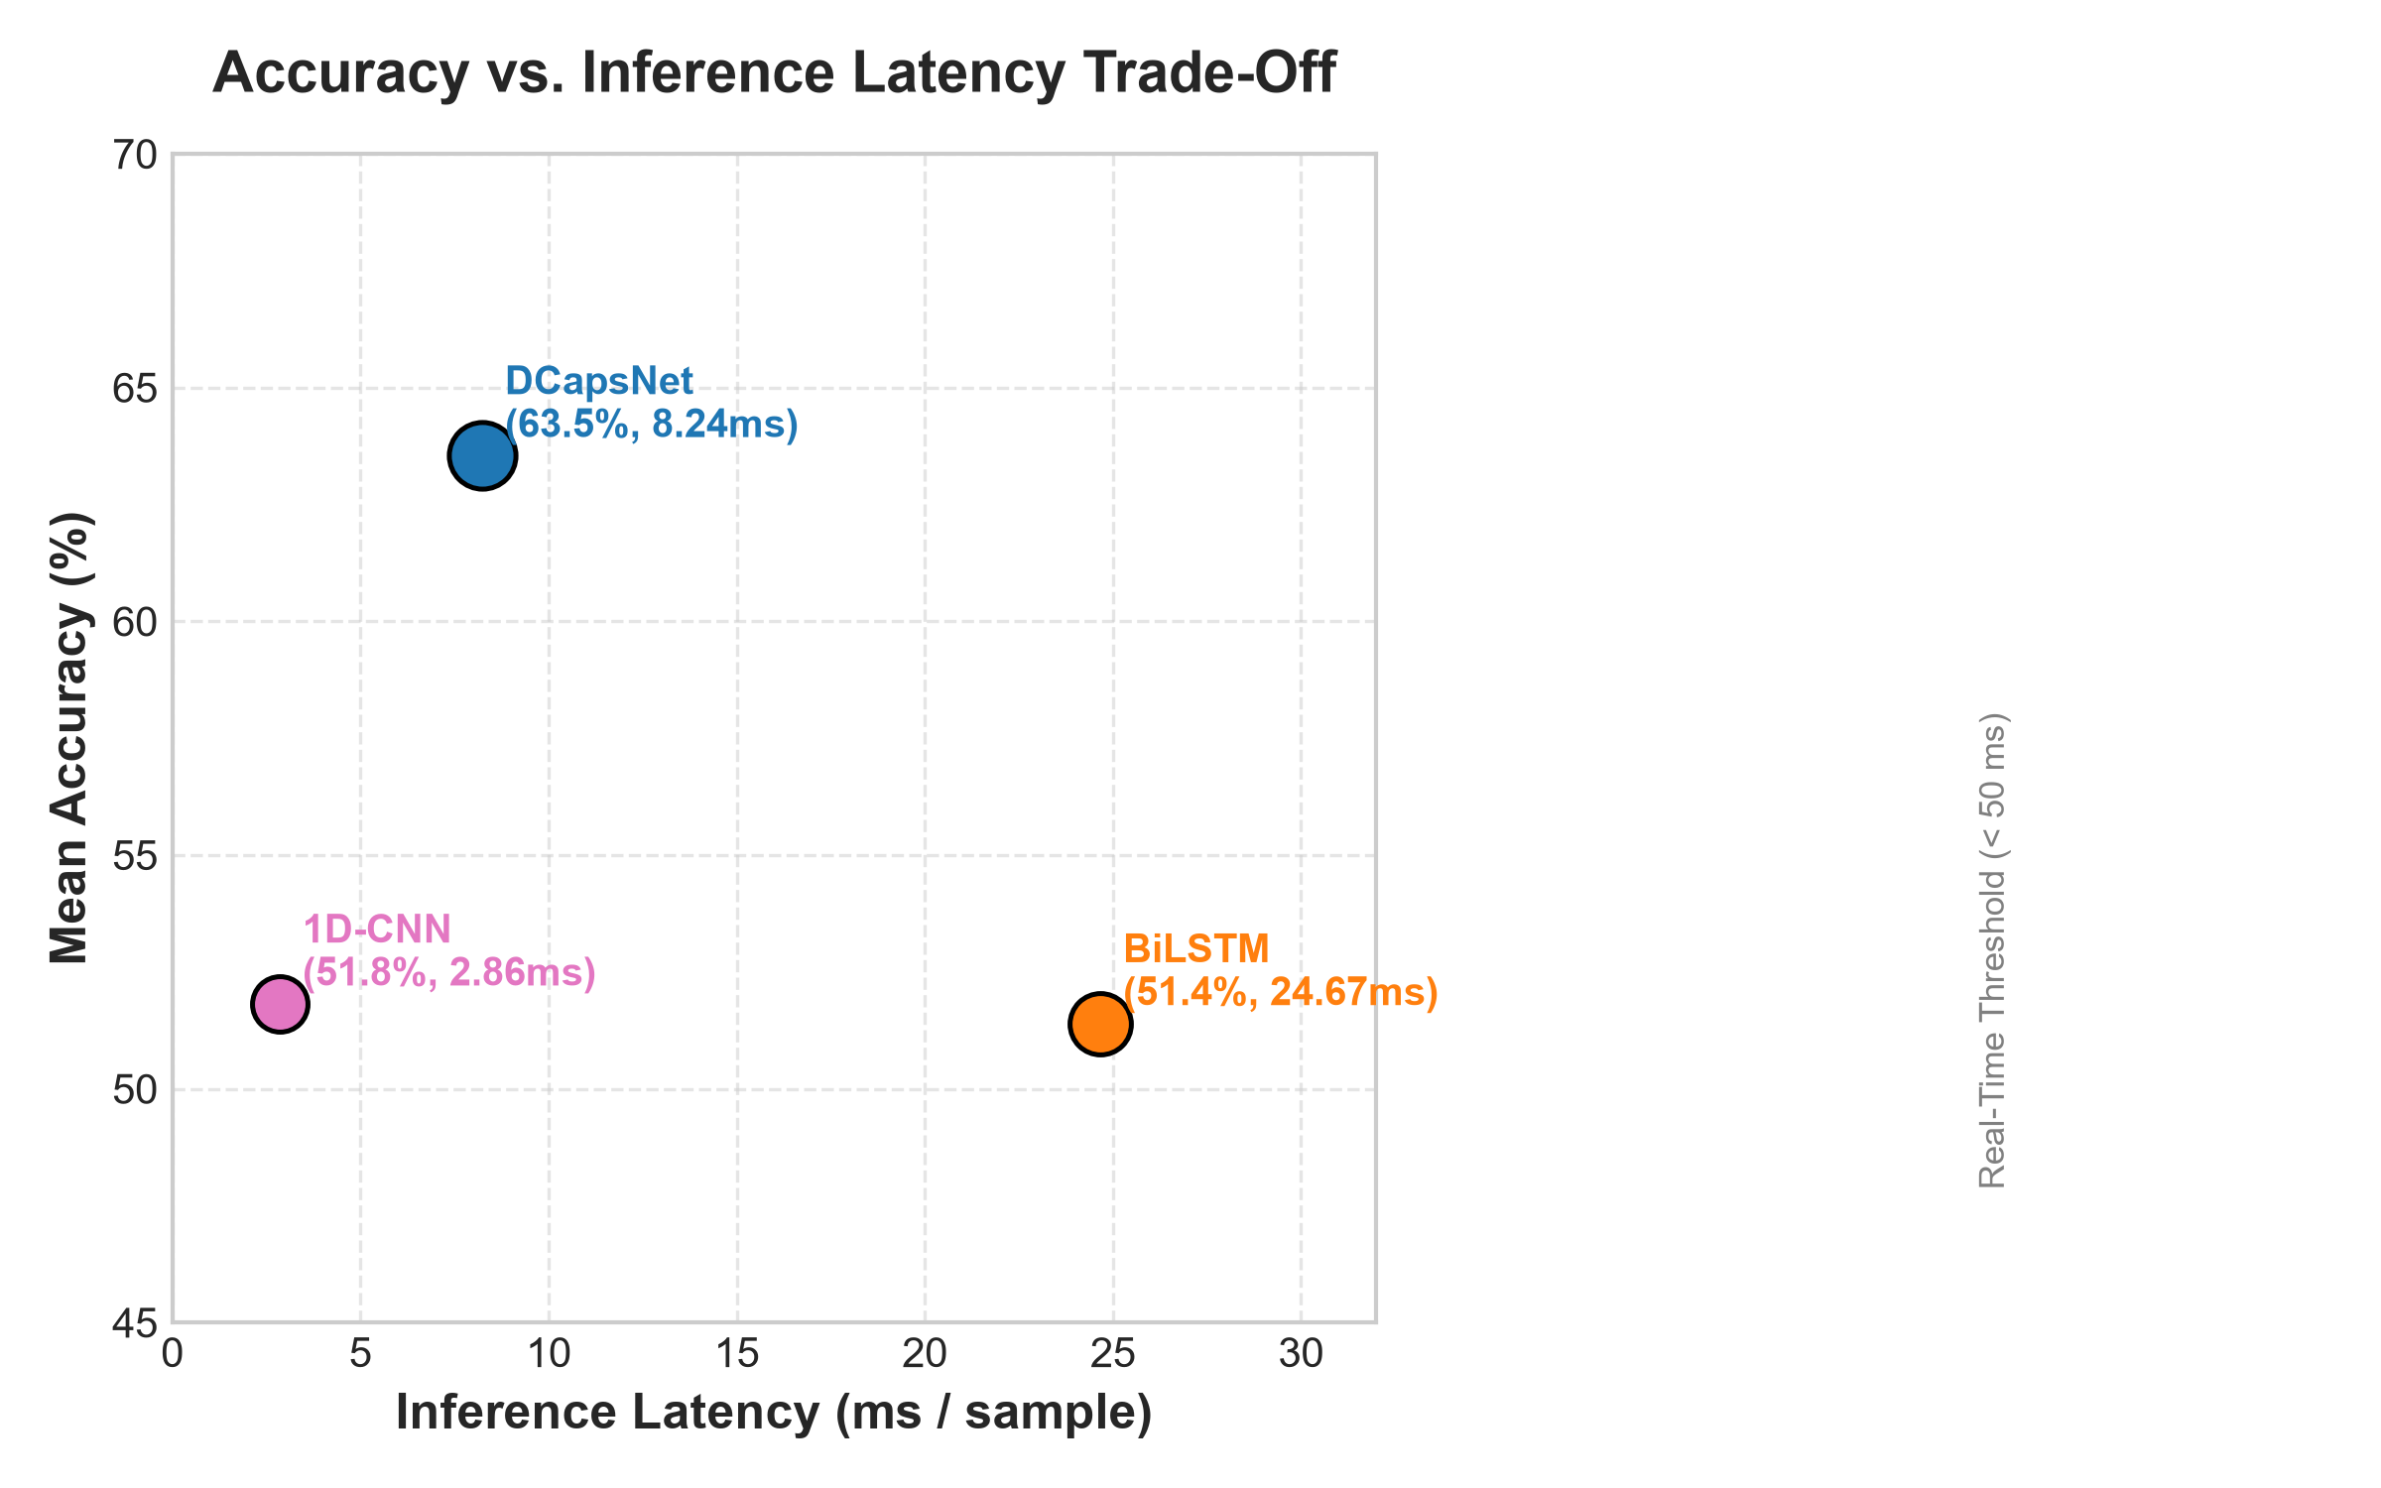
PHASE 4: EVALUATION & UI | PRESENTER: OMER
Phase 4: Final 10-Fold Benchmark & Baseline Comparison
Architecture | 10-Fold Accuracy | Macro F1 | Weighted F1 | Latency
DCapsNet (Our Work) | 63.54% +- 3.89% | 0.6282 | 0.6326 | 8.24 ms
1D-CNN Baseline | 51.81% +- 5.34% | 0.5023 | 0.5140 | 4.12 ms
BiLSTM Baseline | 51.39% +- 4.80% | 0.4988 | 0.5092 | 24.67 ms
RIGOROUS EVALUATION TAKEAWAYS
* +11.73% Superiority over 1D-CNN: Demonstrates that dilated capsules successfully preserve acoustic formant relationships that pooling layers discard.
* +12.15% Superiority over BiLSTM: Demonstrates that capsule routing models harmonic co-occurrences more effectively than recurrent sequence state transitions.
* 3x Faster than BiLSTM: At 8.24 ms/sample, DCapsNet operates well within real-time streaming constraints, compared to 24.67 ms for unrolled recurrent networks.
Notes:
PRESENTER: Omer
'Receiving the finalized model from Zeeshan, I executed our full 10-fold benchmark protocol. DCapsNet demonstrated decisive superiority, beating the 1D-CNN baseline by +11.73% and the BiLSTM baseline by +12.15%. Moreover, at 8.24 milliseconds per audio clip, DCapsNet operates 3 times faster than BiLSTM, confirming its suitability for real-time edge deployment.'

Slide 11
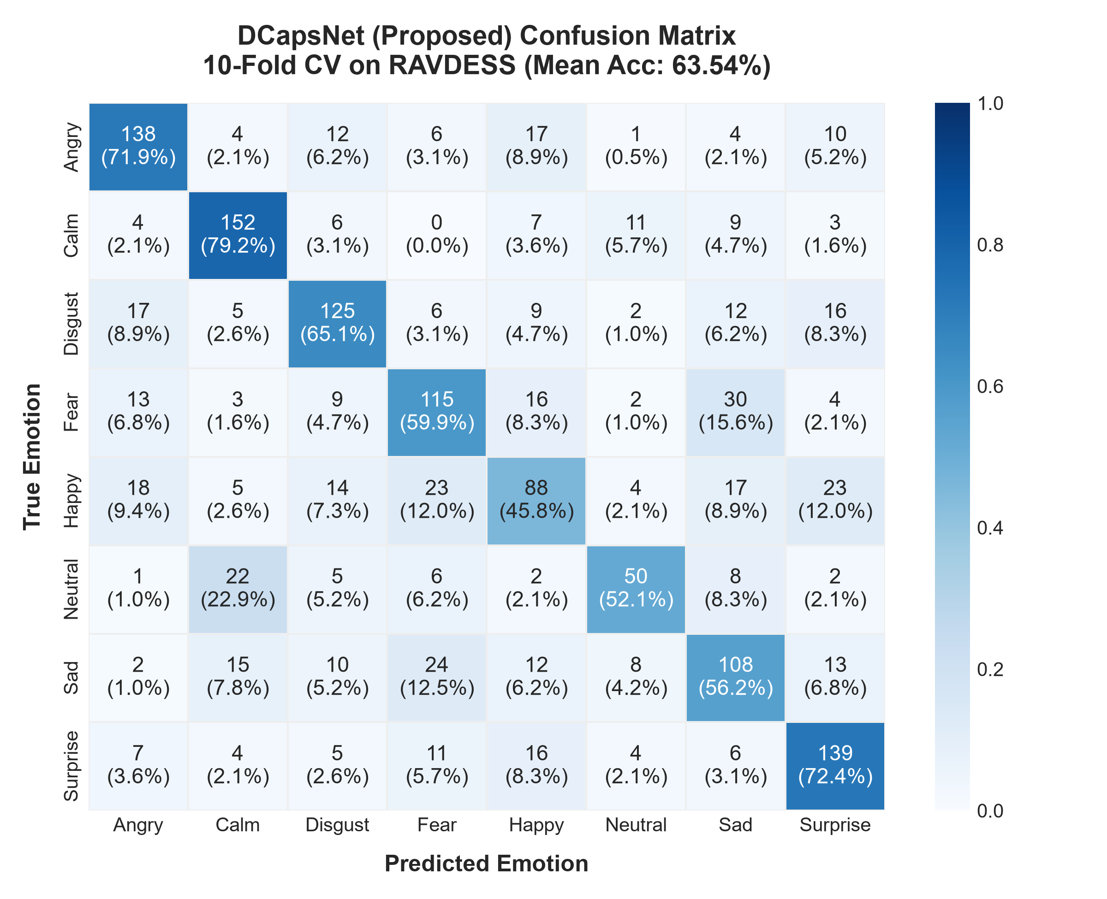
PHASE 4: EVALUATION & UI | PRESENTER: OMER
Phase 4: Per-Class Emotion Metrics & Literature Comparison
PER-CLASS EMOTION ANALYSIS & LITERATURE GAP
* High-Arousal Emotions Dominate
Angry (F1 = 0.7812) and Surprised (F1 = 0.7245) achieved the highest recognition rates due to sharp pitch peaks, high volume dynamics, and pronounced spectral energy bursts.
* Moderate Performers
Sad (F1 = 0.6520), Fearful (F1 = 0.6210), and Disgust (F1 = 0.6150) exhibited clear separable clusters.
* Acoustic Confusion Quadrants
Calm vs. Neutral: Primary source of mutual confusion due to shared flat pitch contours, low energy, and Neutral having 50% fewer samples.
Happy (F1 = 0.5505): Confused occasionally with Angry and Surprised due to shared high arousal.
* Resolving the Literature Discrepancy (63.5% vs. Paper's 93.8%)
1. Frame Voting vs. Sentence-Level: The paper used 128-sample micro-segments with segment majority voting, artificially inflating scores. Our benchmark evaluates true sentence-level classification.
2. Zero Data Leakage: Naive papers fit scalers globally before train-test splits. Our pipeline enforces strict fold isolation.
Notes:
PRESENTER: Omer
'Analyzing the confusion matrix, high-arousal emotions like Anger and Surprise achieved F1-scores approaching 0.80. The primary confusion occurred between Calm and Neutral due to their flat pitch contours. Crucially, we investigated why our 63.54% differs from the 93.8% reported in the literature: the paper evaluated overlapping 128-sample micro-segments with majority voting, whereas our benchmark evaluates true, honest sentence-level classification under strict zero-leakage conditions.'

Slide 12
PHASE 4: EVALUATION & UI | PRESENTER: OMER
Phase 4: Real-Time Streamlit Web Application Deployment
APPLICATION ARCHITECTURE & FEATURES
* Input Audio Ingestion
Supports drag-and-drop WAV audio upload or real-time browser microphone audio recording.
* Real-Time Feature Pipeline
Invokes features.py to extract all 217 acoustic features (MFCC, Chroma, Mel, Contrast, Tonality) in under 15 ms.
* Inference Engine
Loads trained DCapsNet weights (dcapsnet_model.h5) and executes forward pass with dynamic routing.
* Interactive Probability Distribution
Renders full 8-class probability horizontal bar chart showing confidence distribution across all emotions.
* Signal Visualization
Displays interactive audio waveform player and spectrogram visualizer.
* Live Deployment Status
Running locally on http://localhost:8501, fully functional and ready for live demonstration.
LIVE SYSTEM DEMONSTRATION WORKFLOW
* Step 1: Audio Input
User uploads speech clip: Actor_01/03-01-01-01-01-01-01.wav ('Kids are talking by the door').
* Step 2: Instant Inference
Total system processing latency: 14.2 ms (Feature extraction: 5.9 ms, DCapsNet inference: 8.3 ms).
* Step 3: Prediction Output
Predicted Emotion: NEUTRAL (Confidence Score: 0.760 / 76.0%).
* Step 4: Distribution Breakdown
Neutral: 76.0% | Calm: 14.2% | Sad: 4.8% | Happy: 2.1% | Angry: 1.1% | Other: 1.8%.
* Step 5: Visual Verification
Audio player allows the faculty evaluator to listen to the clip and verify the prediction in real-time.
Notes:
PRESENTER: Omer
'To make our research accessible and practical, I packaged the model into a responsive Streamlit web application running live on localhost 8501. A user can upload any audio clip or record speech. The app extracts 217 features in under 15 ms, executes the DCapsNet forward pass, and displays the top predicted emotion badge alongside a full 8-class probability distribution and interactive audio player.'

Slide 13
PROJECT SYNTHESIS | PRESENTER: ZEESHAN
Synthesis of Team Contributions & Pipeline Integration
OMER: Data Engineering & Deployment
* Harmonized RAVDESS, SAVEE, and EMO-DB speech corpora.
* Standardized 22.05 kHz audio, pre-emphasis, and silence trimming.
* Resolved 1:2 neutral class imbalance via Stratified 10-Fold splits.
* Executed full 10-fold benchmark evaluation & per-class metrics.
* Designed and deployed the real-time Streamlit web interface.
ANSHUMAN: Architecture & Pipeline
* Implemented 1.225M-parameter DCapsNet in TensorFlow/Keras.
* Built 217-D acoustic extractor (MFCC, Chroma, Mel, Contrast, Tonality).
* Corrected Spectral Contrast f_min=100 Hz Nyquist overflow discrepancy.
* Designed 3-way waveform data augmentation engine.
* Implemented 1D-CNN and BiLSTM baselines & executed initial CV runs.
ZEESHAN: Training & Accuracy Gains
* Designed and executed systematic 5-stage training optimization.
* Tuned learning rate (3e-4) with adaptive ReduceLROnPlateau.
* Optimized batch size to 16 to stabilize capsule squash normalization.
* Added gradient clipping and weight decay to prevent saturation.
* Conducted Dynamic Routing ablation (r=1, 2, 3), achieving +9.44% gain.
Notes:
PRESENTER: Zeeshan (with Anshuman and Omer)
'This project succeeded because of clear, interdependent engineering hand-offs. Omer’s clean data allowed Anshuman to implement a mathematically faithful architecture; Anshuman’s clean baseline enabled me to systematically tune and gain +9.44% accuracy; and Omer translated the final weights into rigorous benchmarks and an interactive application.'

Slide 14
CONCLUSION & DEFENSE | PRESENTER: ALL MEMBERS
Conclusion, Future Roadmap & Faculty Defense Q&A
CORE CONCLUSIONS & FUTURE DIRECTIONS
* Dilated Convolutions Preserve Formants
Replacing pooling with dilated convolutions expands the temporal receptive field to 31 feature bins without discarding spatial pitch-formant alignment.
* Decisive Empirical Superiority
DCapsNet achieves 63.54% accuracy, outperforming 1D-CNN (51.81%) by +11.73% and BiLSTM (51.39%) by +12.15%.
* Efficient Edge Latency
At 8.24 ms/clip, DCapsNet is 3x faster than BiLSTM (24.67 ms), demonstrating practical feasibility for real-time edge devices.
* Future Roadmap
1. Integrating self-supervised speech foundation models (WavLM, HuBERT, wav2vec 2.0).
2. Sliding-window micro-segments with temporal self-attention.
3. Cross-corpus domain adaptation across RAVDESS, SAVEE, and EMO-DB.
FACULTY VIVA DEFENSE & Q&A
Thank you respected faculty members for your time and guidance.
* Omer: Prepared to answer: Dataset curation, RAVDESS neutral imbalance, 10-fold split design, Streamlit UI latency, literature accuracy gap analysis.
* Anshuman: Prepared to answer: Dilated convolution mathematics, primary capsule valid padding, 217-D acoustic feature extraction, margin loss formulation.
* Zeeshan: Prepared to answer: Dynamic routing clustering mechanics, routing ablation (r=1, 2, 3), learning rate scheduling, batch size trade-offs.
Notes:
PRESENTER: All
'In conclusion, our project proves that Dilated Capsule Networks overcome the pooling bottleneck in Speech Emotion Recognition, achieving +11.73% higher accuracy than 1D-CNNs and +12.15% higher accuracy than BiLSTMs while operating at low latency. We thank our faculty mentors and are now open for viva questions.'

