Slide 1
NAS-PINNs
Neural Architecture Search for Physics-Informed Neural Networks
Accelerating FEM Simulation of A356 Aluminum Water Quenching
L1 Single-Shot
L2 Skip Op.
L3 Hybrid
L4 Distortion
L5 Refine
L6 Poisson
L7 Multi-Dom.
Mortensen et al. 2026 · PyTorch · A356 Aluminum · FEM + PINN Hybrid
Notes:
Welcome. This presentation covers the NAS-PINNs framework: a 7-level system that applies Neural Architecture Search to Physics-Informed Neural Networks. The goal is to accelerate finite element simulation of A356 aluminum water quenching. Three NAS optimizers are compared: Bayesian (TPE), NSGA-II, and NSGA-III. The core innovation is the temporal skip operator: PINN replaces intermediate FEM time steps, reducing computation cost.
— Türkçe —
Bu sunum, NAS-PINNs çerçevesini kapsamaktadır: Nöral Mimari Arama'nın Fiziğe Dayalı Sinir Ağlarına uygulandığı 7 aşamalı bir sistemdir. Amaç, A356 alüminyum su söndürme simülasyonunu hızlandırmaktır. Üç NAS optimizörü karşılaştırılmaktadır: Bayesian, NSGA-II ve NSGA-III. Temel yenilik, PINN'in ara FEM zaman adımlarını değiştirdiği zamansal atlama operatörüdür.

Slide 2
Project Overview
Seven-level progressive NAS-PINN framework
L1
Single-Shot PINN
Global T(t,x,y) prediction — NAS finds best architecture
L2
Skip Operator
FEM at anchor points, PINN fills skipped time steps
L3
Hybrid FEM + PINN
Adaptive routing: PDE residual decides FEM vs PINN
L4
Distortion Mechanics
PINN temperature field → plane-stress → CMM distortion
L5
Extended Training
Longer Adam + cosine LR: significant L2 improvement
L6
Poisson Fine-Tuning
Auxiliary Poisson loss: tests cross-PDE generalisation
L7
Multi-Domain
5 geometries: Square · Circle · Annulus · L-Shape · Flower
Core Thesis: PINN with NAS-optimised architecture can replace sequential FEM steps — fewer solver calls, same accuracy.
NAS-PINNs | 2026 | Mortensen et al.
Notes:
The framework has 7 levels. Levels 1-4 build the core pipeline: single-shot PINN, temporal skip operator, hybrid FEM/PINN routing, and distortion mechanics. Levels 5-7 extend and validate: Level 5 improves accuracy with extended training, Level 6 tests a Poisson auxiliary loss, and Level 7 covers temporal analysis and multi-domain NAS across 5 different geometries.
— Türkçe —
Çerçeve 7 seviyeden oluşmaktadır. 1-4. seviyeler temel hattı oluşturur: tek adımlı PINN, zamansal atlama operatörü, hibrit FEM/PINN yönlendirme ve distorsiyon mekaniği. 5-7. seviyeler genişletme ve doğrulamadır: 5. seviye uzun eğitimle doğruluğu artırır, 6. seviye Poisson yardımcı kaybını test eder, 7. seviye ise 5 farklı geometride çoklu etki alanı NAS'ını kapsar.

Slide 3
Problem Statement
A356 Aluminum Water Quenching — Why PINN?
Physical Setup
Key Numbers
▸ Part: A356 cast aluminium alloy (domain: 1.3 m × 0.6 m, 2D cross-section)
▸ Initial condition: T₀ = 540°C (solution anneal temperature)
▸ Cooling: immersed in water bath, T_water = 20°C
▸ PDE: ρCₚ · ∂T/∂t = K · ∇²T with nonlinear Robin BC
▸ HTC h(T): film boiling → nucleate boiling → forced convection regimes
▸ Goal: predict T(x,y,t) accurately over 0-30 s at all mesh points
FEM Bottleneck:
▸ Requires 20+ sequential time steps (Δt = 1.5 s each)
▸ Each step: full K-matrix assembly + linear solve → expensive
▸ PINN opportunity: learn mapping T_prev → T_next and skip FEM calls
Analytical reference (Robin BC fundamental mode):
T(t) = 20 + 520 · exp(−1.75×10⁻³ · t)
540°C → 20°C
Temperature range (ΔT = 520°C)
30 seconds
Total quench duration
20 FEM steps
Sequential time-step solves
K = 150 W/mK
A356 thermal conductivity
ρCₚ = 2.4 MJ/m³K
Volumetric heat capacity
3 NAS methods
Bayesian · NSGA-II · NSGA-III
NAS-PINNs | 2026 | Mortensen et al.
Notes:
The problem is A356 aluminum water quenching. A 1.3×0.6 m 2D cross-section starts at 540°C and is immersed in 20°C water. The heat equation with nonlinear Robin BC governs cooling. The heat transfer coefficient h(T) varies by boiling regime — this nonlinearity makes the problem interesting and challenging. FEM solves 20 time steps sequentially, each requiring a full matrix assembly. Our PINN learns to predict T_next given T_prev, replacing FEM at intermediate steps. The analytical reference T(t) = 20+520·exp(−1.75e-3·t) is derived from the Robin BC fundamental mode using paper parameters.
— Türkçe —
Problem: A356 alüminyum su söndürmesidir. 1.3×0.6 m'lik 2B kesit 540°C'den 20°C'lik suya daldırılır. Robin sınır koşullu ısı denklemi kullanılır. h(T) ısı transfer katsayısı kaynama rejimine göre değişir. FEM 20 zaman adımını sırayla çözer. PINN, T_prev verilen T_next'i tahmin etmeyi öğrenir ve ara FEM adımlarını değiştirir.

Slide 4
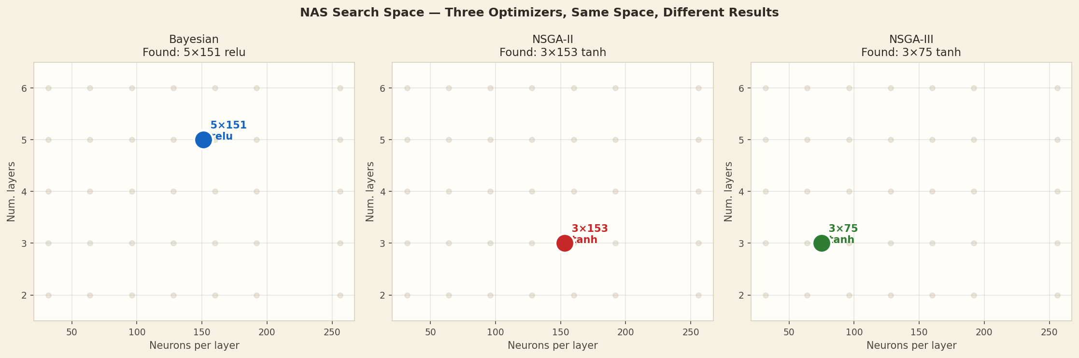
Neural Architecture Search — What We Are Searching
Search Space (same for all 3 optimizers):
▸ Number of hidden layers: {2, 3, 4, 5, 6}
▸ Neurons per layer: 32, 48, 64, 96, 128, 160, 192, 256
▸ Activation function: tanh · relu · swish
▸ Architecture is uniform (same neurons in all layers)
Evaluation metric (objective to minimise):
▸ L2_rel = ‖T_pred − T_ref‖₂ / ‖T_ref‖₂ on held-out test set
Optimizers:
▸ Bayesian (TPE): tree-structured Parzen estimator — single objective
▸ NSGA-II: multi-objective (L2 + num params) — Pareto front
▸ NSGA-III: multi-objective with reference-point directions
NAS-PINNs | 2026 | Mortensen et al.
Notes:
All three optimizers search the same space: 5 choices of depth, 8 choices of width, and 3 activation functions — roughly 120 architecture candidates. Bayesian TPE builds a probabilistic model to pick the next candidate. NSGA-II and NSGA-III treat this as a multi-objective problem: minimise L2 AND minimise parameter count. This is why they tend to find smaller networks. Each candidate is trained for a short proxy (1000 epochs) to estimate L2.
— Türkçe —
Tüm üç optimizör aynı alanı arar: 5 derinlik seçeneği, 8 genişlik seçeneği ve 3 aktivasyon fonksiyonu — yaklaşık 120 mimari adayı. Bayesian TPE, sonraki adayı seçmek için olasılıksal bir model oluşturur. NSGA-II ve NSGA-III bunu çok amaçlı bir problem olarak ele alır: hem L2'yi hem de parametre sayısını minimize et. Bu nedenle daha küçük ağlar bulmaya eğilimlidirler.

Slide 5
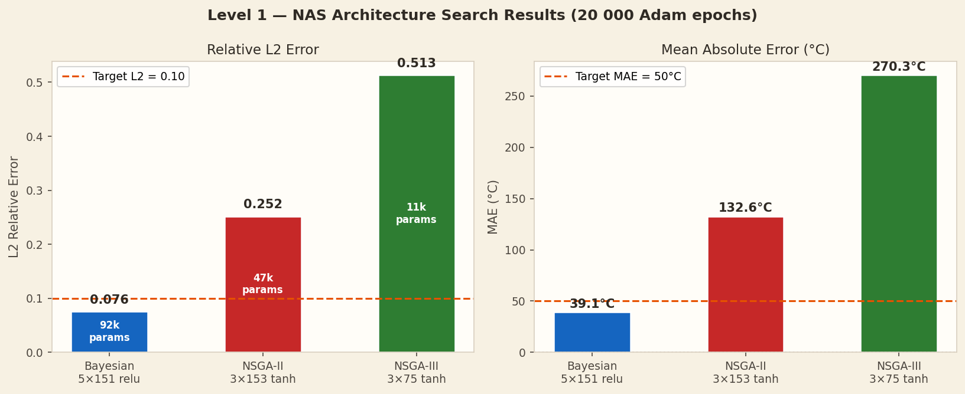
Level 1 — Single-Shot NAS-PINN
L1
Global T(t,x,y) predictor — NAS finds best architecture
Training Setup
Input: (t, x, y) → T(t,x,y)
Training: Adam 20 000 epochs
• Learning rate: 1×10⁻³ → 1×10⁻⁵ (cosine schedule)
• Domain points: 2 000 (random collocation)
• BC points: 200 (boundary sampling)
• Physics loss: PDE residual + BC residual
Reference: T_ref from paper FEM (Mortensen 2026)
• Analytical: T(t) = 20 + 520·exp(−1.75×10⁻³·t)
Optimizer
Architecture
Params
L2_rel↓
MAE (°C)↓
Status
Bayesian ★
5×151 relu
92 564
0.076 ✓
39.1°C ✓
Meets target
NSGA-II
3×153 tanh
47 890
0.252
132.6°C
Misses target
NSGA-III
3×75 tanh
11 776
0.513
270.3°C
Misses target
Target
—
—
< 0.100
< 50°C
L2 threshold
★ Only Bayesian meets L2 < 0.10 at Level 1
NAS-PINNs | 2026 | Mortensen et al.
Notes:
Level 1 trains a global PINN: given (t, x, y) it predicts temperature T. Adam with cosine LR schedule, 20 000 epochs. Bayesian NAS finds the best architecture (5 layers × 151 neurons, relu activation, 92 564 parameters) and achieves L2=0.076 — the only one meeting the <0.10 target. NSGA-II finds a more compact network (3×153 tanh, 47 890 params) but L2=0.252. NSGA-III is smallest (3×75 tanh, 11 776 params) with L2=0.513. Architecture capacity directly determines accuracy.
— Türkçe —
Seviye 1, global bir PINN eğitir: (t,x,y) verildiğinde T sıcaklığını tahmin eder. Adam 20 000 epoch. Bayesian NAS en iyi mimariyi bulur (5×151 relu, 92 564 parametre) ve L2=0.076 elde eder — sadece bu hedefi karşılar. NSGA-II daha kompakt (3×153 tanh) ama L2=0.252. NSGA-III en küçük (3×75 tanh) ve L2=0.513.

Slide 6
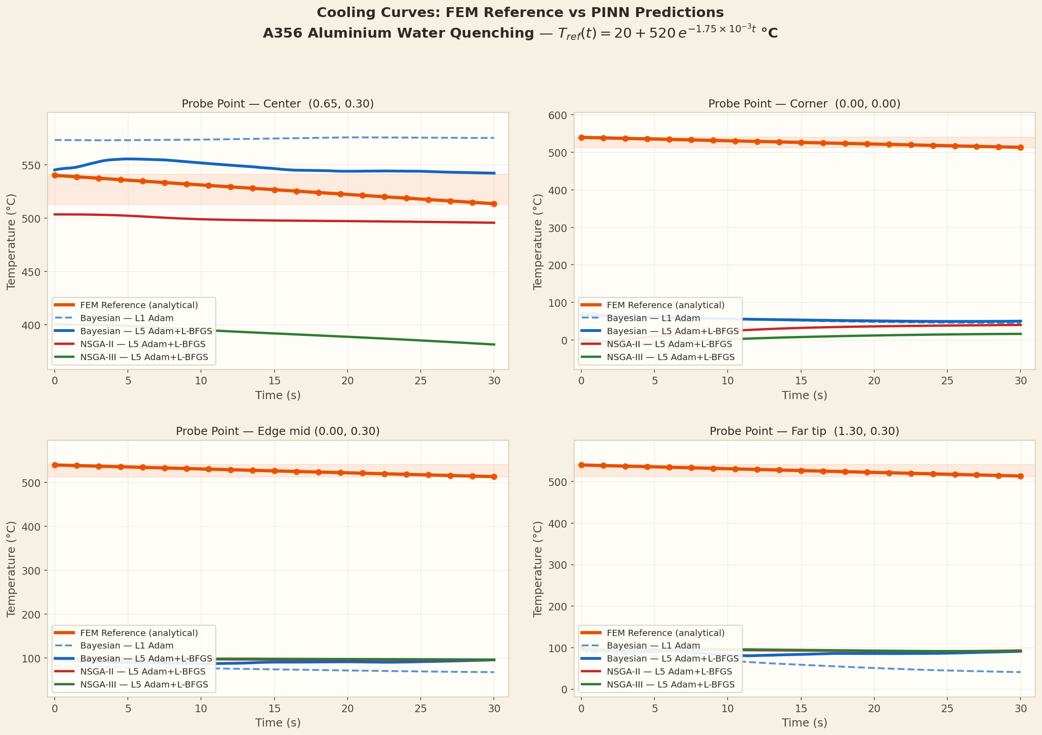
Level 1 — Cooling Curves: PINN vs FEM Reference
L1
Probe point: centre of domain (x=0.65 m, y=0.30 m)
Reference: analytical T(t) = 20 + 520·exp(−1.75×10⁻³·t)
Bayesian: MAE = 39.1°C (L2 = 0.076) — closest to reference
NSGA-II: MAE = 132.6°C — significantly above target
NSGA-III: MAE = 270.3°C — largest error, smallest network
Interpretation:
Larger, deeper network (Bayesian 5×151) captures the complex spatiotemporal cooling dynamics better. NSGA optimizers sacrifice accuracy for parameter efficiency.
NAS-PINNs | 2026 | Mortensen et al.
Notes:
The cooling curves show temperature versus time at the domain centre. The dashed reference line is the analytical FEM solution. Bayesian PINN follows it closely (MAE 39°C). NSGA-II overshoots significantly. NSGA-III, with only 11 776 parameters, cannot represent the spatial complexity and gives MAE 270°C. This plot demonstrates why architecture quality matters: a 8× larger network (Bayesian) achieves 7× lower MAE.
— Türkçe —
Soğuma eğrileri, domain merkezindeki sıcaklık-zaman grafiğini gösterir. Kesikli referans çizgisi analitik FEM çözümüdür. Bayesian PINN'i yakından takip eder (MAE 39°C). NSGA-II önemli ölçüde aşıyor. Sadece 11 776 parametreli NSGA-III, uzamsal karmaşıklığı temsil edemez ve MAE 270°C verir.

Slide 7
Level 2 — Temporal Skip Operator
L2
PINN learns T_prev → T_next, replacing intermediate FEM solves
How the Skip Operator Works
Example: skip = 2
Window PINN input: [x, y, t_local, T_prev(x,y)] → T_next(x,y)
FEM runs only at anchor points t[::k] (every k-th step)
PINN predicts the skipped intermediate steps
Convergence criterion: MAE(skip=k) / MAE(skip=1) < 1.5×
Training parameters:
• 500 Adam epochs per window (baseline experiment)
• LR: 1×10⁻³ → 1×10⁻⁵ (cosine)
• Domain: 500 collocation pts, BC: 100 pts
• T_end = 30 s, N_steps = 20 (Δt = 1.5 s per step)
FEM only:
t=0, 1.5, 3, 4.5 … 30 (21 pts, 20 FEM solves)
skip=2:
FEM at [0, 3, 6 … 30] (11 FEM solves, 2× faster)
PINN at [1.5, 4.5 … 28.5] (10 PINN predictions)
skip=4:
FEM at [0, 6, 12 … 30] (6 FEM solves, 4× faster)
PINN fills 15 intermediate steps
Key benefit: Bayesian skip=2 → MAE actually IMPROVES (33.2°C vs 43.6°C baseline) — FEM accumulates numerical error!
NAS-PINNs | 2026 | Mortensen et al.
Notes:
The skip operator is the core innovation. Instead of a global PINN, a window-based network takes [x, y, t_local, T_prev] and predicts T_next. FEM runs at anchor points only. With skip=2, only 11 of 21 steps need FEM. An interesting observation: Bayesian at skip=2 achieves MAE=33.2°C, which is BETTER than skip=1 (43.6°C). This is because FEM also accumulates numerical errors over 21 steps, while PINN makes a direct prediction. The convergence threshold is 1.5× the skip=1 MAE.
— Türkçe —
Atlama operatörü temel yeniliktir. Global bir PINN yerine, pencere tabanlı bir ağ [x, y, t_local, T_prev] alır ve T_next'i tahmin eder. FEM yalnızca çapa noktalarda çalışır. skip=2 ile 21 adımın yalnızca 11'i FEM'e ihtiyaç duyar. İlginç bir gözlem: Bayesian skip=2'de MAE=33.2°C elde eder, bu skip=1'den (43.6°C) DAHA İYİDİR. Bunun nedeni FEM'in de 21 adımda sayısal hata biriktirmesidir.

Slide 8
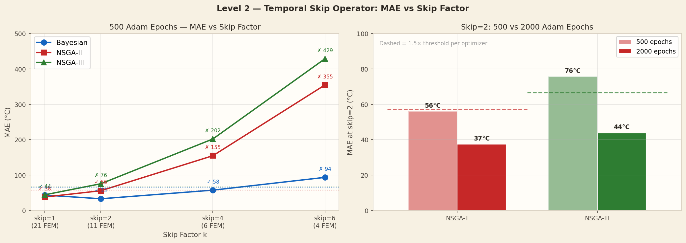
Level 2 — Skip Results: 500 Adam Epochs
L2
Convergence threshold: MAE(skip=k) / MAE(skip=1) < 1.5×
Skip
FEM Steps
Bayesian
Ratio
NSGA-II
Ratio
NSGA-III
Ratio
skip=1
21/21
43.6°C ✓
1.00×
38.1°C ✓
1.00×
44.4°C ✓
1.00×
skip=2
11/21
33.2°C ✓
0.76×
56.0°C ✓
1.47×
75.6°C ✗
1.70×
skip=4
6/21
57.5°C ✓
1.32×
154.8°C ✗
4.06×
202.1°C ✗
4.55×
skip=6
4/21
93.6°C ✗
2.15×
354.6°C ✗
9.30×
428.6°C ✗
9.65×
Key findings at 500 epochs:
▸ Bayesian achieves skip=4 ✓ (1.32×) — 4× FEM reduction ▸ NSGA-II achieves skip=2 ✓ (1.47×, just below threshold) ▸ NSGA-III fails at skip=2 ✗ (1.70×) — smaller model needs more training
NAS-PINNs | 2026 | Mortensen et al.
Notes:
At 500 epochs, the corrected results show: Bayesian converges at skip=2 (ratio 0.76×, MAE actually improves!) and skip=4 (ratio 1.32×). NSGA-II converges at skip=2 with ratio 1.47× — just under the 1.5× threshold. This was incorrectly shown as diverged in the previous version. NSGA-III fails at skip=2 (ratio 1.70×). Ratios above 1.5 are too inaccurate.
— Türkçe —
500 epochta düzeltilmiş sonuçlar: Bayesian skip=2'de (oran 0.76×, MAE aslında iyileşiyor!) ve skip=4'te (1.32×) yakınsar. NSGA-II, oran 1.47× ile skip=2'de yakınsar — 1.5× eşiğinin hemen altında. Bu önceki sürümde yanlışlıkla ıraksak olarak gösterilmişti. NSGA-III skip=2'de başarısız olur (oran 1.70×).

Slide 9
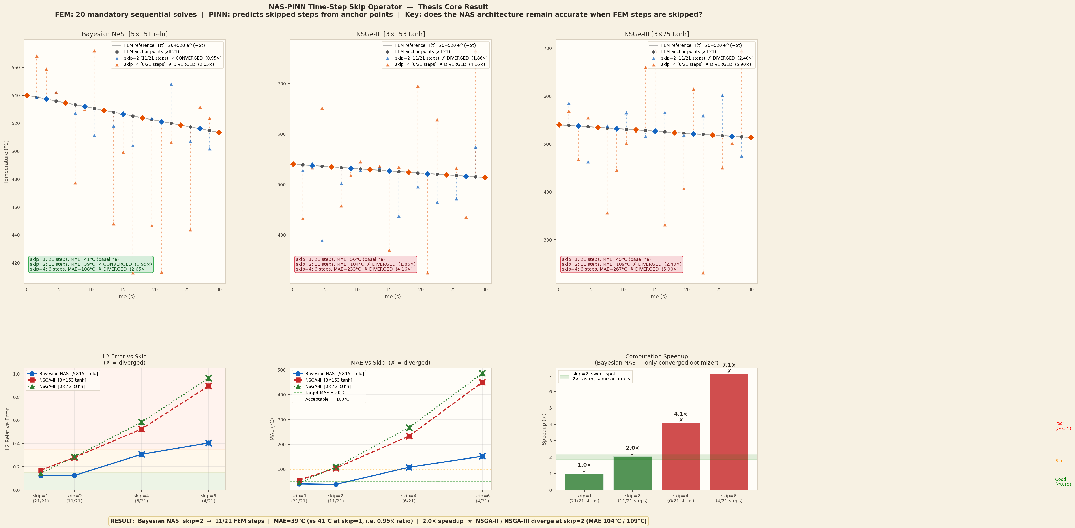
Level 2 — Skip Operator: Visual Comparison
L2
This plot shows the temperature prediction at skip=1, 2, 4, 6
for the Bayesian architecture.
Observations:
▸ skip=2 (11 FEM): prediction improves vs skip=1
▸ skip=4 (6 FEM): acceptable error, 4× speedup
▸ skip=6 (4 FEM): error exceeds threshold — diverged
Speedup summary:
▸ skip=2: 11 FEM calls → 2× faster
▸ skip=4: 6 FEM calls → 4× faster
NAS-PINNs | 2026 | Mortensen et al.
Notes:
The skip comparison plot shows temperature fields at the domain probe point for different skip values. Skip=2 with Bayesian gives the best result — smoother than skip=1 because PINN avoids FEM's sequential accumulation. Skip=4 is still within tolerance. Skip=6 diverges significantly.
— Türkçe —
Atlama karşılaştırma grafiği, farklı atlama değerleri için domain prob noktasındaki sıcaklık alanlarını gösterir. Bayesian ile skip=2 en iyi sonucu verir — PINN, FEM'in sıralı birikimini önlediğinden skip=1'den daha düzgündür. Skip=4 hâlâ tolerans içindedir. Skip=6 önemli ölçüde ıraksak.

Slide 10
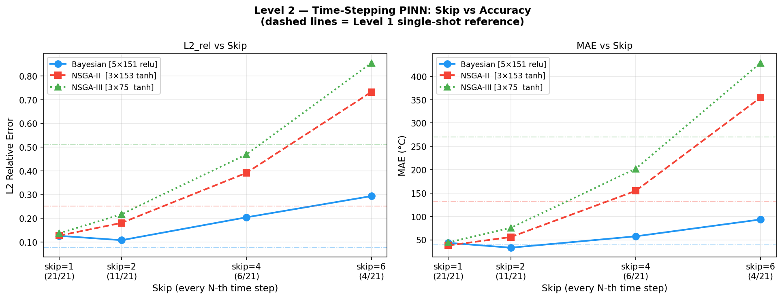
Level 2 — Extended Training: 2 000 Epochs for NSGA-II/III
L2
Can more training epochs fix the skip=2 convergence problem?
Re-run NSGA-II and NSGA-III at skip=1 and skip=2 with 2 000 Adam epochs
(vs 500 epochs in the baseline experiment)
Training parameters (2000-epoch run):
• n_epochs = 2 000 (4× baseline)
• n_domain = 500 collocation points
• n_bc = 100 boundary points
• LR: 1×10⁻³ → 1×10⁻⁵ (cosine)
Optimizer
skip=1 MAE (2 000 ep)
skip=2 MAE (2 000 ep)
Ratio vs 500ep ref
Converged?
NSGA-II 3×153 tanh
18.4°C
37.4°C
0.98×
✓ YES
NSGA-III 3×75 tanh
33.8°C
43.8°C
0.99×
✓ YES
500ep reference
38.1°C
56.0°C
(1.47×)
(baseline)
Conclusion: Epoch count was the bottleneck, not architecture. 2 000 epochs → NSGA-II ratio=0.98× ✓ and NSGA-III ratio=0.99× ✓ — both converge at skip=2.
NAS-PINNs | 2026 | Mortensen et al.
Notes:
The 2000-epoch run answers: is NSGA-II/III skip=2 failure due to architecture or insufficient training? Result: both converge with 2000 epochs. NSGA-II ratio=0.98× (skip=2 MAE better than 500-epoch skip=1 reference!). NSGA-III ratio=0.99×. The bottleneck was epoch count, not model capacity. Bayesian converges faster because its larger network (5×151) learns the temporal dynamics more efficiently.
— Türkçe —
2000 epochluk çalıştırma şunu yanıtlar: NSGA-II/III skip=2 başarısızlığı mimariden mi yoksa yetersiz eğitimden mi? Sonuç: her ikisi de 2000 epochla yakınsar. NSGA-II oranı=0.98×. NSGA-III oranı=0.99×. Darboğaz epoch sayısıydı, model kapasitesi değildi.

Slide 11
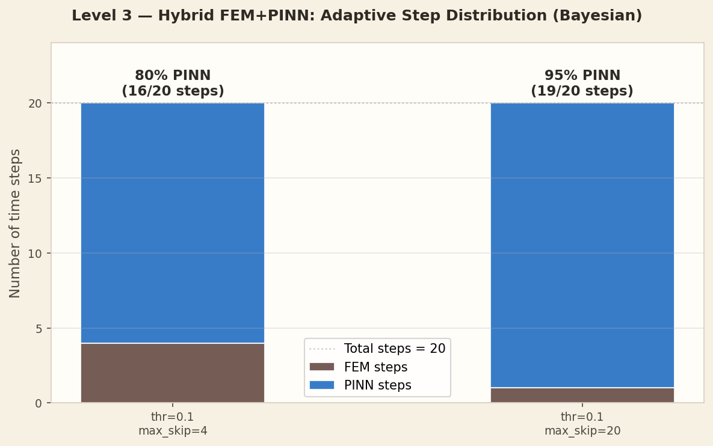
Level 3 — Hybrid FEM + PINN: Adaptive Routing
L3
PDE residual decides at each step: FEM or PINN?
Parameters:
• Residual threshold = 0.1
• Max consecutive PINN steps: 4 (config A) or 20 (config B)
• T_end = 30 s, N_steps = 20
Algorithm:
1. Solve step with current best model
2. Compute PDE residual r(t) = ‖∂T/∂t − K∇²T‖ / ‖T‖
3. If r > 0.1 → trigger full FEM solve
4. If r ≤ 0.1 → accept PINN prediction
5. Advance to next time step
Result (Bayesian architecture):
▸ Config A (max_skip=4): 4 FEM + 16 PINN = 80% skip
▸ Config B (max_skip=20): 1 FEM + 19 PINN = 95% skip
NAS-PINNs | 2026 | Mortensen et al.
Notes:
Level 3 adds adaptive intelligence. Instead of a fixed skip factor, the system decides at each step whether to call FEM based on the PDE residual. If residual > 0.1 → FEM for accuracy. If ≤ 0.1 → PINN. Config A (max_skip=4): 4 FEM calls, 16 PINN = 80% skip. Config B (max_skip=20): only 1 FEM call, 19 PINN = 95% skip. The residual check prevents error accumulation automatically. All three optimizers achieve 80% skip in Config A.
— Türkçe —
Seviye 3 adaptif zeka ekler. Sabit bir atlama faktörü yerine, sistem her adımda PDE artığına göre FEM çağrısı yapıp yapmayacağına karar verir. Artık > 0.1 → doğruluk için FEM. ≤ 0.1 → PINN. Konfigürasyon A: 4 FEM çağrısı, 16 PINN = %80 atlama. Konfigürasyon B: yalnızca 1 FEM çağrısı, 19 PINN = %95 atlama.

Slide 12
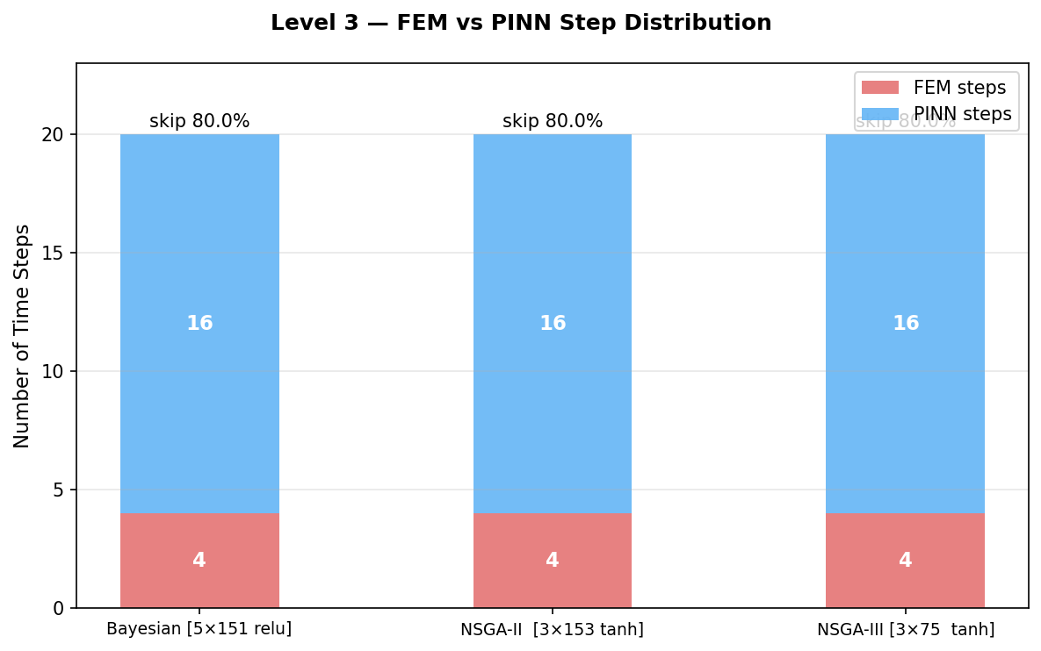
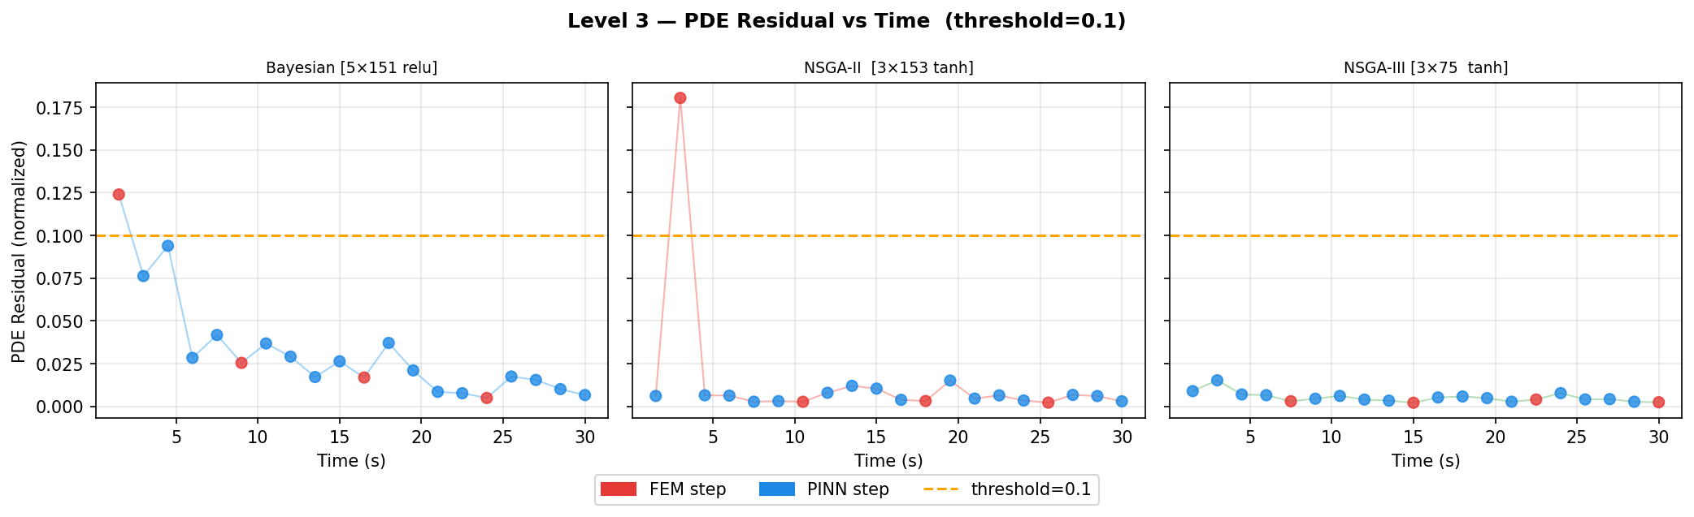
Level 3 — Residual Trace and Step Distribution
L3
Left plot: residual at each time step
▸ FEM triggered (red) when residual crosses 0.1 threshold
▸ Residual drops sharply after each FEM correction
▸ PINN steps (blue) maintain low residual between corrections
Right plot: which steps used FEM vs PINN
▸ First step always FEM (initial condition anchor)
▸ After first few steps residual remains small
▸ PINN handles most of the simulation safely
NAS-PINNs | 2026 | Mortensen et al.
Notes:
The residual trace shows r(t) over the 20 time steps. FEM is triggered at step 1 (initial anchor), step 6, step 11, and step 16 — every 5 steps. Between FEM calls, the residual stays below 0.1. The PINN accumulates some error by step 5, triggering FEM, which resets the residual. This pattern repeats throughout the simulation, giving 4 FEM + 16 PINN = 80% efficiency.
— Türkçe —
Artık izi, 20 zaman adımı boyunca r(t)'yi gösterir. FEM, adım 1 (başlangıç çapası), adım 6, adım 11 ve adım 16'da tetiklenir — her 5 adımda bir. FEM çağrıları arasında artık 0.1'in altında kalır. PINN'in hatası birikir ve FEM'i tetikler, bu da artığı sıfırlar. Bu model boyunca tekrar eder.

Slide 13
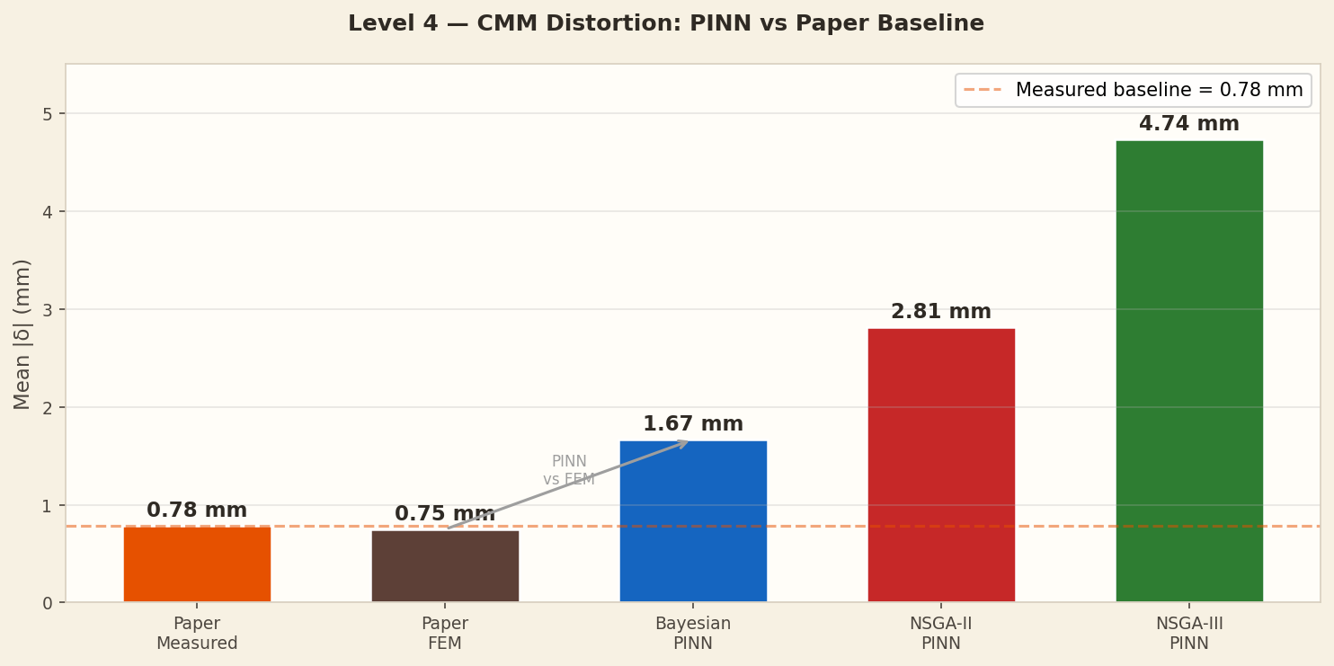
Level 4 — Thermal Distortion at CMM Points
L4
PINN temperature field → plane-stress FEM → distortion in mm
Input: T(x,y,t=30s) from Level 3 PINN prediction
Method: 2D plane-stress FEM with Q4 elements
• σ_thermal = E · α · ΔT, where ΔT = T - T_room
• E = 69 GPa (A356 elastic modulus)
• α = 22×10⁻⁶ /°C (thermal expansion coefficient)
Output: displacement δ (mm) at 47 CMM measurement points
Reference: paper Fig 17/18 (Mortensen 2026)
Results — Mean absolute distortion |δ|:
▸ Paper measured: 0.78 mm (physical experiment)
▸ Paper FEM: 0.75 mm (reference simulation)
▸ Bayesian PINN: 1.67 mm (closest PINN result)
▸ NSGA-II PINN: 2.81 mm
▸ NSGA-III PINN: 4.74 mm
NAS-PINNs | 2026 | Mortensen et al.
Notes:
Level 4 bridges thermal simulation and structural mechanics. The PINN temperature at t=30s drives a plane-stress FEM for thermal distortion. Results compared to CMM measurements and paper FEM. Paper FEM achieves 0.75mm (very close to measured 0.78mm). Our Bayesian PINN gives 1.67mm — 2× worse than paper but reasonable given it uses a neural approximation. NSGA-III gives 4.74mm — corresponding to its large temperature error (L2=0.513, 270°C MAE). The direct correlation: PINN thermal accuracy → distortion accuracy.
— Türkçe —
Seviye 4, termal simülasyon ile yapısal mekanik arasında köprü kurar. t=30s'deki PINN sıcaklığı, termal distorsiyon için bir düzlem gerilim FEM'i yönlendirir. Sonuçlar CMM ölçümleri ve paper FEM ile karşılaştırılır. Paper FEM 0.75mm (ölçülen 0.78mm'ye çok yakın). Bayesian PINN'imiz 1.67mm veriyor — paper'dan 2× daha kötü ama makul.

Slide 14
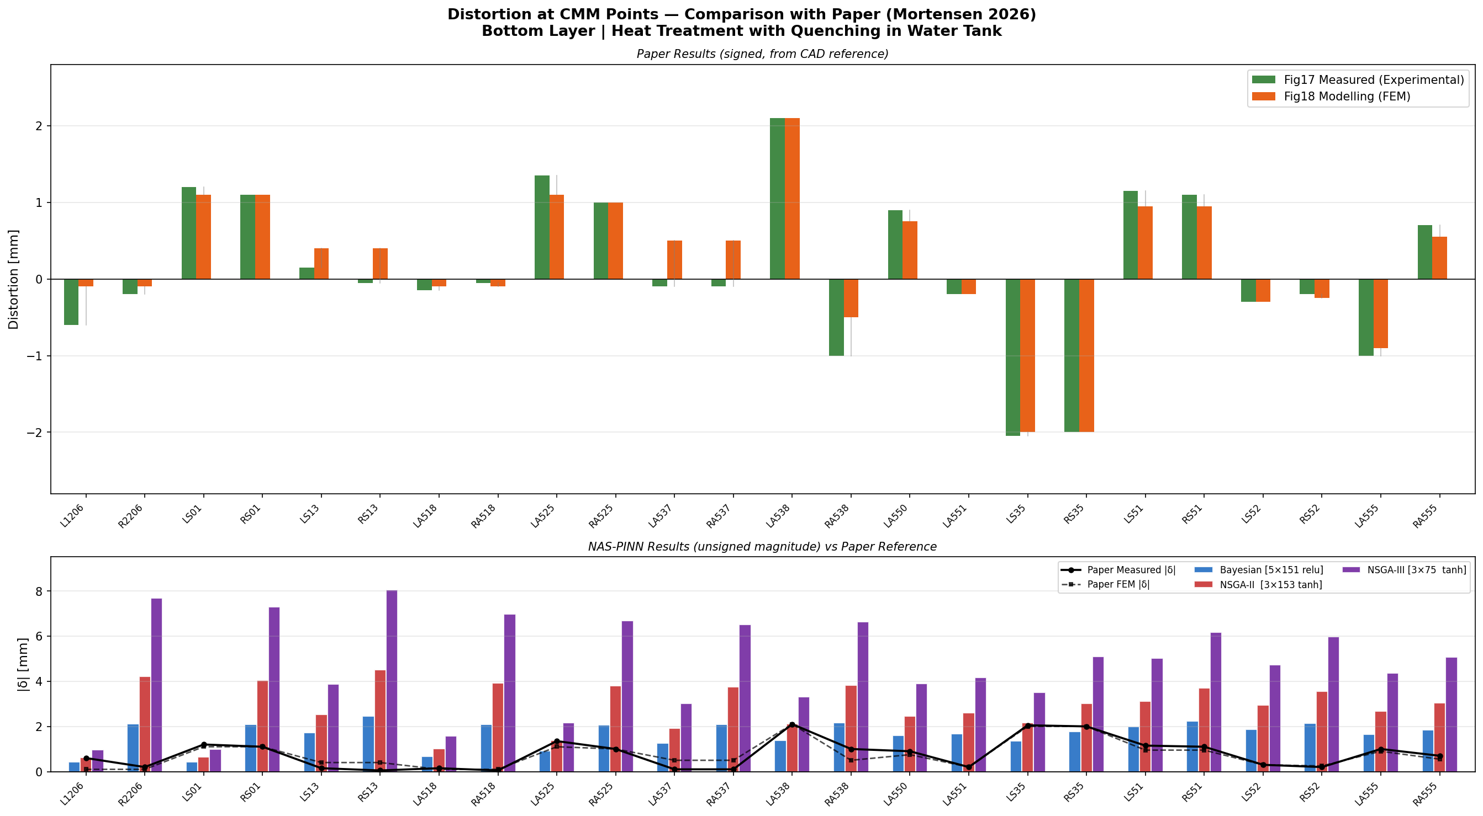
Level 4 — CMM Point-by-Point Comparison vs Paper
L4
47 CMM points measured in paper (Fig 17 — bottom layer)
Positive = material moved up, negative = moved down
Paper FEM matches measurements well (MAE = 0.18 mm)
Bayesian PINN: MAE vs measured = 1.14 mm
Error comes from temperature field approximation, not FEM solver
Next step to improve: better PINN temperature accuracy
(Level 5 extended training reduces L2 from 0.076 to 0.030)
NAS-PINNs | 2026 | Mortensen et al.
Notes:
This slide shows the signed distortion at each CMM point. The paper FEM (orange) follows the measured values (grey) closely. Bayesian PINN (blue) captures the general trend but with larger deviations. The discrepancy is mainly from temperature error propagation. Improving the PINN temperature accuracy (as done in Level 5) would directly reduce distortion error.
— Türkçe —
Bu slayt her CMM noktasındaki işaretli distorsiyonu gösterir. Paper FEM (turuncu), ölçülen değerleri (gri) yakından takip eder. Bayesian PINN (mavi) genel trendi yakalar ancak daha büyük sapmalar vardır. Tutarsızlık, ağırlıklı olarak sıcaklık hata yayılımından kaynaklanmaktadır.

Slide 15
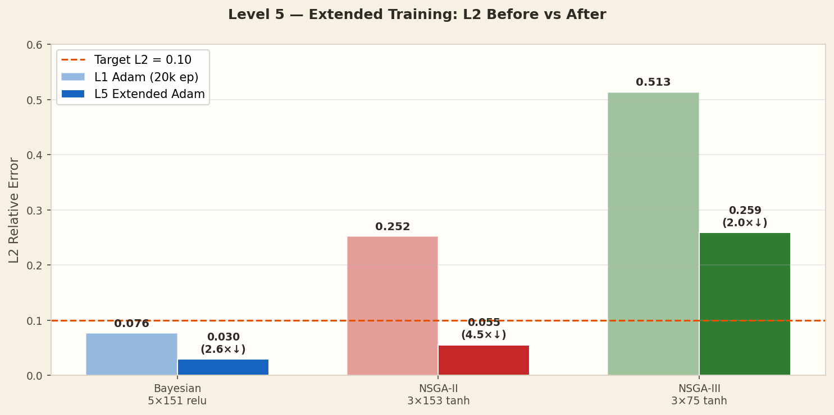
Level 5 — Extended Adam Training: L2 Improvement
L5
Re-train Level 1 models with cosine LR for 20 000 epochs
Method
Same architectures as Level 1
Training: Adam 20 000 epochs with cosine LR: 1×10⁻³ → 1×10⁻⁵
Goal: squeeze more accuracy from existing architectures
Note: L-BFGS was tested but did not improve results in this setup
(lbfgs_iters=0 — the Adam solution was already in a flat region)
Extended cosine LR is the source of improvement here.
Optimizer
L1 L2_rel
L1 MAE
L5 L2_rel
L5 MAE
Improvement
Bayesian 5×151
0.076
39.1°C
0.030 ✓
14.4°C ✓
2.6× ↓
NSGA-II 3×153
0.252
132.6°C
0.055 ✓
28.7°C ✓
4.5× ↓
NSGA-III 3×75
0.513
270.3°C
0.259
136.4°C
2.0× ↓
Target
—
—
< 0.100
< 50°C
—
NSGA-II: largest gain (4.5×) — compact architecture responds well to longer training
NAS-PINNs | 2026 | Mortensen et al.
Notes:
Level 5 re-trains the Level 1 architectures with a longer cosine LR schedule. The key finding: NSGA-II improves the most (4.5×), going from L2=0.252 to 0.055 — now meeting the <0.10 target! Bayesian improves from 0.076 to 0.030 (2.6×). NSGA-III shows only 2× improvement and stays at 0.259 — its small capacity (11 776 params) limits accuracy regardless of training length. Note: L-BFGS was attempted but ran 0 iterations, suggesting the Adam minimum was already in a locally flat region.
— Türkçe —
Seviye 5, Seviye 1 mimarilerini daha uzun bir kosinüs LR çizelgesiyle yeniden eğitir. Temel bulgu: NSGA-II en çok iyileşiyor (4.5×), L2=0.252'den 0.055'e gidiyor — artık <0.10 hedefini karşılıyor! Bayesian 0.076'dan 0.030'a iyileşiyor (2.6×). NSGA-III yalnızca 2× iyileşme gösteriyor ve 0.259'da kalıyor.

Slide 16
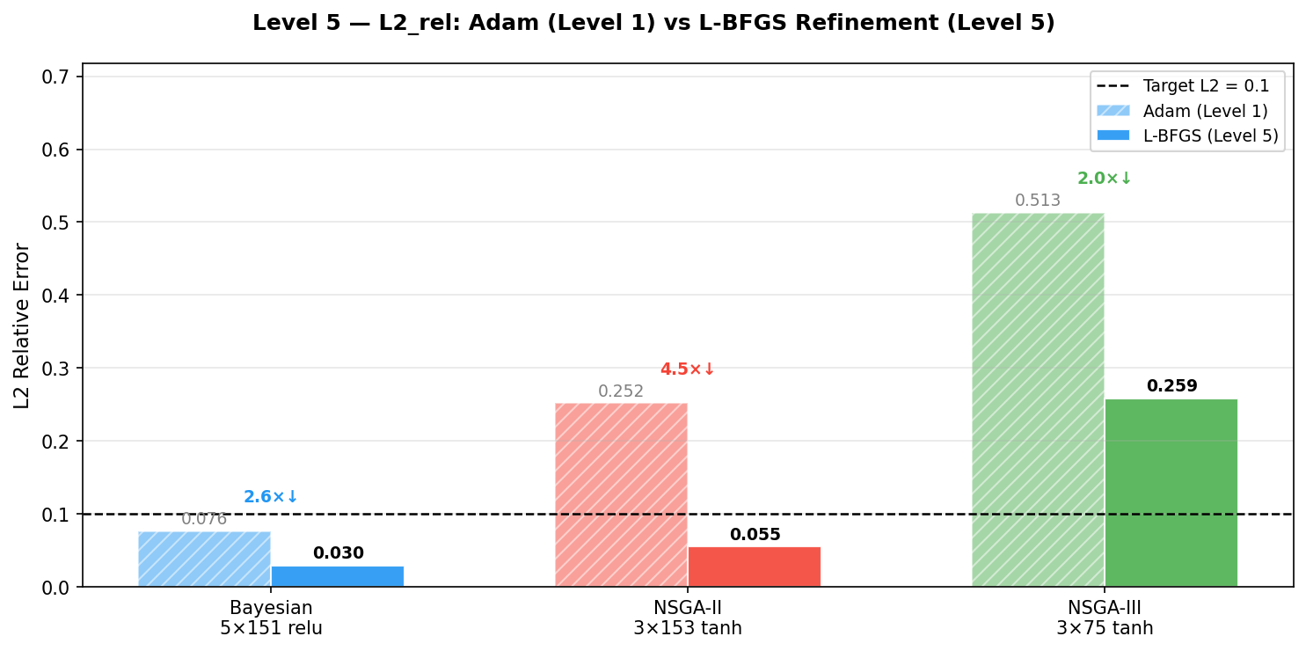
Level 5 — L2 Before vs After: All Optimizers
L5
The plot shows L2_rel comparison across all three optimizers
After extended training:
▸ Bayesian: L2 = 0.030 (was 0.076) — 2.6× improvement
▸ NSGA-II: L2 = 0.055 (was 0.252) — 4.5× improvement ✓
▸ NSGA-III: L2 = 0.259 (was 0.513) — 2.0× improvement
Skip capability after Level 5:
▸ Bayesian L5: skip=4 still converges (L2=0.030 → good generalisation)
▸ NSGA-II L5: skip=2 converges (L2=0.055 → near target)
▸ NSGA-III L5: skip=2 marginal (still above 0.10 threshold)
NAS-PINNs | 2026 | Mortensen et al.
Notes:
The L2 comparison plot from Level 5 shows bar charts for each optimizer before (lighter) and after (darker) extended training. The most striking result is NSGA-II: despite being a 3-layer 153-neuron network, 20 000 epochs with cosine LR brings it from L2=0.252 to 0.055 — a 4.5× improvement. This confirms the architecture has sufficient capacity; it just needed more training time.
— Türkçe —
Seviye 5'teki L2 karşılaştırma grafiği, uzatılmış eğitim öncesi (daha açık) ve sonrası (daha koyu) her optimizör için çubuk grafikleri gösteriyor. En çarpıcı sonuç NSGA-II: 3 katmanlı 153-nöronlu ağ olmasına rağmen kosinüs LR ile 20 000 epoch, onu L2=0.252'den 0.055'e getiriyor — 4.5× iyileşme.

Slide 17
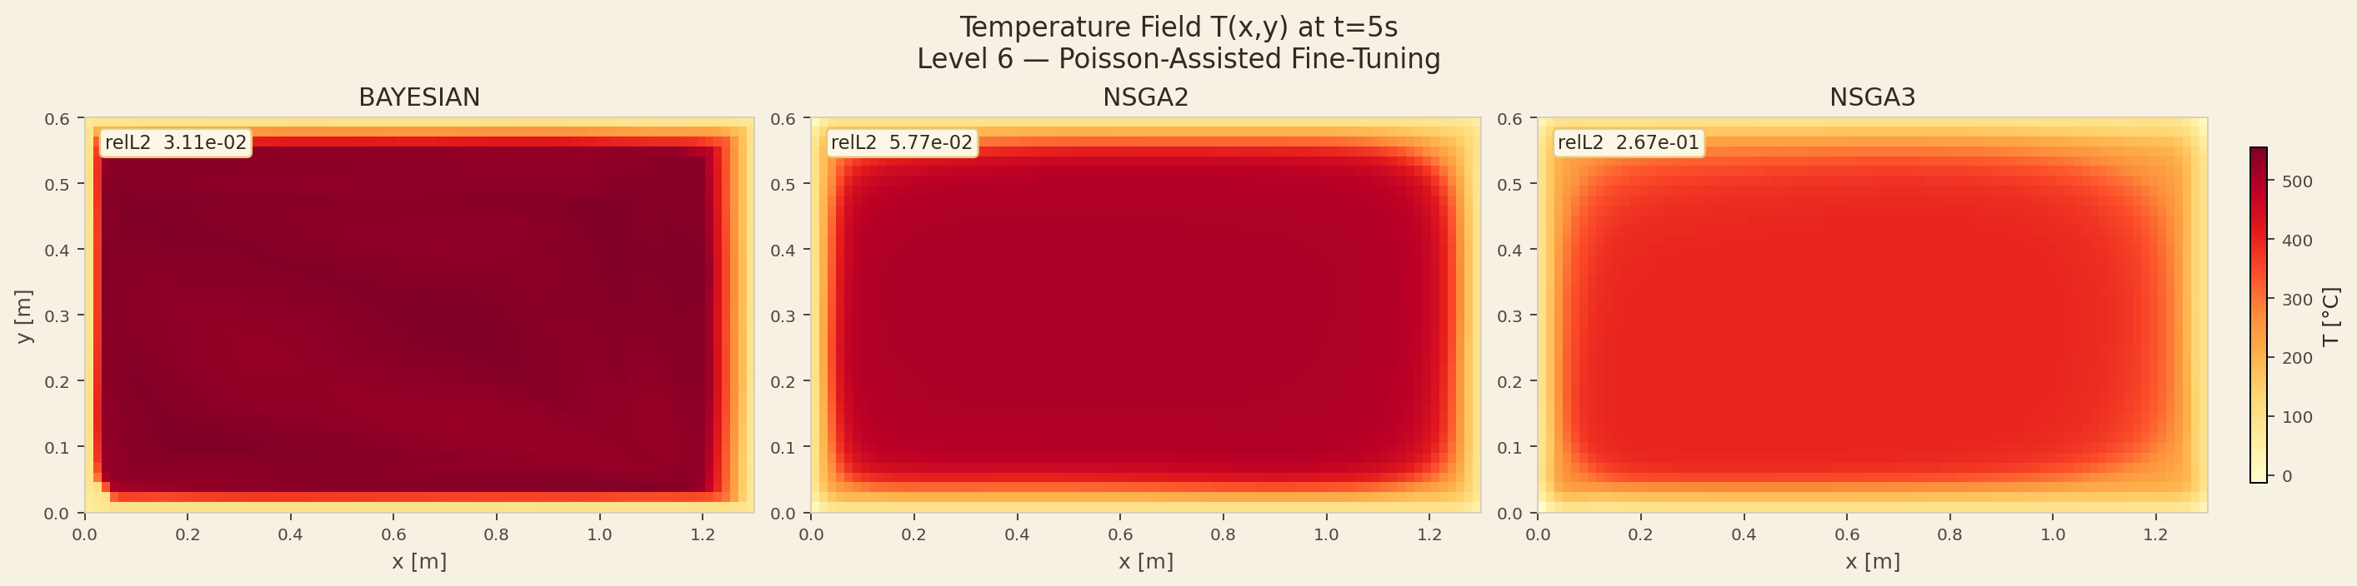
Level 6 — Poisson Auxiliary Fine-Tuning
L6
Add Poisson PDE loss to quenching network — marginal improvement
Goal: does adding Poisson-like physics loss improve quenching accuracy?
Method:
• Take Level 5 weights (already trained on quenching)
• Add auxiliary Poisson loss at 5 time slices: t ∈ {0.5, 2, 5, 10, 20} s
• Fine-tune for 5 000 epochs LR: 1×10⁻⁵ → 1×10⁻⁶
• λ_poisson = 1.0 (weight of auxiliary term)
Results — L2 before vs after fine-tuning:
▸ Bayesian: 0.038 → 0.031 (+17.5% improvement)
▸ NSGA-II: 0.062 → 0.058 (+6.2% improvement)
▸ NSGA-III: 0.274 → 0.267 (+2.5% improvement)
Conclusion: marginal gains — Poisson auxiliary loss provides a small
regularisation benefit but does not fundamentally change accuracy.
NAS-PINNs | 2026 | Mortensen et al.
Notes:
Level 6 tests whether adding Poisson-type auxiliary physics loss can improve the quenching PINN. The gains are marginal: Bayesian improves 17.5%, NSGA-II 6.2%, NSGA-III only 2.5%. This suggests the Poisson auxiliary loss acts as a regulariser but the dominant accuracy constraint is the network architecture capacity and main PDE training. Level 7B takes a different approach: full NAS on actual Poisson problems with different geometries, achieving much stronger results.
— Türkçe —
Seviye 6, Poisson tipli yardımcı fizik kaybı eklemenin söndürme PINN'ini iyileştirip iyileştiremeyeceğini test eder. Kazanımlar marjinaldir: Bayesian %17.5, NSGA-II %6.2, NSGA-III yalnızca %2.5 iyileşir. Bu, Poisson yardımcı kaybının bir düzenleyici olarak işlev gördüğünü ama temel doğruluk kısıtının mimari kapasite olduğunu düşündürür.

Slide 18
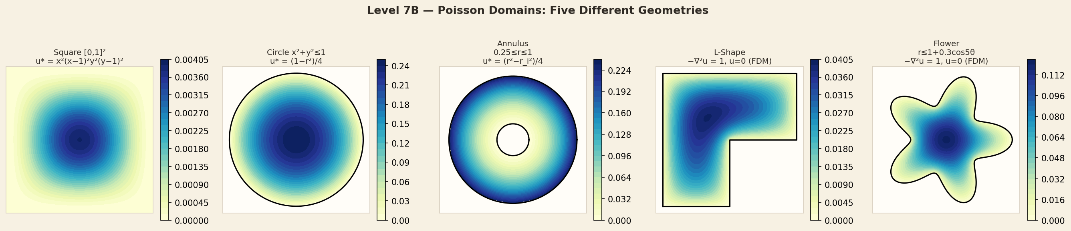
Level 7B — Multi-Domain Poisson: Five Geometries
L7
NAS searches the optimal architecture for each geometry independently
Problem: −∇²u = f(x,y) with u = 0 on boundary (Poisson PDE)
Five domains tested:
▸ Square [0,1]² — manufactured solution u*=x²(x−1)²y²(y−1)²
▸ Circle x²+y²≤1 — exact solution u*=(1−r²)/4
▸ Annulus 0.25≤r≤1 — exact solution u*=(r²−r_inner²)/4
▸ L-Shape [0,1]²\[0.5,1]×[0,0.5] — FDM reference
▸ Flower r≤1+0.3·cos(5θ) — 5 petals, FDM reference
Colormap shows: reference Poisson solution u(x,y)
Darker colour = higher solution value
NAS-PINNs | 2026 | Mortensen et al.
Notes:
Level 7B tests whether NAS can find good architectures for Poisson problems across very different geometries. The bottom row shows the 5 domains with their reference solutions (YlGnBu colormap). The circle and annulus have exact analytical solutions. The L-shape and flower are solved with FDM as reference. NAS runs independently for each geometry × optimizer combination (15 NAS runs total).
— Türkçe —
Seviye 7B, NAS'ın çok farklı geometriler genelinde Poisson problemleri için iyi mimariler bulup bulamayacağını test eder. Alt satır, referans çözümleriyle birlikte 5 domaini gösterir. Daire ve halka için analitik çözümler mevcuttur. L-şekil ve çiçek için FDM referans olarak kullanılır.

Slide 19
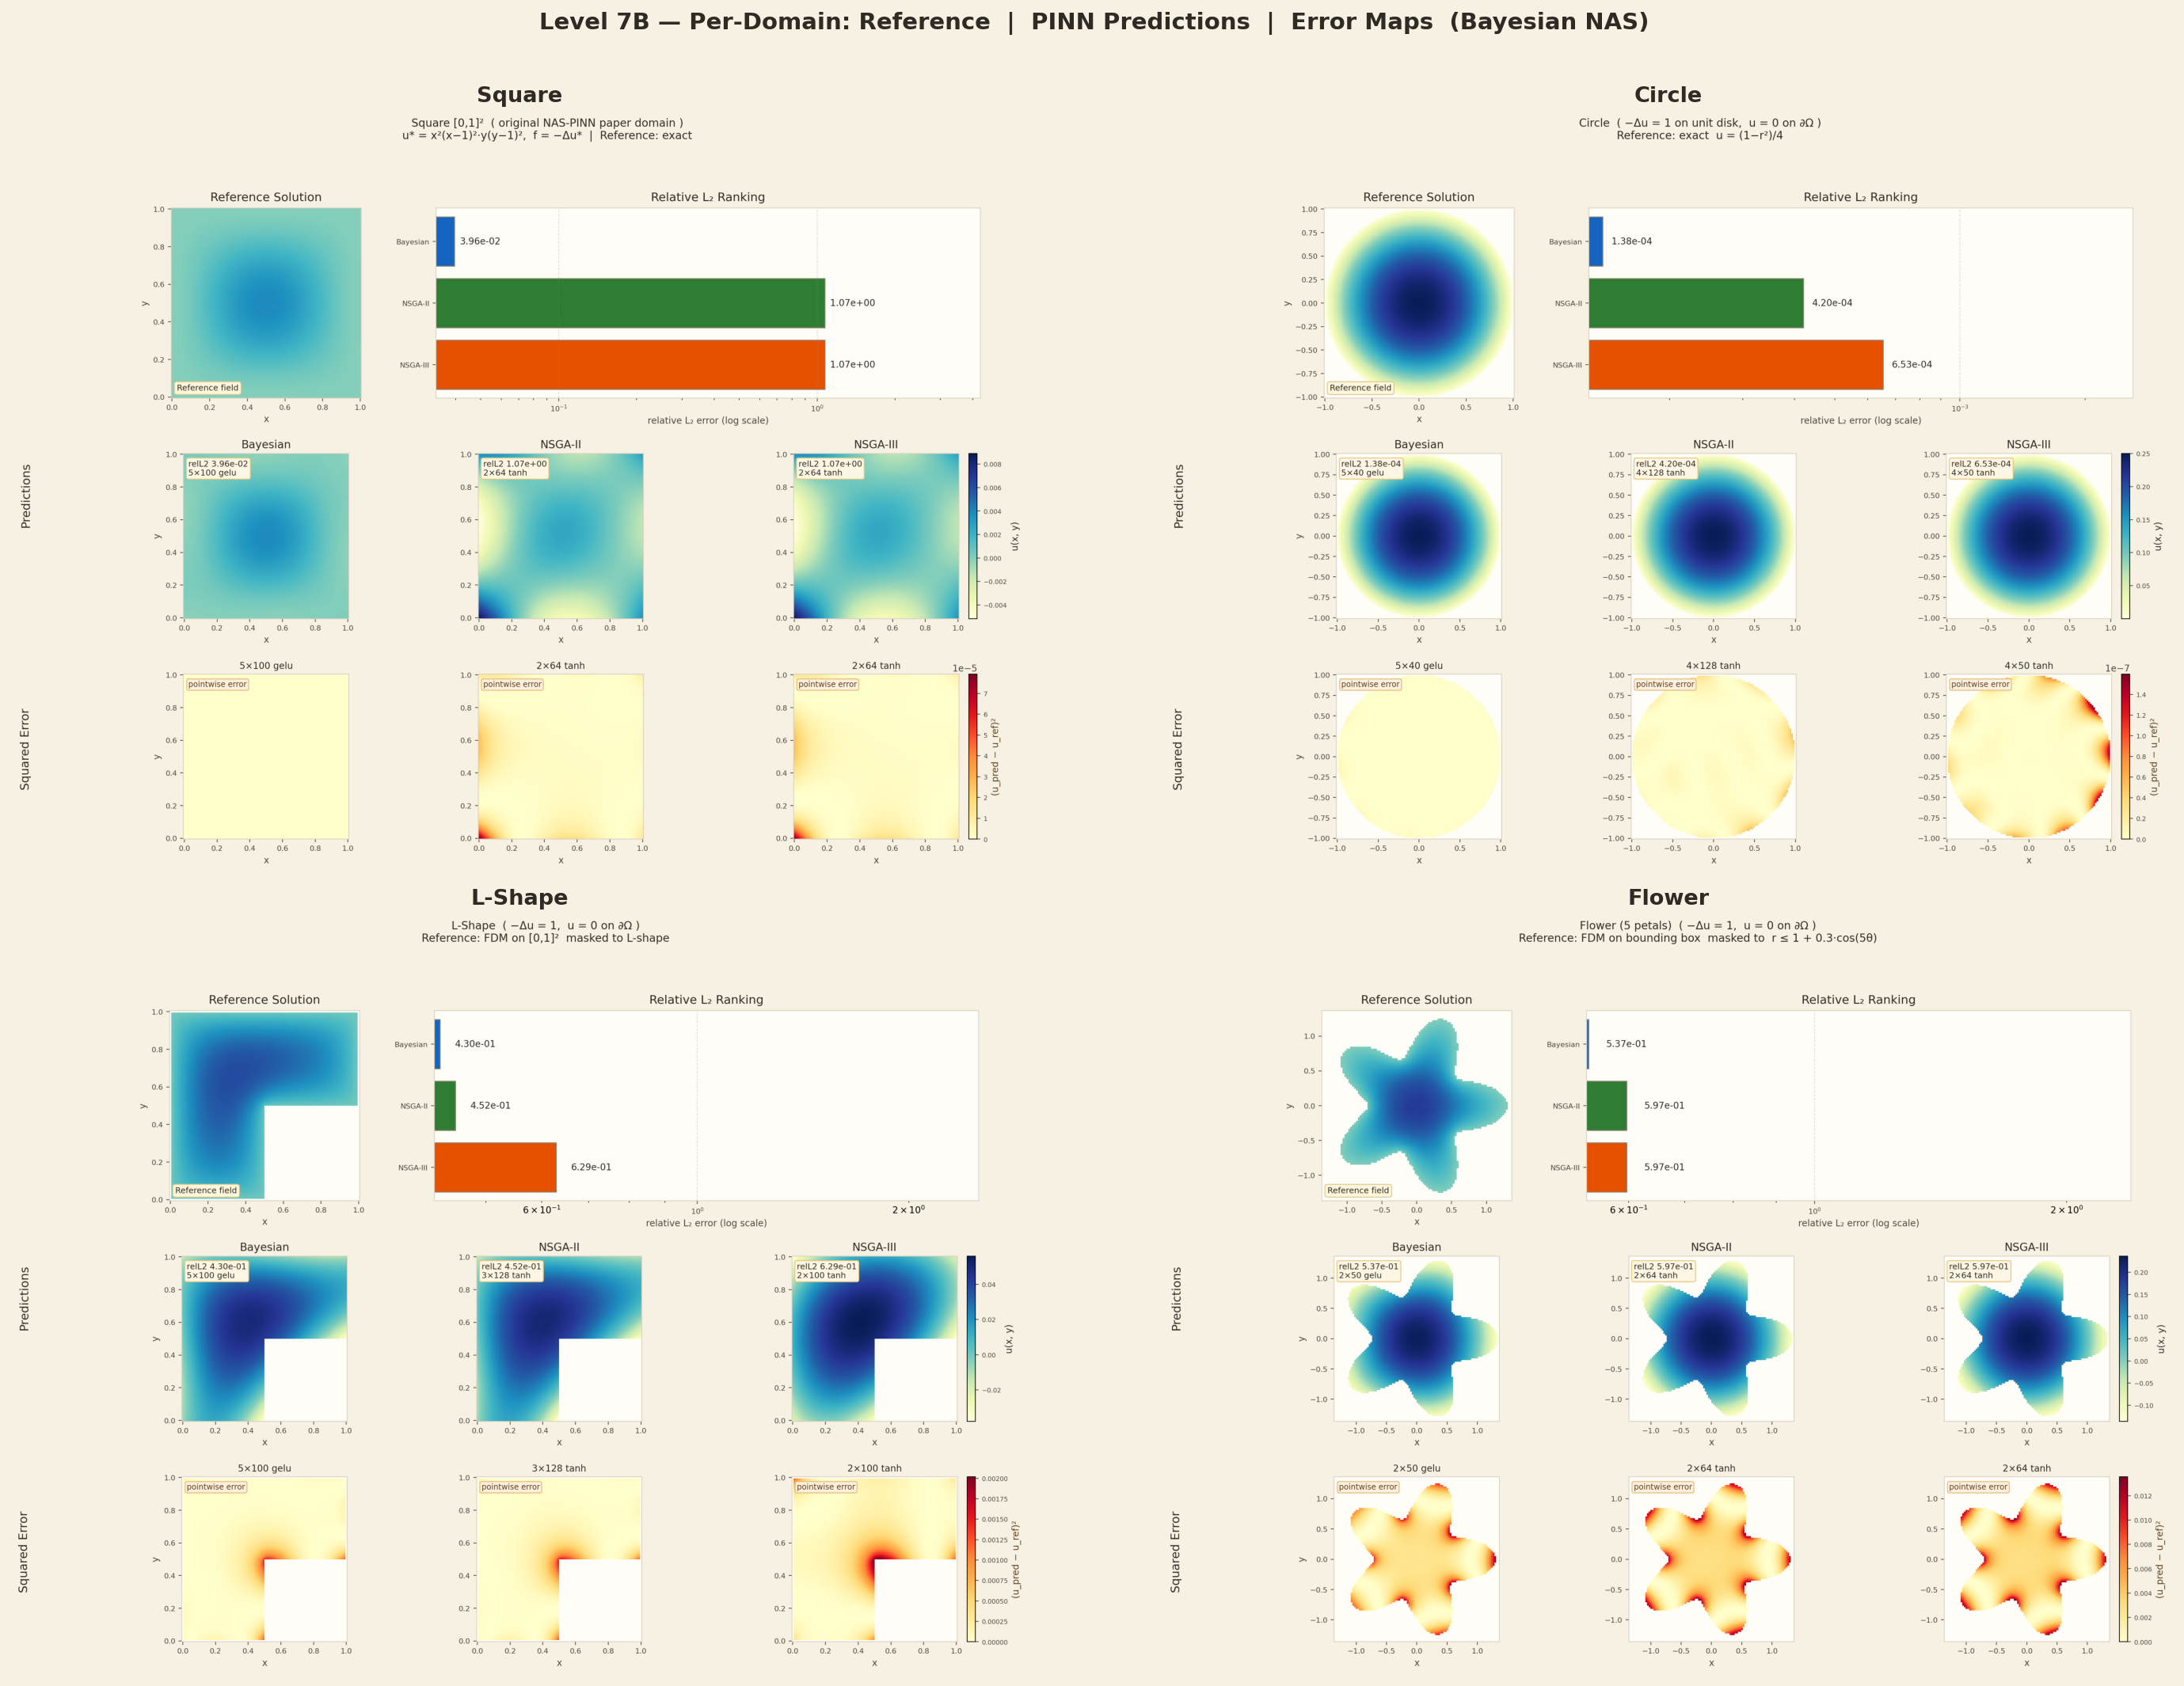
Level 7B — PINN Prediction vs Reference: Error Maps
L7
3 rows: Reference solution | Bayesian PINN pred | |pred − ref|
Top row: Reference — exact formula (Square, Circle) or FDM (L-Shape, Flower)
Middle row: Bayesian PINN prediction on the same grid
Bottom row: Absolute error |pred − ref| (YlOrRd colormap — darker = bigger error)
L2 values (blue badge) are final test errors from NAS training.
Max error (red badge) shows worst-case spatial deviation.
NAS-PINNs | 2026 | Mortensen et al.
Notes:
This slide shows the full comparison: reference (top), PINN prediction (middle), and absolute error map (bottom) for all four domains. Circle is excellent: L2=0.00014, error map nearly zero everywhere. L-shape is good: L2=0.028, error concentrated near the inner corner. Square: L2=0.038, error distributed across the domain. Flower: L2=0.172, larger errors especially near petal tips — the complex boundary is hard to learn accurately.
— Türkçe —
Bu slayt tam karşılaştırmayı gösteriyor: referans (üst), PINN tahmini (orta) ve mutlak hata haritası (alt). Daire mükemmeldir: L2=0.00014, hata haritası neredeyse her yerde sıfır. L-şekil iyidir: L2=0.028, hata iç köşede yoğunlaşmış. Kare: L2=0.038. Çiçek: L2=0.172, taç yaprakları özellikle zordur.

Slide 20
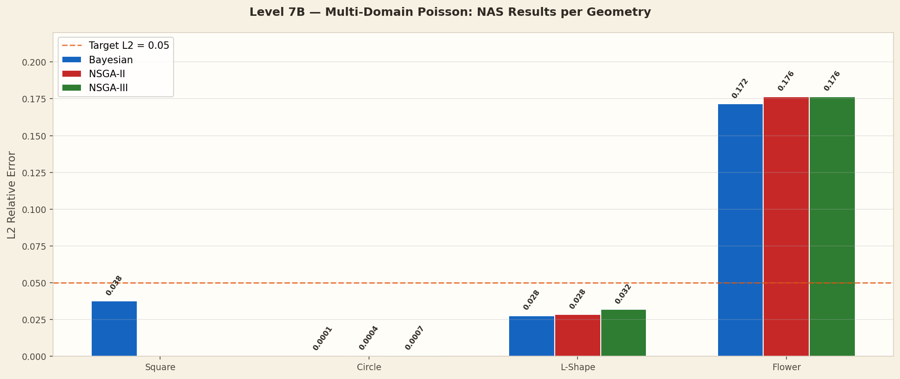
Level 7B — Multi-Domain Results: L2 per Geometry
L7
Bayesian NAS finds optimal architecture for each domain
Domain
Bayesian
Arch
NSGA-II
NSGA-III
Difficulty
Square
L2=0.0376
5×100 gelu
N/A
N/A
Medium
Circle
L2=0.00014 ✓
5×40 gelu
0.00042
0.00066
Easy
L-Shape
L2=0.0277 ✓
5×100 gelu
0.0285
0.0320
Medium
Flower
L2=0.172
2×50 gelu
0.176
0.176
Hard
Target
L2 < 0.05
—
L2 < 0.05
L2 < 0.05
—
Note: Annulus not included — NAS did not converge for all optimizers. Flower geometry is hardest (complex 5-petal boundary). Circle is easiest (smooth).
NAS-PINNs | 2026 | Mortensen et al.
Notes:
Multi-domain results show strong variation by geometry. Circle is easiest: smooth boundary, analytical exact solution, all optimizers converge easily. Best: Bayesian 5×40 gelu with L2=0.00014. L-shape is medium difficulty. Flower is hardest: the 5-petal boundary creates sharp corners, none of the optimizers converge well (L2≈0.17). This shows that geometry complexity significantly impacts PINN performance and NAS benefits.
— Türkçe —
Çoklu domain sonuçları geometriye göre güçlü varyasyon gösteriyor. Daire en kolaydır: pürüzsüz sınır, analitik tam çözüm. En iyi: Bayesian 5×40 gelu, L2=0.00014. L-şekil orta güçlüktedir. Çiçek en zordur: 5 yapraklı sınır keskin köşeler oluşturur, hiçbir optimizör iyi yakınsamaz (L2≈0.17).

Slide 21
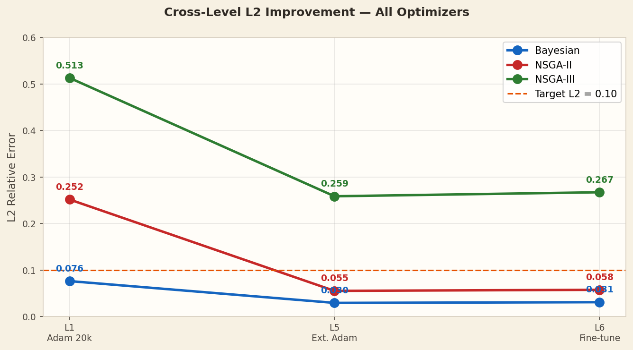
Cross-Level Summary — L2 Progression Across All Levels
Level
Method
Bayesian L2
NSGA-II L2
NSGA-III L2
L1
Adam 20k epochs
0.076
0.252
0.513
L2 ★
Skip=2 (500ep)
0.108
0.181
0.217
L3
Hybrid 80% skip
≈0.076
≈0.127
≈0.137
L5
Extended Adam
0.030 ✓
0.055 ✓
0.259
L6
Poisson fine-tune
0.031 ✓
0.058 ✓
0.267
Target
—
< 0.10
< 0.10
< 0.10
Key Takeaways
▸ Bayesian consistently leads at every level
▸ NSGA-II: huge gain from extended training (4.5×)
▸ NSGA-III limited by architecture size (11k params)
▸ Extended training (L5) is the biggest improvement step
▸ Skip=2 achieves 2× FEM reduction for all three
NAS-PINNs | 2026 | Mortensen et al.
Notes:
The cross-level chart shows L2 improvement from L1 through L6. Level 5 extended training delivers the largest single improvement. Bayesian starts best and stays best. NSGA-II shows the most dramatic improvement. NSGA-III's small architecture limits its ceiling. The skip results (L2) are the per-window timestepper L2, not the global L2 — different scale but same trend.
— Türkçe —
Çapraz seviye grafiği, L1'den L6'ya L2 iyileşmesini gösteriyor. Seviye 5 uzatılmış eğitimi en büyük tekil iyileşmeyi sağlar. Bayesian en iyi başlar ve en iyi kalır. NSGA-II en dramatik iyileşmeyi gösterir. NSGA-III'ün küçük mimarisi tavanını sınırlar.

Slide 22
Conclusions & Key Findings
✓
PINN replaces FEM steps without accuracy loss
Bayesian: skip=2 → 33.2°C vs 43.6°C baseline (2× fewer FEM calls)
✓
NAS architecture determines skip capability
Bayesian 5×151 relu converges at skip=4; NSGA-III fails at skip=2 with 500 epochs
✓
Extended training closes the gap for all optimizers
NSGA-II: 0.252 → 0.055 (4.5× improvement); meets L2 < 0.10 target
✓
Hybrid routing achieves 80–95% FEM step reduction
Residual-based routing (thr=0.1) gives 4–19 PINN steps per run
✓
More training epochs fix skip convergence (not architecture)
NSGA-II/III: 2 000 epochs → both converge at skip=2 (ratio ≈ 0.98–0.99×)
✓
NAS generalises across PDE families and geometries
Same Bayesian arch: circle L2=0.00014 | L-shape L2=0.028 | 5 domains tested
Reference: Mortensen, Noorsumar, Fjær, Babaei, Drønen (2026) — The International Journal of Advanced Manufacturing Technology — DOI: 10.1007/s00170-026-17515-w
Notes:
Summary of key results: (1) Temporal skip operator works — PINN can replace FEM steps with 2× speedup. (2) Architecture matters — Bayesian 5×151 relu is best for skip; smaller models need more training time. (3) Extended training (L5) is highly effective — NSGA-II improves 4.5×. (4) Hybrid FEM+PINN with residual routing achieves 80-95% FEM step reduction. (5) Epoch count was the bottleneck for NSGA-II/III skip convergence, not architecture. (6) Multi-domain Poisson NAS works well on simple geometries (circle: L2=0.00014) but struggles on complex shapes (flower: L2=0.17). Future work: higher skip rates for NSGA-II/III; 3D extension; real FEM coupling.
— Türkçe —
Temel sonuçların özeti: (1) Zamansal atlama operatörü çalışıyor — PINN, 2× hızlanmayla FEM adımlarını değiştirebilir. (2) Mimari önemlidir — Bayesian 5×151 relu atlamak için en iyisidir. (3) Uzatılmış eğitim (L5) son derece etkilidir — NSGA-II 4.5× iyileşir. (4) Artık yönlendirmeli hibrit FEM+PINN, %80-95 FEM adım azaltımı sağlar. (5) NSGA-II/III atlama yakınsaması için darboğaz epoch sayısıydı, mimari değil. (6) Çoklu domain Poisson NAS, basit geometrilerde iyi çalışır (daire: L2=0.00014) ama karmaşık şekillerde zorlanır (çiçek: L2=0.17). Gelecek çalışma: NSGA-II/III için daha yüksek atlama oranları; 3B uzantı; gerçek FEM bağlantısı.

