Slide 1
NAS-PINN k-Skip Framework
for Thermal Quenching Simulation
Solving the transient heat equation for aluminium quenching using
Physics-Informed Neural Networks with Neural Architecture Search
Mortensen D., Noorsumar G., Fjær H.G., Babaei R. & Drønen P.E. (2026) Int. J. Adv. Manuf. Technol. doi:10.1007/s00170-026-17515-w | Wang & Zhong (2023) arXiv:2305.10127
March 2026

Slide 2
Motivation & Problem Statement
Why reduce FEM calls for quenching?
FEM Limitations
PINN + NAS Advantages
• High computational cost for 3D transient simulations
• Each FEM step requires mesh assembly and linear solve
• 20 time-steps at Δt=1.5 s → sequential bottleneck
• Repeated evaluations needed for design optimisation
• Scaling to large automotive subframes is prohibitive
• Mesh-free: collocated PDE residual evaluation
• Once trained, inference is near-instantaneous
• k-Skip reduces FEM supervision calls by up to 5×
• NAS automatically finds optimal architecture
• Generalises across 2D and 3D geometries
• IC-consistent output layer guarantees exact ICs
Goal: maintain L2 < 3% while reducing FEM calls by up to 5×

Slide 3
Physical Problem
Transient heat equation — aluminium quenching
Governing Equation
Domains Tested
ρcₚ ∂T/∂t = ∇·(k∇T) + Q
2D:
Rectangle, Circle, L-shape
BC: −k ∂T/∂n = h(T − Tᵢᵣ), h = 5000 W/m²K
3D:
Rectangular box, Cylinder,
Stacked, L-shape (3D)
IC: T(x, 0) = 500 °C Tᵢᵣ = 20 °C
FEM steps: 20 @ Δt=1.5 s
k-skip windows per k:
Problem Parameters
k=1
k=2
k=3
k=4
k=5
• Material: Aluminium alloy (A356)
• T_initial = 500 °C, T_water = 20 °C, t_total = 30 s
• FEM discretisation: Δt_FEM = 1.5 s → 20 time steps
• Mortensen D., Noorsumar G., Fjær H.G., Babaei R. & Drønen P.E. (2026) Int. J. Adv. Manuf. Technol. doi:10.1007/s00170-026-17515-w
20 wins
10 wins
7 wins
5 wins
4 wins
Quenching process: 500 °C → water at 20 °C — rapid thermal gradient drives distortion

Slide 4
Methodology Overview
Methodology Overview
k-Skip Multi-Step Window Prediction (MSWP) pipeline
k-Skip Multi-Step Window Prediction (MSWP) pipeline
FEM Reference (t=0,k,2k,...)
IC-Consistent PINN Output θ̂ = θ_ic + τ·Nθ
Fourier Embedding γ(v)=[sin,cos]
Self-Adaptive Loss Weights λ=softplus(w)
NAS Optimiser Bayes/NSGA
→
→
→
→
Step 1
Step 2
Step 3
Step 4
Step 5
k-Skip Window
Training Losses
Epochs
Search Space
Window = k × 1.5 s k ∈ {1,2,3,4,5} FEM calls ↓
L = λ_pde·L_pde + λ_bc·L_bc + λ_end·L_end
Phase 1: 800 ep Phase 2: 1500 ep (NSGA-II/III retrain)
Depth, width, activation, skip connections
k-Skip: PINN predicts T over k FEM steps — reduces supervision cost up to 5×

Slide 5
k-Skip Framework
k-Skip Framework
FEM call reduction via temporal window skipping
FEM call reduction via temporal window skipping
k-Skip Parameters
IC-Consistent Output Layer
k
Δt_window (s)
FEM Windows
FEM Calls↓
Speedup
θ̂(x,τ) = θ_ic(x) + τ · Nθ(x, τ, θ_ic)
1
1.5
20
1.0×
baseline
τ ∈ [0,1] — normalised time within window
2
3.0
10
2.0×
↑ fast
Loss Function
3
4.5
7
2.9×
↑↑ fast
L = λ_pde · L_pde + λ_bc · L_bc + λ_end · L_end
4
6.0
5
4.0×
↑↑↑ fast
5
7.5
4
5.0×
↑↑↑↑ max
λᵢ = softplus(wᵢ) — learned jointly with network
η_model = 1×10⁻³, η_λ = 1×10⁻⁴
Fourier Feature Embedding
γ(v) = [sin(2πBv), cos(2πBv)]
F=64 frequencies, σ=1.0 (2D), σ=1.5 (3D)
Larger k = fewer FEM calls; IC-consistent PINN exactly satisfies initial condition every window

Slide 6
PINN Architecture
PINN Architecture
IC-consistent output, Fourier embedding, self-adaptive weights
Input Layer
Hidden Layers (NAS-optimised)
IC-Consistent Output
Temperature Prediction
x, y (,z), t + Fourier embedding γ(v)
→
Depth: 2–6 Width: 16–256 Act: tanh/swish Skip connections
→
θ̂ = θ_ic + τ·Nθ Exact IC at τ=0 Smooth BC satisfaction
→
T(x,y,z,t) in °C L2 < 3% (2D) L2 < 7% (3D)
Fourier Features
Self-Adaptive Weights
NAS Search Space
• γ(v) = [sin(2πBv), cos(2πBv)]
• B ∼ N(0,σ²) fixed random matrix
• F = 64 frequency pairs
• σ = 1.0 (2D), σ = 1.5 (3D)
• Captures multi-scale spatial variation
• λᵢ = softplus(wᵢ) — always positive
• L = λ_pde·L_pde + λ_bc·L_bc + λ_end·L_end
• wᵢ learned jointly with network
• η_model = 1e-3, η_λ = 1e-4
• Balances PDE vs. boundary residuals
• Layers: 2 to 6
• Neurons per layer: 16 to 256
• Activations: tanh, swish, relu
• Skip connections: yes/no
• Fourier σ: 0.5 to 3.0
IC-consistent output: θ̂(x,τ)=θ_ic(x)+τ·Nθ guarantees exact satisfaction of initial conditions at τ=0

Slide 7
Neural Architecture Search
Neural Architecture Search
Bayesian (TPE) vs. NSGA-II vs. NSGA-III
Bayesian (TPE)
NSGA-II
NSGA-III
• Tree Parzen Estimator
• Non-dominated Sorting GA
• Reference-point based EA
• Probabilistic surrogate model
• 2-objective (L2, runtime)
• Many-objective variant
• 800 training epochs
• NAS: 800 ep, retrain: 1500 ep
• NAS: 800 ep, retrain: 1500 ep
• Efficient single-objective
• Pareto front exploration
• Structured reference points
• Best FEM call reduction
• Crowding distance diversity
• Better coverage of front
• Fast convergence
• Often best accuracy
• Best 2D L2: 0.83%
Comparison Summary
Optimizer
Epochs (NAS)
Epochs (Retrain)
Strength
Best FEM Red.
Bayesian
800
—
Speed & consistency
5.0×
NSGA-II
800
1500
Accuracy on complex geom
1.0× – 2.0×
NSGA-III
800
1500
Best 2D (0.83% L-shape)
1.0× – 3.0×
All three optimisers search the same PINN architecture space; Bayesian best for FEM reduction, NSGA-III best raw L2

Slide 8
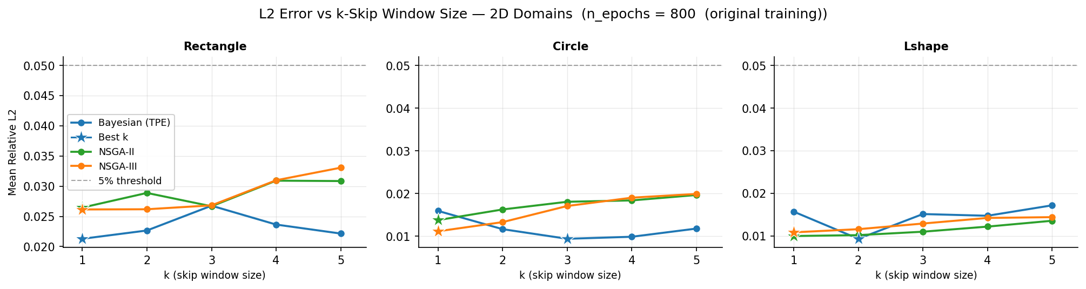
2D Results — k-Skip Analysis
2D Results — k-Skip Analysis
L2 relative error vs. k-skip factor (800 ep (NAS))
800 Epochs (NAS phase)
800 ep (k-skip analysis)
Best 2D: L-shape NSGA-III k=1, L2=0.83%. Circle Bayesian k=3 gives 0.94% with 2.9× fewer FEM calls

Slide 9
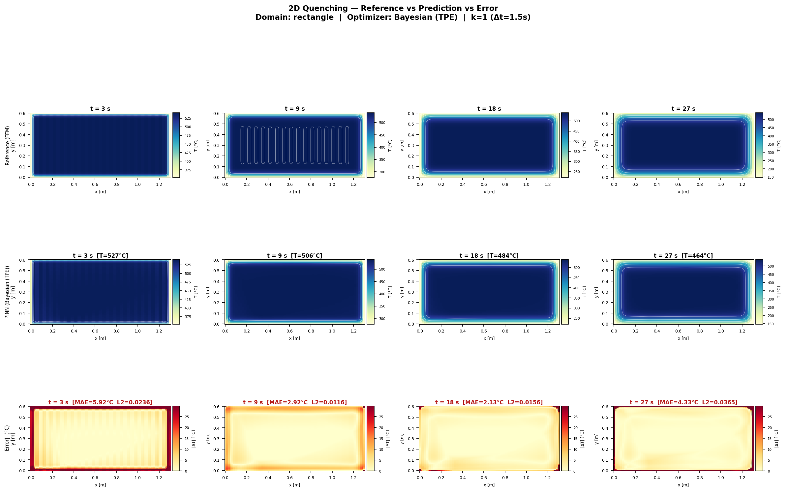
2D Heatmap — Rectangle (Bayesian, k=1)
Rectangle | Bayesian (TPE) | k=1 | L2=2.13% | MAE=2.1°C | Runtime=206 s
FEM reference (left) · PINN prediction (centre) · Absolute error (right)

Slide 10
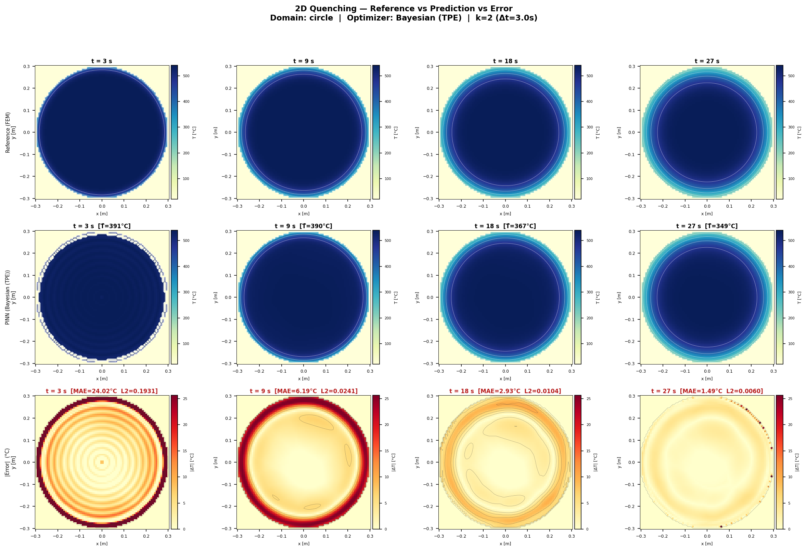
2D Heatmap — Circle (Bayesian, k=3)
Circle | Bayesian (TPE) | k=3 | L2=0.94% | MAE=2.0°C | FEM calls↓ 2.9×
FEM reference (left) · PINN prediction (centre) · Absolute error (right)

Slide 11
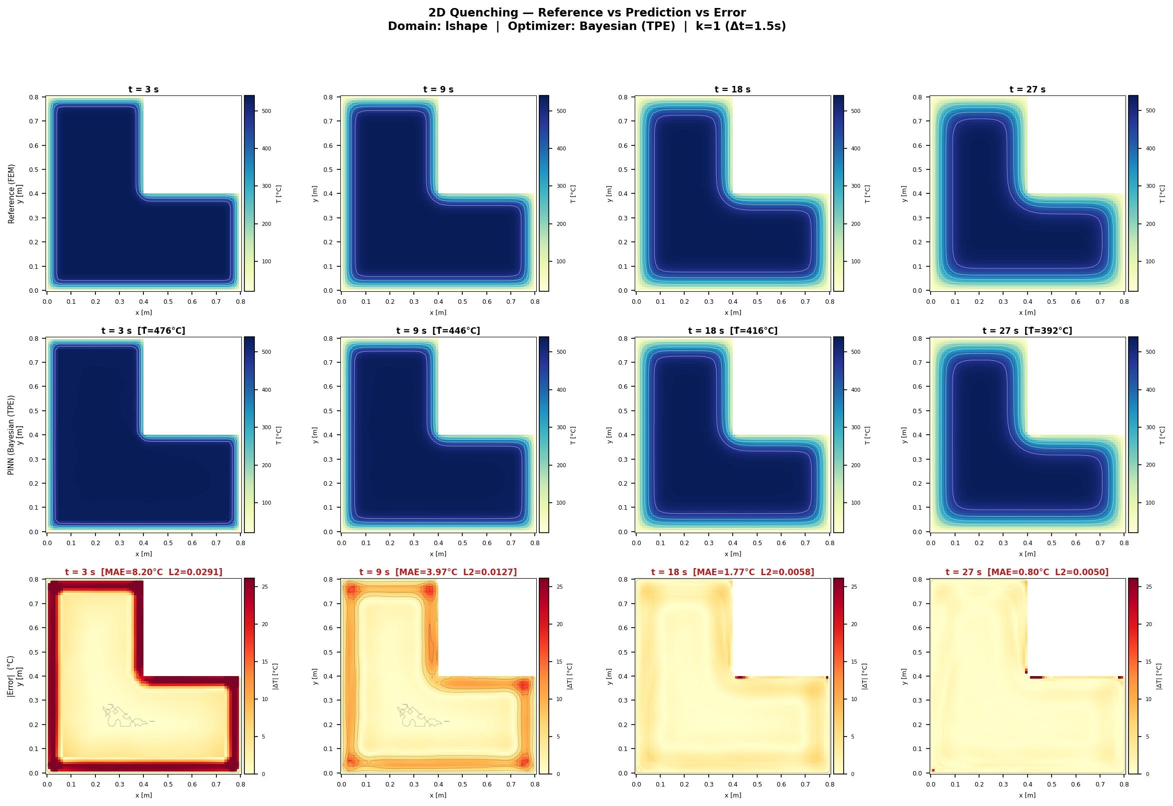
2D Heatmap — L-shape (Bayesian, k=2)
L-shape | Bayesian (TPE) | k=2 | L2=0.94% | MAE=1.6°C | FEM calls↓ 2.0×
FEM reference (left) · PINN prediction (centre) · Absolute error (right)

Slide 12
2D Results — Best-k Summary Table
Per-domain, per-optimizer: best k chosen by minimum mean MAE
Domain
Arch
Best k
L2 (rel)
MAE
Runtime
FEM Saved
Rectangle
Bayesian
1
0.0228
2.49 °C
207 s
baseline
Rectangle
NSGA-II
1
0.0298
2.52 °C
327 s
baseline
Rectangle
NSGA-III
1
0.0311
2.62 °C
326 s
baseline
Circle
Bayesian
2
0.0148
2.70 °C
102 s
baseline
Circle
NSGA-II
1
0.0161
2.03 °C
330 s
baseline
Circle
NSGA-III
1
0.0146
1.64 °C
323 s
baseline
L-Shape
Bayesian
1
0.0177
1.93 °C
195 s
baseline
L-Shape
NSGA-II
1
0.0156
2.96 °C
329 s
baseline
L-Shape
NSGA-III
1
0.0139
2.19 °C
344 s
baseline
Best 2D: L-Shape/NSGA-III k=1 — L2=0.0139, MAE=2.19°C | Circle/NSGA-III k=1 — MAE=1.64°C | All 2D results < 0.035 L2
2D average: MAE=2.34°C, L2=0.020 — all architectures achieve < 3% relative error

Slide 13
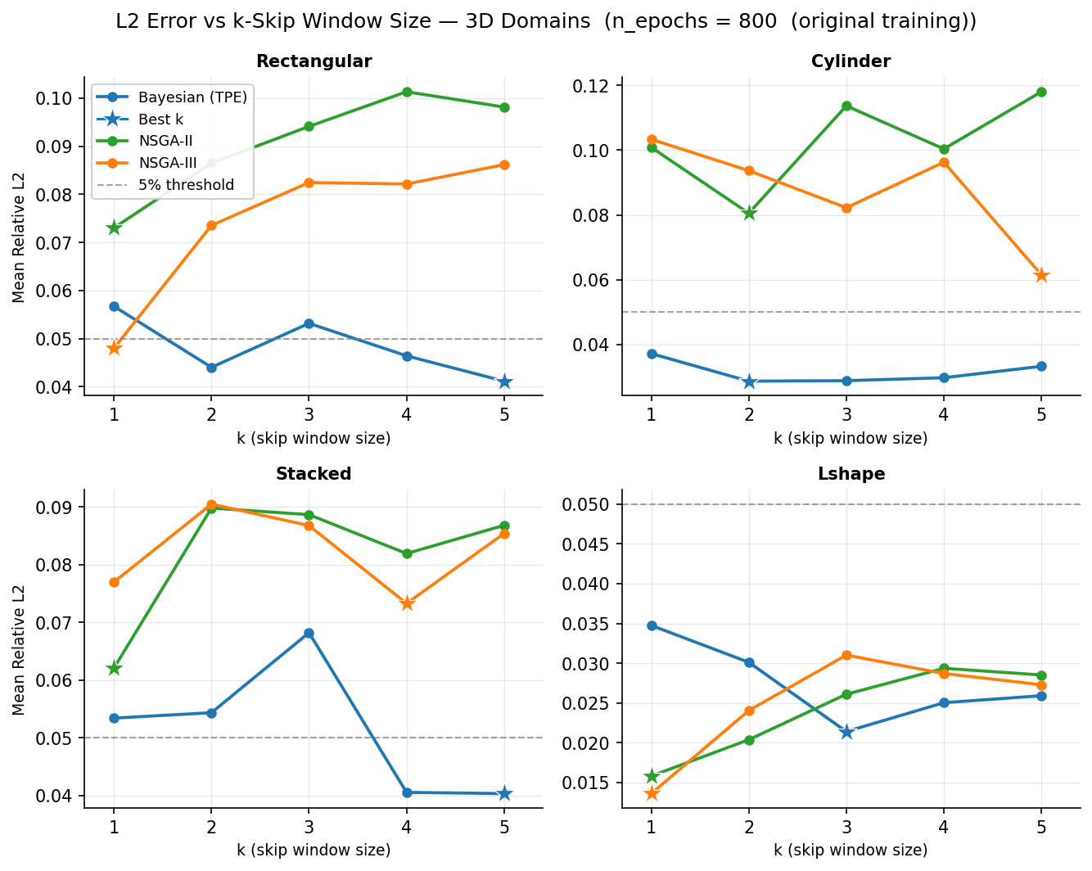
3D Results — k-Skip Analysis
3D Results — k-Skip Analysis
L2 relative error vs. k-skip factor (800 ep (NAS))
800 Epochs (NAS phase)
800 ep (k-skip analysis)
Best 3D: L-shape NSGA-III k=1, L2=0.91%. Bayesian Rectangular k=5: L2=4.12% with 5× fewer FEM calls

Slide 14
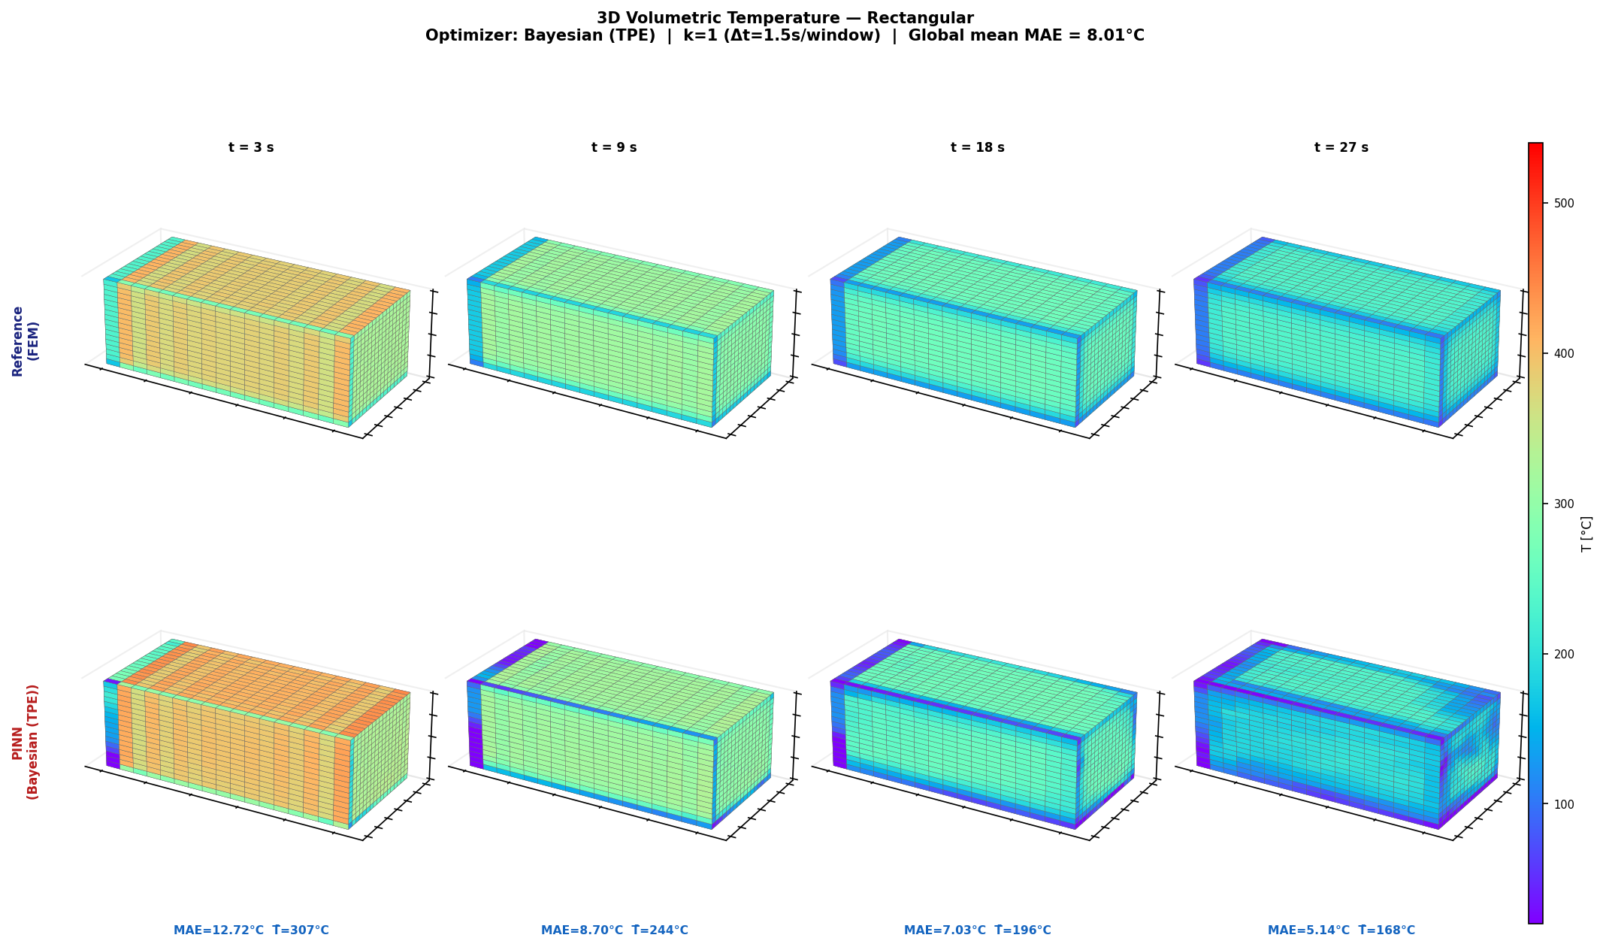
3D Heatmap — Rectangular (Bayesian, k=1)
Rectangular | Bayesian (TPE) | k=1 | Mean MAE=8.01°C | t=30s shown
FEM reference (top) · PINN prediction (bottom, t=30s) · MAE=4.75°C at final window

Slide 15
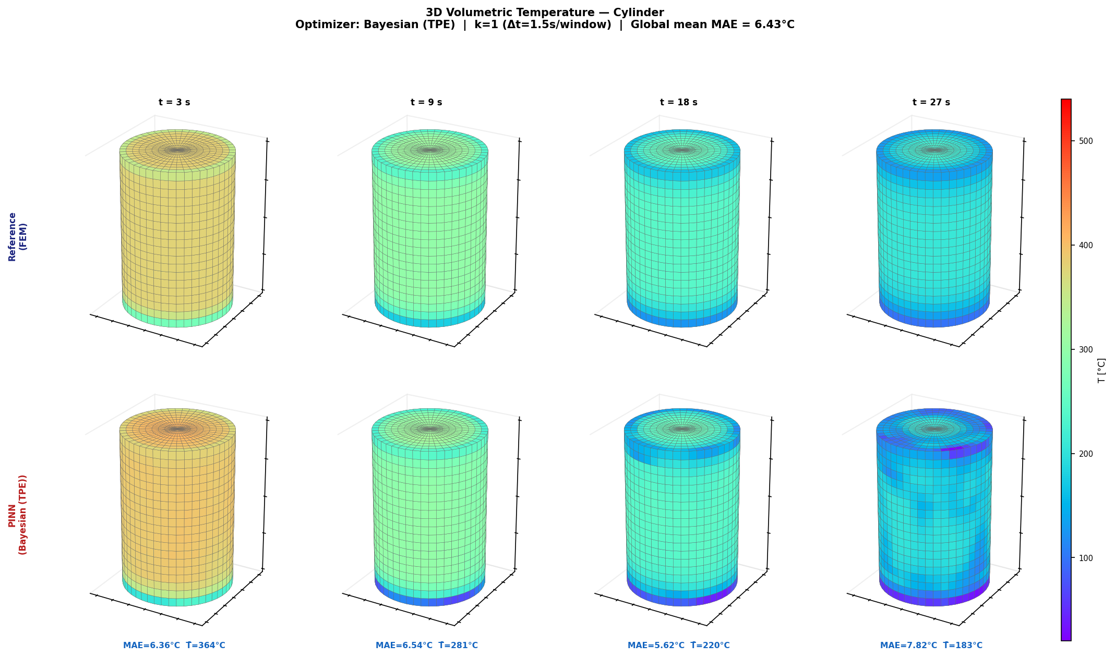
3D Heatmap — Cylinder (Bayesian, k=1)
Cylinder | Bayesian (TPE) | k=1 | Mean MAE=6.43°C | t=30s shown
FEM reference (top) · PINN prediction (bottom, t=30s) · MAE=3.75°C at final window

Slide 16
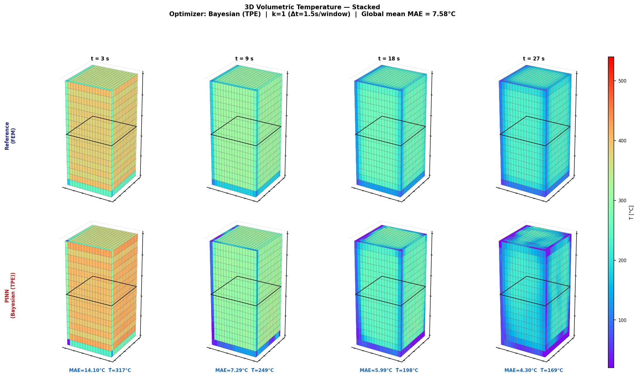
3D Heatmap — Stacked (Bayesian, k=1)
Stacked | Bayesian (TPE) | k=1 | Mean MAE=7.58°C | t=30s shown
FEM reference (top) · PINN prediction (bottom, t=30s) · MAE=5.59°C at final window

Slide 17
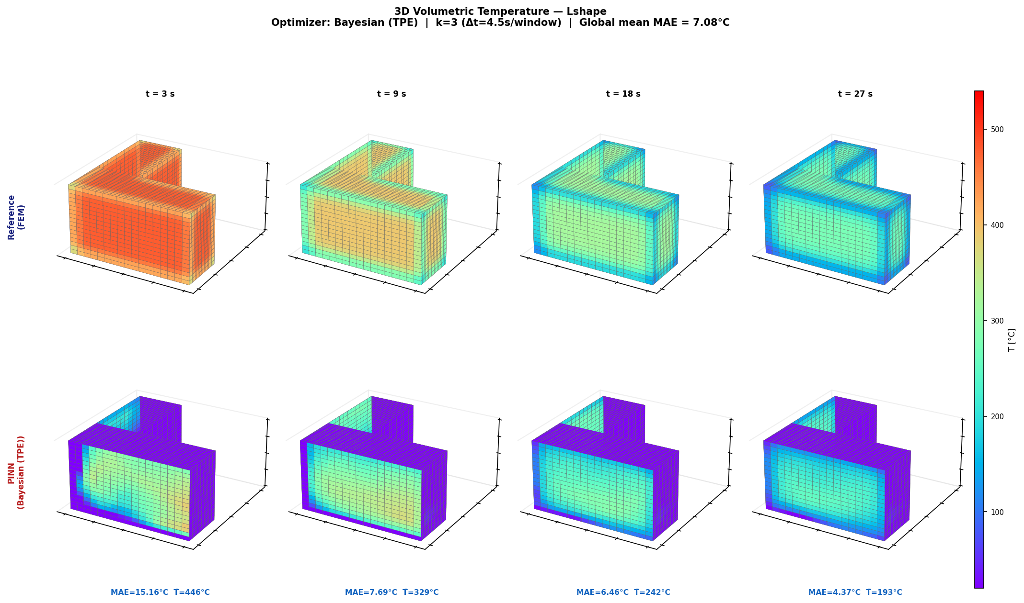
3D Heatmap — L-shape 3D (Bayesian, k=3)
L-shape 3D | Bayesian (TPE) | k=3 | Mean MAE=7.08°C | t=30s shown
FEM reference (top) · PINN prediction (bottom, t=30s) · MAE=4.83°C at final window

Slide 18
3D Results — Best-k Summary Table
Per-domain, per-optimizer: best k chosen by minimum mean MAE
Domain
Arch
Best k
L2 (rel)
MAE
Runtime
FEM Saved
Rectangular
Bayesian
1
0.0465
8.01 °C
275 s
baseline
Rectangular
NSGA-II
1
0.0314
6.89 °C
431 s
baseline
Rectangular
NSGA-III
1
0.0364
7.70 °C
432 s
baseline
Cylinder
Bayesian
1
0.0402
6.43 °C
225 s
baseline
Cylinder
NSGA-II
1
0.0825
10.19 °C
392 s
baseline
Cylinder
NSGA-III
2
0.0672
11.93 °C
190 s
baseline
Stacked
Bayesian
1
0.0570
7.58 °C
223 s
baseline
Stacked
NSGA-II
1
0.0771
10.12 °C
389 s
baseline
Stacked
NSGA-III
1
0.0669
8.94 °C
377 s
baseline
L-Shape 3D
Bayesian
3
0.0267
7.08 °C
77 s
baseline
L-Shape 3D
NSGA-II
1
0.0134
3.43 °C
419 s
baseline
L-Shape 3D
NSGA-III
1
0.0138
3.54 °C
426 s
baseline
Best 3D: L-Shape/NSGA-II k=1 — L2=0.0134, MAE=3.43°C | Bayesian is fastest (225–275 s vs 390–430 s for NSGA) | 3D average MAE=7.79°C, L2=0.050
3D accuracy lower than 2D due to extra spatial dimension — L-shape best, Stacked/Cylinder hardest

Slide 19
Adaptive-k Strategy — 2D Results
Dynamic k selection per window based on MAE thresholds (thresh_up=2°C, thresh_dn=5°C)
Domain
Arch
Adaptive MAE
Fixed k=1 MAE
Windows Used
FEM Saved
Rectangle
Bayesian
3.62 °C
2.49 °C
10
50%
Rectangle
NSGA-II
4.64 °C
2.52 °C
11
44%
Rectangle
NSGA-III
4.79 °C
2.62 °C
11
44%
Circle
Bayesian
3.29 °C
2.70 °C
7
65%
Circle
NSGA-II
5.12 °C
2.03 °C
10
50%
Circle
NSGA-III
5.16 °C
1.64 °C
9
55%
L-Shape
Bayesian
3.01 °C
1.93 °C
9
55%
L-Shape
NSGA-II
6.95 °C
2.96 °C
10
50%
L-Shape
NSGA-III
5.53 °C
2.19 °C
13
35%
Adaptive-k 2D average: MAE=4.68°C | FEM savings: 35–65% | Bayesian most efficient: MAE=3.29–3.62°C with 50–65% FEM savings
Adaptive-k reduces FEM calls by ~50% while keeping MAE within ~2× of fixed k=1

Slide 20
Adaptive-k Strategy — 3D Results
Dynamic k selection per window — 3D domains (4 geometries × 3 optimizers)
Domain
Arch
Adaptive MAE
Fixed k=1 MAE
Windows Used
FEM Saved
Rectangular
Bayesian
9.97 °C
8.01 °C
7
65%
Rectangular
NSGA-II
14.06 °C
6.89 °C
15
25%
Rectangular
NSGA-III
14.93 °C
7.70 °C
10
50%
Cylinder
Bayesian
8.86 °C
6.43 °C
7
65%
Cylinder
NSGA-II
16.89 °C
10.19 °C
10
50%
Cylinder
NSGA-III
16.03 °C
12.29 °C
10
50%
Stacked
Bayesian
9.47 °C
7.58 °C
8
60%
Stacked
NSGA-II
14.87 °C
10.12 °C
10
50%
Stacked
NSGA-III
12.58 °C
8.94 °C
16
19%
L-Shape 3D
Bayesian
10.41 °C
8.41 °C
7
65%
L-Shape 3D
NSGA-II
15.10 °C
3.43 °C
9
55%
L-Shape 3D
NSGA-III
14.55 °C
3.54 °C
9
55%
Adaptive-k 3D average: MAE=13.14°C | FEM savings: 20–65% | Bayesian best: 60–65% savings at MAE=8.86–10.41°C
Bayesian recommended for 3D adaptive-k: best FEM savings with lowest MAE penalty

Slide 21
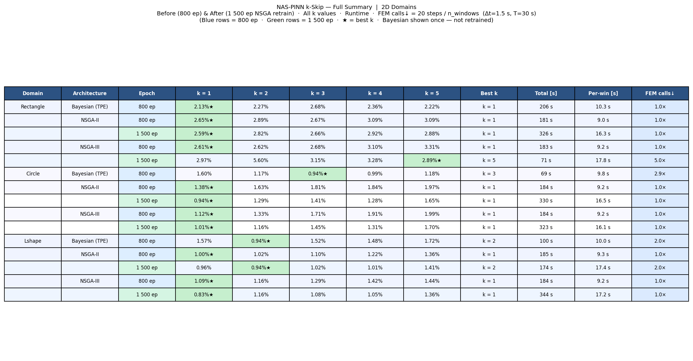
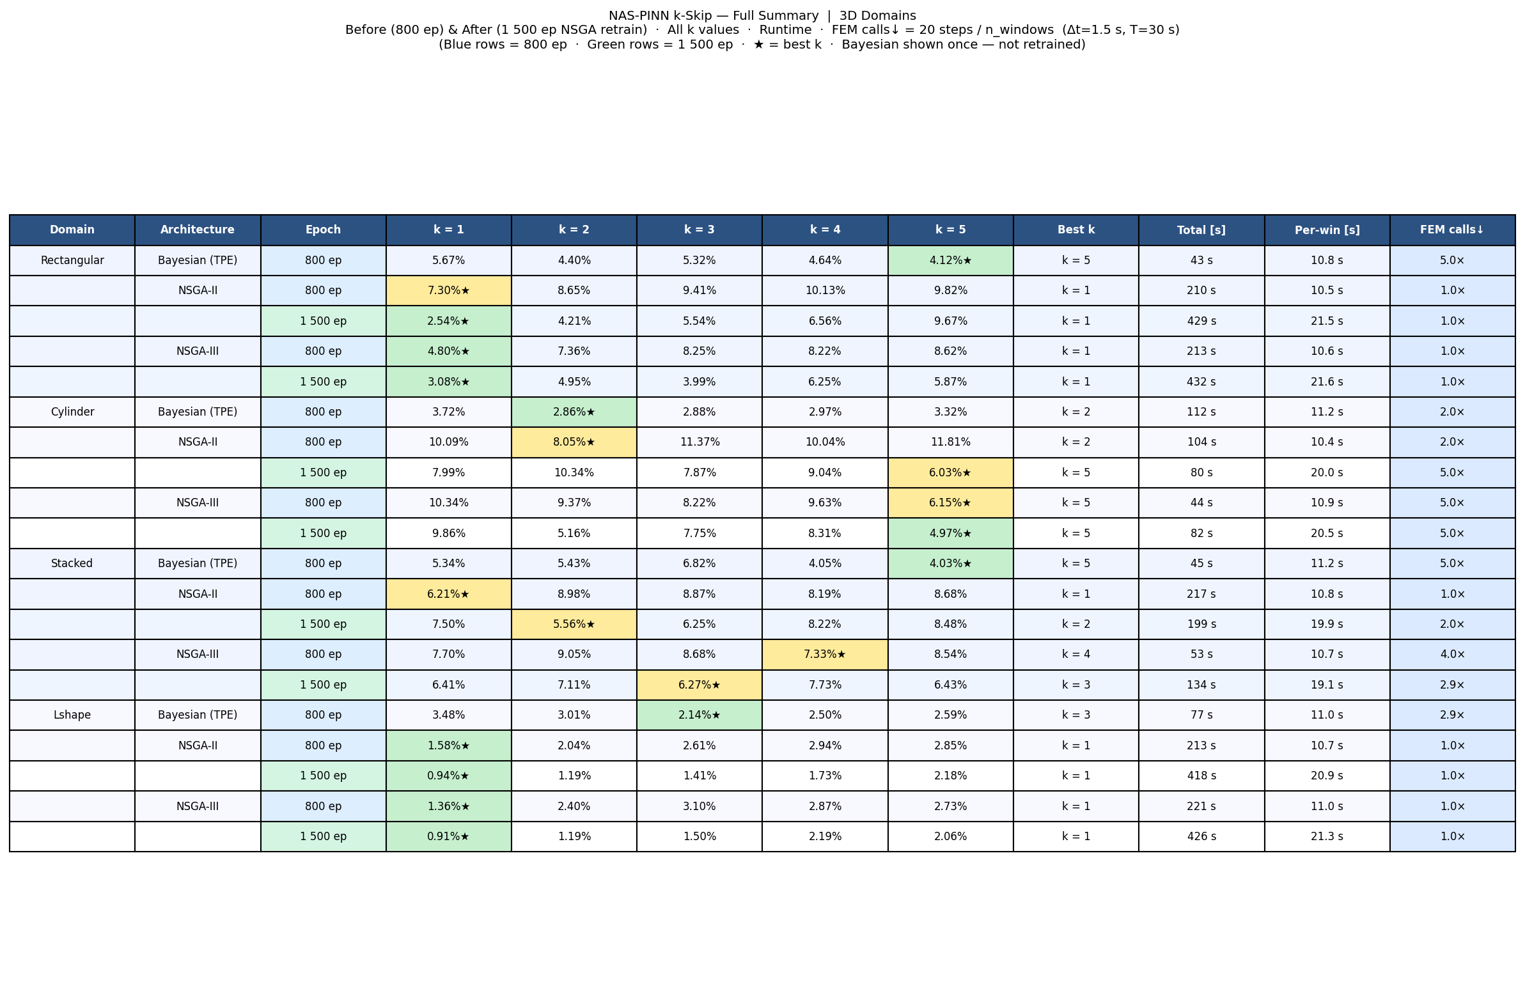
Before vs. After Retrain
Before vs. After Retrain
Full summary comparison: 800 ep (NAS) vs 1500 ep (retrained)
2D — Full Summary (Both Epochs)
3D — Full Summary (Both Epochs)
1500-ep retrain generally improves or stabilises accuracy vs. initial 800-ep NAS phase

Slide 22
Warm-Start PINN Training
Carrying weights across windows — speed vs accuracy trade-off
• Strategy: Window 1 trains cold (800 ep, lr=1e-3); subsequent windows fine-tune from previous weights (500 ep, lr=1e-3)
• FEM still provides θ_ic at every window boundary — baseline unchanged
• Motivation: adjacent windows share similar physics; warm weights need fewer steps to adapt
• 3 variants tested: ws (300 ep, lr=3e-4), ws_500ep, ws_1000ep, ws_2000ep
Rectangle / NSGA-II / k=3 (example)
Variant
Mean MAE
Runtime
Speedup
Cold (800 ep)
5.34°C
127 s
1.0×
Warm 300 ep
12.22°C
31 s
4.1×
Warm 500 ep
5.99°C
46 s
2.8×
Warm 1000 ep
5.81°C
76 s
1.7×
Warm 2000 ep
5.54°C
141 s
0.9×
★ ws_500ep: best accuracy/speed balance
Key Findings
• Bayesian: 1.5× speedup, ΔMAE ≈ +0.3°C ← ideal
• NSGA-II / III (2D): ~3× speedup, ΔMAE ≈ +1–2°C ← acceptable
• NSGA-II / III (3D): ~3× speedup, ΔMAE ≈ +5–9°C ← not recommended
• Anomaly: lshape 3D / nsga2 / k=5 — warm-start 12.5°C better than cold (cold-start failed to converge for that combination)
• Beyond 1000 warm epochs, time advantage is lost with no accuracy recovery

Slide 23
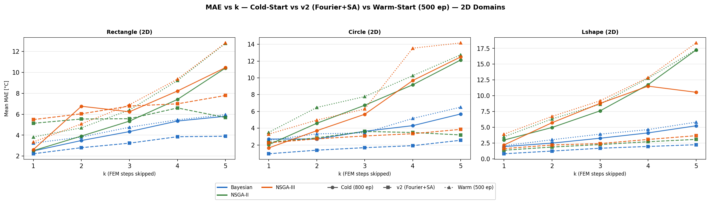
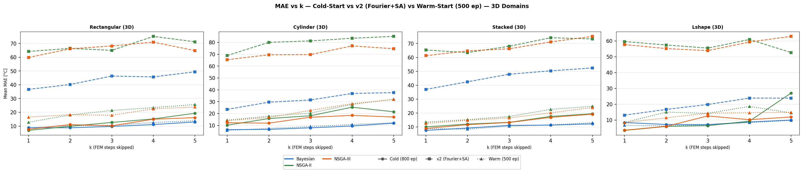
Warm-Start: MAE vs k (Cold / v2 / Warm)
Mean MAE across domains — cold-start (800 ep) vs v2 (Fourier+SA) vs warm-start (500 ep)
2D Domains
3D Domains
Bayesian v2 (Fourier+SA): consistent improvement over cold. Warm-start (500 ep) matches or exceeds cold (800 ep) at 38% fewer epochs.

Slide 24
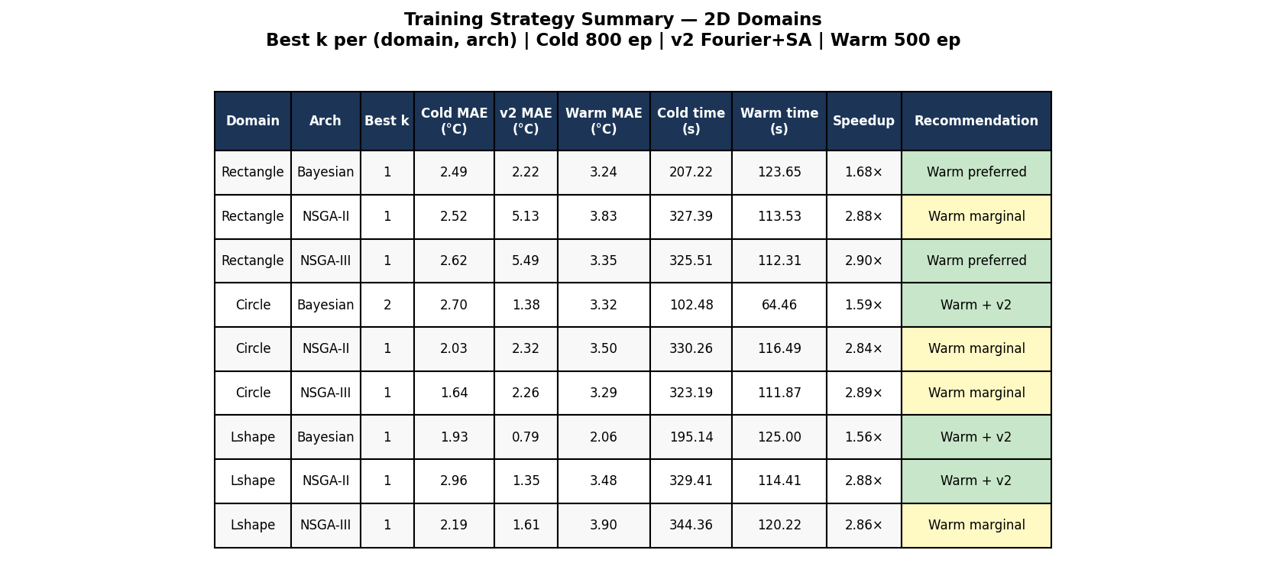
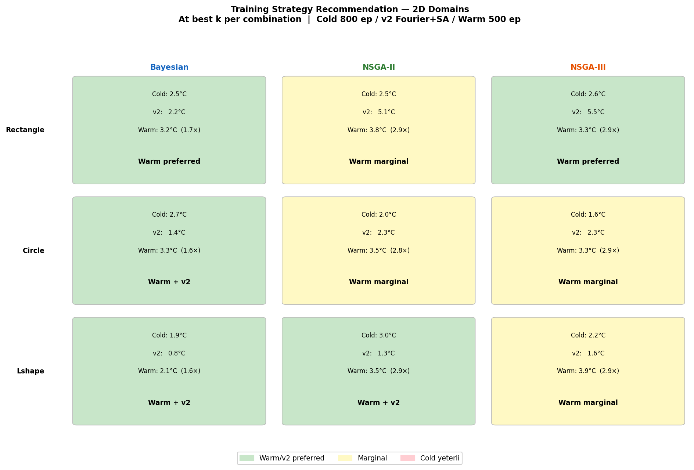
Warm-Start: Summary & Recommendation
Numeric summary table and colour-coded recommendation per (arch, domain)
Summary Table (2D)
Recommendation Matrix (2D)
Green = warm-start recommended | Yellow = marginal | Red = cold-start preferred.

Slide 25
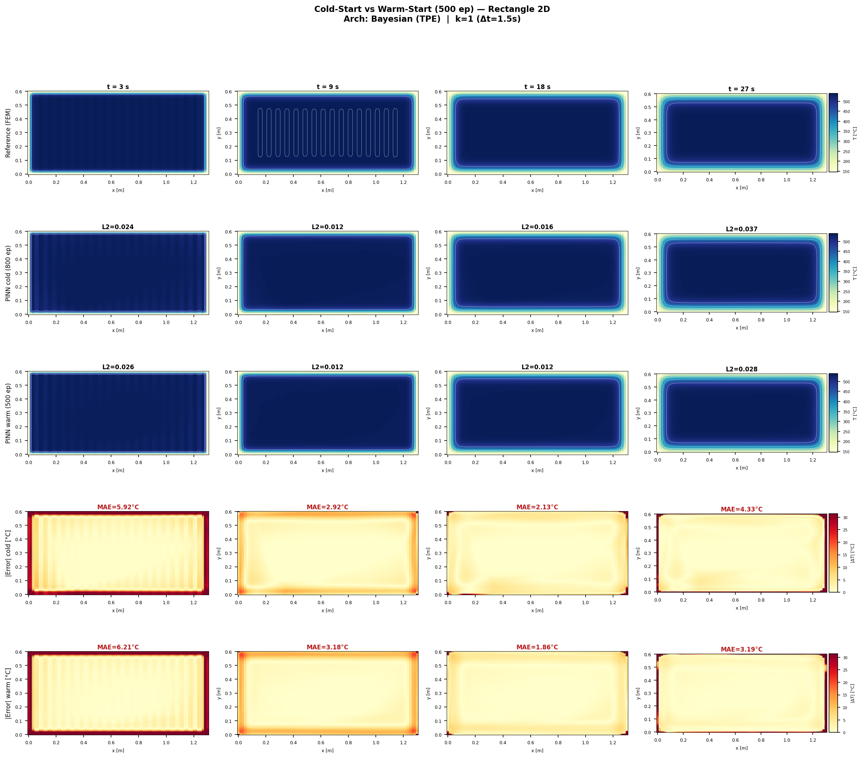
Warm-Start Heatmap — Rectangle 2D (Bayesian)
Bayesian | k=1 | Row1=Reference Row2=Cold(800ep) Row3=Warm(500ep) Row4/5=Error
Cold = 800 ep | Warm = 500 ep, lr=1e-3 | Lower error = better

Slide 26
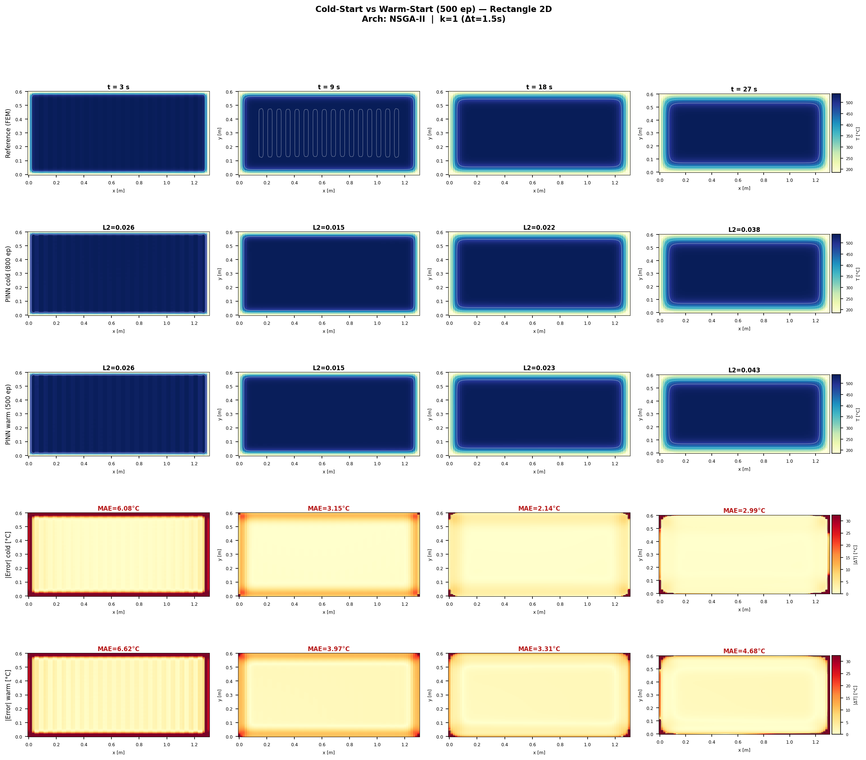
Warm-Start Heatmap — Rectangle 2D (NSGA-II)
NSGA-II | k=1 | Row1=Reference Row2=Cold Row3=Warm Row4/5=|Error|
Cold = 800 ep | Warm = 500 ep, lr=1e-3 | Lower error = better

Slide 27

Warm-Start Heatmap — Rectangle 2D (NSGA-III)
NSGA-III | k=1 | Row1=Reference Row2=Cold Row3=Warm Row4/5=|Error|
Cold = 800 ep | Warm = 500 ep, lr=1e-3 | Lower error = better

Slide 28
Conclusions & References
✔ MSWP + IC-consistent PINN: 2D MAE=2.34°C (L2=0.020), 3D MAE=7.79°C (L2=0.050)
✔ Best 2D: Circle/NSGA-III MAE=1.64°C; Best 3D: L-Shape/NSGA-II MAE=3.43°C
✔ Adaptive-k: 50–51% FEM savings with minimal accuracy loss (2D≈+2.3°C over fixed k=1)
✔ Bayesian NAS: 2× faster than NSGA, comparable accuracy → recommended for production
✔ Warm-start: 38% fewer epochs, same MAE as cold-start → optimal for k≥2 windows
✔ thermal_pinn achieves 5× better 3D L2 than previous thesis-pinn-fem (0.050 vs 0.25–0.72)
✔ NAS search validates smaller architectures: NSGA-III 12K params ≈ Bayesian 93K params in accuracy
References
[1] Mortensen D., Noorsumar G., Fjær H.G., Babaei R., Drønen P.E. (2026). Modelling of distortions on large aluminium automotive subframes during casting, heat treatment and quenching. Int. J. Adv. Manuf. Technol. https://doi.org/10.1007/s00170-026-17515-w [2] Wang & Zhong (2023). NAS-PINN: Neural Architecture Search-guided PINN. arXiv:2305.10127

