Slide 1
NAS-MCO-PINNs
Neural Architecture Search with Multi-Loss Consistency Optimization and Skip Operator for 3D Thermal Simulation
Project Progress Report — March 2026
A356 Aluminum Water Quenching • 48 Training Runs • 4 Domains • 3 NAS Optimizers • 4 Skip Values
4
3
4
48
81%
2.19°C
3D Domains
NAS Optimizers
Skip Values
Total Runs
Max FEM Savings
Best MAE

Slide 2
Motivation & Problem
Why do we need a Skip Operator for PINNs?
Standard PINN Approach
• One PINN training run per FEM time step
• 21 FEM steps → 21 separate PINN trainings
• Heavy computational cost per simulation
• No reuse of learned structure across windows
Our Approach: Skip Operator
• One PINN predicts s steps ahead at once
• FEM calls reduced to ⌈N/s⌉
• s=2: 52% savings | s=6: 81% savings
• NAS finds best architecture automatically
• MCO handles adaptive loss weighting
FEM Computation Savings
Skip s | FEM Steps Saved | Reduction | PINN Runs
s = 1 (baseline) | 0 steps | 0% | 21 runs
s = 2 | 10 steps | 52% | 11 runs
s = 4 | 15 steps | 71% | 6 runs
s = 6 | 17 steps | 81% | 4 runs
θ̂(t + s·Δt) = θ_IC + τ · f_θ(x, y, z, τ, θ_IC)
Residual skip formula — guarantees IC at τ=0

Slide 3
Method: NAS Search + MCO Loss Weighting
Automated architecture search with adaptive loss balancing
Neural Architecture Search (NAS)
Search Space:
• Depth: 2 – 6 hidden layers
• Width: 32 – 256 neurons per layer
• Activations: Tanh / GELU / SiLU
• Skip connections: optional
Optimizers (500 candidates each):
• Bayesian Optimization — surrogate model
• NSGA-II — multi-obj. genetic algorithm
• NSGA-III — reference-point based NSGA
Training: AdamW, 2000 epochs per window
Multi-Loss Consistency Optimization (MCO)
Adaptive loss function:
ℒ = w_target·ℒ_target + 0.05·w_PDE·ℒ_PDE
w_i = 1 / σ_i² (running std per loss term)
→ no manual weight tuning needed
Physical Parameters (A356 Aluminum):
• ρ = 2670 kg/m³, c_p = 963 J/(kg·K)
• k = 151 W/(m·K)
• h = 2000 W/(m²·K), T_∞ = 20°C, T_0 = 540°C
• PDE: ρ·c_p·∂T/∂t = ∇·(k·∇T)
Water quenching: 21 FEM time steps total

Slide 4
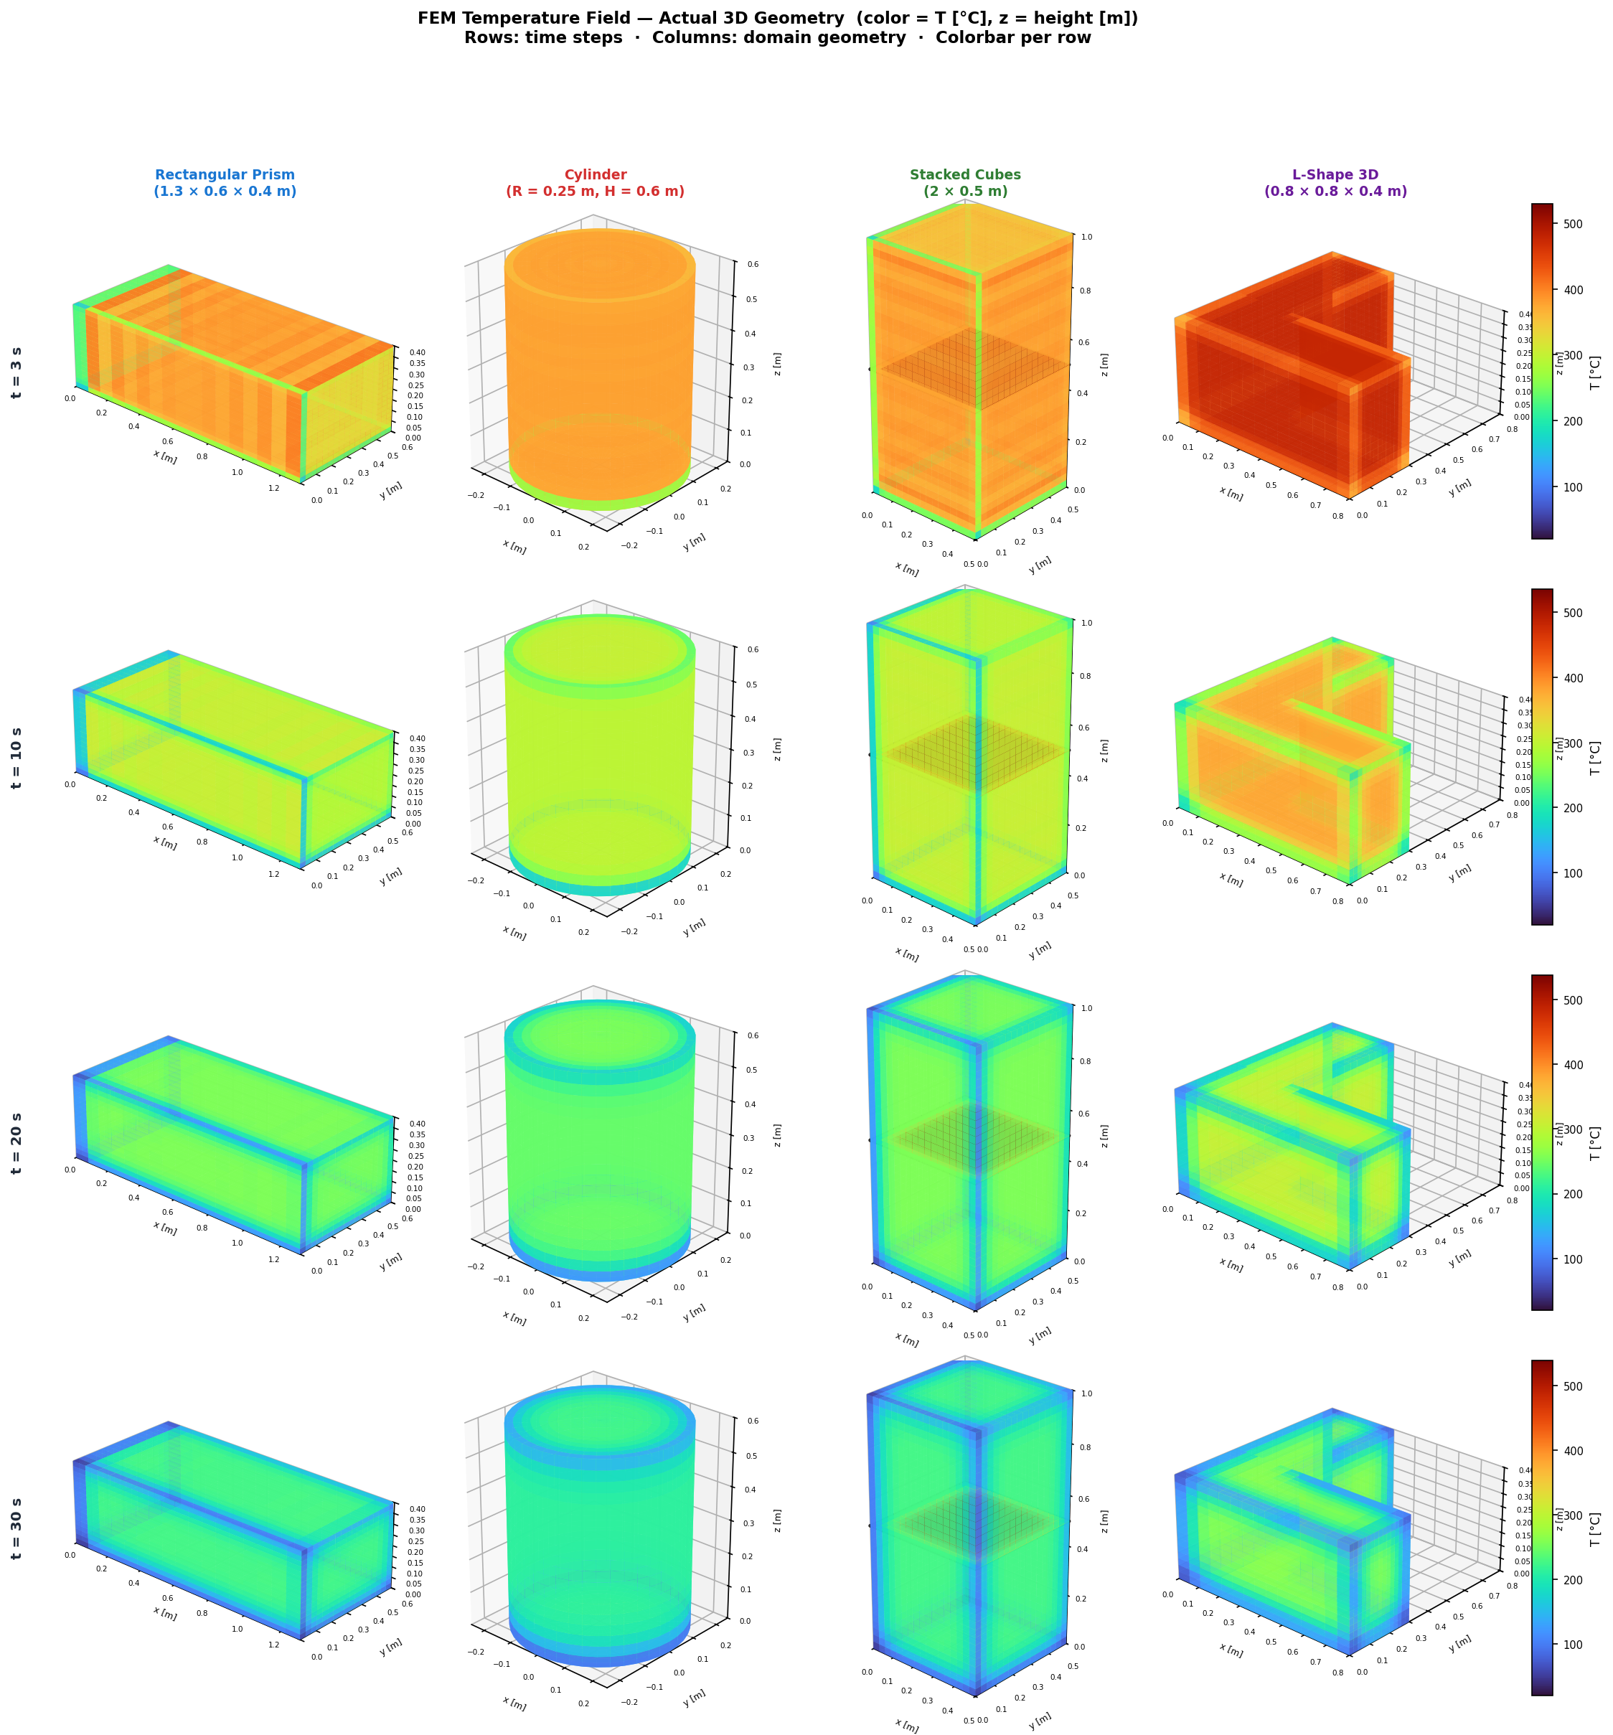
Four 3D Thermal Domains
A356 aluminum water quenching — different geometric complexities
Rectangular Prism
Cylinder
Stacked Cubes
L-Shape
1.3 × 0.6 × 0.4 m Simple cuboid — baseline geometry Uniform convective cooling
R = 0.25 m, H = 0.6 m Axisymmetric — curved surfaces Radial heat flux
2 × 0.5 m stacked Geometric interface effect Multi-region cooling
0.8 × 0.8 × 0.4 m Concave corner — complex geometry Numerical FD reference
Figure: Predicted temperature fields on z-midplane (Turbo colormap: blue=20°C, yellow=540°C) | skip=2, Bayesian NAS

Slide 5
Results: MAE Summary — All 48 Runs
MAE (°C) per domain, optimizer, and skip value
Color coding: dark green = best per row | light green < 8°C | yellow 8-15°C | red > 15°C
Domain | Optimizer | skip=1 (0%) | skip=2 (52%) | skip=4 (71%) | skip=6 (81%)
Rectangular Prism | Bayesian | 5.53 | 10.31 | 21.39 | 15.65
Rectangular Prism | NSGA-II | 5.41 | 10.39 | 20.99 | 25.86
Rectangular Prism | NSGA-III | 5.41 | 10.50 | 21.00 | 25.90
Cylinder | Bayesian | 5.33 | 10.69 | 11.54 | 10.23
Cylinder | NSGA-II | 4.23 | 8.69 | 18.93 | 25.38
Cylinder | NSGA-III | 4.20 | 9.14 | 16.24 | 22.54
Stacked Cubes | Bayesian | 4.95 | 9.80 | 21.64 | 17.18
Stacked Cubes | NSGA-II | 5.32 | 10.20 | 19.60 | 25.69
Stacked Cubes | NSGA-III | 5.12 | 10.27 | 19.77 | 25.51
L-Shape | Bayesian | 5.60 | 6.19 | 5.61 | 5.60
L-Shape | NSGA-II | 2.19 | 5.74 | 15.45 | 22.53
L-Shape | NSGA-III | 2.19 | 5.72 | 15.51 | 22.73

Slide 6
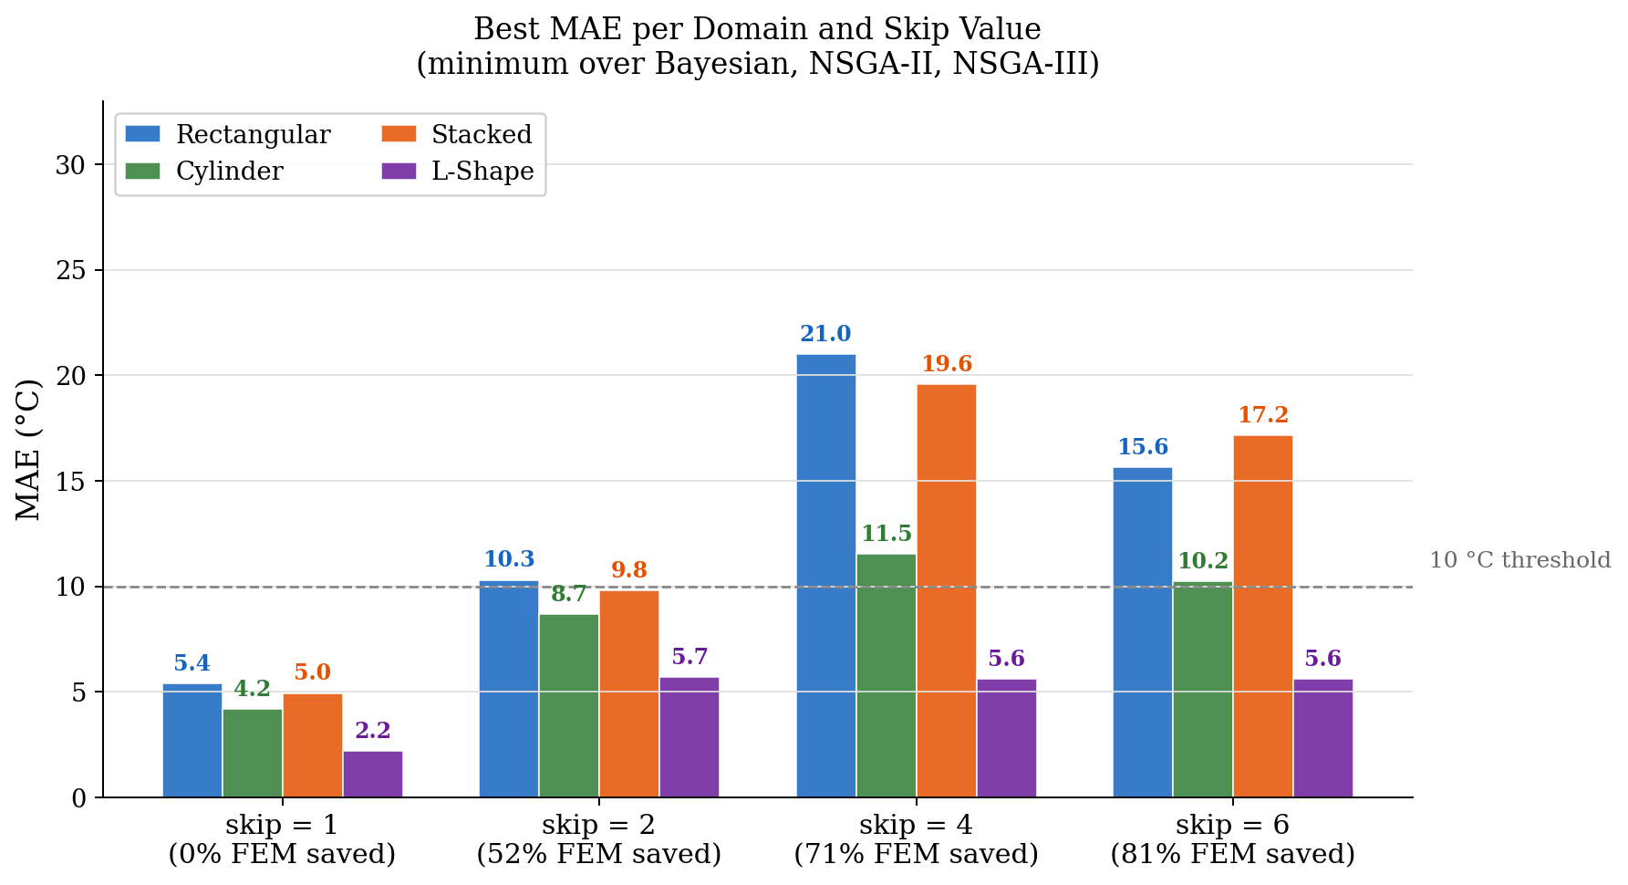
Results: Best MAE per Domain & Skip Value
Minimum over three NAS optimizers (Bayesian, NSGA-II, NSGA-III)

Slide 7
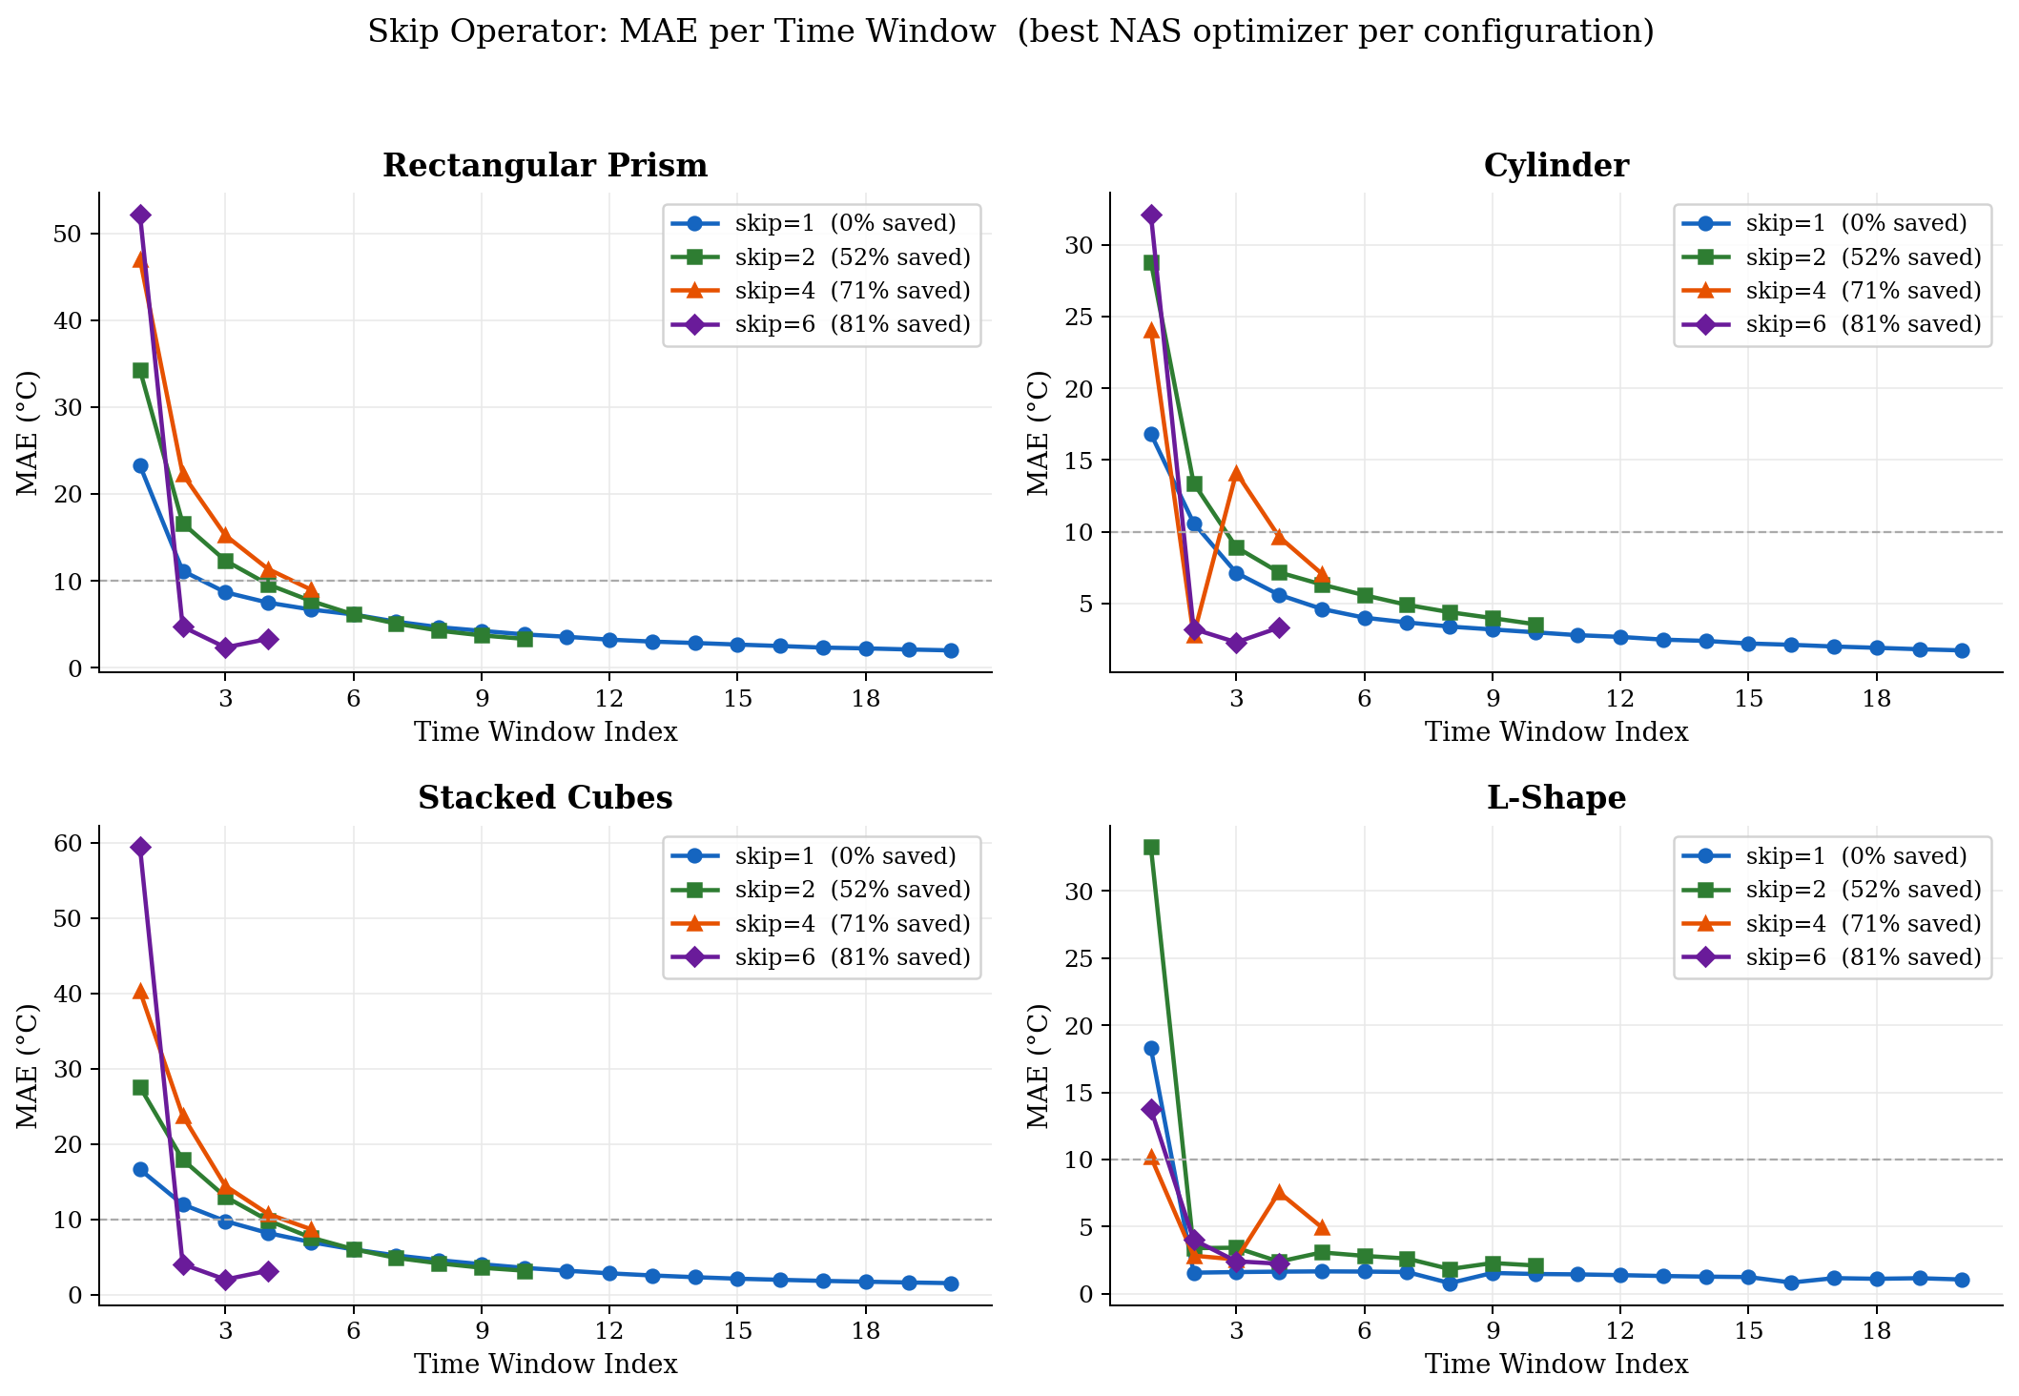
Results: Skip Operator Timeline
MAE per time window — accuracy-efficiency trade-off across all domains

Slide 8
3D Thermal Fields — All Domains
Predicted temperature on z-midplane | Turbo colormap: blue=20°C, yellow=540°C

Slide 9
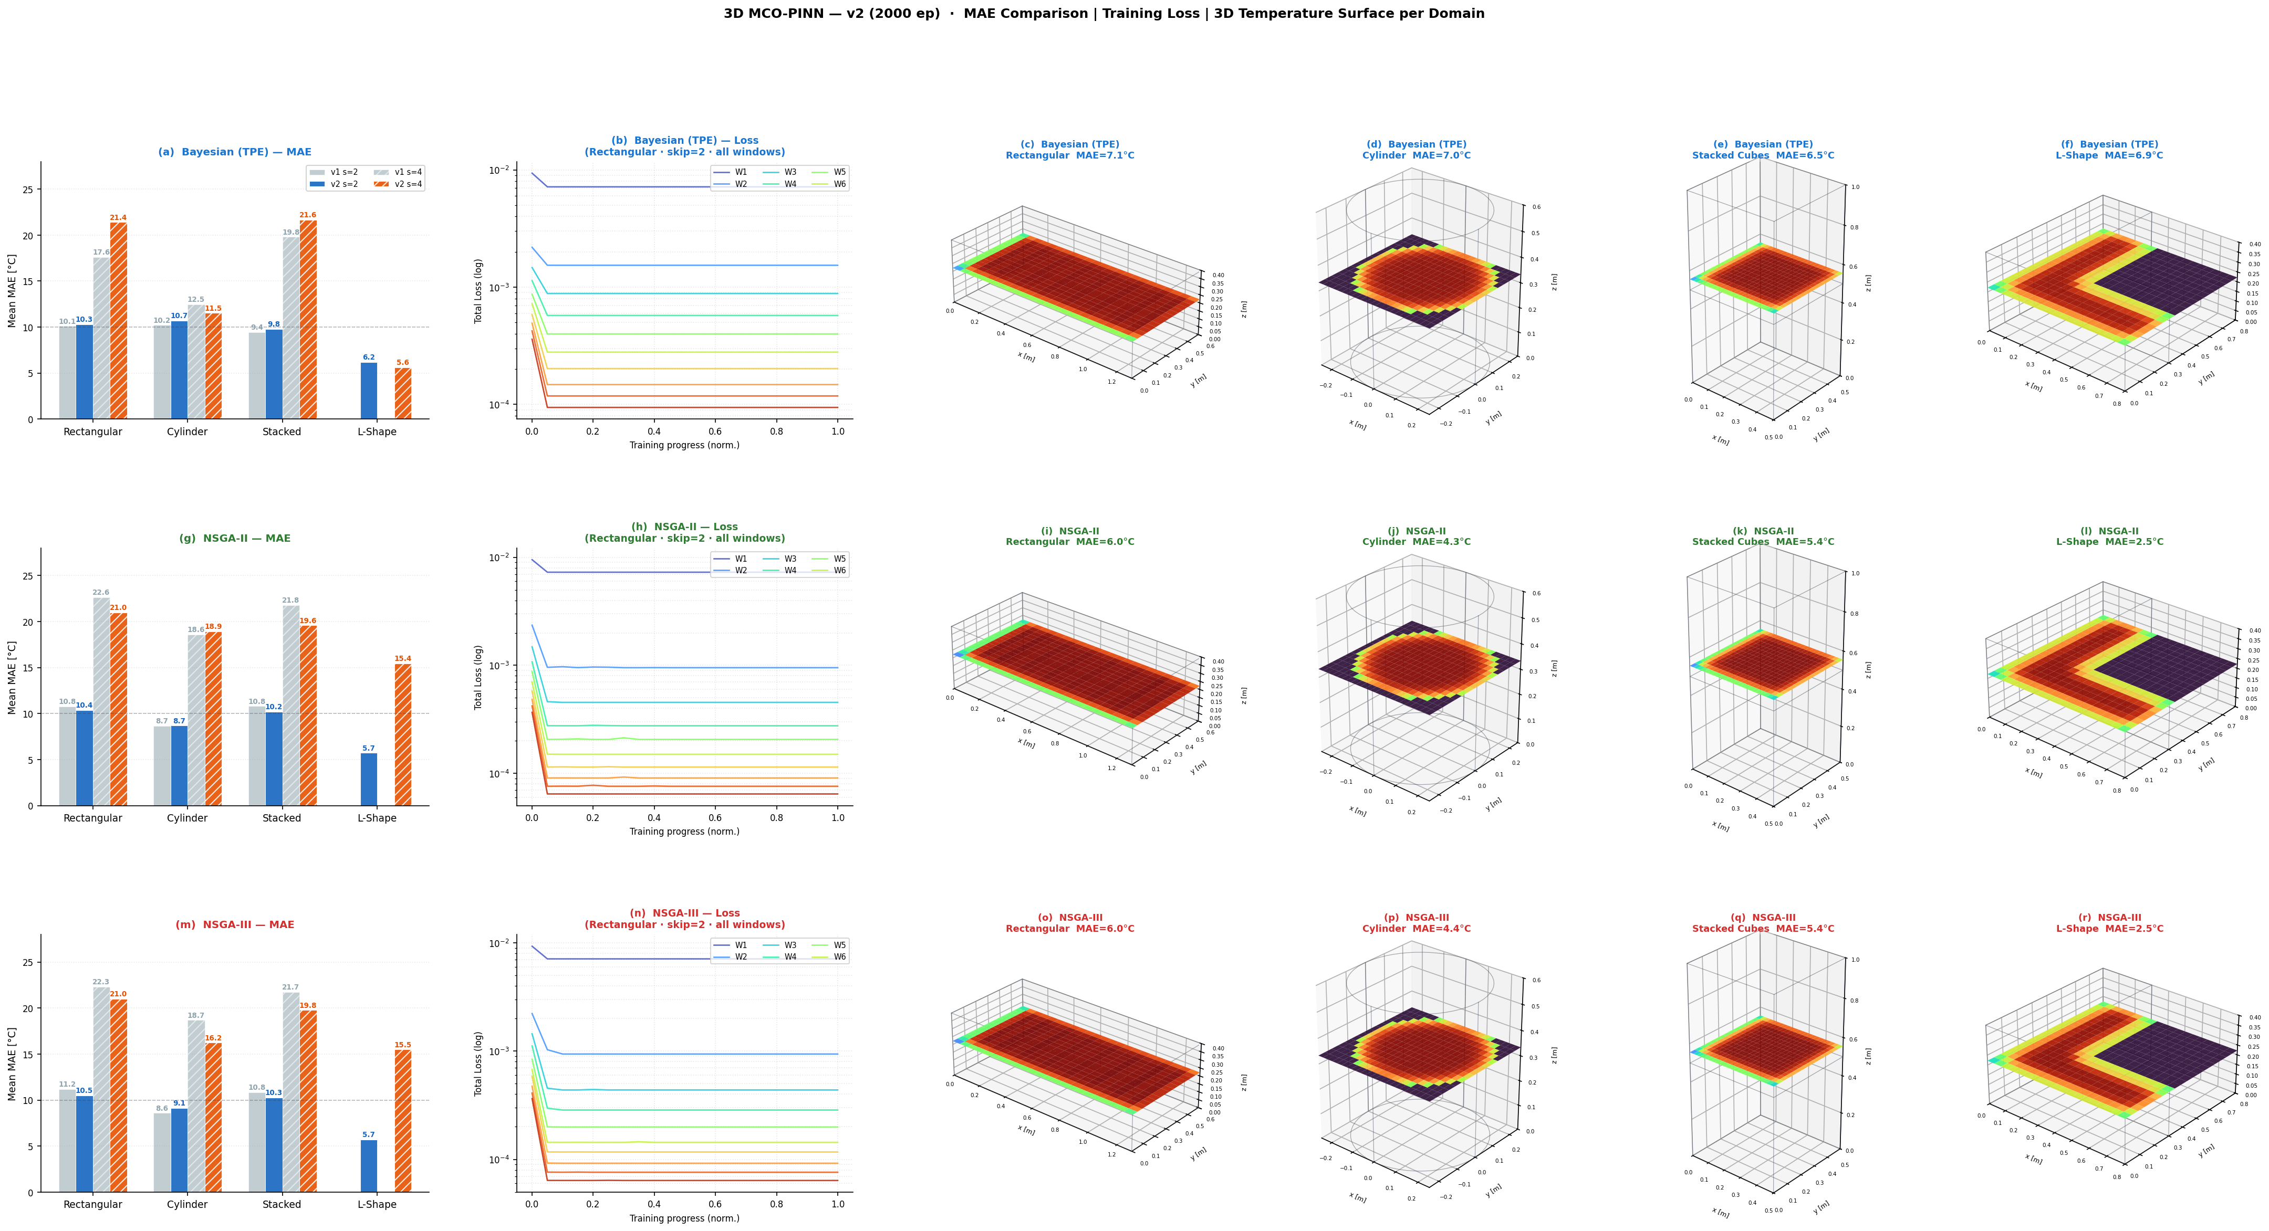
3D Results: NAS Optimizer Comparison
MAE comparison across Bayesian / NSGA-II / NSGA-III for all domains and skip values

Slide 10
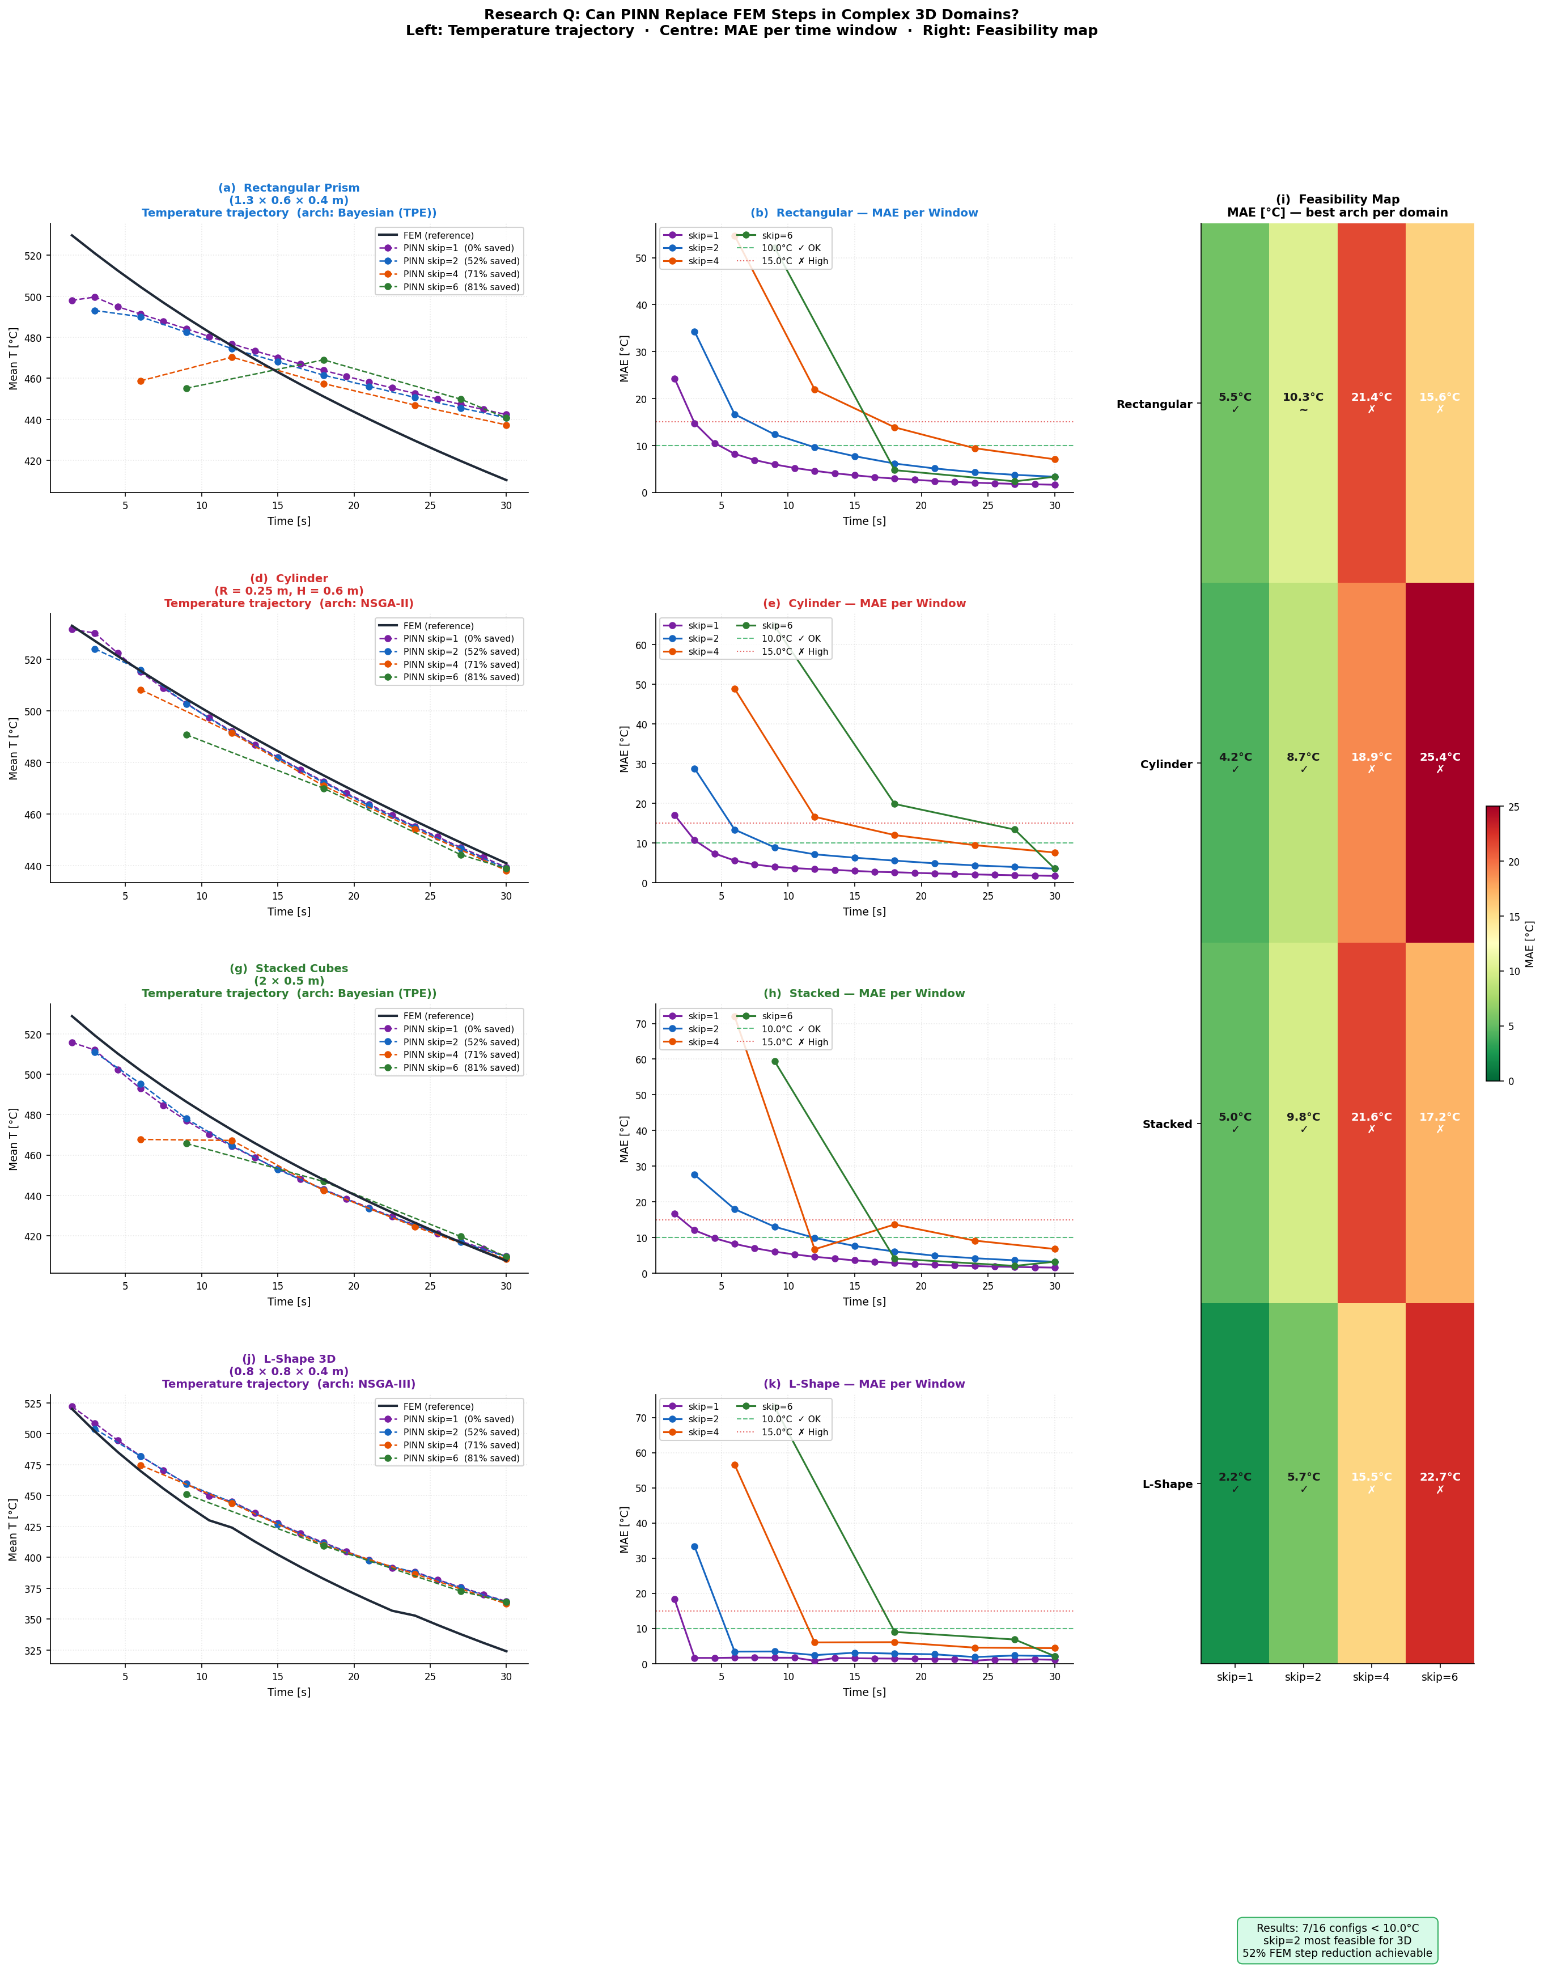
3D Feasibility Analysis
FEM savings vs. accuracy trade-off — practical operating ranges

Slide 11
Key Findings & Conclusions
▶ Best accuracy (skip=1): 2.19°C MAE on L-Shape with NSGA-II/III. All domains achieve < 5.6°C.
▶ Practical optimum (skip=2): 52% FEM savings while keeping MAE < 11°C for all domains. Recommended default.
▶ Fast screening (skip=6): 81% FEM reduction. MAE 5.6–22.5°C — suitable for rapid feasibility checks.
▶ NAS optimizer comparison: Bayesian best on simple geometries (Rectangular, Stacked). NSGA-II/III superior on complex L-Shape.
▶ MCO adaptive weighting: w_i = 1/σ_i² eliminates manual loss tuning across all four geometries.
▶ L-Shape domain: Concave-corner geometry validated against numerical FD reference. Skip=1/2 achieves excellent accuracy.

Slide 12
Thank You
NAS-MCO-PINNs: Skip Operator for 3D Thermal Simulation
4 Domains • 3 NAS Optimizers • 4 Skip Values • 48 Total Runs Best MAE: 2.19°C • Max FEM Savings: 81% • Practical Optimum: skip=2 (52% savings, <11°C)

