Slide 1
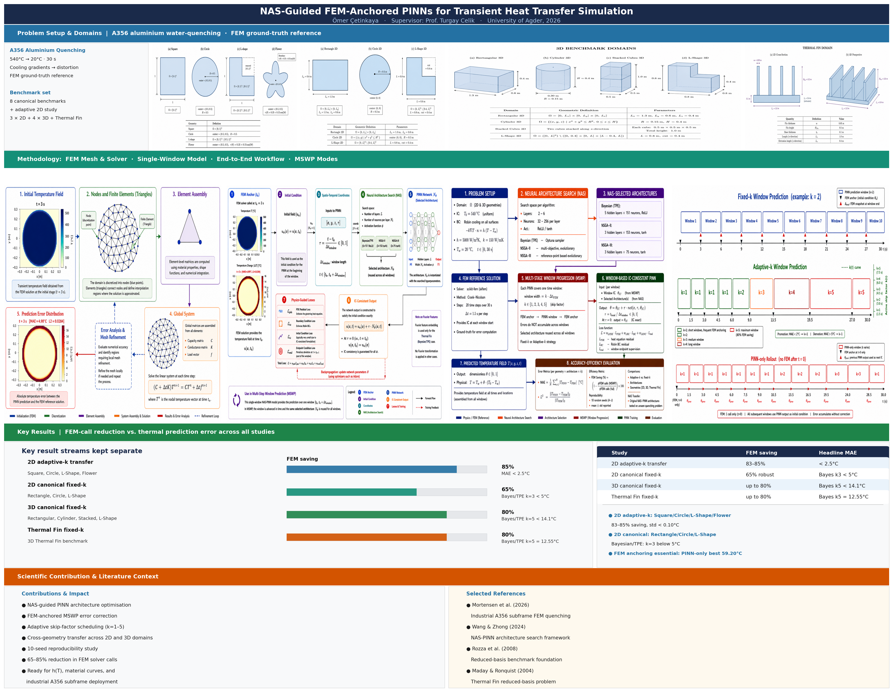
UiA | University of Agder
NAS-Guided FEM-Anchored PINNs
Multi-Step Window Prediction for Transient A356 Water Quenching
Step Optimization in Thermal Simulation Using Selective Finite Element Method Step Skipping
Omer Cetinkaya | University of Agder | 2026
Supervisor: Prof. Turgay Celik
UiA | University of Agder
Master Thesis Defense
1

Slide 2
Presentation Structure
INTRODUCTION
Intro
Theory
Method
Results
Why this problem · what we built · how we test
Heat equation · FEM · PINN · NAS-PINN
How FEM works · How NAS-PINN works · How MSWP works
2D · 3D · Thermal Fin · MAE and FEM saving numbers
Discussion
Conclusion
References
What the numbers mean · which architecture wins · when FEM is needed
65-85% FEM saving · limitations · next steps
Mortensen 2026 · Wang & Zhong 2024 · Raissi 2019
UiA | University of Agder
Master Thesis Defense
2

Slide 3
Intro: What We Do in This Project
INTRODUCTION
The project begins with an industrial A356 aluminium quenching problem and asks whether Finite Element Method (FEM) time-step calls can be reduced without losing useful temperature accuracy.
Reference paper
Our approach
Validation path
The reference study models water quenching of cast A356 automotive subframes. Its FEM simulation gives the industrial motivation: temperature gradients during quenching drive distortion.
We keep the same physical process setting, but test a different route: FEM provides anchor snapshots and NAS-PINN predicts selected intermediate windows.
Because the real industrial data arrived late, the workflow starts with controlled surrogate geometries and then moves toward more complex 3D and Thermal Fin benchmarks.
Material
Initial T
Bath T
Quench
Goal
A356
540 C
20 C
30 s
skip FEM
aluminium
hot part
water
transient
with anchors
UiA | University of Agder
Master Thesis Defense
3

Slide 4
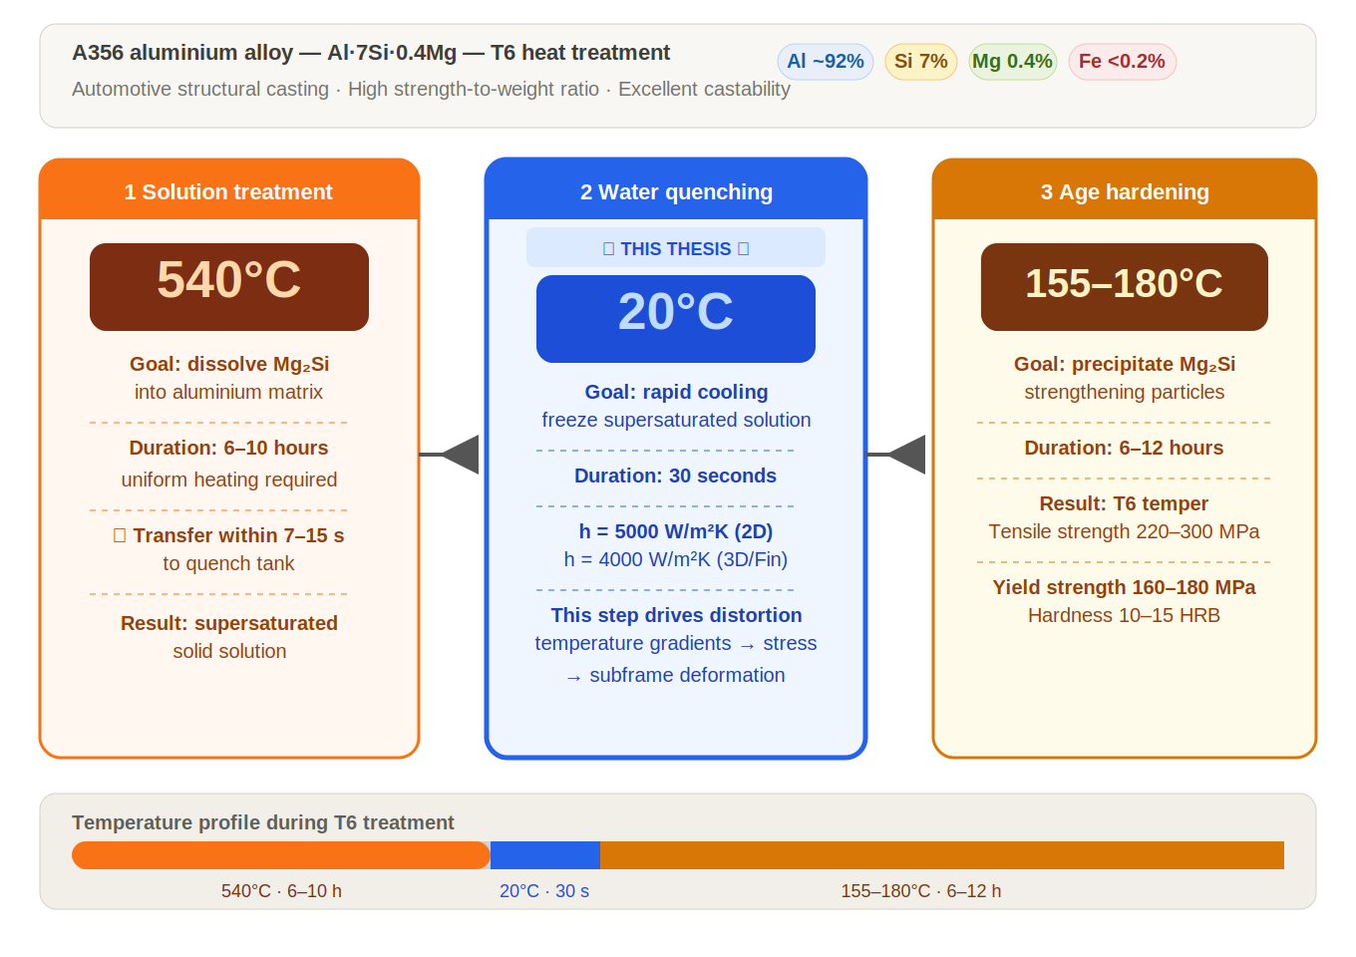
What is A356 aluminium? - T6 heat treatment process
INTRODUCTION
A356 aluminium
A356 is an aluminium-silicon casting alloy. It is common in cast automotive parts because it is light and has useful mechanical properties.
Water quenching
After heating, the hot part is cooled quickly in water. This fast cooling changes the temperature field inside the part.
Why simulation is needed
Fast cooling can create strong temperature gradients. These gradients can cause distortion and residual stress.
Connection to this thesis
Mortensen et al. (2026) use FEM for A356 automotive subframe quenching. This thesis uses that industrial problem as motivation for FEM-step reduction.
Source: Mortensen et al. (2026), finite element simulation of water quenching in cast A356 automotive subframes.
UiA | University of Agder
Master Thesis Defense
4

Slide 5
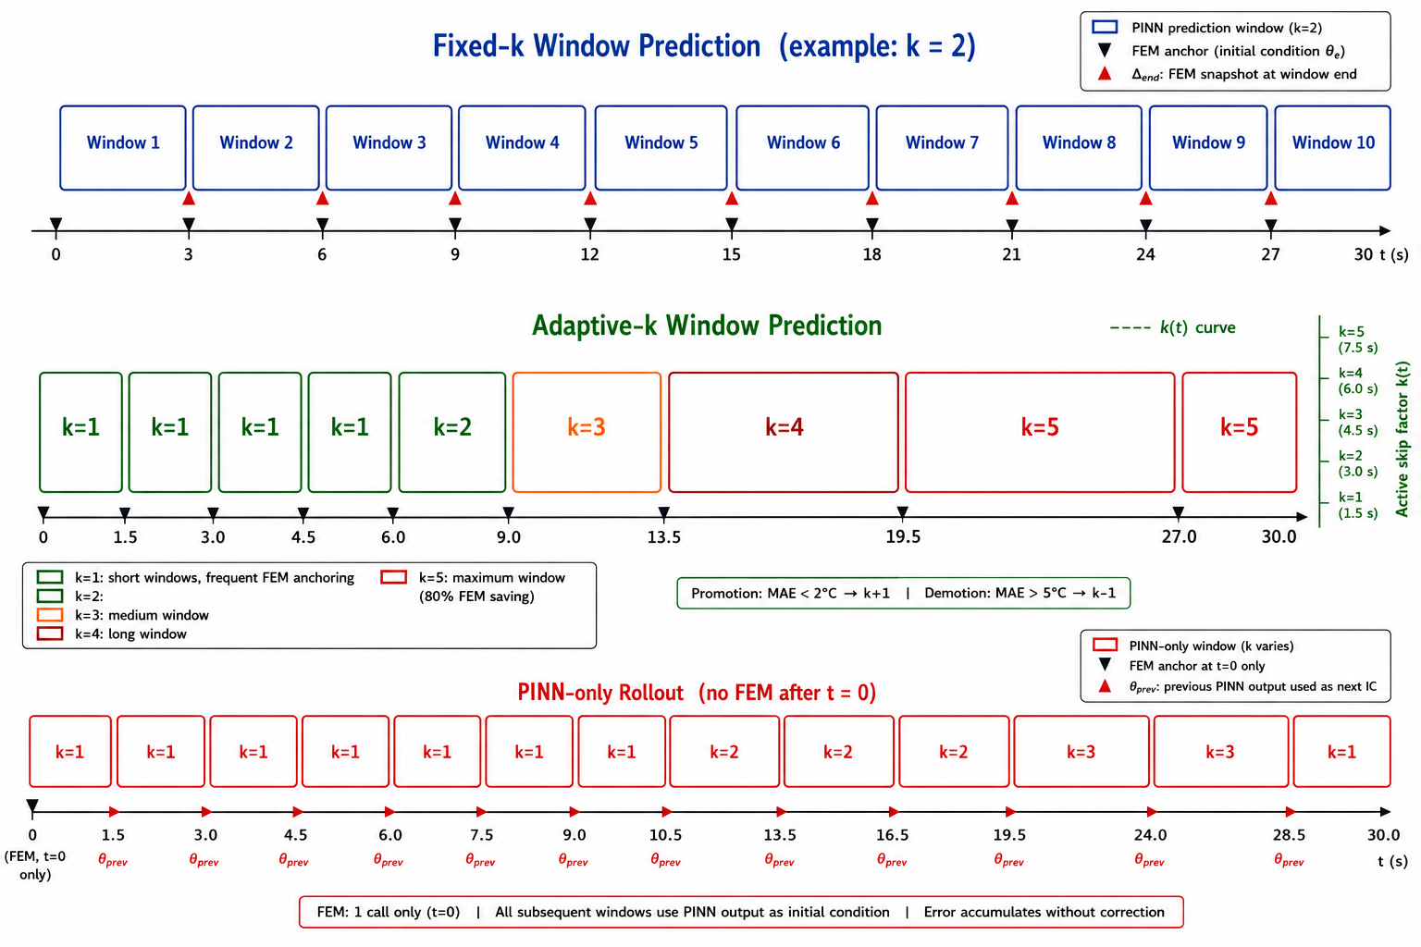
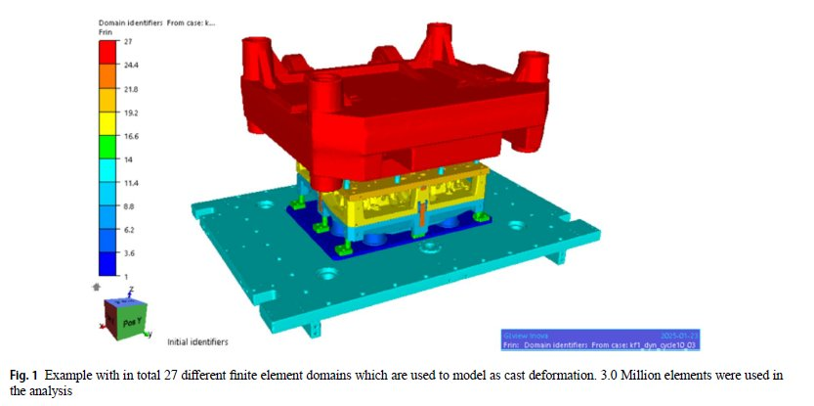
Intro: From the Reference Paper to This Thesis
INTRODUCTION
We follow the industrial quenching problem from the reference paper, then test whether FEM time-step calls can be reduced with a FEM-anchored NAS-PINN strategy.
Problem statement
Figure 1.1 shows the three operating modes of the MSWP framework. Starting from the reference paper, the thesis keeps the same quenching setting but tests whether selected FEM steps can be skipped with NAS-PINN predictions.
Why surrogate geometries first?
The real industrial data arrived late, so the method was validated first on controlled geometries: NAS-PINN source domains, canonical 2D domains, then 3D and Thermal Fin benchmarks.
Initial temperature
Water bath
Simulation time
2D h
3D/Fin h
540 C
20 C
30 s
A356 part
quench medium
transient cooling
W/(m2K)
W/(m2K)
UiA | University of Agder
Master Thesis Defense
5

Slide 6
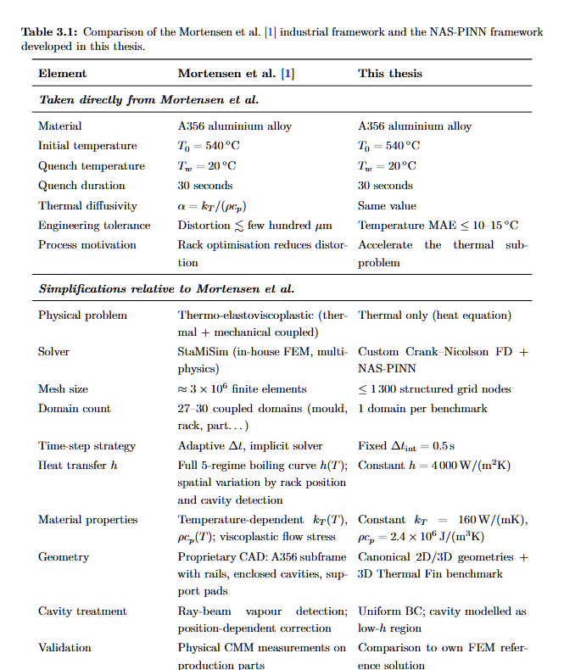
Reference Paper Inputs and Thesis Use
INTRODUCTION
Table 3.1: what is taken from the reference study
Important comparison
Reference paper
Industrial A356 water-quenching problem; FEM is used to simulate thermal behaviour and distortion risk.
What we keep
Same physical motivation: hot A356 part, water bath, transient cooling and FEM reference fields.
What we change
The thesis does not simulate the full industrial subframe first. It validates the method on controlled 2D, 3D and Thermal Fin benchmarks.
How we use it
FEM snapshots become trusted anchors. NAS-PINN predicts selected intermediate windows to reduce FEM time-step calls.
Main message: the reference paper gives the industrial FEM-quenching motivation; this thesis tests a FEM-anchored acceleration strategy.
UiA | University of Agder
Master Thesis Defense
6

Slide 7
Research Question and Contributions
INTRODUCTION
How many FEM solver calls can be replaced by PINN predictions while keeping temperature error within engineering limits?
We built
We tested
We measured
Error limits
A FEM-anchored NAS-PINN framework that predicts intermediate thermal fields while FEM snapshots remain the correction source.
Fixed-k, adaptive-k and PINN-only modes were evaluated from simple 2D domains to complex 3D and Thermal Fin cases.
MAE, relative L2 error, skip-factor schedule and FEM-call reduction are reported together.
Geometry-dependent thresholds: 10 C for canonical 2D; 15 C for 3D and Thermal Fin.
Engineering tolerance calculation
Delta T = T0 - Tw = 540 C - 20 C = 520 C | 15 C / 520 C = 0.0288 = 2.9% approx. 3% | 10 C / 520 C = 1.9%
UiA | University of Agder
Master Thesis Defense
7

Slide 8
Heat Transfer Model
THEORY AND FEM BACKGROUND
The whole framework is built on transient heat transfer during water quenching.
Governing equation
Boundary condition
Initial condition
rho cp dT/dt = div(kT grad T)
This describes how the temperature field evolves inside the solid part.
-kT grad(T) . n = h (T - Tw)
This represents heat leaving the hot metal surface into the quench water.
T(x,0) = T0
In this thesis: T0 = 540 C and Tw = 20 C.
How Finite Element Method (FEM) uses it
How PINN uses it
FEM discretises the domain and solves this equation to produce reference temperature snapshots.
PINN predicts T(x,t) and penalises violations of the PDE, boundary condition and initial condition.
UiA | University of Agder
Master Thesis Defense
8

Slide 9
Finite Element Method (FEM), Physics-Informed Neural Network (PINN) and Neural Architecture Search PINN (NAS-PINN)
THEORY AND FEM BACKGROUND
FEM
PINN
NAS-PINN
What is it?
A numerical solver for the heat equation.
How we used it?
It gives reliable anchor snapshots.
Key point: FEM is not removed.
What is it?
A neural network for T(x,t).
How it learns?
It uses data error + heat-equation error.
Key point: physics is inside the loss.
What is it?
PINN + architecture search.
What is searched?
Depth, width and activation.
Key point: we do not choose the network manually.
Defense message
We used FEM for trust, PINN for prediction, and NAS to choose a better neural architecture for different geometries.
UiA | University of Agder
Master Thesis Defense
9

Slide 10
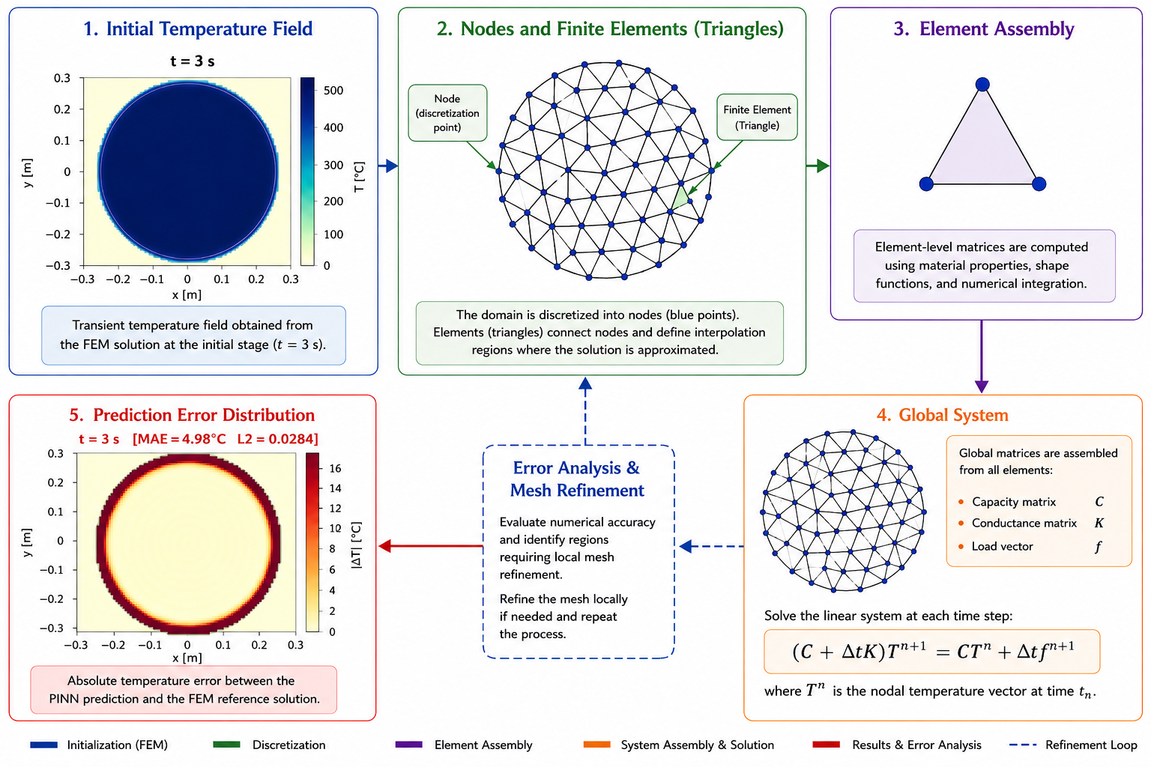
FEM Process: How It Works
THEORY AND FEM BACKGROUND
Step 1: physics
Define geometry, material properties, initial condition and boundary conditions.
Step 2: discretise
Split the domain into grid or mesh nodes.
Step 3: solve
Advance the heat equation in time with the numerical solver.
Step 4: output
Save temperature fields as reference snapshots.
UiA | University of Agder
Master Thesis Defense
10

Slide 11
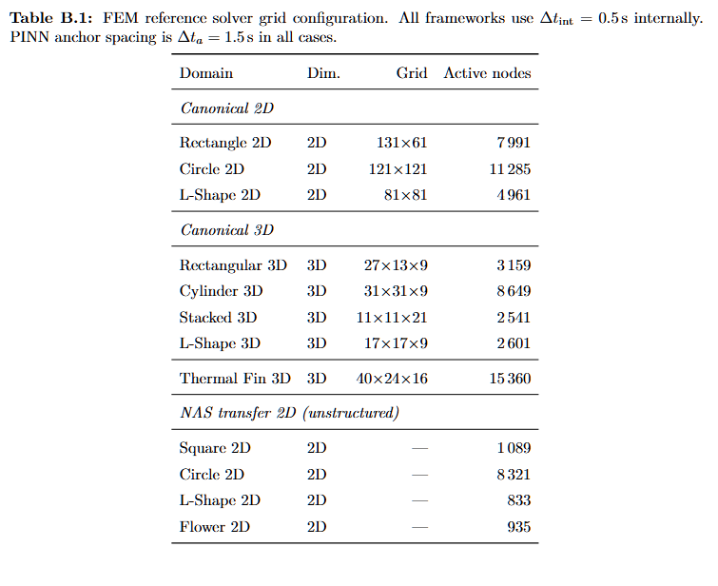
FEM Solver and Mesh Configuration
THEORY AND FEM BACKGROUND
Step after FEM process
After defining the FEM workflow, I show the actual grids and active nodes.
Why it matters
The reference error depends on the numerical grid quality and domain resolution.
How I use it
These FEM fields become the baseline for MAE, L2 and anchor snapshots.
UiA | University of Agder
Master Thesis Defense
11

Slide 12
FEM vs PINN: Runtime Logic
THEORY AND FEM BACKGROUND
Method | First use | Repeated use | Why it matters
FEM | Can be fast for one small case | Must solve again for each new case | Cost grows with many runs
PINN | Training can be slower | Inference is very fast | Good for repeated prediction
MSWP | Uses FEM anchors | Skips selected FEM calls | Keeps trust while reducing cost
My simple message
PINN trade-off
Why MSWP
FEM is reliable, but repeated solves can be costly.
PINN pays a training cost first, then reuses the trained model quickly.
I keep FEM anchors, but replace selected intermediate solves with PINN predictions.
UiA | University of Agder
Master Thesis Defense
12

Slide 13
FEM
METHOD
FEM
PINN
→
FEM gives us the reference. Now: how does PINN learn to predict without FEM?
UiA | University of Agder
Master Thesis Defense
13

Slide 14
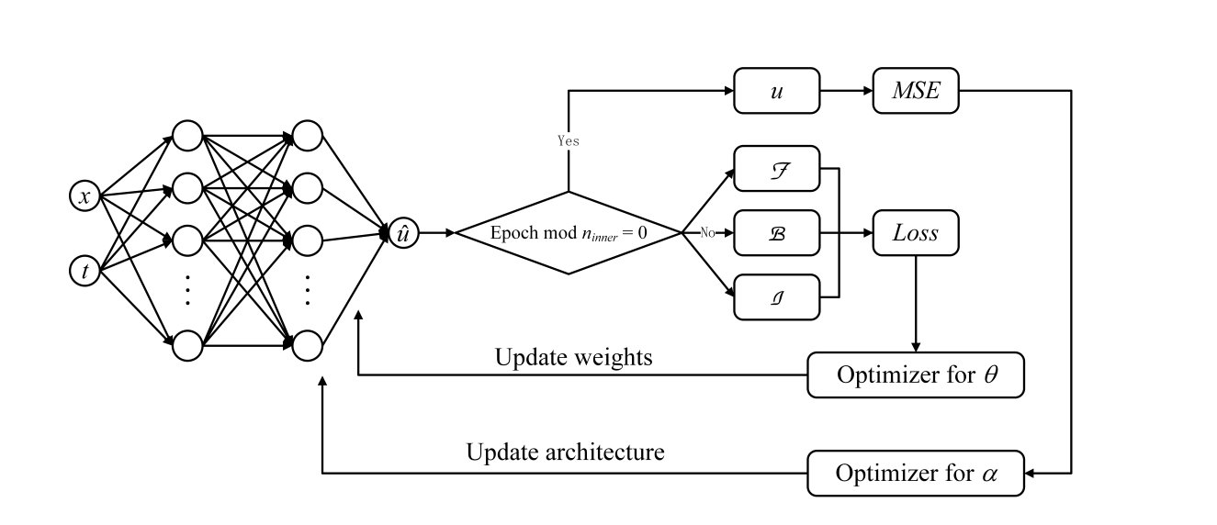
Method Source: NAS-PINN
METHOD
NAS-PINN source
How this thesis adapts it
Wang and Zhong (2024) provide the methodological starting point: a PINN is not chosen manually, but selected through neural architecture search for solving PDEs.
The thesis keeps the NAS-PINN idea but changes the deployment setting: FEM anchors are retained, the network predicts intermediate time windows, and MSWP controls solver-call reduction.
UiA | University of Agder
Master Thesis Defense
14

Slide 15
PINN
METHOD
PINN
NAS-PINN
→
PINN works. But which architecture? Enter: Neural Architecture Search.
UiA | University of Agder
Master Thesis Defense
15

Slide 16
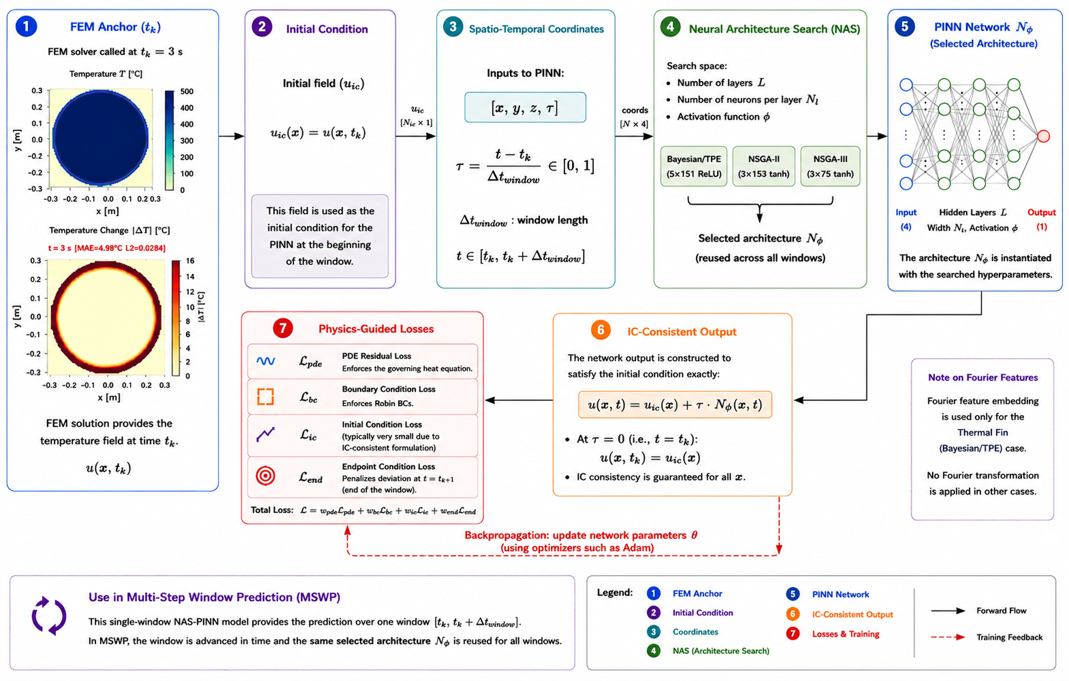
NAS-PINN Process
METHOD
Step 1: anchor
Use the FEM field at the start of one window.
Step 2: prediction
PINN predicts T(x,t) inside this window.
Step 3: loss
Physics and endpoint terms control the prediction.
Step 4: NAS
Architecture search chooses the best network design.
UiA | University of Agder
Master Thesis Defense
16

Slide 17
Architecture Search and Training Protocol
METHOD
Strategy | Selected architecture | Role in method
Bayesian/TPE | 5 layers x 151, ReLU | High-capacity accuracy-focused model
NSGA-II | 3 layers x 153, tanh | Accuracy-size trade-off
NSGA-III | 3 layers x 75, tanh | Compact Pareto-diverse model
Search setting
Training
Why transfer?
Search once on the 2D rectangle validation domain, then transfer architectures.
Each window is trained with Adam followed by L-BFGS.
Industrial use requires architecture robustness across geometries.
UiA | University of Agder
Master Thesis Defense
17

Slide 18
Optimisation Methods Used
METHOD
Method | Search idea | Why used here | Architecture
Bayesian/TPE | Single-objective probabilistic search | Find an accurate architecture with limited trials | 5 x 151, ReLU
NSGA-II | Multi-objective evolutionary search | Balance accuracy and compactness | 3 x 153, tanh
NSGA-III | Reference-point many-objective search | Promote diverse compact Pareto solutions | 3 x 75, tanh
Key message
The optimisation methods were not random choices; they test different architecture-search philosophies under the same FEM-anchored quenching framework.
UiA | University of Agder
Master Thesis Defense
18

Slide 19
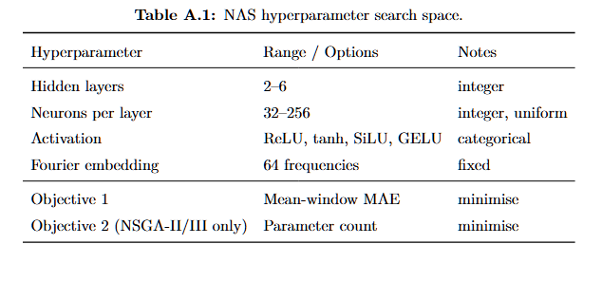
NAS Hyperparameter Search Space
METHOD
Same search space
All NAS strategies use the same candidate choices.
What changes?
Bayesian/TPE, NSGA-II and NSGA-III search this space differently.
Why include it?
It makes the architecture comparison fair and reproducible.
UiA | University of Agder
Master Thesis Defense
19

Slide 20
NAS-PINN
METHOD
NAS-PINN
MSWP
→
We have the architecture. Now: how do FEM + NAS-PINN work together?
UiA | University of Agder
Master Thesis Defense
20

Slide 21
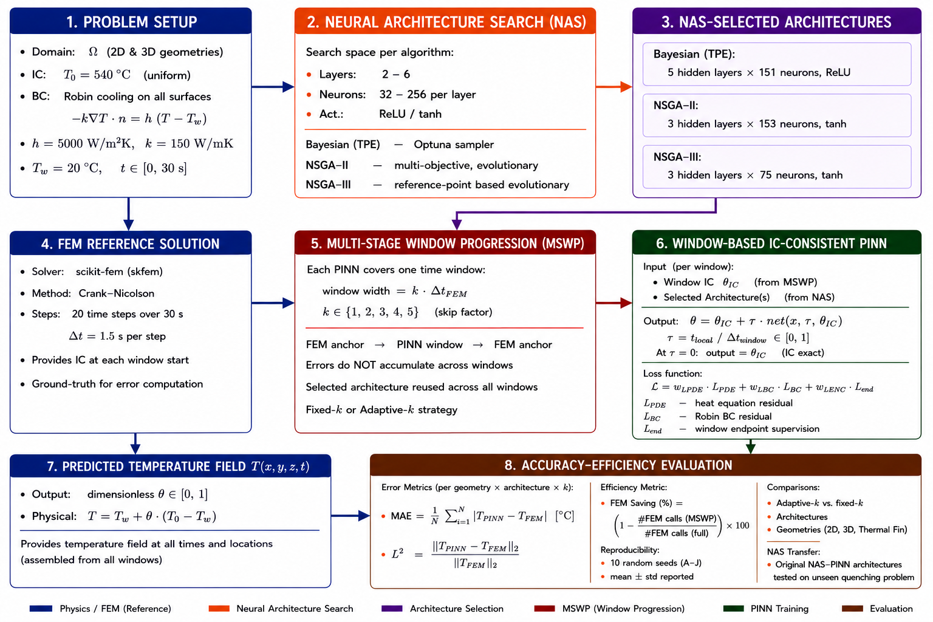
MSWP Framework: Working Logic
METHOD
Step 1: FEM anchors
FEM gives trusted reference states at selected times.
Step 2: choose k
The skip factor decides how many FEM calls are skipped.
Step 3: PINN predicts
NAS-PINN fills the skipped thermal windows.
Step 4: correct
The next FEM anchor limits drift and resets the field.
UiA | University of Agder
Master Thesis Defense
21

Slide 22
Skip Factor and Operating Modes
METHOD
Formula
Delta t_k = k * Delta t_a, with Delta t_a = 1.5 s
k | Windows | FEM saving
1 | 20 | 0%
2 | 10 | 50%
3 | 7 | 65%
4 | 5 | 75%
5 | 4 | 80%
Operating modes
Fixed-k tests constant windows, adaptive-k changes k during the transient, and PINN-only removes FEM correction after the first state.
UiA | University of Agder
Master Thesis Defense
22

Slide 23
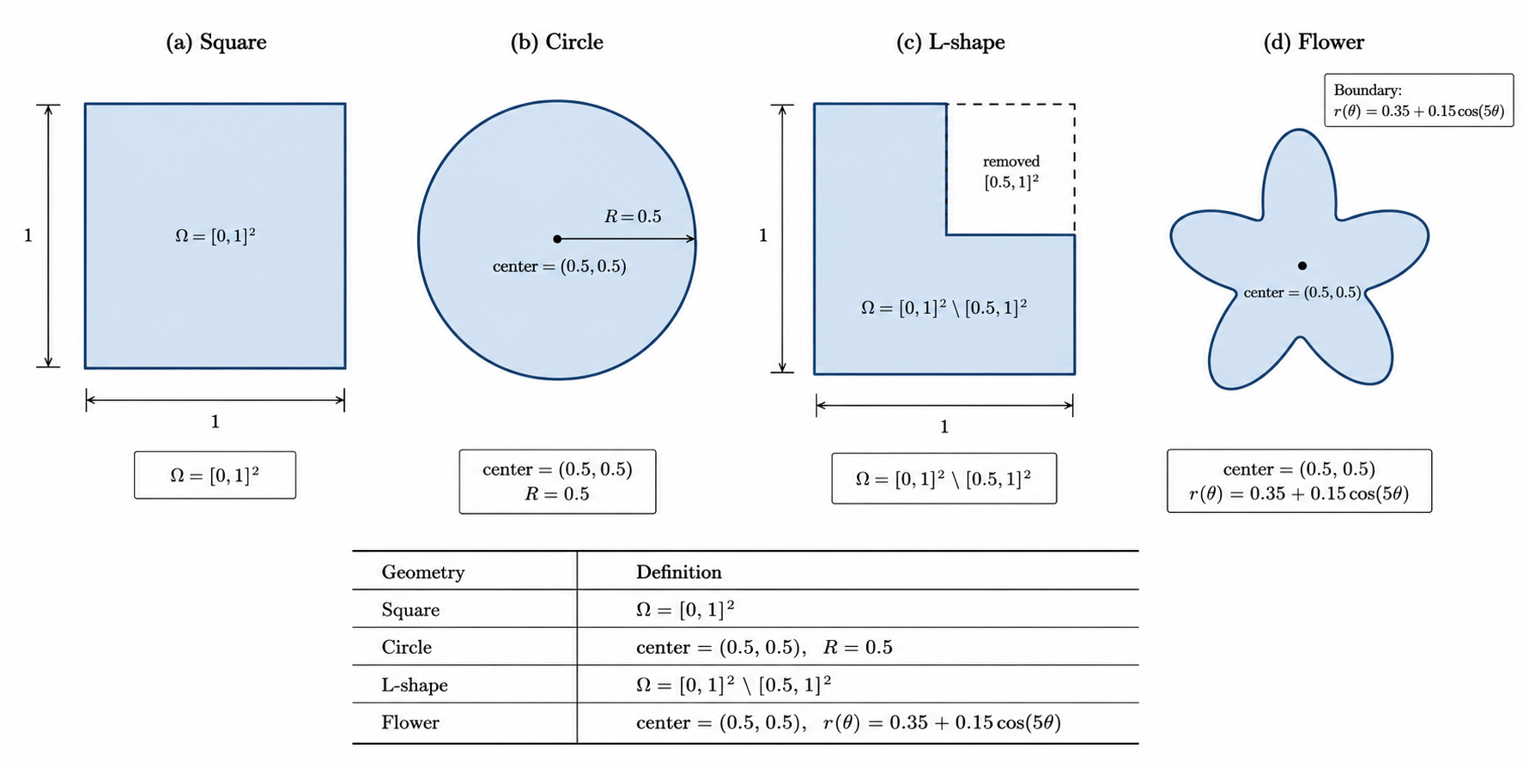
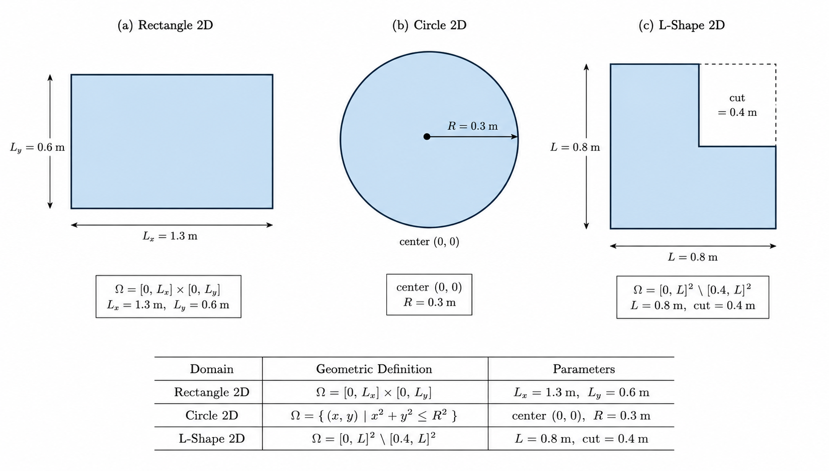
Benchmark Domains: 2D Domain Groups
BENCHMARKS AND METRICS
Level 1: NAS transfer + adaptive-k
Level 2: canonical 2D fixed-k sweep
Domains: Square, Circle, L-Shape, Flower. Purpose: test NAS-PINN transfer architecture and our NAS-found architectures under adaptive-k. Values: T0=540 C, Tw=20 C, h=5000, kT=160.
Domains: Rectangle, Circle, L-Shape. Purpose: compare Bayesian/TPE, NSGA-II and NSGA-III over k=1...5. Values: T0=540 C, Tw=20 C, h=5000, kT=150.
UiA | University of Agder
Master Thesis Defense
23

Slide 24
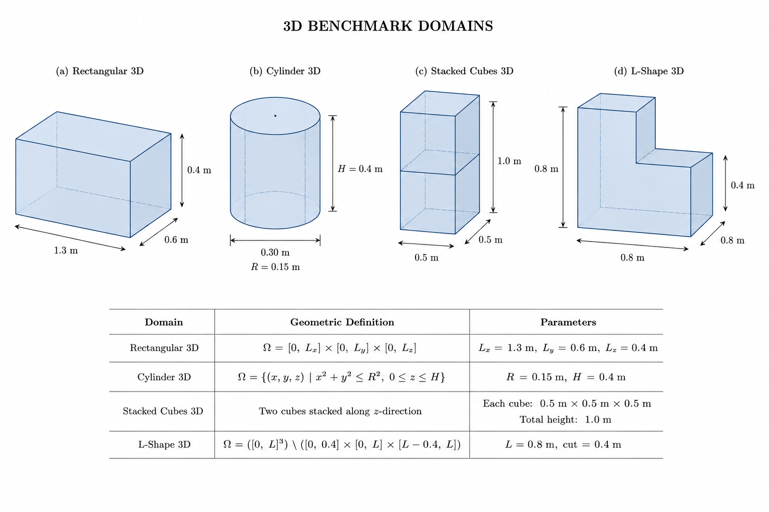
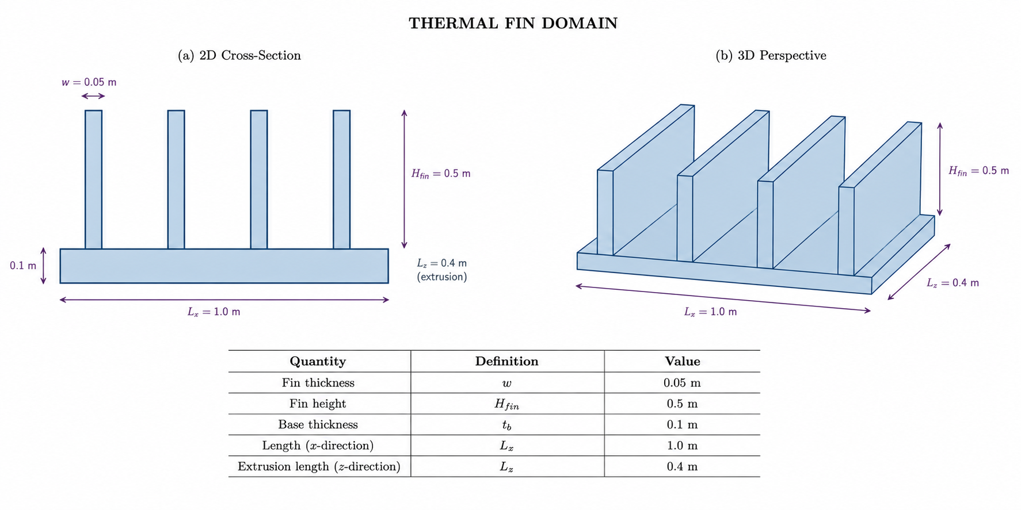
Benchmark Domains: 3D and Thermal Fin
BENCHMARKS AND METRICS
Level 3: canonical 3D
Level 4: Thermal Fin
Rectangular, Cylinder, Stacked Cubes and L-Shape Prism test whether the method remains stable when geometric complexity increases.
Thermal Fin is the most demanding benchmark; it tests anchoring, architecture capacity and Fourier features under sharp local gradients.
UiA | University of Agder
Master Thesis Defense
24

Slide 25
Evaluation Metrics
BENCHMARKS AND METRICS
Mean Absolute Error (MAE)
MAE = (1/N) sum_i |T_i^PINN - T_i^FEM|
Main accuracy metric. It is reported as mean-window MAE over the prediction windows.
How I read the numbers
MAE: average temperature error in deg C.
Relative L2: spatial field quality at 30 s.
R(k): saved FEM solver calls.
Together, they show the trade-off between accuracy and computational cost.
Relative L2 Error
Rel. L2 = ||T_hat - T_FEM||_2 / ||T_FEM - T_w||_2
Full-field error, normalised by the temperature change above the water bath. Here T_w = 20 deg C.
Important note from the report
Final-window MAE alone can be misleading in PINN-only tests.
Near 30 s, the field naturally moves toward the water temperature.
So the mean-window MAE is used as the primary metric.
FEM Anchor Reduction
R(k) = (1 - N_win(k)/20) x 100%
Efficiency metric. It shows how many FEM anchor calls are saved when the PINN predicts longer windows.
Source: Chapter 3, Evaluation Metrics.
UiA | University of Agder
Master Thesis Defense
25

Slide 26
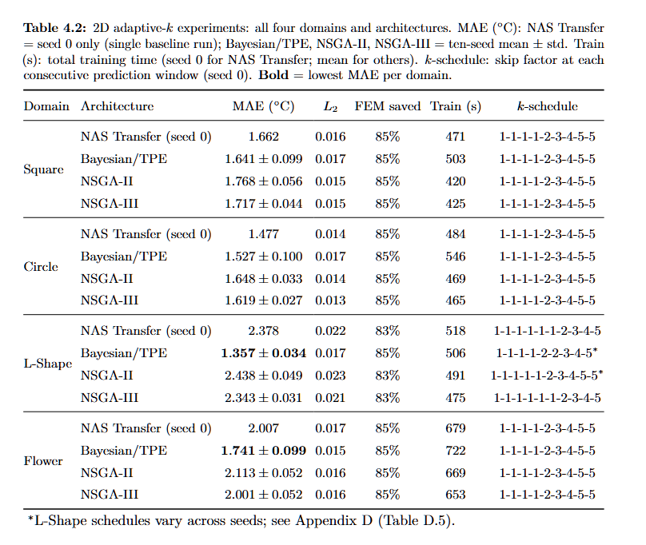
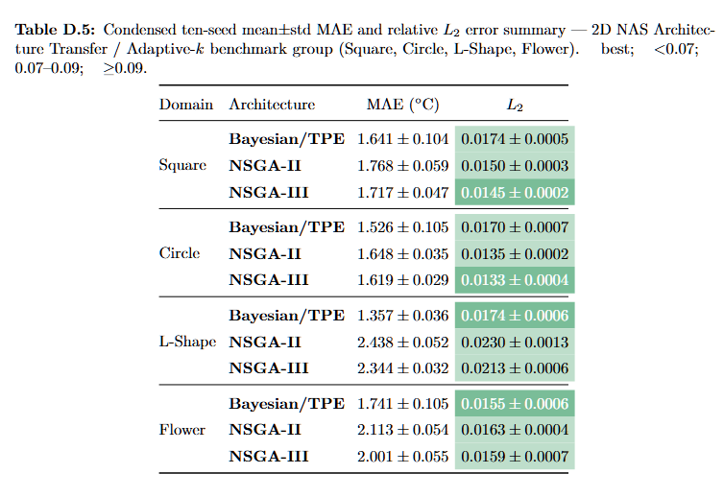
2D Adaptive-k: MAE and L2 Summary
RESULTS
MAE
L2
Key result
Average Celsius error over windows. It answers: how large is the temperature error on average?
Relative field error at t=30 s. It answers: is the full spatial field close to FEM?
Low MAE and low L2: adaptive-k saves FEM calls without losing field quality.
UiA | University of Agder
Master Thesis Defense
26

Slide 27
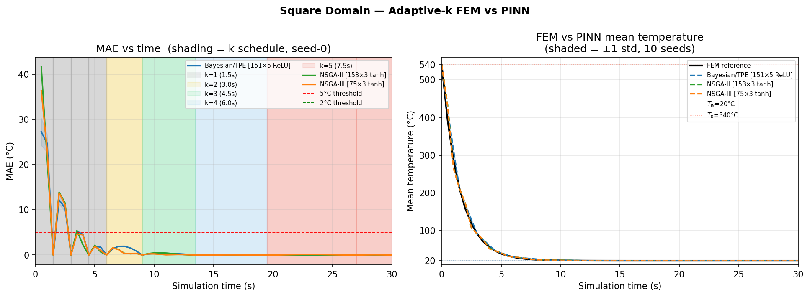
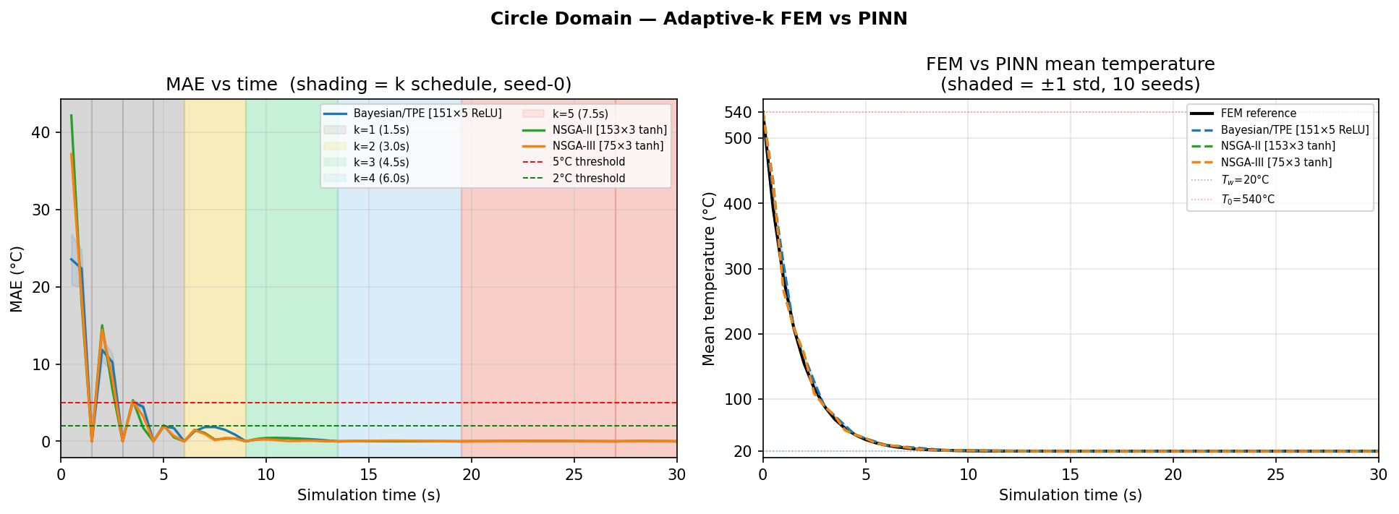
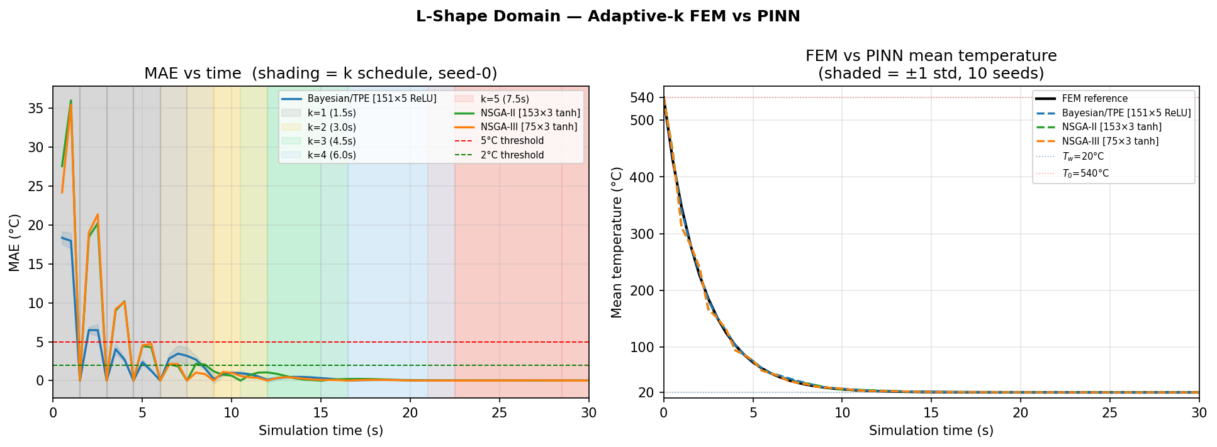
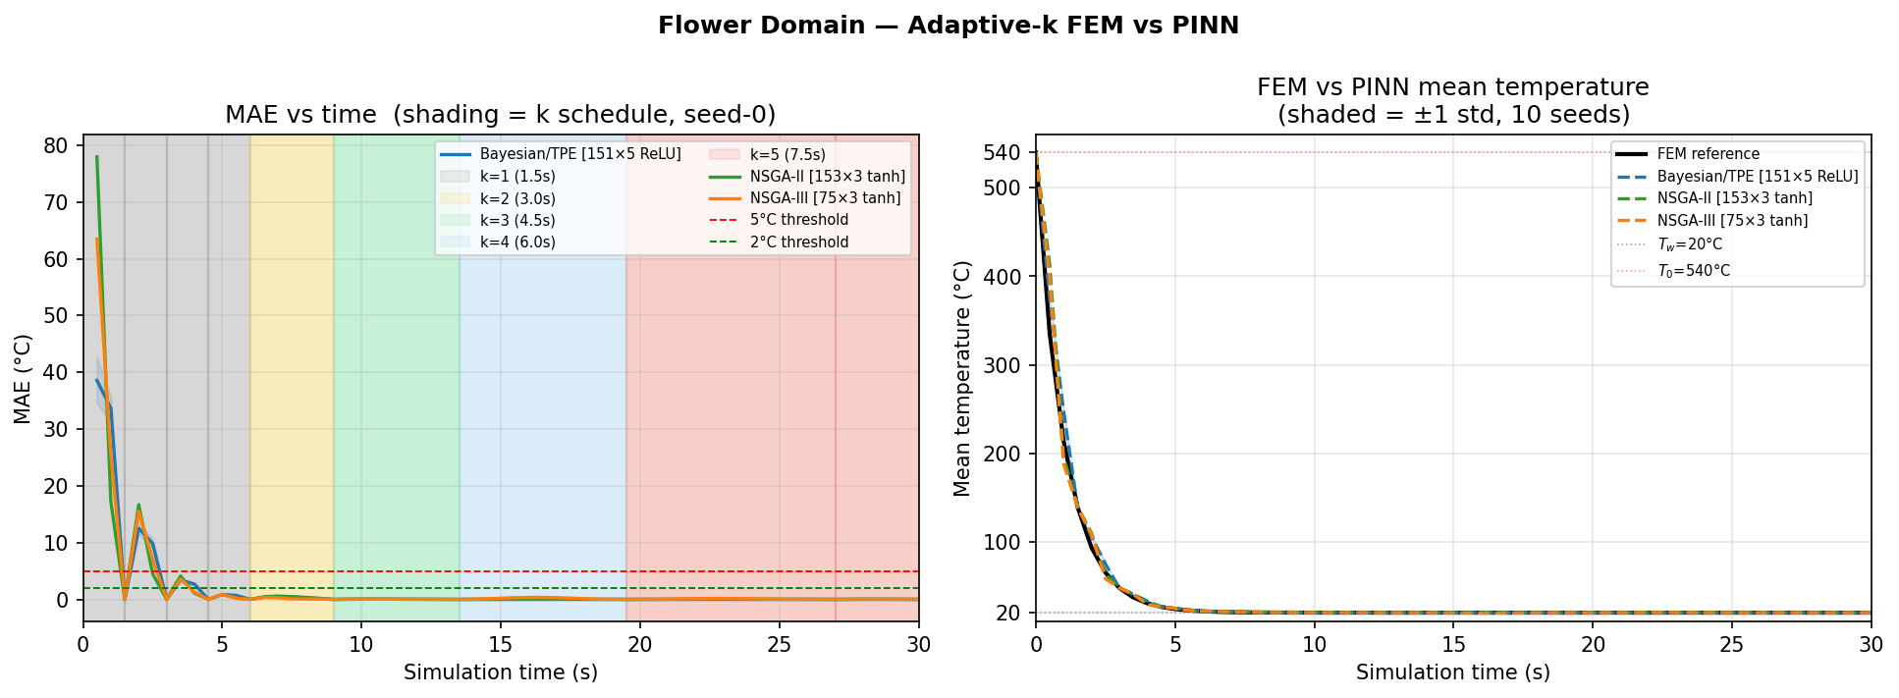
2D Adaptive-k: Figure 4.1 FEM-PINN Curves
RESULTS
What I found
Why it happens
Result link
FEM and PINN curves are close. Error is highest in early windows.
Early cooling has steep gradients. Complex boundaries make local errors harder.
I use this to explain why adaptive-k works and why L2 stays low.
UiA | University of Agder
Master Thesis Defense
27

Slide 28
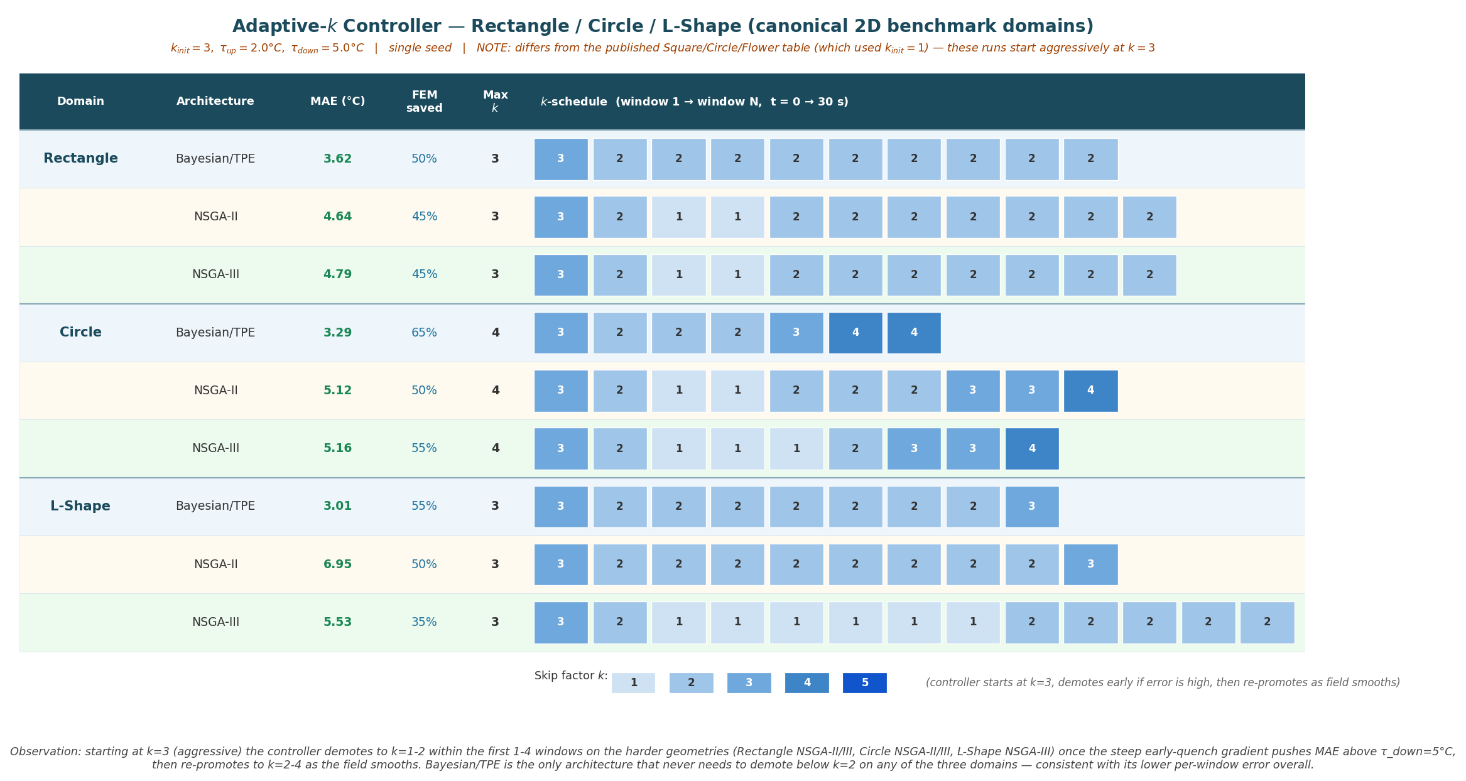
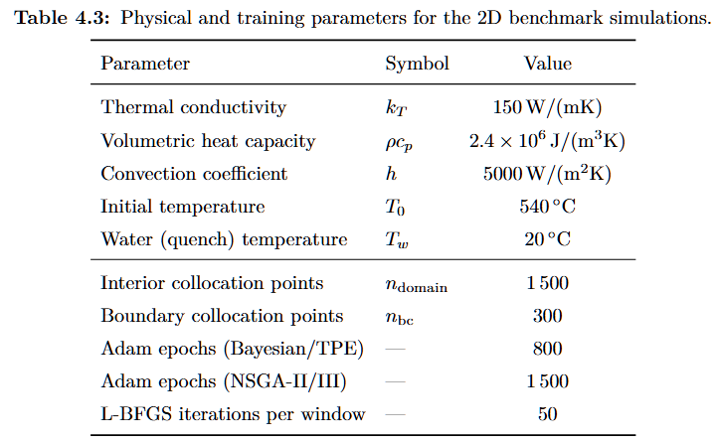
Canonical 2D: Setup and Adaptive-k Schedule
RESULTS
Why this helps
The setup gives the experiment rules. The schedule table shows when FEM calls are skipped. Read them together before judging MAE and L2.
UiA | University of Agder
Master Thesis Defense
28

Slide 29
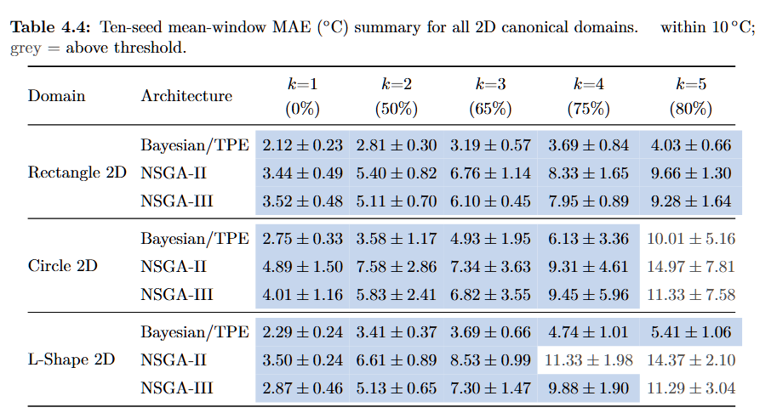
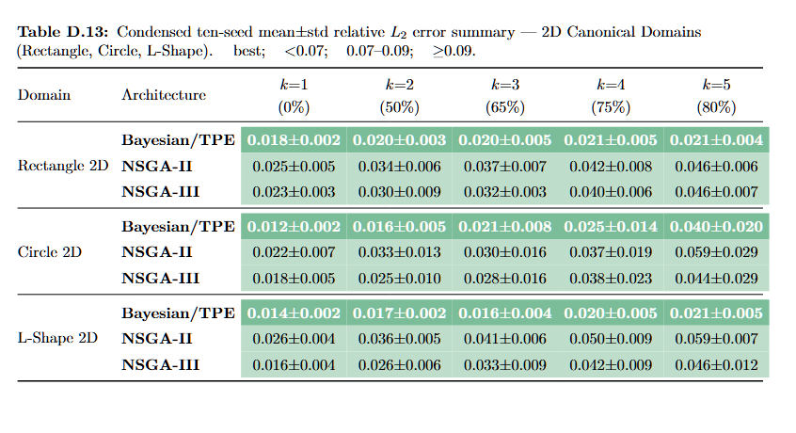
Canonical 2D: MAE and L2 Summary
RESULTS
MAE
L2
Key result
Average error across windows. It is the engineering temperature error.
Field error at t=30 s. It checks if the full temperature map is right.
Bayesian/TPE stays strongest; high k is harder for complex geometry.
UiA | University of Agder
Master Thesis Defense
29

Slide 30
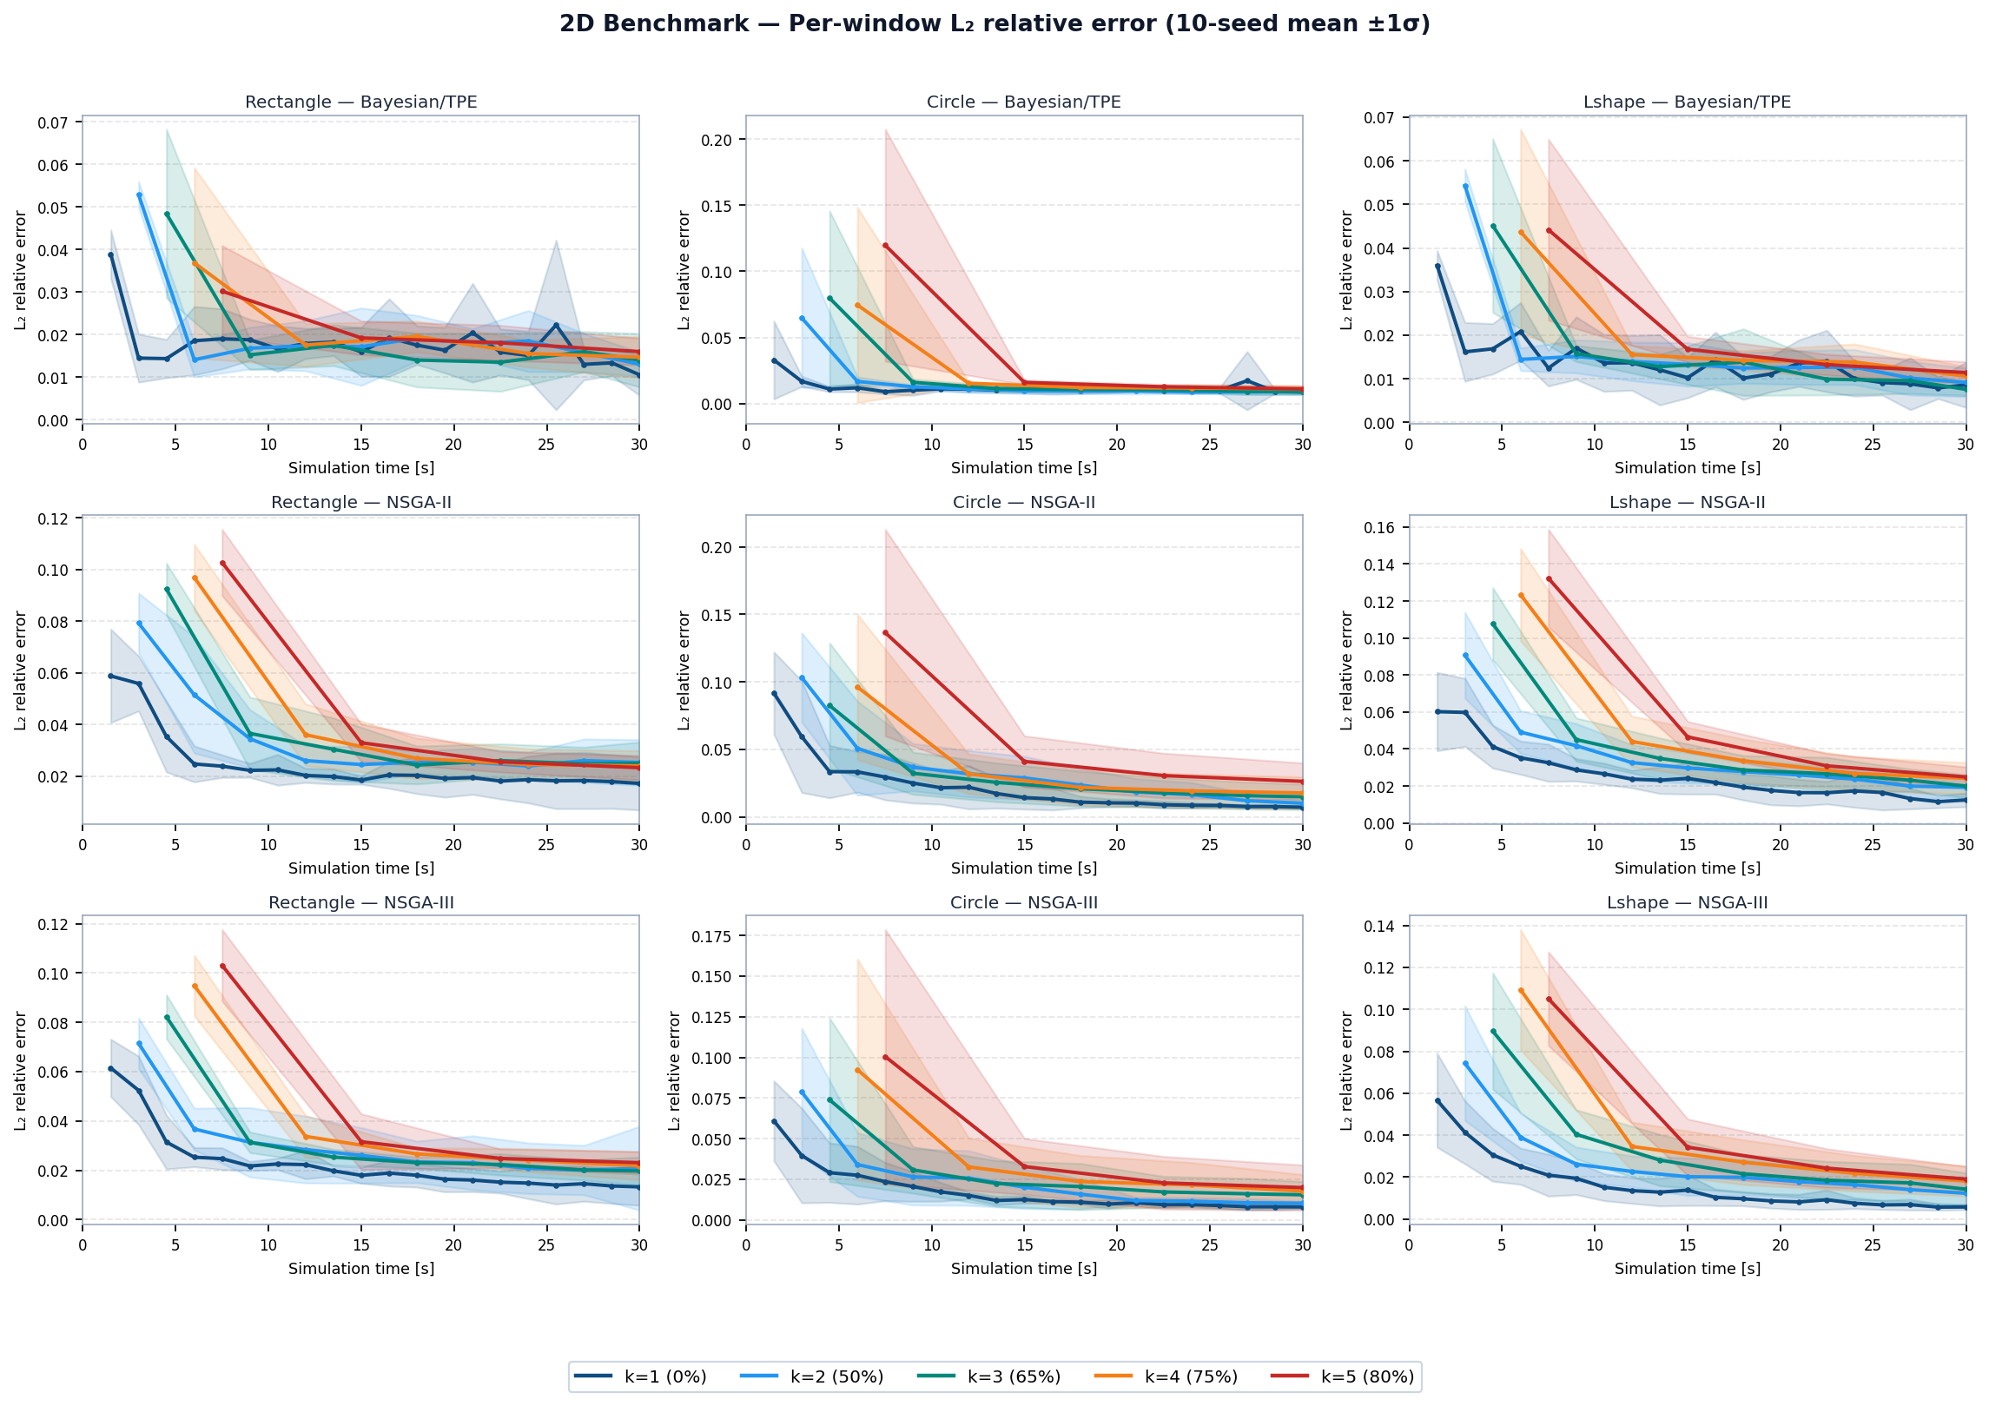
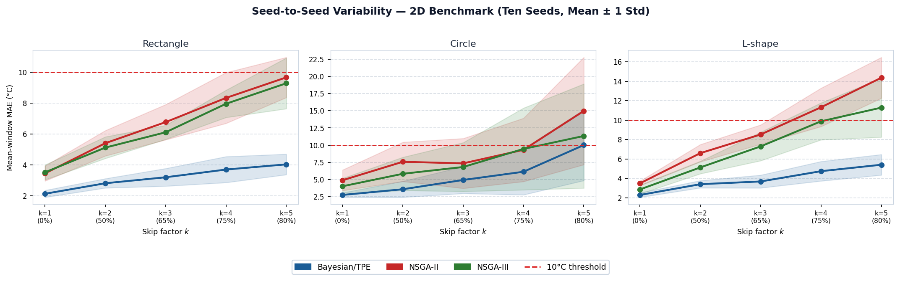
Canonical 2D: MAE Variability and L2 Curves
RESULTS
MAE graph
L2 graph
Together
Shows mean error and seed stability.
Shows full-field error over time.
Bayesian/TPE is robust; early windows are hardest.
UiA | University of Agder
Master Thesis Defense
30

Slide 31
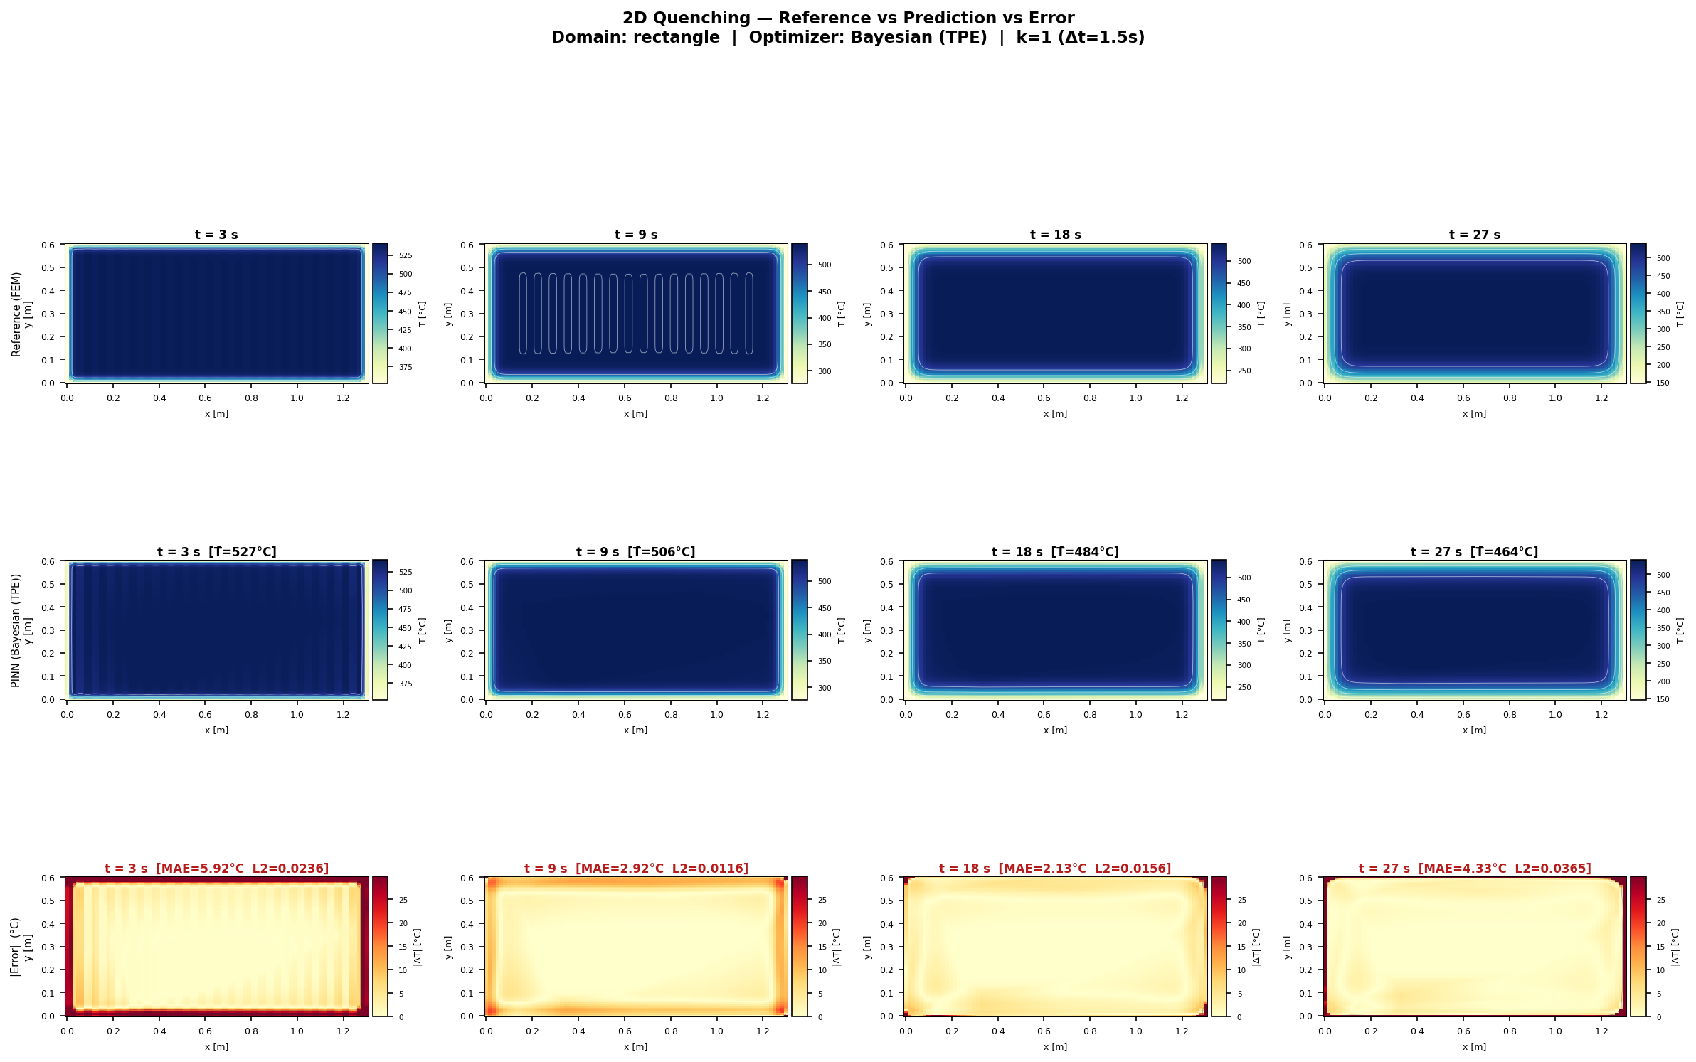
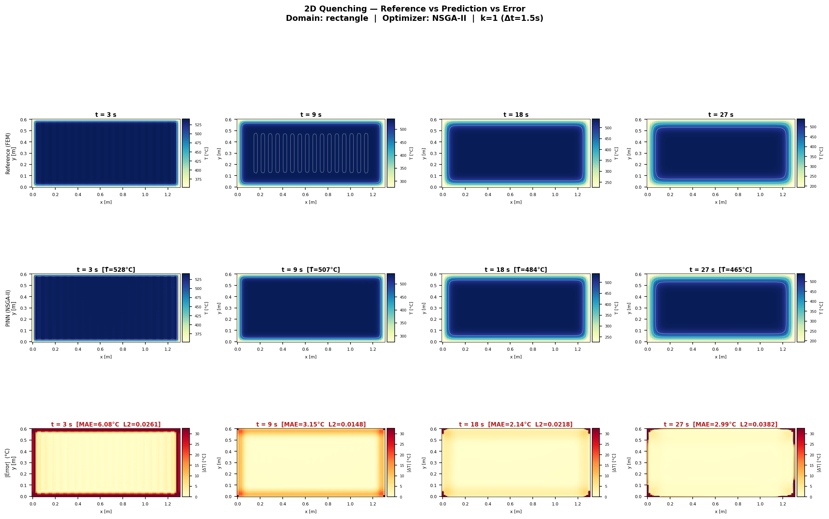
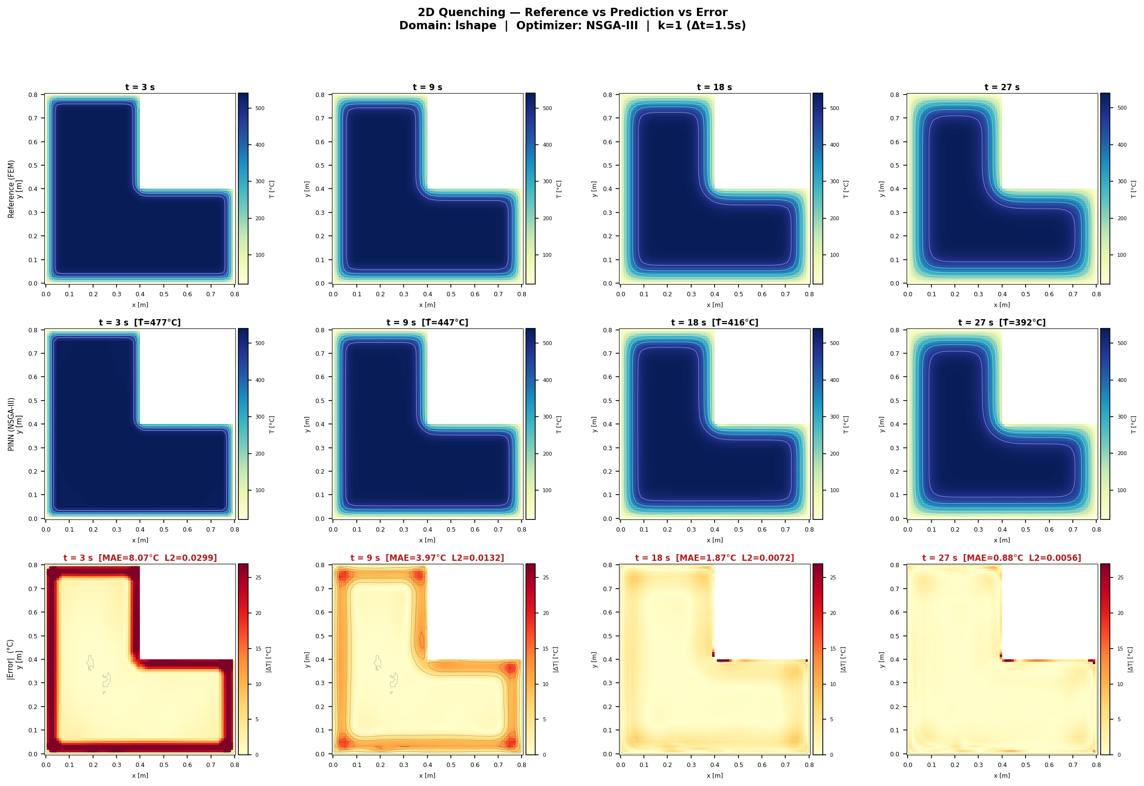
Canonical 2D Heat Maps: Best Geometry per Architecture
RESULTS
Why these?
How to read
Message
One best representative geometry per architecture.
MAE tells average error; heat map shows where the field error appears.
The best visual cases still need L2/MAE support.
UiA | University of Agder
Master Thesis Defense
31

Slide 32
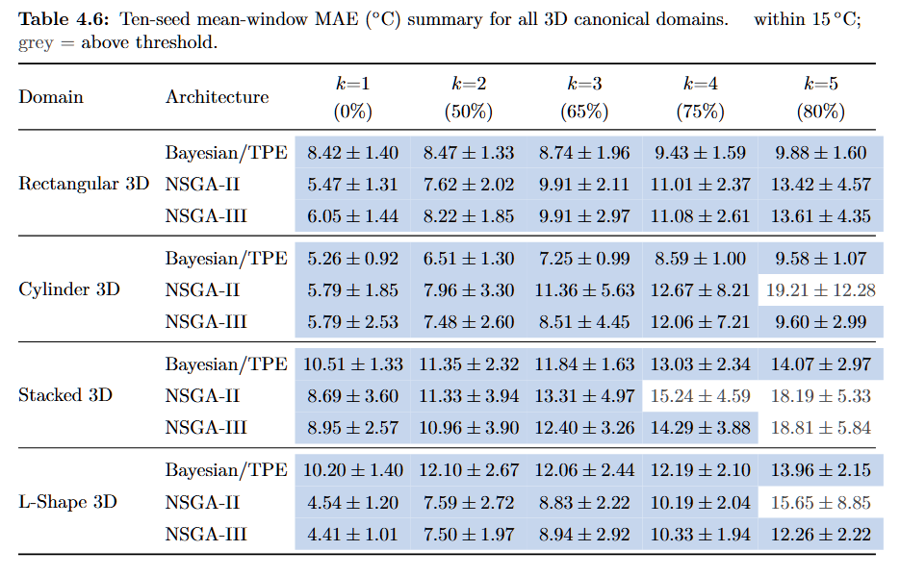
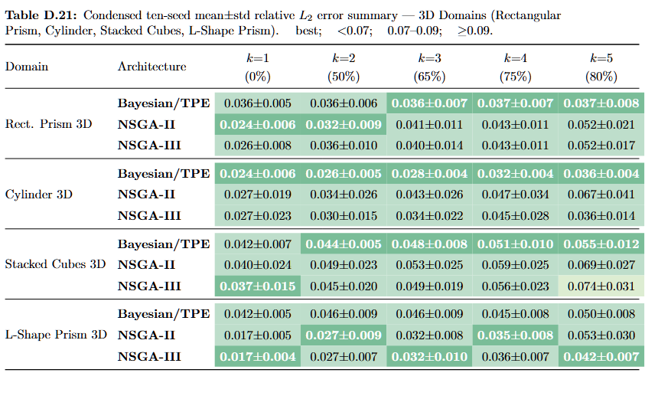
3D Results: MAE and L2 Summary
RESULTS
MAE
L2
Key result
Average Celsius error over 3D windows. Lower is better.
Field error at t=30 s. It checks the 3D temperature volume.
Bayesian/TPE is robust, but curved and stacked geometries are harder.
UiA | University of Agder
Master Thesis Defense
32

Slide 33
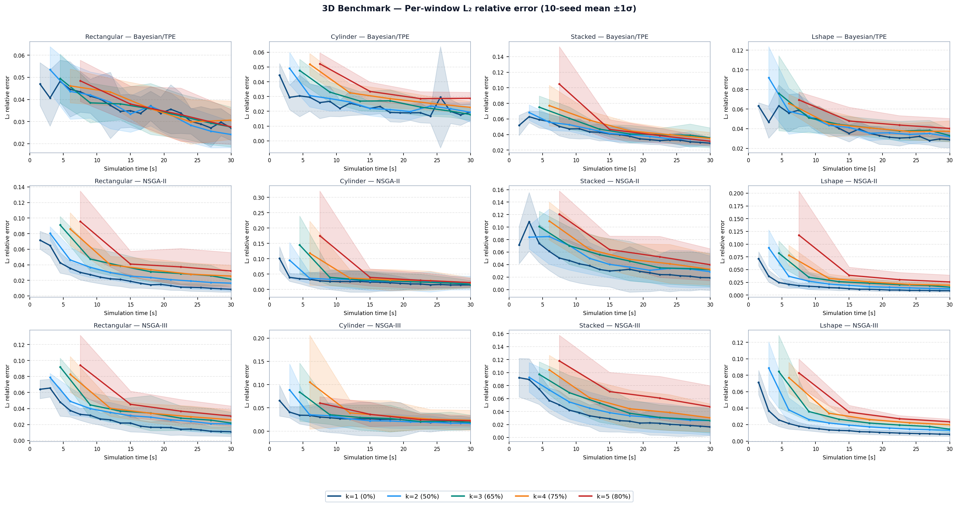
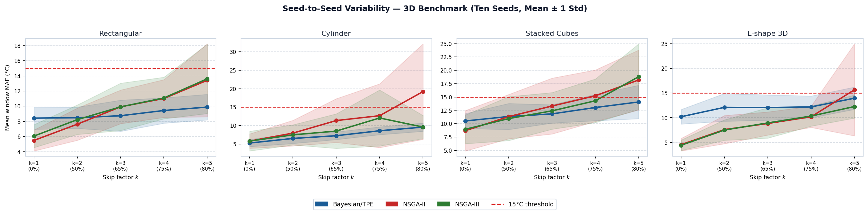
3D Results: MAE Variability and L2 Curves
RESULTS
MAE graph
L2 graph
Together
Shows seed sensitivity for each 3D geometry.
Shows field error during the 30 s quench.
3D difficulty is geometry-dependent.
UiA | University of Agder
Master Thesis Defense
33

Slide 34
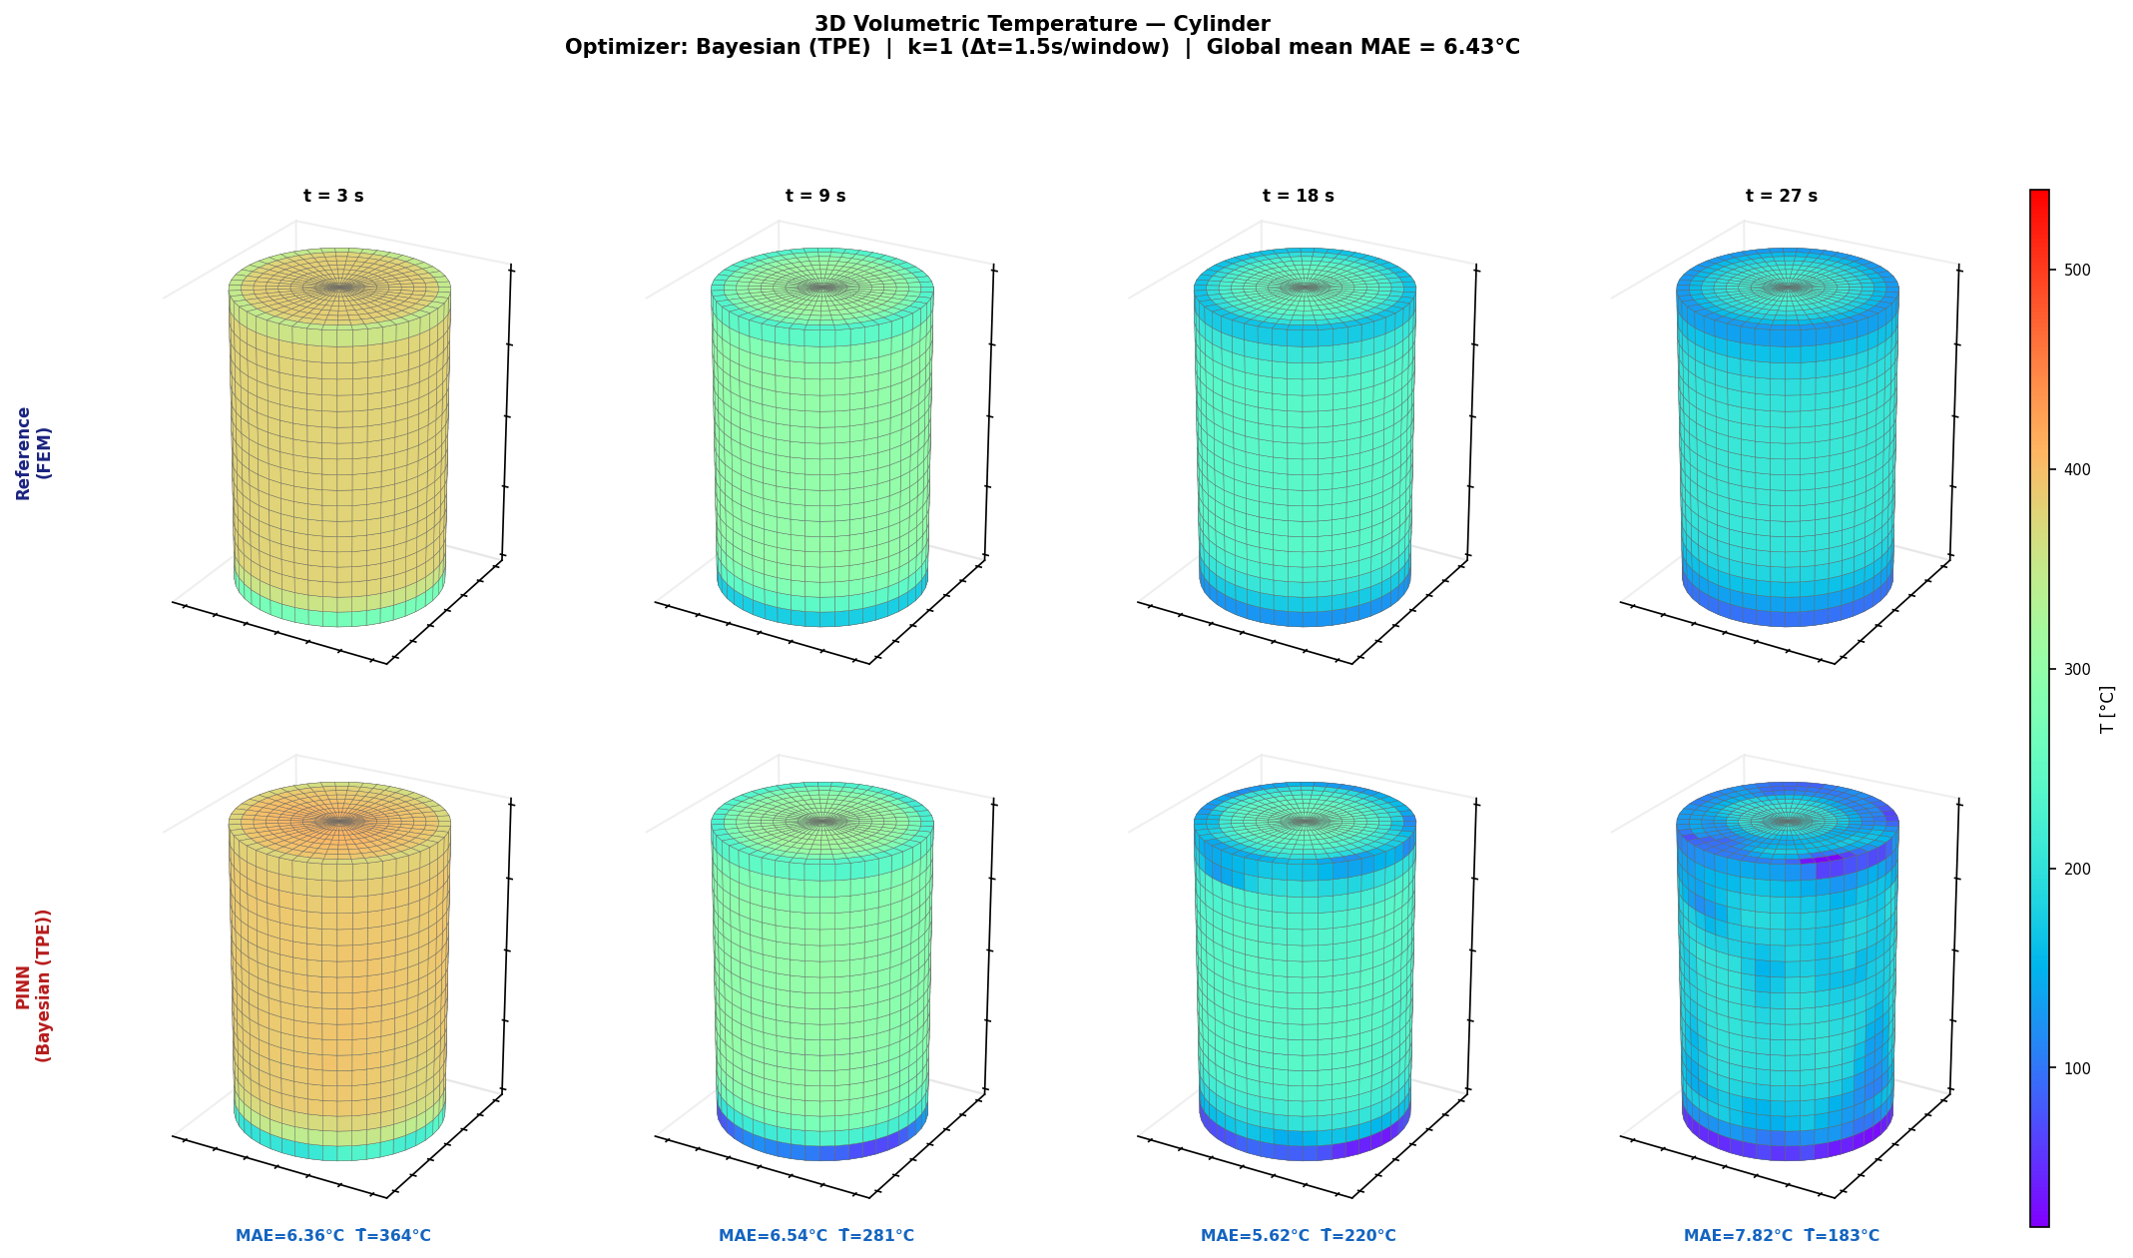
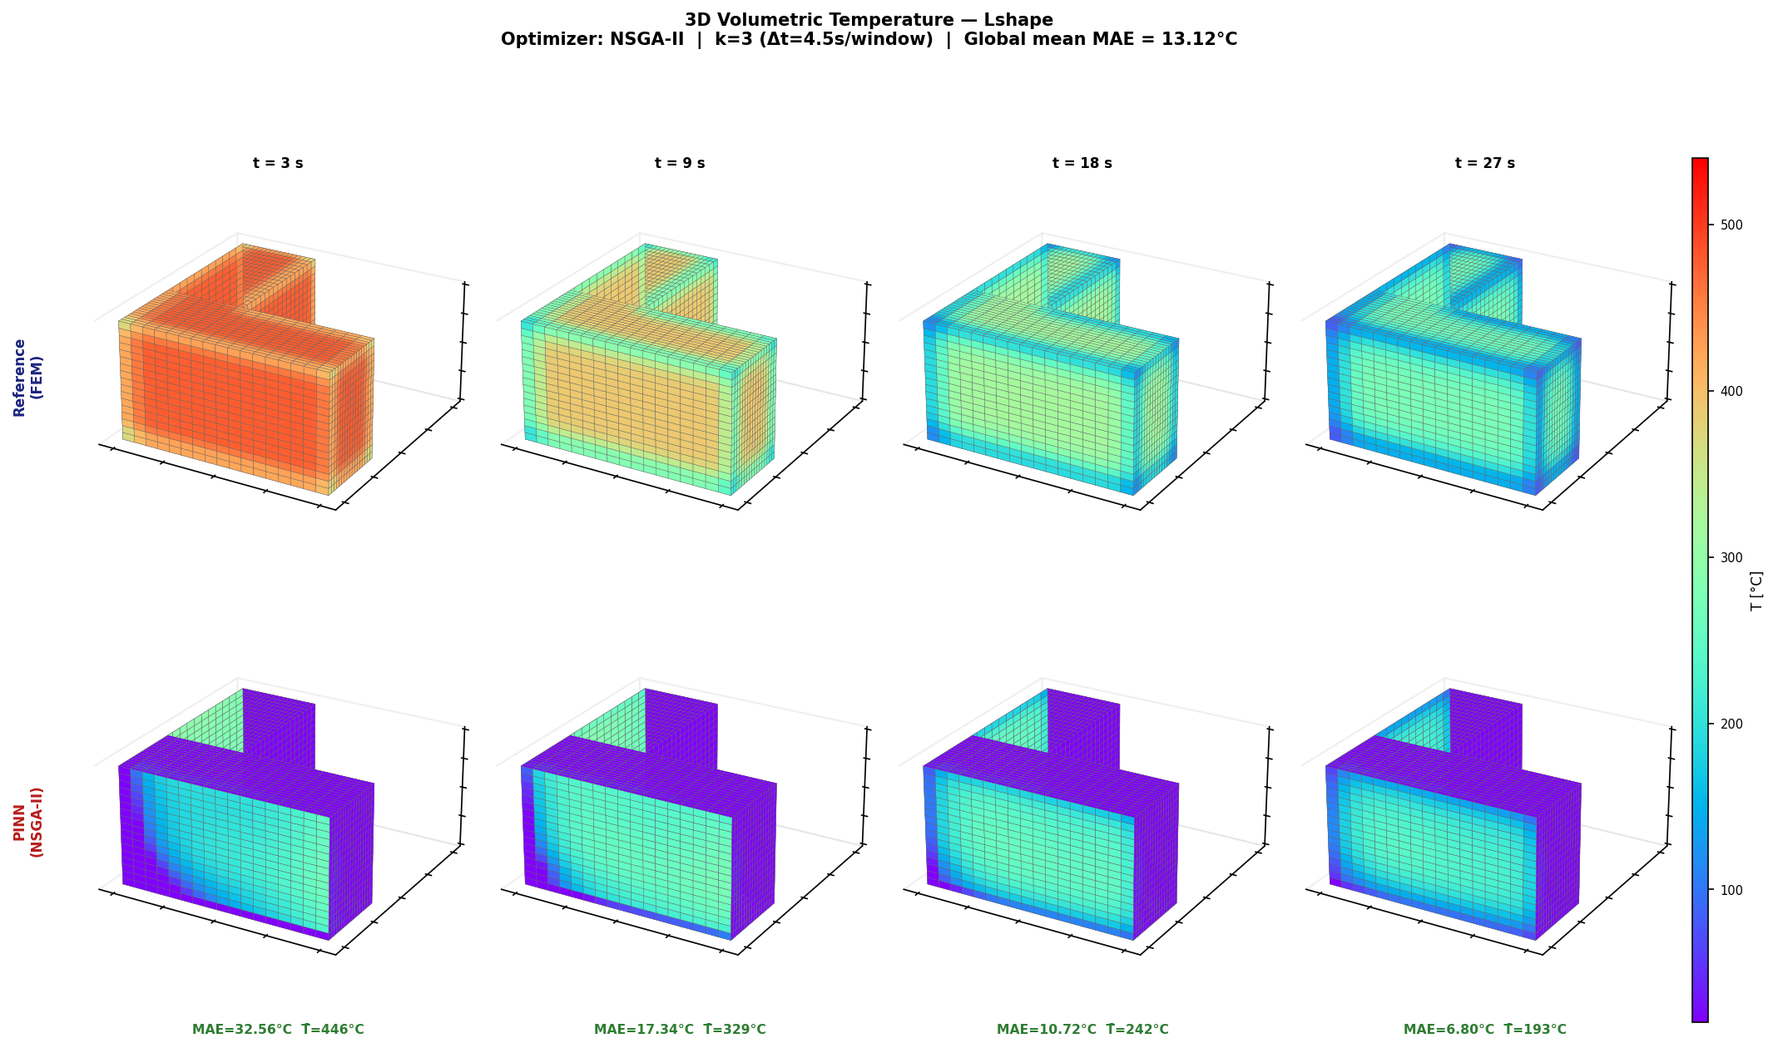
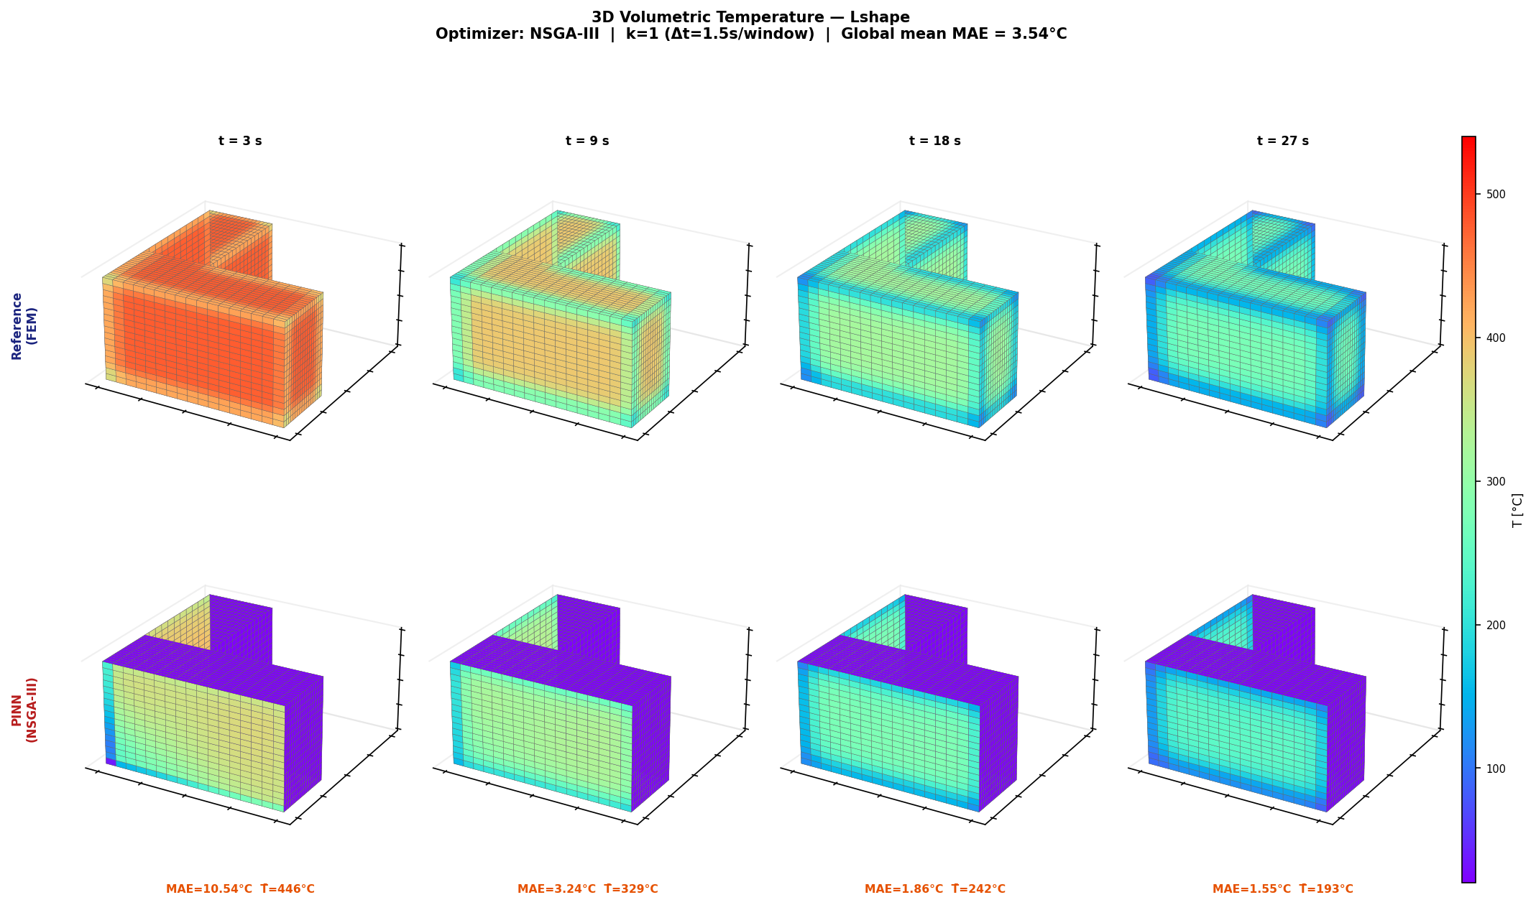
Canonical 3D Heat Maps: Best Geometry per Architecture
RESULTS
Why these?
How to read
Message
One strong 3D visual case per architecture.
Volumetric maps show geometry-specific field behaviour.
3D accuracy depends strongly on geometry.
UiA | University of Agder
Master Thesis Defense
34

Slide 35
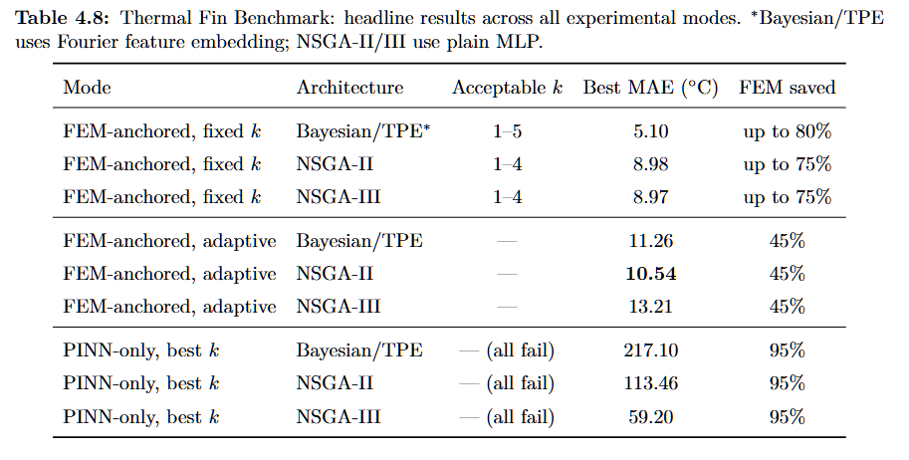
Thermal Fin: MAE and L2 Summary
RESULTS
Architecture | k=1 | k=2 | k=3 | k=4 | k=5
Bayesian/TPE* | 0.049 | 0.053 | 0.062 | 0.070 | 0.080
NSGA-II | 0.054 | 0.064 | 0.070 | 0.077 | 0.082
NSGA-III | 0.057 | 0.066 | 0.071 | 0.077 | 0.085
Reading note
MAE = average Celsius error over windows. L2 = relative field error at t=30 s.
MAE
L2
Key result
Shows average thermal accuracy and FEM-saving trade-off.
Shows if the final temperature field shape is close to FEM.
Bayesian/TPE with Fourier has the best field accuracy.
UiA | University of Agder
Master Thesis Defense
35

Slide 36
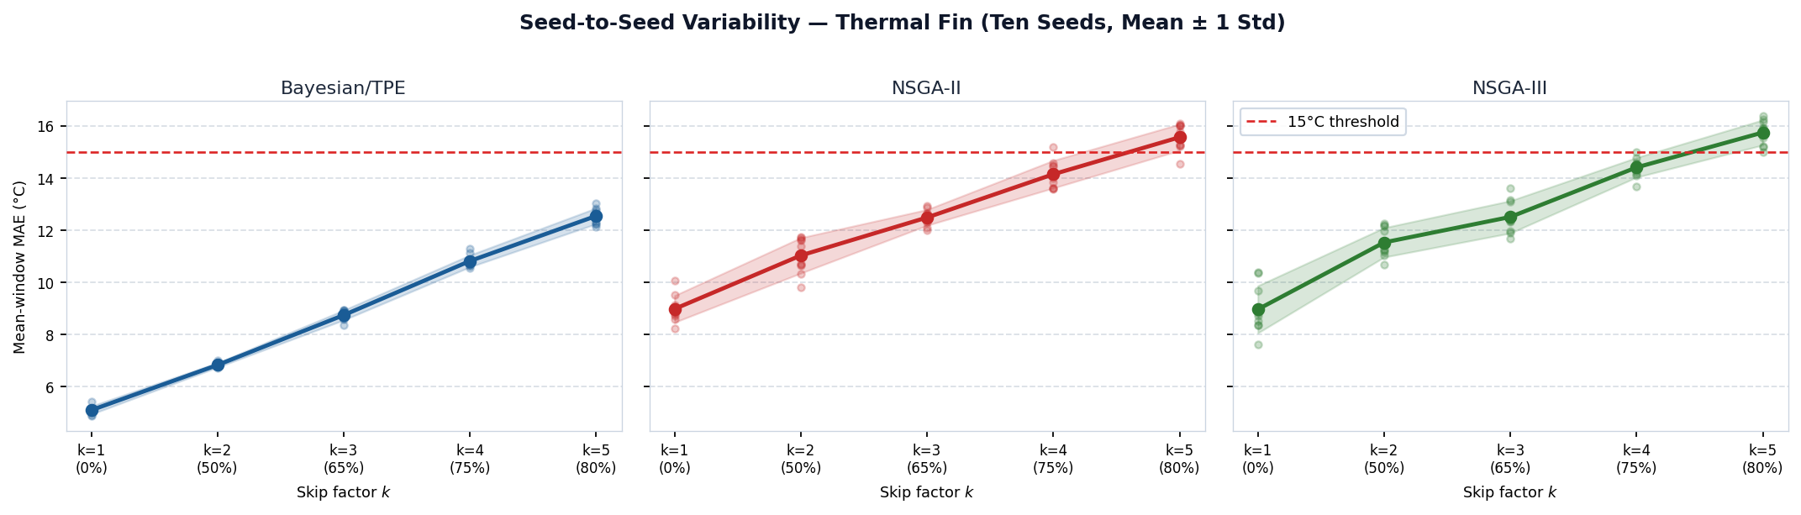
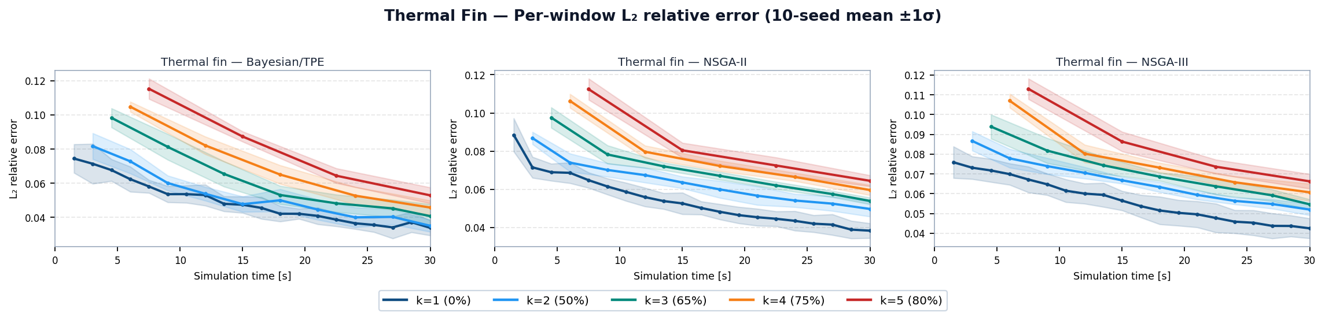
Thermal Fin: MAE Variability and L2 Curves
RESULTS
MAE graph
L2 graph
Together
Fourier makes Bayesian/TPE stable.
Higher k increases field error.
Good result, but FEM anchors are still needed.
UiA | University of Agder
Master Thesis Defense
36

Slide 37
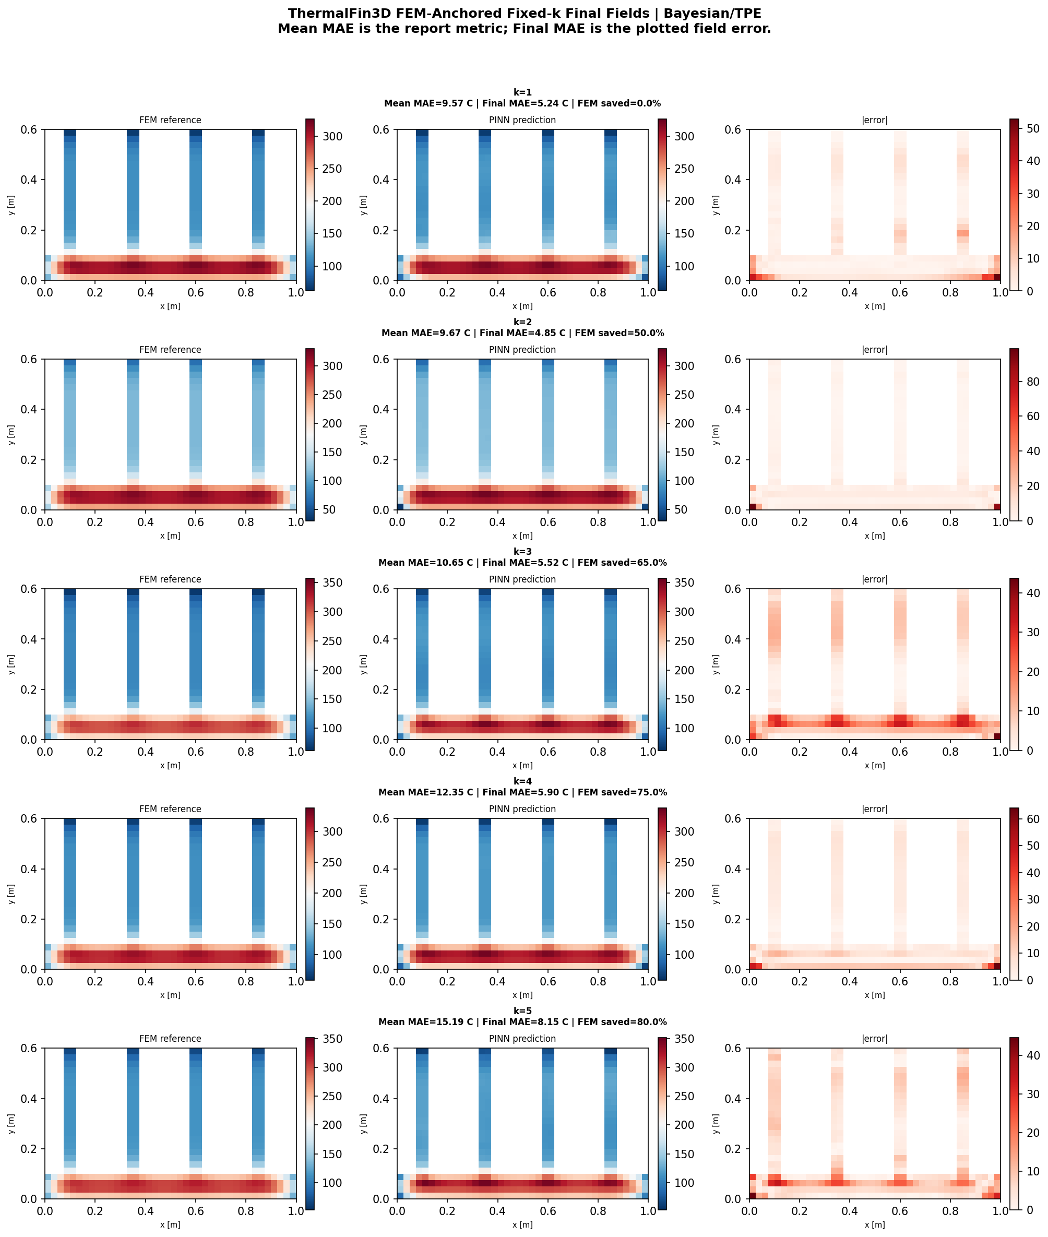
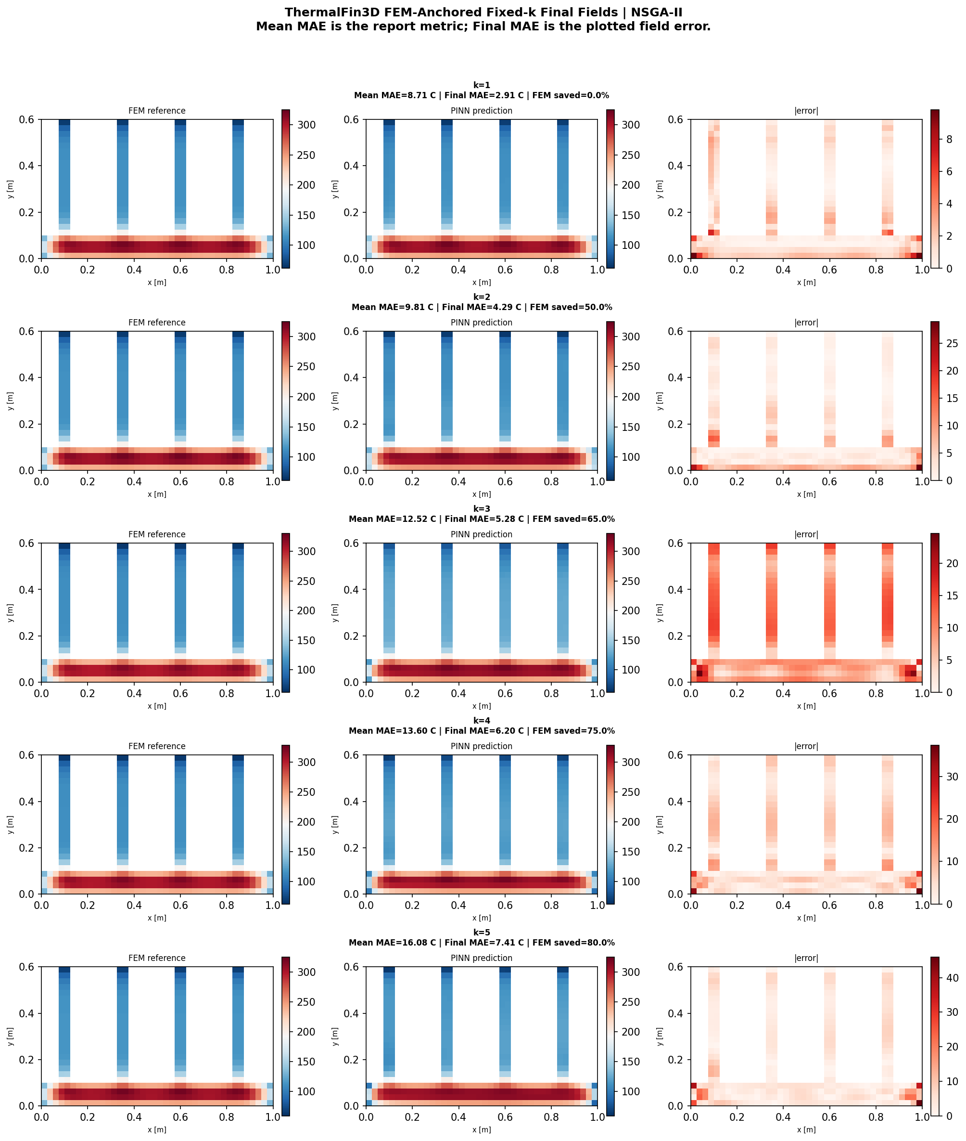
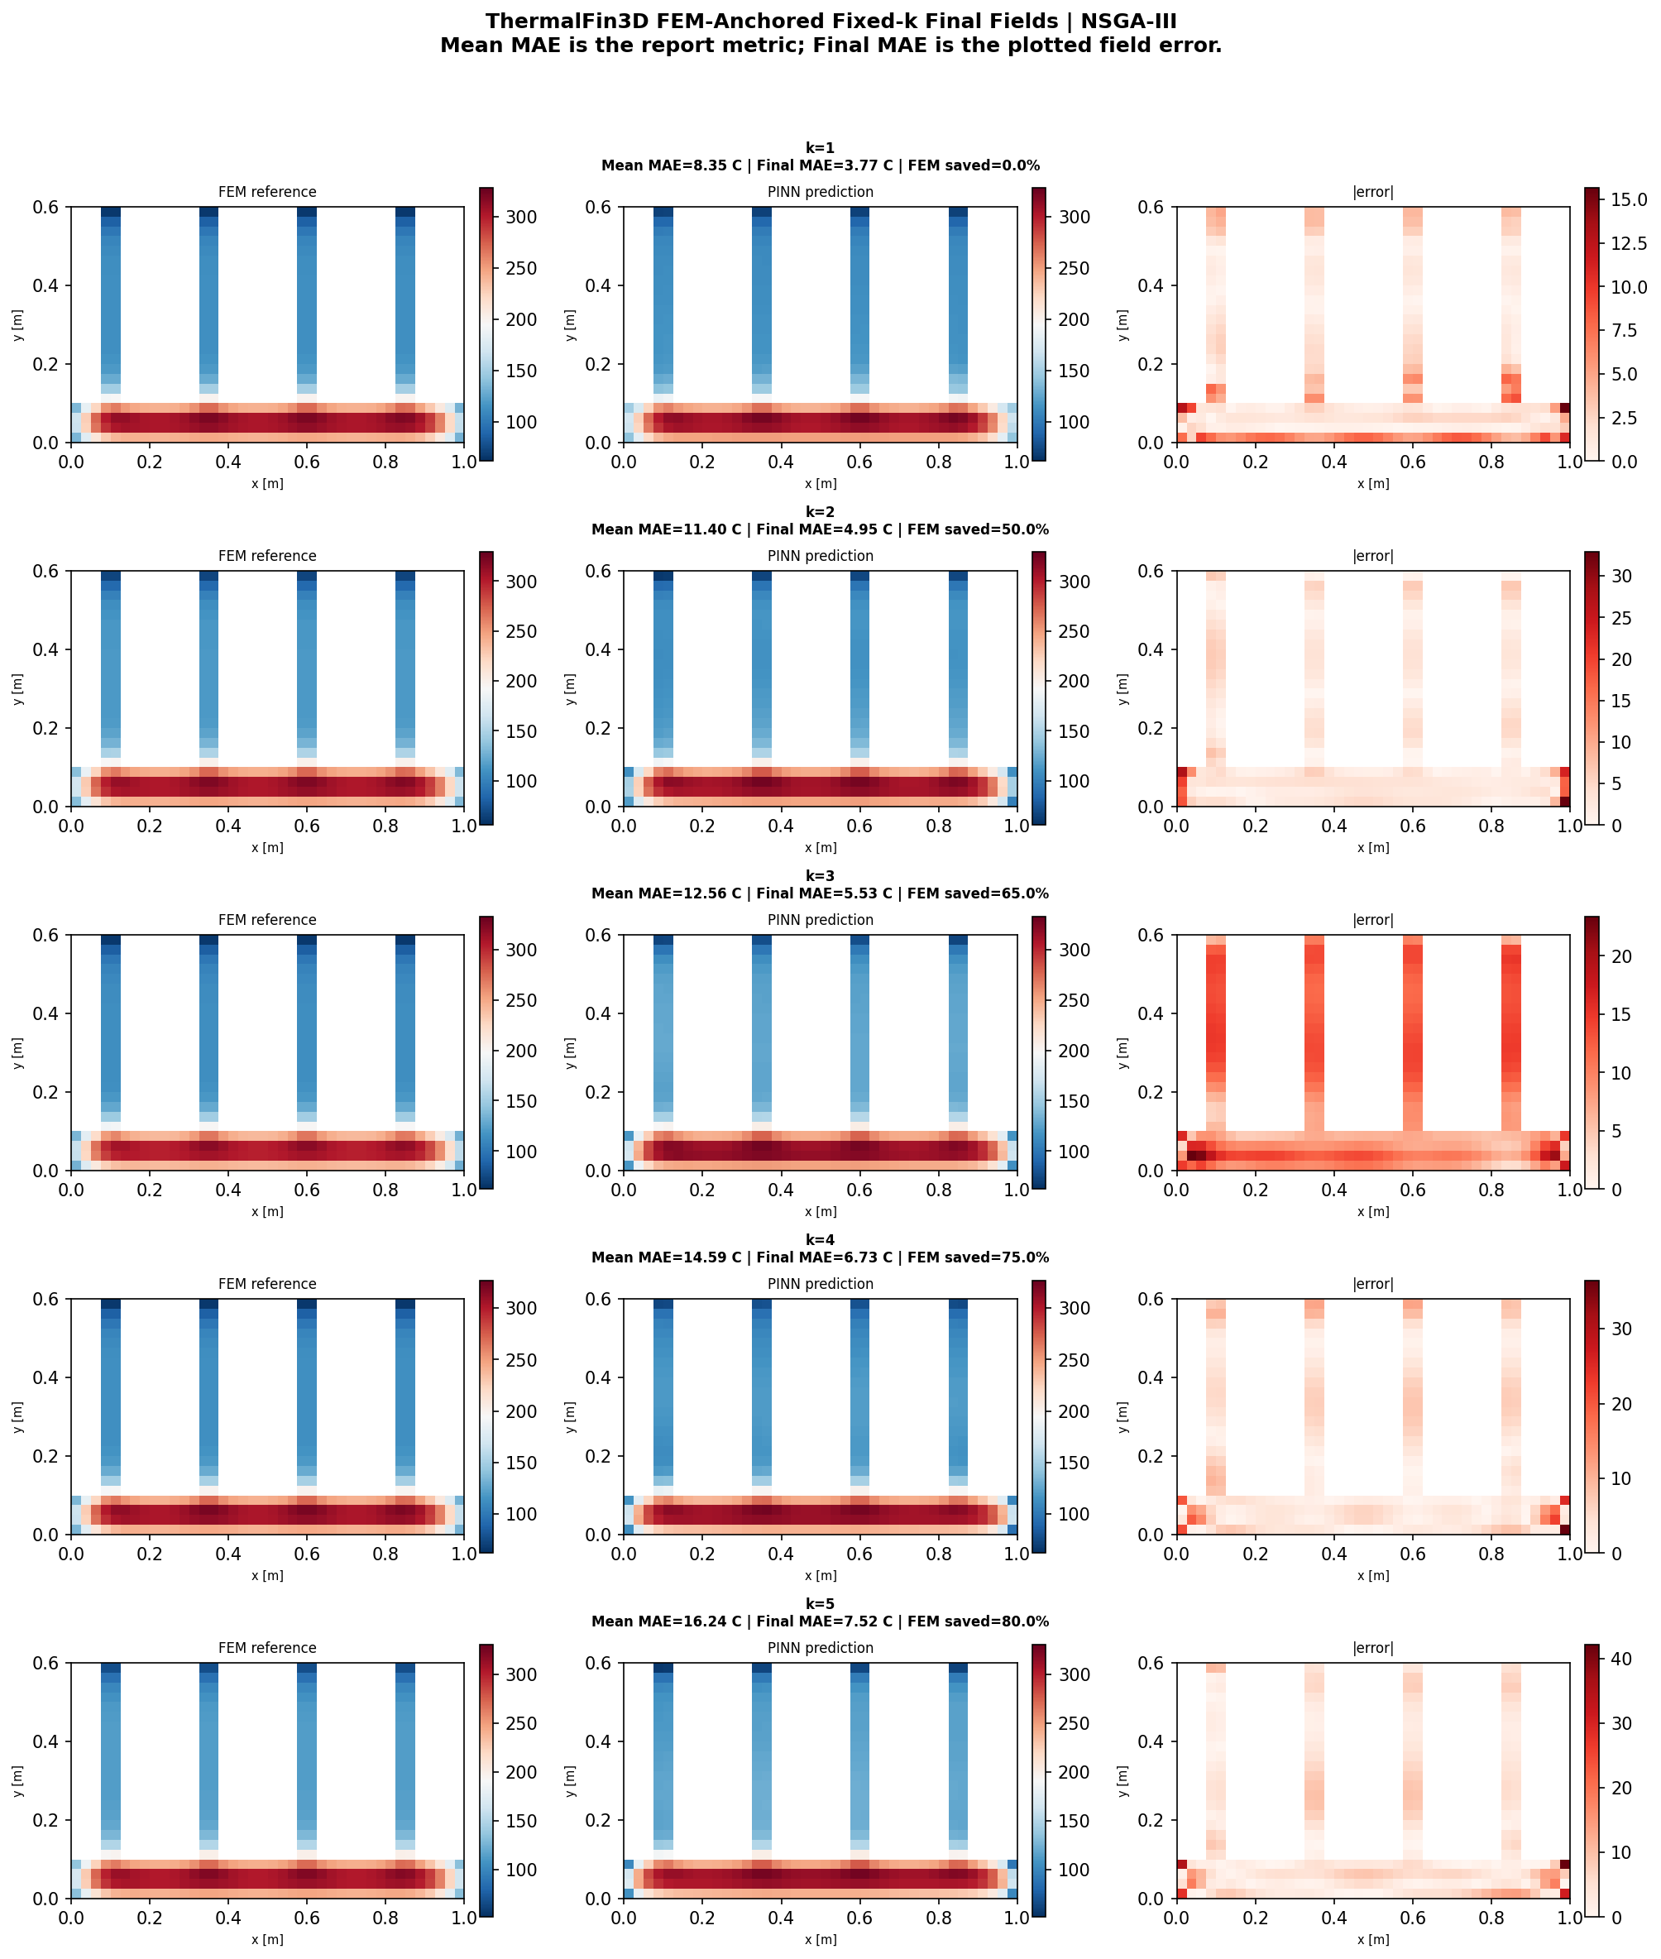
Thermal Fin: Fixed-k Heat Maps (2D)
RESULTS
Interpretation
These 2D cross-sections show that FEM anchoring keeps the error pattern local and controlled.
UiA | University of Agder
Master Thesis Defense
37

Slide 38
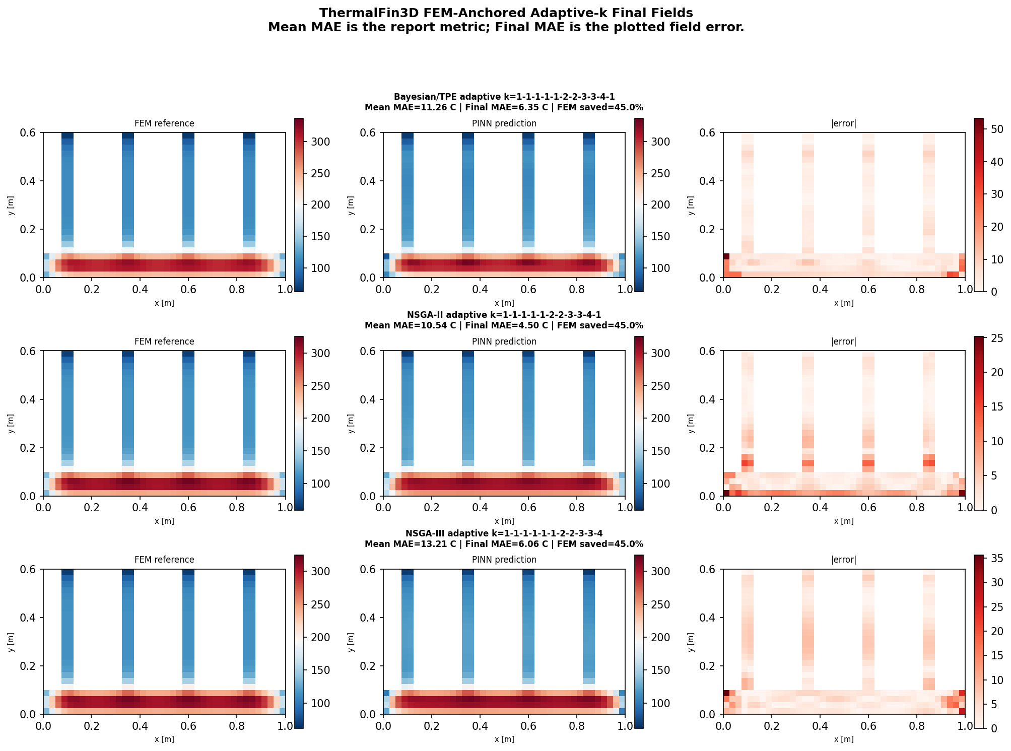
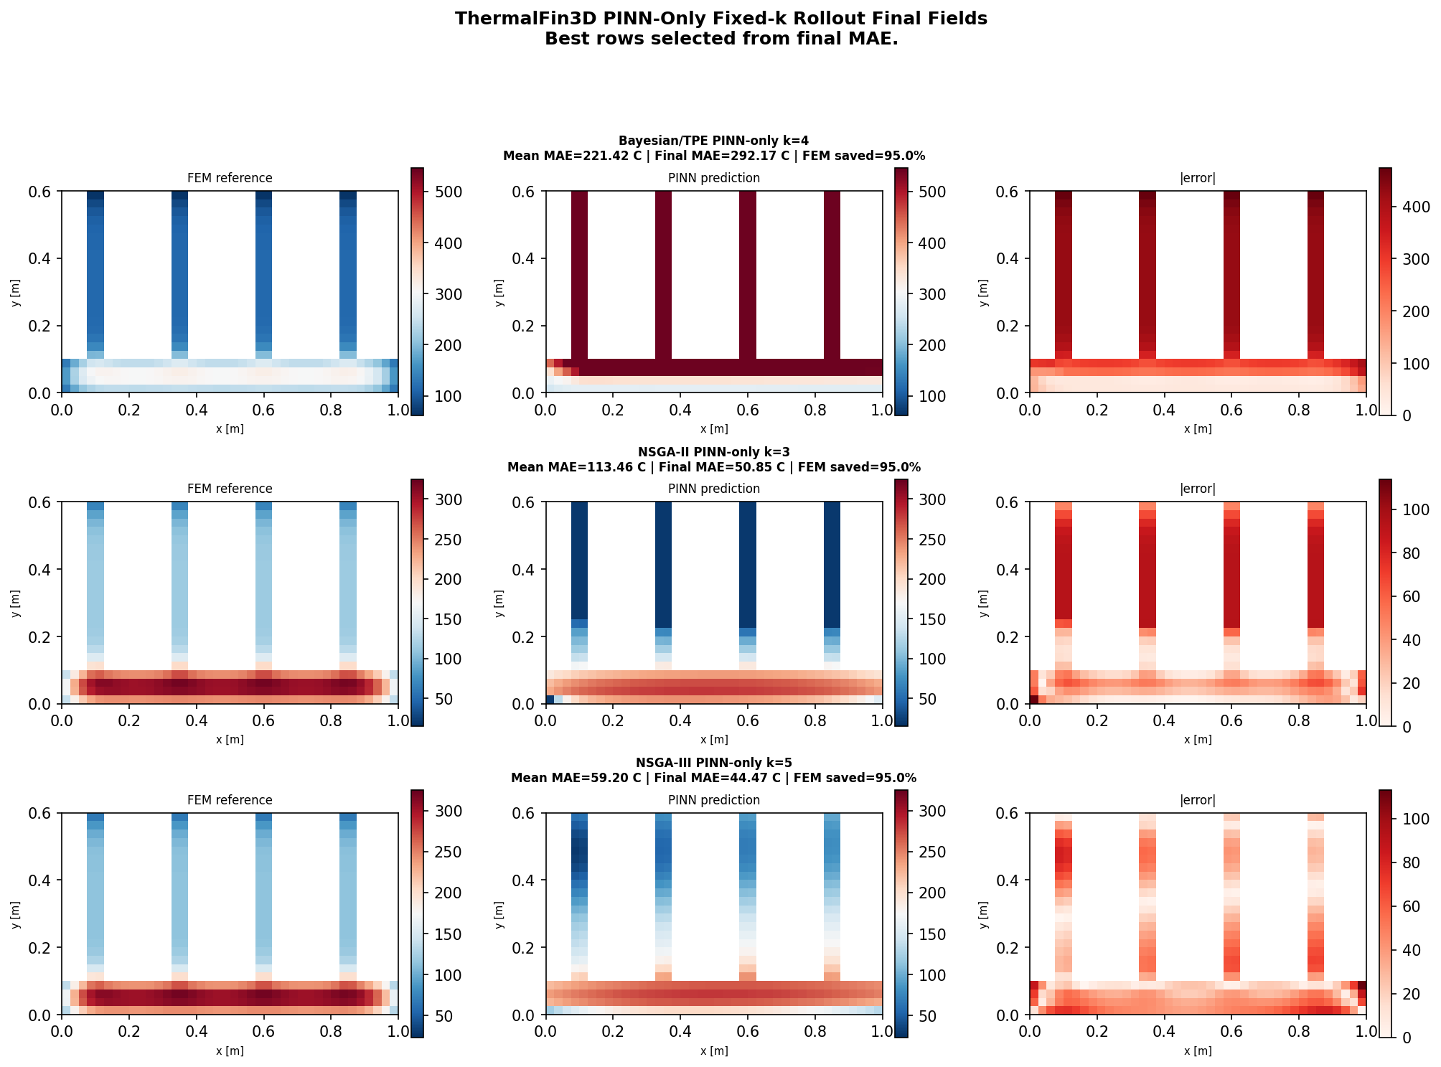
Thermal Fin: Adaptive vs PINN-only Heat Maps (2D)
RESULTS
With FEM anchors
Without FEM anchors
The field is corrected at window boundaries.
Errors accumulate and spread across the field.
UiA | University of Agder
Master Thesis Defense
38

Slide 39
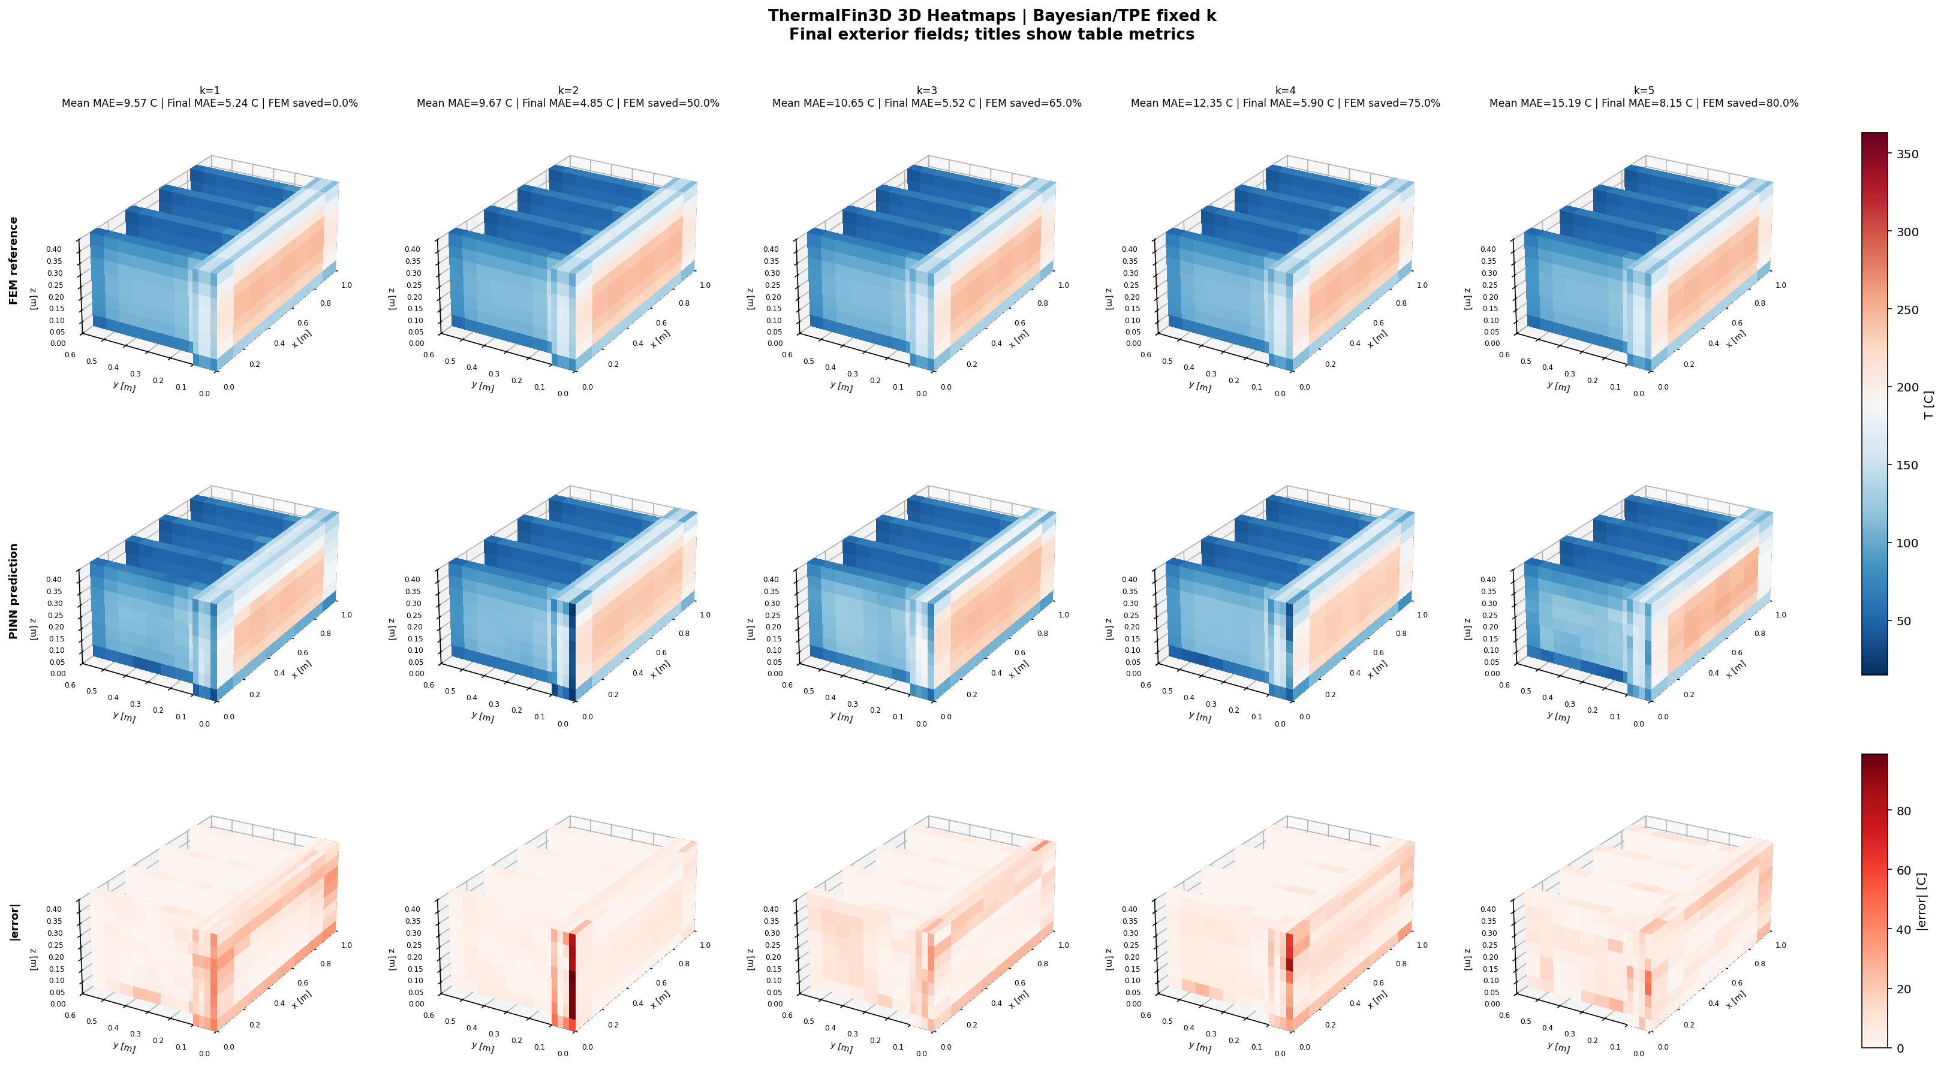
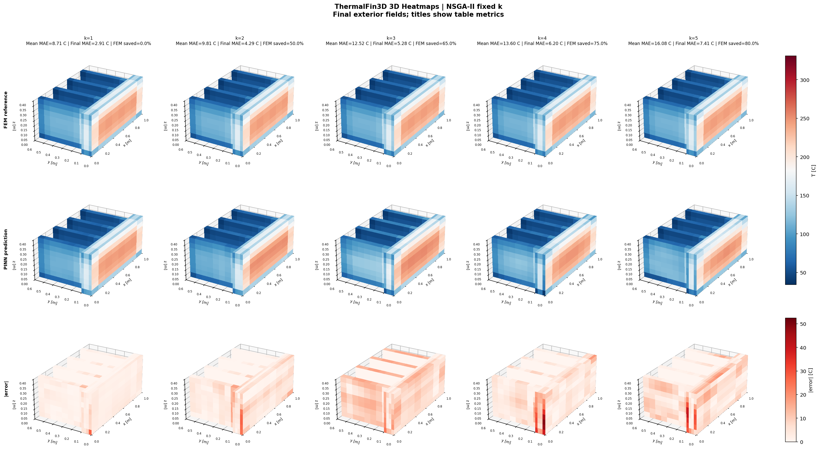
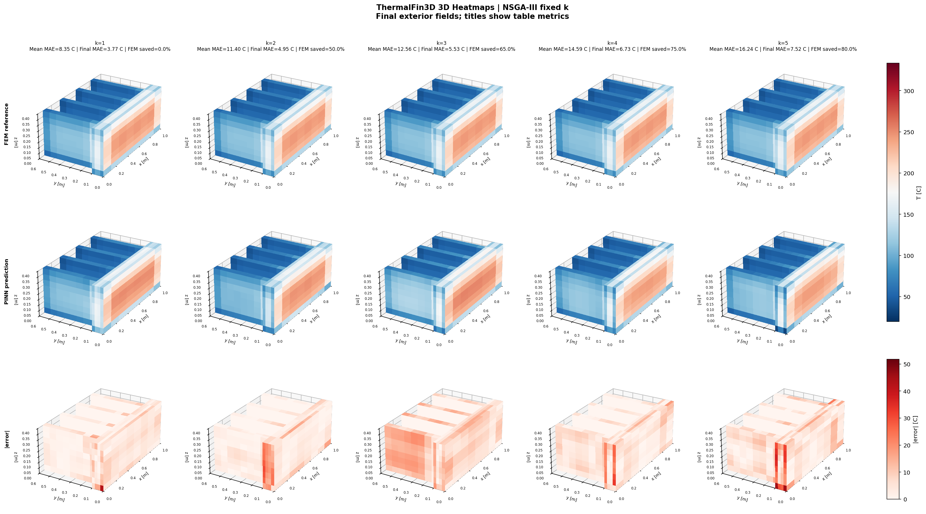
Thermal Fin: Fixed-k Volumetric Views (3D)
RESULTS
Interpretation
The volumetric view confirms the table result: sharp fin regions are the hardest parts of the domain.
UiA | University of Agder
Master Thesis Defense
39

Slide 40
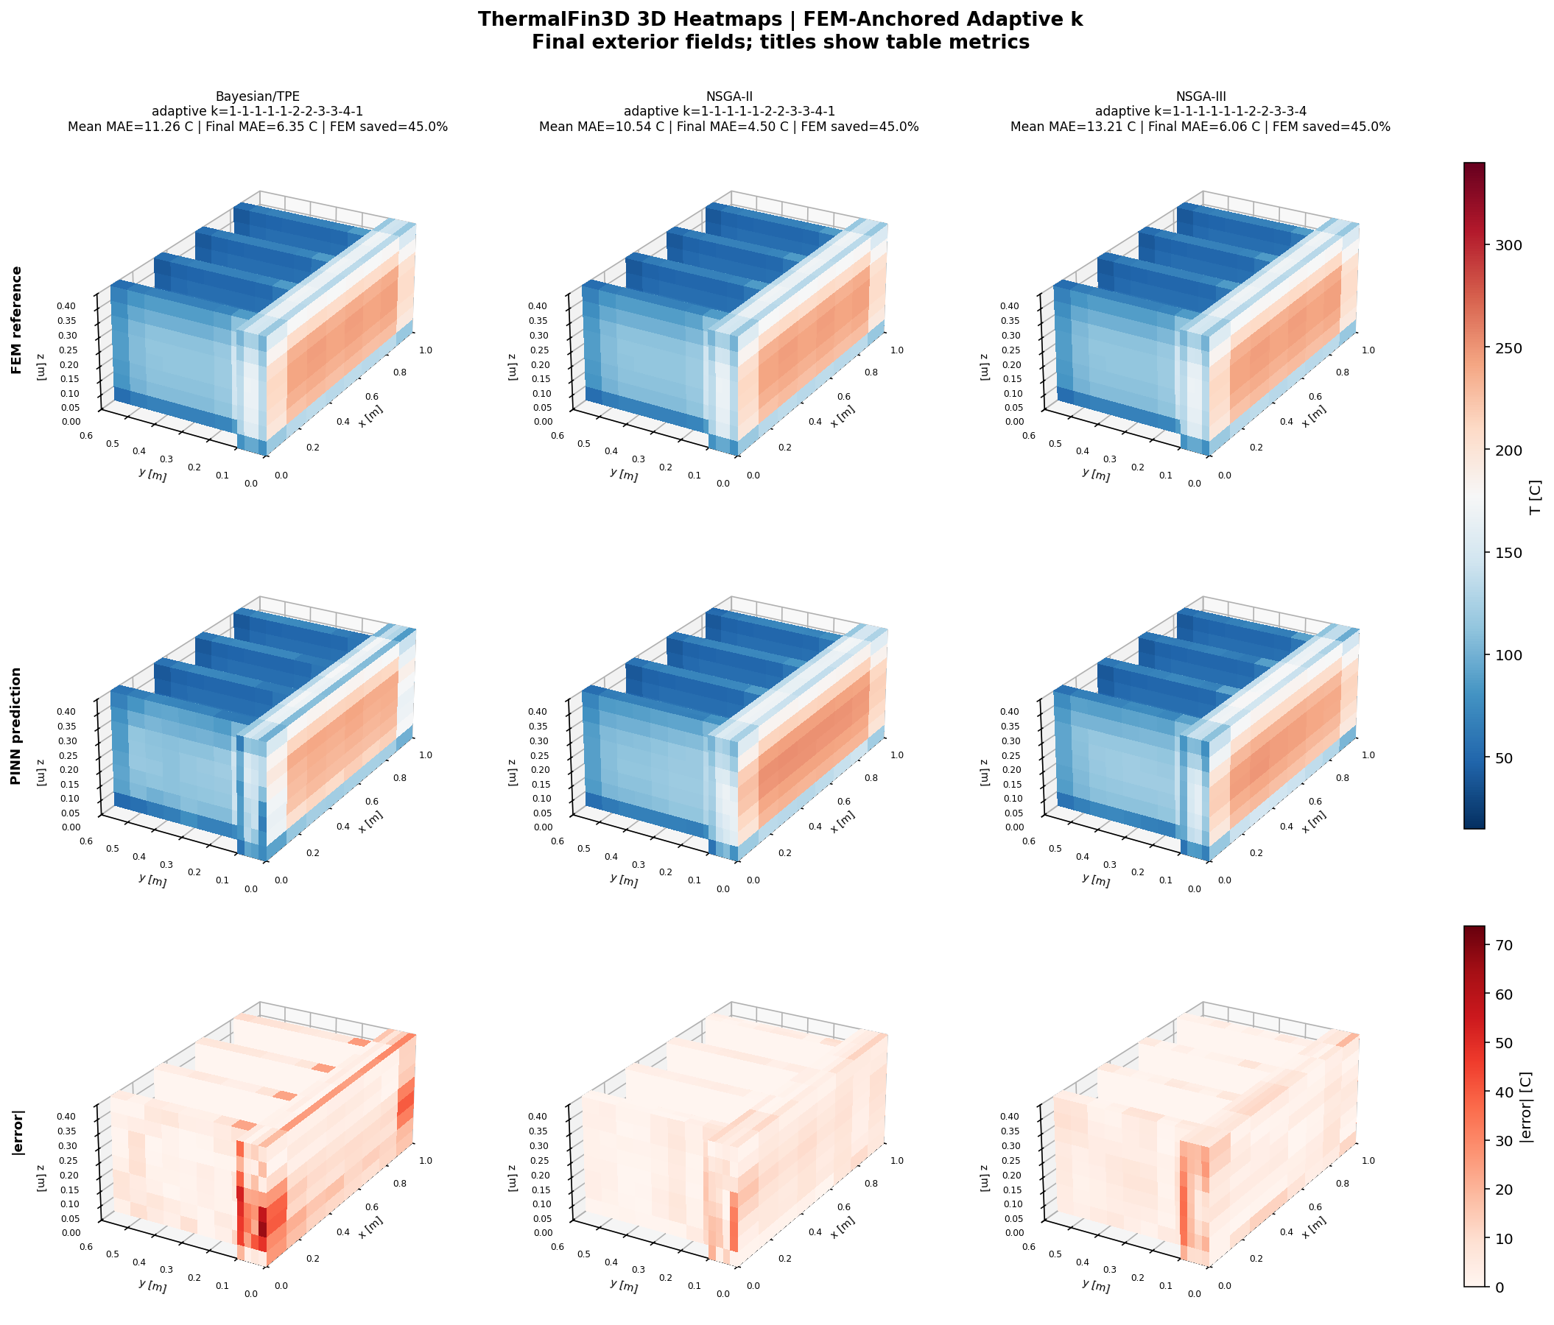
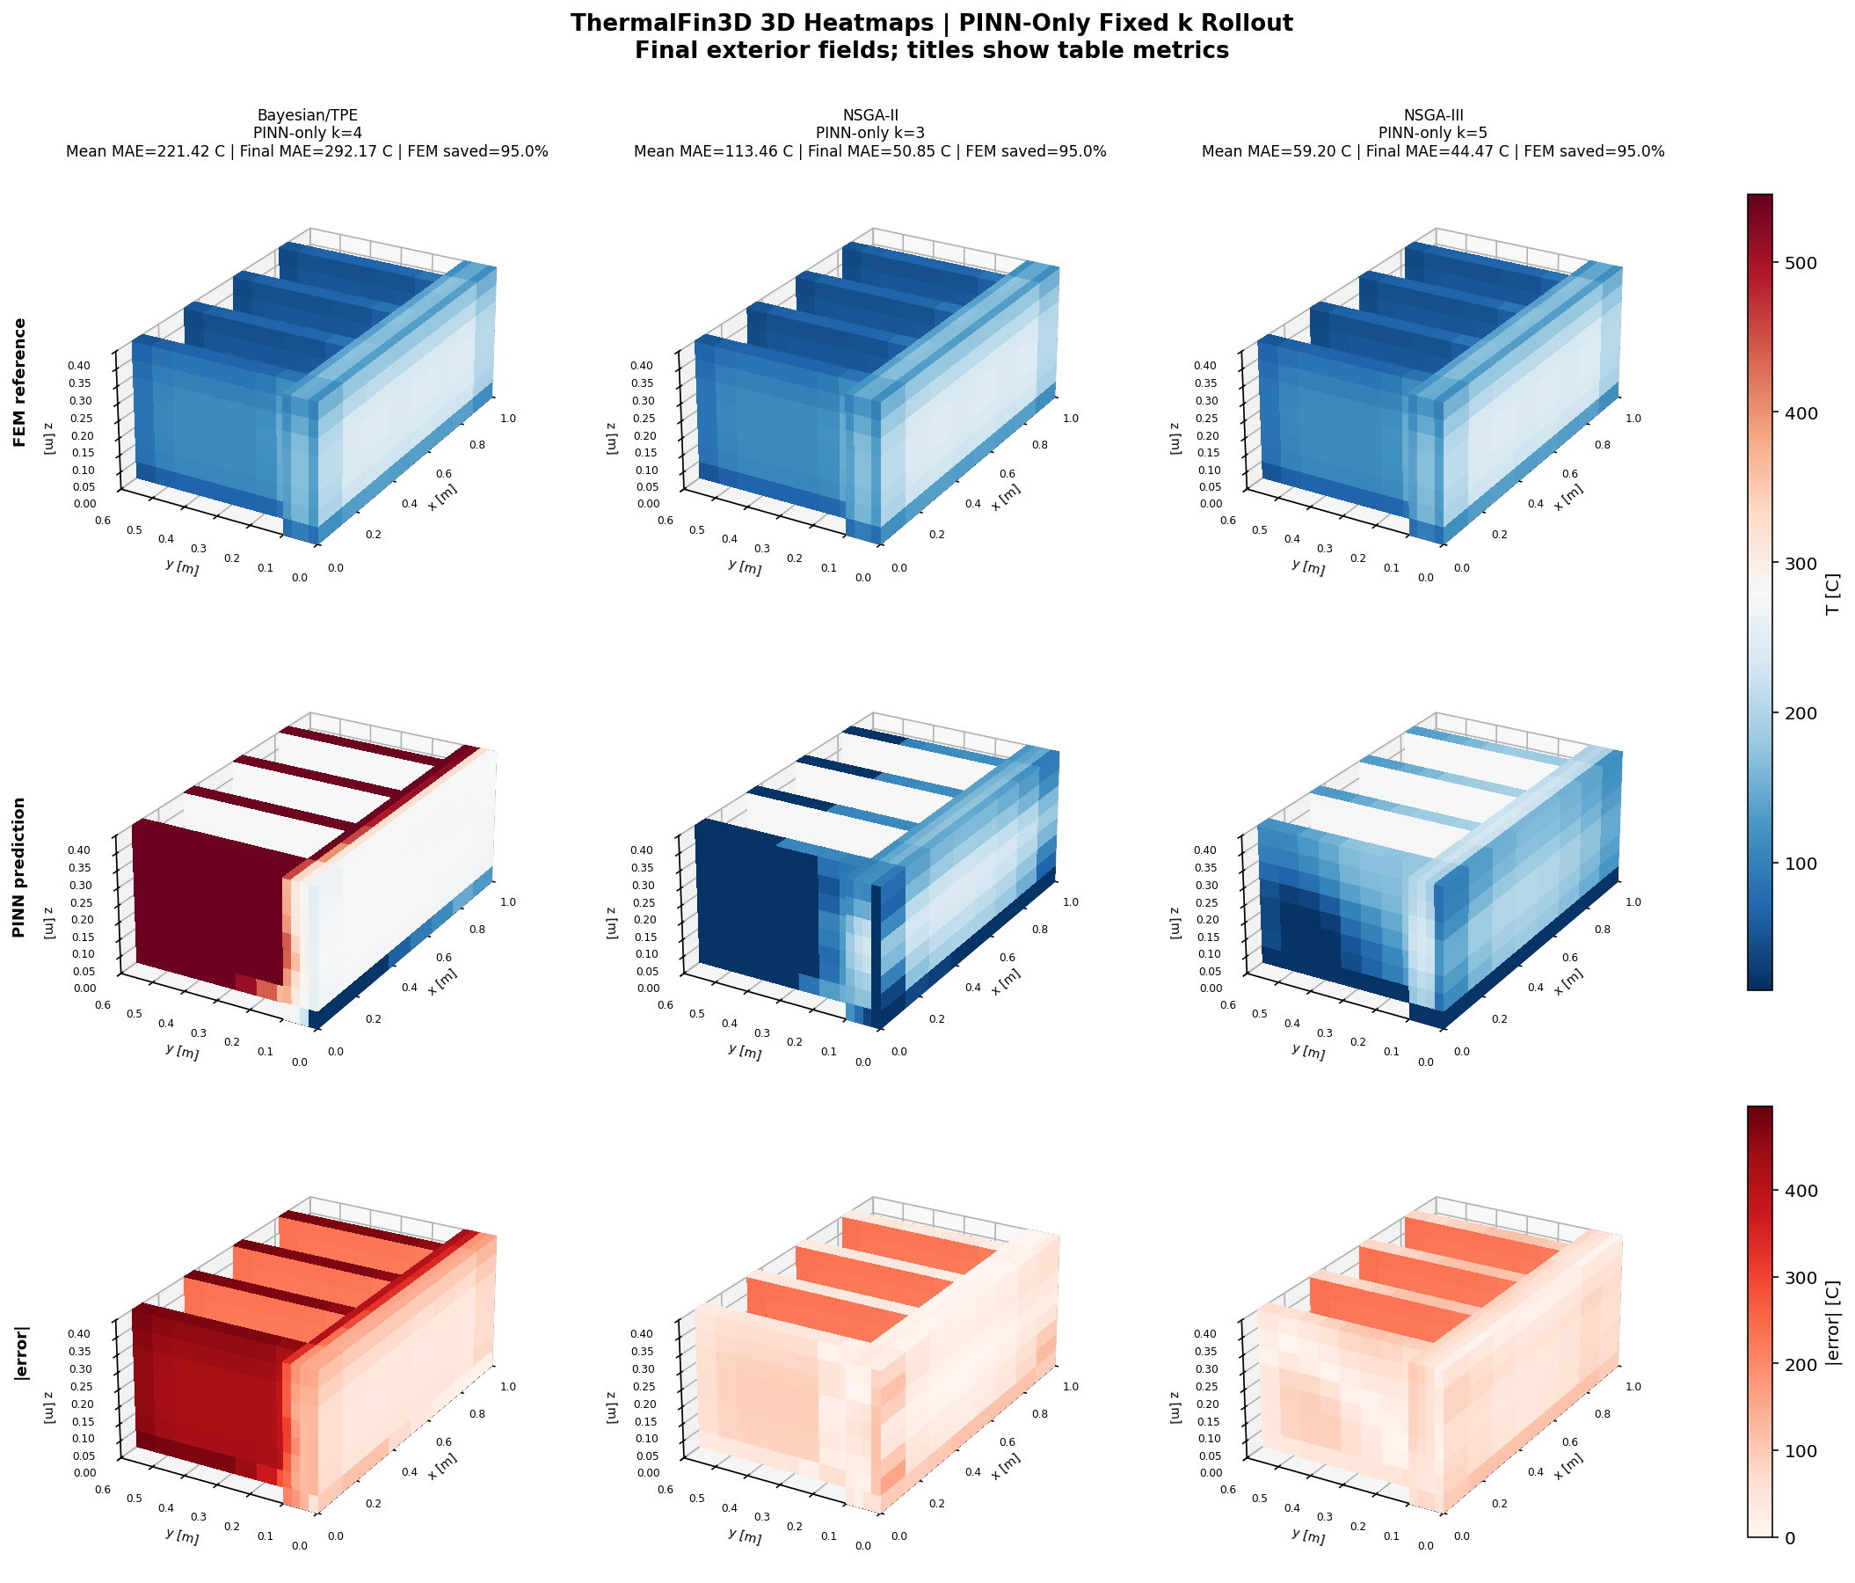
Thermal Fin: Adaptive vs PINN-only Volumetric Views (3D)
RESULTS
With FEM anchors
Without FEM anchors
Periodic correction keeps the 3D field stable.
Prediction drift becomes visible in the volume.
UiA | University of Agder
Master Thesis Defense
40

Slide 41


Thermal Fin: Ablation Tables F.1 and F.2
RESULTS
Fourier result
Endpoint result
It lowers MAE and helps with sharp fin gradients.
It prevents window drift and keeps training stable.
Main message
These are not cosmetic choices; both support stable FEM-anchored prediction on the hardest benchmark.
UiA | University of Agder
Master Thesis Defense
41

Slide 42
Discussion: 2D Adaptive-k and Canonical 2D
DISCUSSION
2D adaptive-k
Canonical 2D
Key explanation
What I found: all architectures achieved about 83-85% FEM saving with low MAE.
Why: the controller keeps short windows during the early rapid cooling phase and promotes k only after the field becomes smoother.
What I found: Bayesian/TPE stays strongest as k increases. Circle and L-Shape expose geometry sensitivity at high k.
Why: compact architectures lose accuracy faster when boundaries are curved or gradients are concentrated.
MAE growth is not only a training issue. It is linked to physical gradient structure, boundary shape and the length of unsupported prediction windows.
UiA | University of Agder
Master Thesis Defense
42

Slide 43
Discussion: 3D and Thermal Fin
DISCUSSION
Canonical 3D
Thermal Fin
PINN-only
Bayesian/TPE reaches k=5 on all four 3D domains within the 15 C band. NSGA-II/III are more geometry-sensitive at high k.
Bayesian/TPE + Fourier remains within the 15 C band at all k values. NSGA-II/III are acceptable through k=4, but k=5 becomes too demanding.
PINN-only errors are much larger because each imperfect prediction becomes the next initial condition. I use this to confirm that periodic FEM correction is necessary.
UiA | University of Agder
Master Thesis Defense
43

Slide 44
Discussion: Cross-Domain Guidance
DISCUSSION
Question | Discussion answer | Practical guidance
Which architecture transfers best? | Bayesian/TPE is strongest in 7 of 8 canonical cases and robust on Thermal Fin. | Use Bayesian/TPE as default deployment architecture.
When is adaptive-k useful? | It protects the early steep-gradient phase and increases k as the field relaxes. | Use adaptive-k for simple/intermediate geometries.
Can FEM be removed? | No. PINN-only accumulates error and fails especially on complex geometries. | Keep periodic FEM anchoring.
What is MSWP's role? | It maps geometry and architecture to maximum useful k. | Use it as a FEM-reduction strategy, not replacement.
UiA | University of Agder
Master Thesis Defense
44

Slide 45
Conclusion: Summary of Results
CONCLUSION
Finding | Evidence | Meaning
FEM calls can be reduced | 65-85% saving in many anchored cases | MSWP is effective as an accelerator
Bayesian/TPE is most robust | Strong 2D, 3D and Thermal Fin performance | Recommended default architecture
Adaptive-k helps | 83-85% saving with low MAE in 2D transfer study | Useful for early steep gradients
PINN-only fails | Thermal Fin best PINN-only is 59.20 C | FEM correction is necessary
UiA | University of Agder
Master Thesis Defense
45

Slide 46
Conclusion: Limitations
CONCLUSION
Physics simplification
Solver validation
NAS and data scope
Constant kT, rho cp and h. Real quenching uses temperature-dependent material properties and five boiling regimes.
Reference fields come from the in-house Crank-Nicolson solver, not from StaMiSim or Abaqus. Mesh independence remains future work.
NAS budget and benchmark geometries are finite. The real Mortensen mesh is the next deployment target, not yet the main experiment.
UiA | University of Agder
Master Thesis Defense
46

Slide 47
Conclusion: Future Work and Closing Remarks
CONCLUSION
Future step | Why it matters
Apply to Mortensen industrial mesh | Direct test on the target deployment geometry
Use full h(T) boiling curve | Closer physics to industrial water quenching
Architecture-specific adaptive-k | Better thresholds for each architecture's baseline error
Residual-based sampling | More training effort where physics residual is hardest
Validate against StaMiSim/Abaqus | Confirm that benchmark errors reflect true physics accuracy
UiA | University of Agder
Master Thesis Defense
47

Slide 48
References
CLOSING
Mortensen, D., Noorsumar, G., Fjaer, H. G., Babaei, R., & Dronen, P. E. (2026). Mitigating distortions in cast automotive subframes: A finite element simulation approach. The International Journal of Advanced Manufacturing Technology, 142, 5879-5898.
Wang, Y., & Zhong, L. (2024). NAS-PINN: Neural architecture search-guided physics-informed neural network for solving PDEs. Journal of Computational Physics, 496, 112603.
Raissi, M., Perdikaris, P., & Karniadakis, G. E. (2019). Physics-informed neural networks. Journal of Computational Physics, 378, 686-707.
Deb, K. et al. (2002). A fast and elitist multiobjective genetic algorithm: NSGA-II. IEEE Transactions on Evolutionary Computation.
Deb, K., & Jain, H. (2014). An evolutionary many-objective optimization algorithm using reference-point-based nondominated sorting: NSGA-III. IEEE Transactions on Evolutionary Computation.
Akiba, T. et al. (2019). Optuna: A next-generation hyperparameter optimization framework. KDD.
UiA | University of Agder
Master Thesis Defense
48

Slide 49
Q&A Preparation
CLOSING
Question | Short answer | Result link
What is FEM? | A trusted numerical solver used as reference and anchor. | It gives the correction snapshots.
What is PINN? | A neural network trained with data error and heat-equation physics. | It predicts between FEM anchors.
What is NAS-PINN? | A PINN whose architecture is selected by search, not by hand. | Bayesian/TPE is the most robust choice.
MAE vs L2? | MAE is average Celsius error; L2 is field error at t=30 s. | Both are needed to judge accuracy.
Why adaptive-k? | It changes window length based on error. | It saves FEM calls safely in simpler cases.
Why not PINN-only? | Without FEM anchors, errors accumulate. | Thermal Fin PINN-only fails clearly.
Why is PINN useful if training is slow? | Training is paid once; inference is fast for repeated use. | Useful when many FEM solves are needed.
How I use this slide
I answer in one or two sentences, then point back to the MAE/L2 or heat-map evidence.
UiA | University of Agder
Master Thesis Defense
49

Slide 50
Thank You
CLOSING
Thank you
Questions and discussion
Main takeaway
FEM-anchored NAS-PINN can reduce FEM calls while keeping useful thermal-field accuracy. FEM is accelerated, not removed.
UiA | University of Agder
Master Thesis Defense
50

