Slide 1
UiA | University of Agder
NAS-Guided FEM-Anchored PINNs
Multi-Step Window Prediction for Transient A356 Water Quenching
Step Optimization in Thermal Simulation Using Selective Finite Element Method Step Skipping
Omer Cetinkaya | University of Agder | 2026
Supervisor: Prof. Turgay Celik
UiA | University of Agder
Master Thesis Defense
1

Slide 2
Presentation Structure
INTRODUCTION
What this slide means
- Intro
- Why this problem · what we built · how we test
- Theory
- Heat equation · FEM · PINN · NAS-PINN
- Method
- How FEM works · How NAS-PINN works · How MSWP works
- Results
- 2D · 3D · Thermal Fin · MAE and FEM saving numbers
- The talk moves from problem to evidence.
- First: theory and method. Then: benchmarks and results.
UiA | University of Agder
Master Thesis Defense
2

Slide 3
The project begins with an industrial A356 aluminium quenching problem and asks whether Finite Element Method (FEM) time-step calls can be reduced without losing useful temperature accuracy.
INTRODUCTION
What this slide means
- The project begins with an industrial A356 aluminium quenching problem and asks whether Finite Element Method (FEM) time-step calls can be reduced without losing useful temperature accuracy.
- Reference paper
- The reference study models water quenching of cast A356 automotive subframes. Its FEM simulation gives the industrial motivation: temperature gradients during quenching drive distortion.
- Our approach
- We keep the same physical process setting, but test a different route: FEM provides anchor snapshots and NAS-PINN predicts selected intermediate windows.
- Validation path
- Because the real industrial data arrived late, the workflow starts with controlled surrogate geometries and then moves toward more complex 3D and Thermal Fin benchmarks.
- Material
- We simulate water quenching of hot A356 aluminium.
- The goal is to reduce repeated FEM work with anchors.
UiA | University of Agder
Master Thesis Defense
3

Slide 4
What is A356 aluminium? - T6 heat treatment process
INTRODUCTION
What this slide means
- A356 aluminium A356 is an aluminium-silicon casting alloy. It is common in cast automotive parts because it is light and has useful mechanical properties.
- Water quenching After heating, the hot part is cooled quickly in water. This fast cooling changes the temperature field inside the part.
- Why simulation is needed Fast cooling can create strong temperature gradients. These gradients can cause distortion and residual stress.
- Connection to this thesis Mortensen et al. (2026) use FEM for A356 automotive subframe quenching. This thesis uses that industrial problem as motivation for FEM-step reduction.
- Source: Mortensen et al. (2026), finite element simulation of water quenching in cast A356 automotive subframes.
- A356 is a cast aluminium alloy used in engineering parts.
- Quenching controls cooling history after heat treatment.
UiA | University of Agder
Master Thesis Defense
4

Slide 5
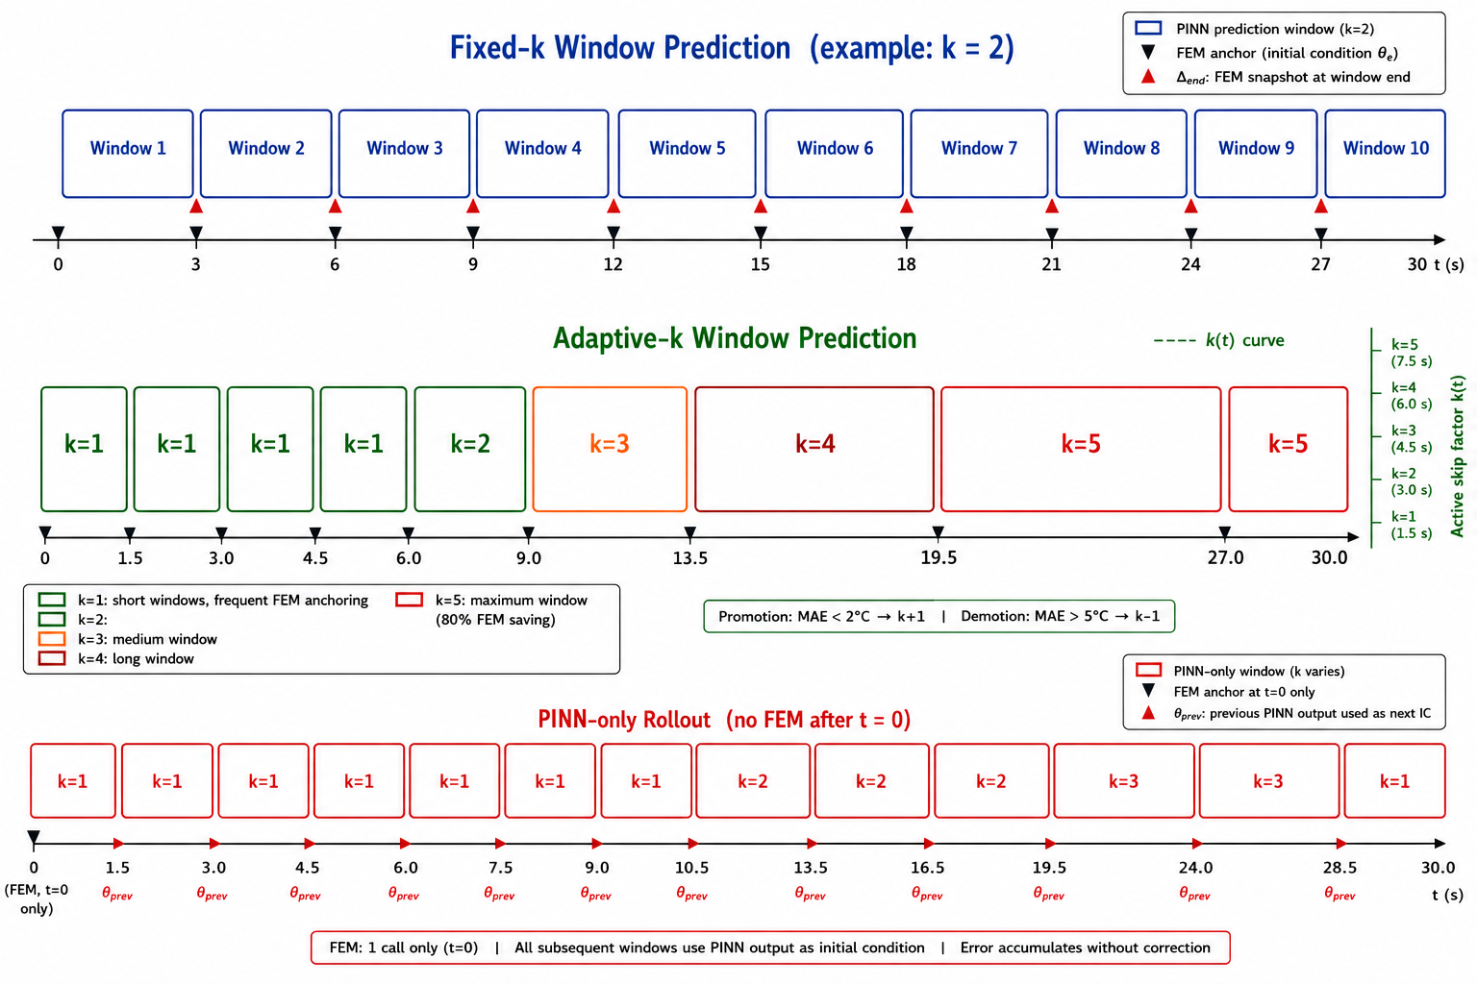
We follow the industrial quenching problem from the reference paper, then test whether FEM time-step calls can be reduced with a FEM-anchored NAS-PINN strategy.
INTRODUCTION
Reading note
- The reference paper gives the FEM-quenching background.
- This thesis tests FEM-anchored NAS-PINN prediction.
UiA | University of Agder
Master Thesis Defense
5

Slide 6
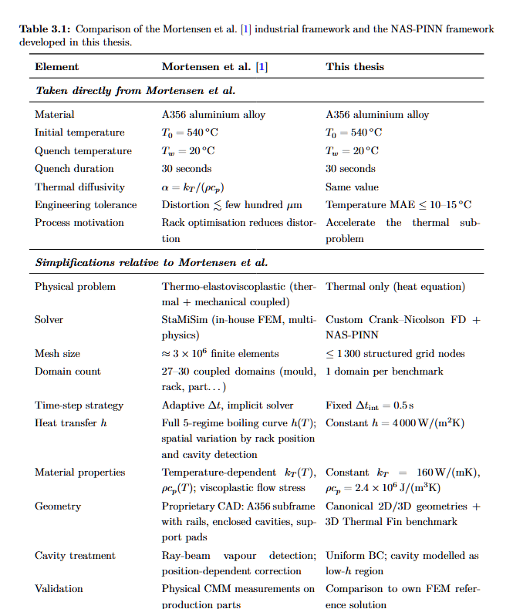
Table 3.1: what is taken from the reference study
INTRODUCTION
Reading note
- The table separates reference-paper inputs from thesis use.
- FEM remains the trusted source; NAS-PINN predicts between anchors.
UiA | University of Agder
Master Thesis Defense
6

Slide 7
Research Question and Contributions
INTRODUCTION
What this slide means
- How many FEM solver calls can be replaced by PINN predictions while keeping temperature error within engineering limits?
- We built
- A FEM-anchored NAS-PINN framework that predicts intermediate thermal fields while FEM snapshots remain the correction source.
- We tested
- Fixed-k, adaptive-k and PINN-only modes were evaluated from simple 2D domains to complex 3D and Thermal Fin cases.
- We measured
- MAE, relative L2 error, skip-factor schedule and FEM-call reduction are reported together.
- Error limits
- Main question: how many FEM calls can be skipped?
- The answer must balance FEM saving and useful accuracy.
UiA | University of Agder
Master Thesis Defense
7

Slide 8
The whole framework is built on transient heat transfer during water quenching.
THEORY AND FEM BACKGROUND
What this slide means
- The whole framework is built on transient heat transfer during water quenching.
- Governing equation
- rho cp dT/dt = div(kT grad T) This describes how the temperature field evolves inside the solid part.
- Boundary condition
- -kT grad(T) . n = h (T - Tw) This represents heat leaving the hot metal surface into the quench water.
- Initial condition
- T(x,0) = T0 In this thesis: T0 = 540 C and Tw = 20 C.
- How Finite Element Method (FEM) uses it
- FEM and PINN use the same heat-transfer physics.
- FEM solves it on a mesh; PINN uses it in the loss.
UiA | University of Agder
Master Thesis Defense
8

Slide 9
Finite Element Method (FEM), Physics-Informed Neural Network (PINN) and Neural Architecture Search PINN (NAS-PINN)
THEORY AND FEM BACKGROUND
What this slide means
- FEM
- What is it? A numerical solver for the heat equation. How we used it? It gives reliable anchor snapshots. Key point: FEM is not removed.
- PINN
- What is it? A neural network for T(x,t). How it learns? It uses data error + heat-equation error. Key point: physics is inside the loss.
- NAS-PINN
- What is it? PINN + architecture search. What is searched? Depth, width and activation. Key point: we do not choose the network manually.
- Defense message
- We used FEM for trust, PINN for prediction, and NAS to choose a better neural architecture for different geometries.
- FEM is the reliable reference.
- PINN predicts with physics loss; NAS-PINN searches the architecture.
UiA | University of Agder
Master Thesis Defense
9

Slide 10
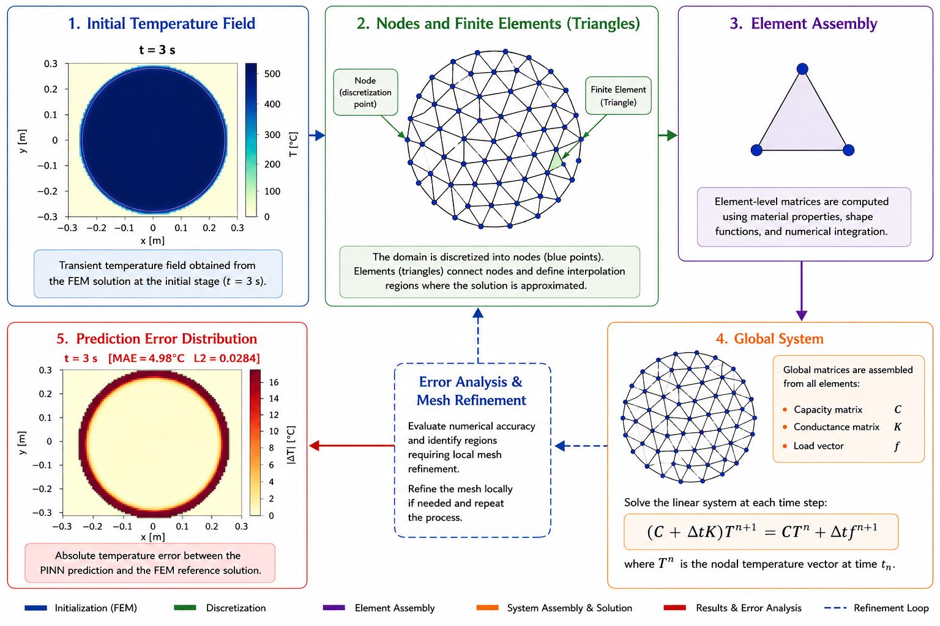
FEM Process: How It Works
THEORY AND FEM BACKGROUND
Reading note
- FEM process: define physics, discretise, solve in time, save snapshots.
- These snapshots become trusted anchors for the thesis.
UiA | University of Agder
Master Thesis Defense
10

Slide 11
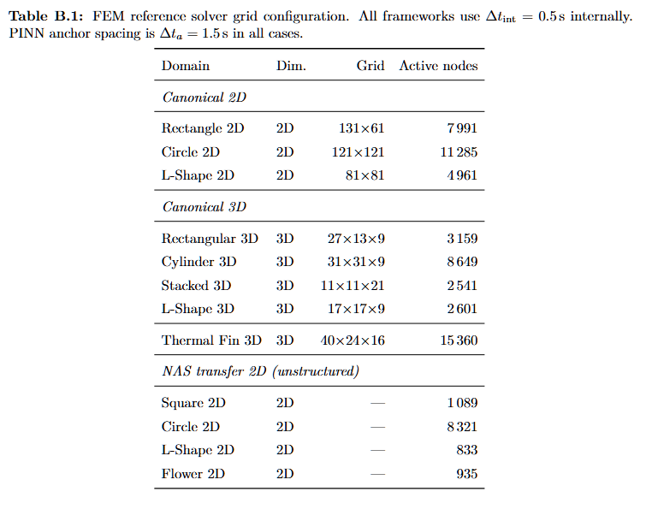
FEM Solver and Mesh Configuration
THEORY AND FEM BACKGROUND
Reading note
- The table shows grid size and active nodes.
- This defines the FEM reference used for anchors and metrics.
UiA | University of Agder
Master Thesis Defense
11

Slide 12
FEM vs PINN: Runtime Logic
THEORY AND FEM BACKGROUND
Method | First use | Repeated use | Why it matters FEM | Can be fast for one small case | Must solve again for each new case | Cost grows with many runs PINN | Training can be slower | Inference is very fast | Good for repeated prediction MSWP | Uses FEM anchors | Skips selected FEM calls | Keeps trust while reducing cost
What this slide means
- One FEM run may be acceptable, but many repeated runs are costly.
- PINN is trained first, then can predict faster later.
UiA | University of Agder
Master Thesis Defense
12

Slide 13
FEM
METHOD
What this slide means
- FEM
- →
- PINN
- FEM gives us the reference. Now: how does PINN learn to predict without FEM?
- FEM gives trusted states.
- Next, the neural model predicts between these states.
UiA | University of Agder
Master Thesis Defense
13

Slide 14
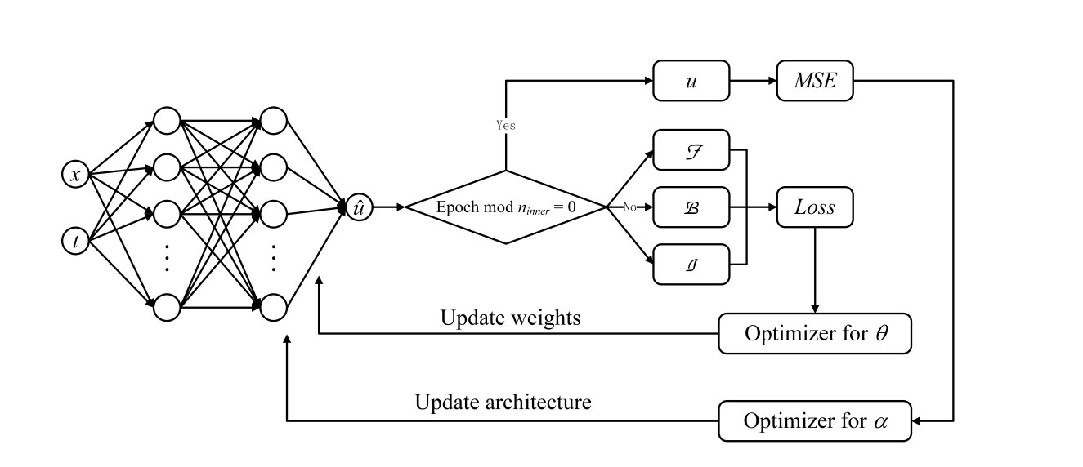
Method Source: NAS-PINN
METHOD
Reading note
- NAS-PINN searches for a strong network architecture.
- This avoids manually choosing one fixed model.
UiA | University of Agder
Master Thesis Defense
14

Slide 15
PINN
METHOD
What this slide means
- PINN
- →
- NAS-PINN
- PINN works. But which architecture? Enter: Neural Architecture Search.
- PINN gives physics-based learning.
- NAS-PINN adds architecture search.
UiA | University of Agder
Master Thesis Defense
15

Slide 16
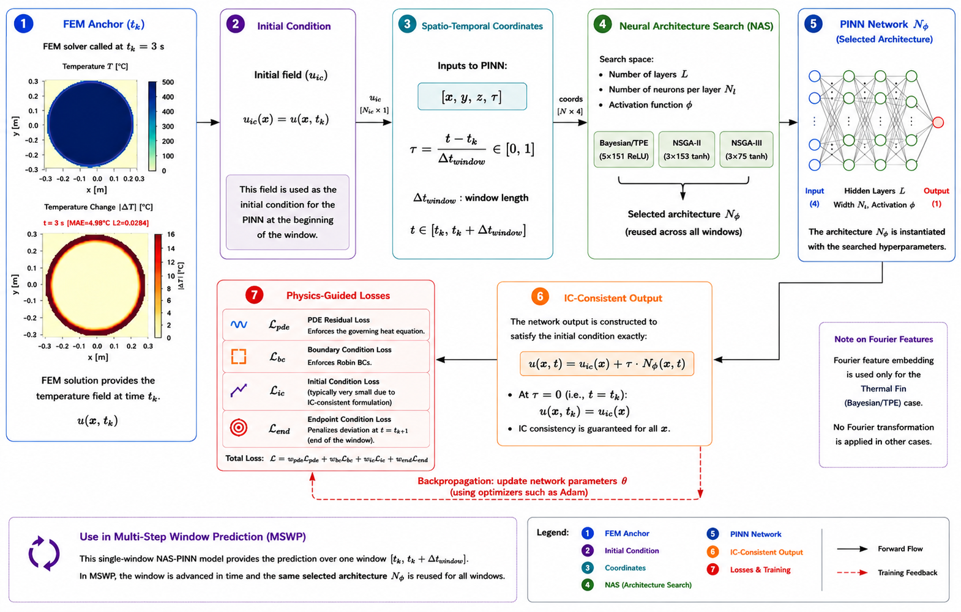
NAS-PINN Process
METHOD
Seven-step reading path
1. FEM anchor
FEM gives the anchor temperature field at the start of the window.
2. Initial condition
This FEM field becomes the initial condition for the PINN.
3. Coordinates
The model takes space and time coordinates as input.
4. NAS search
NAS searches different network architectures.
5. PINN network
The selected PINN predicts the temperature field.
6. IC-consistent output
The output matches the initial condition at the window start.
7. Physics-guided losses
Physics, boundary, initial and endpoint losses train the model.
Key idea: FEM gives trust, NAS chooses the network, and PINN predicts the temperature inside each window.
UiA | University of Agder
Master Thesis Defense
16

Slide 17
Architecture Search and Training Protocol
METHOD
Strategy | Selected architecture | Role in method Bayesian/TPE | 5 layers x 151, ReLU | High-capacity accuracy-focused model NSGA-II | 3 layers x 153, tanh | Accuracy-size trade-off NSGA-III | 3 layers x 75, tanh | Compact Pareto-diverse model
What this slide means
- Architecture search is done first.
- Adam gives broad progress; L-BFGS improves final fit.
UiA | University of Agder
Master Thesis Defense
17

Slide 18
Optimisation Methods Used
METHOD
Method | Search idea | Why used here | Architecture Bayesian/TPE | Single-objective probabilistic search | Find an accurate architecture with limited trials | 5 x 151, ReLU NSGA-II | Multi-objective evolutionary search | Balance accuracy and compactness | 3 x 153, tanh NSGA-III | Reference-point many-objective search | Promote diverse compact Pareto solutions | 3 x 75, tanh
What this slide means
- All three search methods use the same search space.
- This makes the comparison fair.
UiA | University of Agder
Master Thesis Defense
18

Slide 19
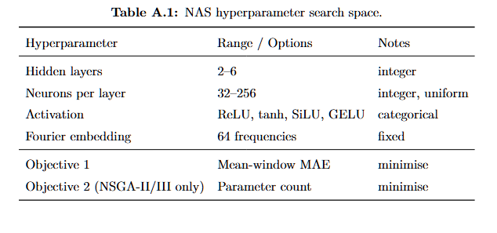
NAS Hyperparameter Search Space
METHOD
Reading note
- The search space defines what NAS can choose.
- It makes the experiment reproducible.
UiA | University of Agder
Master Thesis Defense
19

Slide 20
NAS-PINN
METHOD
What this slide means
- NAS-PINN
- →
- MSWP
- We have the architecture. Now: how do FEM + NAS-PINN work together?
- The selected NAS-PINN is ready.
- Next: how it is used over time.
UiA | University of Agder
Master Thesis Defense
20

Slide 21
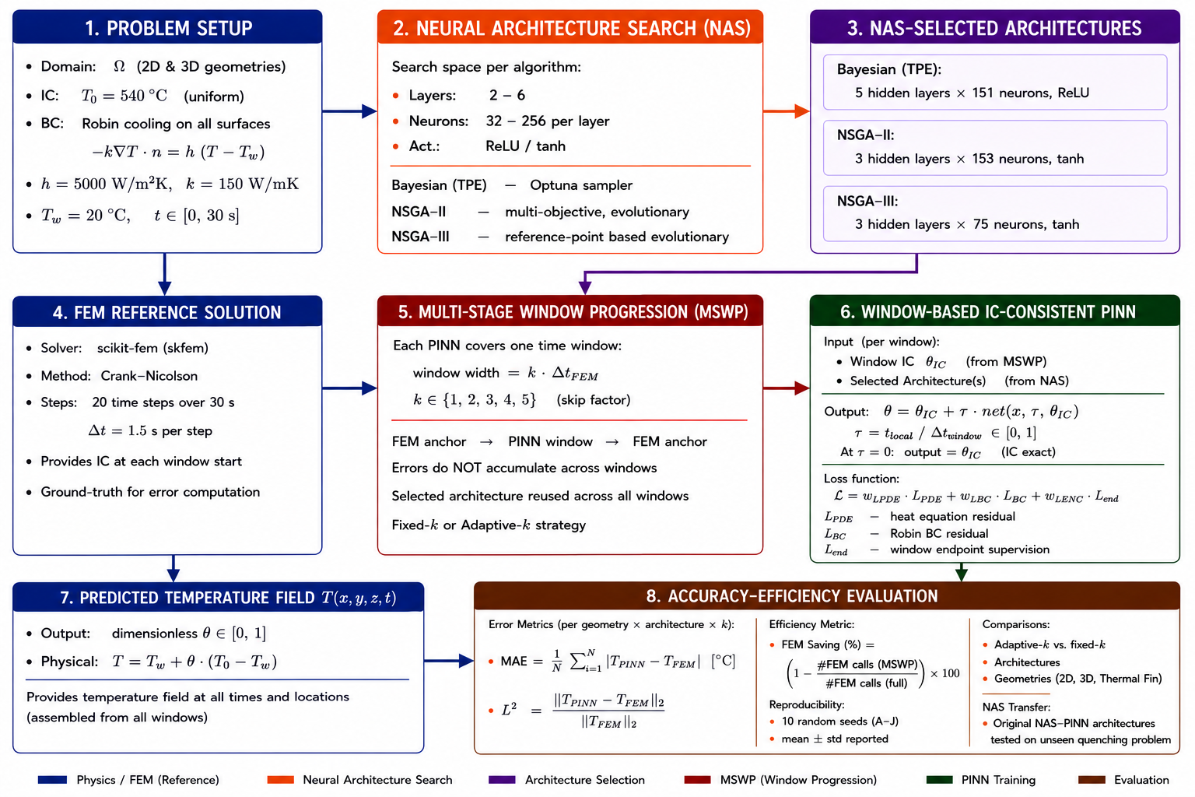
MSWP Framework: Working Logic
METHOD
Reading note
- MSWP: FEM anchor, NAS-PINN window prediction, next FEM anchor.
- The next anchor limits drift.
UiA | University of Agder
Master Thesis Defense
21

Slide 22
Skip Factor and Operating Modes
METHOD
Reading note
- Small k means more FEM correction. Large k saves more FEM calls but is harder.
- The modes test different correction levels.
UiA | University of Agder
Master Thesis Defense
22

Slide 23
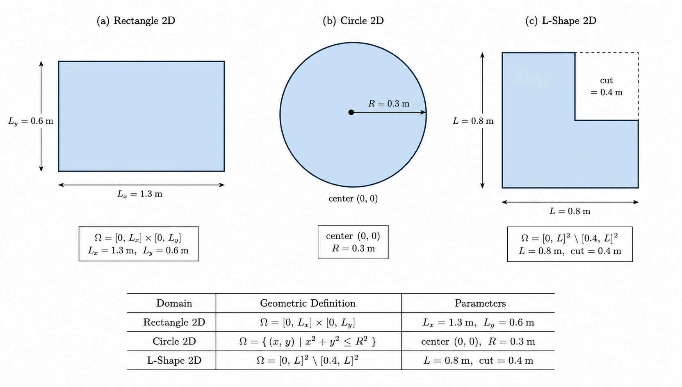
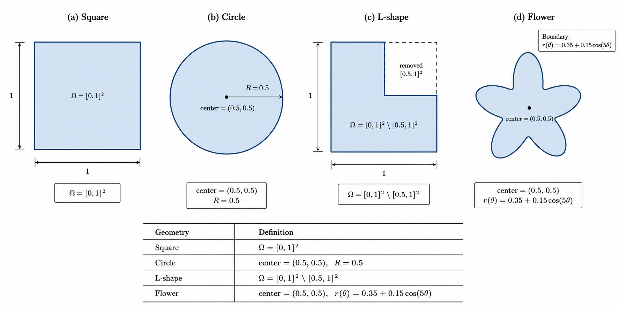
Benchmark Domains: 2D Domain Groups
BENCHMARKS AND METRICS
Reading note
- 2D domains are easier to inspect visually.
- They test transfer and geometry sensitivity.
UiA | University of Agder
Master Thesis Defense
23

Slide 24
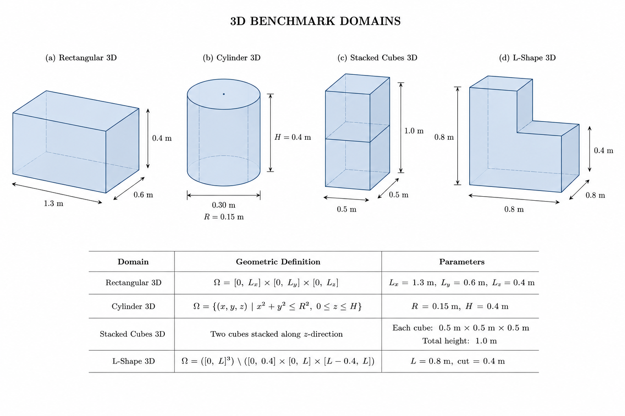
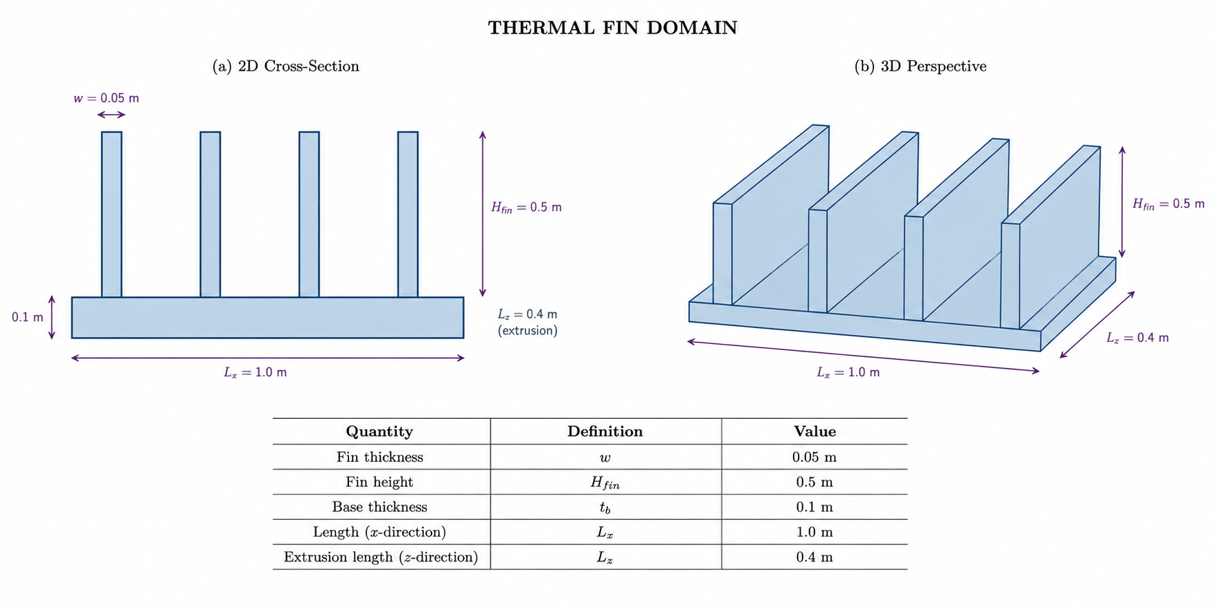
Benchmark Domains: 3D and Thermal Fin
BENCHMARKS AND METRICS
Reading note
- 3D and Thermal Fin test volumetric stability.
- Thermal Fin is hardest because of thin, sharp geometry.
UiA | University of Agder
Master Thesis Defense
24

Slide 25
Evaluation Metrics
BENCHMARKS AND METRICS
What this slide means
- Mean Absolute Error (MAE) MAE = (1/N) sum_i |T_i^PINN - T_i^FEM| Main accuracy metric. It is reported as mean-window MAE over the prediction windows.
- Relative L2 Error Rel. L2 = ||T_hat - T_FEM||_2 / ||T_FEM - T_w||_2 Full-field error, normalised by the temperature change above the water bath. Here T_w = 20 deg C.
- FEM Anchor Reduction R(k) = (1 - N_win(k)/20) x 100% Efficiency metric. It shows how many FEM anchor calls are saved when the PINN predicts longer windows.
- How I read the numbers MAE: average temperature error in deg C. Relative L2: spatial field quality at 30 s. R(k): saved FEM solver calls. Together, they show the trade-off between accuracy and computational cost.
- Important note from the report Final-window MAE alone can be misleading in PINN-only tests. Near 30 s, the field naturally moves toward the water temperature. So the mean-window MAE is used as the primary metric.
- Source: Chapter 3, Evaluation Metrics.
- MAE measures average temperature error.
- Relative L2 checks final field quality; FEM reduction measures saved calls.
UiA | University of Agder
Master Thesis Defense
25

Slide 26
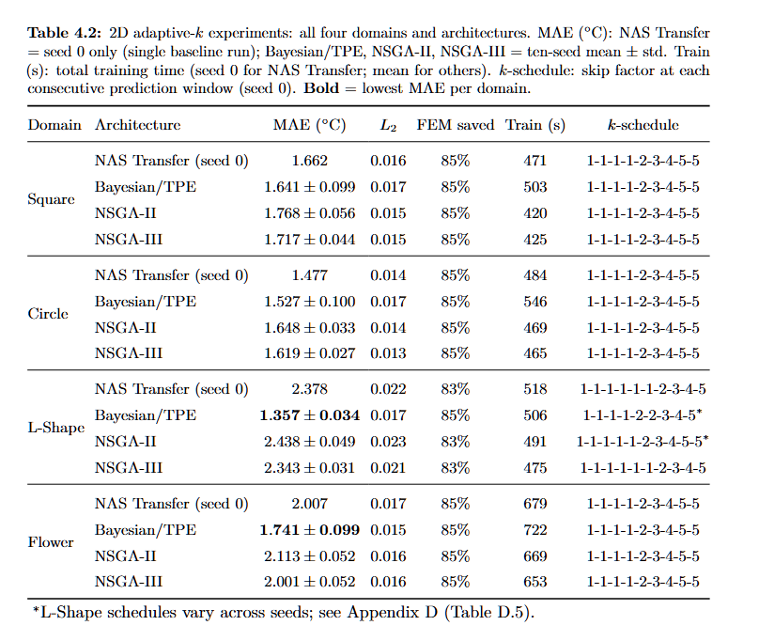
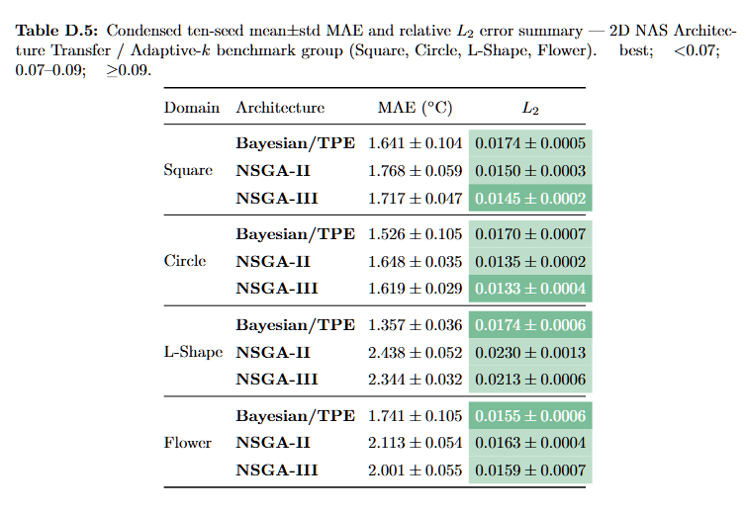
2D Adaptive-k: MAE and L2 Summary
RESULTS
Reading note
- 2D NAS-transfer results: MAE shows average error, L2 shows final field quality.
- Low error with FEM saving means the method works here.
UiA | University of Agder
Master Thesis Defense
26

Slide 27
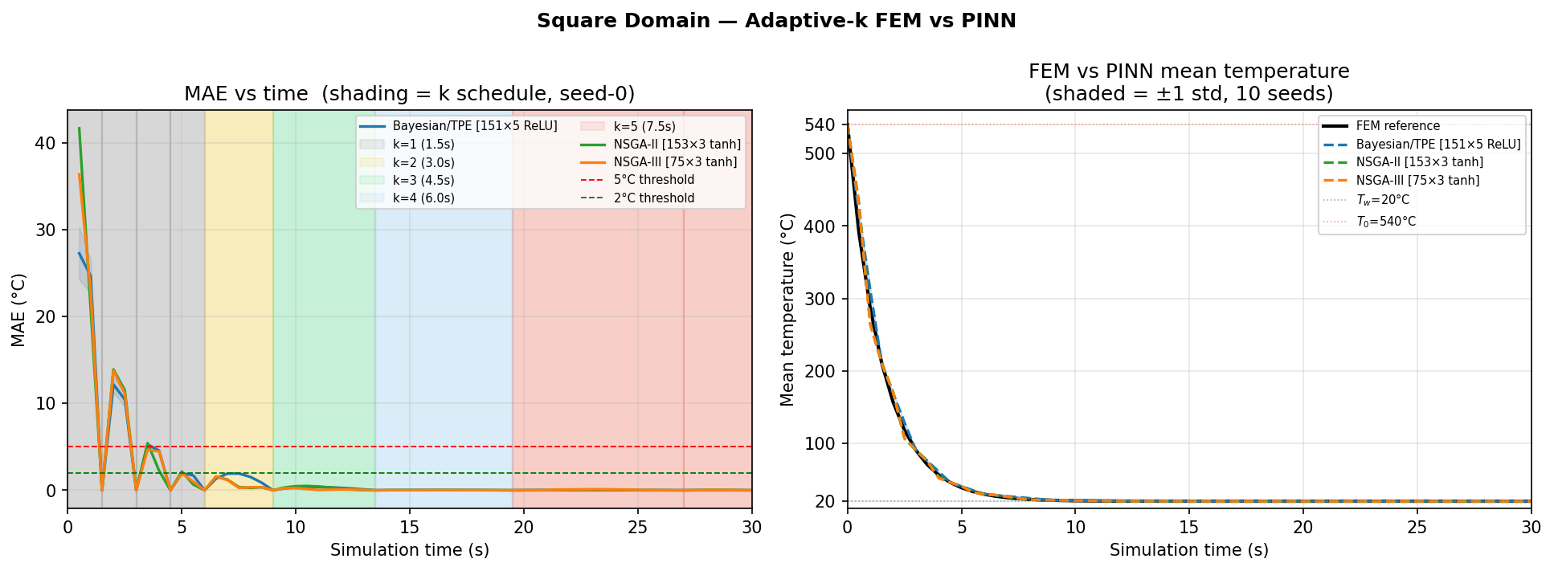
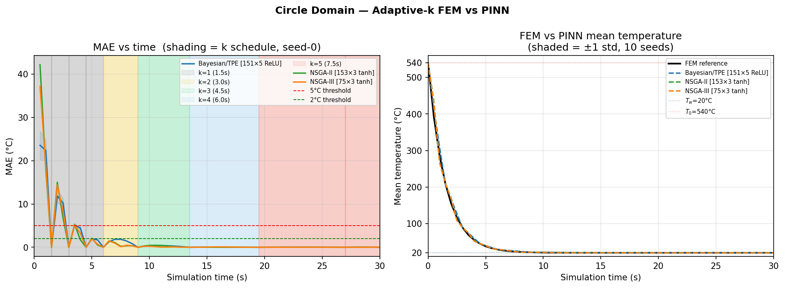
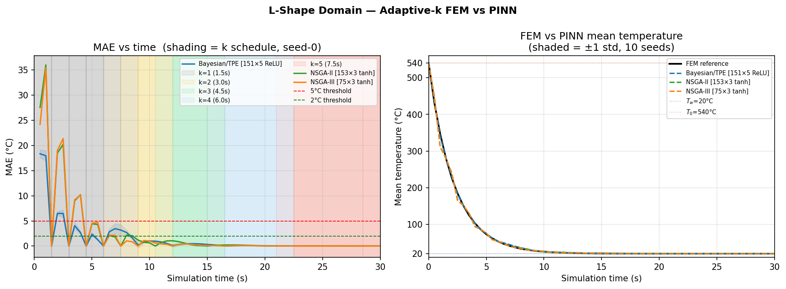
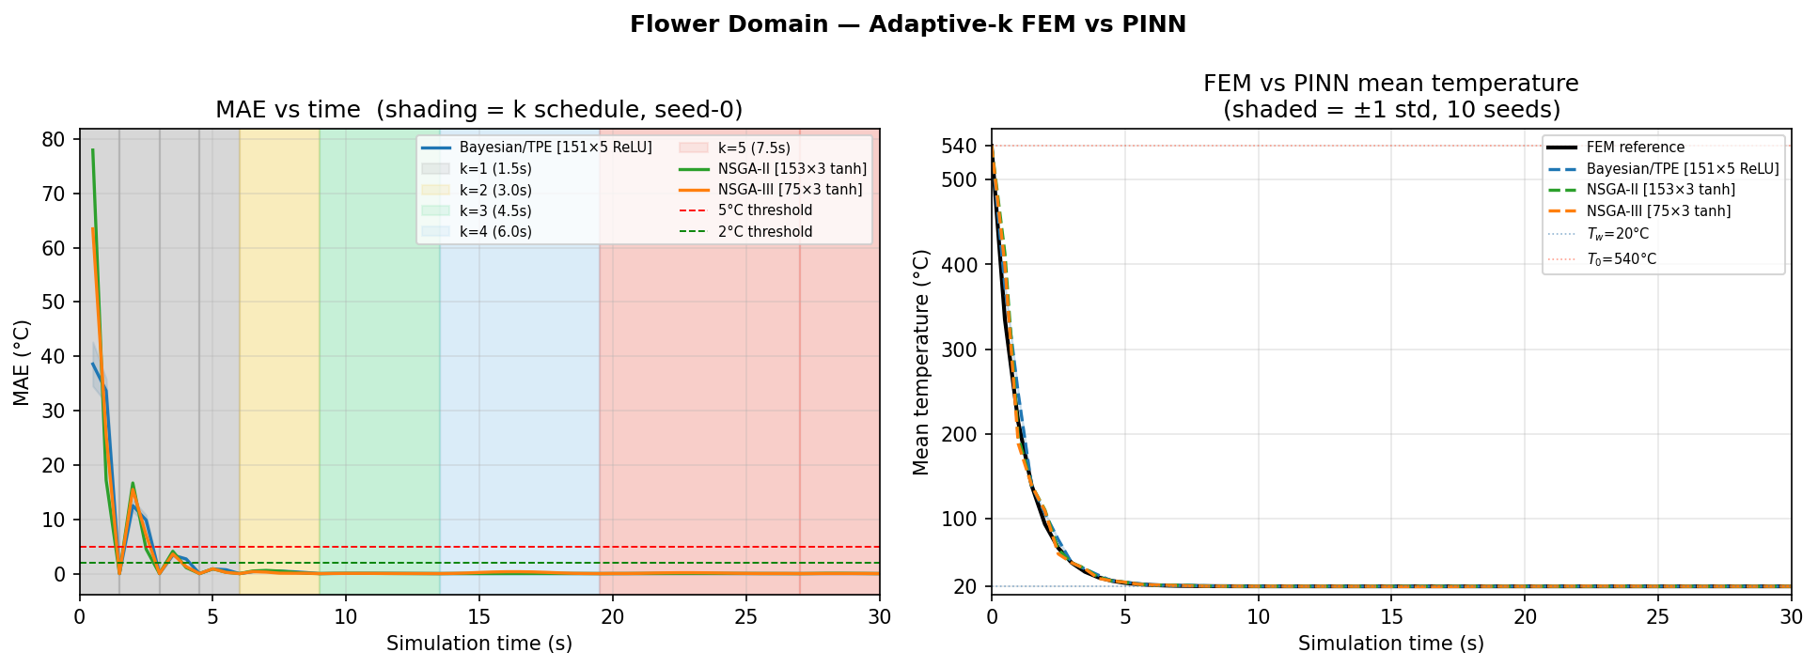
2D Adaptive-k: Figure 4.1 FEM-PINN Curves
RESULTS
Reading note
- The curves compare FEM cooling history with PINN prediction.
- Close curves mean the transient behaviour is followed well.
UiA | University of Agder
Master Thesis Defense
27

Slide 28
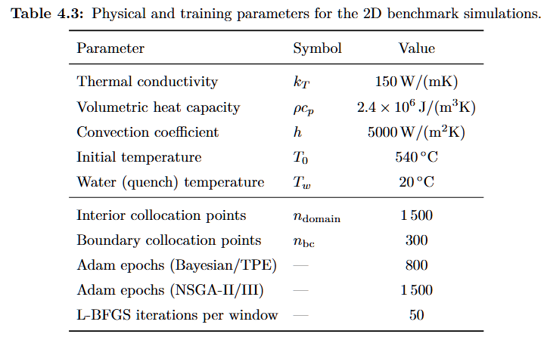
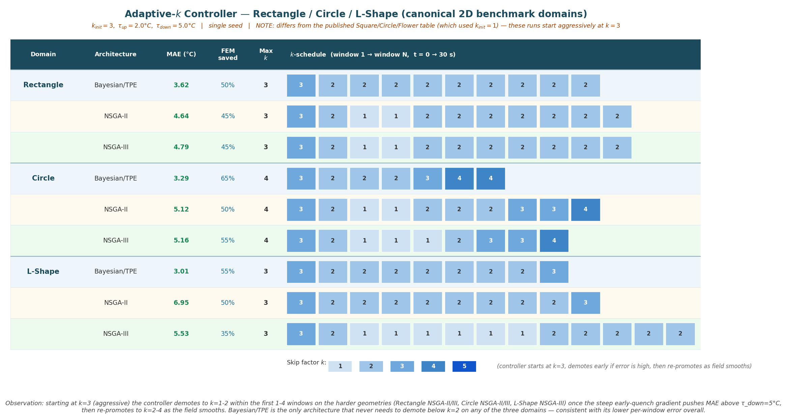
Canonical 2D: Setup and Adaptive-k Schedule
RESULTS
Reading note
- This setup explains when FEM calls are kept or skipped.
- It prepares the 2D MAE and L2 result tables.
UiA | University of Agder
Master Thesis Defense
28

Slide 29
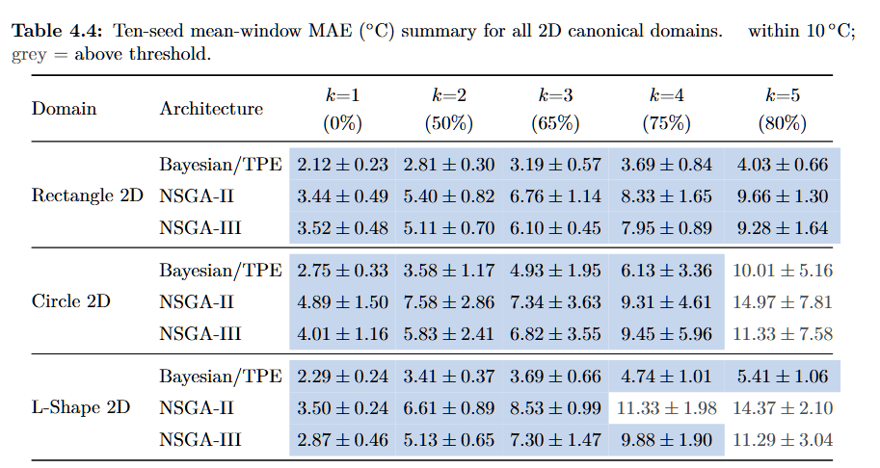
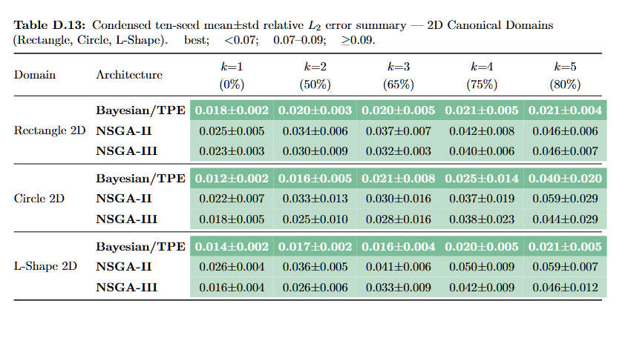
Canonical 2D: MAE and L2 Summary
RESULTS
Reading note
- MAE and L2 are read together.
- Low MAE plus low L2 means reliable prediction.
UiA | University of Agder
Master Thesis Defense
29

Slide 30
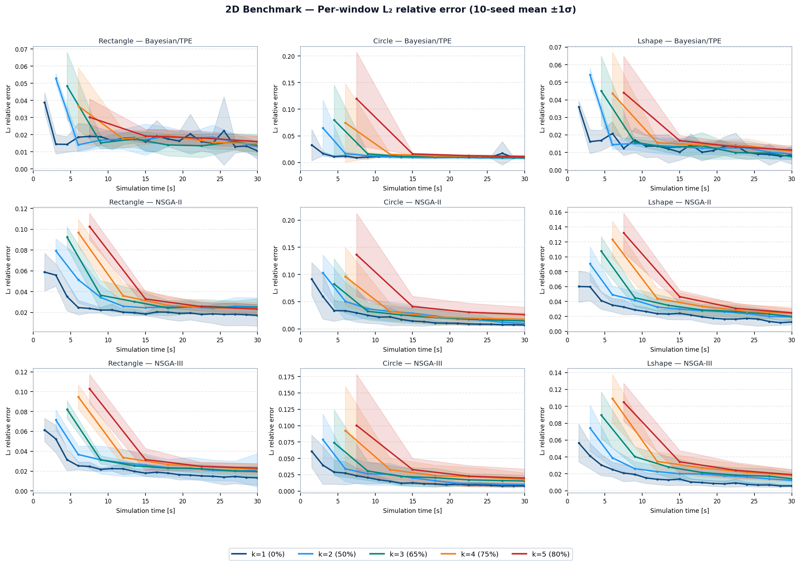
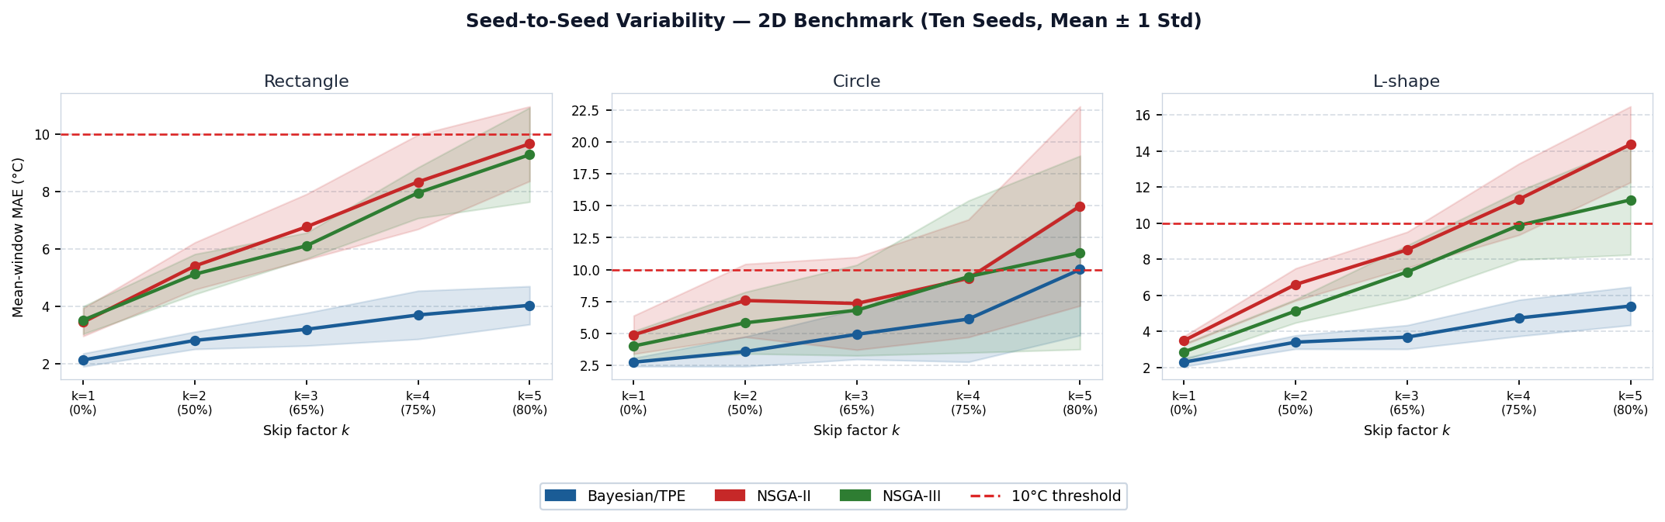
Canonical 2D: MAE Variability and L2 Curves
RESULTS
Reading note
- Variability shows seed stability.
- L2 curves show field error through time.
UiA | University of Agder
Master Thesis Defense
30

Slide 31
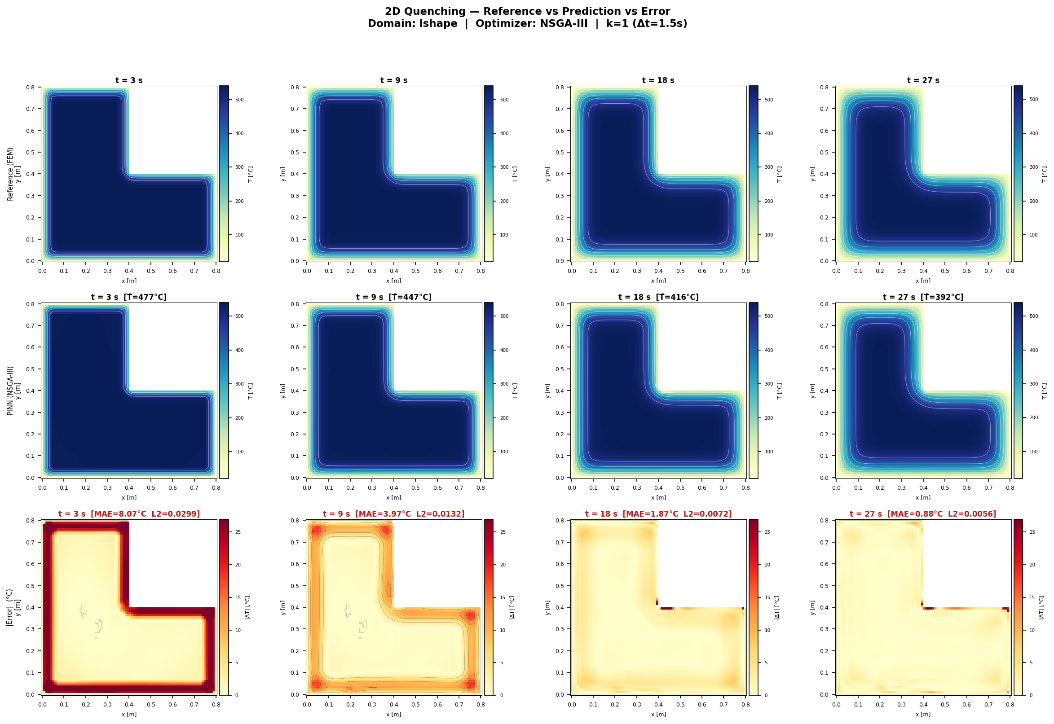
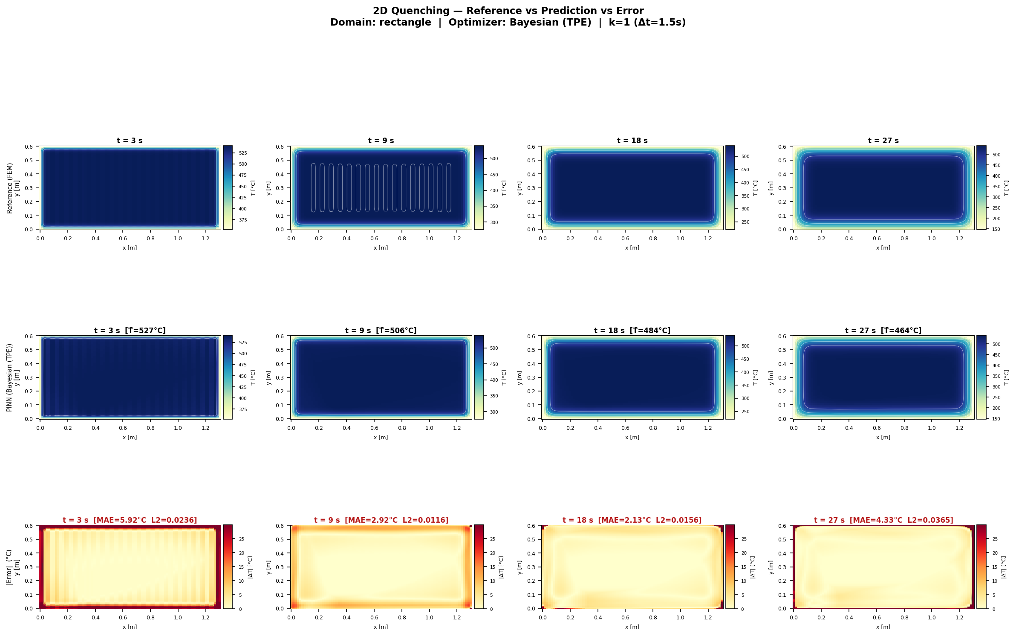
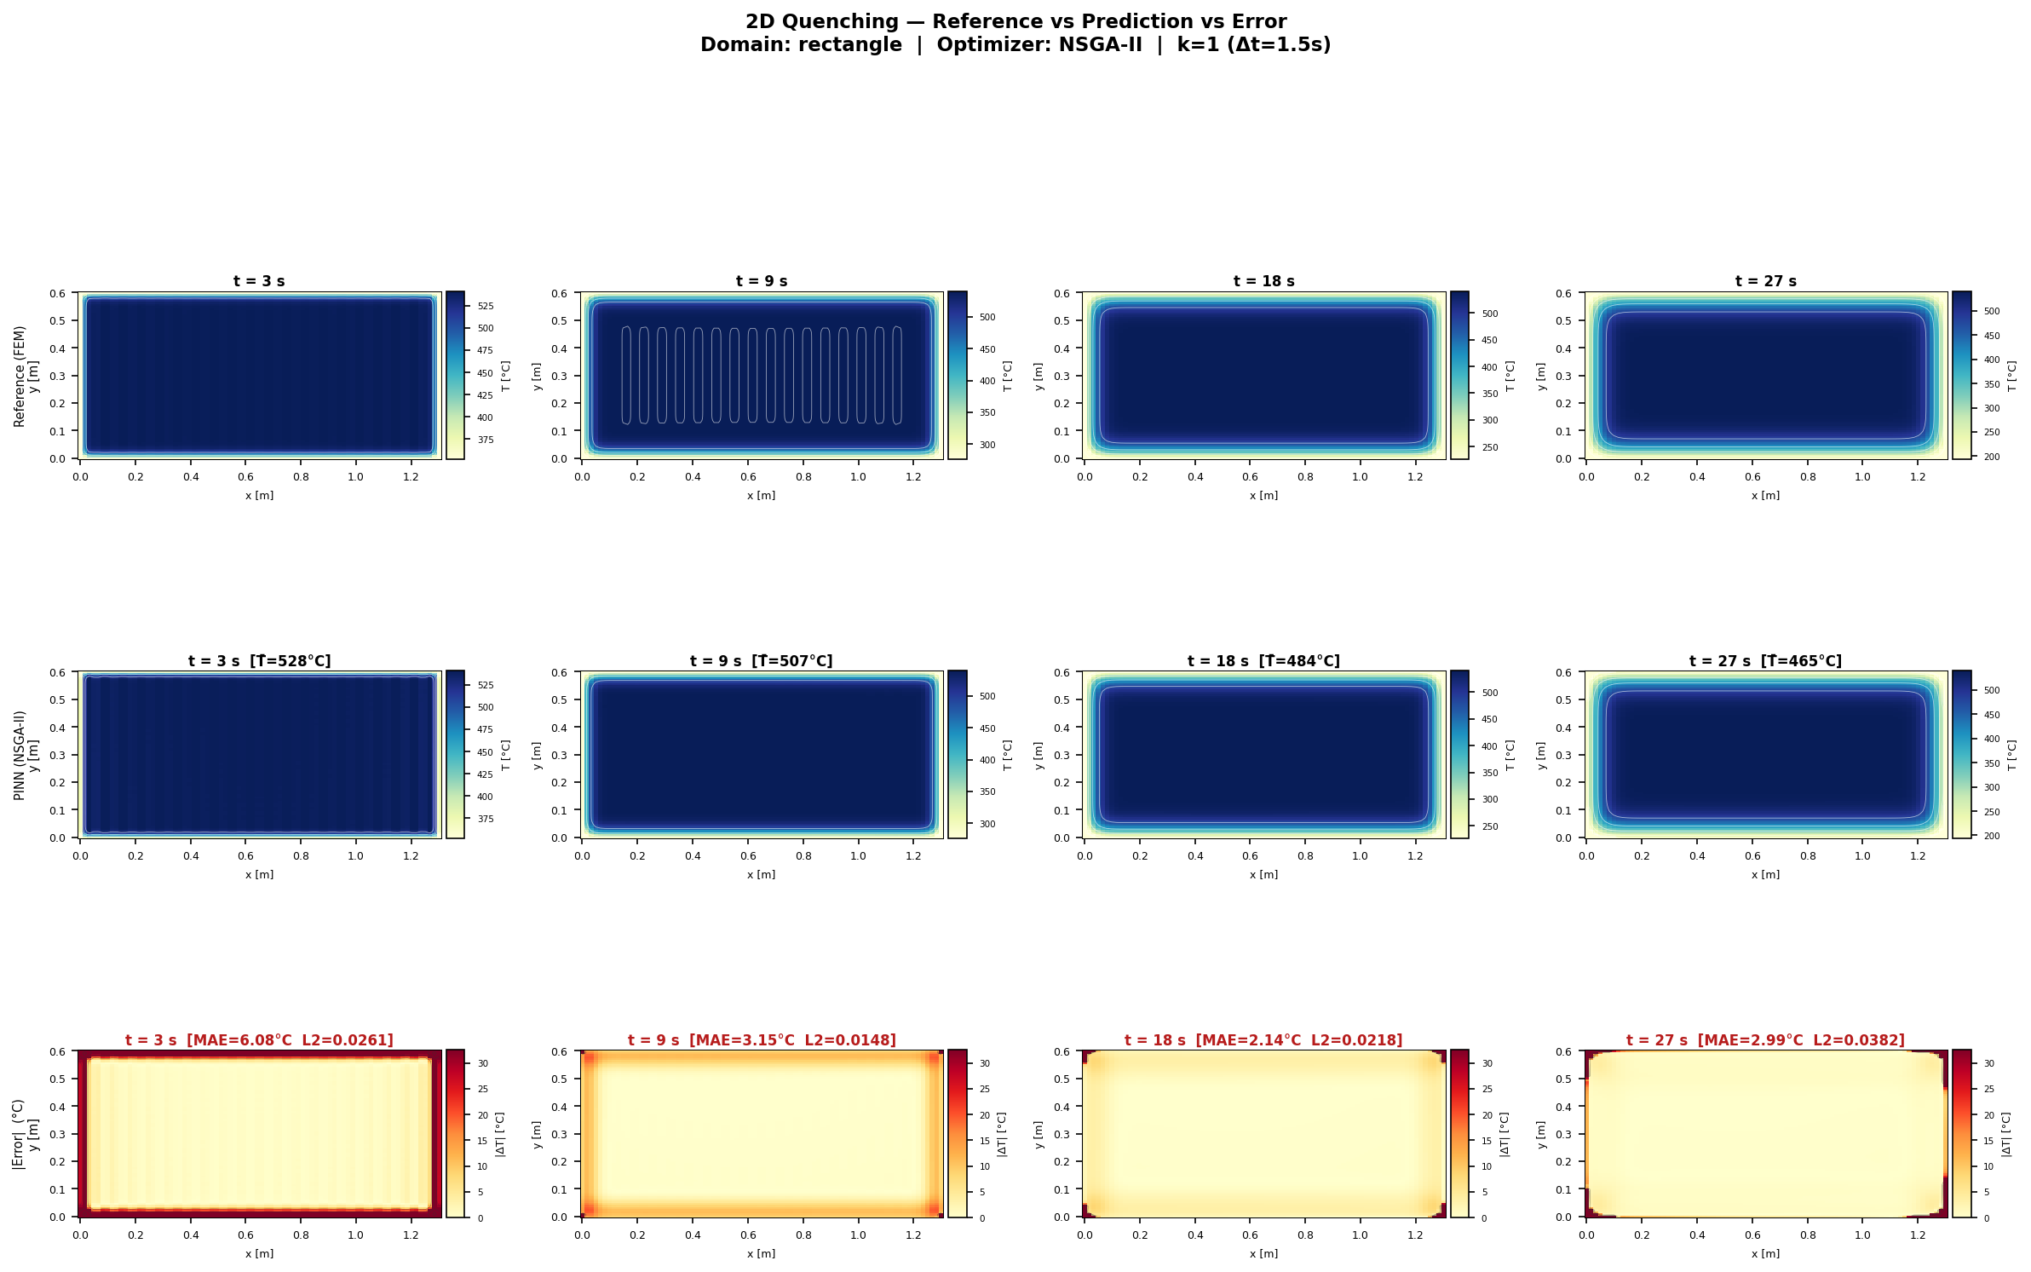
Canonical 2D Heat Maps: Best Geometry per Architecture
RESULTS
Reading note
- Heat maps show where the error appears.
- They support the numerical tables visually.
UiA | University of Agder
Master Thesis Defense
31

Slide 32
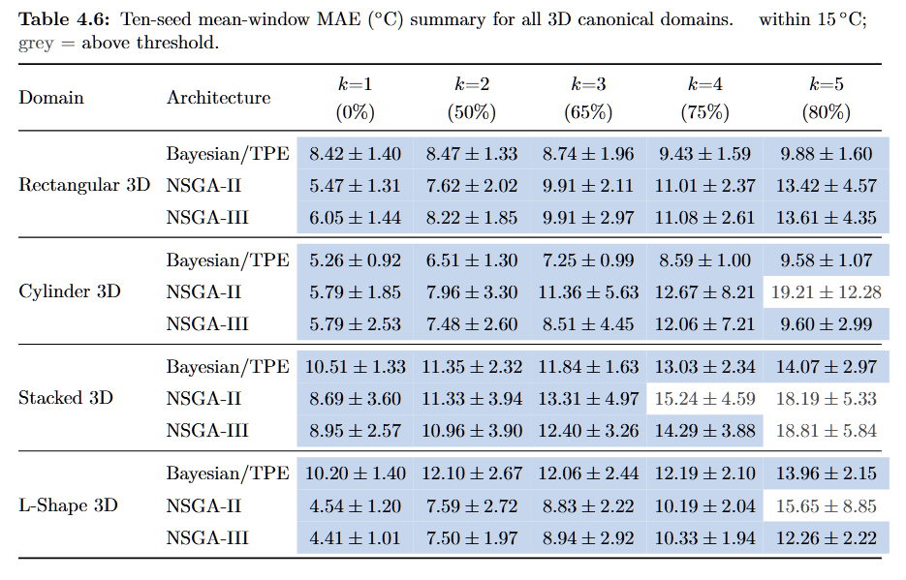
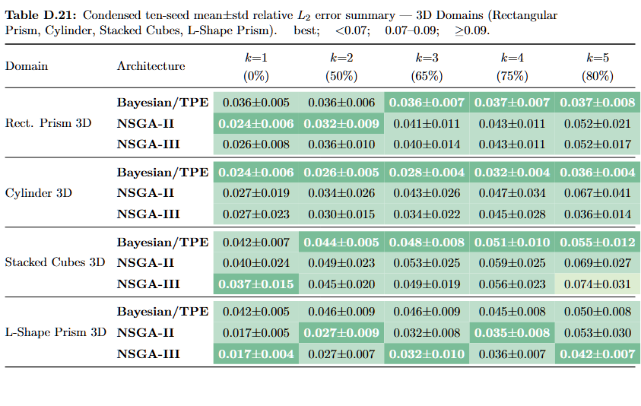
3D Results: MAE and L2 Summary
RESULTS
Reading note
- 3D tables show average volumetric error and final field quality.
- 3D geometry makes prediction harder than 2D.
UiA | University of Agder
Master Thesis Defense
32

Slide 33
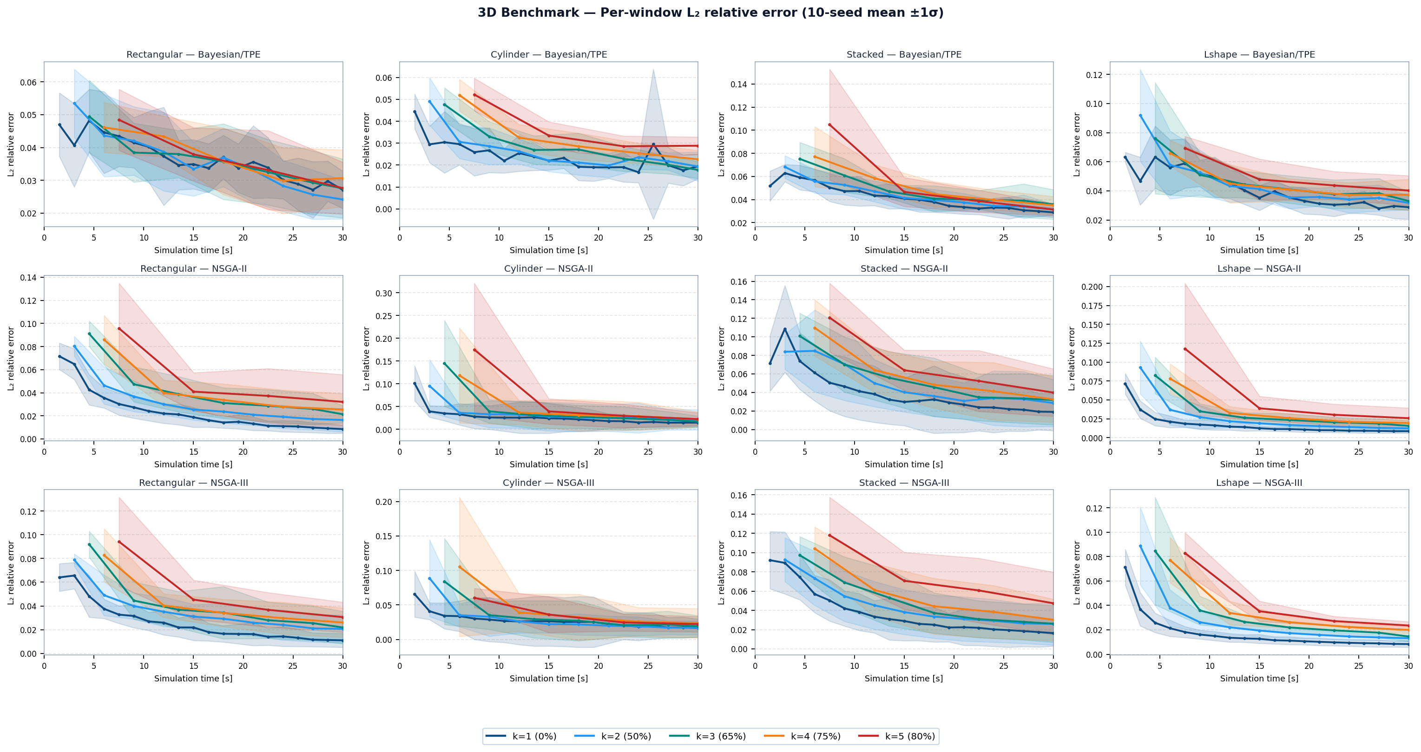
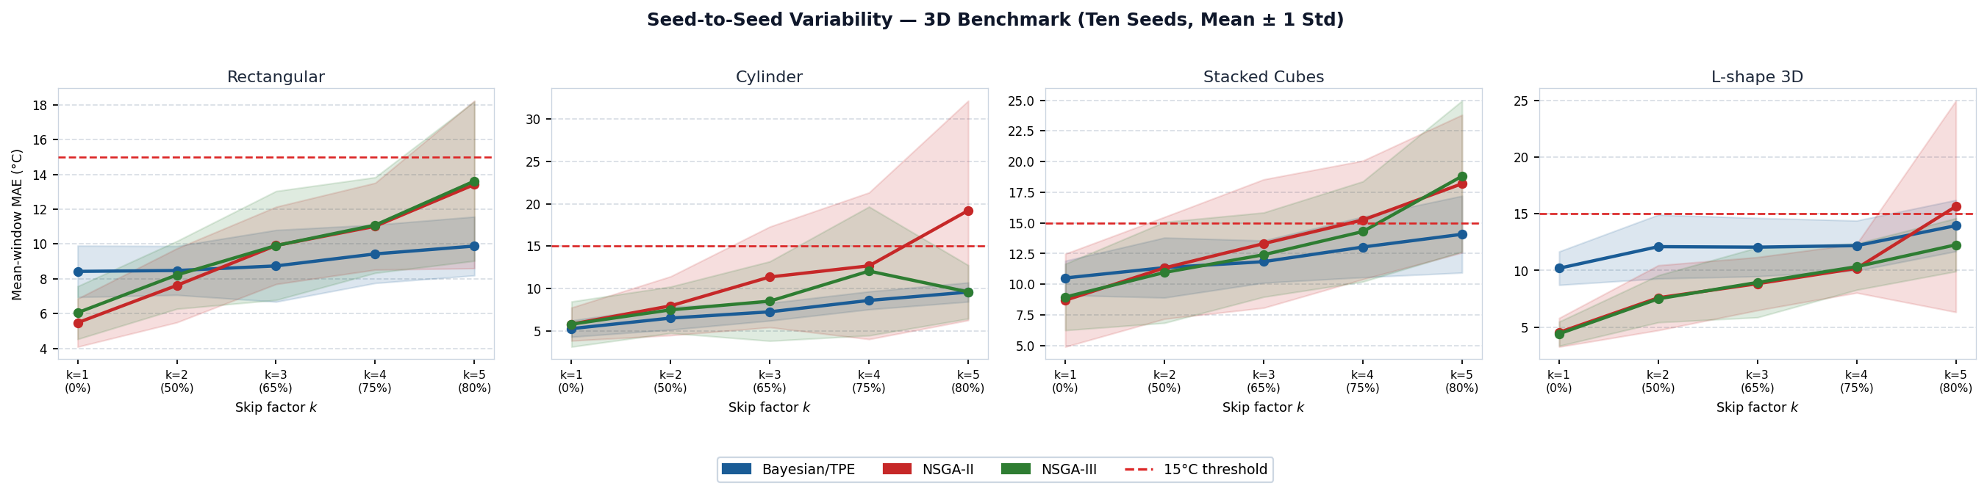
3D Results: MAE Variability and L2 Curves
RESULTS
Reading note
- These plots show 3D stability and time trends.
- The best k depends on geometry.
UiA | University of Agder
Master Thesis Defense
33

Slide 34
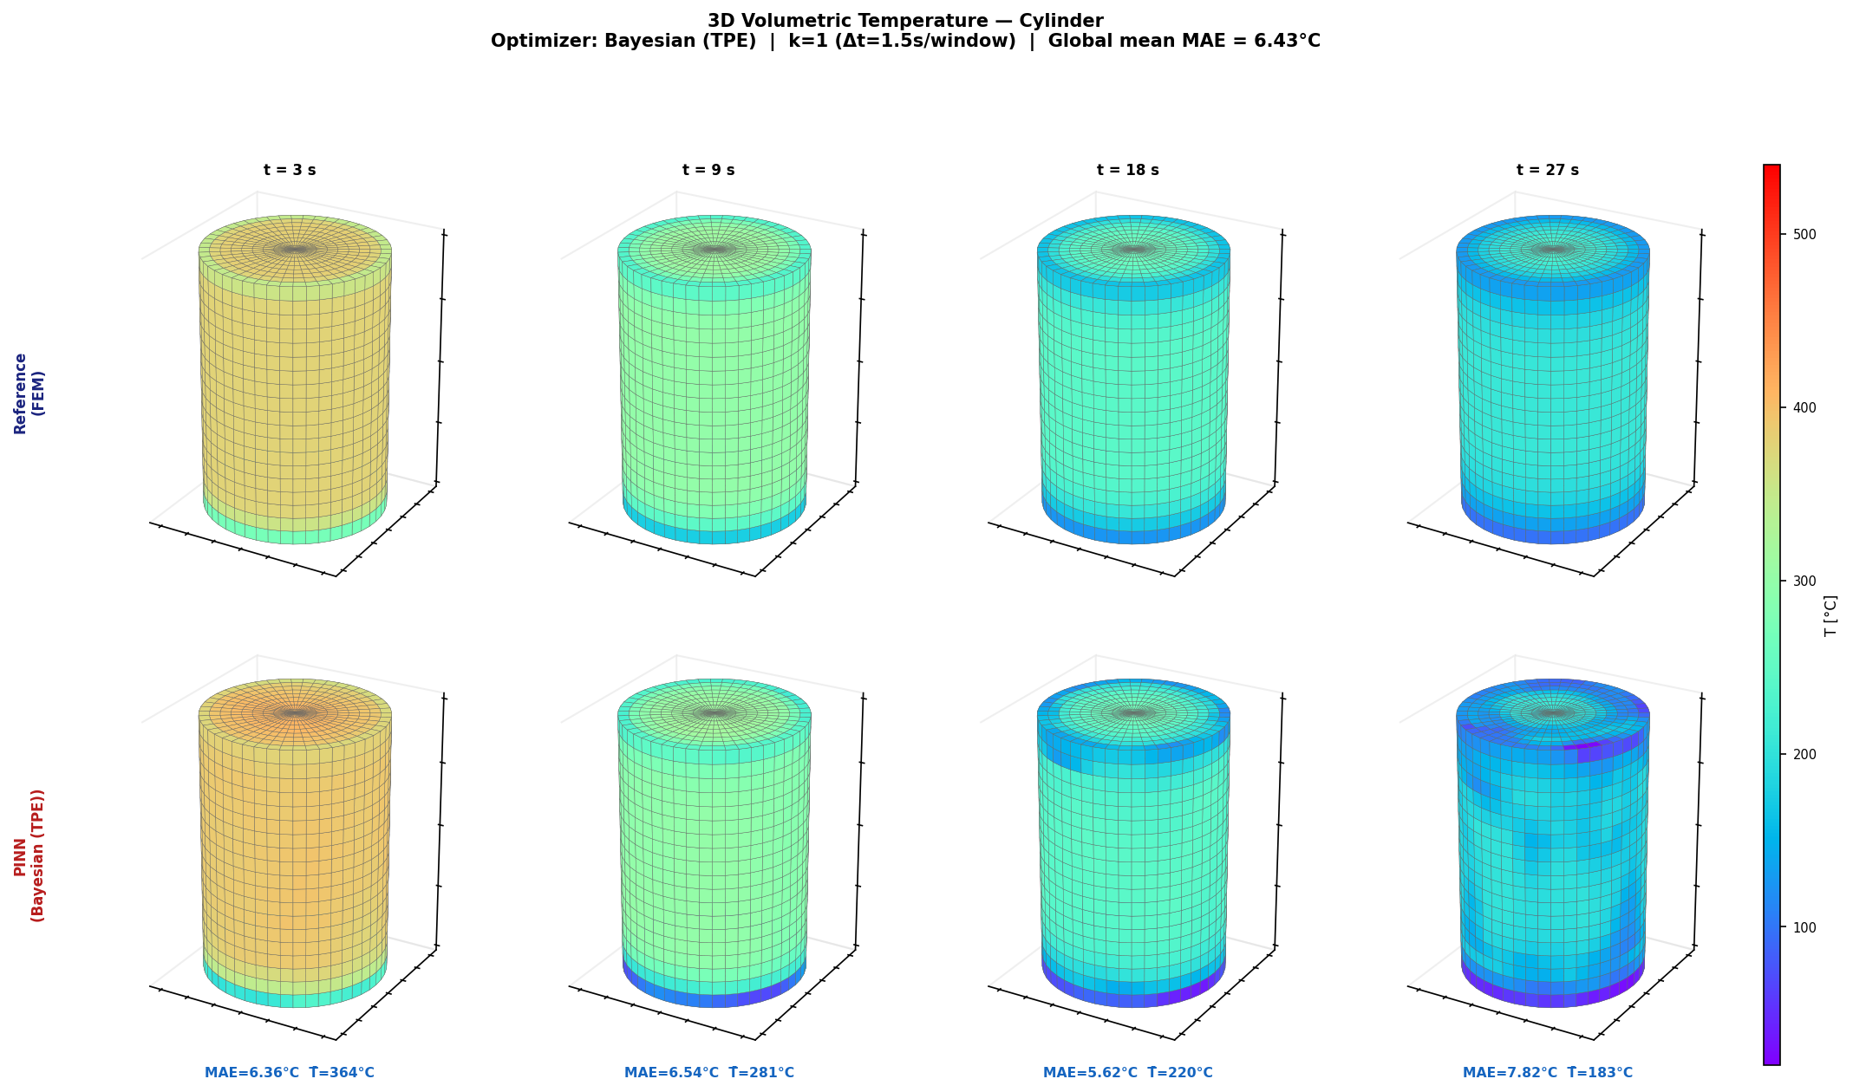
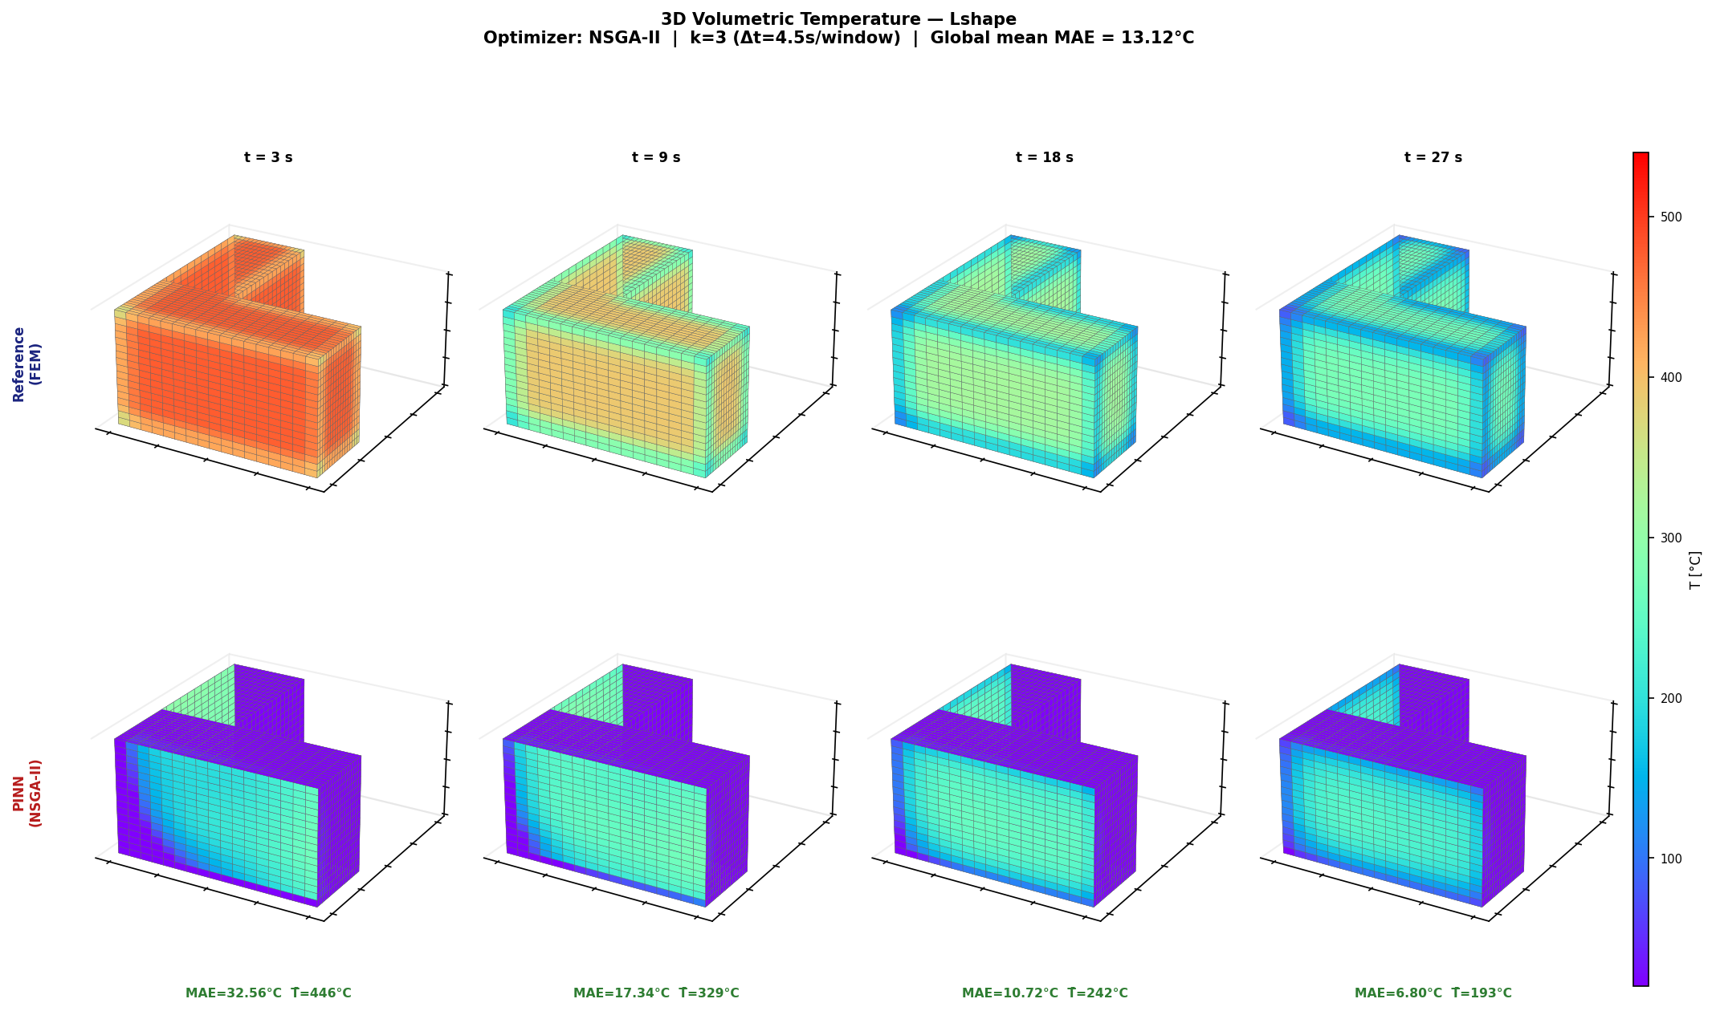
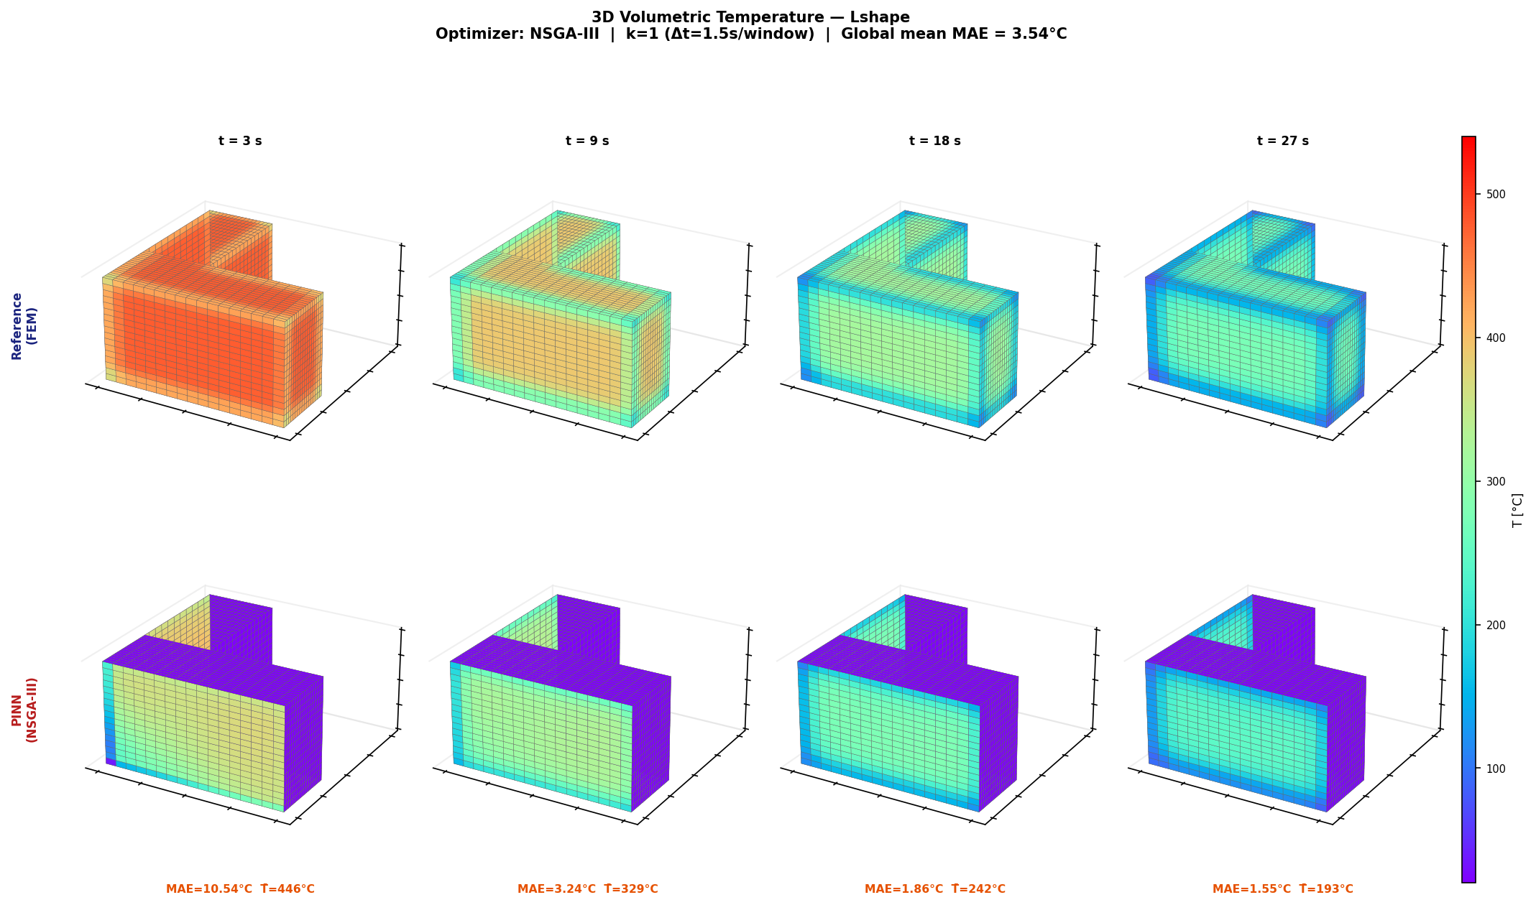
Canonical 3D Heat Maps: Best Geometry per Architecture
RESULTS
Reading note
- The 3D heat map shows volumetric behaviour.
- It helps identify local error regions.
UiA | University of Agder
Master Thesis Defense
34

Slide 35
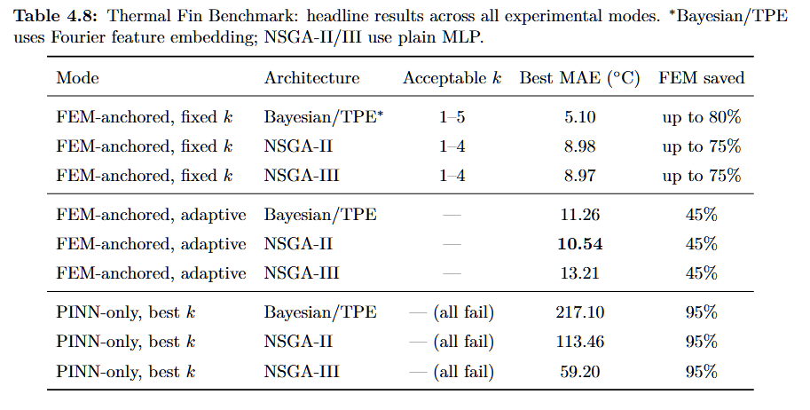
Thermal Fin: MAE and L2 Summary
RESULTS
Reading note
- Thermal Fin is the hardest benchmark.
- Bayesian/TPE with Fourier gives the strongest field accuracy.
UiA | University of Agder
Master Thesis Defense
35

Slide 36
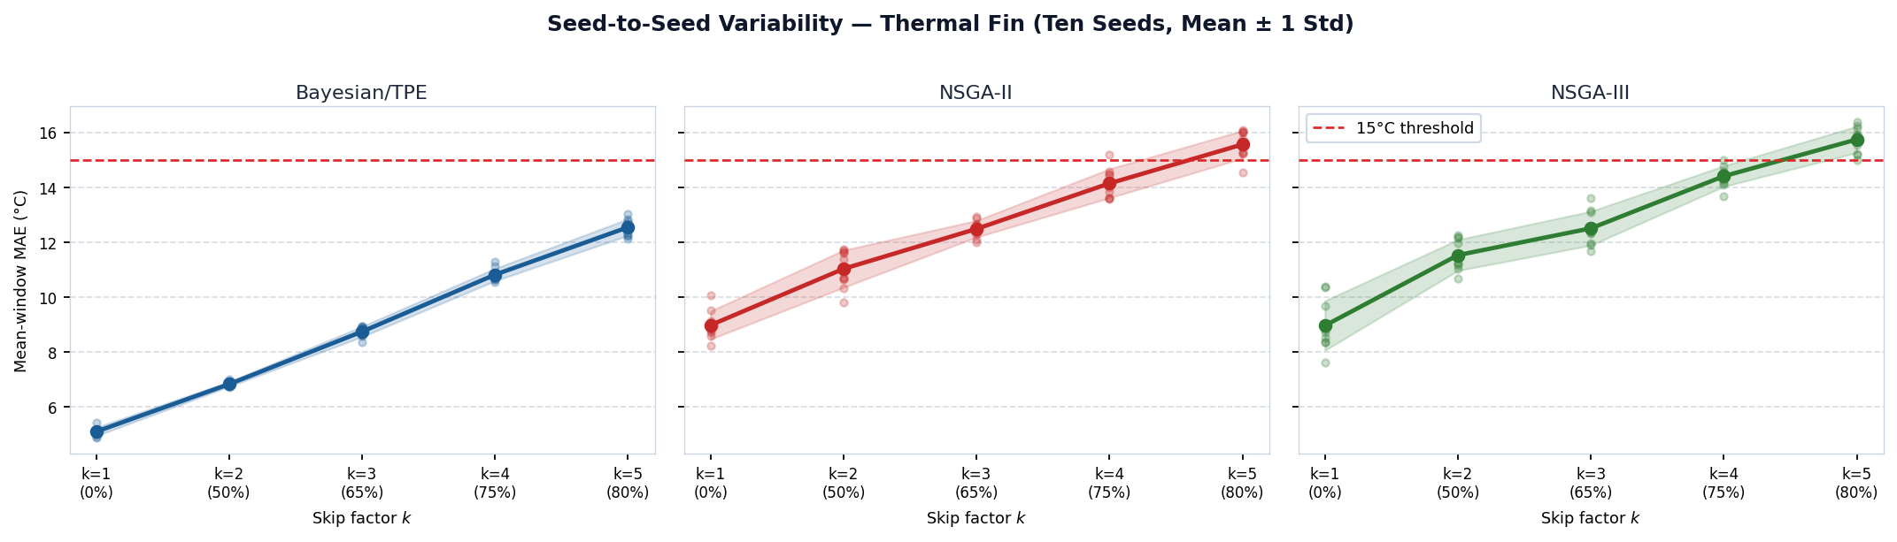
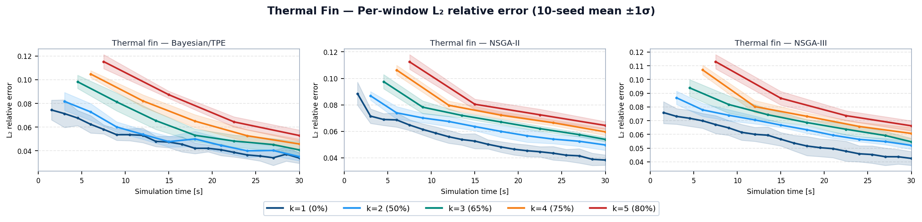
Thermal Fin: MAE Variability and L2 Curves
RESULTS
Reading note
- Higher k makes Thermal Fin prediction harder.
- Fourier features improve Bayesian/TPE stability.
UiA | University of Agder
Master Thesis Defense
36

Slide 37
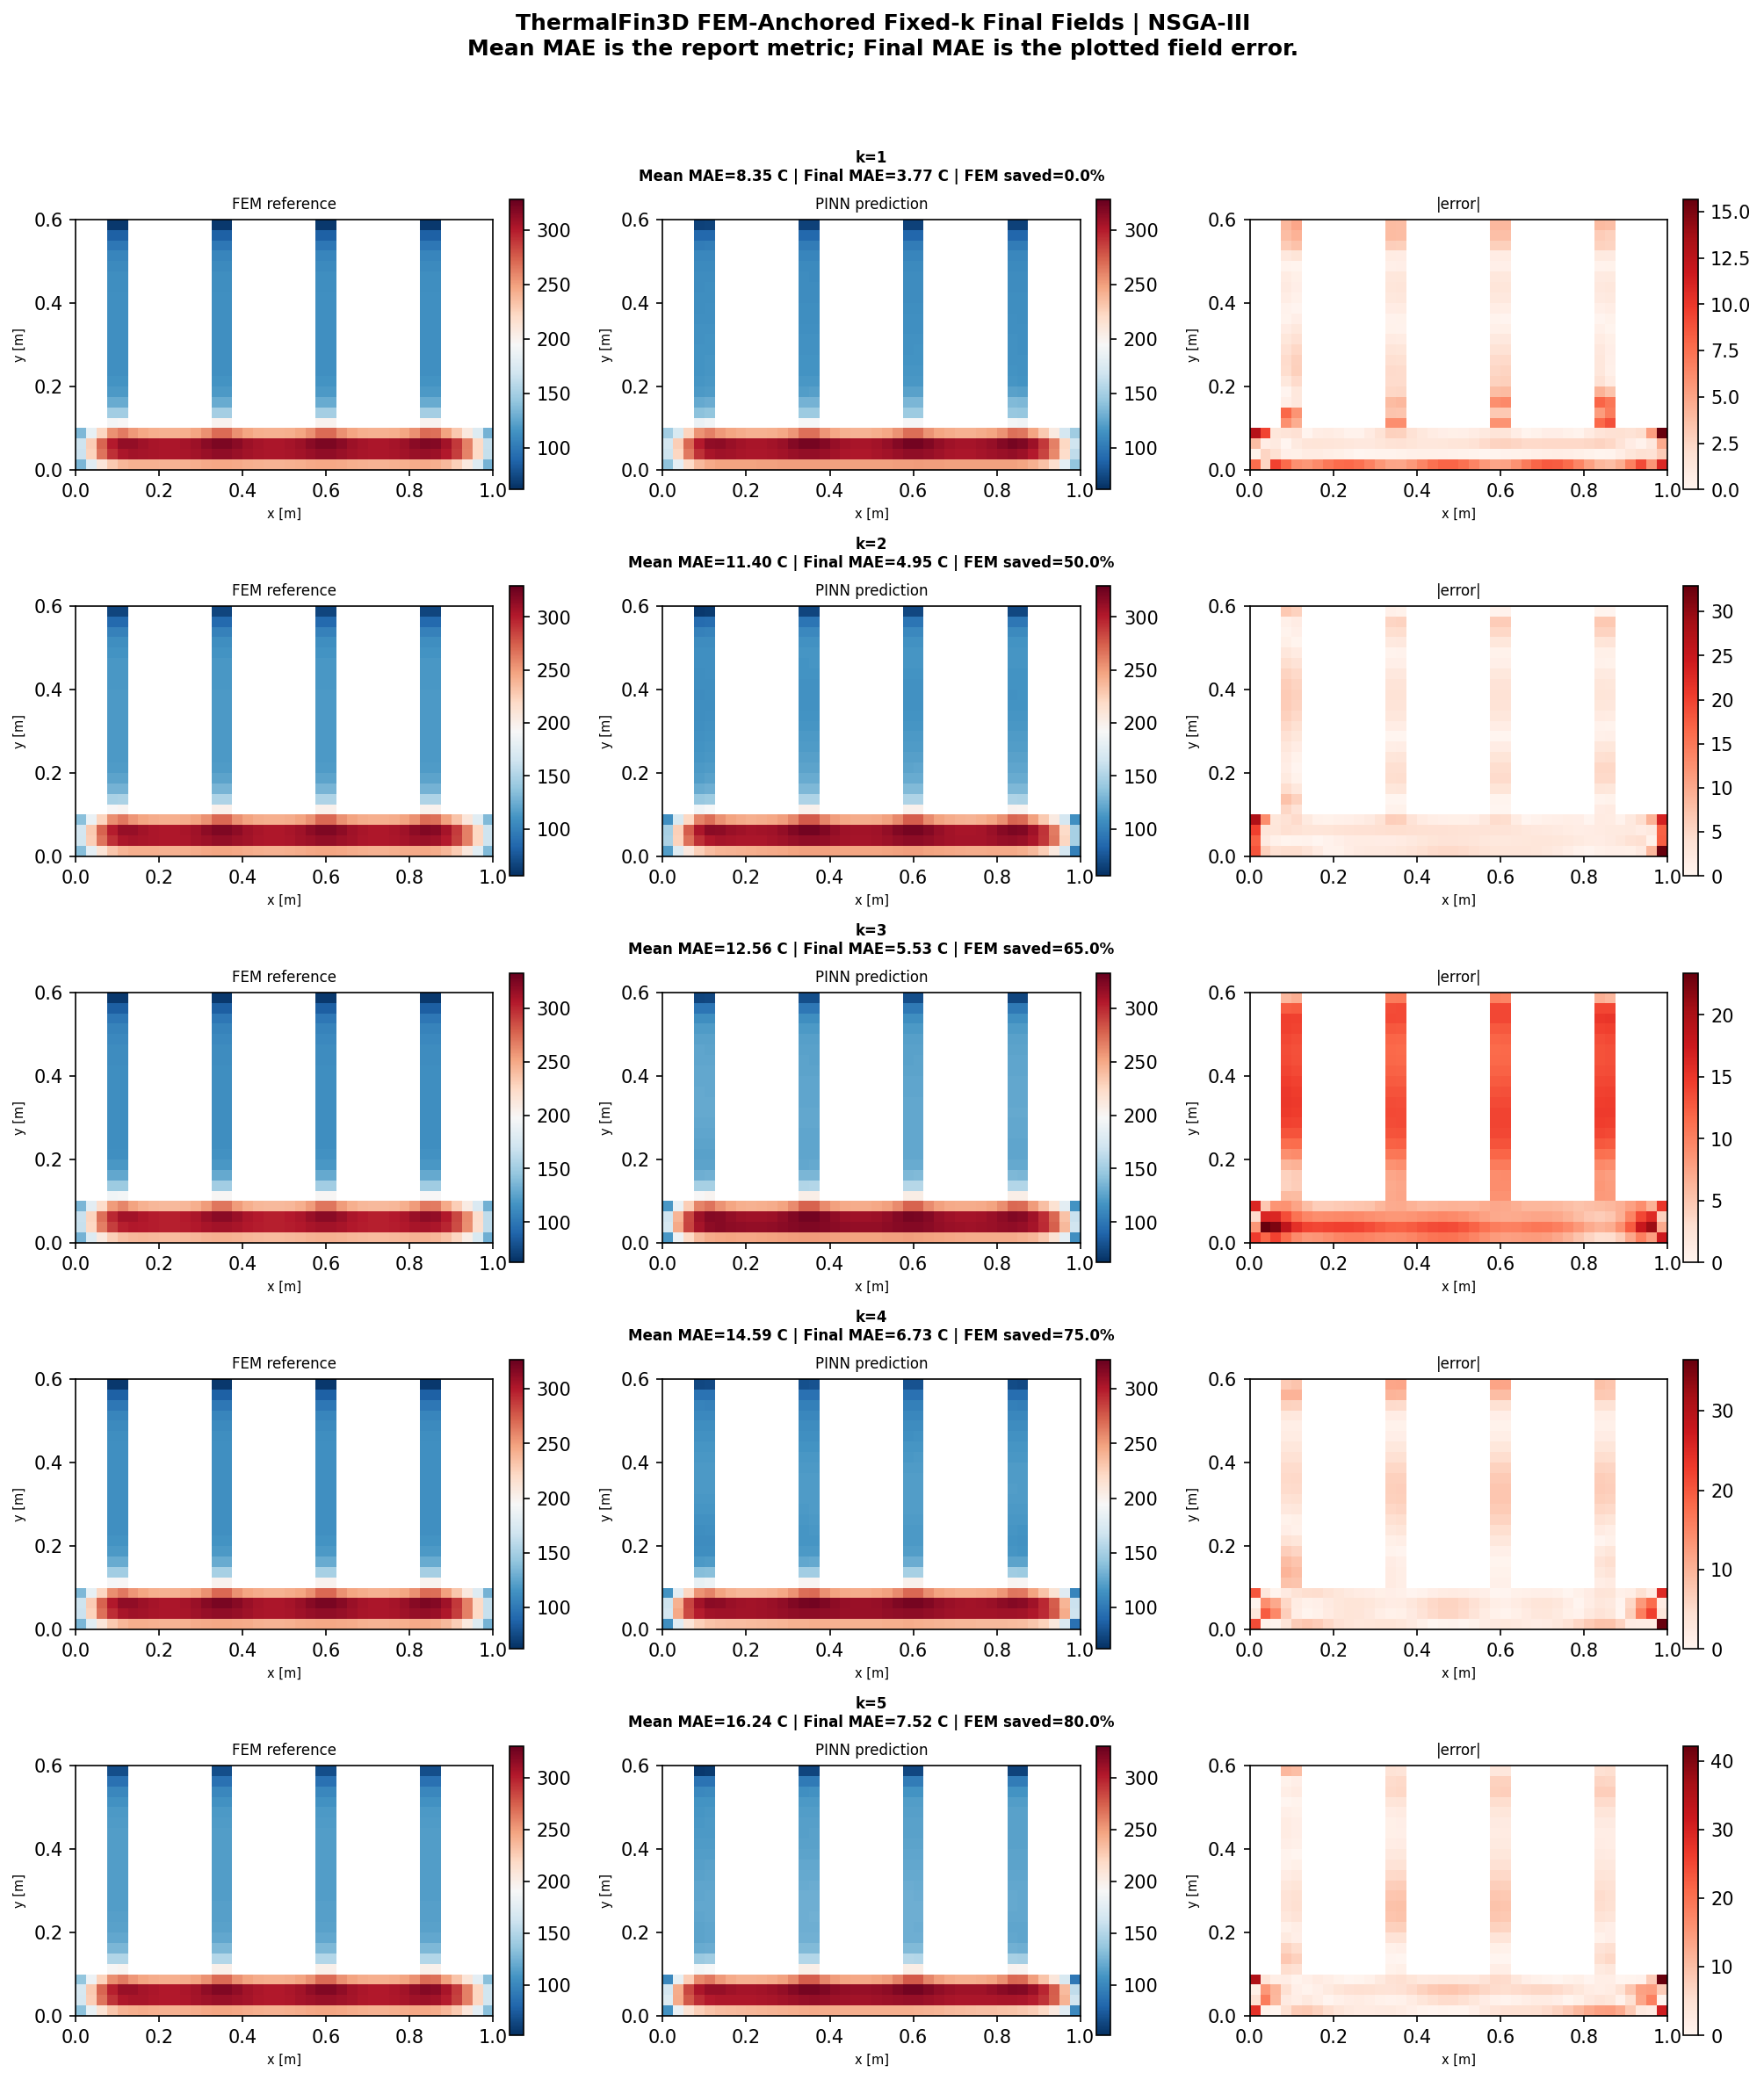
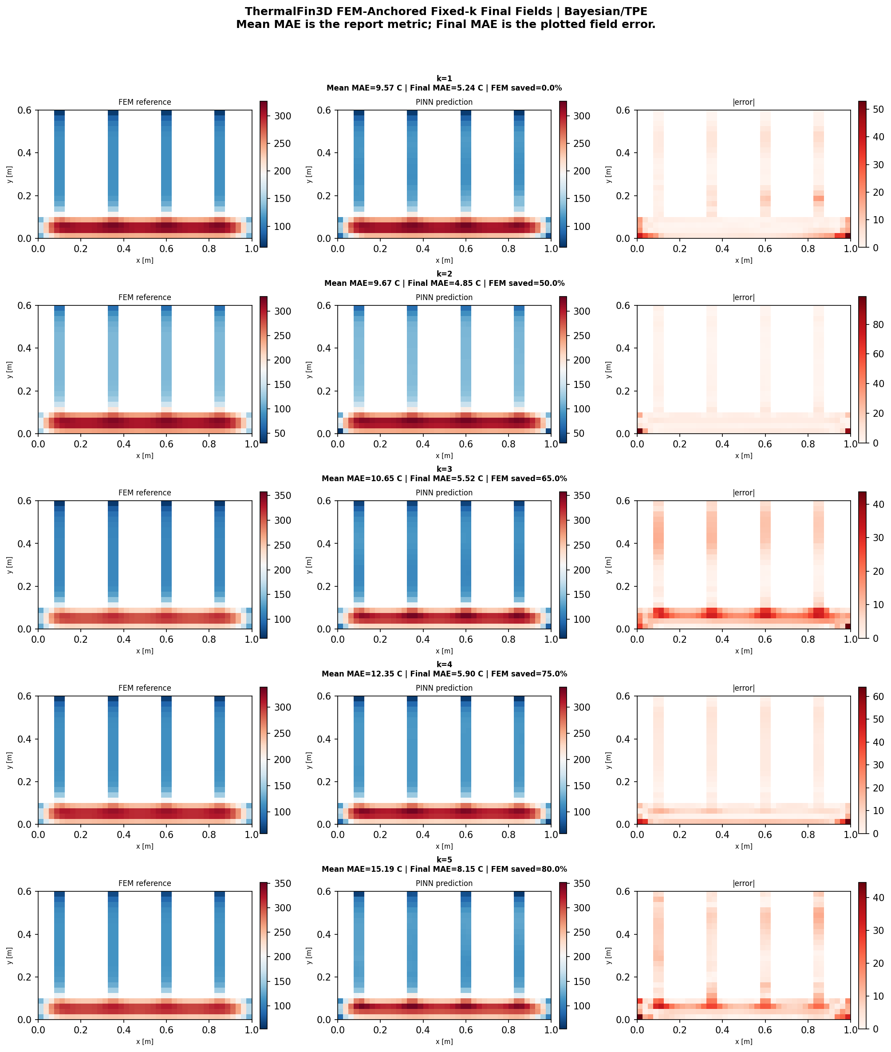
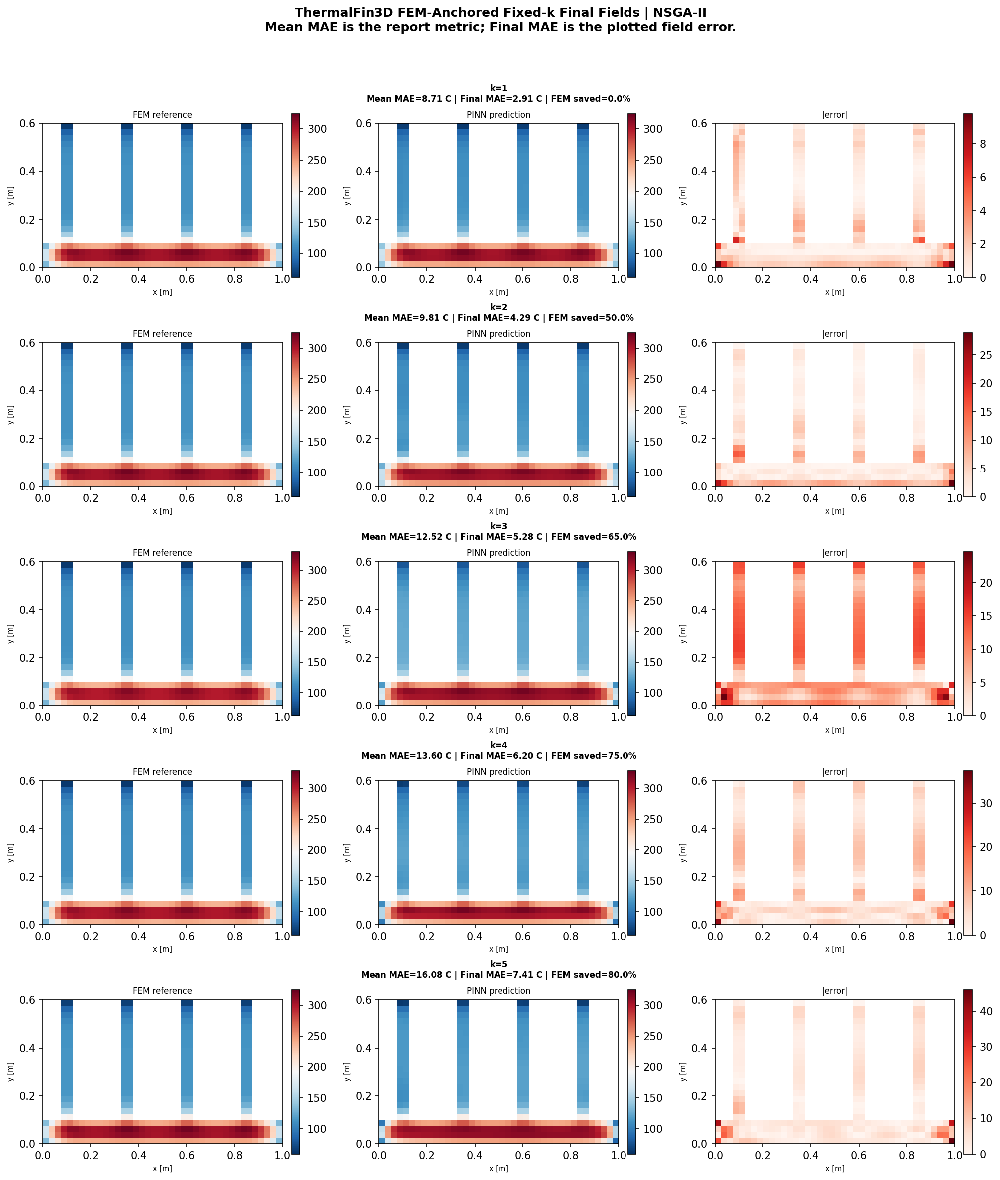
Thermal Fin: Fixed-k Heat Maps (2D)
RESULTS
Reading note
- Cross-section heat maps compare FEM, PINN, and error.
- They show where local errors remain.
UiA | University of Agder
Master Thesis Defense
37

Slide 38
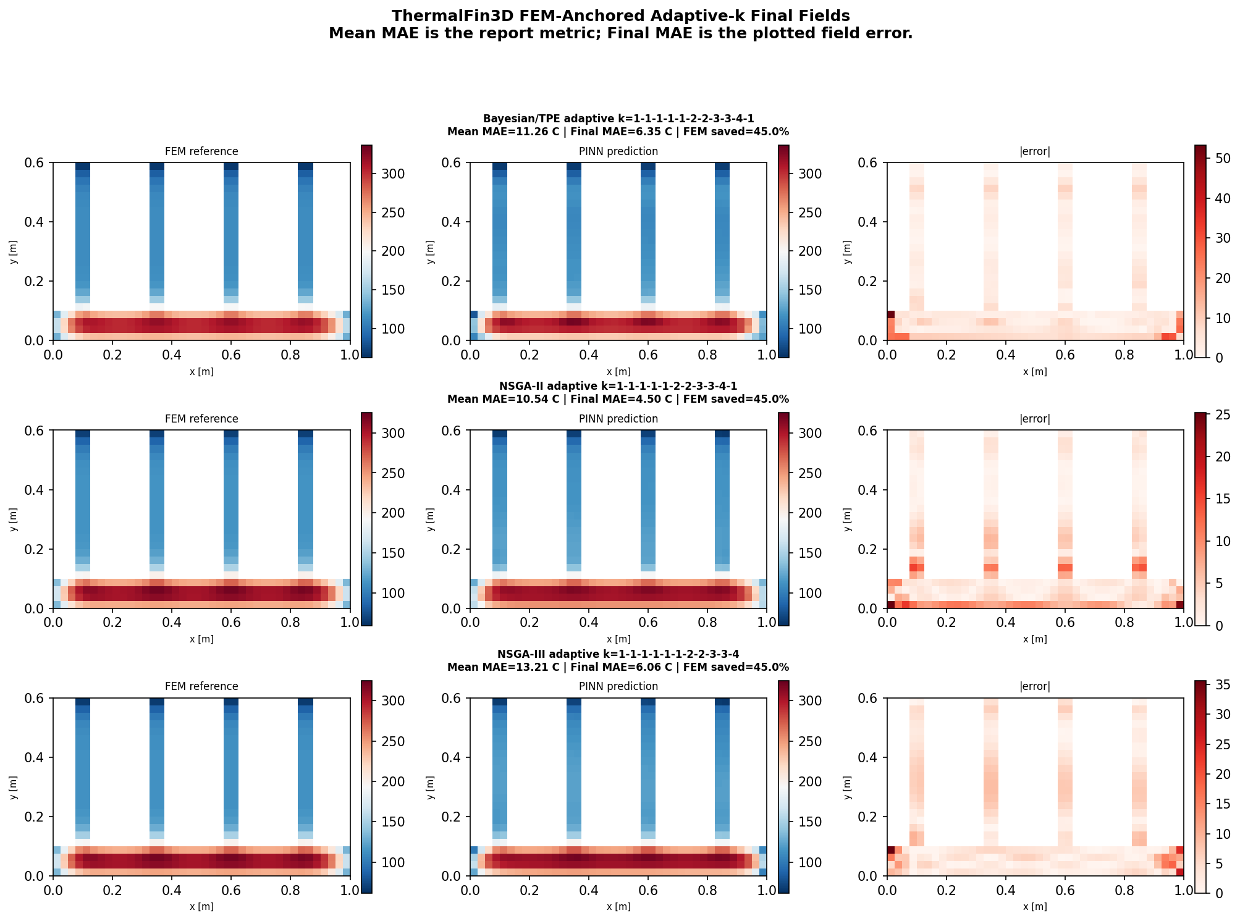
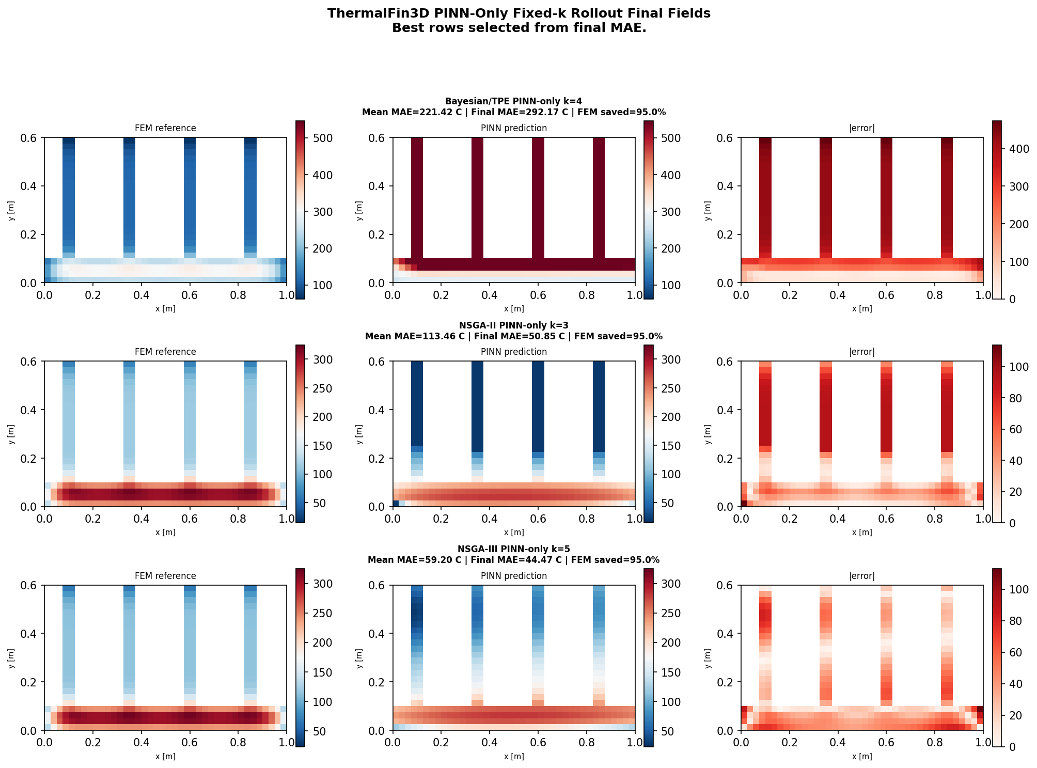
Thermal Fin: Adaptive vs PINN-only Heat Maps (2D)
RESULTS
Reading note
- Adaptive-k uses FEM anchors to correct the field.
- PINN-only removes corrections, so errors can accumulate.
UiA | University of Agder
Master Thesis Defense
38

Slide 39
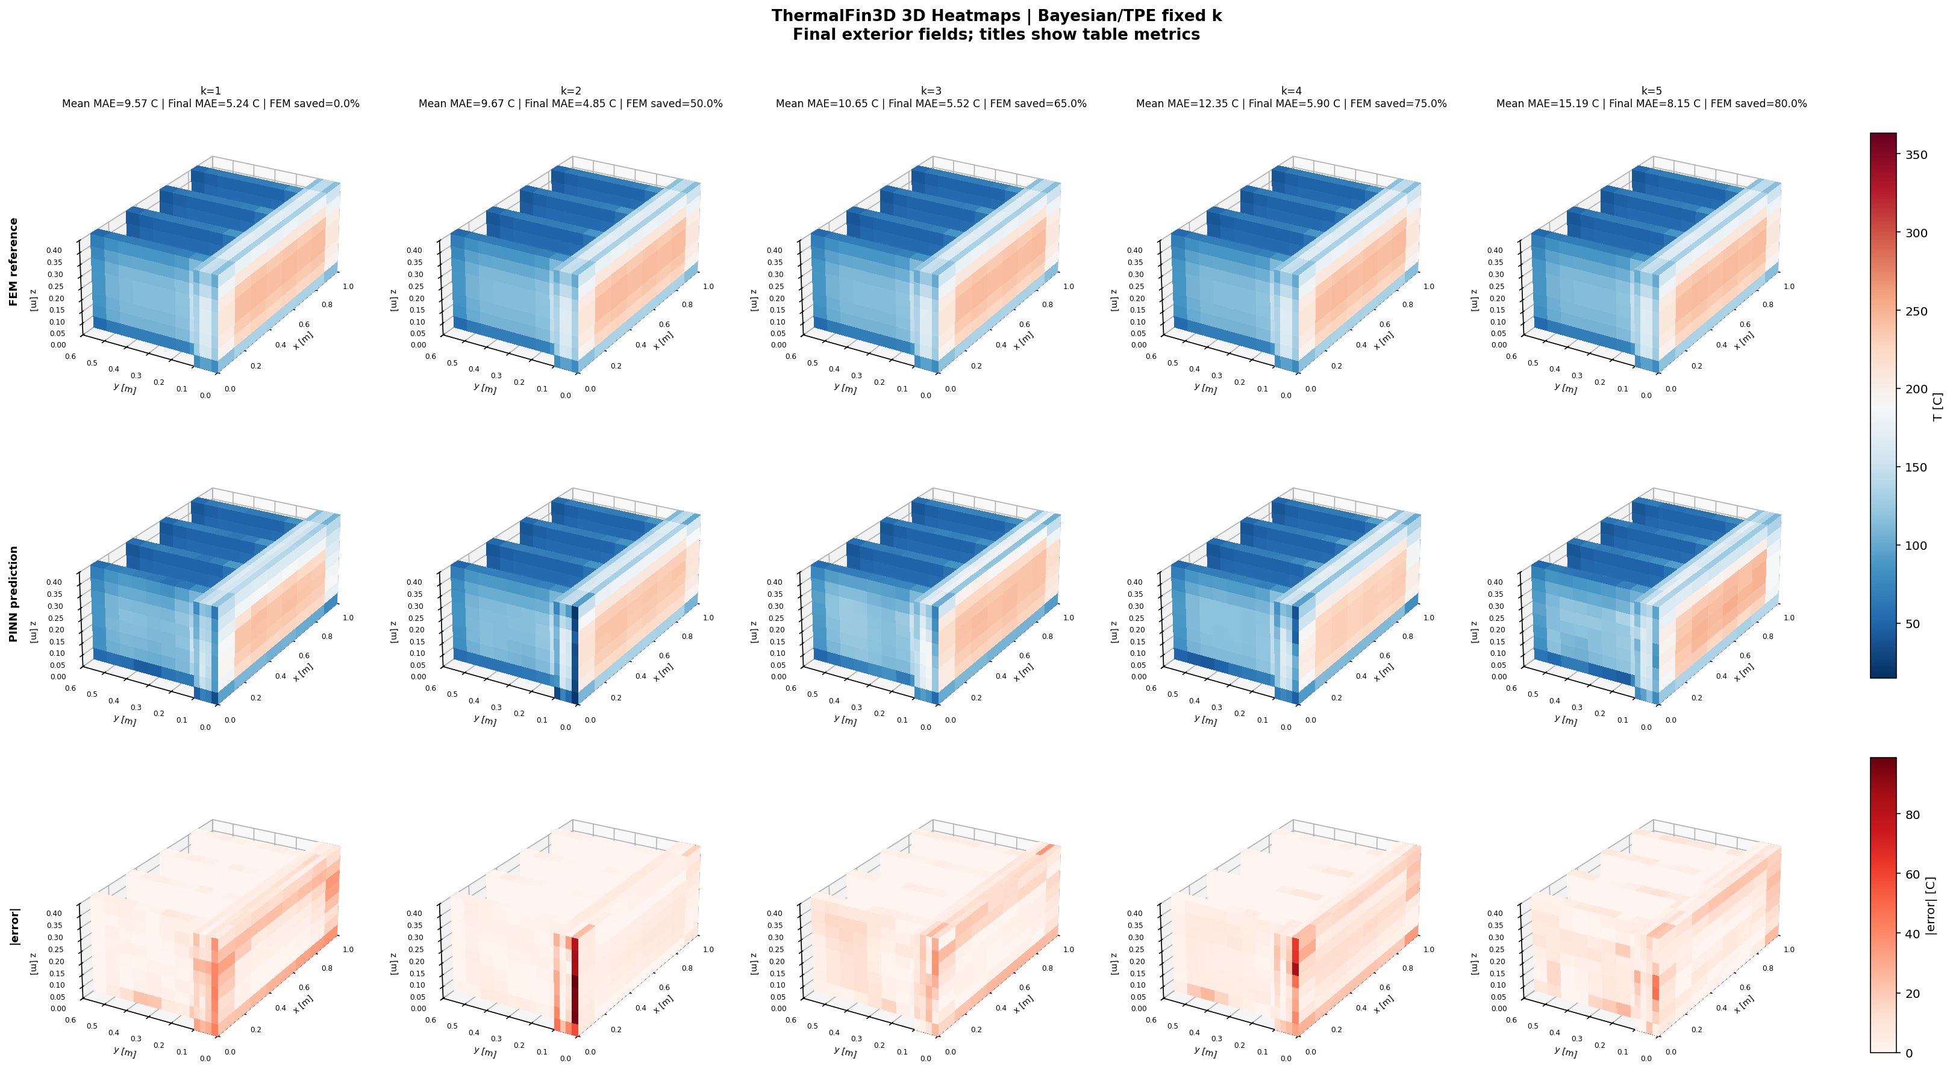
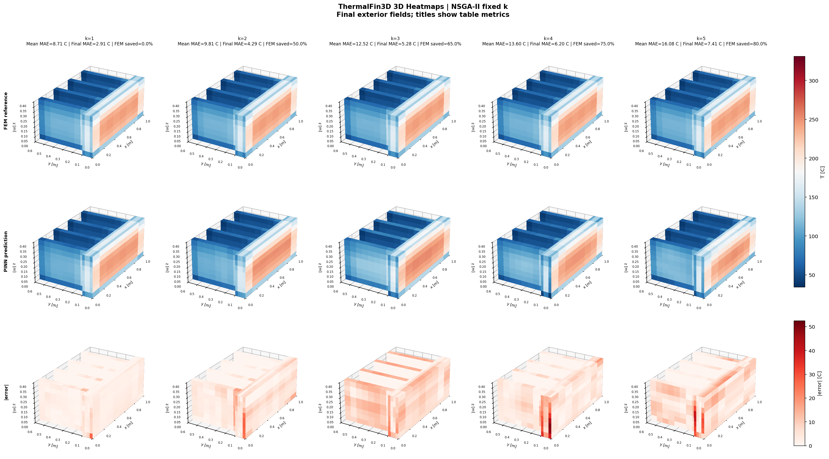
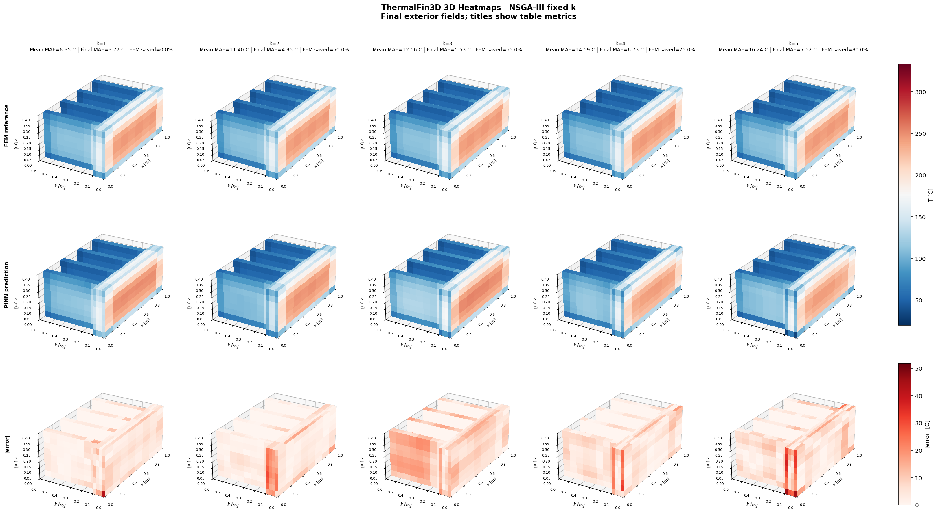
Thermal Fin: Fixed-k Volumetric Views (3D)
RESULTS
Reading note
- The volumetric view checks the full 3D field.
- Sharp fin regions are difficult.
UiA | University of Agder
Master Thesis Defense
39

Slide 40
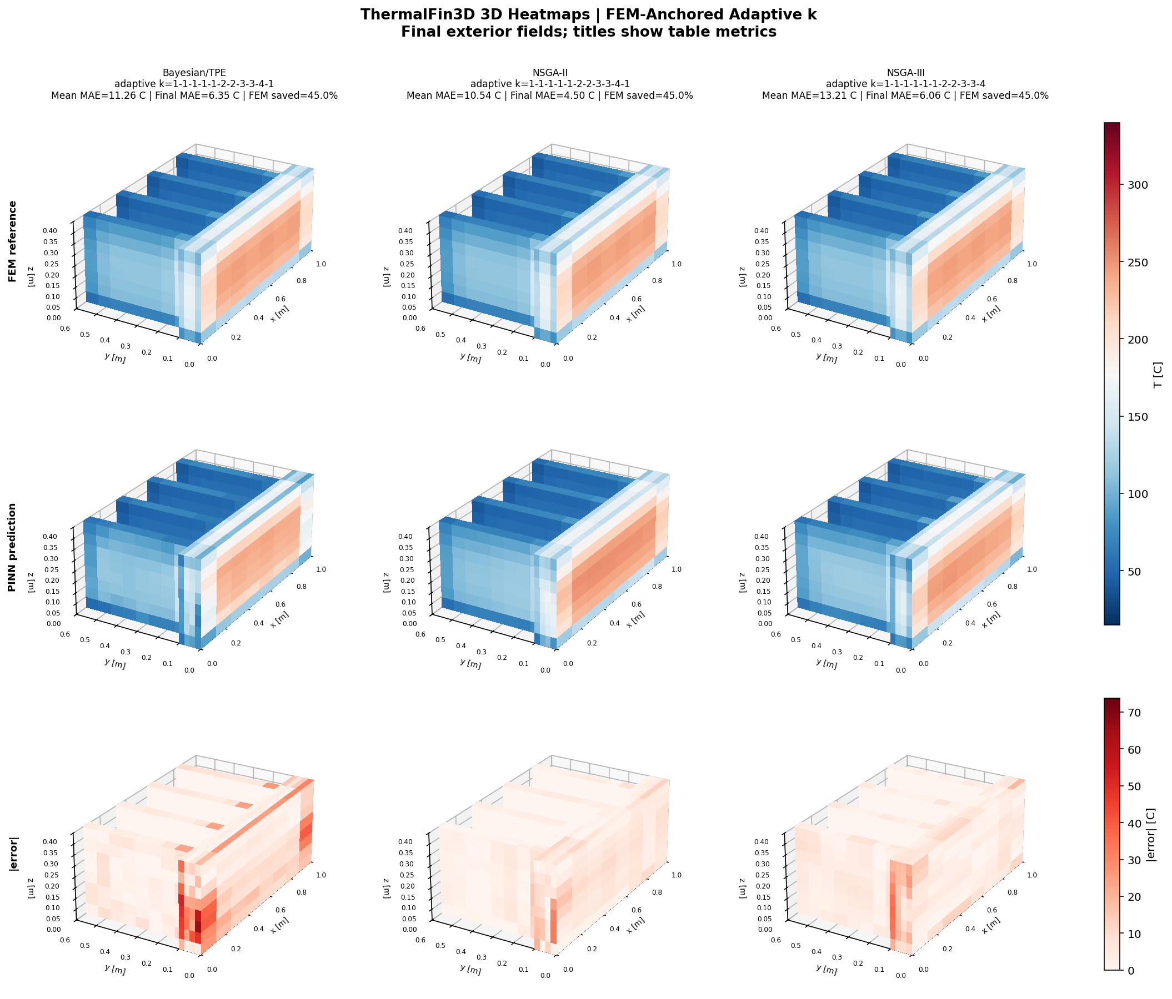
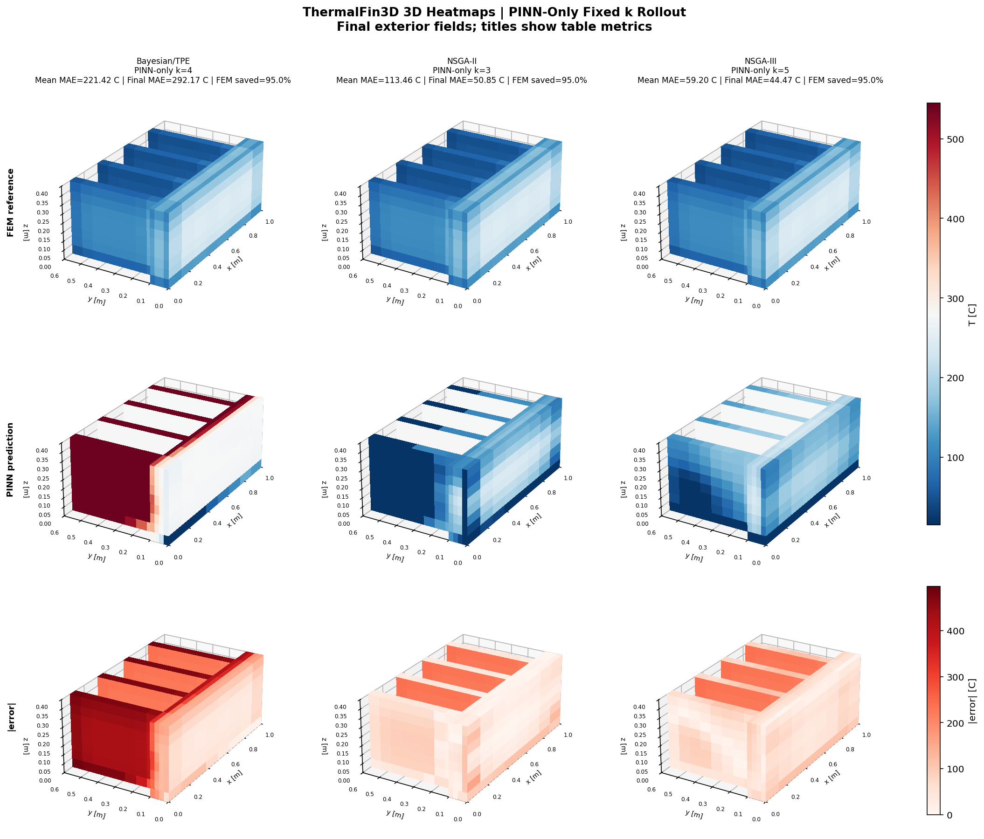
Thermal Fin: Adaptive vs PINN-only Volumetric Views (3D)
RESULTS
Reading note
- Anchored prediction keeps the 3D field more stable.
- PINN-only makes drift easier to see.
UiA | University of Agder
Master Thesis Defense
40

Slide 41
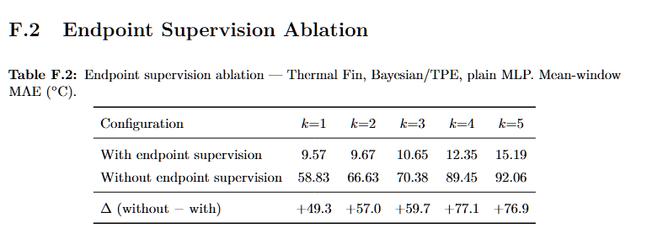
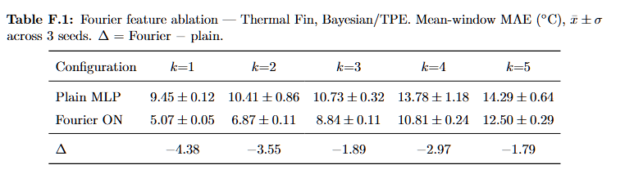
Thermal Fin: Ablation Tables F.1 and F.2
RESULTS
Reading note
- Fourier features help complex spatial patterns.
- Endpoint supervision controls window drift.
UiA | University of Agder
Master Thesis Defense
41

Slide 42
Discussion: 2D Adaptive-k and Canonical 2D
DISCUSSION
What this slide means
- 2D adaptive-k
- What I found: all architectures achieved about 83-85% FEM saving with low MAE. Why: the controller keeps short windows during the early rapid cooling phase and promotes k only after the field becomes smoother.
- Canonical 2D
- What I found: Bayesian/TPE stays strongest as k increases. Circle and L-Shape expose geometry sensitivity at high k. Why: compact architectures lose accuracy faster when boundaries are curved or gradients are concentrated.
- Key explanation
- MAE growth is not only a training issue. It is linked to physical gradient structure, boundary shape and the length of unsupported prediction windows.
- 2D results show useful FEM saving with low error.
- Complex boundaries and high k make prediction harder.
UiA | University of Agder
Master Thesis Defense
42

Slide 43
Discussion: 3D and Thermal Fin
DISCUSSION
What this slide means
- Canonical 3D
- Bayesian/TPE reaches k=5 on all four 3D domains within the 15 C band. NSGA-II/III are more geometry-sensitive at high k.
- Thermal Fin
- Bayesian/TPE + Fourier remains within the 15 C band at all k values. NSGA-II/III are acceptable through k=4, but k=5 becomes too demanding.
- PINN-only
- PINN-only errors are much larger because each imperfect prediction becomes the next initial condition. I use this to confirm that periodic FEM correction is necessary.
- 3D and Thermal Fin show stronger geometry sensitivity.
- Thermal Fin confirms that anchors are important.
UiA | University of Agder
Master Thesis Defense
43

Slide 44
Discussion: Cross-Domain Guidance
DISCUSSION
Question | Discussion answer | Practical guidance Which architecture transfers best? | Bayesian/TPE is strongest in 7 of 8 canonical cases and robust on Thermal Fin. | Use Bayesian/TPE as default deployment architecture. When is adaptive-k useful? | It protects the early steep-gradient phase and increases k as the field relaxes. | Use adaptive-k for simple/intermediate geometries. Can FEM be removed? | No. PINN-only accumulates error and fails especially on complex geometries. | Keep periodic FEM anchoring. What is MSWP's role? | It maps geometry and architecture to maximum useful k. | Use it as a FEM-reduction strategy, not replacement.
What this slide means
- Accuracy, FEM saving, and stability must be balanced.
- The best choice is not always the largest k.
UiA | University of Agder
Master Thesis Defense
44

Slide 45
Conclusion: Summary of Results
CONCLUSION
Finding | Evidence | Meaning FEM calls can be reduced | 65-85% saving in many anchored cases | MSWP is effective as an accelerator Bayesian/TPE is most robust | Strong 2D, 3D and Thermal Fin performance | Recommended default architecture Adaptive-k helps | 83-85% saving with low MAE in 2D transfer study | Useful for early steep gradients PINN-only fails | Thermal Fin best PINN-only is 59.20 C | FEM correction is necessary
What this slide means
- The thesis builds a FEM-anchored NAS-PINN workflow.
- Selected FEM calls can be reduced with useful accuracy.
UiA | University of Agder
Master Thesis Defense
45

Slide 46
Conclusion: Limitations
CONCLUSION
What this slide means
- Physics simplification
- Constant kT, rho cp and h. Real quenching uses temperature-dependent material properties and five boiling regimes.
- Solver validation
- Reference fields come from the in-house Crank-Nicolson solver, not from StaMiSim or Abaqus. Mesh independence remains future work.
- NAS and data scope
- NAS budget and benchmark geometries are finite. The real Mortensen mesh is the next deployment target, not yet the main experiment.
- The material model is simplified.
- The benchmarks are controlled, not full industrial validation.
UiA | University of Agder
Master Thesis Defense
46

Slide 47
Conclusion: Future Work and Closing Remarks
CONCLUSION
Future step | Why it matters Apply to Mortensen industrial mesh | Direct test on the target deployment geometry Use full h(T) boiling curve | Closer physics to industrial water quenching Architecture-specific adaptive-k | Better thresholds for each architecture's baseline error Residual-based sampling | More training effort where physics residual is hardest Validate against StaMiSim/Abaqus | Confirm that benchmark errors reflect true physics accuracy
What this slide means
- Future work should use temperature-dependent properties and industrial geometries.
- Goal: faster repeated simulation with controlled error.
UiA | University of Agder
Master Thesis Defense
47

Slide 48
Mortensen, D., Noorsumar, G., Fjaer, H. G., Babaei, R., & Dronen, P. E. (2026). Mitigating distortions in cast automotive subframes: A finite element simulation approach. The International Journal of Advanced Manufacturing Technology, 142, 5879-5898.
CLOSING
What this slide means
- Mortensen, D., Noorsumar, G., Fjaer, H. G., Babaei, R., & Dronen, P. E. (2026). Mitigating distortions in cast automotive subframes: A finite element simulation approach. The International Journal of Advanced Manufacturing Technology, 142, 5879-5898. Wang, Y., & Zhong, L. (2024). NAS-PINN: Neural architecture search-guided physics-informed neural network for solving PDEs. Journal of Computational Physics, 496, 112603. Raissi, M., Perdikaris, P., & Karniadakis, G. E. (2019). Physics-informed neural networks. Journal of Computational Physics, 378, 686-707. Deb, K. et al. (2002). A fast and elitist multiobjective genetic algorithm: NSGA-II. IEEE Transactions on Evolutionary Computation. Deb, K., & Jain, H. (2014). An evolutionary many-objective optimization algorithm using reference-point-based nondominated sorting: NSGA-III. IEEE Transactions on Evolutionary Computation. Akiba, T. et al. (2019). Optuna: A next-generation hyperparameter optimization framework. KDD.
- The references connect the industrial quenching problem and the NAS-PINN method.
UiA | University of Agder
Master Thesis Defense
48

Slide 49
Q&A Preparation
CLOSING
Question | Short answer | Result link What is FEM? | A trusted numerical solver used as reference and anchor. | It gives the correction snapshots. What is PINN? | A neural network trained with data error and heat-equation physics. | It predicts between FEM anchors. What is NAS-PINN? | A PINN whose architecture is selected by search, not by hand. | Bayesian/TPE is the most robust choice. MAE vs L2? | MAE is average Celsius error; L2 is field error at t=30 s. | Both are needed to judge accuracy. Why adaptive-k? | It changes window length based on error. | It saves FEM calls safely in simpler cases. Why not PINN-only? | Without FEM anchors, errors accumulate. | Thermal Fin PINN-only fails clearly. Why is PINN useful if training is slow? | Training is paid once; inference is fast for repeated use. | Useful when many FEM solves are needed.
What this slide means
- For accuracy questions: use MAE and L2.
- For speed questions: use FEM anchor reduction.
UiA | University of Agder
Master Thesis Defense
49

Slide 50
Thank You
CLOSING
What this slide means
- Thank you
- Questions and discussion
- Main takeaway
- FEM-anchored NAS-PINN can reduce FEM calls while keeping useful thermal-field accuracy. FEM is accelerated, not removed.
- Final message: FEM is not removed.
- FEM anchors give trust; NAS-PINN reduces selected repeated FEM work.
UiA | University of Agder
Master Thesis Defense
50

