Slide 1
UiA | University of Agder
NAS-Guided FEM-Anchored PINNs
Multi-Step Window Prediction for Transient A356 Water Quenching
Step Optimization in Thermal Simulation Using Selective Finite Element Method Step Skipping
Omer Cetinkaya | University of Agder | 2026
Supervisor: Prof. Turgay Celik
UiA | University of Agder
Master Thesis Defense
1

Slide 2
Presentation Structure
INTRODUCTION
What this slide means
- Intro
- Why this problem · what we built · how we test
- Theory
- Heat equation · FEM · PINN · NAS-PINN
- Method
- How FEM works · How NAS-PINN works · How MSWP works
- Results
- 2D · 3D · Thermal Fin · MAE and FEM saving numbers
- The presentation moves from problem to evidence.
- First: theory and method.
- Then: benchmarks, results, discussion, and conclusion.
UiA | University of Agder
Master Thesis Defense
2

Slide 3
The project begins with an industrial A356 aluminium quenching problem and asks whether Finite Element Method (FEM) time-step calls can be reduced without losing useful temperature accuracy.
INTRODUCTION
What this slide means
- The project begins with an industrial A356 aluminium quenching problem and asks whether Finite Element Method (FEM) time-step calls can be reduced without losing useful temperature accuracy.
- Reference paper
- The reference study models water quenching of cast A356 automotive subframes. Its FEM simulation gives the industrial motivation: temperature gradients during quenching drive distortion.
- Our approach
- We keep the same physical process setting, but test a different route: FEM provides anchor snapshots and NAS-PINN predicts selected intermediate windows.
- Validation path
- Because the real industrial data arrived late, the workflow starts with controlled surrogate geometries and then moves toward more complex 3D and Thermal Fin benchmarks.
- Material
- We simulate water quenching of hot A356 aluminium.
- The model must follow a changing temperature field.
- The goal is to reduce repeated FEM work with anchors.
UiA | University of Agder
Master Thesis Defense
3

Slide 4
What is A356 aluminium? - T6 heat treatment process
INTRODUCTION
What this slide means
- A356 aluminium A356 is an aluminium-silicon casting alloy. It is common in cast automotive parts because it is light and has useful mechanical properties.
- Water quenching After heating, the hot part is cooled quickly in water. This fast cooling changes the temperature field inside the part.
- Why simulation is needed Fast cooling can create strong temperature gradients. These gradients can cause distortion and residual stress.
- Connection to this thesis Mortensen et al. (2026) use FEM for A356 automotive subframe quenching. This thesis uses that industrial problem as motivation for FEM-step reduction.
- Source: Mortensen et al. (2026), finite element simulation of water quenching in cast A356 automotive subframes.
- A356 is a cast aluminium alloy used in engineering parts.
- Quenching controls the cooling history after heat treatment.
- This motivates faster repeated thermal simulation.
UiA | University of Agder
Master Thesis Defense
4

Slide 5
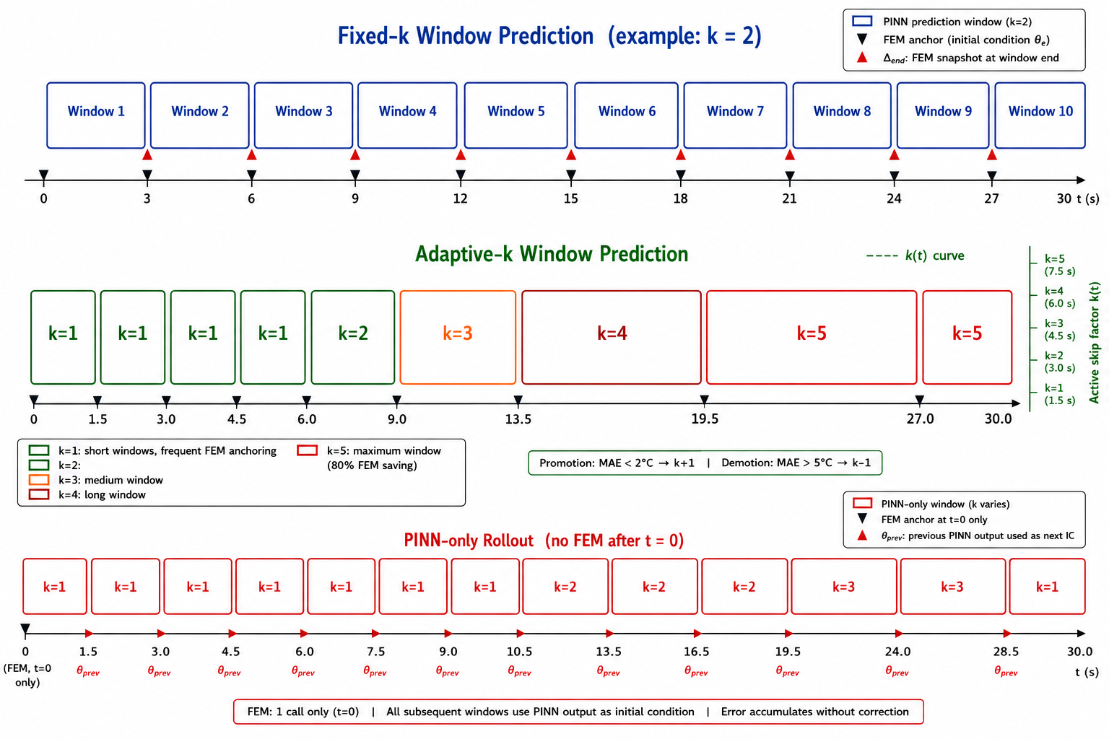
We follow the industrial quenching problem from the reference paper, then test whether FEM time-step calls can be reduced with a FEM-anchored NAS-PINN strategy.
INTRODUCTION
What this slide means
- The reference paper gives the industrial FEM-quenching background.
- This thesis keeps the same physical motivation.
- The new part is FEM-anchored NAS-PINN prediction.
UiA | University of Agder
Master Thesis Defense
5

Slide 6
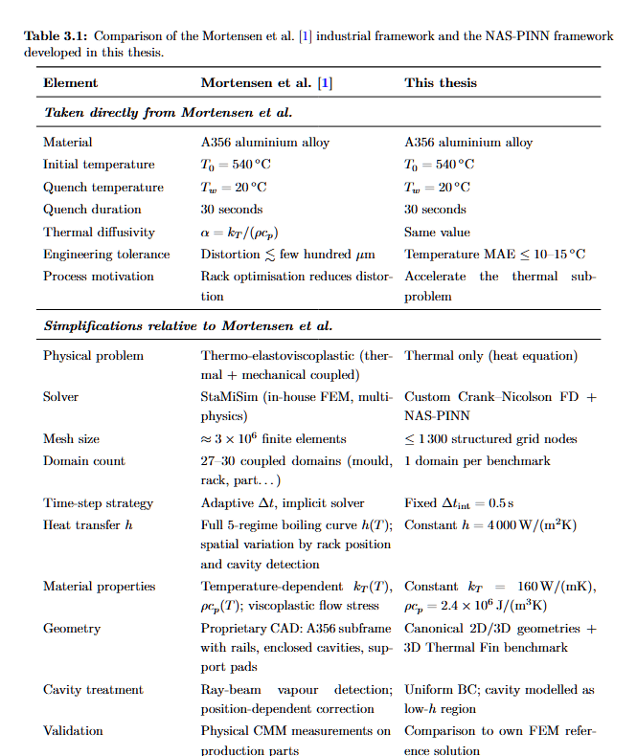
Table 3.1: what is taken from the reference study
INTRODUCTION
What this slide means
- The table separates reference-paper inputs from thesis use.
- FEM remains the trusted source.
- NAS-PINN is tested between FEM anchor fields.
UiA | University of Agder
Master Thesis Defense
6

Slide 7
Research Question and Contributions
INTRODUCTION
What this slide means
- How many FEM solver calls can be replaced by PINN predictions while keeping temperature error within engineering limits?
- We built
- A FEM-anchored NAS-PINN framework that predicts intermediate thermal fields while FEM snapshots remain the correction source.
- We tested
- Fixed-k, adaptive-k and PINN-only modes were evaluated from simple 2D domains to complex 3D and Thermal Fin cases.
- We measured
- MAE, relative L2 error, skip-factor schedule and FEM-call reduction are reported together.
- Error limits
- Main question: how many FEM calls can be skipped?
- Accuracy must stay useful, not only visually close.
- The contribution is the anchored workflow and benchmark evidence.
UiA | University of Agder
Master Thesis Defense
7

Slide 8
The whole framework is built on transient heat transfer during water quenching.
THEORY AND FEM BACKGROUND
What this slide means
- The whole framework is built on transient heat transfer during water quenching.
- Governing equation
- rho cp dT/dt = div(kT grad T) This describes how the temperature field evolves inside the solid part.
- Boundary condition
- -kT grad(T) . n = h (T - Tw) This represents heat leaving the hot metal surface into the quench water.
- Initial condition
- T(x,0) = T0 In this thesis: T0 = 540 C and Tw = 20 C.
- How Finite Element Method (FEM) uses it
- FEM and PINN use the same heat-transfer physics.
- FEM solves the equation on a grid or mesh.
- PINN uses the equation inside the loss function.
UiA | University of Agder
Master Thesis Defense
8

Slide 9
Finite Element Method (FEM), Physics-Informed Neural Network (PINN) and Neural Architecture Search PINN (NAS-PINN)
THEORY AND FEM BACKGROUND
What this slide means
- FEM
- What is it? A numerical solver for the heat equation. How we used it? It gives reliable anchor snapshots. Key point: FEM is not removed.
- PINN
- What is it? A neural network for T(x,t). How it learns? It uses data error + heat-equation error. Key point: physics is inside the loss.
- NAS-PINN
- What is it? PINN + architecture search. What is searched? Depth, width and activation. Key point: we do not choose the network manually.
- Defense message
- We used FEM for trust, PINN for prediction, and NAS to choose a better neural architecture for different geometries.
- FEM is the reliable numerical reference.
- PINN predicts temperature with physics loss.
- NAS-PINN searches the network design automatically.
UiA | University of Agder
Master Thesis Defense
9

Slide 10
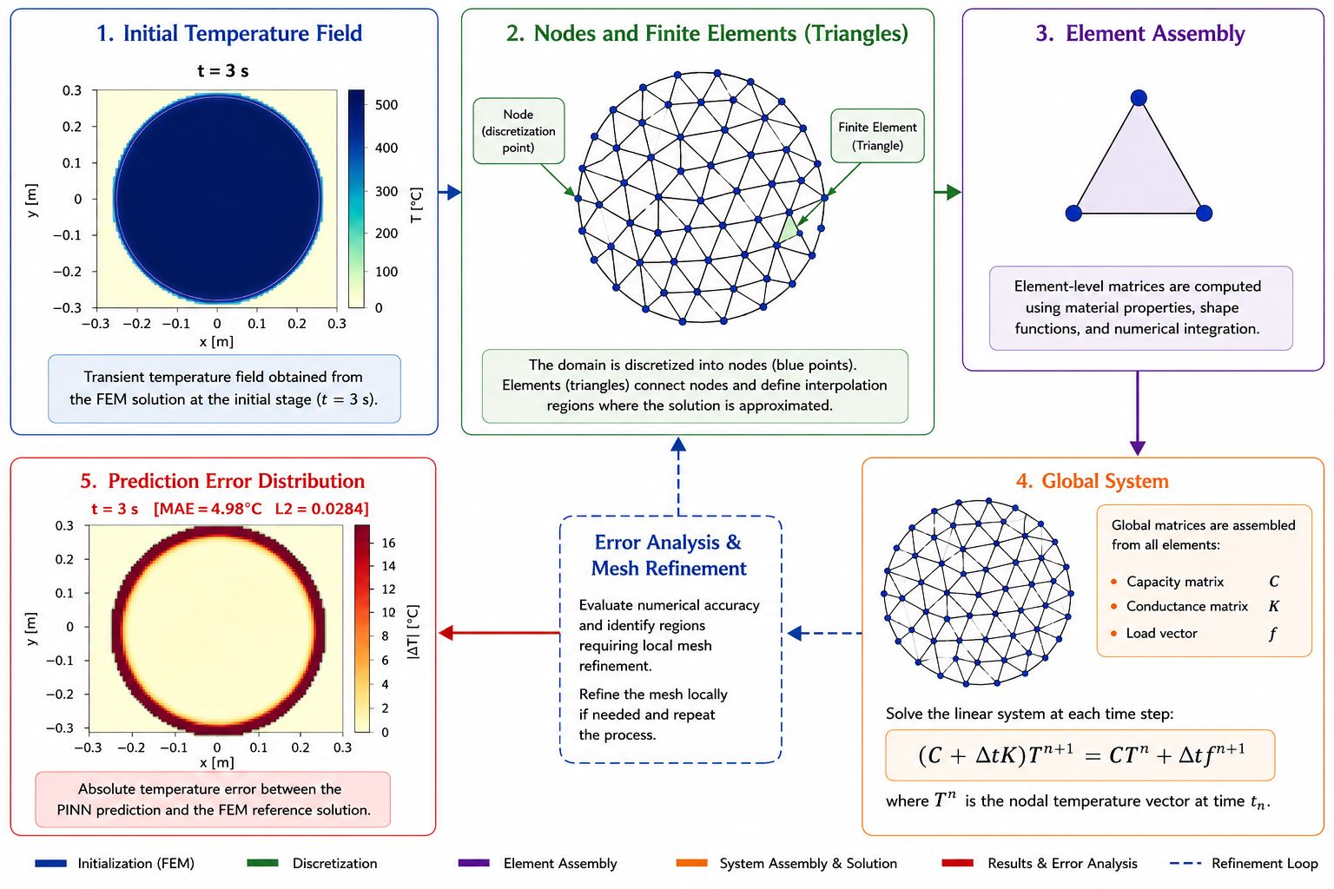
FEM Process: How It Works
THEORY AND FEM BACKGROUND
What this slide means
- Step 1: define geometry, material, and boundary conditions.
- Step 2: discretise the domain into nodes.
- Step 3: solve the transient heat equation.
- Step 4: save temperature snapshots as trusted references.
UiA | University of Agder
Master Thesis Defense
10

Slide 11
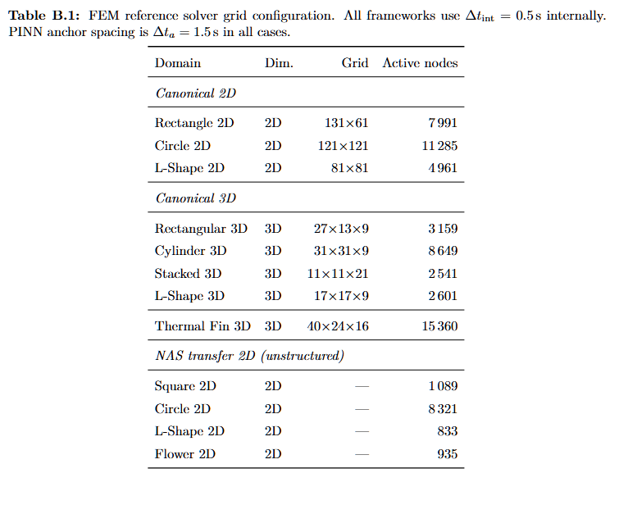
FEM Solver and Mesh Configuration
THEORY AND FEM BACKGROUND
What this slide means
- The table shows grid size and active nodes.
- Reference quality depends on this setup.
- These FEM fields are used for anchors and metrics.
UiA | University of Agder
Master Thesis Defense
11

Slide 12
FEM vs PINN: Runtime Logic
THEORY AND FEM BACKGROUND
What this slide means
Method | First use | Repeated use | Why it matters FEM | Can be fast for one small case | Must solve again for each new case | Cost grows with many runs PINN | Training can be slower | Inference is very fast | Good for repeated prediction MSWP | Uses FEM anchors | Skips selected FEM calls | Keeps trust while reducing cost
- One FEM run may be acceptable.
- Many repeated FEM runs can become costly.
- PINN training is expensive first, but prediction can be faster later.
- This is why FEM is accelerated, not removed.
UiA | University of Agder
Master Thesis Defense
12

Slide 13
FEM
METHOD
What this slide means
- FEM
- →
- PINN
- FEM gives us the reference. Now: how does PINN learn to predict without FEM?
- FEM gives trusted states.
- Next, the neural model predicts between these states.
UiA | University of Agder
Master Thesis Defense
13

Slide 14
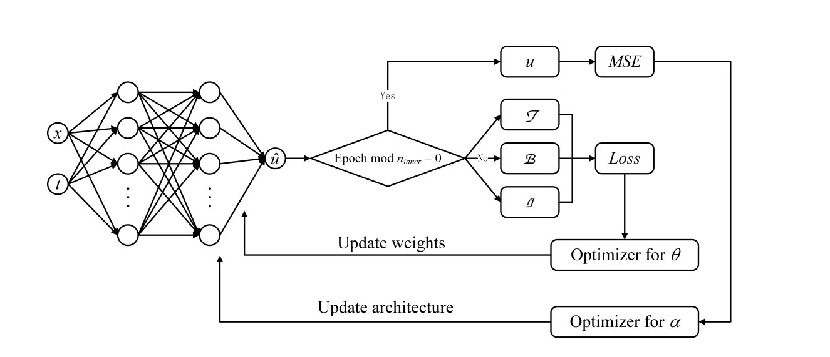
Method Source: NAS-PINN
METHOD
What this slide means
- NAS-PINN searches for a strong network architecture.
- This avoids manually choosing one fixed model.
- Different geometries may need different capacity.
UiA | University of Agder
Master Thesis Defense
14

Slide 15
PINN
METHOD
What this slide means
- PINN
- →
- NAS-PINN
- PINN works. But which architecture? Enter: Neural Architecture Search.
- PINN gives physics-based learning.
- NAS-PINN adds architecture search.
- The next slide shows the full process.
UiA | University of Agder
Master Thesis Defense
15

Slide 16
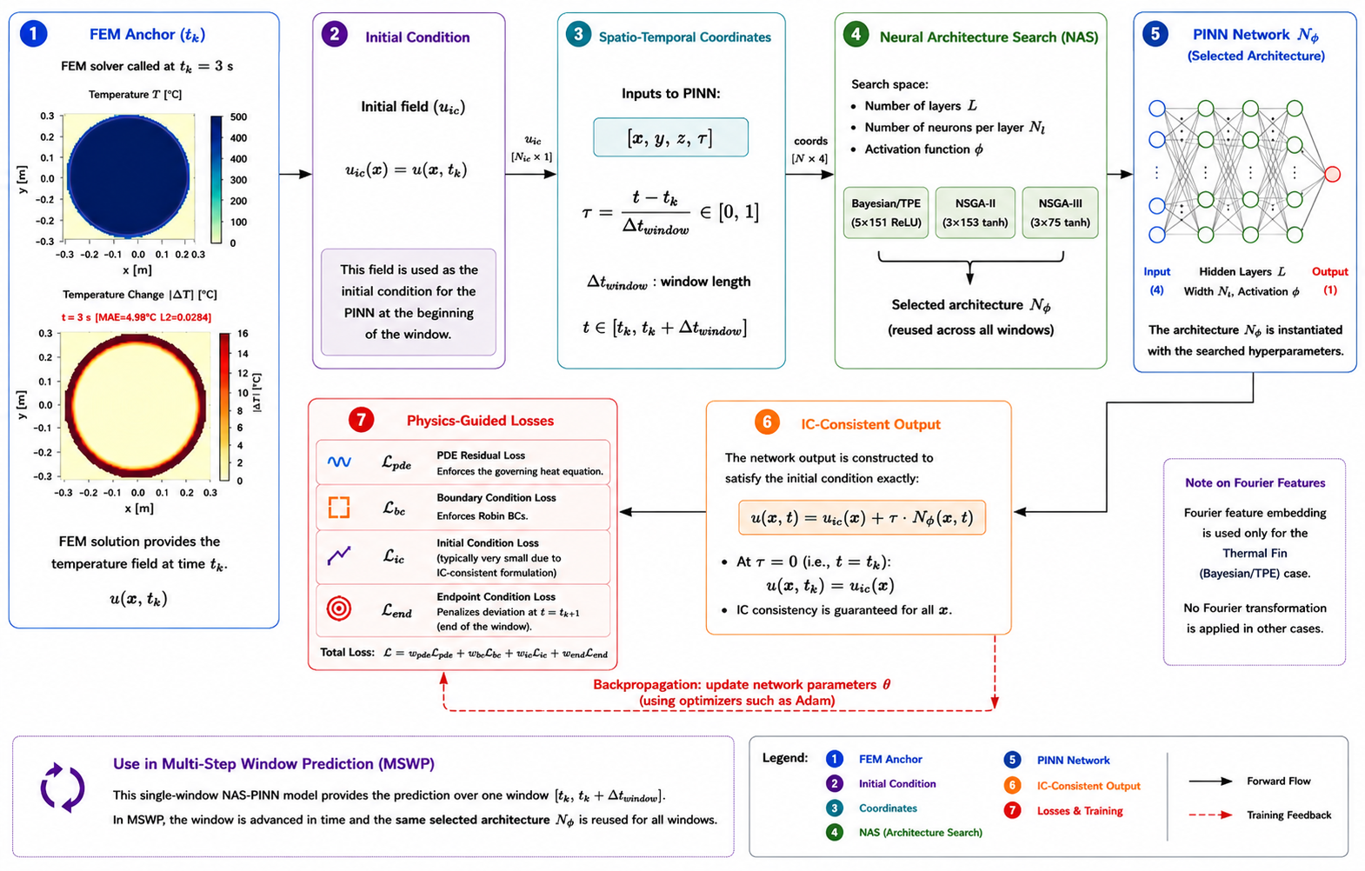
NAS-PINN Process
METHOD
What this slide means
- Step 1: FEM gives reference data.
- Step 2: PINN loss combines data and physics.
- Step 3: NAS tests candidate networks.
- Step 4: the selected model predicts thermal windows.
UiA | University of Agder
Master Thesis Defense
16

Slide 17
Architecture Search and Training Protocol
METHOD
What this slide means
Strategy | Selected architecture | Role in method Bayesian/TPE | 5 layers x 151, ReLU | High-capacity accuracy-focused model NSGA-II | 3 layers x 153, tanh | Accuracy-size trade-off NSGA-III | 3 layers x 75, tanh | Compact Pareto-diverse model
- Architecture search is done first.
- Adam gives broad training progress.
- L-BFGS improves the final fit.
- The same protocol is used for fair comparison.
UiA | University of Agder
Master Thesis Defense
17

Slide 18
Optimisation Methods Used
METHOD
What this slide means
Method | Search idea | Why used here | Architecture Bayesian/TPE | Single-objective probabilistic search | Find an accurate architecture with limited trials | 5 x 151, ReLU NSGA-II | Multi-objective evolutionary search | Balance accuracy and compactness | 3 x 153, tanh NSGA-III | Reference-point many-objective search | Promote diverse compact Pareto solutions | 3 x 75, tanh
- Bayesian/TPE, NSGA-II, and NSGA-III search the same space.
- This makes the comparison fair.
- The result shows which search strategy works best.
UiA | University of Agder
Master Thesis Defense
18

Slide 19
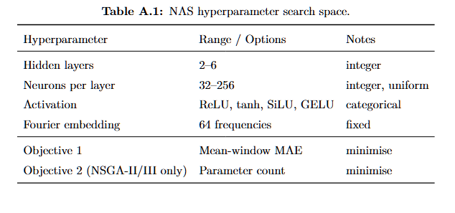
NAS Hyperparameter Search Space
METHOD
What this slide means
- The search space defines what NAS can choose.
- It includes layers, neurons, activation, and embedding.
- This makes the experiment reproducible.
UiA | University of Agder
Master Thesis Defense
19

Slide 20
NAS-PINN
METHOD
What this slide means
- NAS-PINN
- →
- MSWP
- We have the architecture. Now: how do FEM + NAS-PINN work together?
- The selected NAS-PINN model is now ready.
- The next question is how to use it over time.
UiA | University of Agder
Master Thesis Defense
20

Slide 21
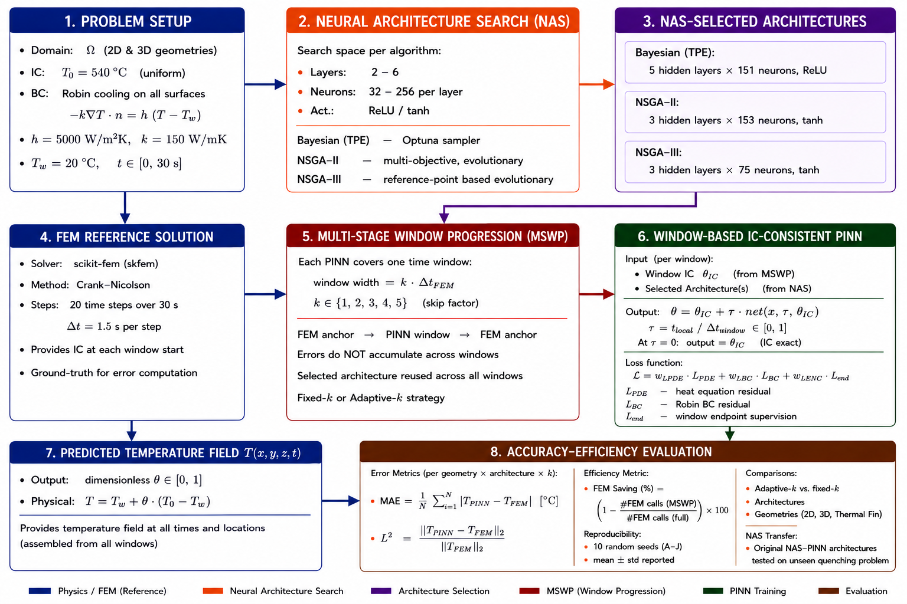
MSWP Framework: Working Logic
METHOD
What this slide means
- Step 1: FEM gives an anchor field.
- Step 2: NAS-PINN predicts the next window.
- Step 3: the next FEM anchor checks and resets the field.
- This limits drift and makes the method safer than PINN-only.
UiA | University of Agder
Master Thesis Defense
21

Slide 22
Skip Factor and Operating Modes
METHOD
What this slide means
- Small k means more FEM correction and easier prediction.
- Large k saves more FEM calls but is harder.
- Fixed-k, adaptive-k, and PINN-only test different correction levels.
UiA | University of Agder
Master Thesis Defense
22

Slide 23
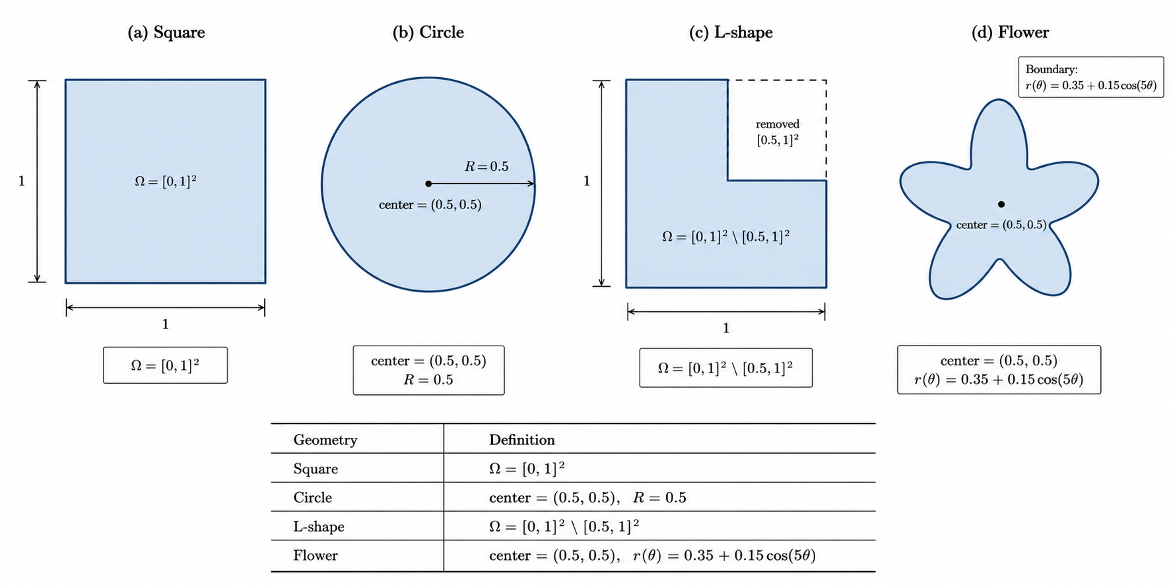
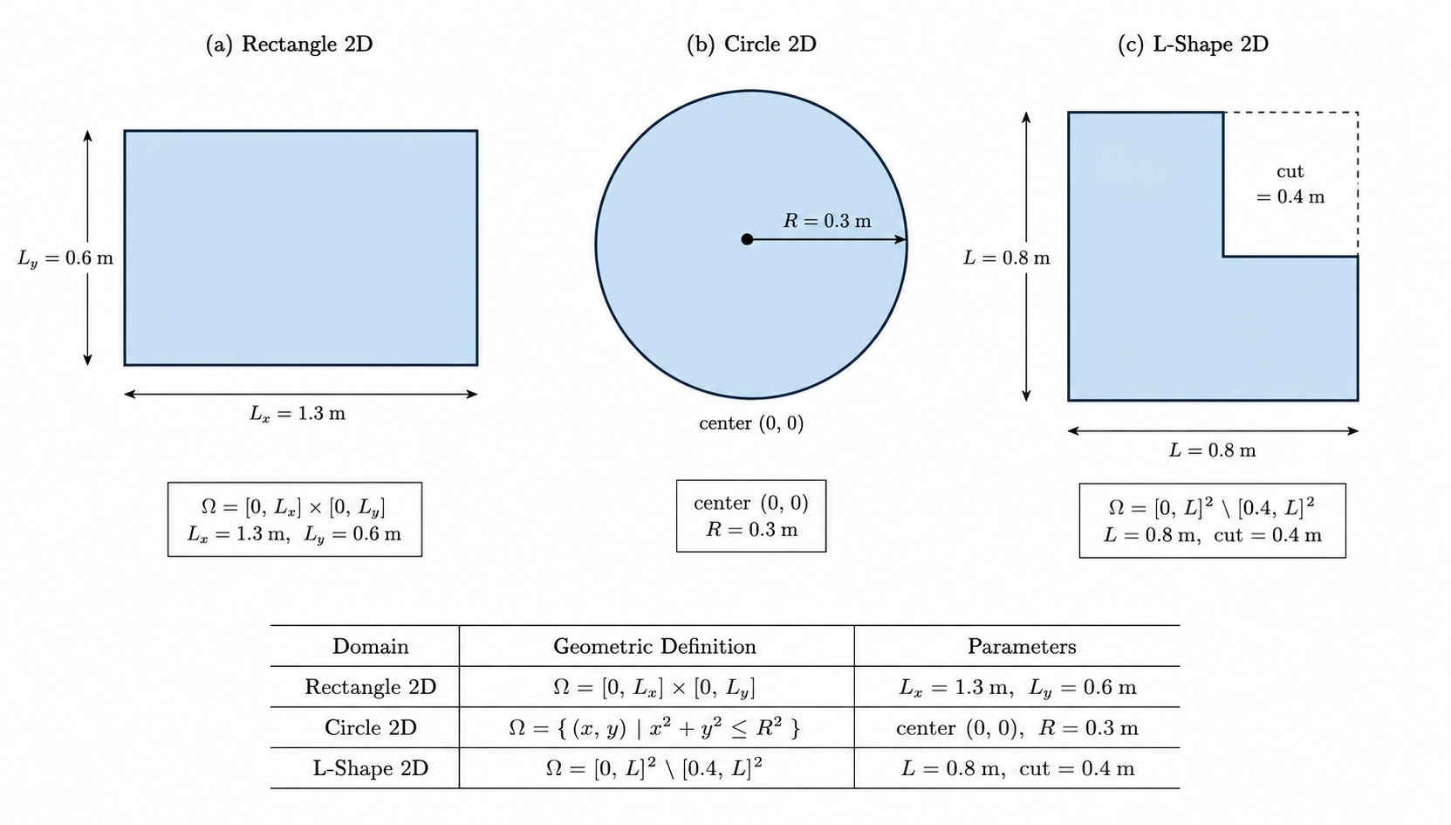
Benchmark Domains: 2D Domain Groups
BENCHMARKS AND METRICS
What this slide means
- 2D benchmarks are easier to inspect visually.
- They test transfer and geometry sensitivity.
- They prepare the method before harder 3D tests.
UiA | University of Agder
Master Thesis Defense
23

Slide 24
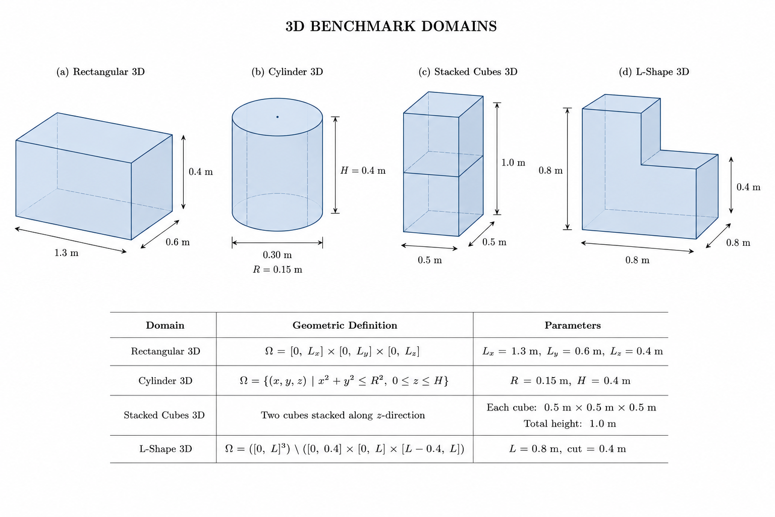
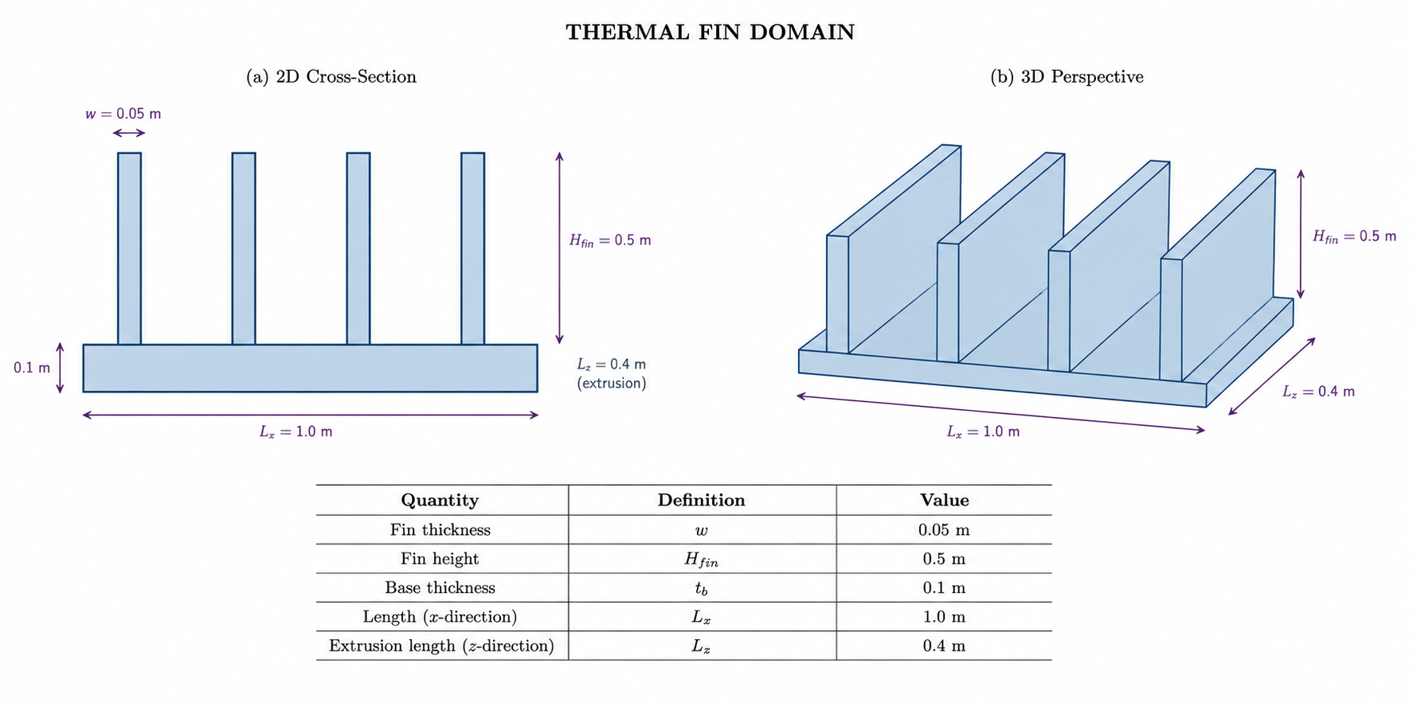
Benchmark Domains: 3D and Thermal Fin
BENCHMARKS AND METRICS
What this slide means
- 3D benchmarks test volumetric stability.
- Thermal Fin is harder because of thin and sharp regions.
- These cases test the method under more difficult geometry.
UiA | University of Agder
Master Thesis Defense
24

Slide 25
Evaluation Metrics
BENCHMARKS AND METRICS
What this slide means
- Mean Absolute Error (MAE) MAE = (1/N) sum_i |T_i^PINN - T_i^FEM| Main accuracy metric. It is reported as mean-window MAE over the prediction windows.
- Relative L2 Error Rel. L2 = ||T_hat - T_FEM||_2 / ||T_FEM - T_w||_2 Full-field error, normalised by the temperature change above the water bath. Here T_w = 20 deg C.
- FEM Anchor Reduction R(k) = (1 - N_win(k)/20) x 100% Efficiency metric. It shows how many FEM anchor calls are saved when the PINN predicts longer windows.
- How I read the numbers MAE: average temperature error in deg C. Relative L2: spatial field quality at 30 s. R(k): saved FEM solver calls. Together, they show the trade-off between accuracy and computational cost.
- Important note from the report Final-window MAE alone can be misleading in PINN-only tests. Near 30 s, the field naturally moves toward the water temperature. So the mean-window MAE is used as the primary metric.
- Source: Chapter 3, Evaluation Metrics.
- MAE measures average temperature error.
- Relative L2 checks full-field quality at 30 seconds.
- FEM anchor reduction measures saved FEM calls.
- All three metrics must be read together.
UiA | University of Agder
Master Thesis Defense
25

Slide 26
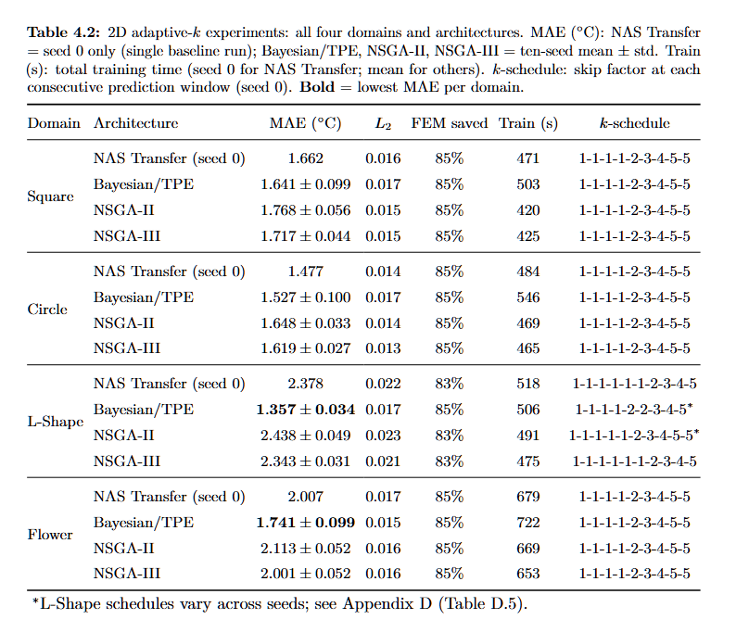
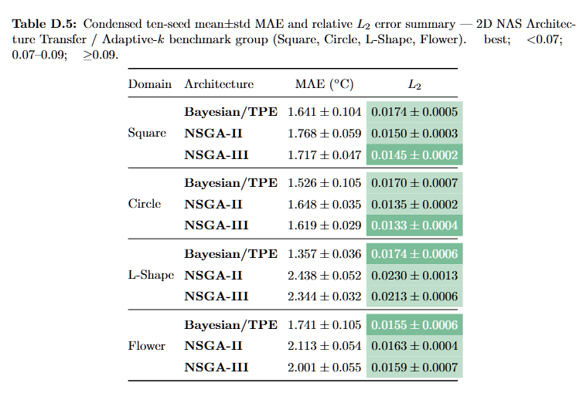
2D Adaptive-k: MAE and L2 Summary
RESULTS
What this slide means
- These are the 2D NAS-transfer adaptive-k results.
- MAE shows average window error.
- L2 shows final field quality.
- Low errors with FEM saving mean the method is successful here.
UiA | University of Agder
Master Thesis Defense
26

Slide 27
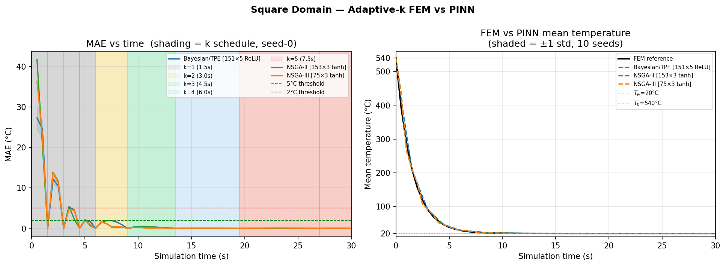
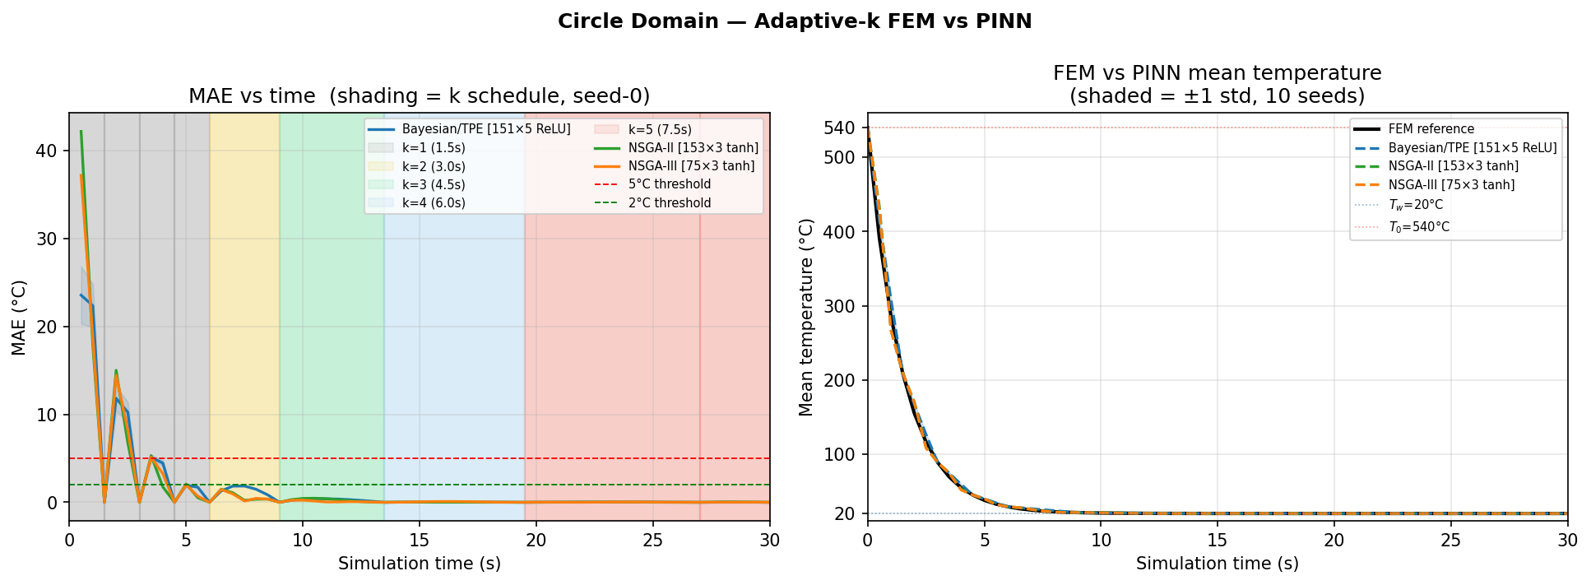
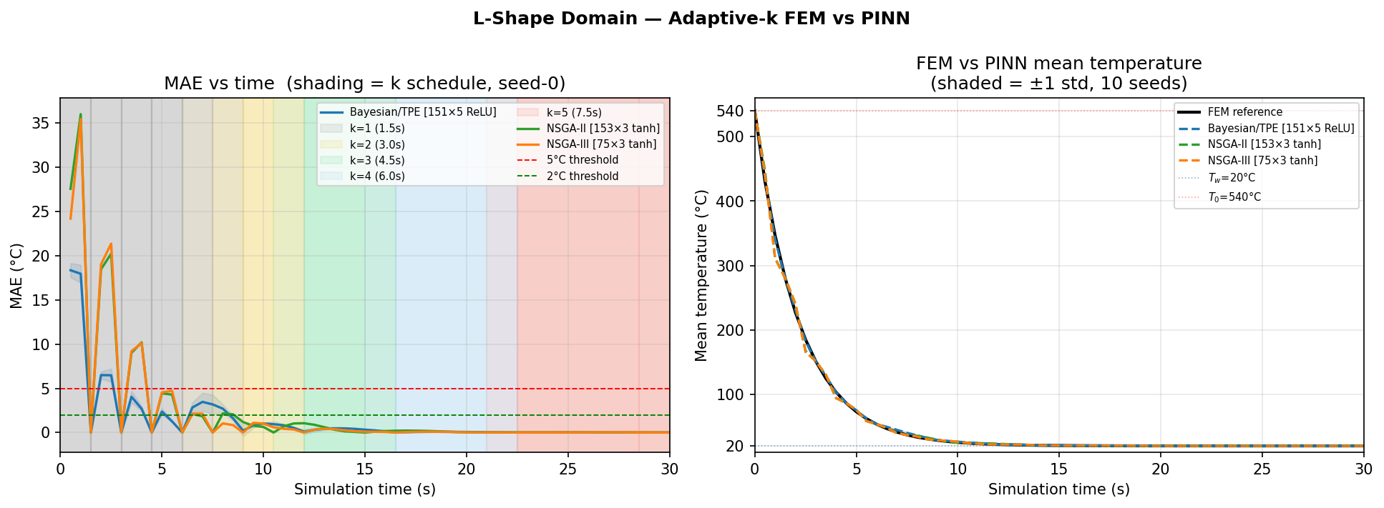
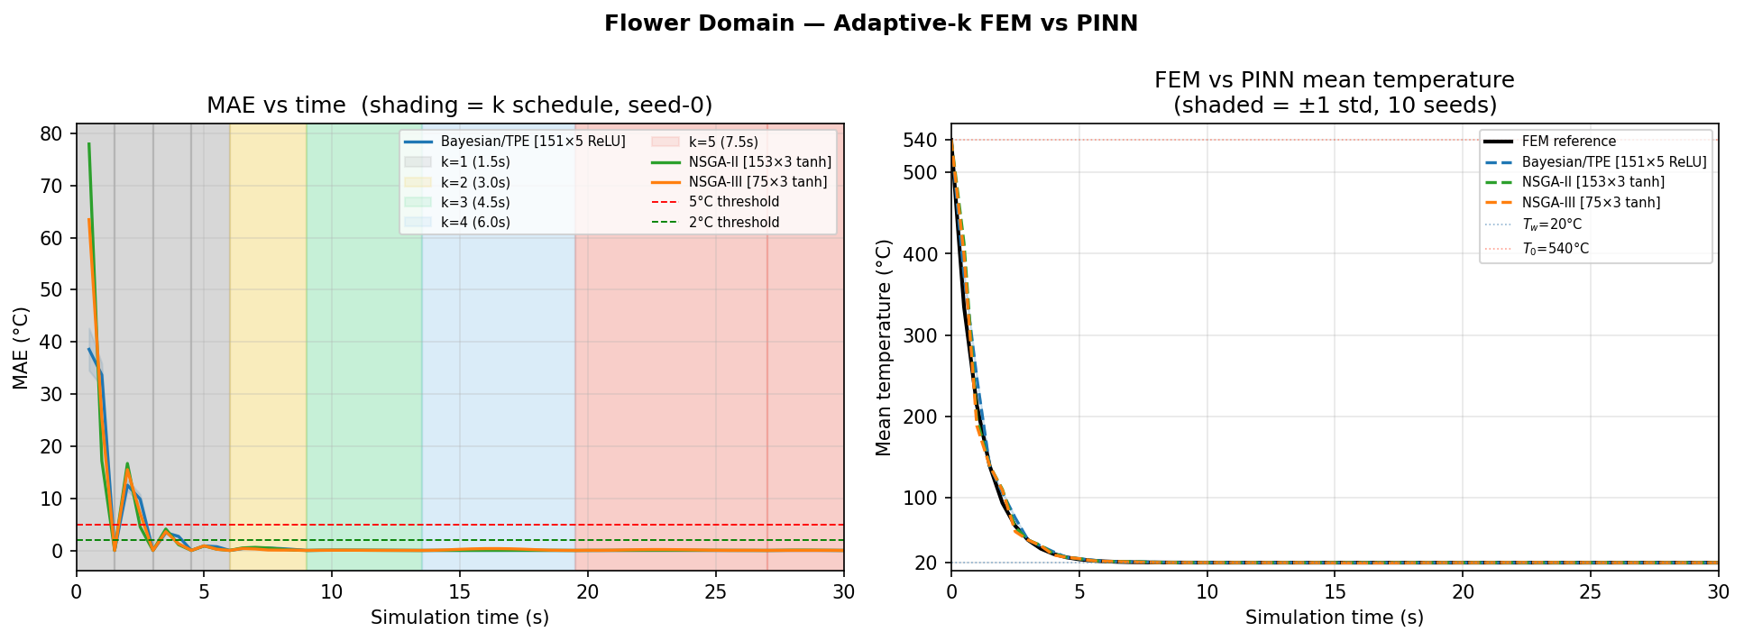
2D Adaptive-k: Figure 4.1 FEM-PINN Curves
RESULTS
What this slide means
- The curves compare FEM cooling history with PINN prediction.
- Close curves mean the transient behaviour is followed well.
- This supports the table results visually.
UiA | University of Agder
Master Thesis Defense
27

Slide 28
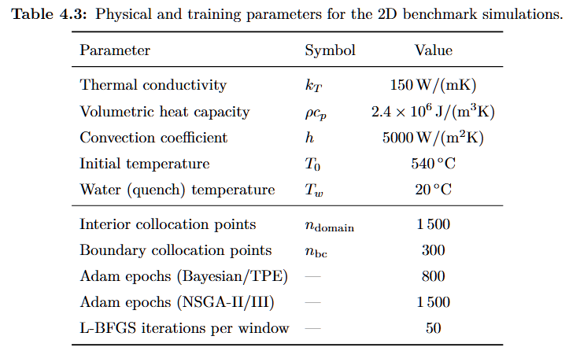
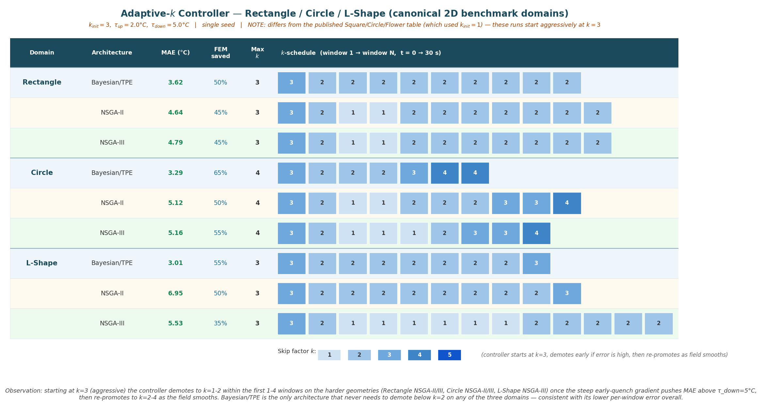
Canonical 2D: Setup and Adaptive-k Schedule
RESULTS
What this slide means
- This slide explains the canonical 2D setup.
- The schedule shows when FEM calls are skipped.
- It prepares the MAE and L2 result tables.
UiA | University of Agder
Master Thesis Defense
28

Slide 29
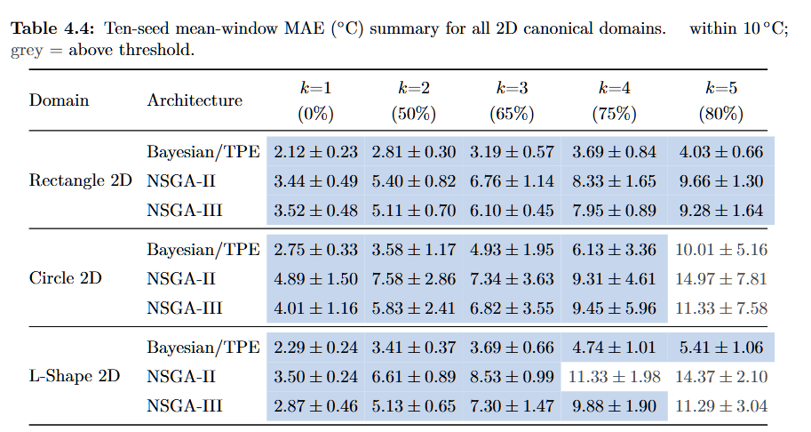
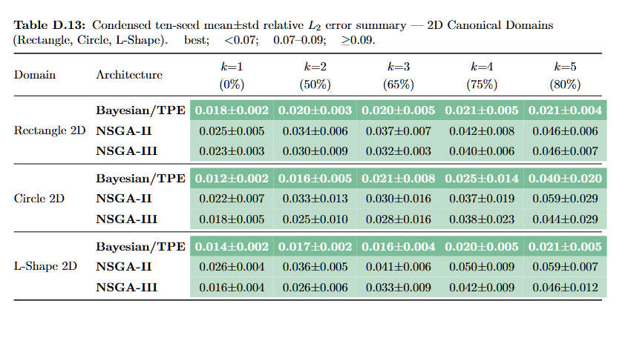
Canonical 2D: MAE and L2 Summary
RESULTS
What this slide means
- MAE and L2 are shown side by side.
- Low MAE means small average temperature error.
- Low L2 means the final field is close to FEM.
- If either grows, the geometry or k is harder.
UiA | University of Agder
Master Thesis Defense
29

Slide 30
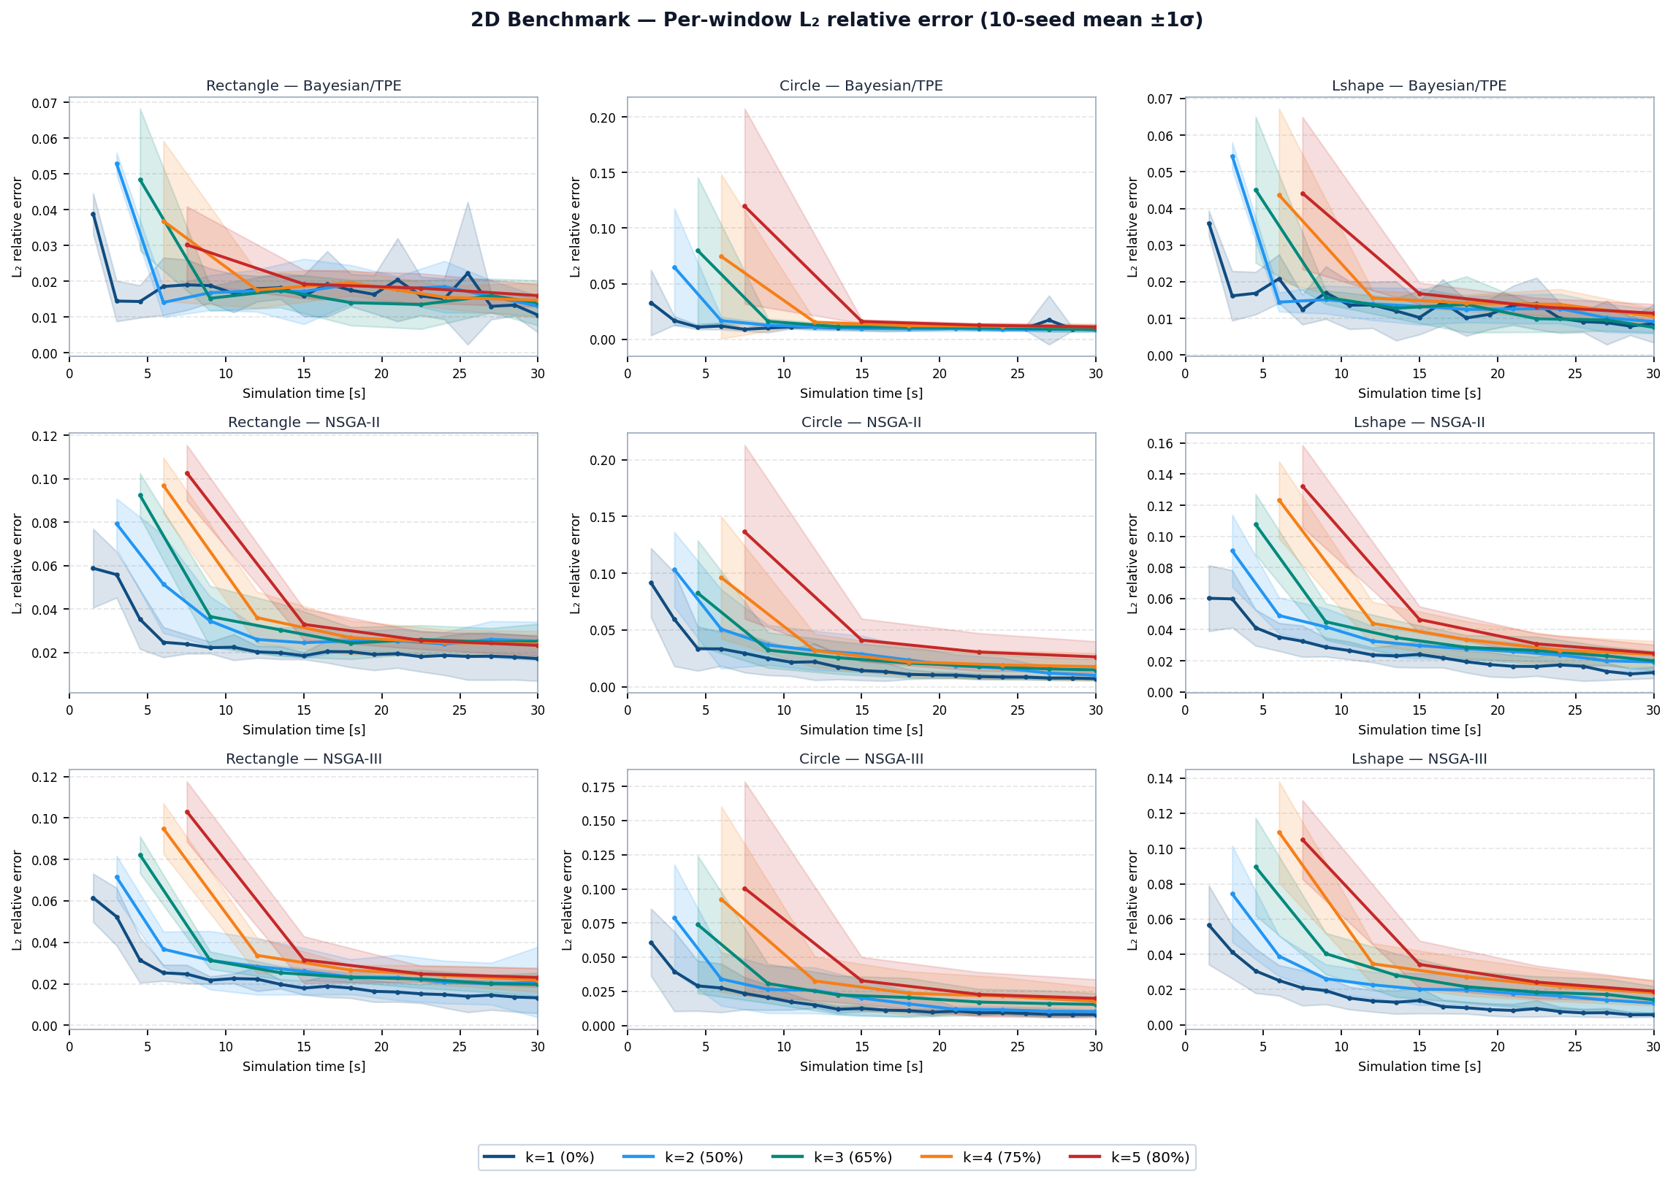
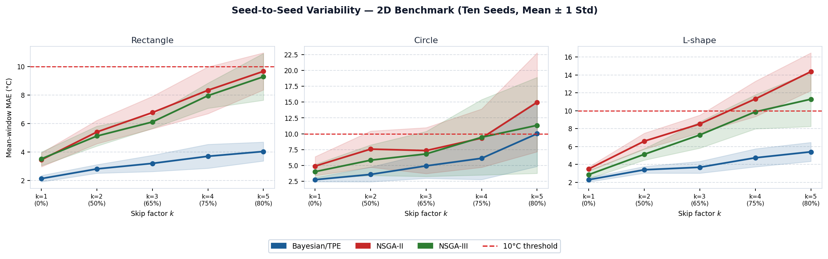
Canonical 2D: MAE Variability and L2 Curves
RESULTS
What this slide means
- Variability shows seed stability.
- L2 curves show field error through time.
- This explains robustness, not only average error.
UiA | University of Agder
Master Thesis Defense
30

Slide 31
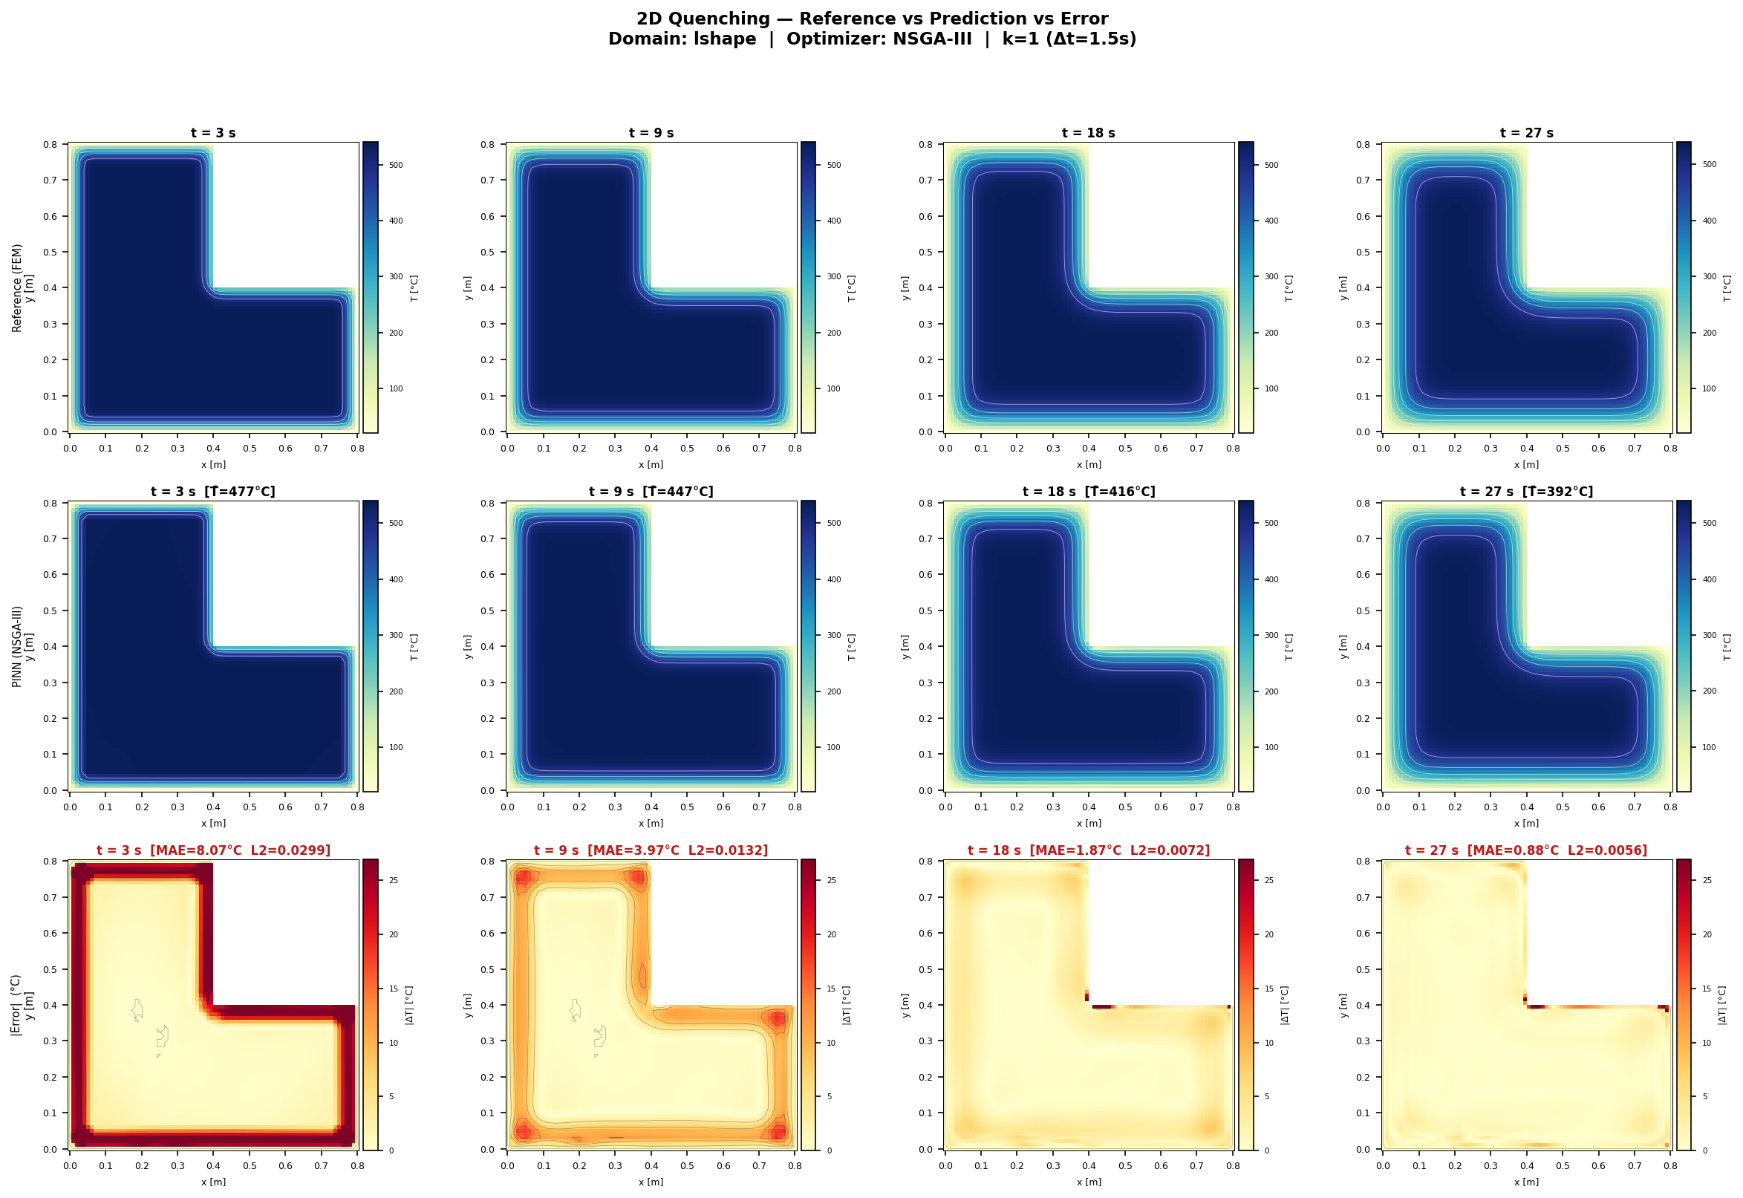
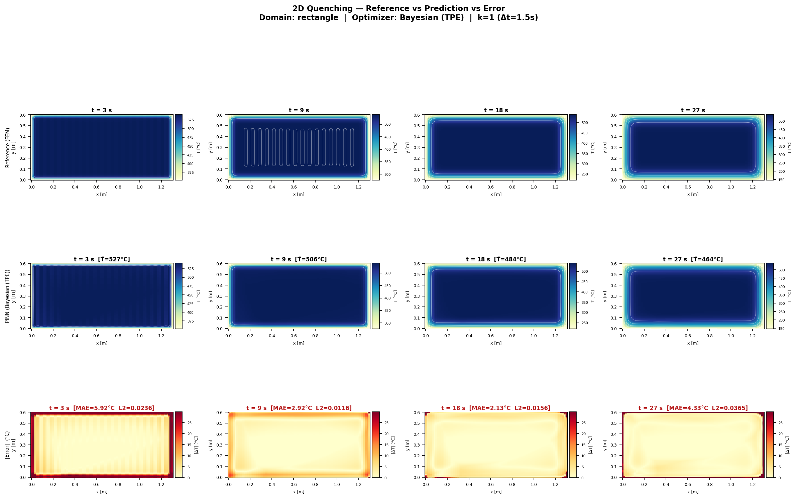
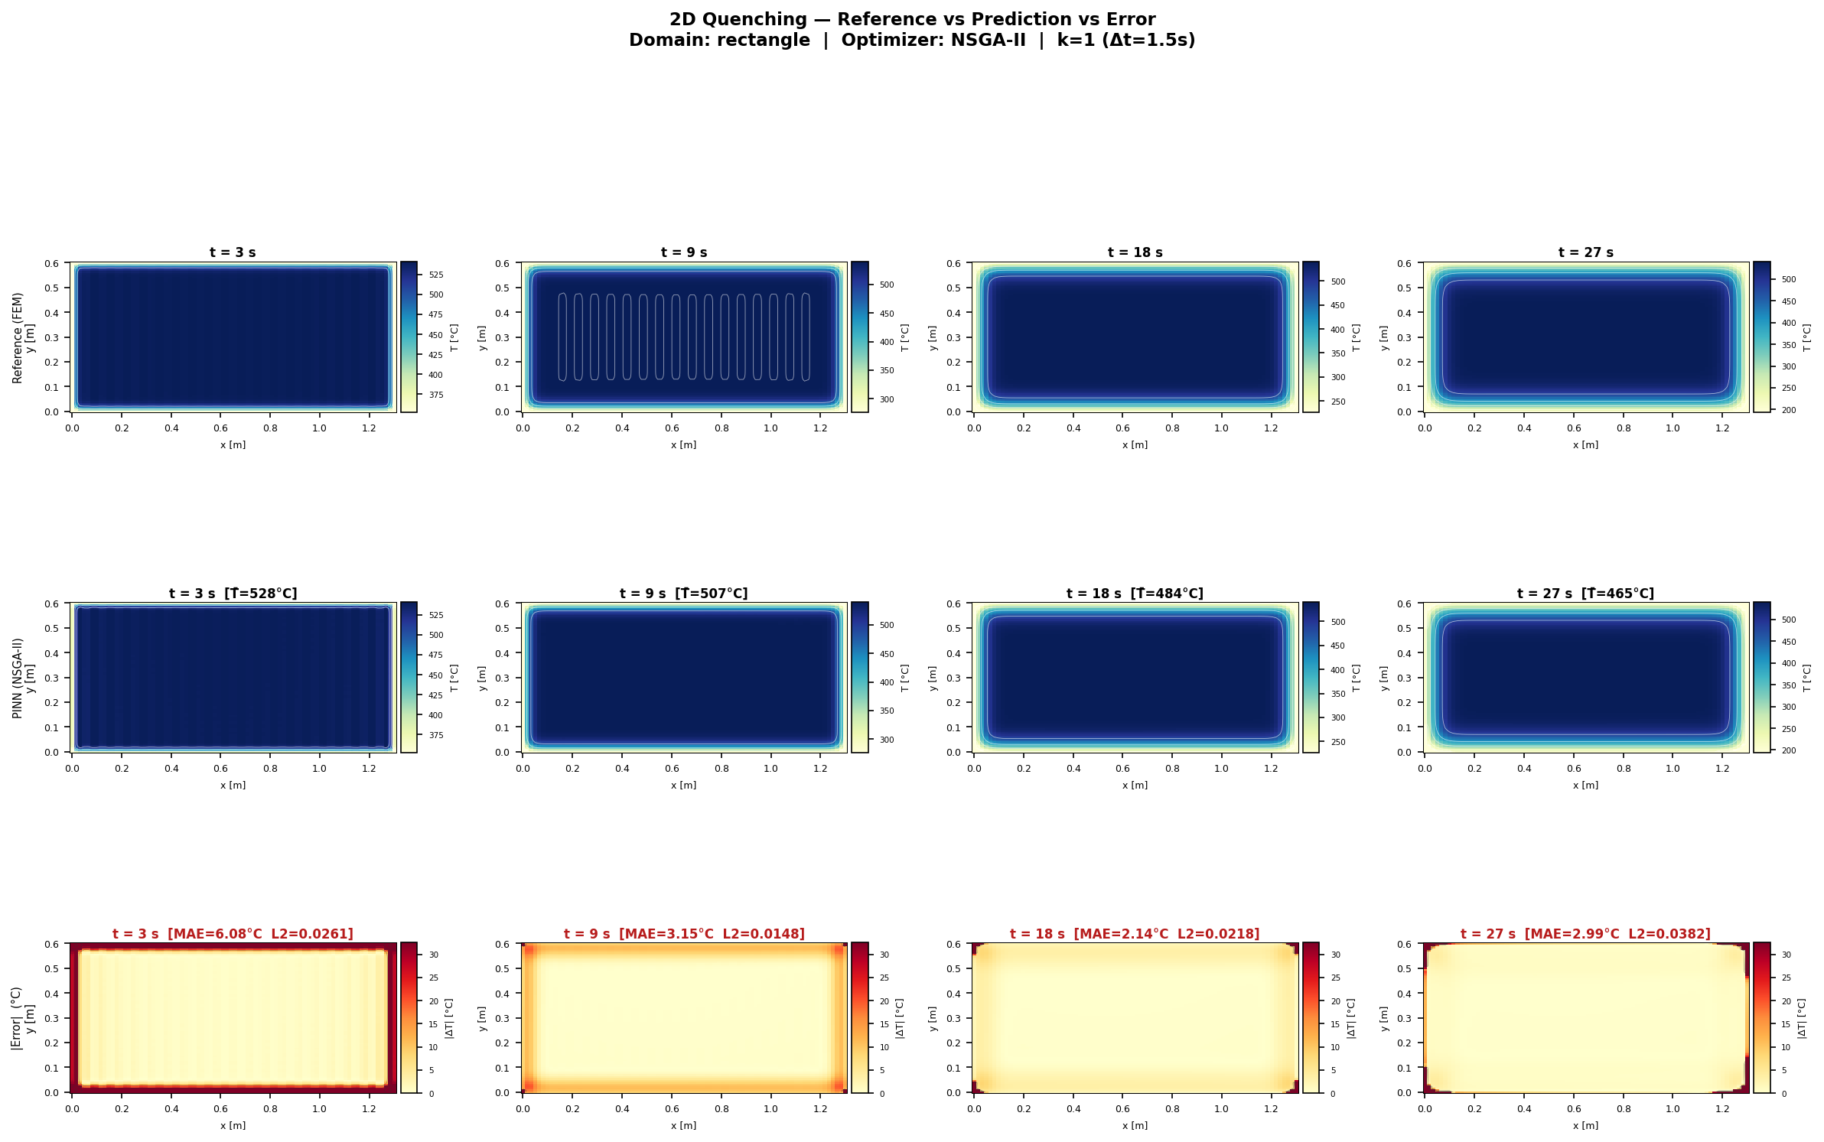
Canonical 2D Heat Maps: Best Geometry per Architecture
RESULTS
What this slide means
- Heat maps show where the error appears.
- They support the numerical tables.
- Local boundary errors can be seen visually.
UiA | University of Agder
Master Thesis Defense
31

Slide 32
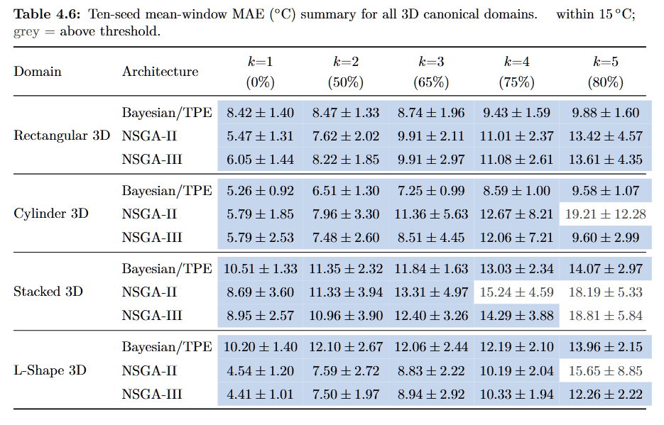
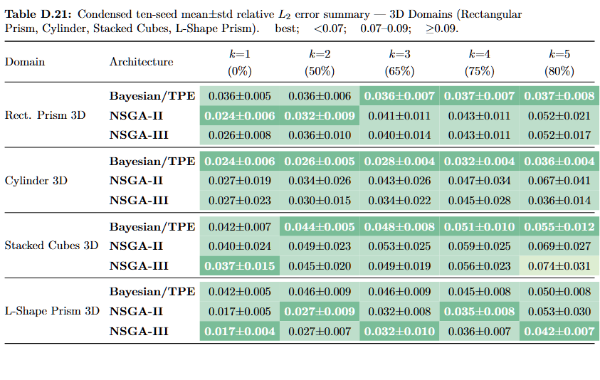
3D Results: MAE and L2 Summary
RESULTS
What this slide means
- These are the main 3D benchmark tables.
- MAE measures average volumetric prediction error.
- L2 checks final 3D field quality.
- 3D geometry makes prediction harder than 2D.
UiA | University of Agder
Master Thesis Defense
32

Slide 33
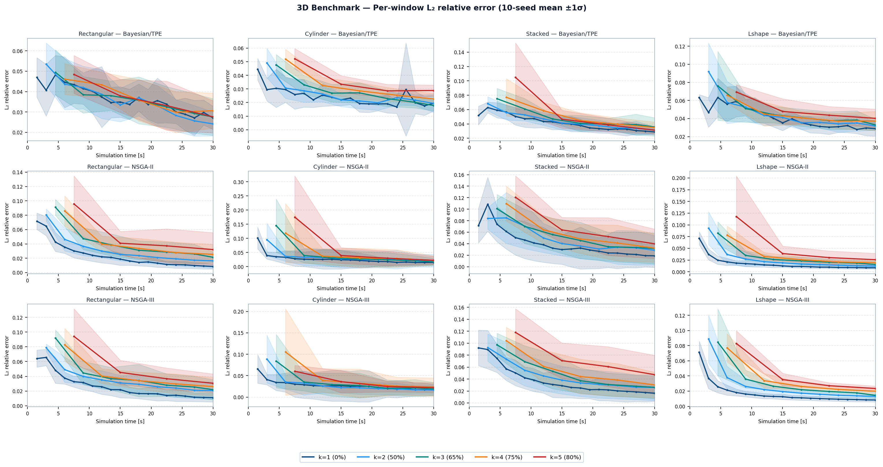
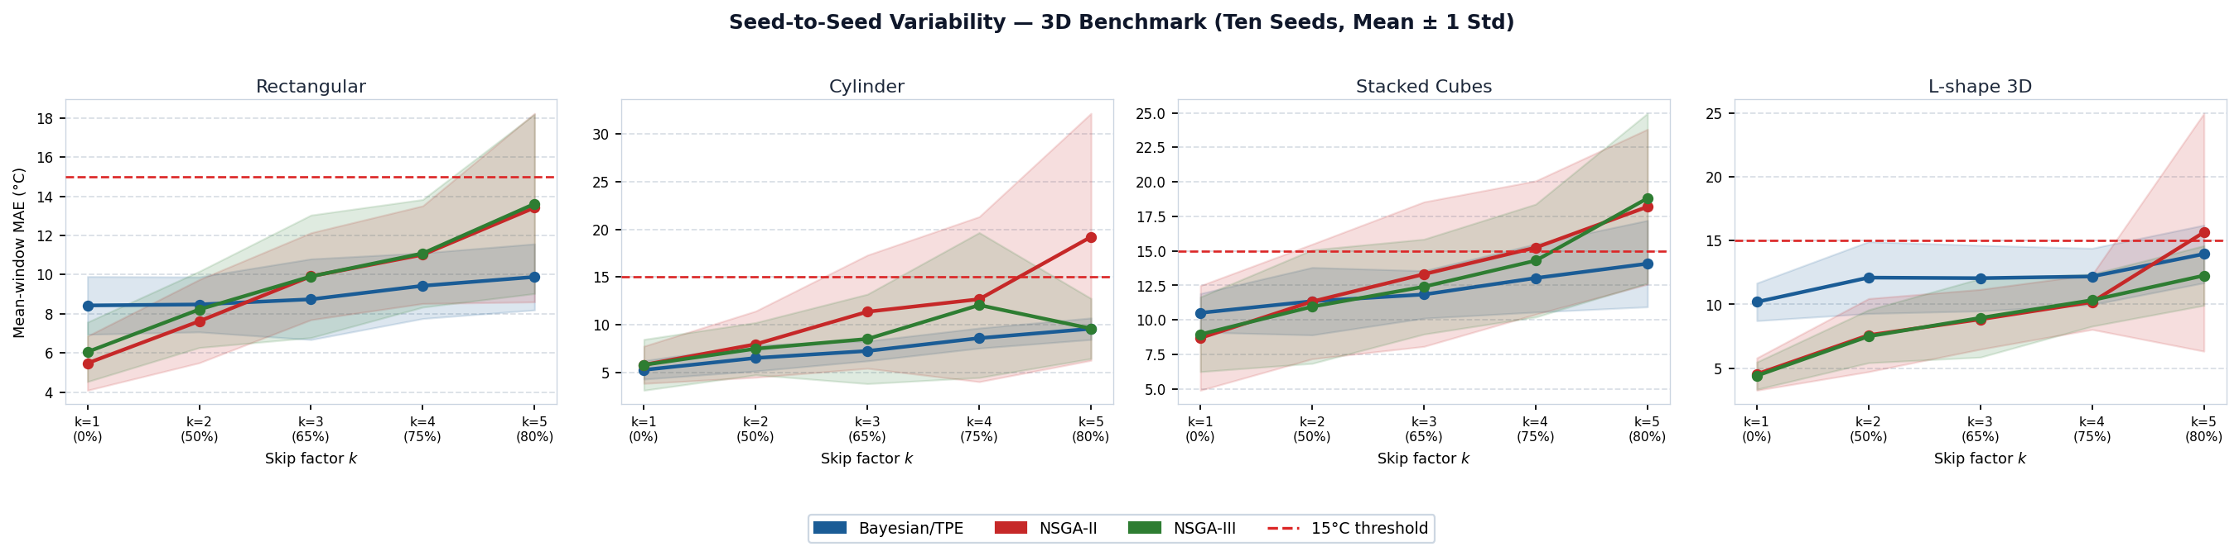
3D Results: MAE Variability and L2 Curves
RESULTS
What this slide means
- These plots show 3D stability and time trends.
- Some geometries are more sensitive to k.
- The best k is geometry-dependent.
UiA | University of Agder
Master Thesis Defense
33

Slide 34
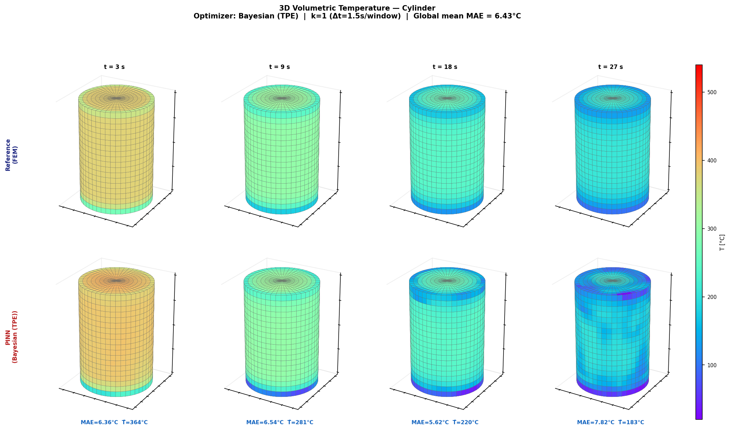
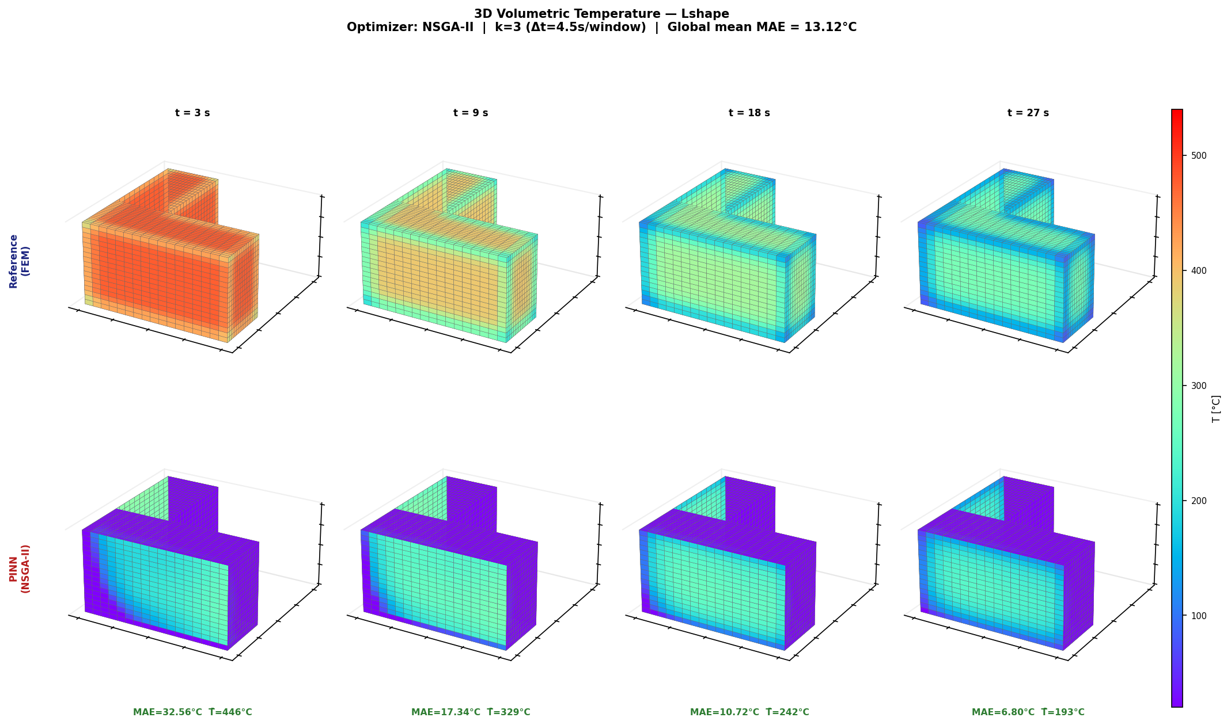
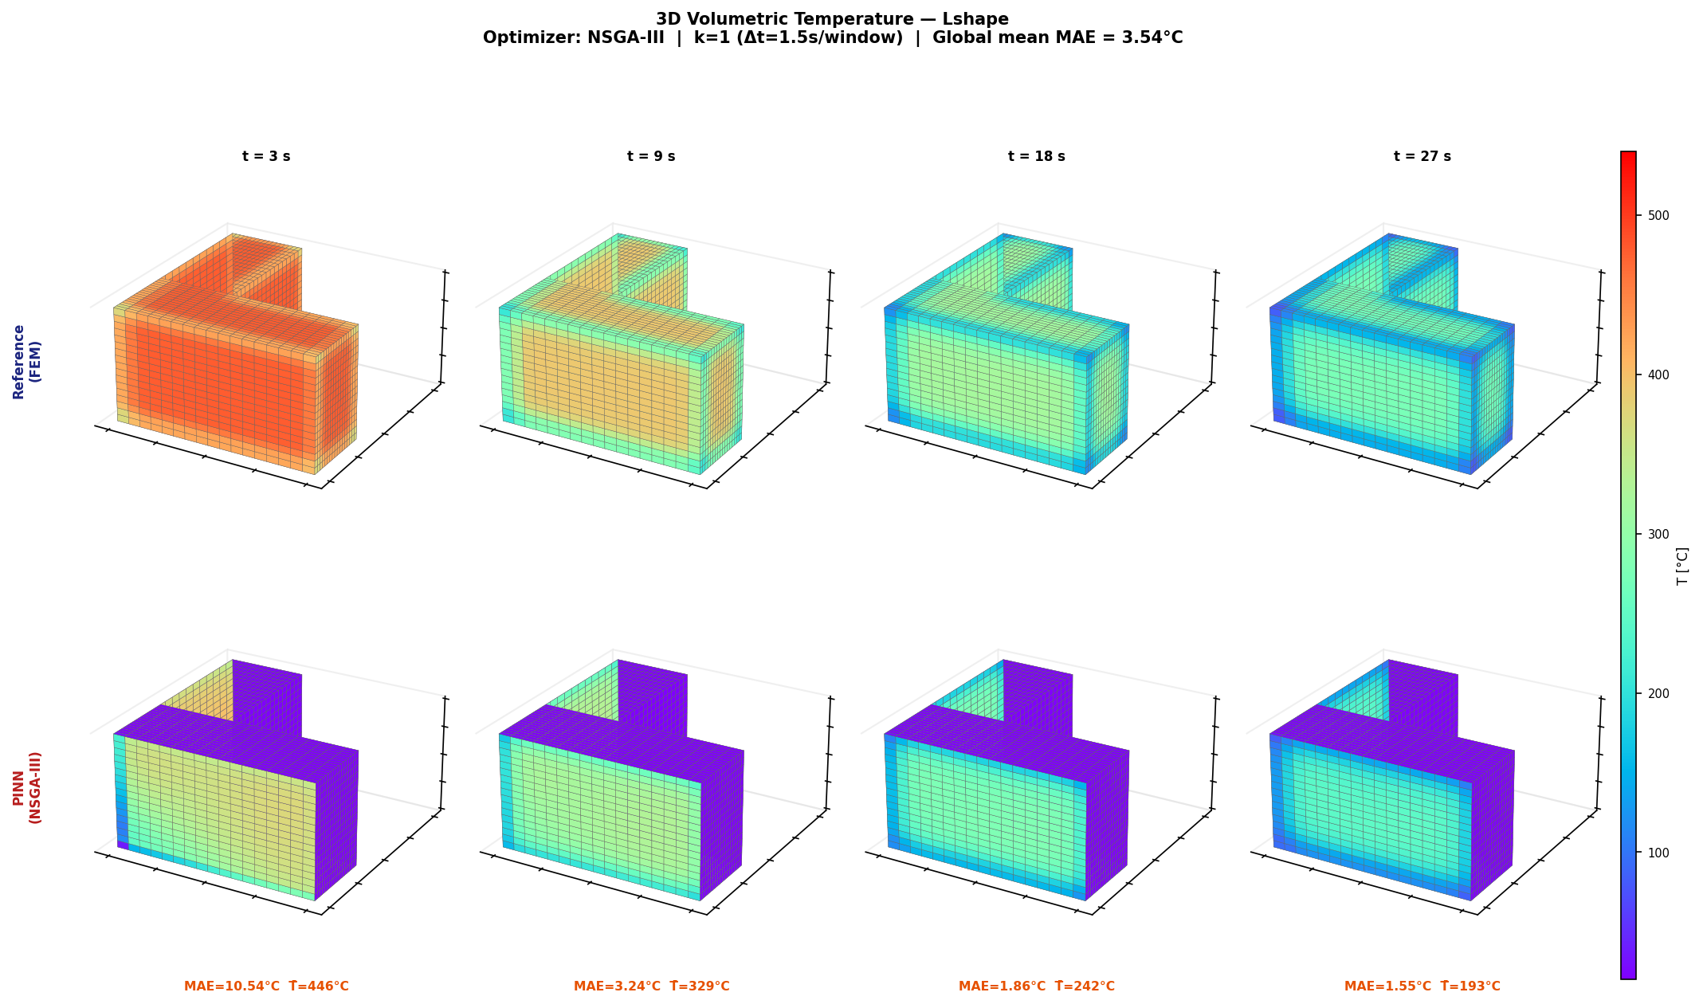
Canonical 3D Heat Maps: Best Geometry per Architecture
RESULTS
What this slide means
- The 3D heat map shows volumetric behaviour.
- It helps identify local error regions.
- This supports the numerical results.
UiA | University of Agder
Master Thesis Defense
34

Slide 35
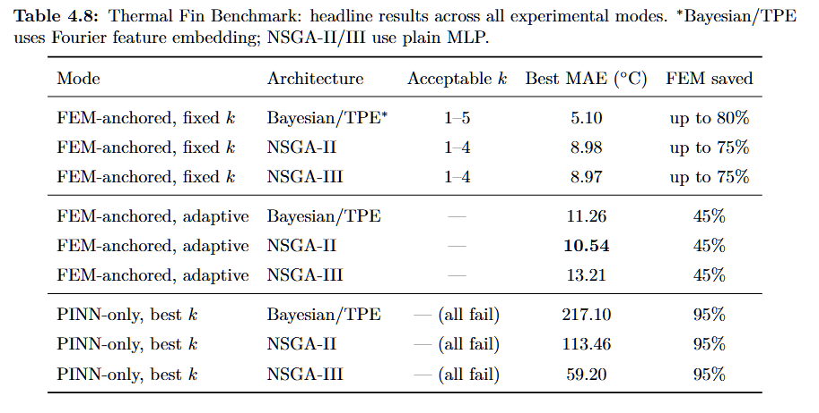
Thermal Fin: MAE and L2 Summary
RESULTS
What this slide means
- Thermal Fin is the hardest benchmark.
- MAE shows average thermal accuracy.
- L2 shows final field quality.
- Bayesian/TPE with Fourier features gives the strongest field accuracy.
UiA | University of Agder
Master Thesis Defense
35

Slide 36
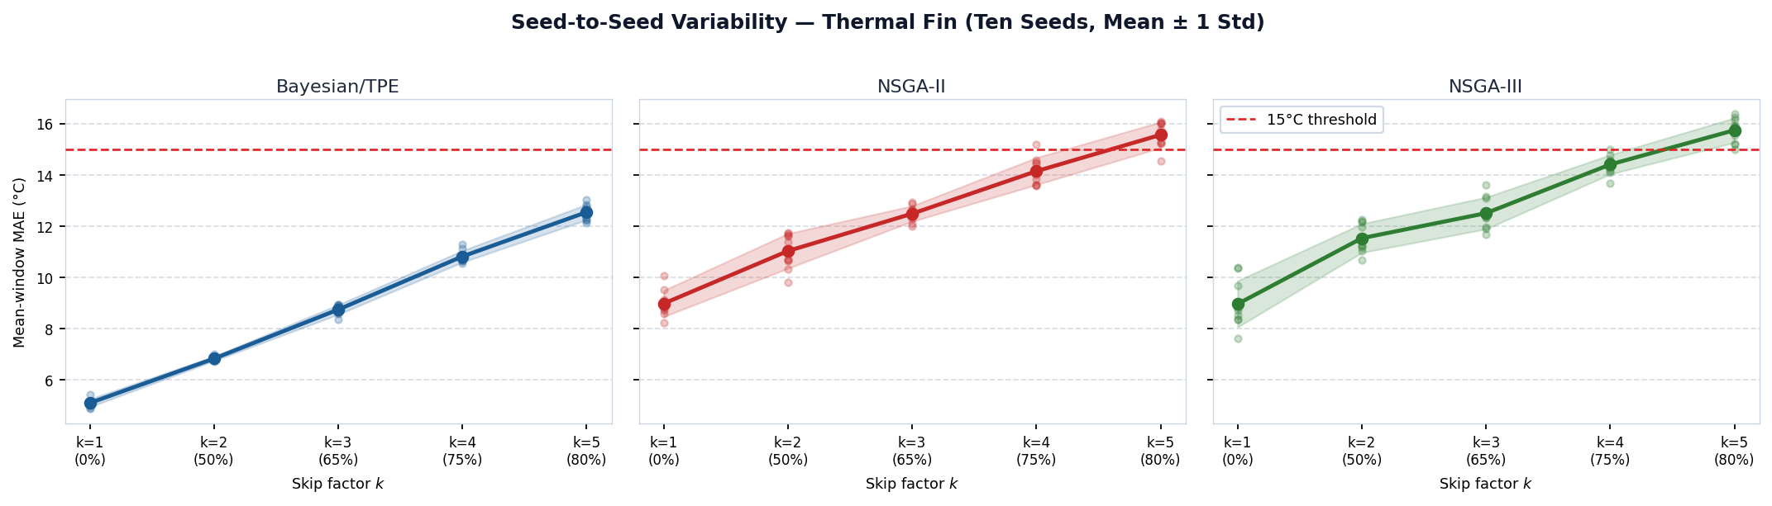
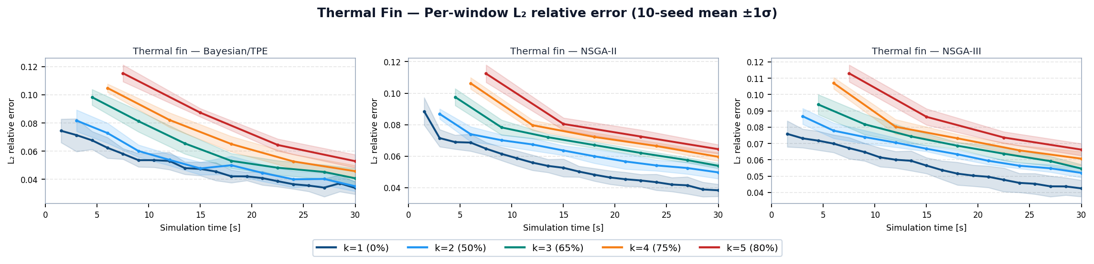
Thermal Fin: MAE Variability and L2 Curves
RESULTS
What this slide means
- Higher k makes Thermal Fin prediction harder.
- Fourier features improve Bayesian/TPE stability.
- The trend supports the summary table.
UiA | University of Agder
Master Thesis Defense
36

Slide 37
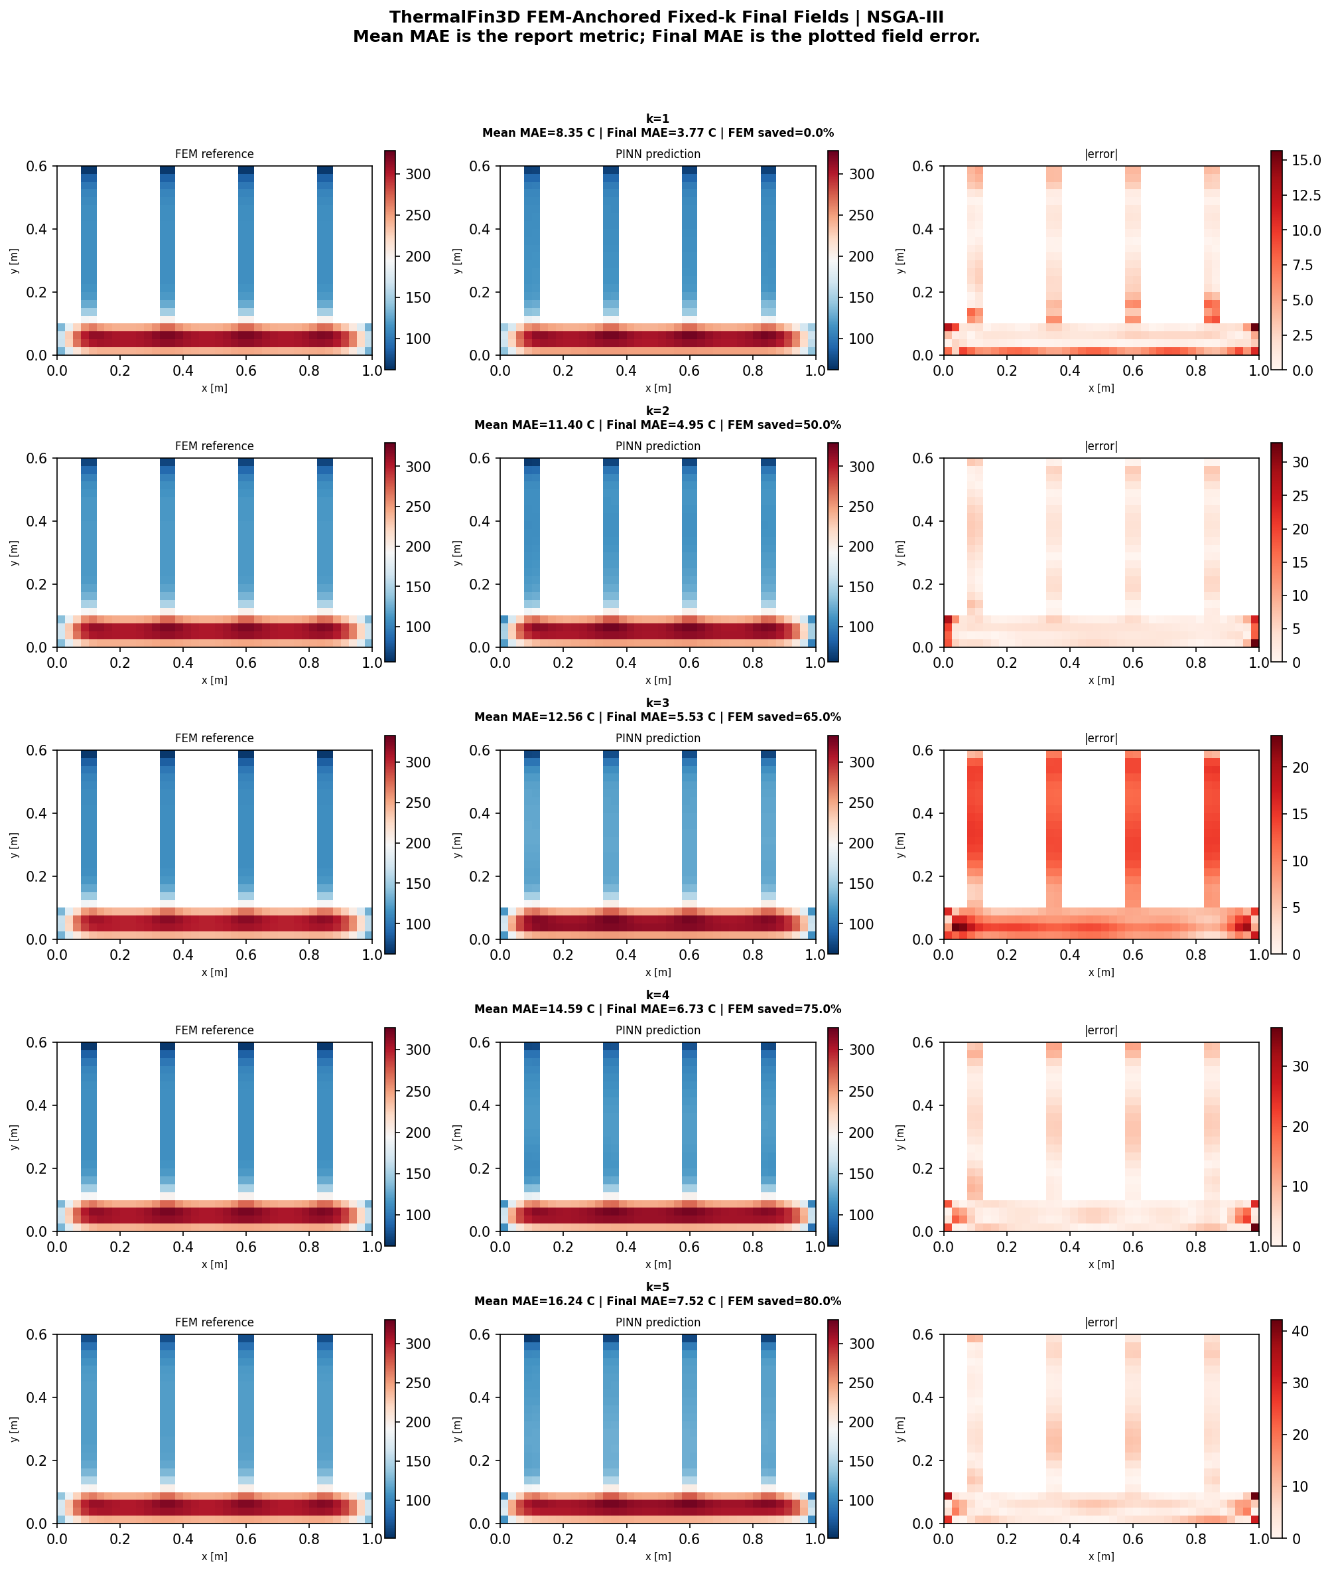
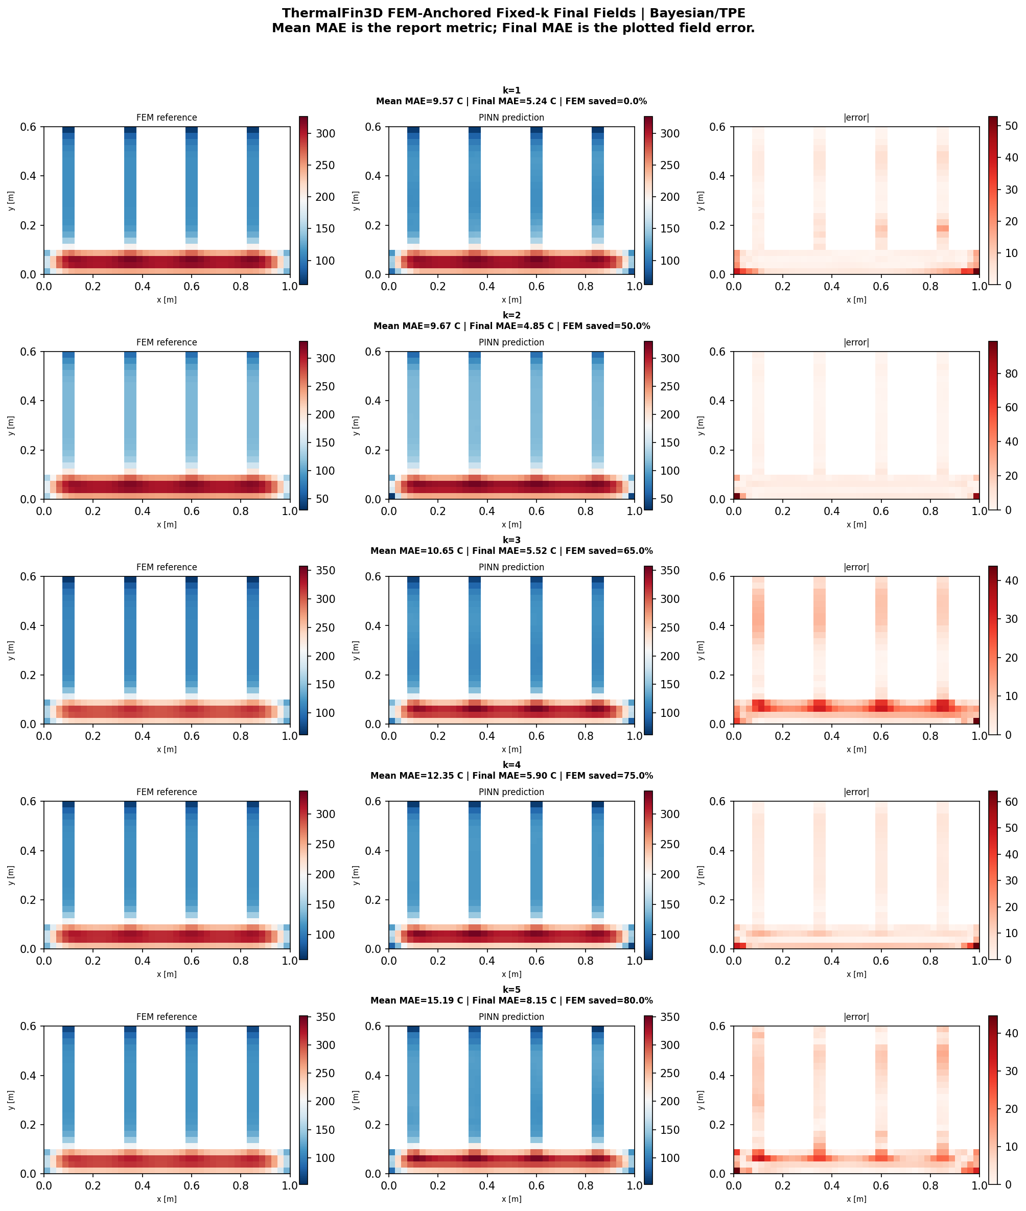
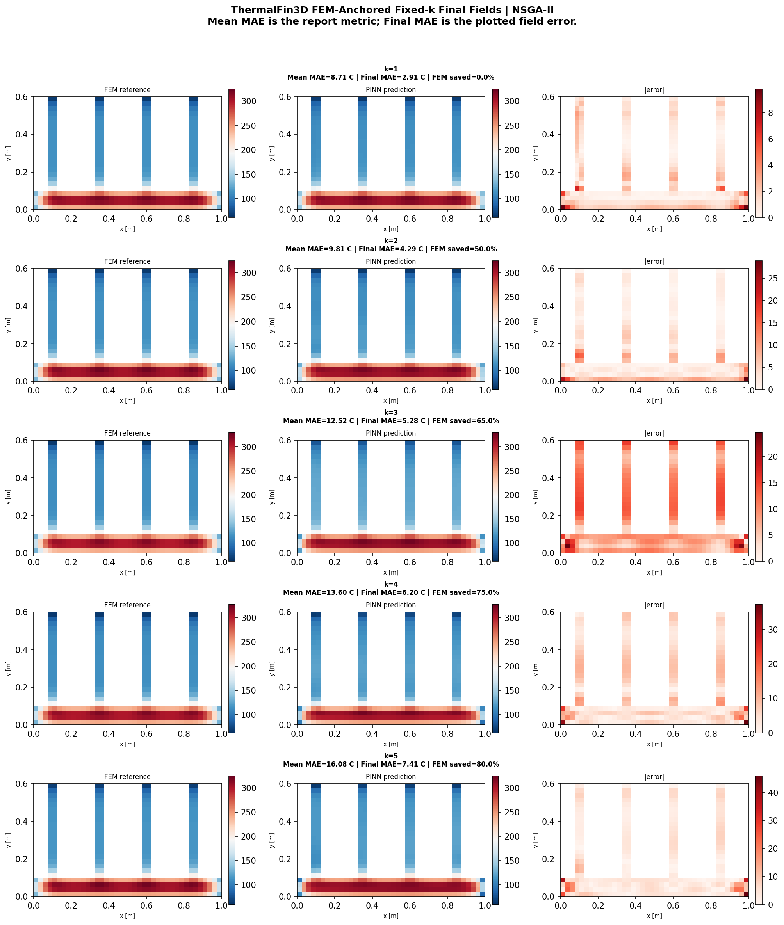
Thermal Fin: Fixed-k Heat Maps (2D)
RESULTS
What this slide means
- The 2D cross-section heat maps compare FEM, PINN, and error.
- They show where local errors remain.
- FEM anchoring keeps the error more controlled.
UiA | University of Agder
Master Thesis Defense
37

Slide 38
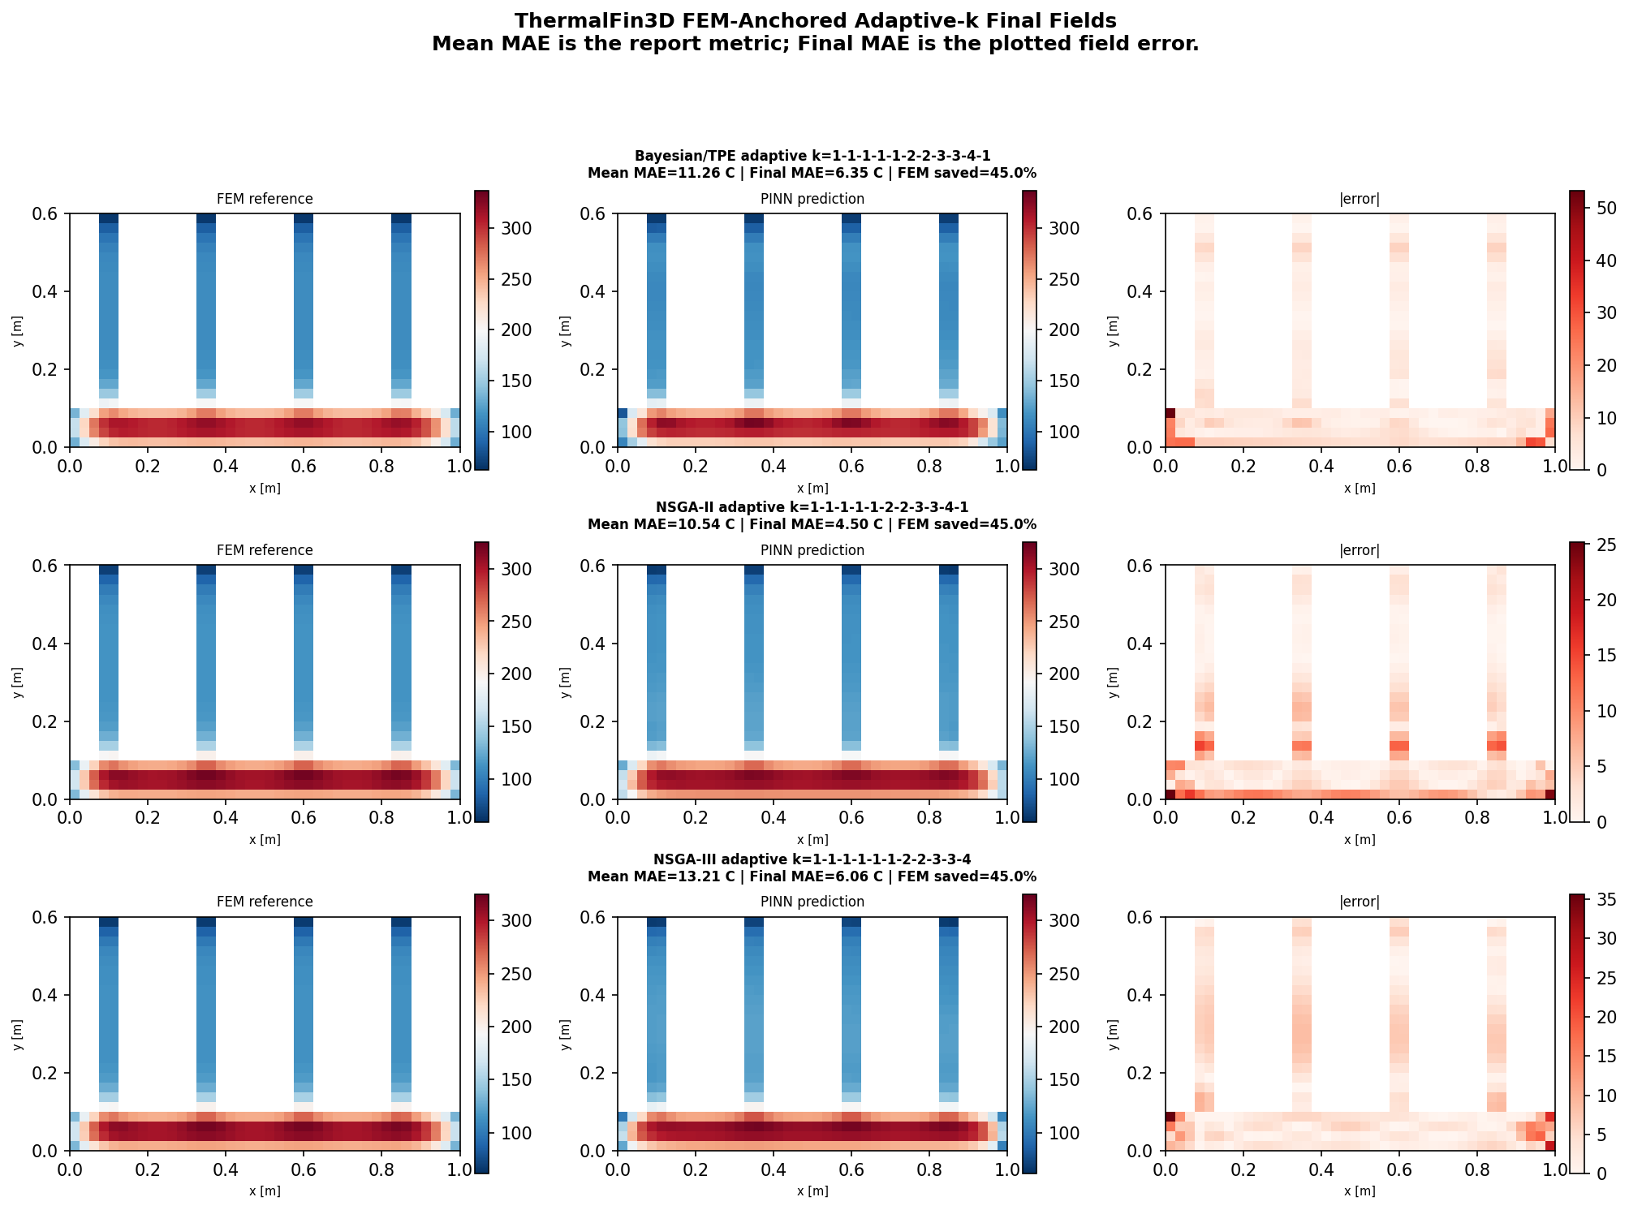
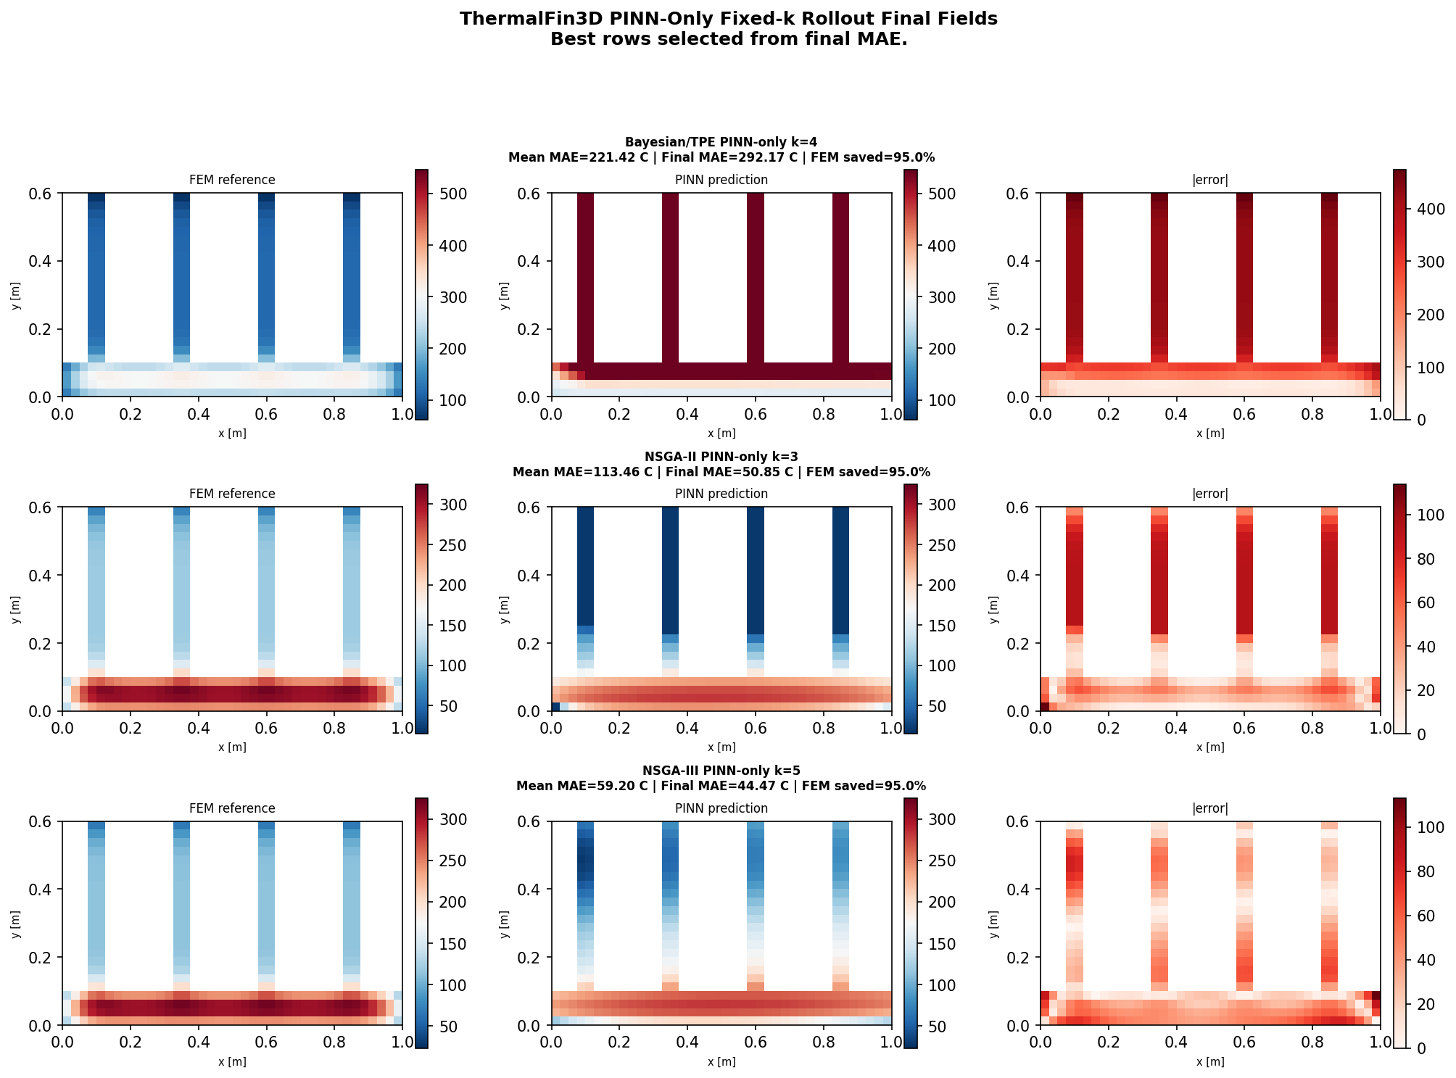
Thermal Fin: Adaptive vs PINN-only Heat Maps (2D)
RESULTS
What this slide means
- Adaptive-k uses FEM anchors to correct the field.
- PINN-only removes these corrections.
- Without anchors, errors can accumulate.
UiA | University of Agder
Master Thesis Defense
38

Slide 39
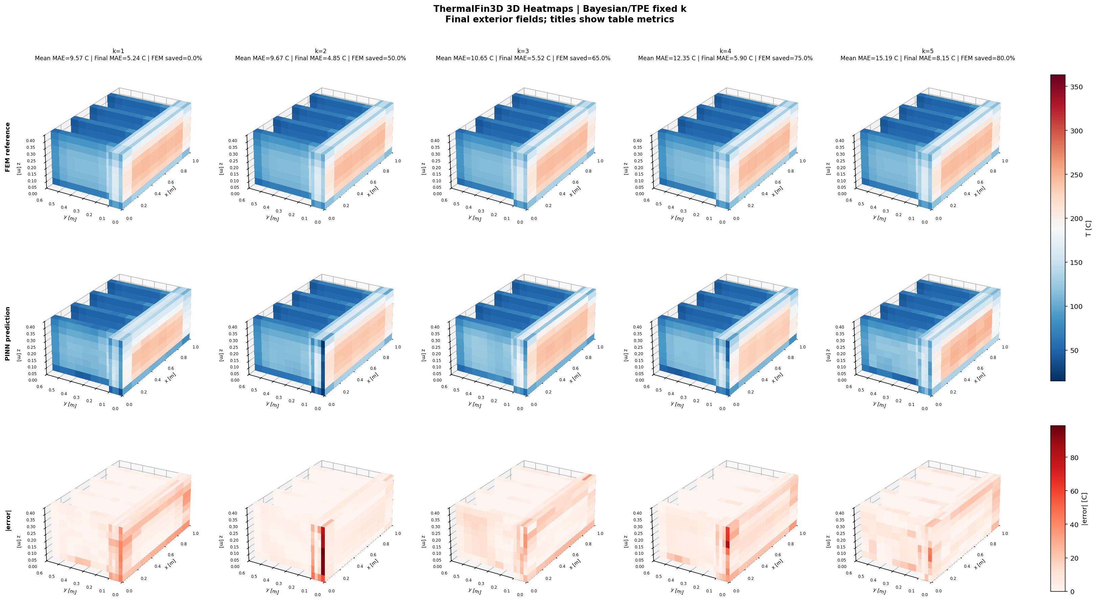
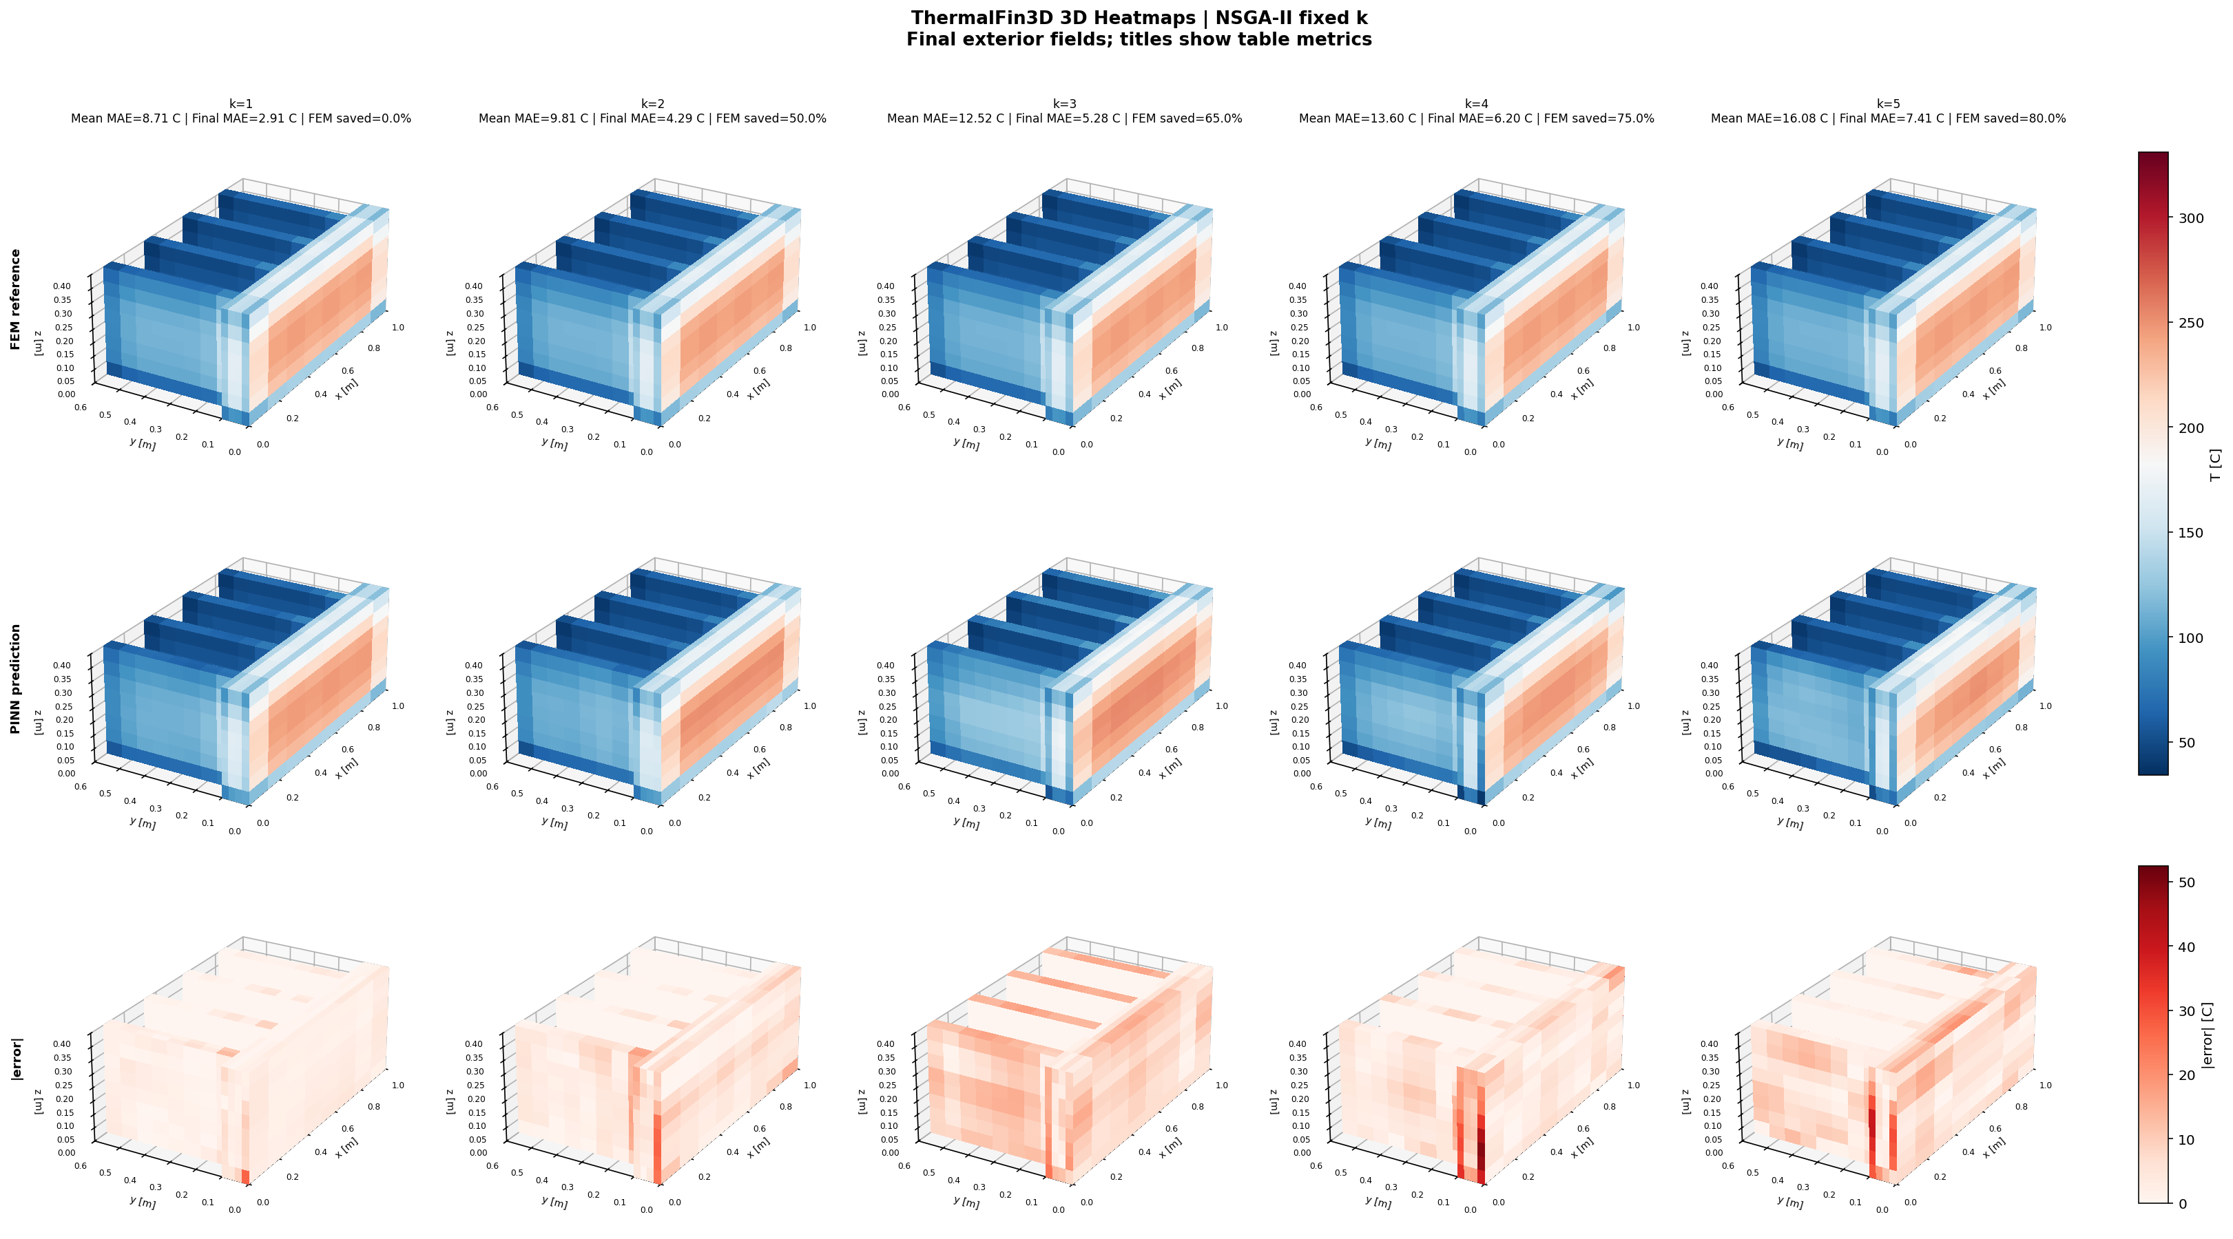
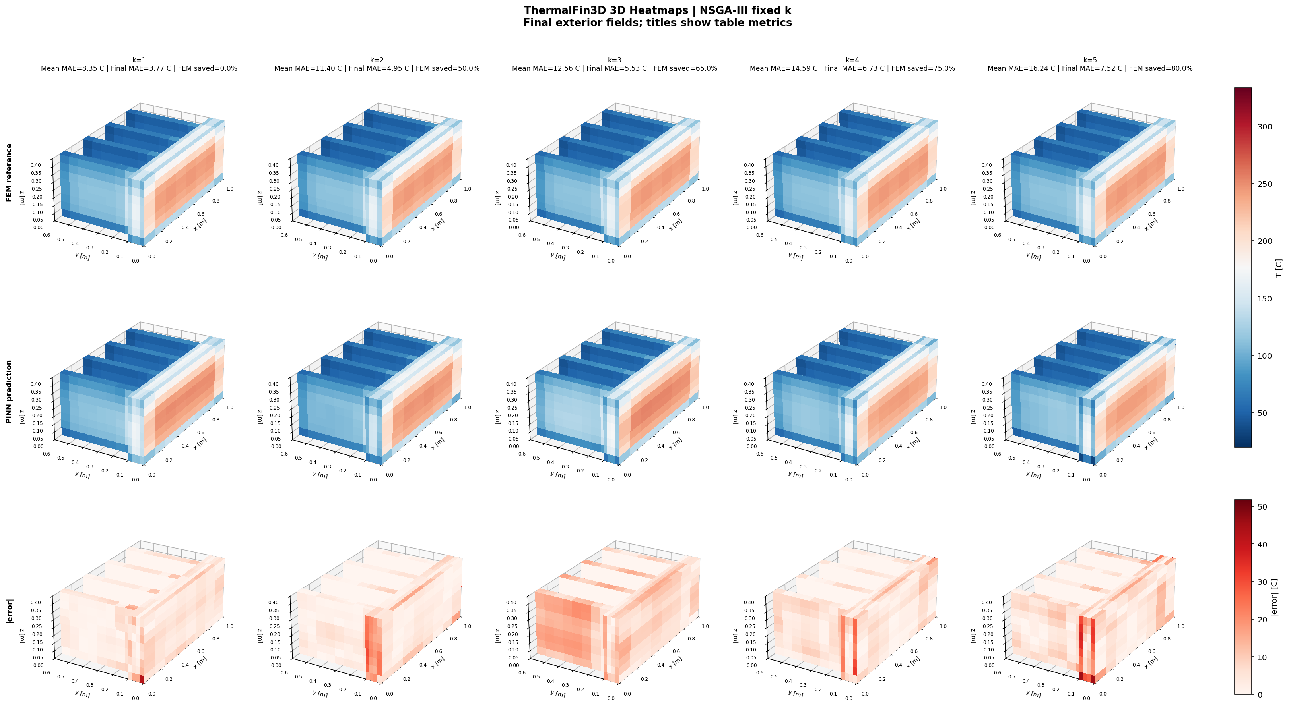
Thermal Fin: Fixed-k Volumetric Views (3D)
RESULTS
What this slide means
- The volumetric view checks the full 3D field.
- Sharp fin regions are difficult.
- This visual result supports the table.
UiA | University of Agder
Master Thesis Defense
39

Slide 40
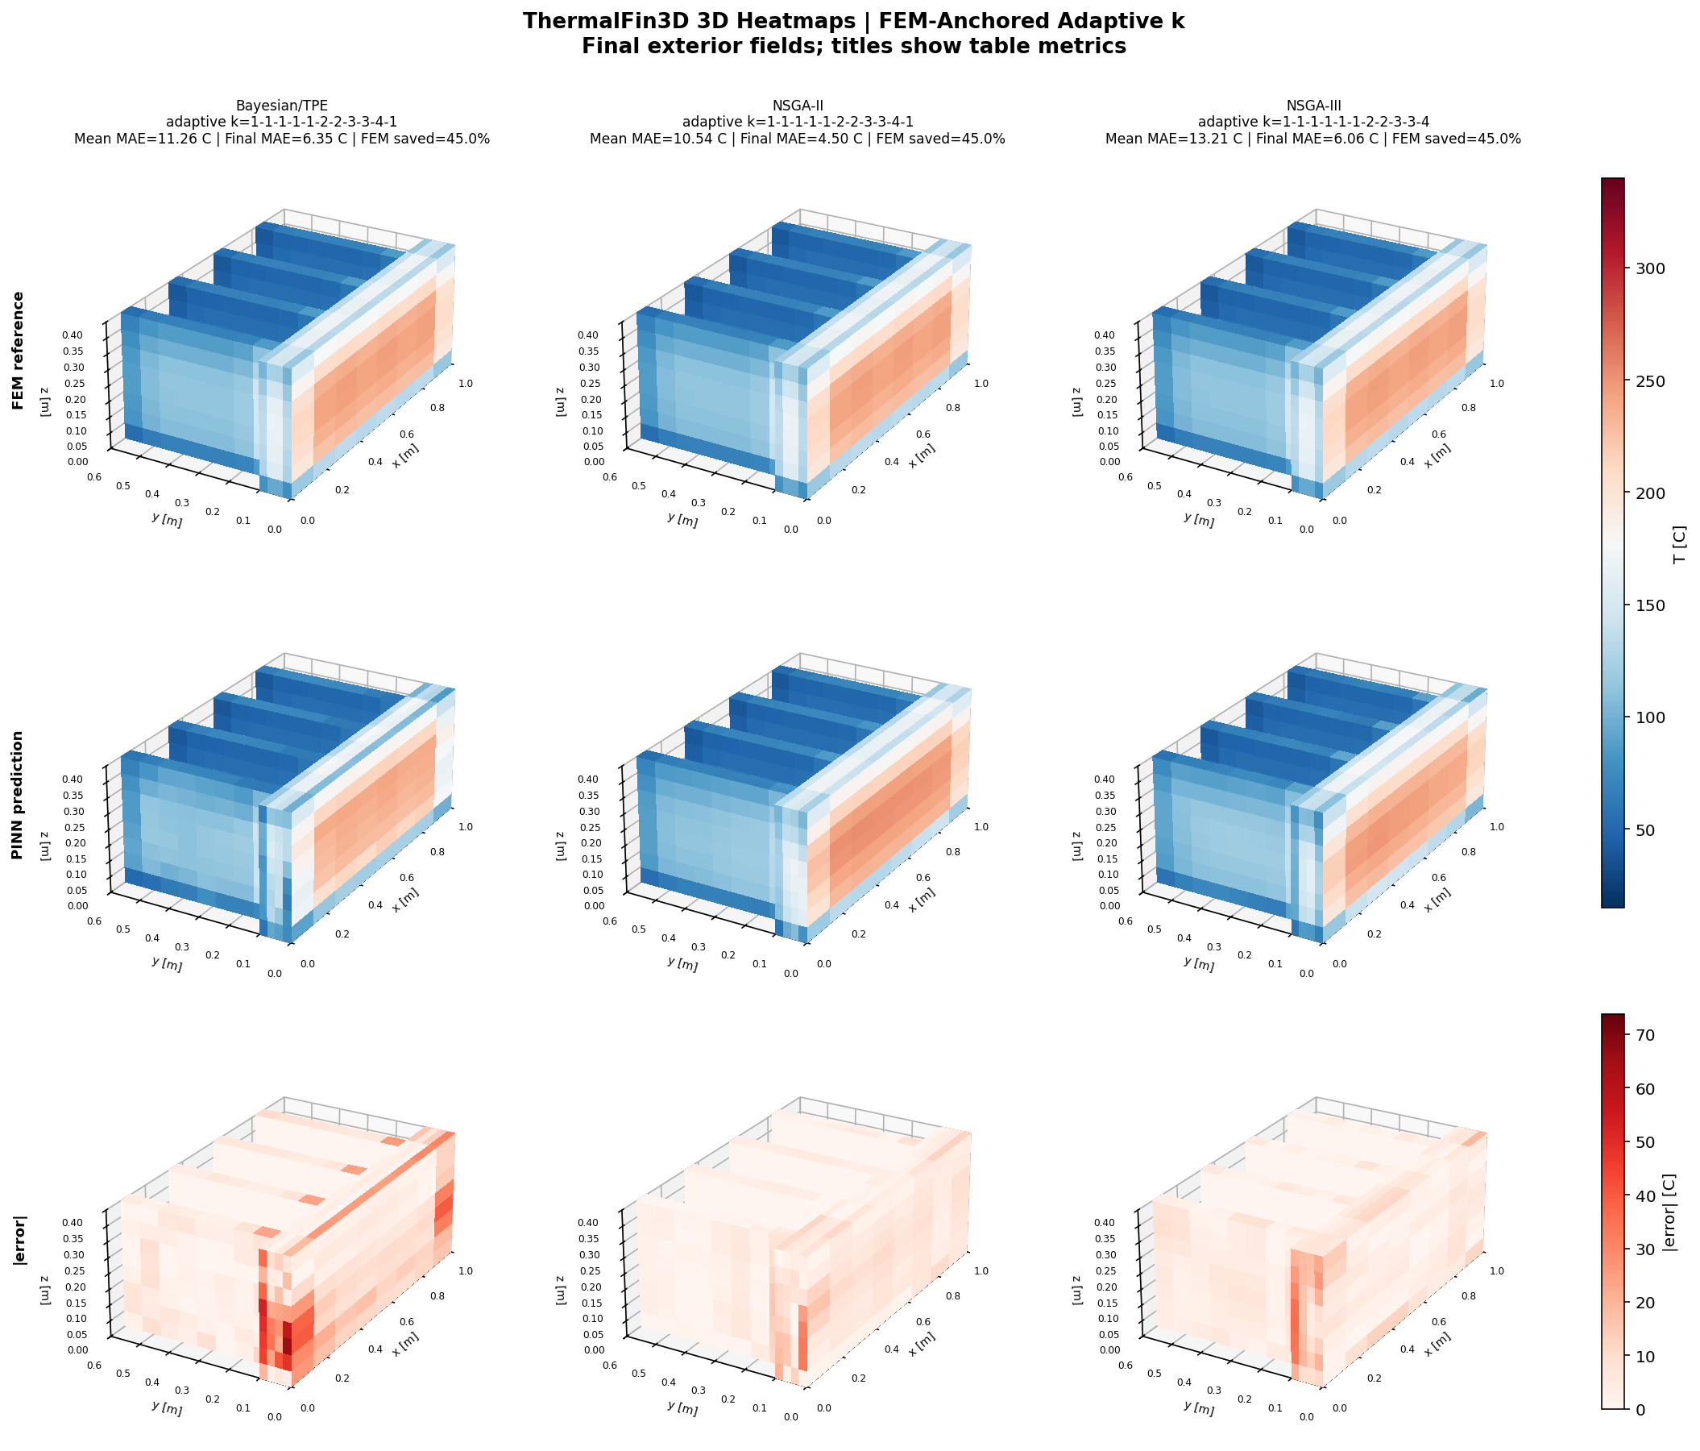
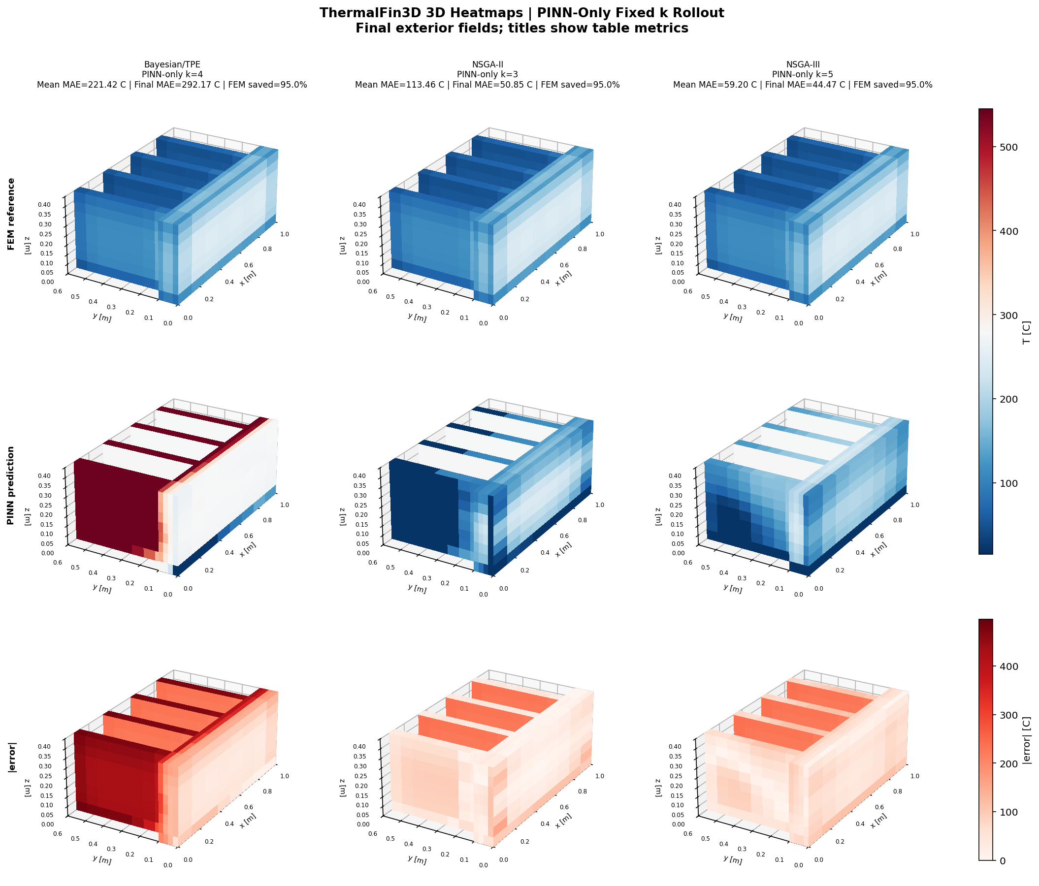
Thermal Fin: Adaptive vs PINN-only Volumetric Views (3D)
RESULTS
What this slide means
- Anchored prediction keeps the 3D field more stable.
- PINN-only shows drift more clearly.
- This demonstrates why anchors are needed.
UiA | University of Agder
Master Thesis Defense
40

Slide 41
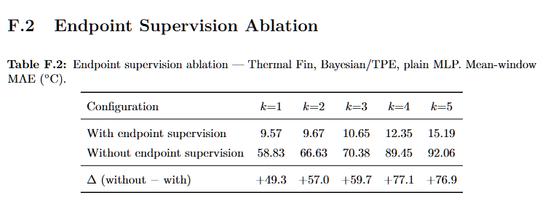
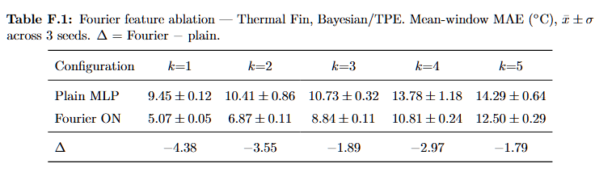
Thermal Fin: Ablation Tables F.1 and F.2
RESULTS
What this slide means
- Fourier features help complex spatial patterns.
- Endpoint supervision controls window drift.
- The ablation shows these choices are important.
UiA | University of Agder
Master Thesis Defense
41

Slide 42
Discussion: 2D Adaptive-k and Canonical 2D
DISCUSSION
What this slide means
- 2D adaptive-k
- What I found: all architectures achieved about 83-85% FEM saving with low MAE. Why: the controller keeps short windows during the early rapid cooling phase and promotes k only after the field becomes smoother.
- Canonical 2D
- What I found: Bayesian/TPE stays strongest as k increases. Circle and L-Shape expose geometry sensitivity at high k. Why: compact architectures lose accuracy faster when boundaries are curved or gradients are concentrated.
- Key explanation
- MAE growth is not only a training issue. It is linked to physical gradient structure, boundary shape and the length of unsupported prediction windows.
- 2D results show useful FEM saving with low error.
- Complex boundaries and high k make prediction harder.
- The method works, but geometry still matters.
UiA | University of Agder
Master Thesis Defense
42

Slide 43
Discussion: 3D and Thermal Fin
DISCUSSION
What this slide means
- Canonical 3D
- Bayesian/TPE reaches k=5 on all four 3D domains within the 15 C band. NSGA-II/III are more geometry-sensitive at high k.
- Thermal Fin
- Bayesian/TPE + Fourier remains within the 15 C band at all k values. NSGA-II/III are acceptable through k=4, but k=5 becomes too demanding.
- PINN-only
- PINN-only errors are much larger because each imperfect prediction becomes the next initial condition. I use this to confirm that periodic FEM correction is necessary.
- 3D and Thermal Fin show stronger geometry sensitivity.
- Thermal Fin confirms that anchors are important.
- The anchor strategy must match the geometry.
UiA | University of Agder
Master Thesis Defense
43

Slide 44
Discussion: Cross-Domain Guidance
DISCUSSION
What this slide means
Question | Discussion answer | Practical guidance Which architecture transfers best? | Bayesian/TPE is strongest in 7 of 8 canonical cases and robust on Thermal Fin. | Use Bayesian/TPE as default deployment architecture. When is adaptive-k useful? | It protects the early steep-gradient phase and increases k as the field relaxes. | Use adaptive-k for simple/intermediate geometries. Can FEM be removed? | No. PINN-only accumulates error and fails especially on complex geometries. | Keep periodic FEM anchoring. What is MSWP's role? | It maps geometry and architecture to maximum useful k. | Use it as a FEM-reduction strategy, not replacement.
- If accuracy is most important, use smaller k or stronger anchoring.
- If speed is more important, larger k can be tested.
- The best choice balances error, saving, and stability.
UiA | University of Agder
Master Thesis Defense
44

Slide 45
Conclusion: Summary of Results
CONCLUSION
What this slide means
Finding | Evidence | Meaning FEM calls can be reduced | 65-85% saving in many anchored cases | MSWP is effective as an accelerator Bayesian/TPE is most robust | Strong 2D, 3D and Thermal Fin performance | Recommended default architecture Adaptive-k helps | 83-85% saving with low MAE in 2D transfer study | Useful for early steep gradients PINN-only fails | Thermal Fin best PINN-only is 59.20 C | FEM correction is necessary
- The thesis builds a FEM-anchored NAS-PINN workflow.
- Multi-Step Window Prediction reduces selected FEM calls.
- Useful thermal-field accuracy is maintained.
UiA | University of Agder
Master Thesis Defense
45

Slide 46
Conclusion: Limitations
CONCLUSION
What this slide means
- Physics simplification
- Constant kT, rho cp and h. Real quenching uses temperature-dependent material properties and five boiling regimes.
- Solver validation
- Reference fields come from the in-house Crank-Nicolson solver, not from StaMiSim or Abaqus. Mesh independence remains future work.
- NAS and data scope
- NAS budget and benchmark geometries are finite. The real Mortensen mesh is the next deployment target, not yet the main experiment.
- The material model is simplified.
- The benchmarks are controlled, not full industrial validation.
- These limits define future work.
UiA | University of Agder
Master Thesis Defense
46

Slide 47
Conclusion: Future Work and Closing Remarks
CONCLUSION
What this slide means
Future step | Why it matters Apply to Mortensen industrial mesh | Direct test on the target deployment geometry Use full h(T) boiling curve | Closer physics to industrial water quenching Architecture-specific adaptive-k | Better thresholds for each architecture's baseline error Residual-based sampling | More training effort where physics residual is hardest Validate against StaMiSim/Abaqus | Confirm that benchmark errors reflect true physics accuracy
- Future work should use temperature-dependent properties.
- More industrial geometries should be tested.
- The goal is faster repeated simulation with controlled error.
UiA | University of Agder
Master Thesis Defense
47

Slide 48
Mortensen, D., Noorsumar, G., Fjaer, H. G., Babaei, R., & Dronen, P. E. (2026). Mitigating distortions in cast automotive subframes: A finite element simulation approach. The International Journal of Advanced Manufacturing Technology, 142, 5879-5898.
CLOSING
What this slide means
- Mortensen, D., Noorsumar, G., Fjaer, H. G., Babaei, R., & Dronen, P. E. (2026). Mitigating distortions in cast automotive subframes: A finite element simulation approach. The International Journal of Advanced Manufacturing Technology, 142, 5879-5898. Wang, Y., & Zhong, L. (2024). NAS-PINN: Neural architecture search-guided physics-informed neural network for solving PDEs. Journal of Computational Physics, 496, 112603. Raissi, M., Perdikaris, P., & Karniadakis, G. E. (2019). Physics-informed neural networks. Journal of Computational Physics, 378, 686-707. Deb, K. et al. (2002). A fast and elitist multiobjective genetic algorithm: NSGA-II. IEEE Transactions on Evolutionary Computation. Deb, K., & Jain, H. (2014). An evolutionary many-objective optimization algorithm using reference-point-based nondominated sorting: NSGA-III. IEEE Transactions on Evolutionary Computation. Akiba, T. et al. (2019). Optuna: A next-generation hyperparameter optimization framework. KDD.
- Mortensen et al. motivate the A356 quenching problem.
- The NAS-PINN reference supports architecture search.
- These sources connect the physical problem and method.
UiA | University of Agder
Master Thesis Defense
48

Slide 49
Q&A Preparation
CLOSING
What this slide means
Question | Short answer | Result link What is FEM? | A trusted numerical solver used as reference and anchor. | It gives the correction snapshots. What is PINN? | A neural network trained with data error and heat-equation physics. | It predicts between FEM anchors. What is NAS-PINN? | A PINN whose architecture is selected by search, not by hand. | Bayesian/TPE is the most robust choice. MAE vs L2? | MAE is average Celsius error; L2 is field error at t=30 s. | Both are needed to judge accuracy. Why adaptive-k? | It changes window length based on error. | It saves FEM calls safely in simpler cases. Why not PINN-only? | Without FEM anchors, errors accumulate. | Thermal Fin PINN-only fails clearly. Why is PINN useful if training is slow? | Training is paid once; inference is fast for repeated use. | Useful when many FEM solves are needed.
- For accuracy questions, refer to MAE and L2.
- For speed questions, refer to FEM anchor reduction.
- For reliability, refer to FEM anchors and heat maps.
UiA | University of Agder
Master Thesis Defense
49

Slide 50
Thank You
CLOSING
What this slide means
- Thank you
- Questions and discussion
- Main takeaway
- FEM-anchored NAS-PINN can reduce FEM calls while keeping useful thermal-field accuracy. FEM is accelerated, not removed.
- Final message: FEM is not removed.
- FEM anchors give trust.
- NAS-PINN reduces selected repeated FEM work.
UiA | University of Agder
Master Thesis Defense
50

