Slide 2

Welcome to UiA

Slide 3
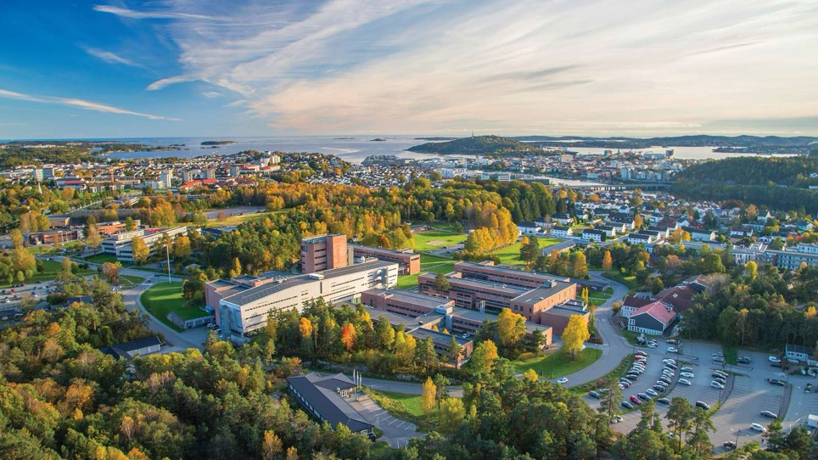
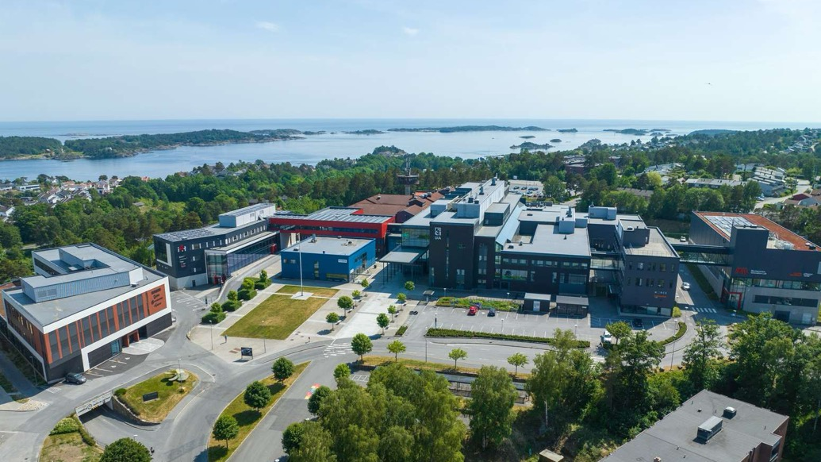
Campus
Grimstad
3,500 students
Campus
Kristiansand
10,500 students

Slide 4
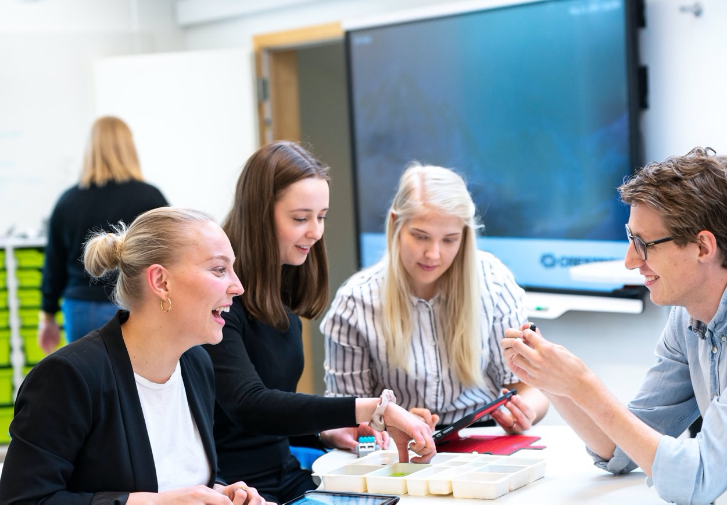
Our vision: Co-creating for tomorrow’s knowledge

Slide 5
Values
Openness
Trust
Academic quality
Respect

Slide 6
International collaboration
Incoming exchange students
564
International full degree students
395
Countries
150
International staff
313
Outgoing
537
Universities
250
European
University
Alliance

Slide 7
More recent milestones
The origins of UiA
1828: Natural History Museum and Botanical Garden (Kristiansand Museum)
1920:
Nursing education
(in Arendal)
1967:
Engineering education
(Agder Regional College of Technology)
1994:
Six colleges are merged to form Agder University College
2007:
The University of Agder is accredited
2010:
The new campus in Grimstad opens
1839:
Teacher education
(Holt Seminar)
1965: Music education
(Agder Music Conservatory)
1969:
Business education
(Agder Regional College)
2001: The new campus in Kristiansand opens
2017: The Natural History Museum and Botanical Garden become part of UiA

Slide 8
UiA today

Slide 9
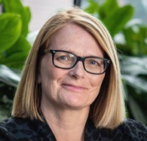
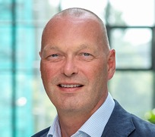
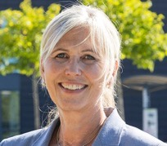
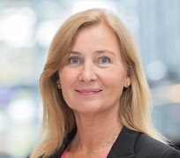
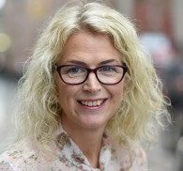
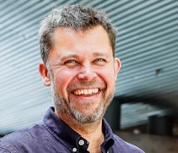
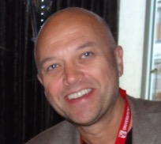
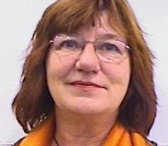
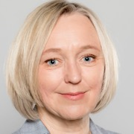
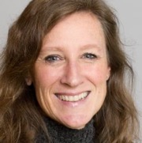
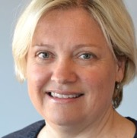
Academic
management
Sunniva Whittaker
Rector
Hans Kjetil Lysgård
Pro-Rector
Gøril Hannås
Vice-Rector for External Relations and Innovation
Hilde Inntjore
Vice-Rector for Education
Marit Wergeland
Dean of Faculty of Fine Arts
Leif Skiftenes Flak
Dean of Faculty of Social Sciences
Anders Johan Wickstrøm Andersen
Dean of Faculty of Health and Sport Sciences
Gunn Bjørnsen
Dean of the Teacher Education Unit
Anne Cathrine Gjærde
Dean of the Faculty of Engineering and Science
Kristin Wallevik
Dean of the School of Business and Law
Ingunn Folkestad Breistein
Dean of the Faculty of Humanities and Education

Slide 10
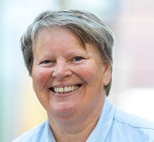
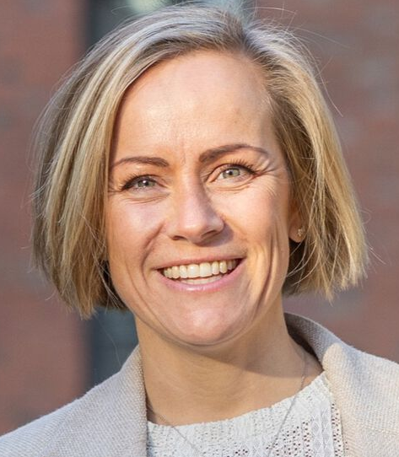
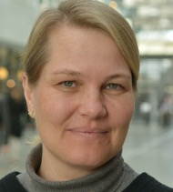
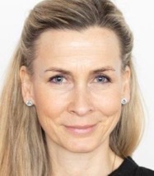

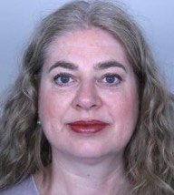
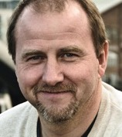
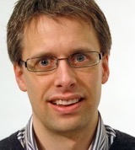
The University Director’s management team
Seunn Smith-Tønnessen
University Director
Erle Wright Severinsen
Acting Director of External Relations
Hanne Graver Møvig
Director of Academic Affairs
Ann Camilla Schulze-Krogh
Director of Research and Innovation
Øivind Dagsvik
Eskedal
Director of Communication
Helene Braathen
Director of
Human Resources
Tord Tjeldnes
Director of IT
Kjetil Hellang
Director of Finance and Campus Management

Slide 11
Notes:
6 fakultet + lærerutdanning i matrise
23 institutt
24 sentre
1 museum
1 studiesenter på Lesvos

Slide 12
UiA in numbers
Graduates
2944
Staff
1529
Students
14 185
Budget NOK (2025)
1,96 billion
External funding NOK
361 million
PhD candidates
415
PhDs awarded
67

Slide 13
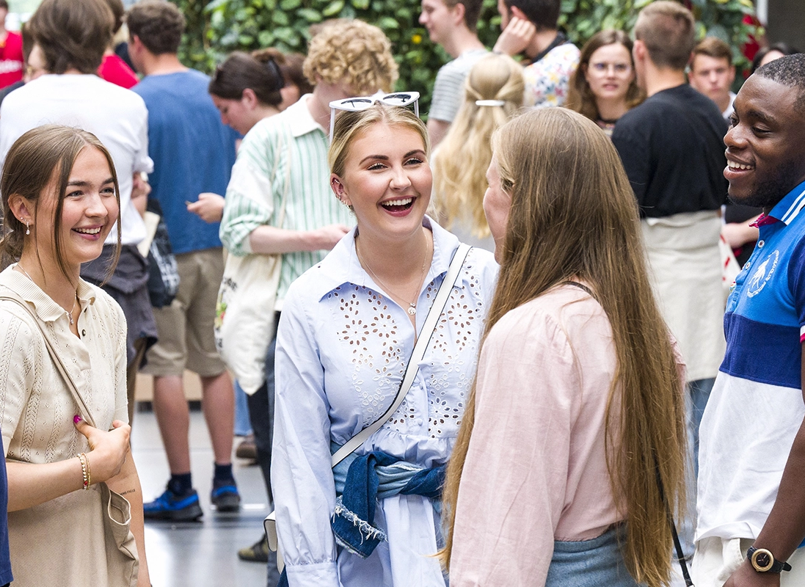
The students’ university
Strengthens student democracy and student influence
Involves students in research and innovation
Develops campuses as attractive and sustainable places to study
Prepares students for a changing workforce

Slide 14
The students’ university
Services throughout the academic year
UiA Help
First-line support and guidance
University
Library
Literature search, reference management, language guidance
Academic writing and study skills (Norwegian and English)
Academic Advisement
Student advisors
Programme coordinators
Help with
mathematics
Jobs and Career
UiA Career
Guidance, CV checks
Help
with coding
Nyskaping Student
Support for innovation and entrepreneurship (UiA start-up service)
Health and Counseling
Resource center
Accessibility services
Supported studies
The first weeks
Start-up, introduction
and orientation
The first semester
Mentor schemes where experienced students follow up first-year students
Alumni and Continuing Education
Networking and skills development
Lifelong learning

Slide 28
















Regional
collaboration
Community
engagement
and
innovation
Education
Research
and artistic development

Slide 29













Collaboration agreements
Goal:
A means to achieve the ambition of further developing and strengthening our partnerships
Areas of collaboration:
Strategic initiatives
Collaborative research, development and innovation projects
Research-based innovation
PhD/postdocs
Staff mobility
Education and skills development
Bachelor's and master's projects
Infrastructure
Profiling of collaborative knowledge environments

Slide 30
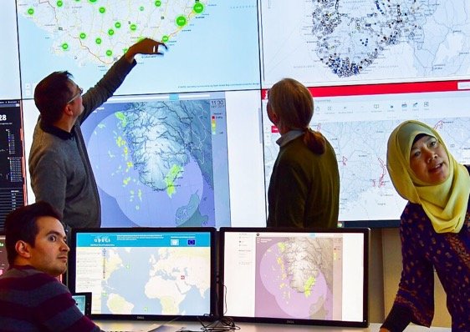

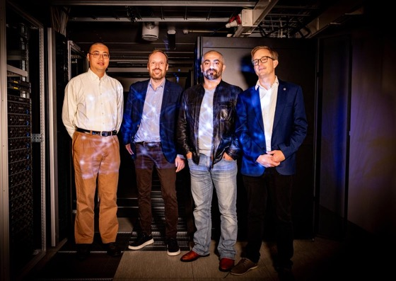
Priority research centres
CIEM: Centre for Integrated Emergency Management
Centre for lifecourse nutrition
CAIR: Centre for Artificial Intelligence Research

Slide 31
Co-creation forums

Slide 32
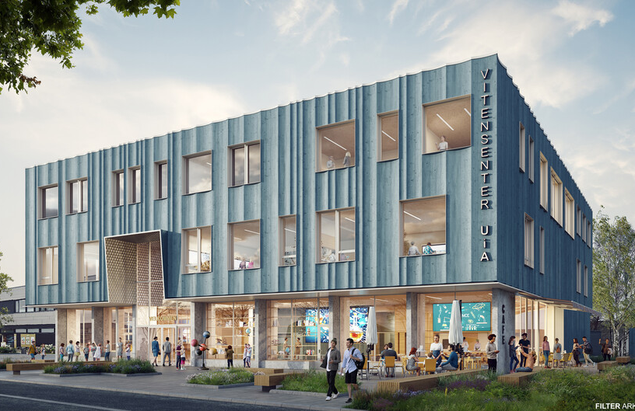
Vitensenteret Kristiansand UiA An arena for exploratory learning, interdisciplinary collaboration, makerspaces, research communication, and teaching. Connects children, young people, students, researchers, and community stakeholders. A shared-use building of 3,000 m² across three floors, with exhibitions, learning spaces, and a stage. UiA occupies approximately 1,000 m².

Slide 33
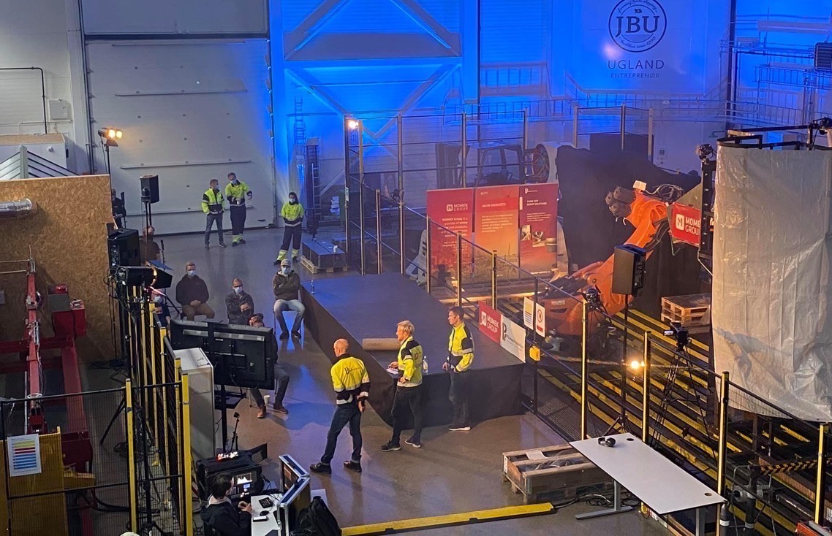

Mechatronics Innovation Lab National centre for innovation, pilot testing and technology qualification in mechatronics 2000 m² test centre 55 of the latest technologies available on the market

Slide 34

UiA CoLAB UiA CoLAB is part of the Research and Innovation Department, which plays a key role in implementing the university’s strategy for research, artistic development work, and innovation. CoLAB consists of an interdisciplinary team with expertise in innovation, design, pedagogy, art, and more.

Slide 35
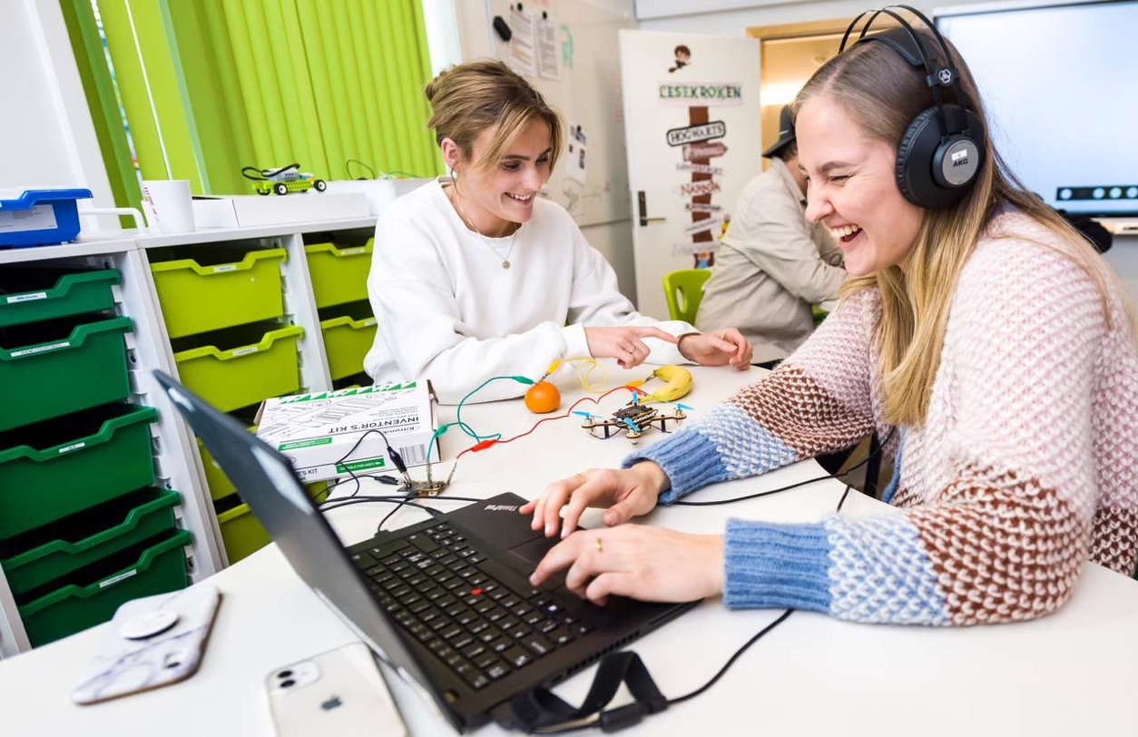
The Teaching Lab Technology-rich teaching space with flexible furniture, facilitating creative and active learning methods

Slide 36
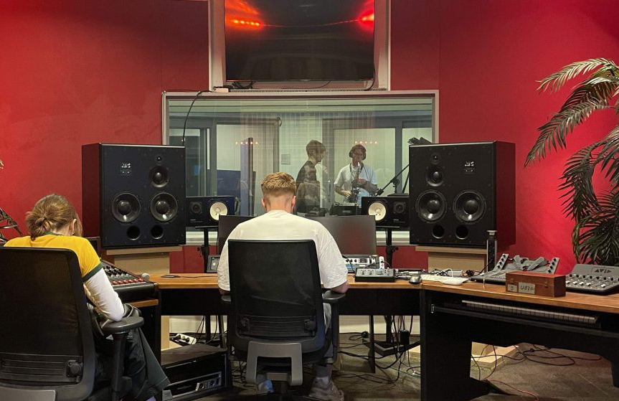
CreateMe Centre for Excellence in Education (SFU)

Slide 37

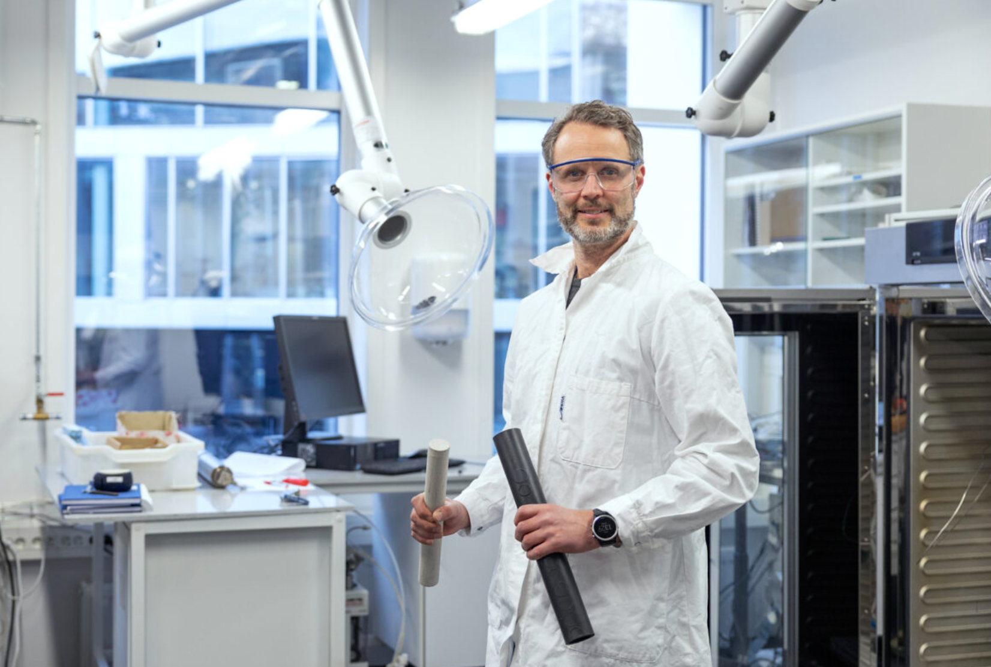
NORCE – Norwegian Research Centre AS UiA is a co-owner of one of Norway's largest independent research institutes.

Slide 38
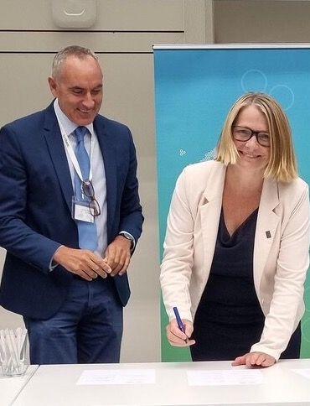
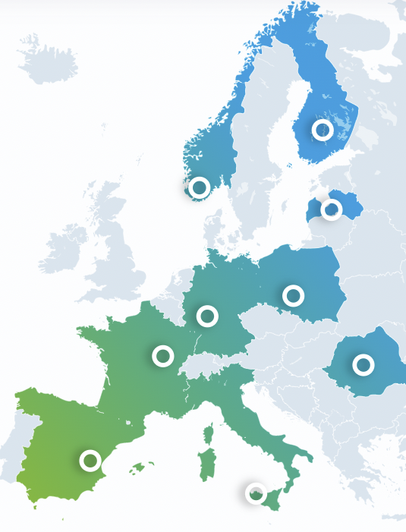
The FORTHEM Alliance
FORTHEM is one of 73 European University Alliances funded by the European Commission’s Erasmus+ programme. The alliance consists of nine universities from nine different countries that collaborate across borders in education, research, innovation, and civic engagement.Through the alliance, students, university staff, businesses, schools, and other organizations gain access to a wide range of opportunities for international cooperation.The University of Agder became a member of FORTHEM in September 2022.

Slide 39

Internationally accredited The School was accredited by the Association to Advance Collegiate Schools of Business (AACSB) in 2019. Reaccredited in 2023/2024

Slide 40
Study programmes

Slide 41
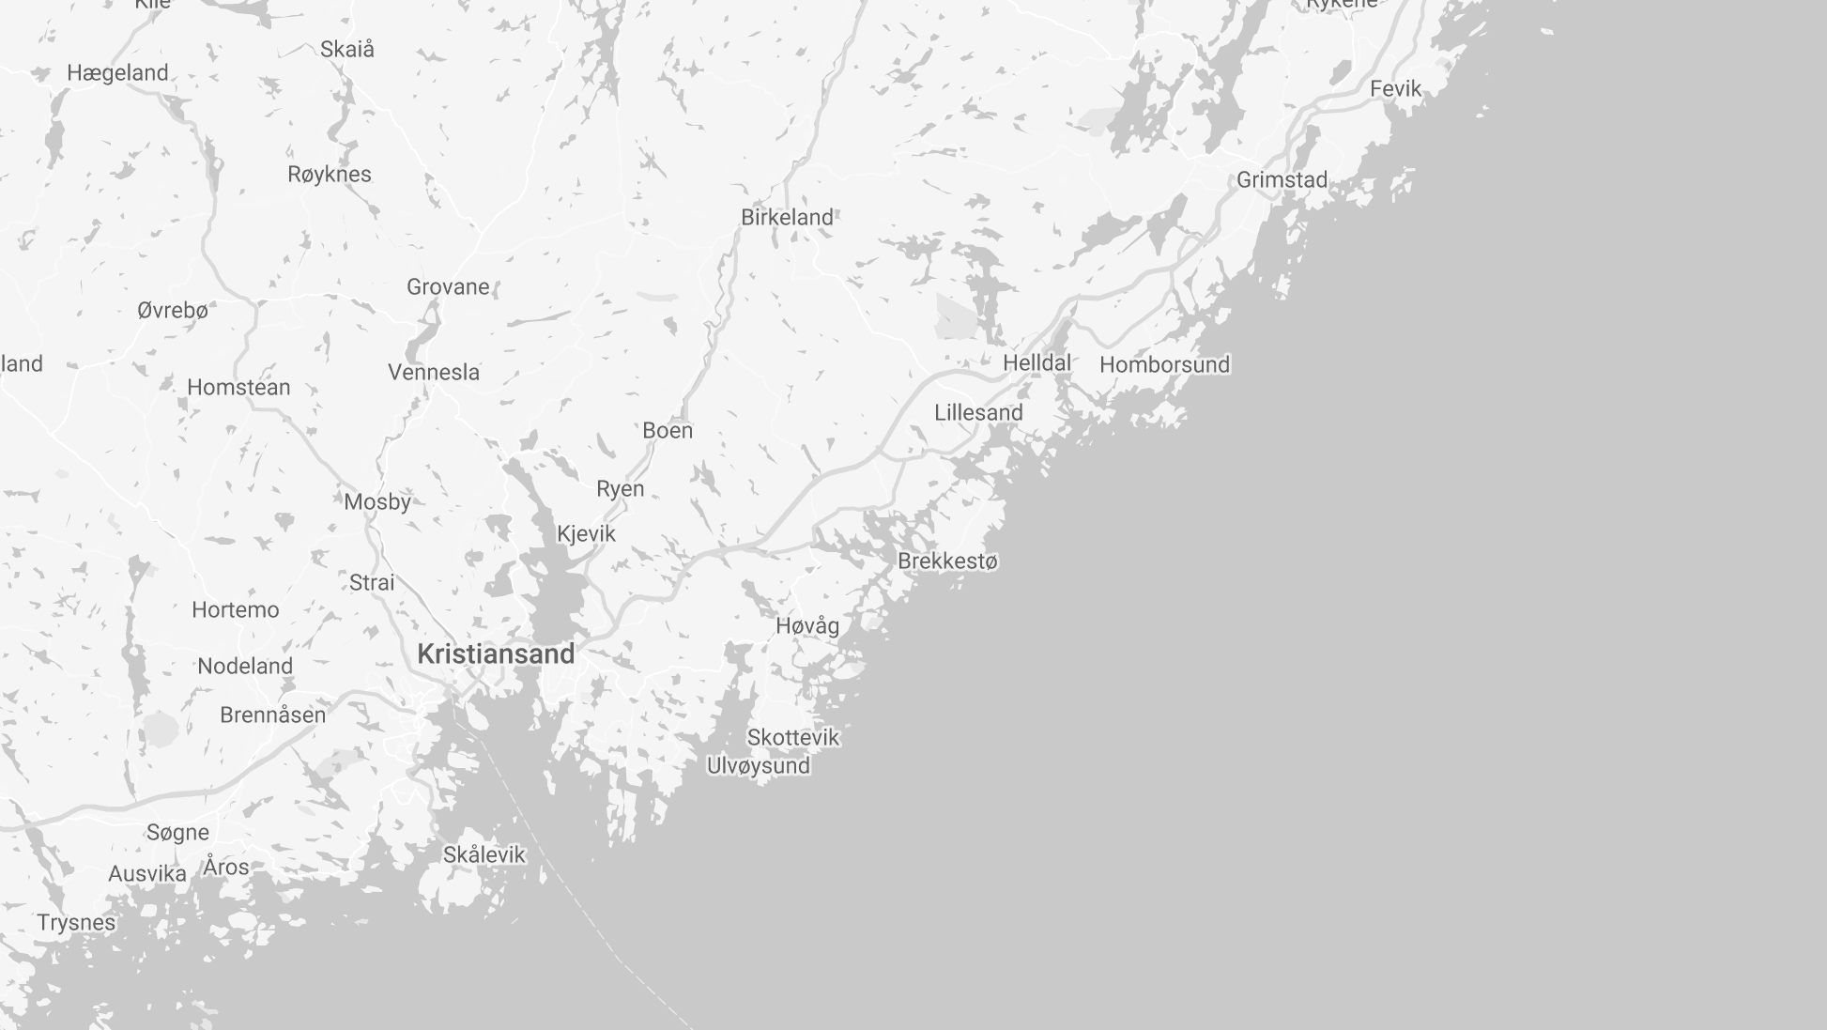

Grimstad
31 min
Kristiansand
Notes:
(Hvor langt er det til/fra der du er på besøk? F eks: ca 4 timer til Oslo. Ca 3 timer til Stavanger. Tog/buss/fly?)

Slide 42

46
Bachelor’s programmes
34
One-year programmes
51
Master’s programmes
Programmes in the
following fields of study:
Health, social sciences, and sports sciences
Natural sciences
History, philosophy, and religion
Social sciences
Engineering, technology, and IT
Languages, literature, communication, and media
Arts, theatre, and music
Economics, management, administration, and law
Teacher education and pedagogy

Slide 43

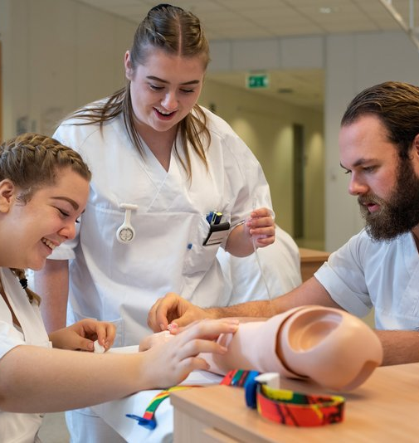
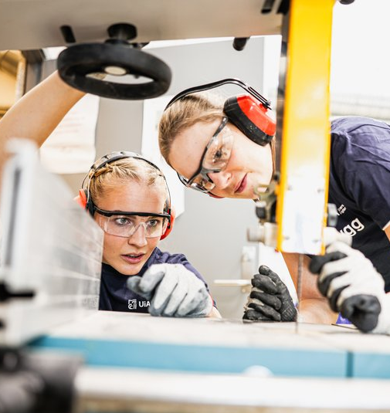

Our largest fields of study
Teaching
Education sector
Nursing
Specialist nurse
Engineering
Master of Science
in Engineering
Business and
Economics
Master of Science in Economics and Business Administration

Slide 44

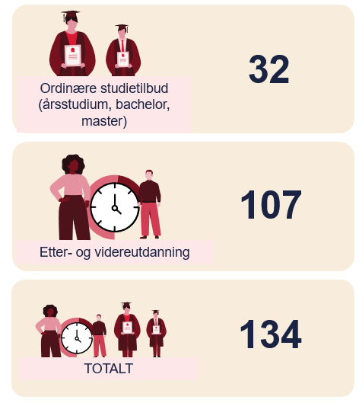

Flexible studies at UiA
Part-time
Session-based (on-campus sessions)
Online
(or combinations)

Slide 45
Flexible studies at UiA
Part-time
Session-based (on-campus sessions)
Online
(or combinations)

Slide 46

Continuing education from UiA Time to learn something new?
Non-credit courses leading to a complete
master's degree in
Business, management, administration and law
Health, social sciences and sport
Engineering, technology and IT
Kindergarten, primary and secondary education
Social studies
Continuing education courses can be customised for your company at uia.no/videre

Slide 47
We focus on

Slide 48
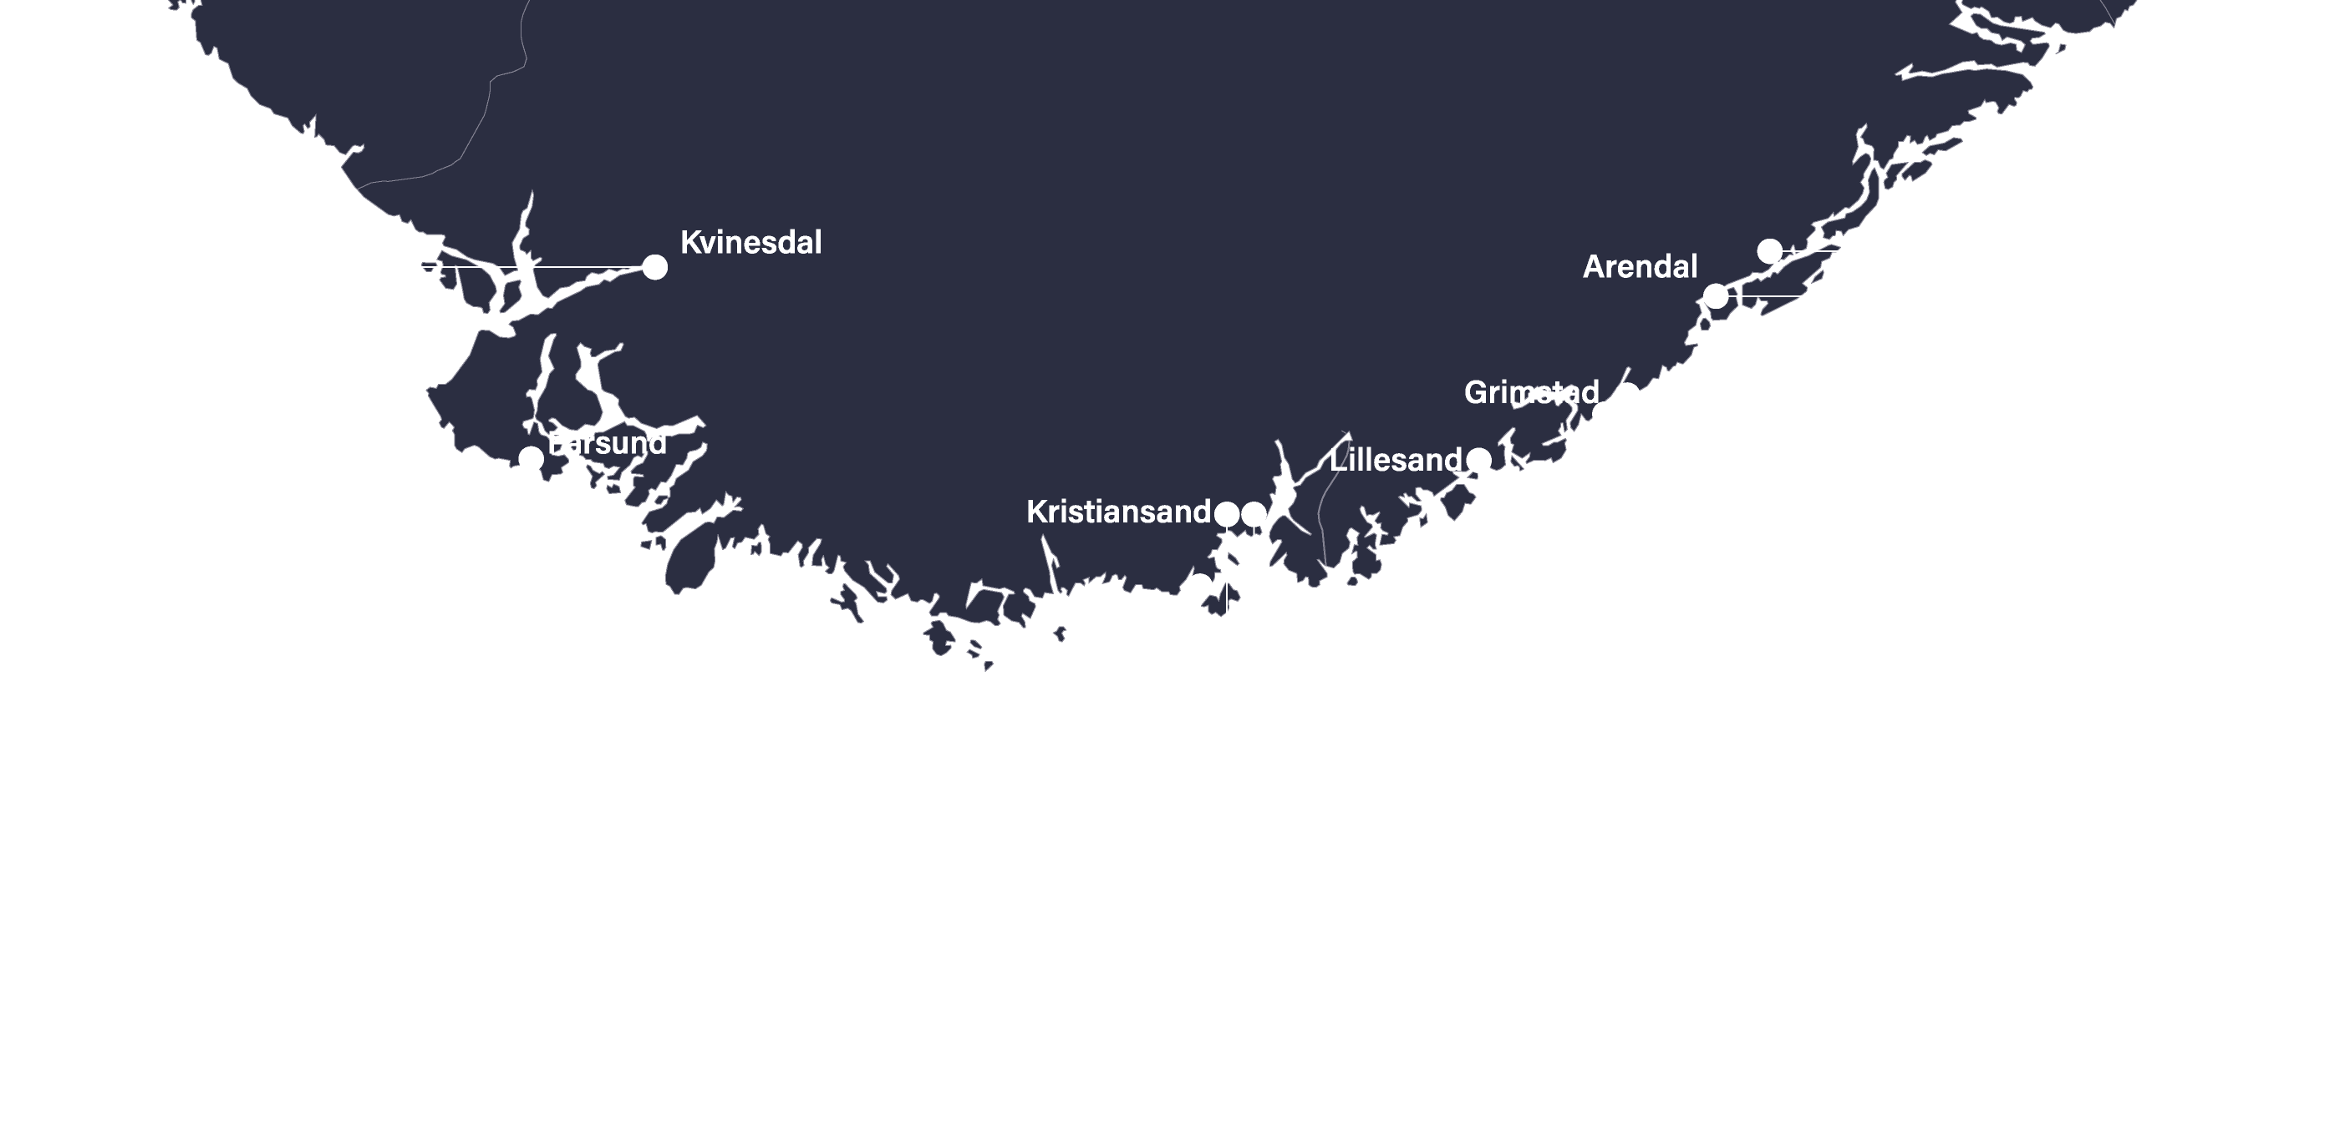
Batteri
Battery

Slide 49

Offshore wind
Technology and
engineering
Economy and business
Social sciences
Science
Law

Slide 50
Climate/environment/ sustainability
Notes:
Universitetene er svar på det meste – vi har en kjempespennende jobb foran oss!

Slide 51
The university's different roles
As an academic institution:
Teaching
Research
Dissemination
As a large enterprise:
Leasing buildings
Travel to and from campus
Business travel
Procurements
Notes:
Universitetet som akademisk institusjon

