Slide 1
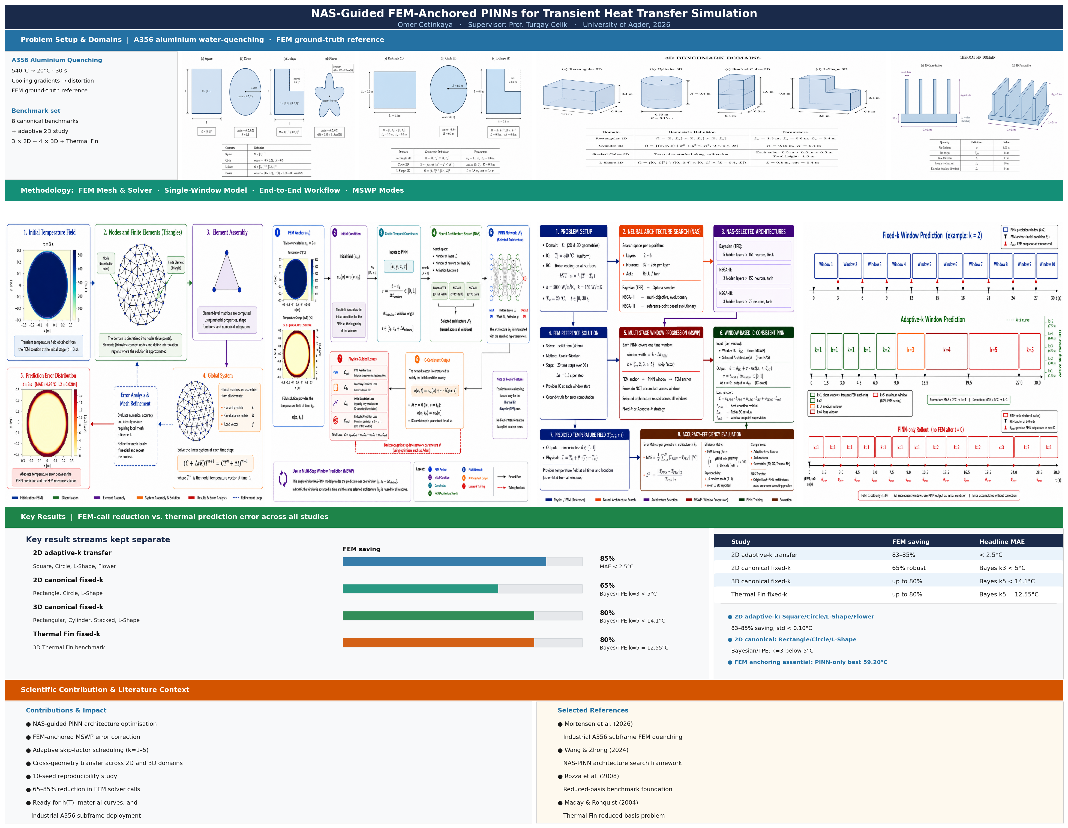
UiA | University of Agder
NAS-Guided FEM-Anchored PINNs
Multi-Step Window Prediction for Transient A356 Water Quenching
Step Optimization in Thermal Simulation Using Selective Finite Element Method Step Skipping
Omer Cetinkaya | University of Agder | 2026
Supervisor: Prof. Turgay Celik
UiA | University of Agder
Master Thesis Defense
1

