Slide 1
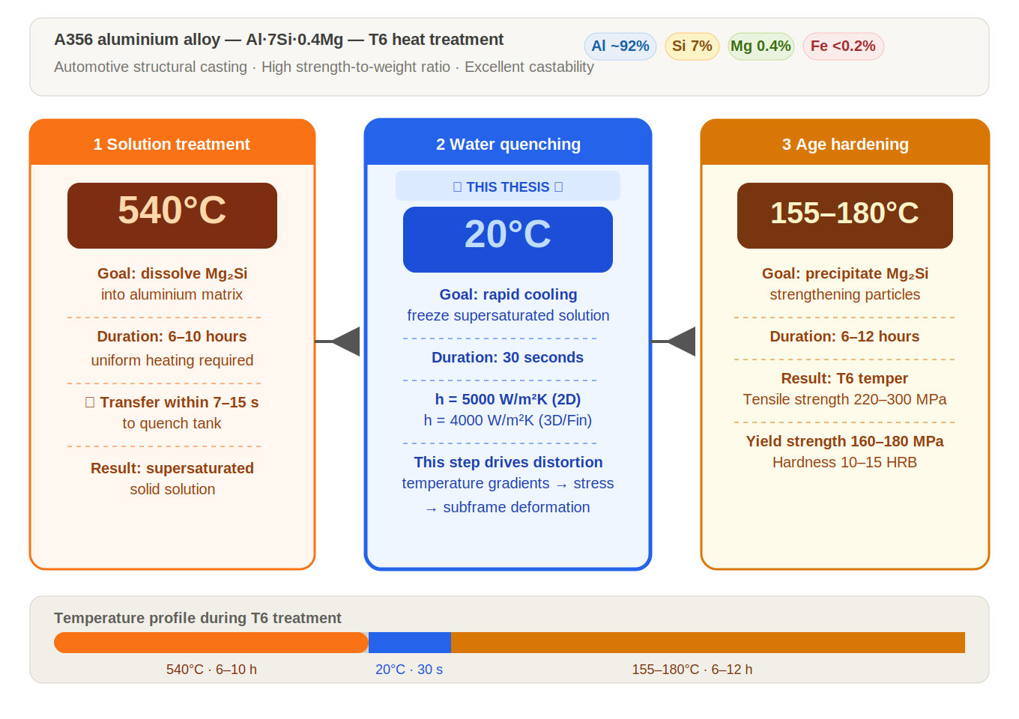
What is A356 aluminium? - T6 heat treatment process
INTRODUCTION
A356 aluminium
A356 is an aluminium-silicon casting alloy. It is common in cast automotive parts because it is light and has useful mechanical properties.
Water quenching
After heating, the hot part is cooled quickly in water. This fast cooling changes the temperature field inside the part.
Why simulation is needed
Fast cooling can create strong temperature gradients. These gradients can cause distortion and residual stress.
Connection to this thesis
Mortensen et al. (2026) use FEM for A356 automotive subframe quenching. This thesis uses that industrial problem as motivation for FEM-step reduction.
Source: Mortensen et al. (2026), finite element simulation of water quenching in cast A356 automotive subframes.
UiA | University of Agder
Master Thesis Defense
4

