Slide 1
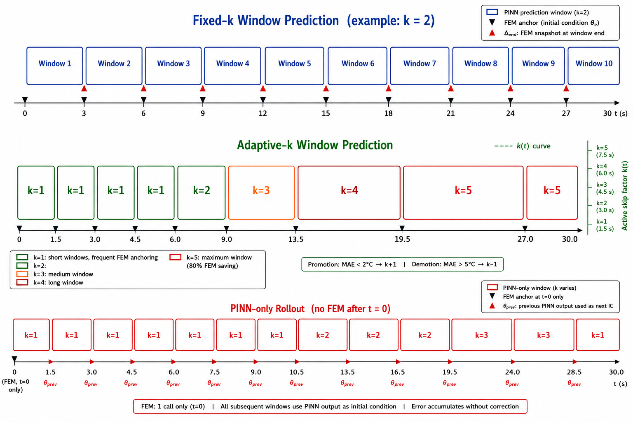
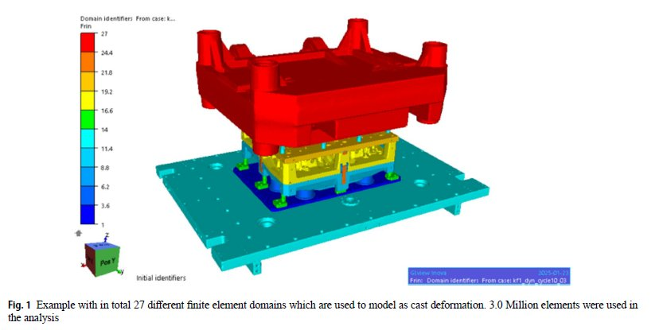
Intro: From the Reference Paper to This Thesis
INTRODUCTION
We follow the industrial quenching problem from the reference paper, then test whether FEM time-step calls can be reduced with a FEM-anchored NAS-PINN strategy.
Problem statement
Figure 1.1 shows the three operating modes of the MSWP framework. Starting from the reference paper, the thesis keeps the same quenching setting but tests whether selected FEM steps can be skipped with NAS-PINN predictions.
Why surrogate geometries first?
The real industrial data arrived late, so the method was validated first on controlled geometries: NAS-PINN source domains, canonical 2D domains, then 3D and Thermal Fin benchmarks.
Initial temperature
Water bath
Simulation time
2D h
3D/Fin h
540 C
20 C
30 s
A356 part
quench medium
transient cooling
W/(m2K)
W/(m2K)
UiA | University of Agder
Master Thesis Defense
5

