Slide 1
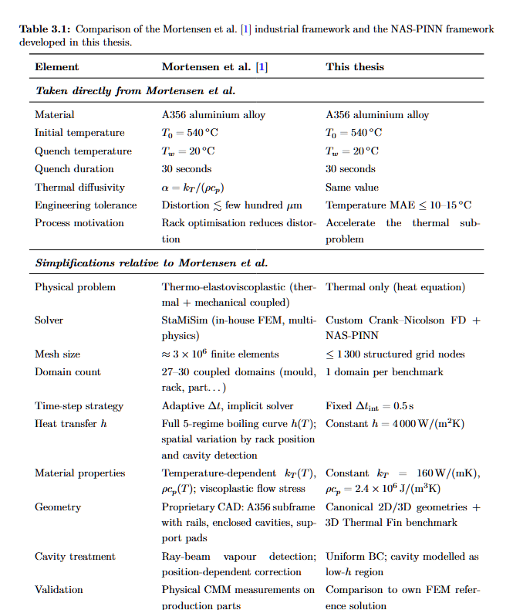
Reference Paper Inputs and Thesis Use
INTRODUCTION
Table 3.1: what is taken from the reference study
Important comparison
Reference paper
Industrial A356 water-quenching problem; FEM is used to simulate thermal behaviour and distortion risk.
What we keep
Same physical motivation: hot A356 part, water bath, transient cooling and FEM reference fields.
What we change
The thesis does not simulate the full industrial subframe first. It validates the method on controlled 2D, 3D and Thermal Fin benchmarks.
How we use it
FEM snapshots become trusted anchors. NAS-PINN predicts selected intermediate windows to reduce FEM time-step calls.
Main message: the reference paper gives the industrial FEM-quenching motivation; this thesis tests a FEM-anchored acceleration strategy.
UiA | University of Agder
Master Thesis Defense
6

