Slide 1
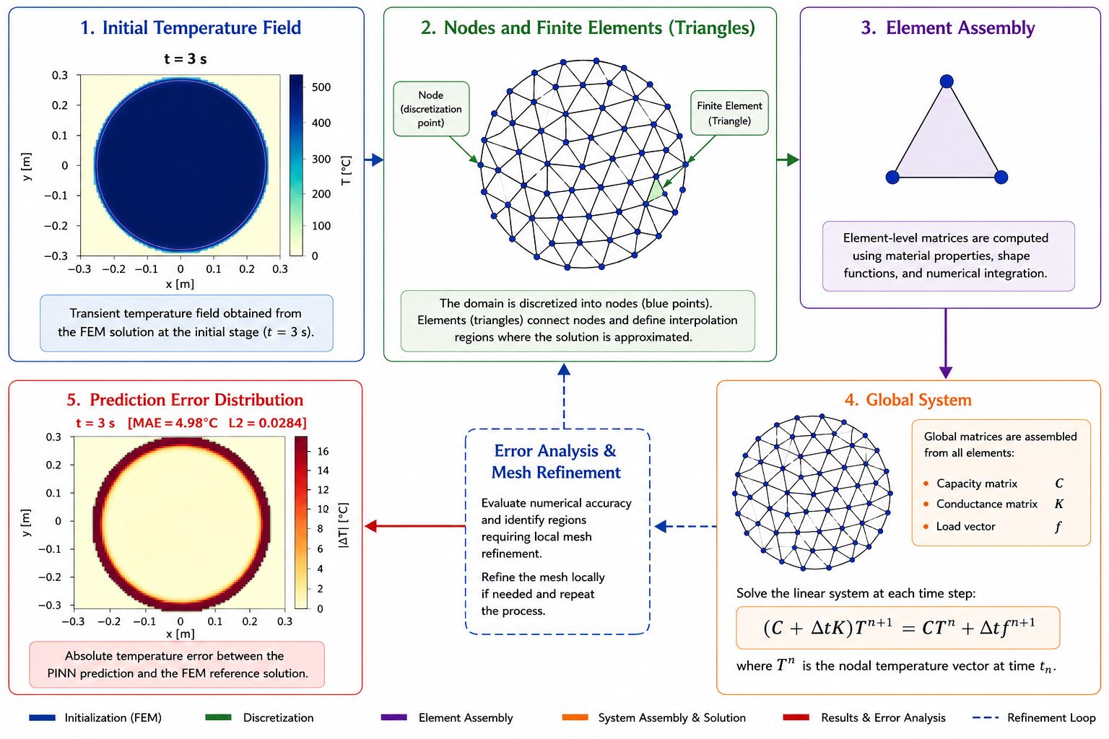
FEM Process: How It Works
THEORY AND FEM BACKGROUND
Step 1: physics
Define geometry, material properties, initial condition and boundary conditions.
Step 2: discretise
Split the domain into grid or mesh nodes.
Step 3: solve
Advance the heat equation in time with the numerical solver.
Step 4: output
Save temperature fields as reference snapshots.
UiA | University of Agder
Master Thesis Defense
10

