Slide 1
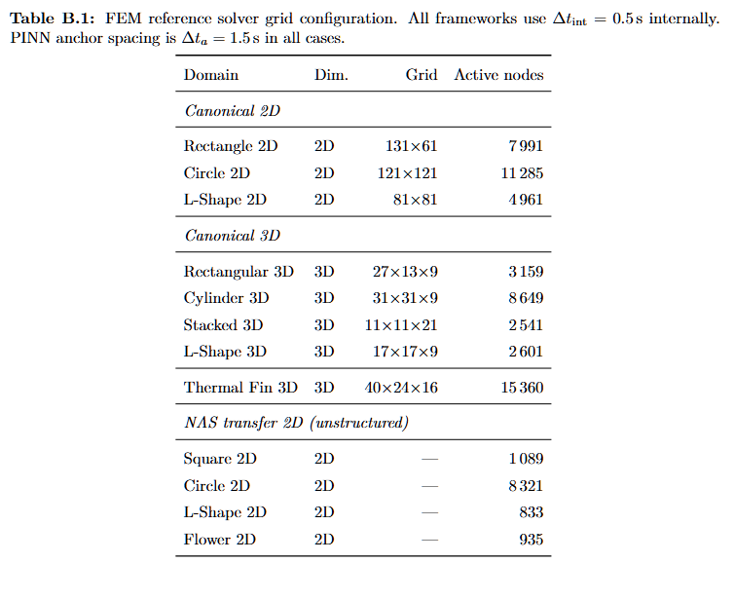
FEM Solver and Mesh Configuration
THEORY AND FEM BACKGROUND
Step after FEM process
After defining the FEM workflow, I show the actual grids and active nodes.
Why it matters
The reference error depends on the numerical grid quality and domain resolution.
How I use it
These FEM fields become the baseline for MAE, L2 and anchor snapshots.
UiA | University of Agder
Master Thesis Defense
11

