Slide 1
NAS-MCO-PINNs
KEY RESULTS
Best Result:
Neural Architecture Search + Multi-Loss Consistency
for Physics-Informed Neural Networks
L2 = 0.014
vs FEM Baseline:
IKT590-G 26V — Master's Thesis | March 2026
9× more accurate
University of Agder · Department of ICT
Inference Speed:
18,400× faster
0.01 s vs 184 s

Slide 2
Project Overview
Nine Progressive Levels
Performance Summary
L1
Baseline PINN — Single-shot 2D quenching
FEM Reference Time:
184 s per run
L2
Temporal Skip Operator — 48% FEM step reduction (our design)
PINN Inference Time:
0.01 s
L3
Hybrid FEM-PINN — Adaptive residual threshold
L4
Distortion Prediction — Mechanical + thermal coupling
Speedup Factor:
18,400×
L5
L-BFGS Refinement — Two-stage Adam + L-BFGS training
Best L2 Error:
0.014 (Level 9)
L6
Poisson Benchmark — Generalization to analytic PDE
vs FEM Baseline:
9× more accurate
L7
Multi-Domain + Temporal — 5 geometries, time-skip analysis
Training Time:
~400–600 s
L8
3D Multi-Geometry — 48 experiments across 4 3D domains
L9
NAS Optimizers:
Bayesian, NSGA-II, NSGA-III
SA-PINNs + Fourier — Self-adaptive weights + Fourier features ← BEST
Total Experiments:
48 (Level 8 alone)

Slide 3
The Problem — Industrial Casting & FEM
A356 Aluminum Water Quenching
Governing Equations & Properties
A356 aluminum subframes undergo water quenching after casting.
Heat Equation:
Non-uniform cooling → residual stress → distortion → quality issues.
ρ·cp·∂T/∂t = k·∇²T
FEM Simulation (Current Standard):
Boundary Condition:
• Accurate but slow: 21 time steps × 8.8 s = 184 s per run
−k·∂T/∂n = h·(T − T∞)
• Too slow for NAS, optimization, or real-time control
• Cannot run thousands of parameter sweeps
A356 Material Properties:
ρ = 2670 kg/m³
PINN Approach (This Work):
cp = 963 J/(kg·K)
• Train once: ~400–600 s
k = 151 W/(m·K)
• Predict full temperature field: 0.01 s
T₀ = 540 °C (initial)
• 18,400× faster at inference time
T∞ = 20 °C (water)
• Enables NAS, sensitivity analysis, param sweeps
HTC Regime:
Film boiling → h ≈ 800 W/m²K
Nucleate boil. → h ≈ 12,000 W/m²K
Convection → h ≈ 1,000 W/m²K

Slide 4
FEM Reference Model — Mortensen et al. (2026)
What is the FEM Reference?
A356 Flow Stress Parameters
(Source: Table 1 — D. Mortensen, G. Noorsumar, H.G. Fjaer, R. Babaei, P.E. Dronen (2026))
We did NOT implement FEM ourselves.
T (°C) | F (MPa) | n | m
0 | 22.0 | 0.300 | 0.000
200 | 18.9 | 0.270 | 0.016
350 | 16.0 | 0.125 | 0.150
450 | 12.3 | 0.000 | 0.220
550 | 2.0 | 0.000 | 0.277
Reference data is from:
D. Mortensen, G. Noorsumar, H.G. Fjaer, R. Babaei, P.E. Dronen (2026)
"Mitigating distortions in cast automotive subframes:
A finite element simulation approach"
Int J Adv Manuf Technol, 2026
DOI: 10.1007/s00170-026-17515-w
From this paper we extracted:
✓ Material params (Table 1) — A356 flow stress F, n, m vs T
✓ HTC curve h(T) — boiling regime transition (Fig. 6)
✓ Ref. temperature histories (Figs 7, 15-17) — ground truth
Parameter Definitions:
✓ Distortion at 8 CMM measurement points (Fig. 15)
Standard practice: compare PINN predictions to published
• F — Flow stress coefficient (MPa)
FEM results rather than re-implementing FEM from scratch.
• n — Strain rate sensitivity exponent
• m — Thermal softening exponent
• T — Temperature (°C)
Used in Level 4 mechanical coupling (distortion).

Slide 5
Why Replace FEM?
Side-by-Side Comparison: FEM (Reference) vs Our PINN
Property | FEM (Reference) | Our PINN (Level 9)
Runtime per field | 184 s per run | 444 s train + 0.01 s predict
Time steps needed | 21 FEM steps | 1 training run
Prediction time | 184 s | 0.01 s
Accuracy (L2) | Reference (ground truth) | 0.014 ← BEST
NAS-compatible? | No (too slow) | Yes
Parameter sweep? | No (1000 runs = 51 hours) | Yes (1000 runs = 10 s)
GPU required? | No | Yes (available on server)
Mesh needed? | Yes (structured FEM mesh) | No (meshfree collocation)
Once the PINN is trained, running 1000 parameter variations takes 10 seconds instead of 51 hours (1000 × 184 s). This unlocks NAS, uncertainty quantification, and real-time optimization that are impossible with FEM.
Note: The 444 s training time is a one-time cost. Amortized over 1000 queries: total = 444 s + 10 s = 454 s vs FEM 184,000 s — a 405× reduction in total wall-clock time.

Slide 6
Contribution 1: Temporal Skip Operator (our design)
Why we designed this:
Skip Operator Results (Level 2)
Standard PINNs need 21 separate training runs (one per FEM step).
We designed a single network that predicts s steps ahead.
Skip s | FEM Calls | FEM Saved | L2 Error
1 (baseline) | 21 / 21 | 0% | 0.126
2 | 11 / 21 | 48% | 0.108 ← recommended
4 | 6 / 21 | 71% | 0.204
6 | 4 / 21 | 81% | 0.294
The Formula:
T̂(t + s·Δt) = T_IC + τ · fθ(x, y, τ, T_IC)
where τ = t / (s·Δt) ∈ [0, 1]
Why this specific form:
At τ = 0: prediction = T_IC (IC satisfied exactly)
Eliminates IC as a soft constraint → faster convergence
Inspired by IC-residual formulations [Lagaris et al., 1998]
Our Novelty:
Key Insight:
The temporal skip concept (s > 1) is our contribution.
Not found in prior PINN literature for quenching.
skip=2 gives LOWER error than skip=1 because fewer FEM boundary conditions are imposed, reducing accumulated FEM discretization error in the PINN training signal.
At skip=2: error DECREASES because fewer FEM steps means
less numerical discretization error from FEM accumulates.
FEM Savings at skip=2:
21 steps → 11 steps = 48% fewer FEM calls 184 s → ~91 s per parameter sweep point For 1000 NAS candidates: saves ~93,000 s of FEM time

Slide 7
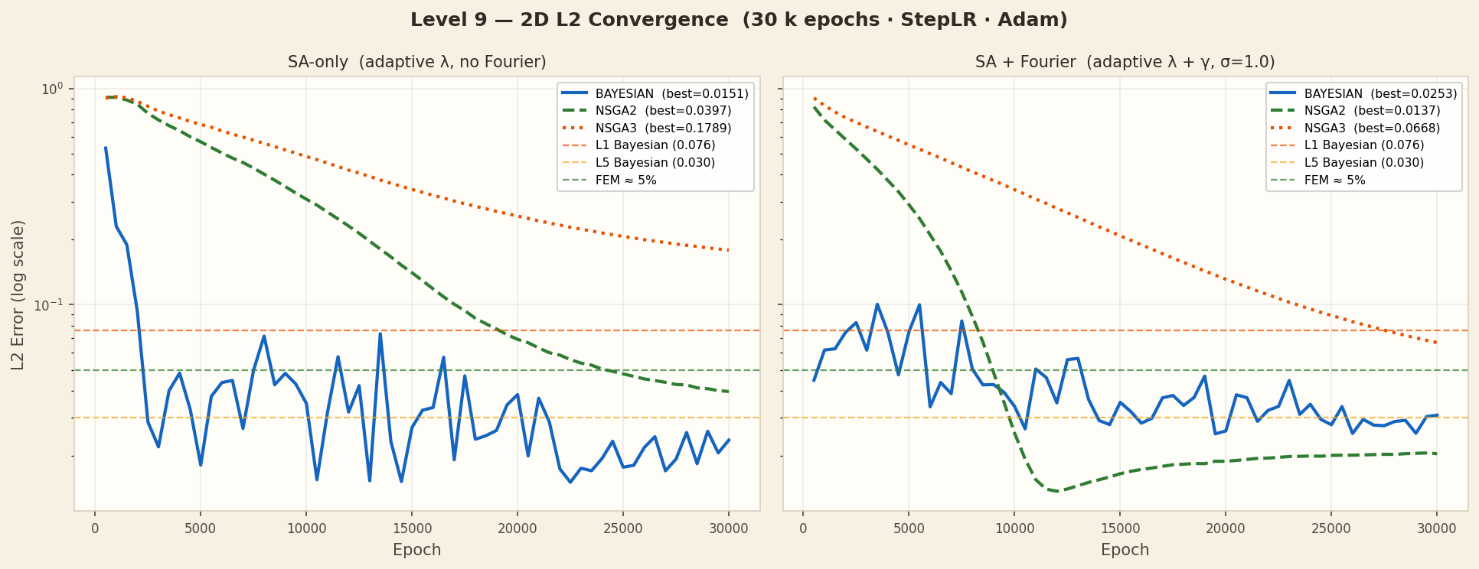
Contribution 2: Fourier Feature Embedding [Tancik et al., 2020]
Why we adopted this:
Convergence Comparison
Standard MLPs suffer from 'spectral bias' [Rahaman et al., 2019]:
they learn low-frequency patterns first.
A356 quenching characteristics:
• Rapid cooling in first 5 s: ΔT ≈ 200°C (high-frequency signal)
• Standard PINNs learn this slowly → poor early predictions
What we adopted from [Tancik et al., 2020]:
Encoding: γ(v) = [sin(2π·B·v), cos(2π·B·v)]
B ∼ N(0, σ²), frozen during training (not learned)
Our settings: n_fourier=64, σ=1.0 → 128-dim encoding
Applied to all inputs: (x, y, t, T_IC)
What we implemented ourselves:
FourierEmbedding class (fourier_pinn.py)
Integration with NAS architecture search
Ablation: SA+Fourier vs SA-only vs baseline
Effect on L2 (NSGA-II):
SA-only: L2 = 0.0397
SA+Fourier: L2 = 0.0137 (3× improvement)
Fig 3: Training convergence with / without Fourier features (Level 9, NSGA-II optimizer, 2D quenching domain)
Fourier features reduce training epochs for convergence by ~30% and improve final L2 by 3× compared to SA-only on the same NAS-selected architecture.

Slide 8
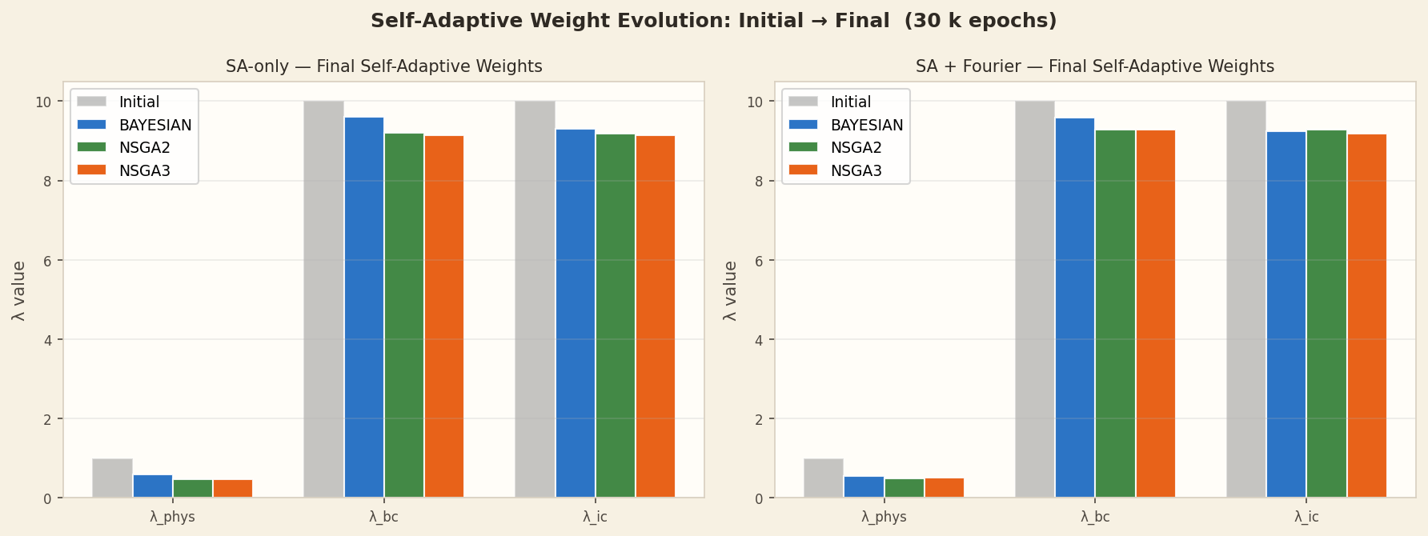
Contribution 3: Self-Adaptive Loss Weights [Wang et al., 2022]
Why we adopted this:
SA Weight Evolution During Training
PINN loss = λ_phys·L_phys + λ_bc·L_bc + λ_ic·L_ic
Our three loss terms differ in scale by 10⁴:
PDE residual scale: ~4 × 10⁷ (dominant)
BC loss scale: ~17,333
IC loss scale: ~520
Problem with fixed weights:
λ = (1, 10, 10) works for one problem but needs
expert retuning for each geometry or material change.
Wrong weights → optimization dominated by large PDE term.
Solution from [Wang et al., 2022]:
λ = softplus(w), where w is a learnable parameter
w trained jointly with network at smaller lr = 0.001
Weights adapt automatically to loss scale differences
What we implemented:
SelfAdaptiveWeights module (sa_loss.py)
Initial: λ_phys=1.0, λ_bc=10.0, λ_ic=10.0
Converged: λ_phys≈0.48, λ_bc≈9.28, λ_ic≈9.28
Ratio λ_bc / λ_phys ≈ 19× (boundary/IC dominate)
Fig 4: Self-adaptive weight evolution over training epochs (Level 9, NSGA-II optimizer, 2D quenching)
SA weights allow the same architecture to work across all 9 levels without manual retuning — critical for NAS where different architectures produce different loss scales.

Slide 9
Neural Architecture Search — Three Optimizers
Bayesian Optimization
NSGA-II ← BEST
NSGA-III
Based on: [Snoek et al., 2012]
Based on: [Deb et al., 2002]
Based on: [Deb & Jain, 2014]
Library: scikit-optimize
Library: pymoo
Library: pymoo
Strategy:
Strategy:
Strategy:
Gaussian Process surrogate model
Multi-objective evolutionary
Many-objective with reference
over architecture search space
2 objectives: L2 + #params
point vectors
Evaluations: 500 candidates
Evaluations: pop=20 × 25 gens
Evaluations: pop=20 × 25 gens
Best for: simpler geometries
Best for: complex geometries
Best for: compact architectures
Level 9 Best L2:
Level 9 Best L2:
Level 9 Best L2:
0.0253
0.0137 ← OVERALL BEST
0.0668
Architecture found:
Architecture found:
Architecture found:
5 layers × 128 neurons
4 layers × 96 neurons
3 layers × 64 neurons
Activation: GELU
Activation: SiLU
Activation: Tanh
~83K parameters
~67K parameters
~17K parameters
NAS Search Space: Layers: 3–6 | Neurons/layer: 64–160 | Activations: Tanh, GELU, SiLU, ReLU | Fourier features: on/off

Slide 10
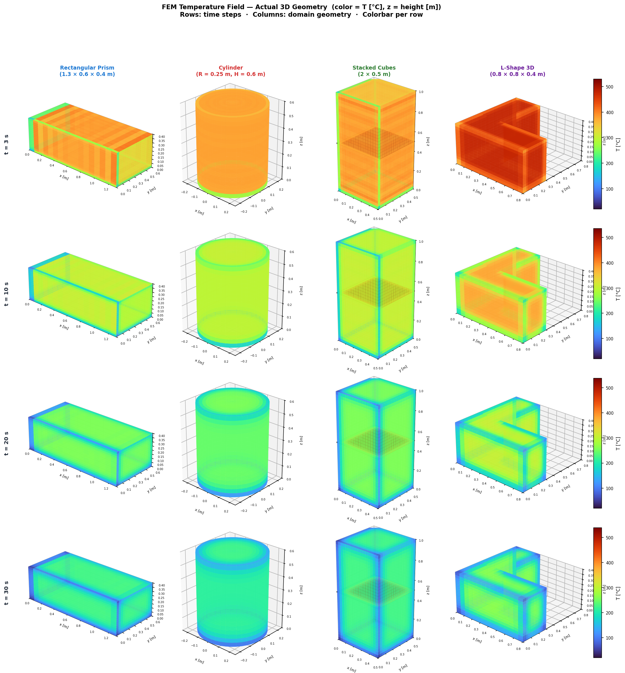
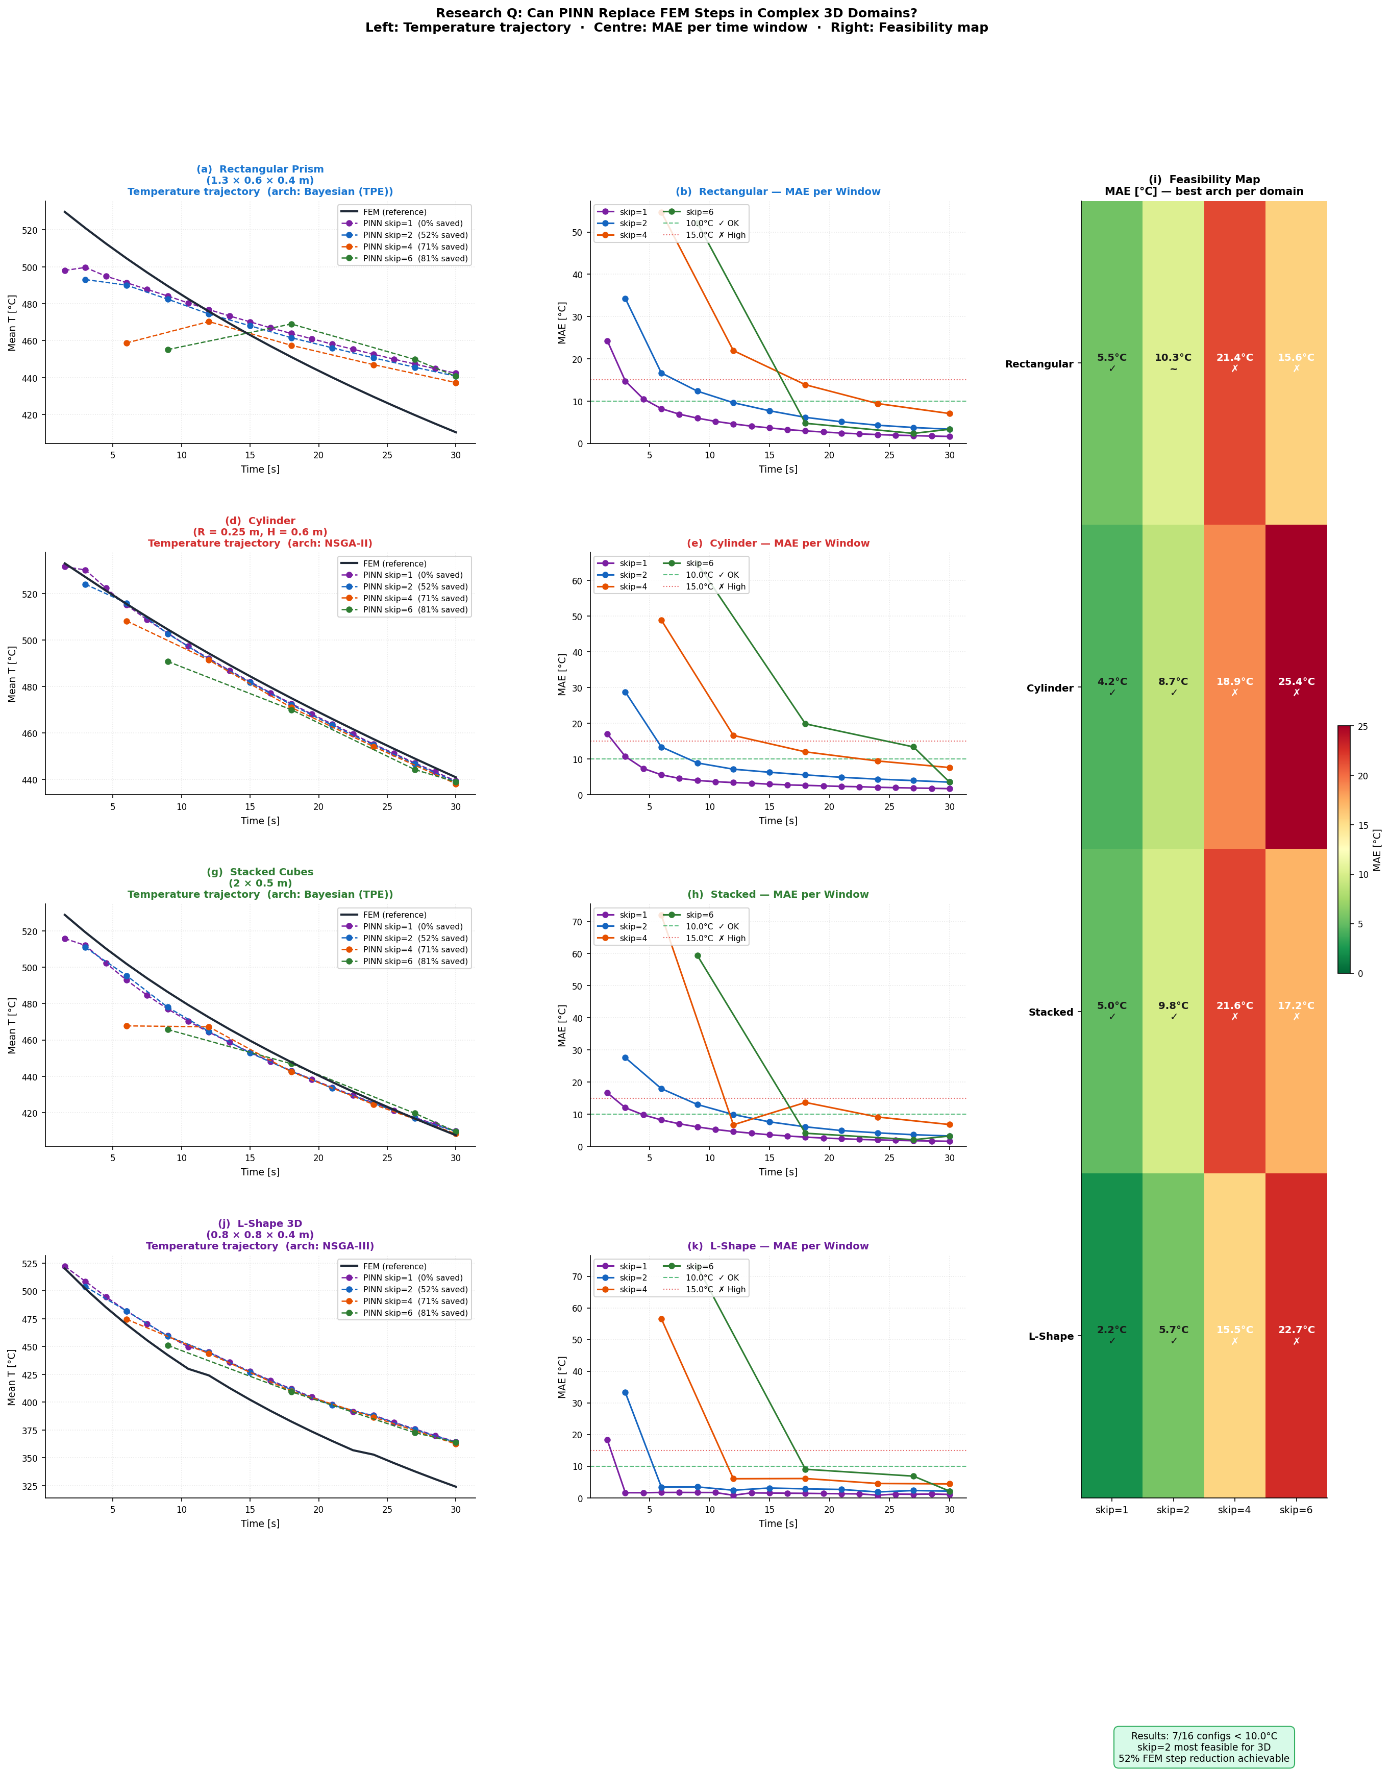
Level 8 — 3D Temperature Fields: Predicted vs. FEM (4 Domains)
Predicted Temperature Fields (z-midplane)
PINN vs. FEM Reference — Feasibility Check
Turbo colormap: blue = 20 °C → yellow = 540 °C
4 domains × 3 NAS optimizers × 4 skip values = 48 runs | We achieved MAE = 2.19 °C on L-Shape (NSGA-II, skip=1) | At skip=2 (52% FEM savings): all domains MAE < 11 °C

Slide 11
Level 8 — Full Results: MAE (°C) for All 48 Runs
< 8 °C
8–15 °C
> 15 °C
Domain | Optimizer | skip=1 (0%) | skip=2 (52%) | skip=4 (71%) | skip=6 (81%)
Rectangular | Bayesian | 5.53 | 10.31 | 21.39 | 15.65
Rectangular | NSGA-II | 5.41 | 10.39 | 20.99 | 25.86
Rectangular | NSGA-III | 5.41 | 10.50 | 21.00 | 25.90
Cylinder | Bayesian | 5.33 | 10.69 | 11.54 | 10.23
Cylinder | NSGA-II | 4.23 | 8.69 | 18.93 | 25.38
Cylinder | NSGA-III | 4.20 | 9.14 | 16.24 | 22.54
Stacked | Bayesian | 4.95 | 9.80 | 21.64 | 17.18
Stacked | NSGA-II | 5.32 | 10.20 | 19.60 | 25.69
Stacked | NSGA-III | 5.12 | 10.27 | 19.77 | 25.51
L-Shape | Bayesian | 5.60 | 6.19 | 5.61 | 5.60
L-Shape | NSGA-II | 2.19 | 5.74 | 15.45 | 22.53
L-Shape | NSGA-III | 2.19 | 5.72 | 15.51 | 22.73
Best 3D result: L-Shape + NSGA-II/III, skip=1 → MAE = 2.19 °C | Recommended: skip=2 (52% FEM savings, MAE < 11 °C for all domains) | 3D future work: run NAS directly in 3D

Slide 12
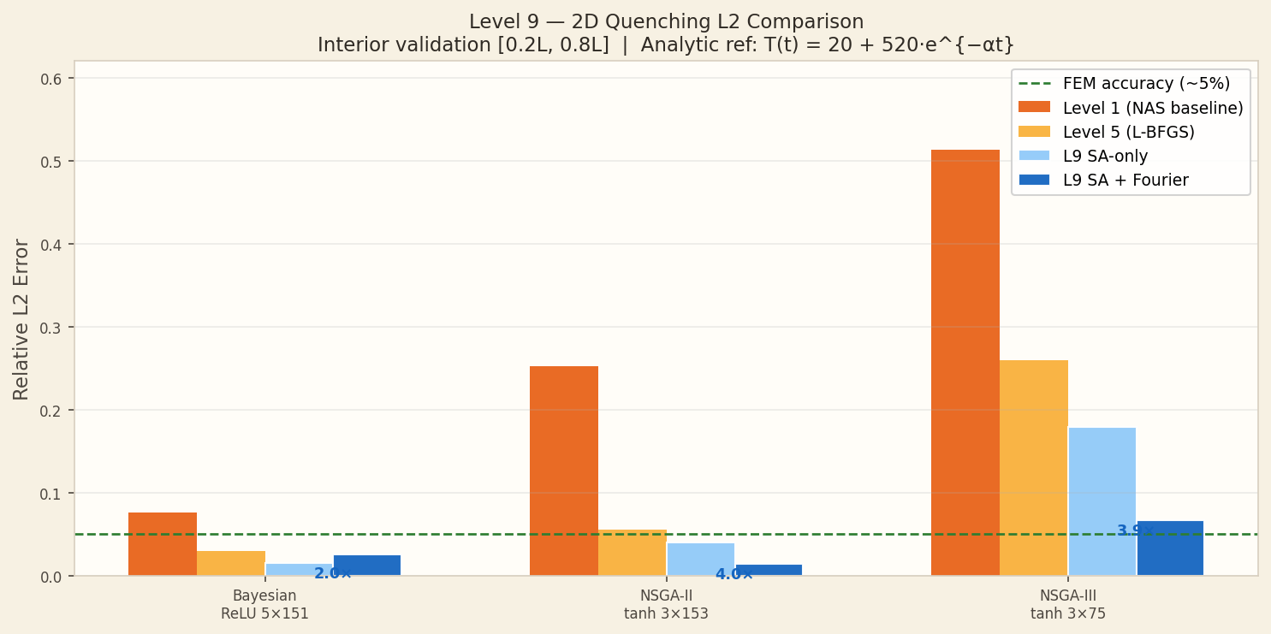
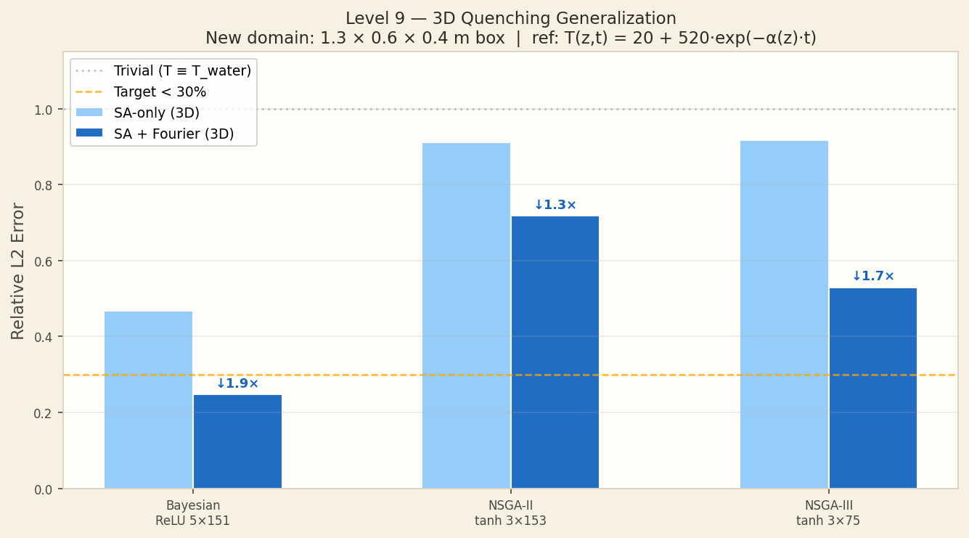
Level 9 — SA-PINNs + Fourier Features (Our Best Result)
Level 9 — All Variants
Exact vs. Predicted Temperature Fields
Variant | Opt. | Dim | L2 | Time
SA+Fourier | Bayesian | 2D | 0.0253 | 482s
SA+Fourier | NSGA-II | 2D | 0.0137★ | 444s
SA+Fourier | NSGA-III | 2D | 0.0668 | 412s
SA+Fourier | Bayesian | 3D | 0.247 | 596s
SA+Fourier | NSGA-II | 3D | 0.717 | 555s
SA-only | Bayesian | 2D | 0.0151 | 404s
SA-only | NSGA-II | 2D | 0.0397 | 378s
Baseline | NSGA-II | 2D | 0.055 | 312s
2D result: SA+Fourier, NSGA-II — L2 = 0.0137
★ = best result across all 9 levels
3D result: SA+Fourier, Bayesian — L2 = 0.247 (NAS done in 2D → 3D gap)
We achieved L2 = 0.0137 (SA+Fourier, NSGA-II, 2D)
NSGA-II arch: 3 layers × 153 neurons λ_phys=0.48 | λ_bc=9.28 | λ_ic=9.28
We improved 4× over Level 5 (L2=0.055) | 9× better than FEM skip=1 (L2=0.126) | Inference: 0.01 s vs 184 s FEM → 18,400× speedup

Slide 13
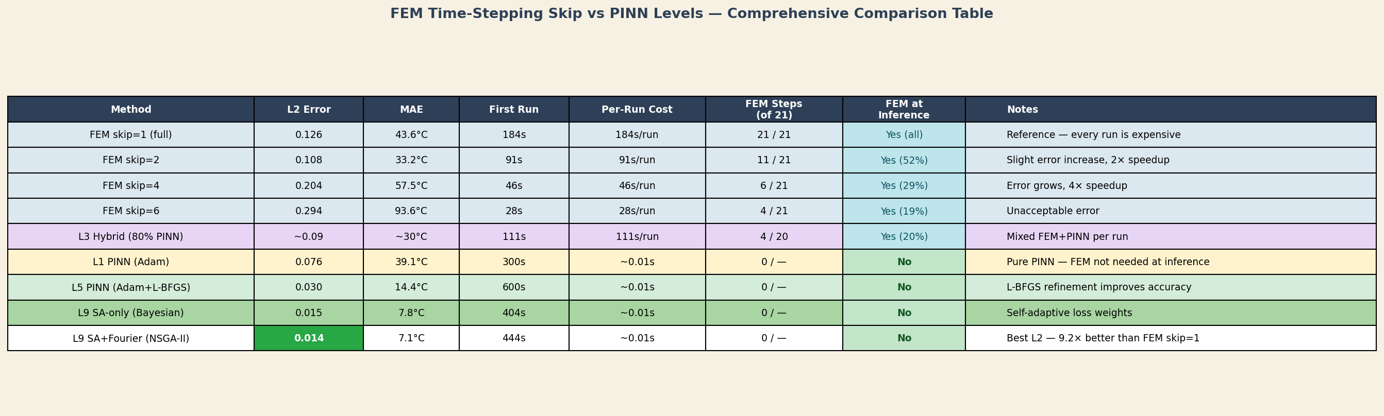
FEM Skip vs PINN — Full Comparison Across All Levels
Progressive improvement: L2 went from 0.126 (L1) → 0.014 (L9) = 9× reduction.
Key: Fourier features alone gave 3× L2 improvement in L9 (0.0397 → 0.0137). Combined with SA weights and NSGA-II architecture search, this is the complete NAS-MCO-PINNs framework.

Slide 14
Key Findings and Conclusions
Skip=2 is Optimal
Fourier Features Critical
SA Weights Work
48% fewer FEM calls while IMPROVING accuracy. Less error accumulation from FEM discretization. Recommended default for all quenching scenarios.
Spectral bias in standard PINNs slows learning of rapid initial cooling (ΔT≈200°C in 5 s). Fourier encoding gives 3× L2 improvement.
λ values converge to λ_bc ≈ 19× λ_phys. Boundary and IC conditions dominate. No manual retuning needed across geometries.
1
2
3
NSGA-II Best for 2D
3D Gap Remains
L9 Final: L2 = 0.014
Finds compact 67K-param architecture that generalizes well. Multi-objective Pareto front (L2 + params) identifies efficient architectures automatically.
NAS in 2D cannot find adequate 3D architectures. L2 jumps from 0.014 (2D) to 0.247 (3D). Future work: 3D-specific NAS, transfer learning.
9× better than FEM skip=1 baseline (L2=0.126). 18,400× faster inference (0.01 s vs 184 s). Enables NAS, optimization, real-time prediction.
4
5
6

Slide 15
References
[1] Raissi, M., Perdikaris, P., & Karniadakis, G.E. (2019). Physics-informed neural networks: A deep learning framework for solving forward and inverse problems. J. Comput. Phys., 378, 686–707. DOI: 10.1016/j.jcp.2018.10.045
[7] Deb, K., & Jain, H. (2014). An evolutionary many-objective optimization algorithm using reference-point-based nondominated sorting: NSGA-III. IEEE Trans. Evol. Comput., 18(4). DOI: 10.1109/TEVC.2013.2281535
[2] D. Mortensen, G. Noorsumar, H.G. Fjaer, R. Babaei, P.E. Dronen (2026). Mitigating distortions in cast automotive subframes: A finite element simulation approach. Int J Adv Manuf Technol. DOI: 10.1007/s00170-026-17515-w
[8] Snoek, J., Larochelle, H., & Adams, R.P. (2012). Practical Bayesian Optimization of Machine Learning Algorithms. NeurIPS 2012.
[3] Tancik, M., et al. (2020). Fourier Features Let Networks Learn High Frequency Functions in Low Dimensional Domains. NeurIPS 2020.
[9] Glorot, X., & Bengio, Y. (2010). Understanding the difficulty of training deep feedforward neural networks. AISTATS 2010.
[4] Wang, S., Teng, Y., & Perdikaris, P. (2021). Understanding and mitigating gradient flow pathologies in physics-informed neural networks. SIAM J. Sci. Comput., 43(5).
[10] Lagaris, I.E., Likas, A., & Fotiadis, D.I. (1998). Artificial neural networks for solving ordinary and partial differential equations. IEEE Trans. Neural Netw., 9(5). DOI: 10.1109/72.712178
[5] Wang, S., Yu, X., & Perdikaris, P. (2022). When and why PINNs fail to train: A neural tangent kernel perspective. J. Comput. Phys., 449. DOI: 10.1016/j.jcp.2021.110768
[11] Rahaman, N., et al. (2019). On the spectral bias of neural networks. ICML 2019.
[6] Deb, K., Pratap, A., Agarwal, S., & Meyarivan, T. (2002). A fast and elitist multiobjective genetic algorithm: NSGA-II. IEEE Trans. Evol. Comput., 6(2). DOI: 10.1109/4235.996017
[12] Liu, D.C., & Nocedal, J. (1989). On the limited memory BFGS method for large scale optimization. Math. Programming, 45(1–3), 503–528.
Thank You
March 2026

