Slide 1
Movie Recommendation System
Group 13
Spyridon Floros
Pavlos Karageorgiadis
Omer Ahmed Khan
Georgios Leventis

Slide 2





What is a Recommendation System?
A information - filtering system that predicts the user preferences for specific items.
In our case, these items are movies.
Some examples of Recommendation Systems:

Slide 3
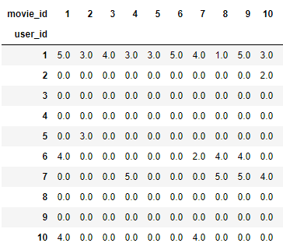
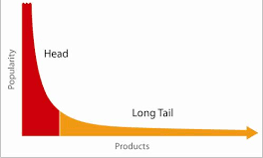
Utility Matrix and Long Tail
Utility Matrix
Two classes – Users and Items
Entries are user – item pairs
Sparse matrix, no explicit info about user’s preferences
Goal is to predict the unknown data
Long Tail Phenomenon
Physical stores provide most popular items
Online stores provide the entire range of items – the tail as well as the popular items

Slide 4
Types of Recommendation Systems
Collaborative – Filtering
Analyzes similarities between users and/or item interactions.
People that agreed on the past will agree on the future.
Generates recommendations using information about rating profiles for different users
Content – Based
Recommends items to user based on previously high rated items by the user
Features of the item are used to describe it and the user profile is built in such a way, that indicates the type of items the user likes.

Slide 5
Advantages / Disadvantages
Collaborative Filtering
Advantages:
Captures change in user interest over time
Not required to understand item content
Content - Based
Advantages:
No need for data on other users
Recommend new/unpopular items
Recommend for users with unique taste
Disadvantages:
Overspecialization
Can’t use quality judgement of other users
Disadvantages:
Popularity biased
Sparse data
Cold - start problem

Slide 6
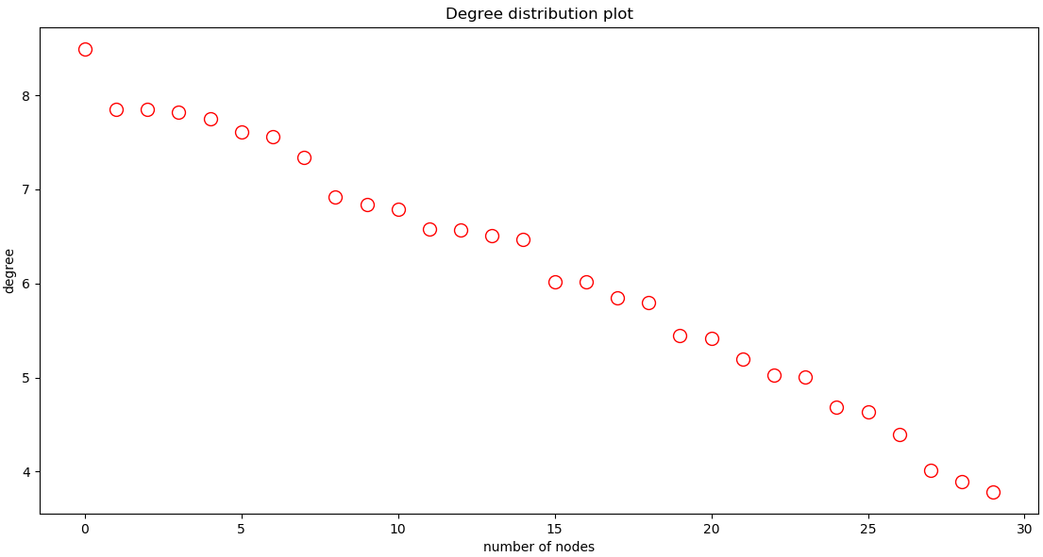
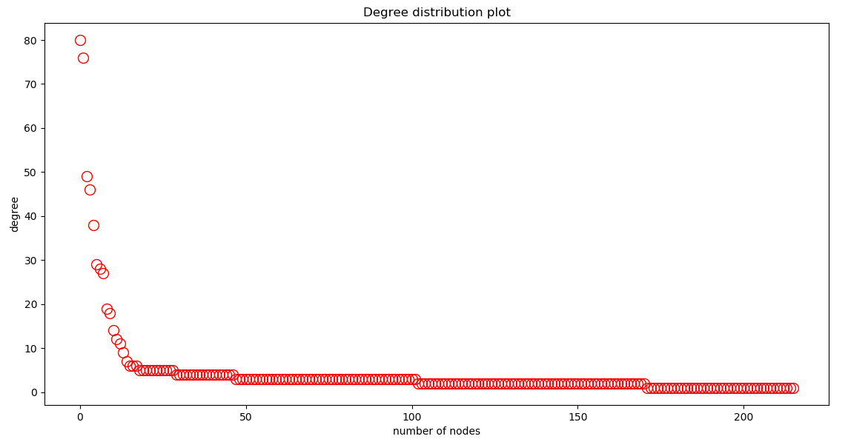
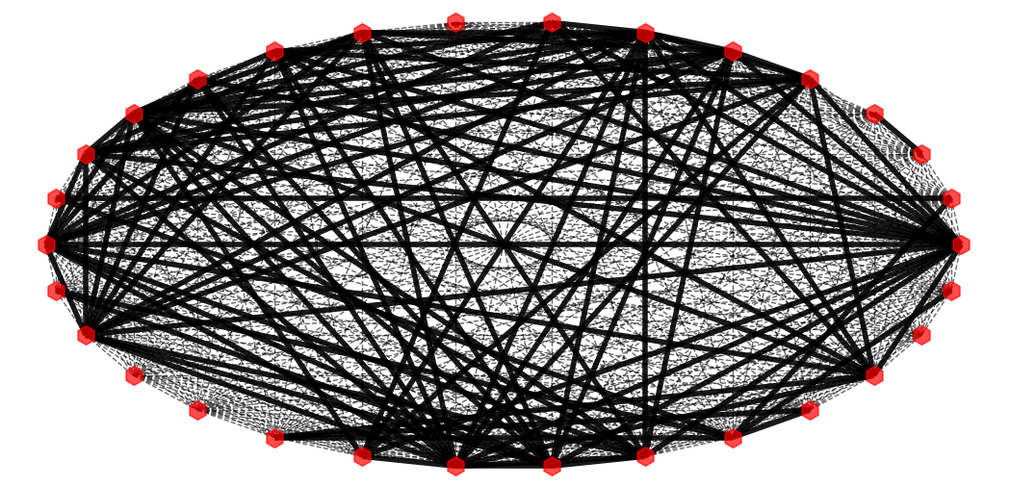
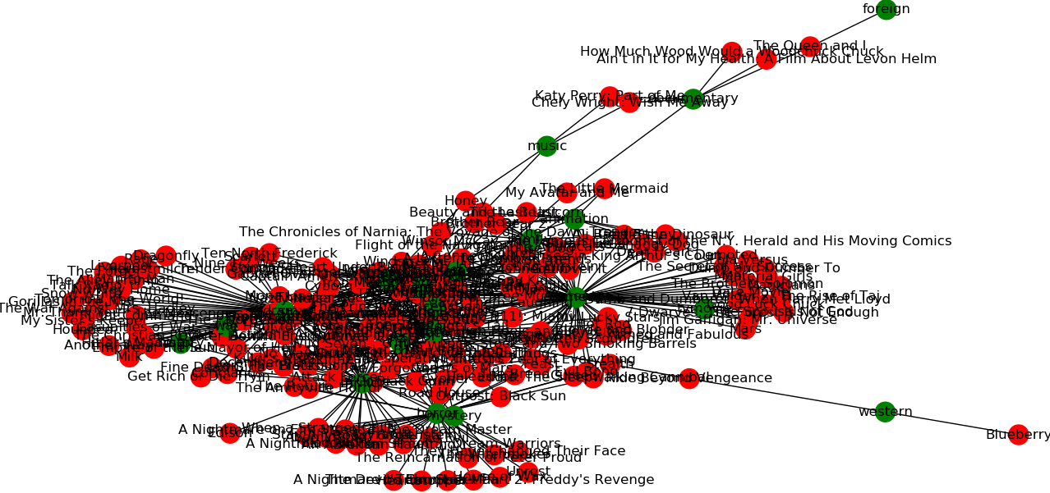
Processing the Data
MovieLens 100K Dataset
100,000 ratings by 1,000 users to 1,700 movies.
u.user: age, sex, occupation. u.item: title, genres. u.data: user, movie, rating.
Splitting dataset to trainset, testset.
The Movies Dataset
45,000 movies metadata
movies_metadata: genres, id, original_title, overview, vote_average, vote_count. keywords: id, keywords. credits: id, cast, crew.
Extract values cast, crew.
.

Slide 7



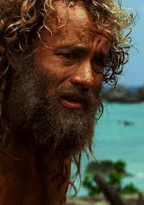



Collaborative - Filtering

Slide 8

Collaborative – Filtering Methods
The mean rating for the movie by all the users who have rated it
Mean
2. Weighted Mean
We give more preference to the users whose ratings are similar
3. User Demographics
Users of the same demographic have similar taste.
4. KNN
Clustering based on user and movie. kNN finds the k nearest neighbors of a user who rated that movie.
5. SVD
Matrix factorization based predictions for missing values on original ratings matrix.

Slide 9
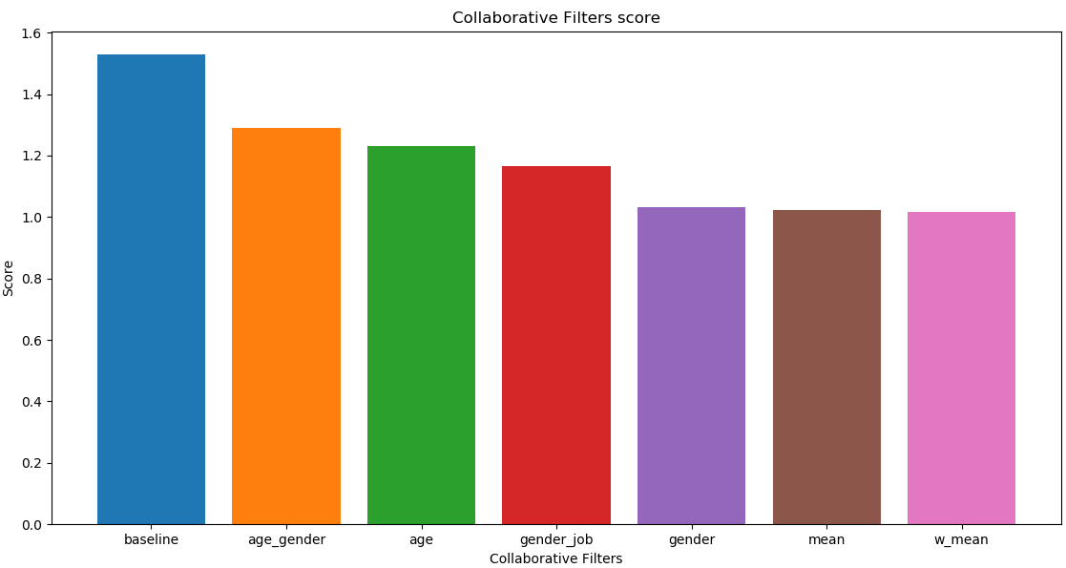
Evaluation and Score
Our evaluation of the collaborative - filtering approach is based on a score function that calculates the RMSE of the rating predicted by every filter. The RMSE measures the average magnitude of the error.

Slide 10
Content - Based Methods
TF-IDF(term frequency - inverse document frequency).
Word classification of overview and keywords.
Cosine similarity on Cast, Director, Keywords and Genres.
Soup built based on the director, the cast, the keywords and the genres of a movie.
Improved cosine similarity based on votes count and vote average.
Combined soup and weighted rating value that we applied based on the vote count and average of each movie.

Slide 11
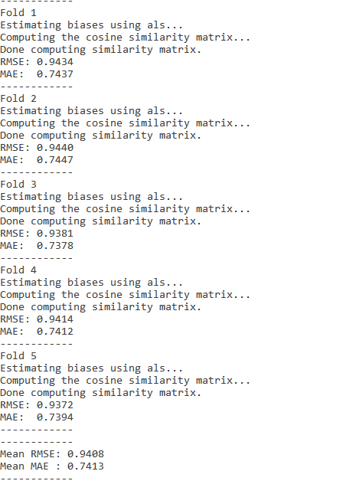
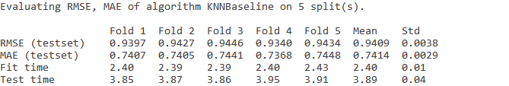
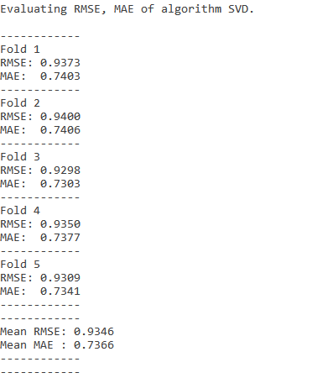
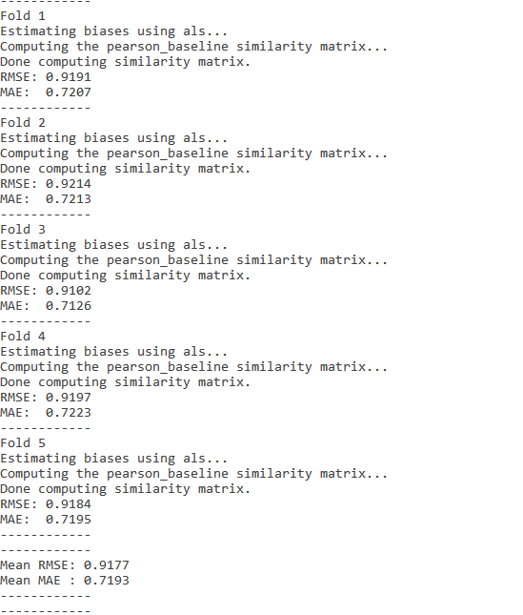
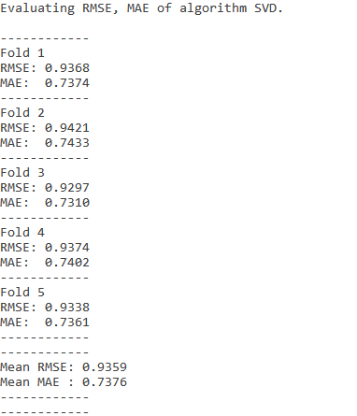
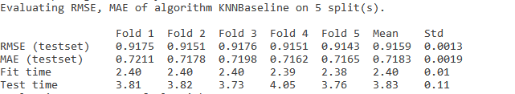
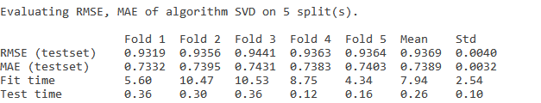
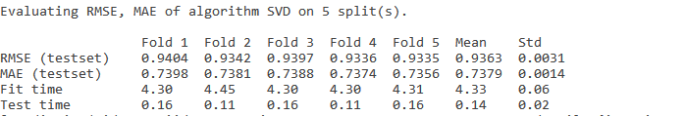
Testing
We cross validate our results using the function from Surprise comparing both RMSE - MAE methods.The MAE measures the average magnitude of the errors in a set of forecasts.
MEASURES
COSINE SIMILARITY
PEARSON SIMILARITY

Slide 13
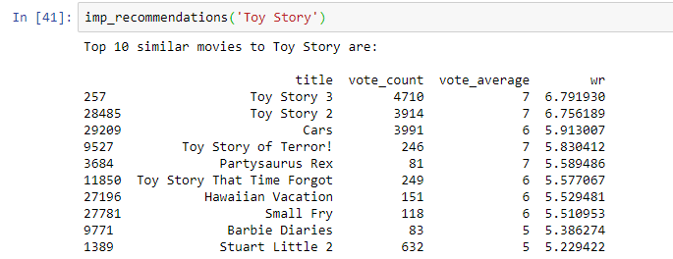
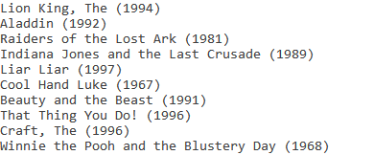
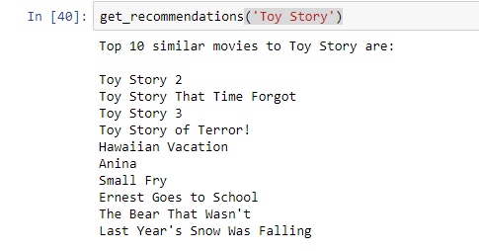
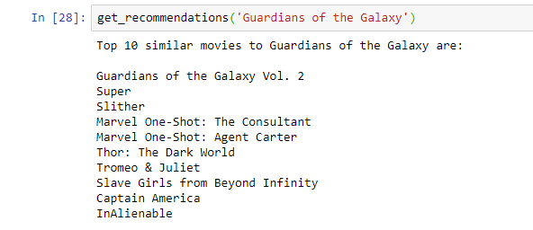
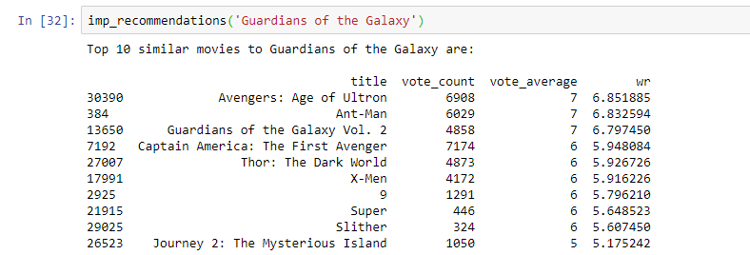
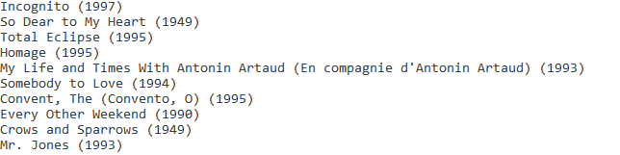
Results and Future Work
Content - Based filtering more taxing on hardware resources.
Processes text feature for every movie.
Collaborative filtering popularity bias.
Popular items are more likely to be recommended.
Combination leads to Hybrid Recommendation System:
More accurate predictions.
Able to solve cold - start problem, combining collaborative filtering for warm items and content - based filtering for cold items.

Slide 14

Questions

