Slide 1
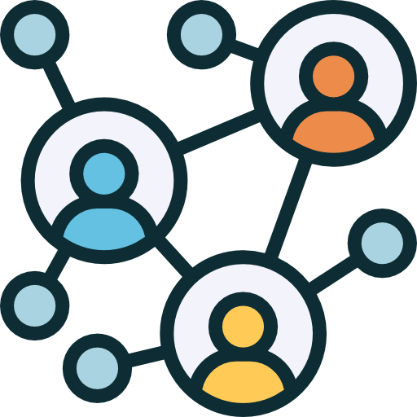



ROAD
MATE
Enjoy the same road -TOGETHER

Slide 2

Carpool – It didn’t work…
Who is this guy?
Chats overflow

Slide 3
Introducing…

Slide 4
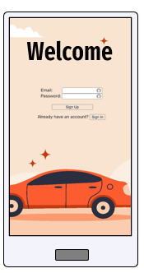
Introducing…
Bridging Connections –
Eliminating Carpool Strangeness.

Slide 5
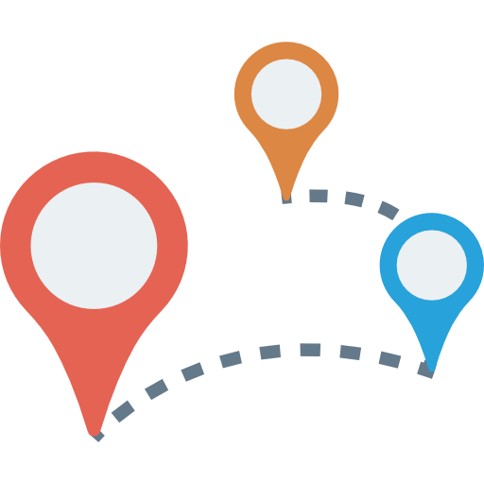
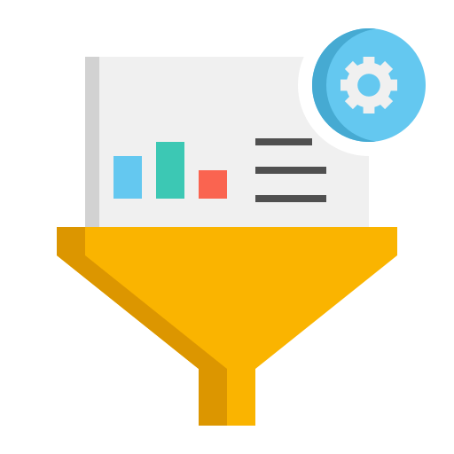
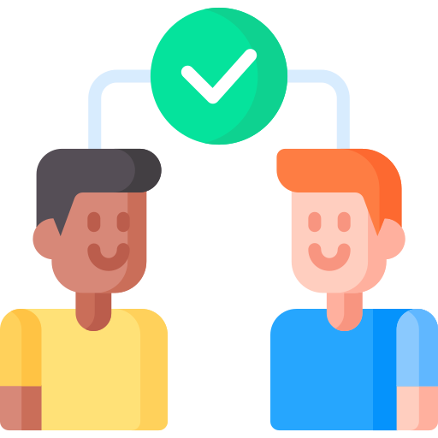

Introducing…
Bridging Connections –
Eliminating Carpool Strangeness.
Customized travel plan
Personalizing your RoadMate
Harness communities

Slide 6
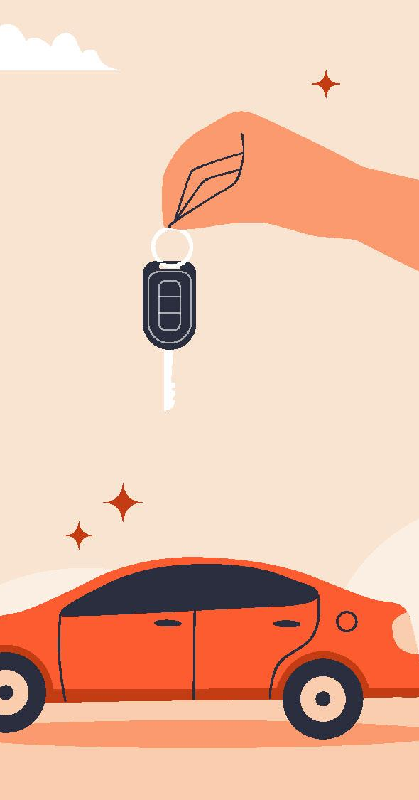
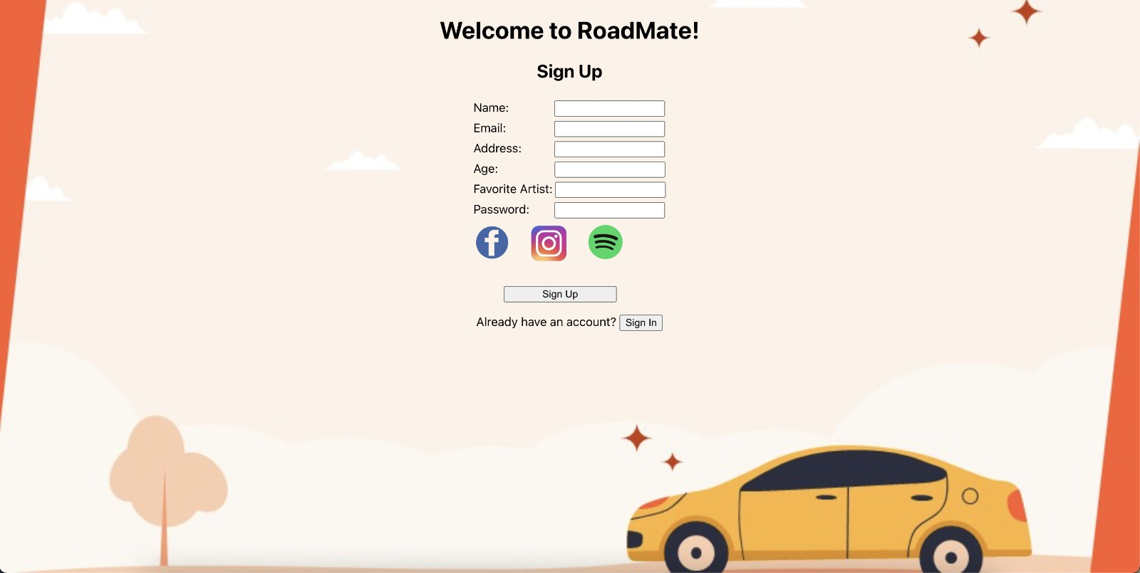
How does it work?
Sign Up –
Ignite your networking!
01

Slide 7

How does it work?
Search for a ride!
02
01

Slide 8
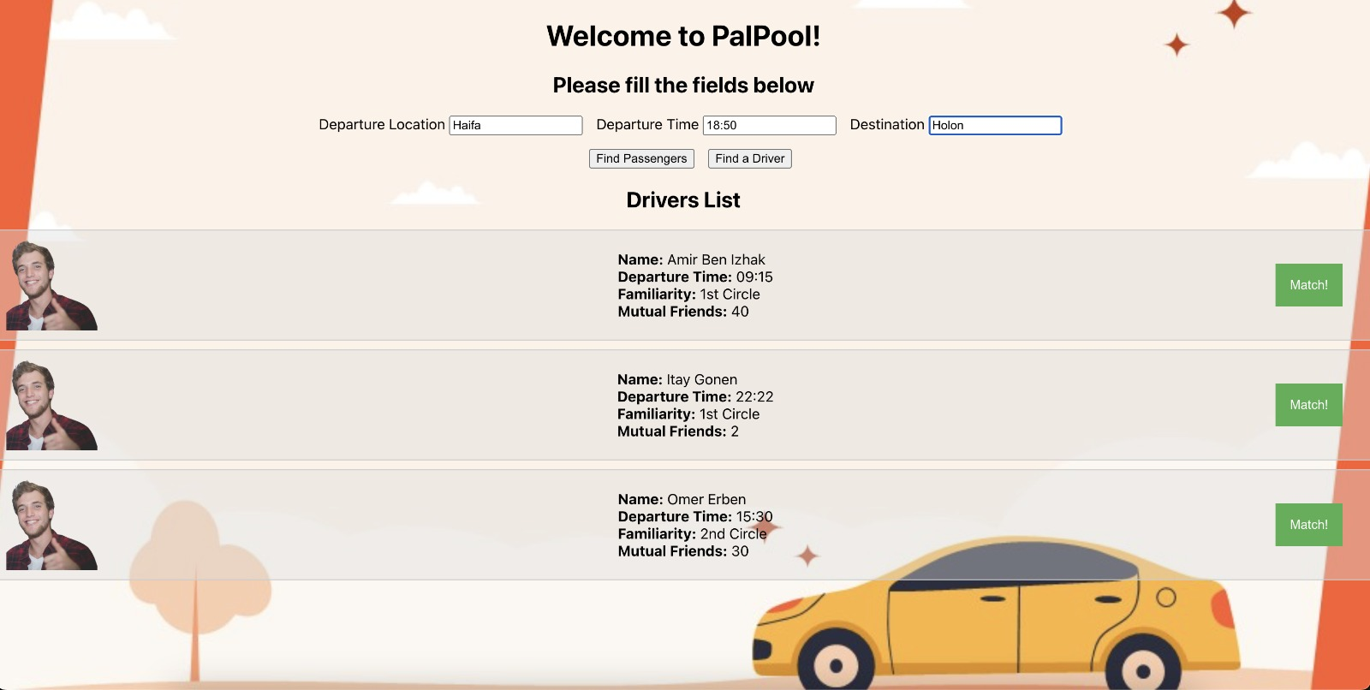
How does it work?
Filter & Search !
03
Match will be final after both sides approve!
02
01

Slide 9
Behind the scenes
Available Rides
Determining avaliable rides

Slide 10
Behind the scenes
Available Rides
Determining avaliable rides
Filtering
Filtering irrelevant rides based on the user’s input

Slide 11
Behind the scenes
Available Rides
Determining avaliable rides
Filtering
Filtering irrelevant rides based on the user’s input
Sorting
Applying network algorithm on user data

Slide 12
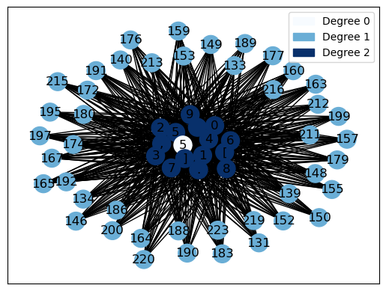
Behind the scenes

Slide 13
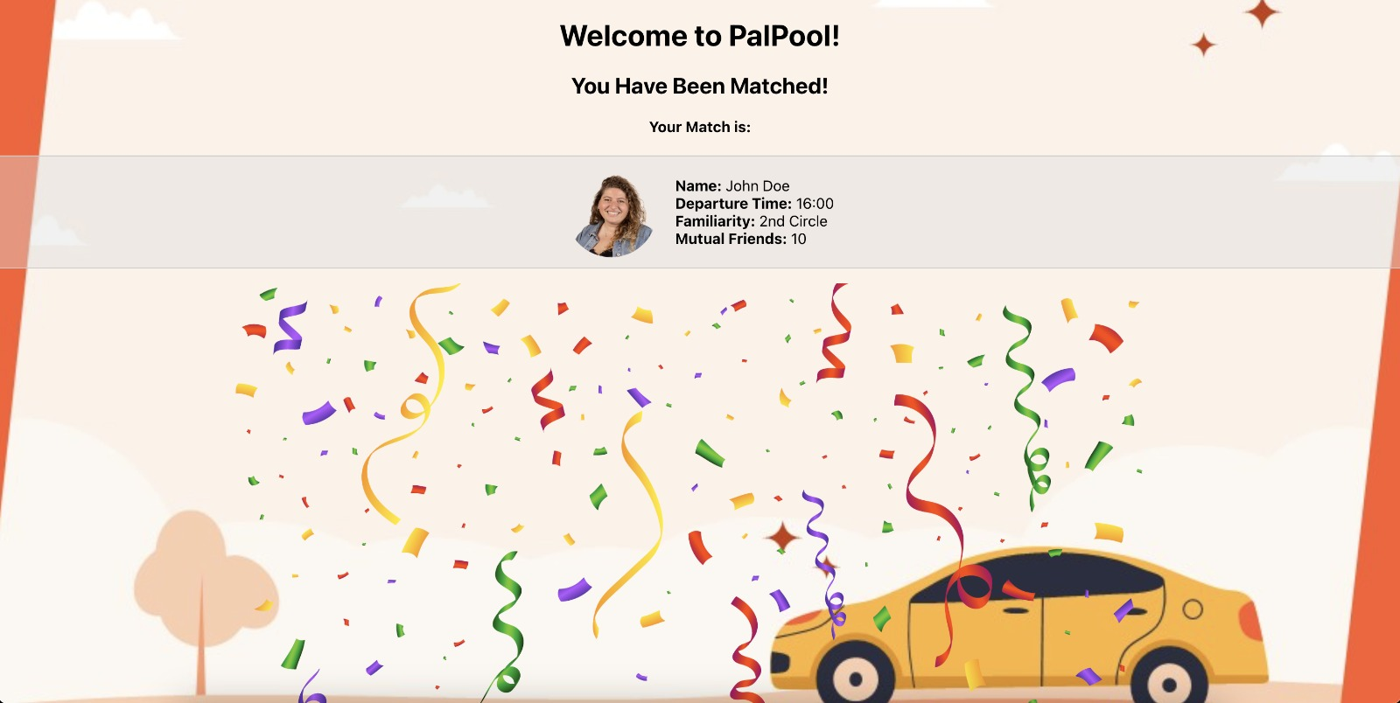
How does it work?
04
Match !
03
02
01

Slide 14
And many more…
Roads Ahead…
Social Networks & Clustering
Geographic flexibility
Integration with existing platforms
Managing routines
Enrich personal profile

