Slide 1
RunTracker App
Sophie Prahia, Miki Hershcovitz, Omer Erben
28/10/24

Slide 2
The Need for Efficient Run Tracking
In a world with infinite amount of information, it’s easy to get lost. In that regard, we would like to help runners find the best routes for them to run in, by providing general info about the route and the distance from their current location. In addition, runners need accurate and reliable tracking of their runs for performance monitoring.

Slide 3
The Need for Efficient Run Tracking
Existing Solutions:
Various apps exist but often holistic solution like ours. In most of them it’s not possible to add new routes and keep personal records. Examples for those apps are MapMyRun by Under Armour, Nike Run Club, Adidas Running

Slide 4
The Need for Efficient Run Tracking
Proposed Solution: RunTracker App
Provides athletes with running routes
Allows athletes to add new routes to the app
Keeps general and personal info on the routes
Leverages cloud services for scalability and reliability.

Slide 5
The RunTracker App
Core Features:
Real-time GPS tracking and recording during new runs
Routes database
Routes selection by radius from current location
Personal record tracking
Route public rating
User friendly UI
SuperUser
Running data displayed by HeatMap

Slide 6
RunTracker Software Architecture
Overview:
Azure based serverless structure
React native app
Azure Services:
Azure Functions: Serverless compute service for running backend logic
Azure Storage: For storing metadata, users, authentication info and routes
Signal R
React App:
User’s Geo-Location
Routes info displayed on a world map
User classification to regular and superuser

Slide 7
Application Flow

Slide 8
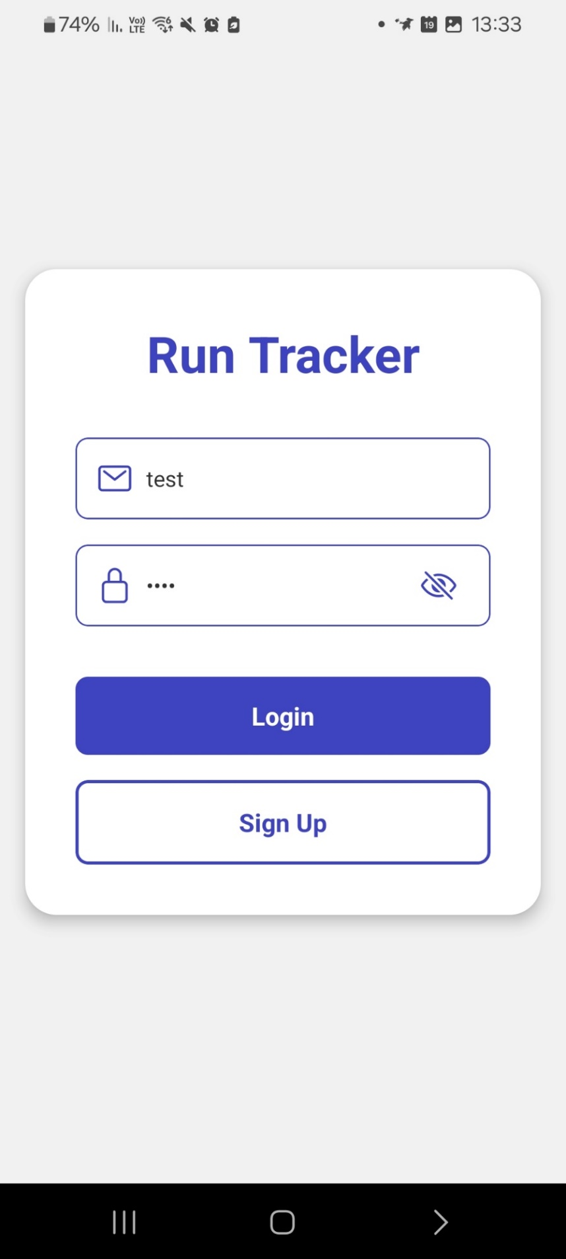
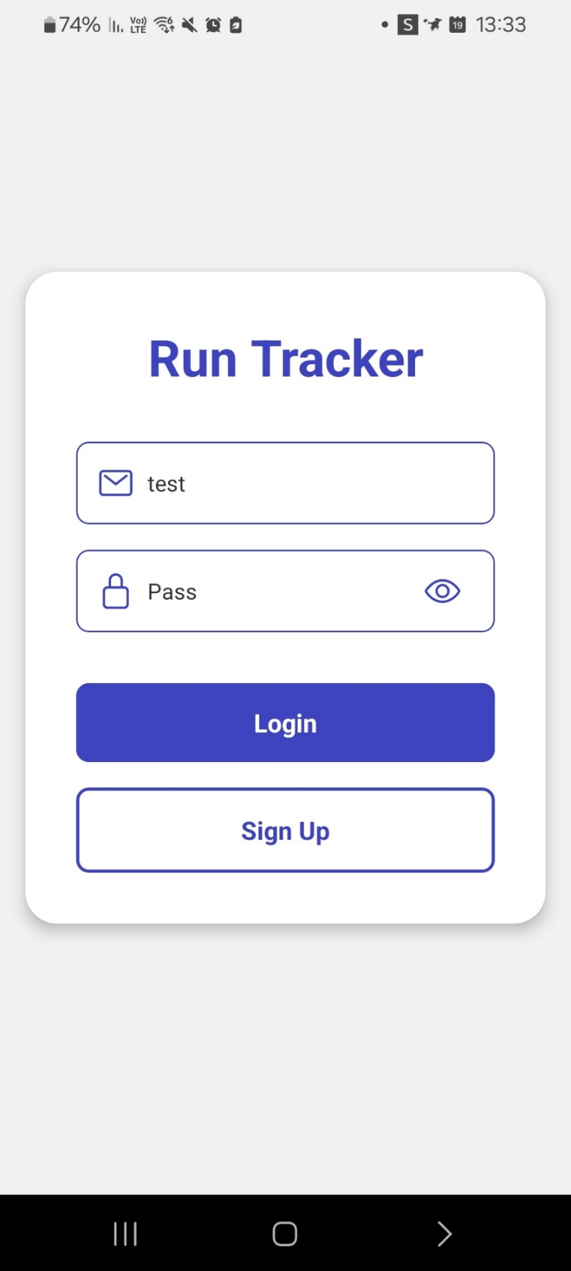
Sign Up and Log in Page

Slide 9
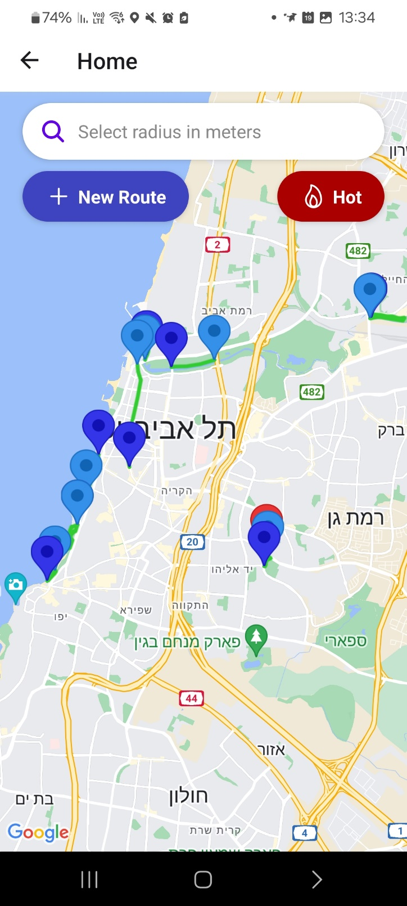
Home Page

Slide 10
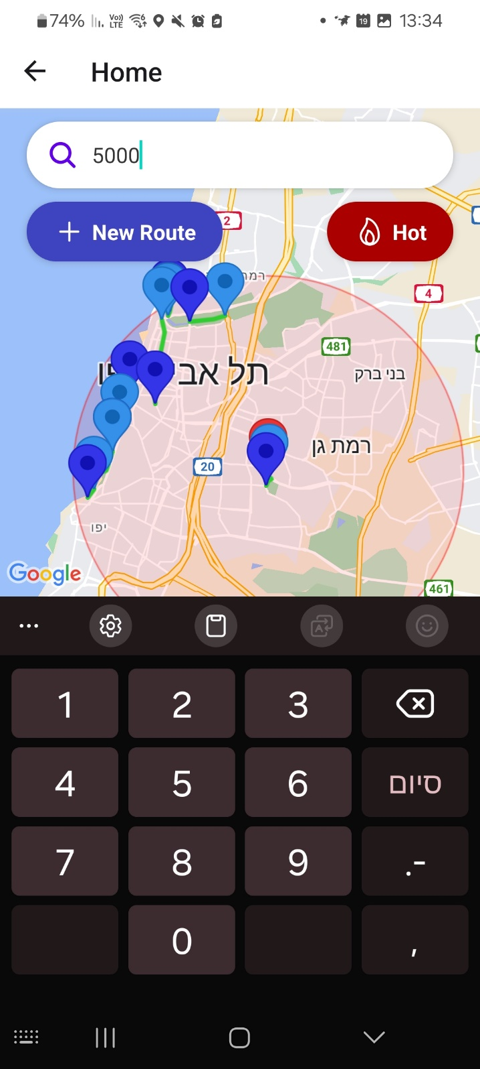
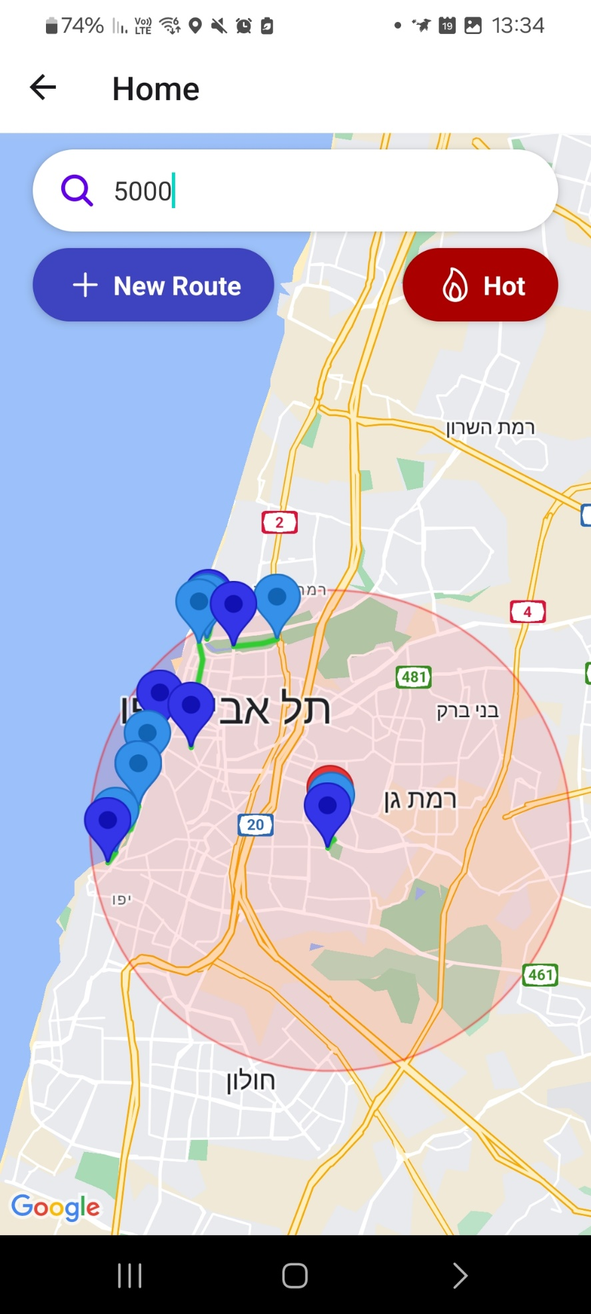
Radius

Slide 11
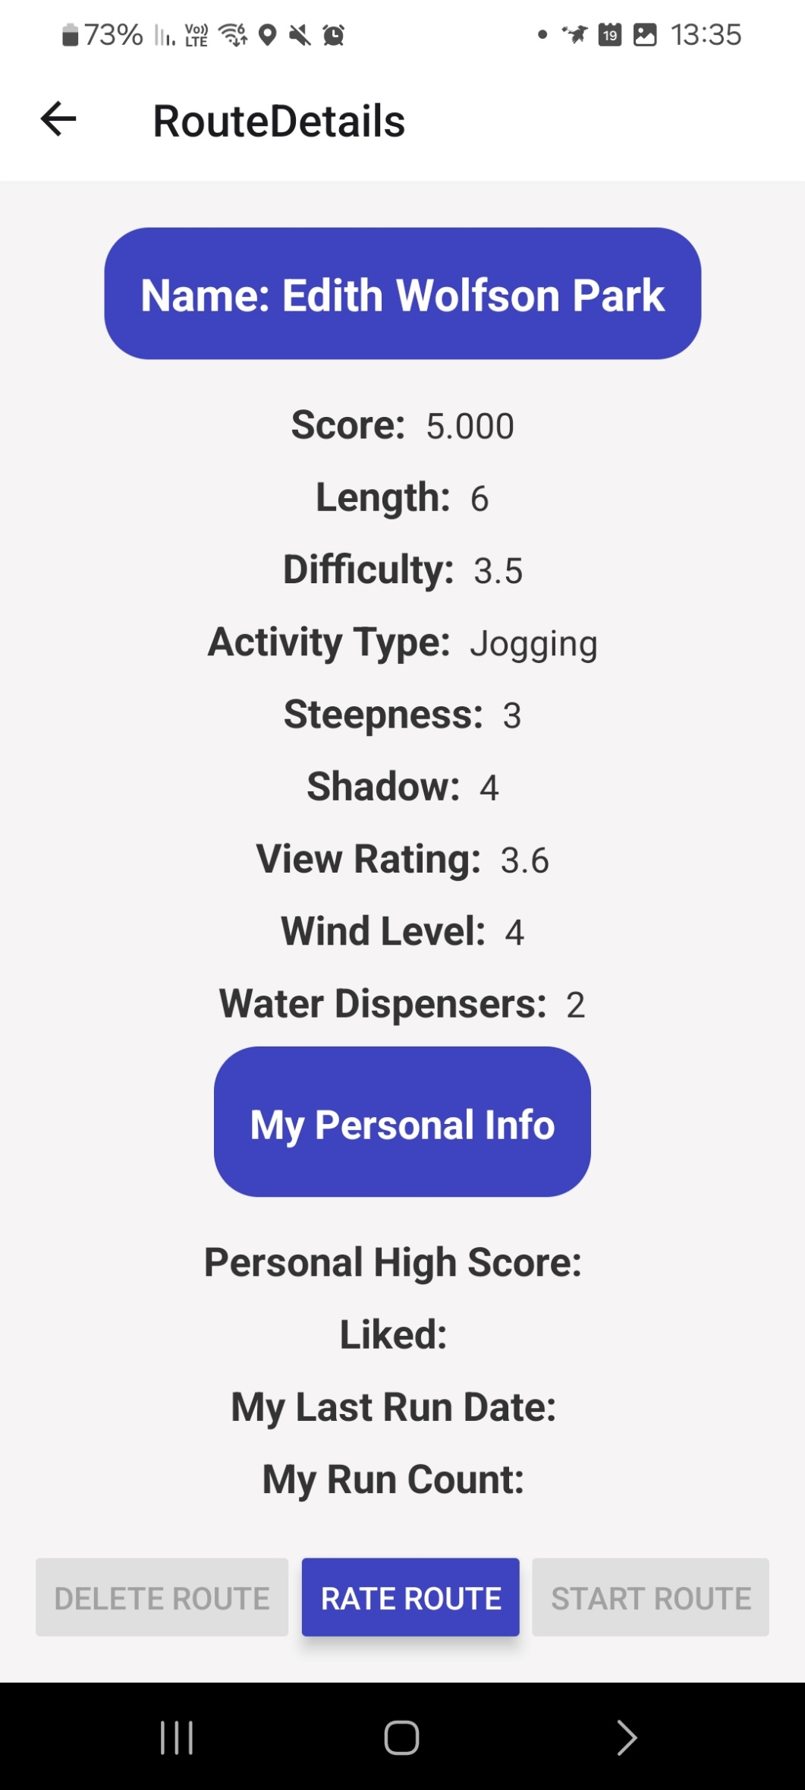
Route details + Start running on existing route

Slide 12
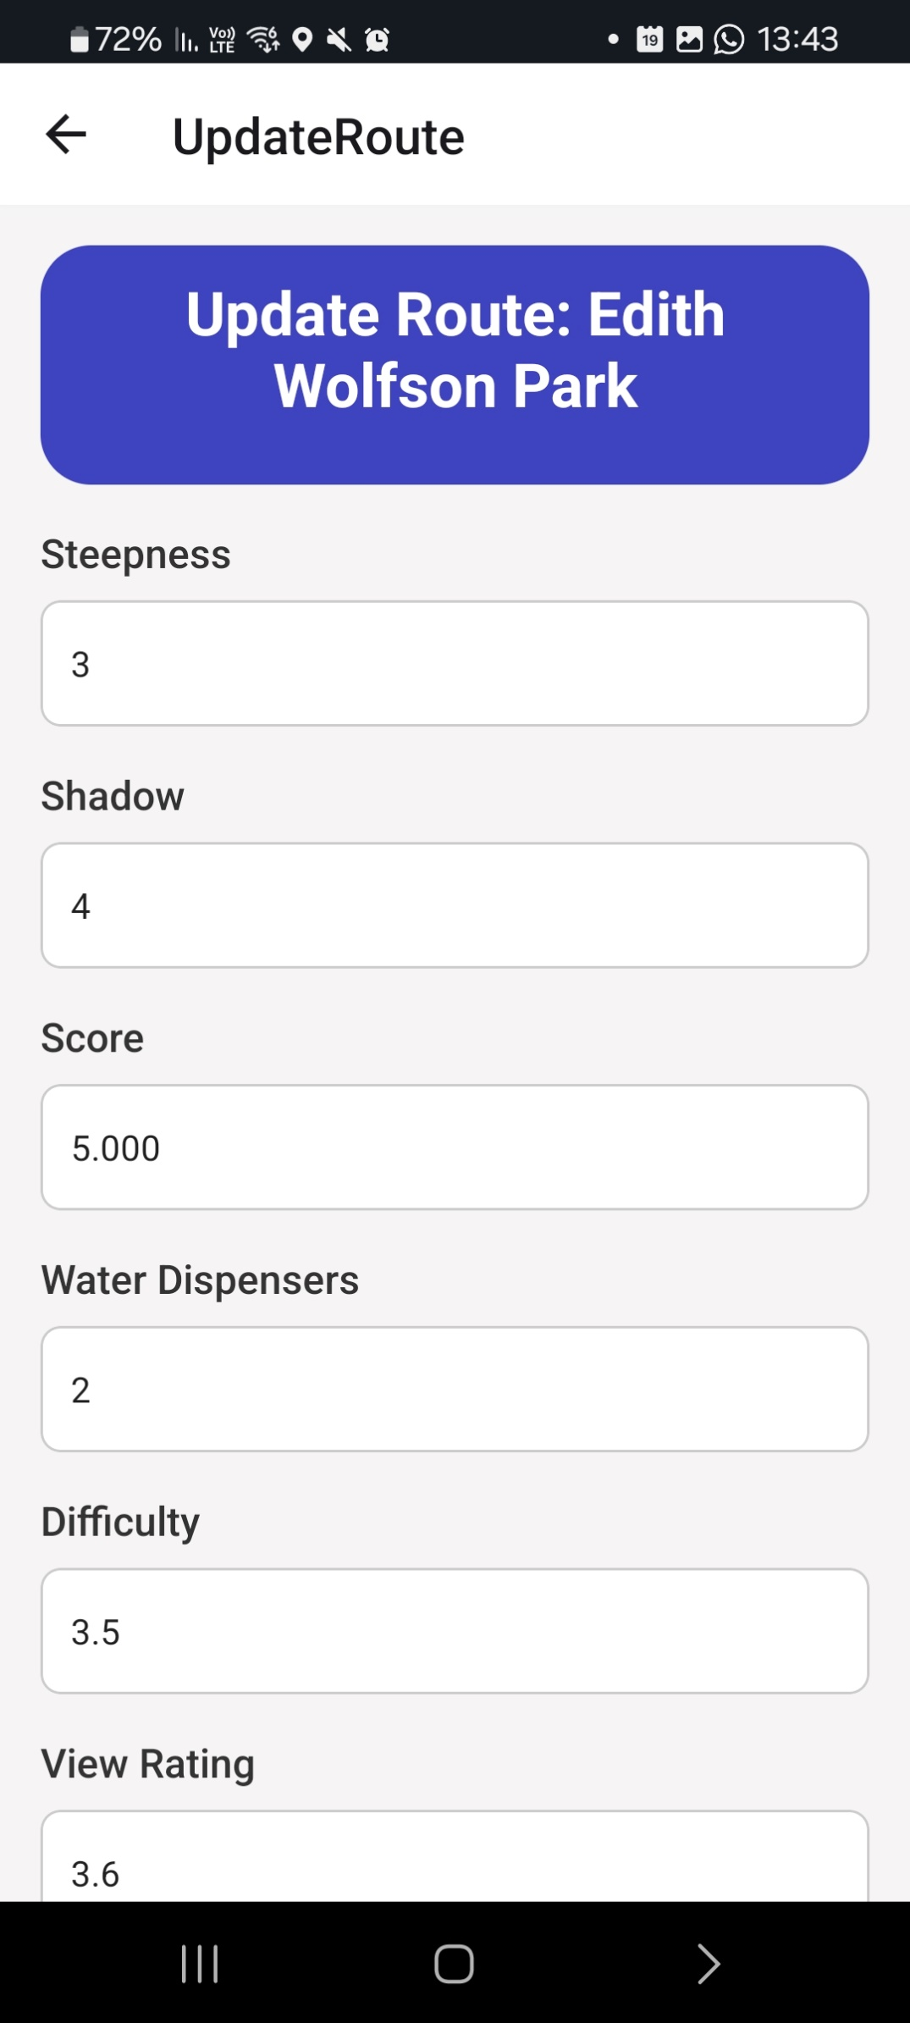
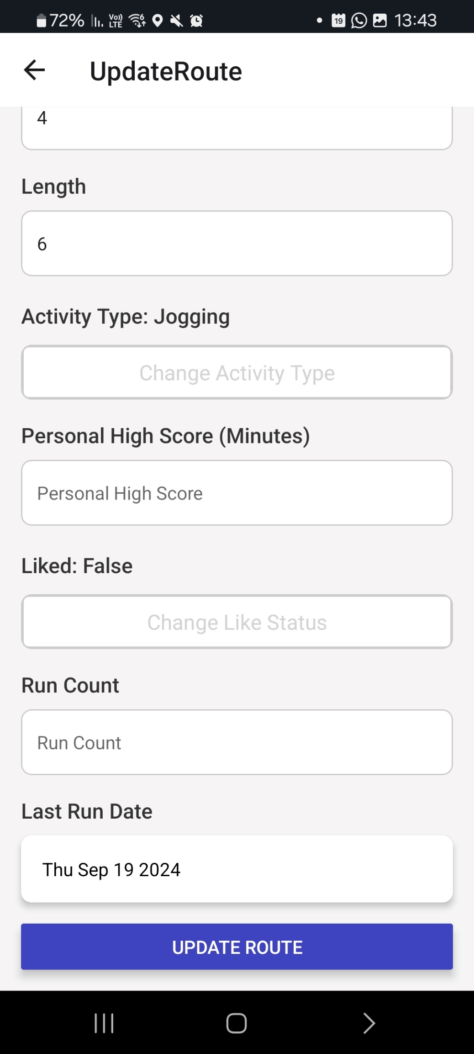
Rate route

Slide 13
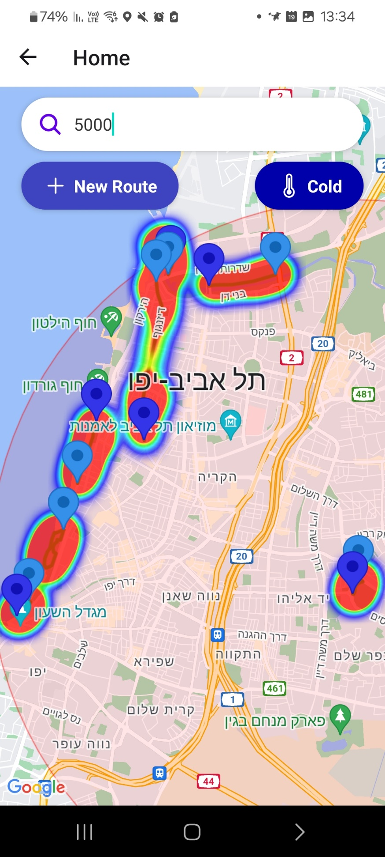
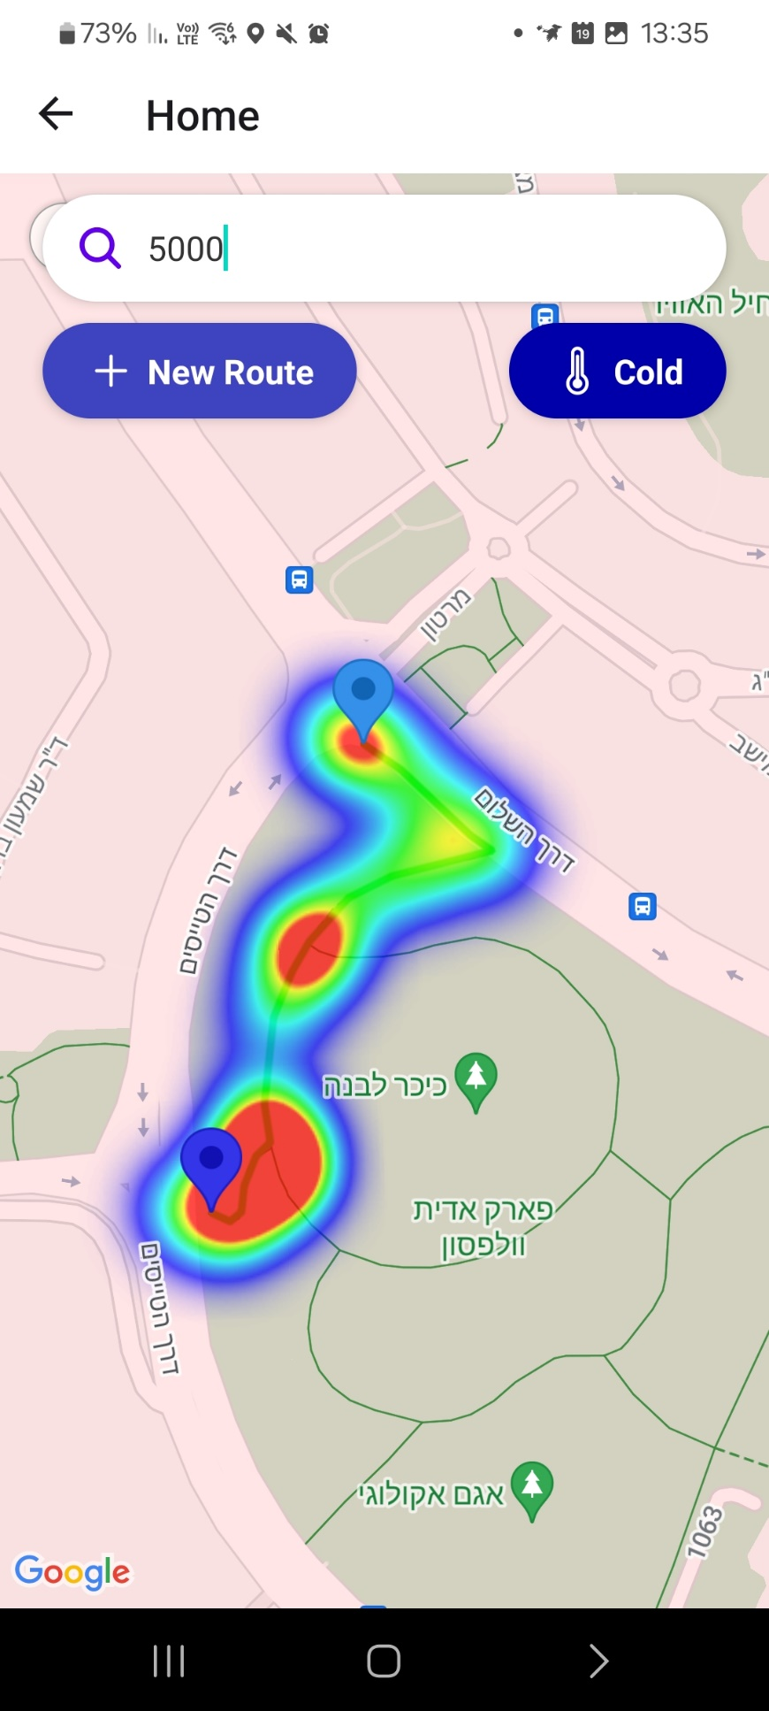
HeatMap

Slide 14
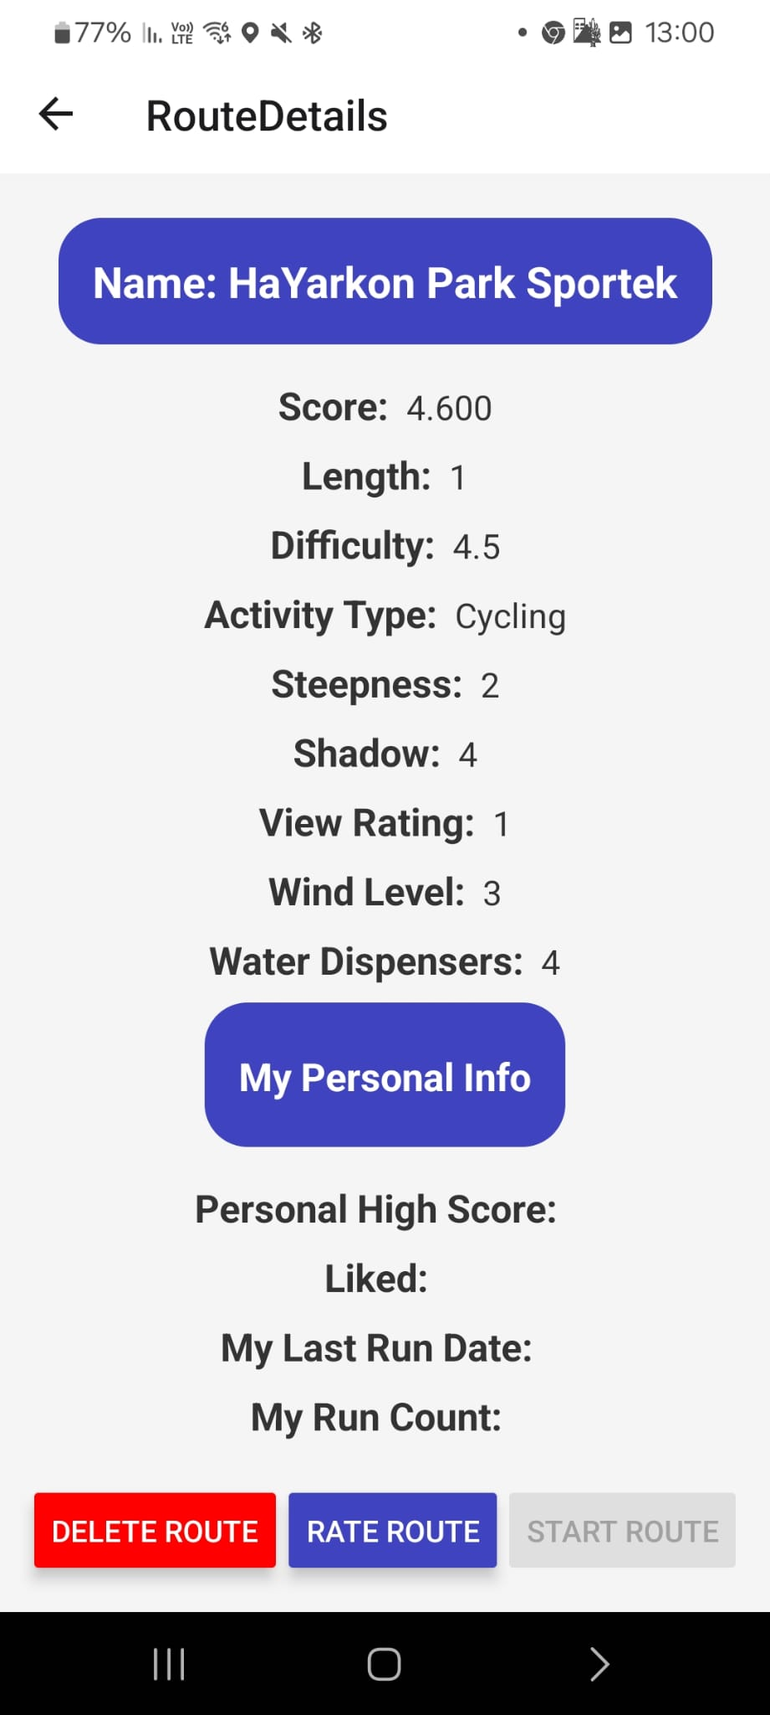
SuperUser Functionality

Slide 15
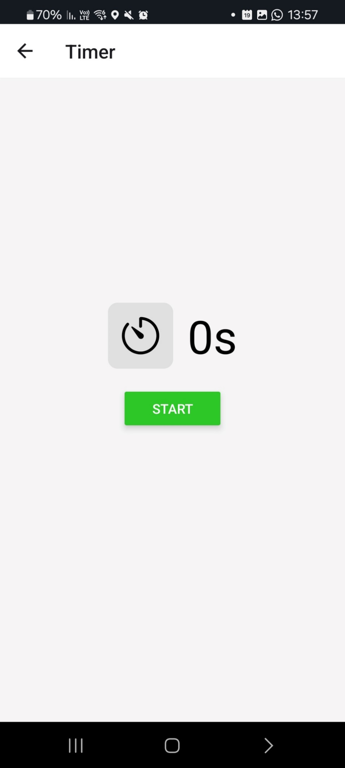
Recording new route
Notes:
גם אם מקליטים וגם אם רצים על מסלול קיים – הדאטה מתווסף להיטמפ

Slide 16
GitHub Link
https://github.com/OmerErben/RunTracker-2024

Slide 17
Questions?

