Slide 1
Spotify Music Habits Analysis
Understanding and visualizing personal Spotify listening habits to uncover patterns and trends.

Slide 2
Data Source and Tools
- Data Source:
Exported personal Spotify data (JSON files).
- Tools Used:
Python (pandas, matplotlib, seaborn), GitHub for documentation.

Slide 3
Methodology
1. Data Preprocessing:
- Combined and cleaned data from JSON files.
- Added derived columns (hour, weekday).
2. Exploratory Data Analysis (EDA):
- Top artists and tracks.
- Temporal trends (hour, weekday).
3. Visualization:
- Bar and line charts for insights.

Slide 4
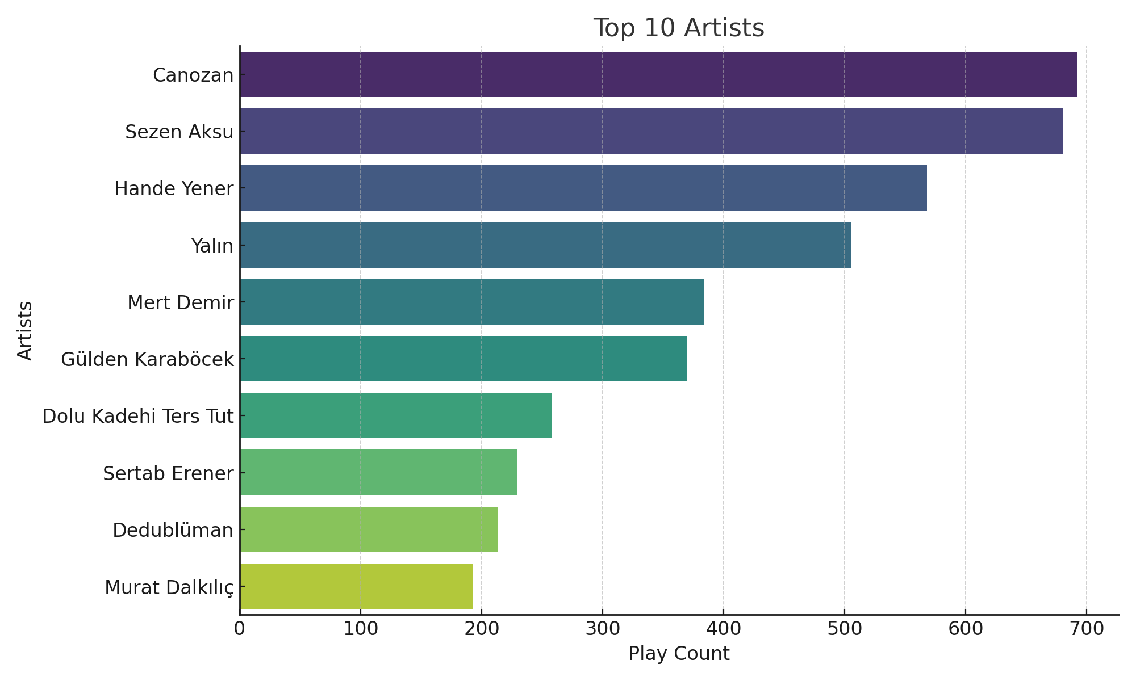
Key Findings - Top Artists

Slide 5
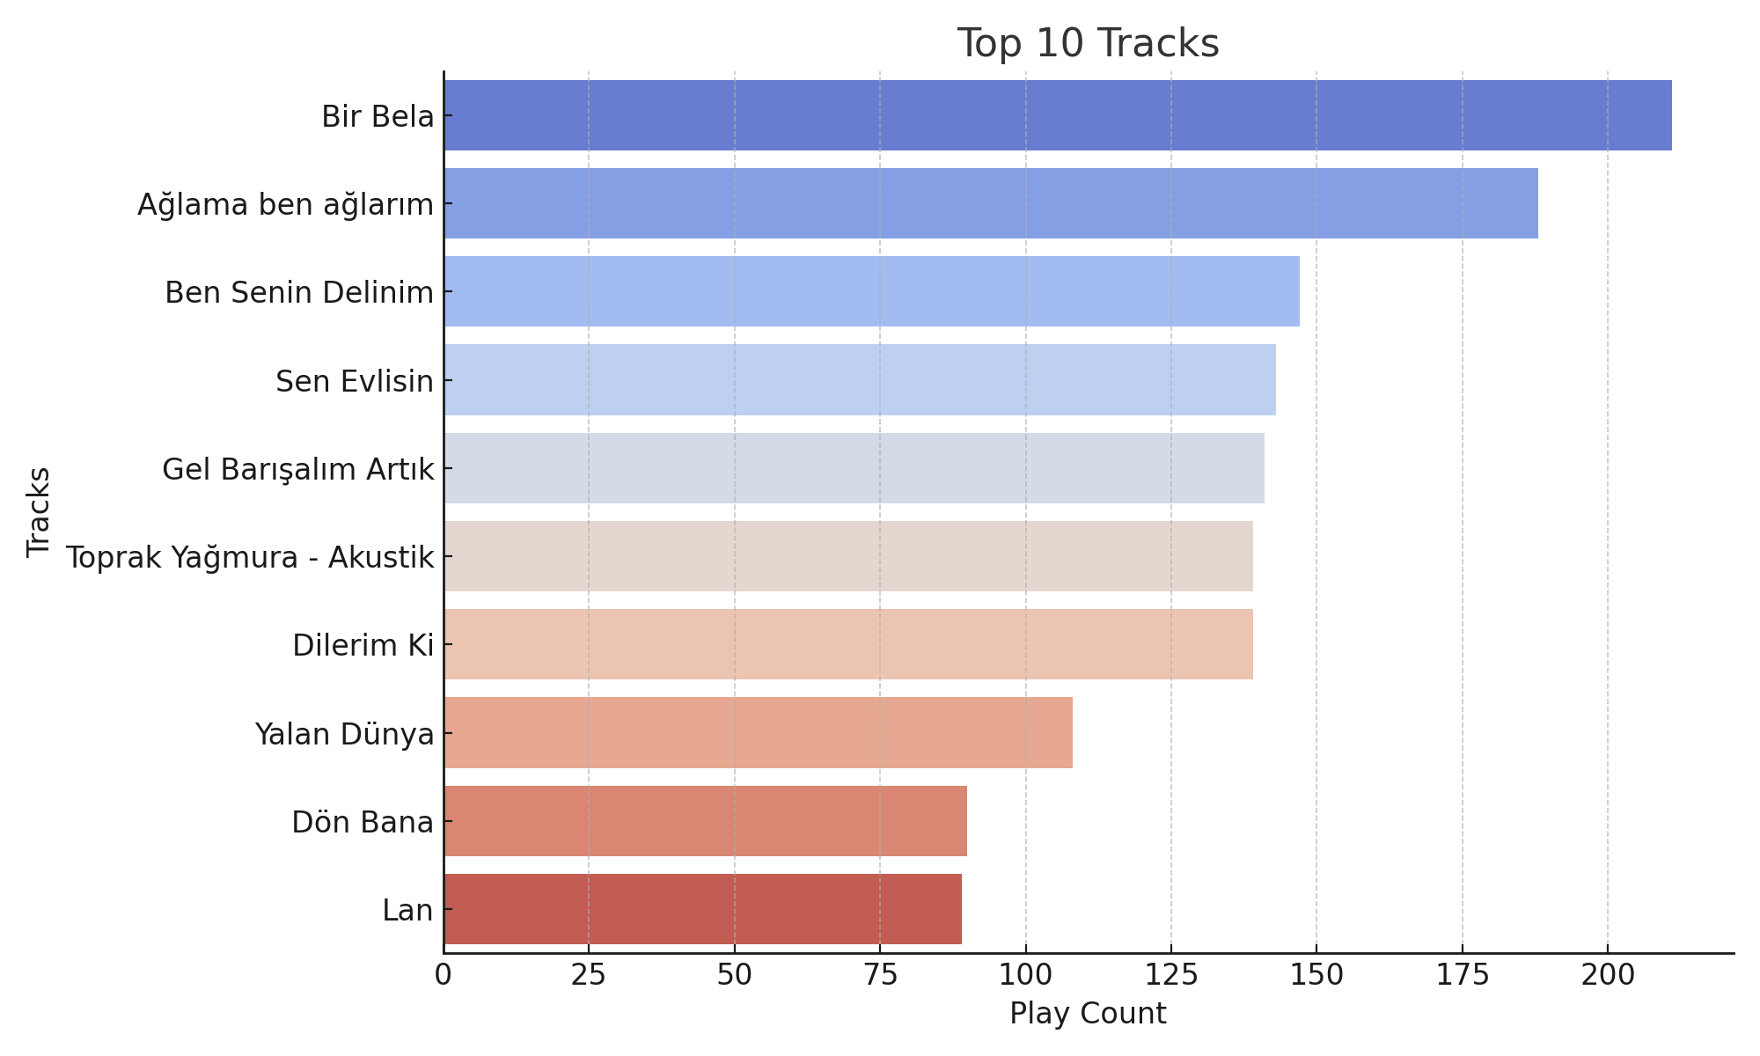
Key Findings - Top Tracks

Slide 6
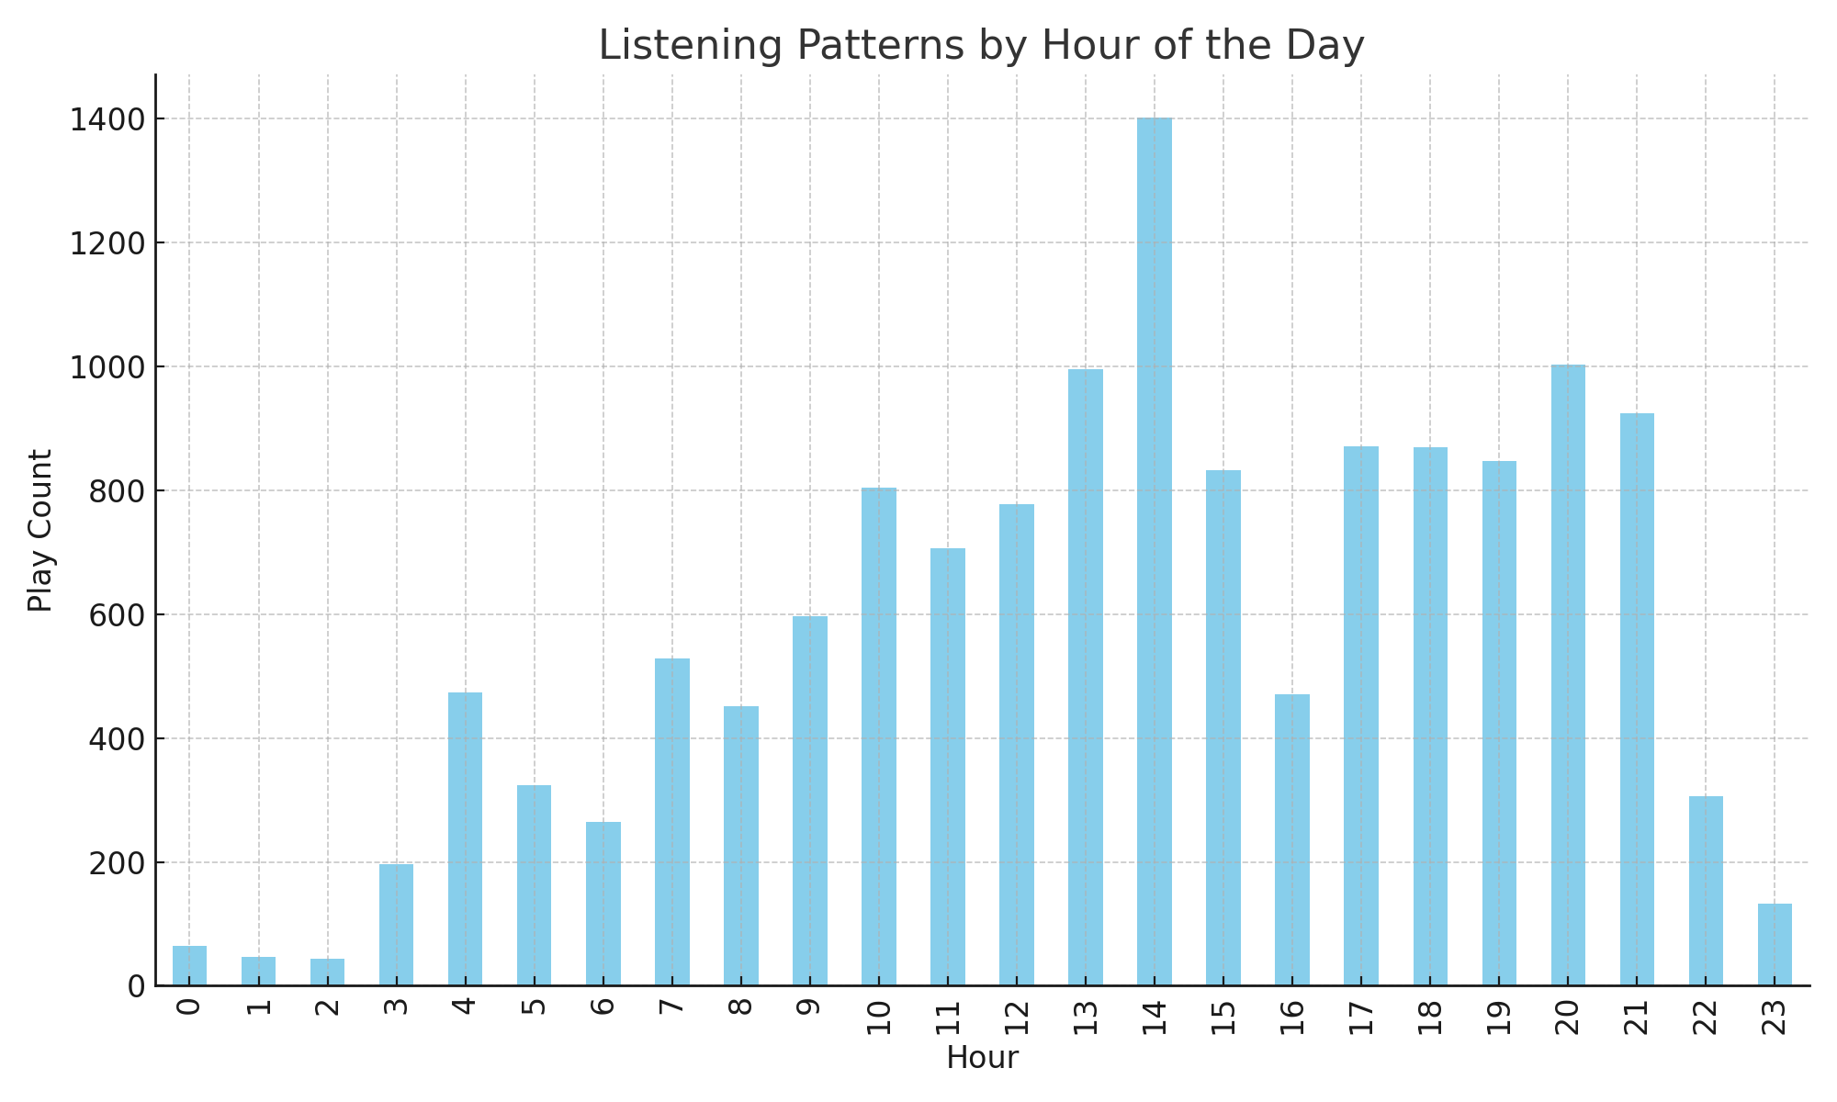
Temporal Analysis by Hour

Slide 7
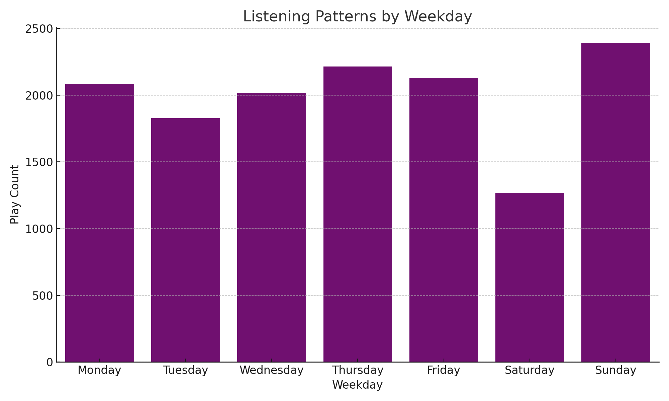
Temporal Analysis by Weekday

Slide 8
Limitations and Future Work
- Limitations:
Data limited to the provided JSON export; genres not analyzed.
- Future Work:
Predictive modeling and seasonal trend analysis.

Slide 9
Conclusion
- Summary:
Clear insights into personal listening habits and trends.
- Next Steps:
Extend analysis for genres and predictive modeling.

