Slide 1
Spotify Music Habits Analysis
Understanding and visualizing personal Spotify listening habits to uncover patterns and trends.

Slide 2
Data Source and Tools
- Data Source:
Exported personal Spotify data (JSON files).
- Tools Used:
Python (pandas, matplotlib, seaborn), GitHub for documentation.

Slide 3
Methodology
1. Data Preprocessing:
- Combined and cleaned data from JSON files.
- Added derived columns (hour, weekday).
2. Exploratory Data Analysis (EDA):
- Top artists and tracks.
- Temporal trends (hour, weekday).
3. Visualization:
- Bar and line charts for insights.

Slide 4
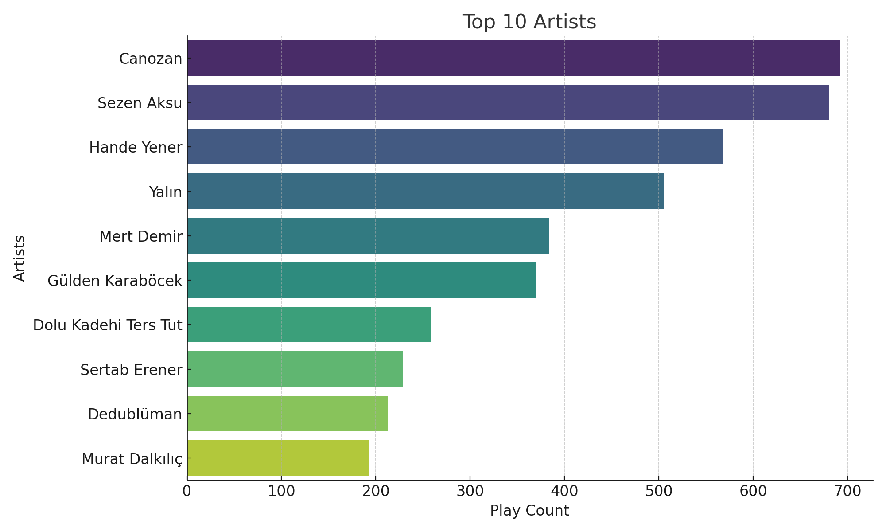
Key Findings - Top Artists

Slide 5
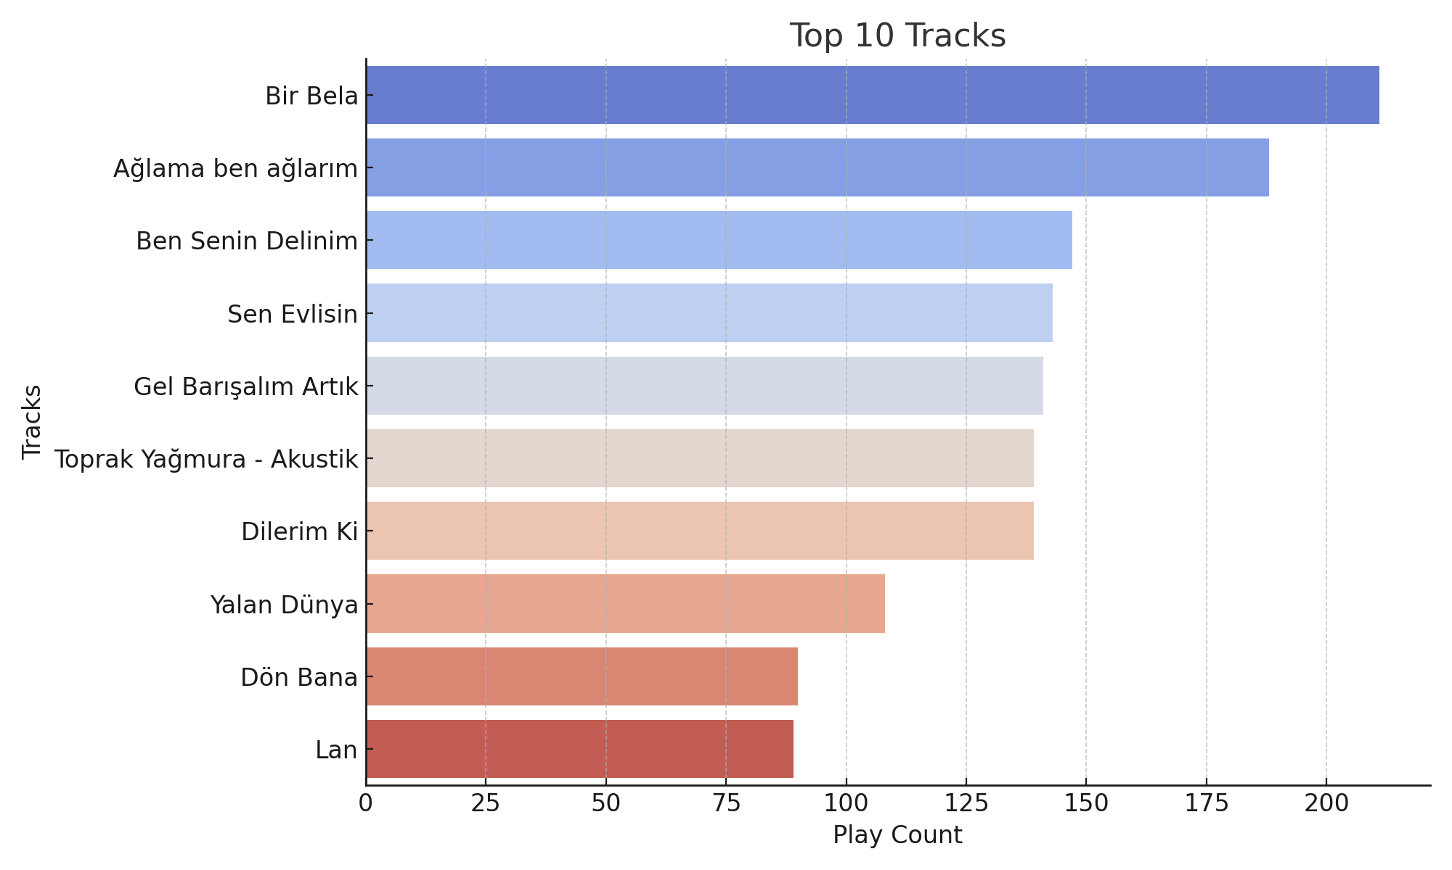
Key Findings - Top Tracks

Slide 6
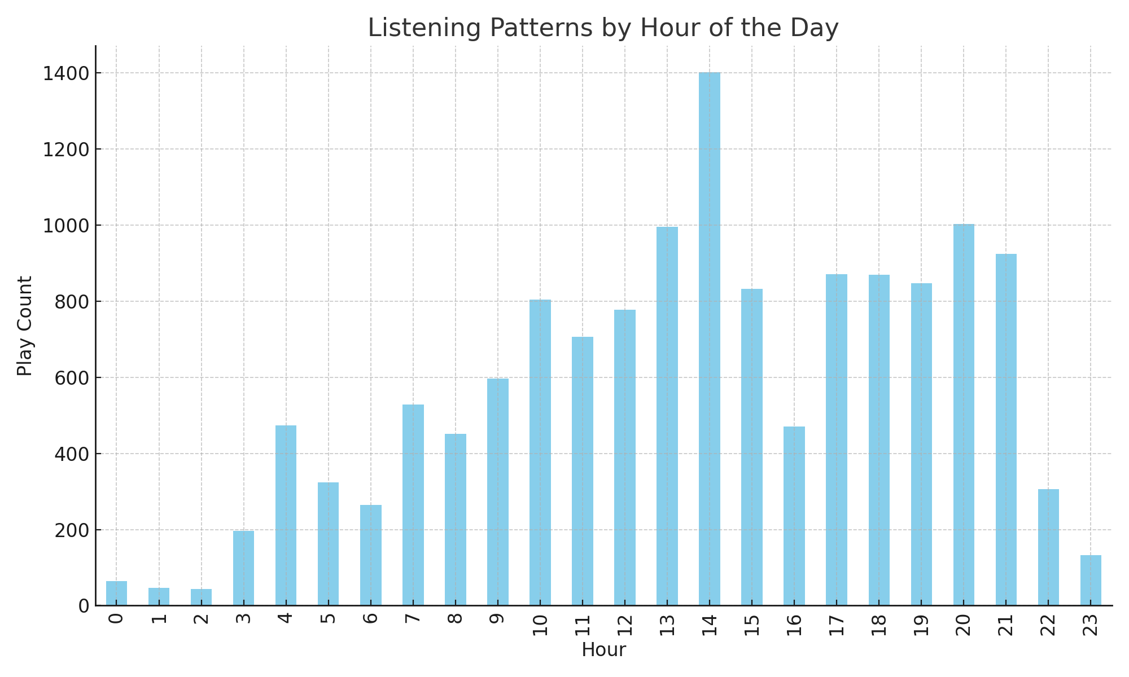
Temporal Analysis by Hour

Slide 7
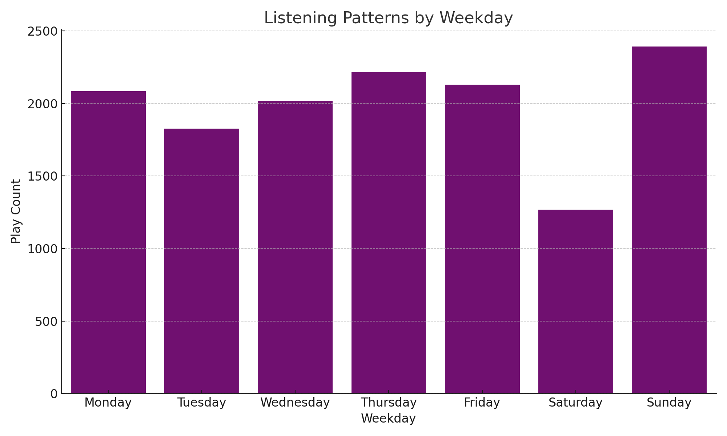
Temporal Analysis by Weekday

Slide 8
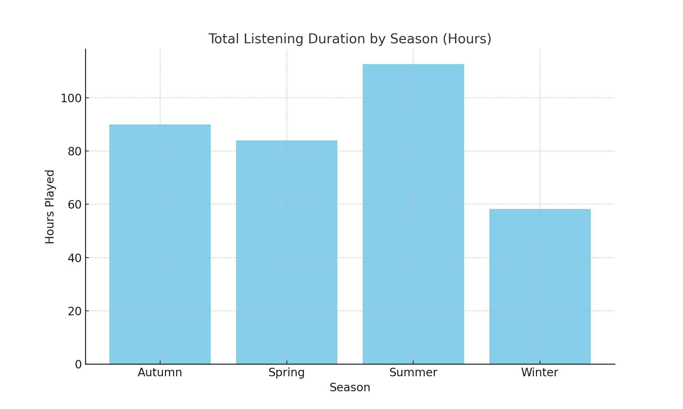
Seasonal Listening Duration

Slide 9
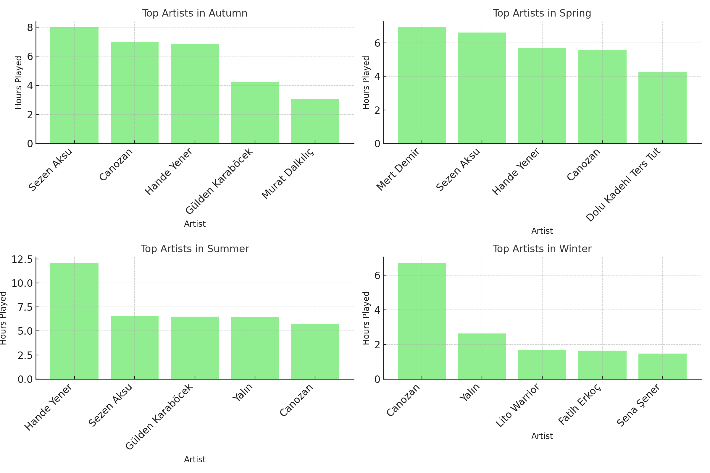
Top Artists by Season

Slide 10
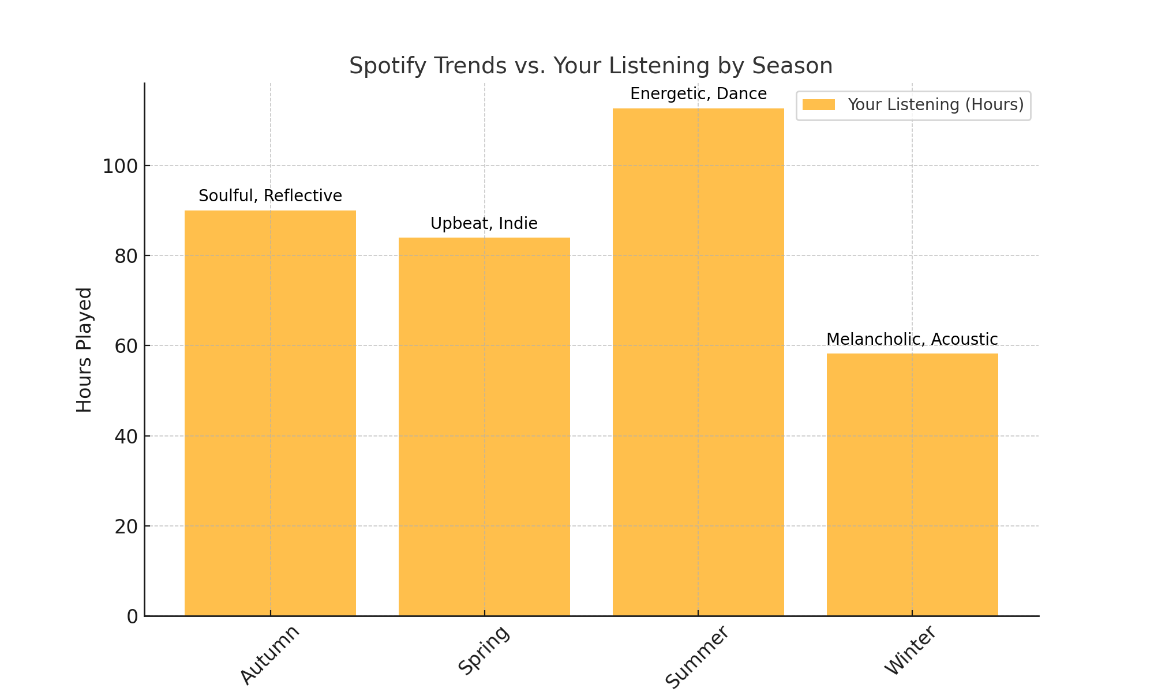
Spotify Trends vs. User Data

Slide 11
Insights and Conclusions
1. Listening Duration Trends:
- Highest listening hours occurred in Summer, aligning with energetic seasonal moods.
- Winter showed lower listening hours, indicating a calmer or melancholic mood.
2. Seasonal Genre Preferences:
- Personal listening habits reflect general Spotify trends, e.g., upbeat tracks in Spring and Summer.
- A preference for acoustic and melancholic tracks in Winter aligns with Spotify trends.
3. Artist-Specific Preferences:
- Your favorite artists during each season strongly reflect your unique mood and taste.
- While general Spotify trends match the genres, your artist choices emphasize individuality.
4. General Observations:
- Significant overlap exists between your habits and Spotify's seasonal trends.
- Personal artist and track preferences add a distinct layer to your listening patterns.

Slide 12
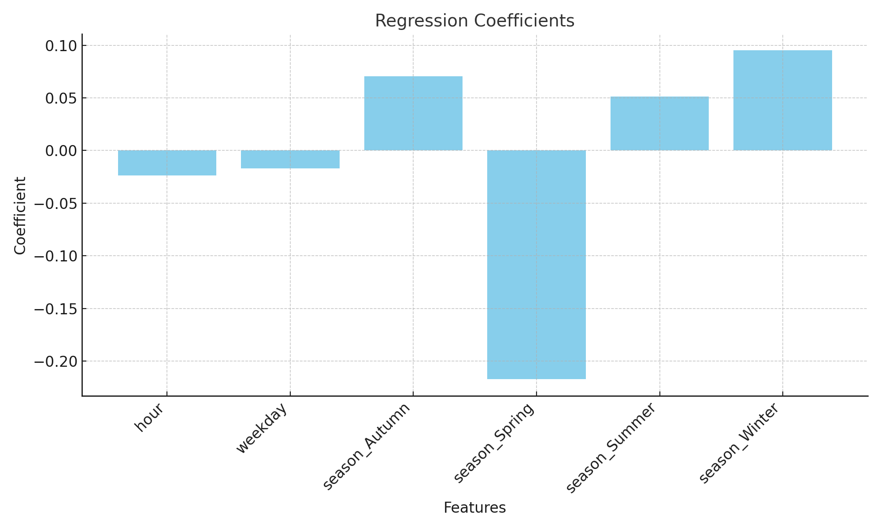
Regression Coefficients

Slide 13
Regression Analysis: Insights
1. Model Performance:
- R-squared is 0.0034, indicating the model explains very little of the variance in listening time.
- Other factors likely influence listening time beyond season, hour, and weekday.
2. Effect of Features:
- Hour: Slight decrease in listening time as the day progresses.
- Weekday: Marginally lower listening time on weekdays compared to weekends.
- Seasons: Winter and Autumn show slightly higher listening times, while Spring shows lower listening times.
3. Limitations:
- Existing features are insufficient to explain listening behavior.
- Additional factors like genre, mood, or activity context could improve predictions.

