Slide 1
E-Asset Management
By: WFS_Pun_4_Team4

Slide 2
Contents
Introduction
Homepage
User Registration
User login
Activity Diagram
Employee(User) Homepage
Functions of Employee Homepage
Admin Login
Admin Homepage
Functionality of Admin homepage

Slide 3
Introduction
The E-Asset Management system is a web-based application to keep track of several assets that can be borrowed, their availability, their current location, the current borrower and the asset history.
Assets include Laptops, Books, Mobiles and Devices

Slide 4
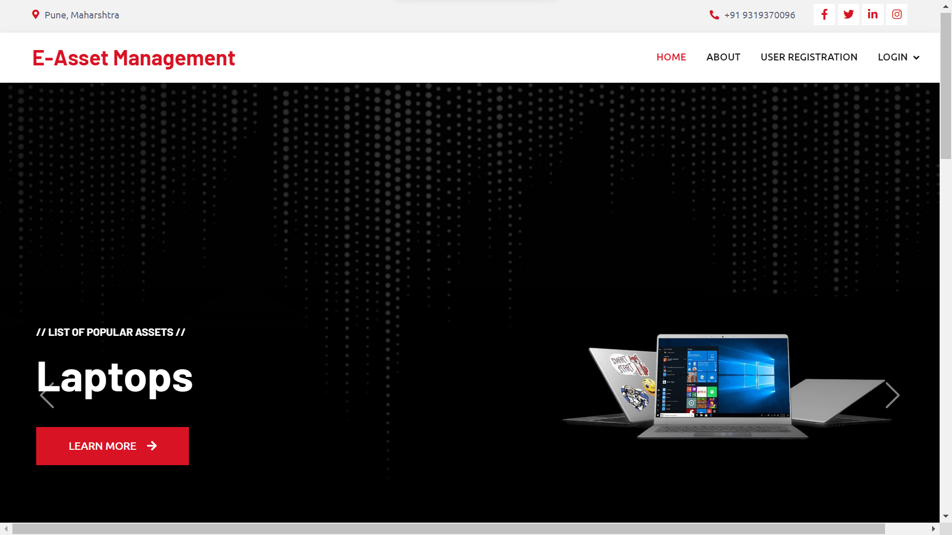
Homepage

Slide 5
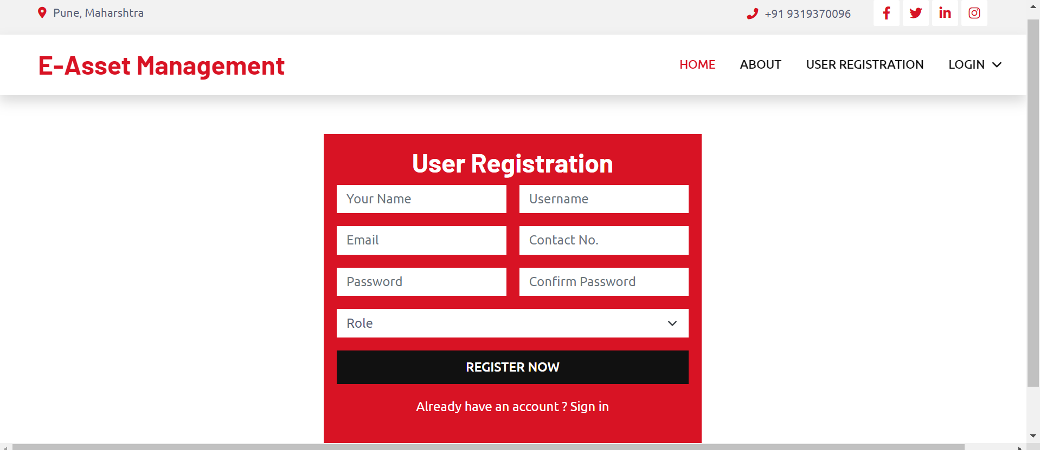
User Registration
All fields are mandatory & have all the necessary validators.(need to register before login)

Slide 6
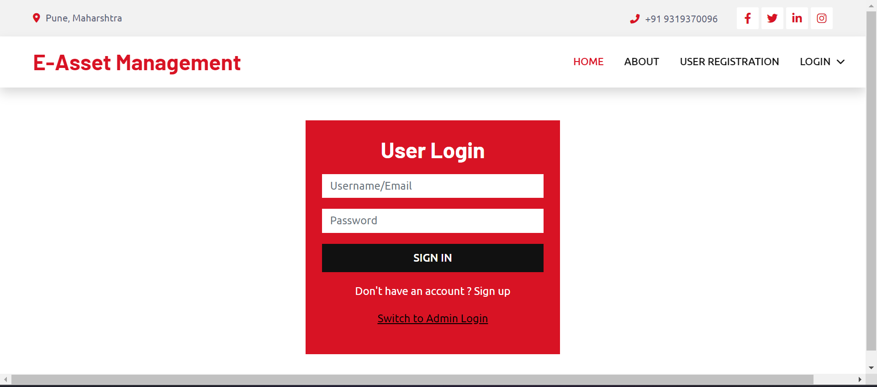
User login
After registering , user can login here
Toggle switch for admin login

Slide 7
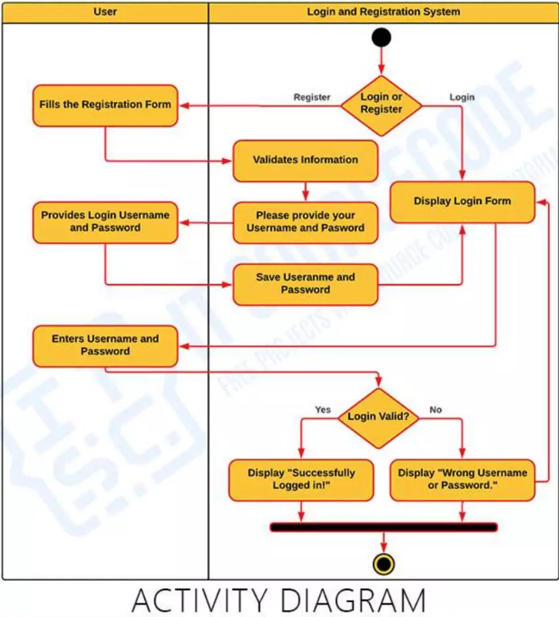
Diagram 1

Slide 8
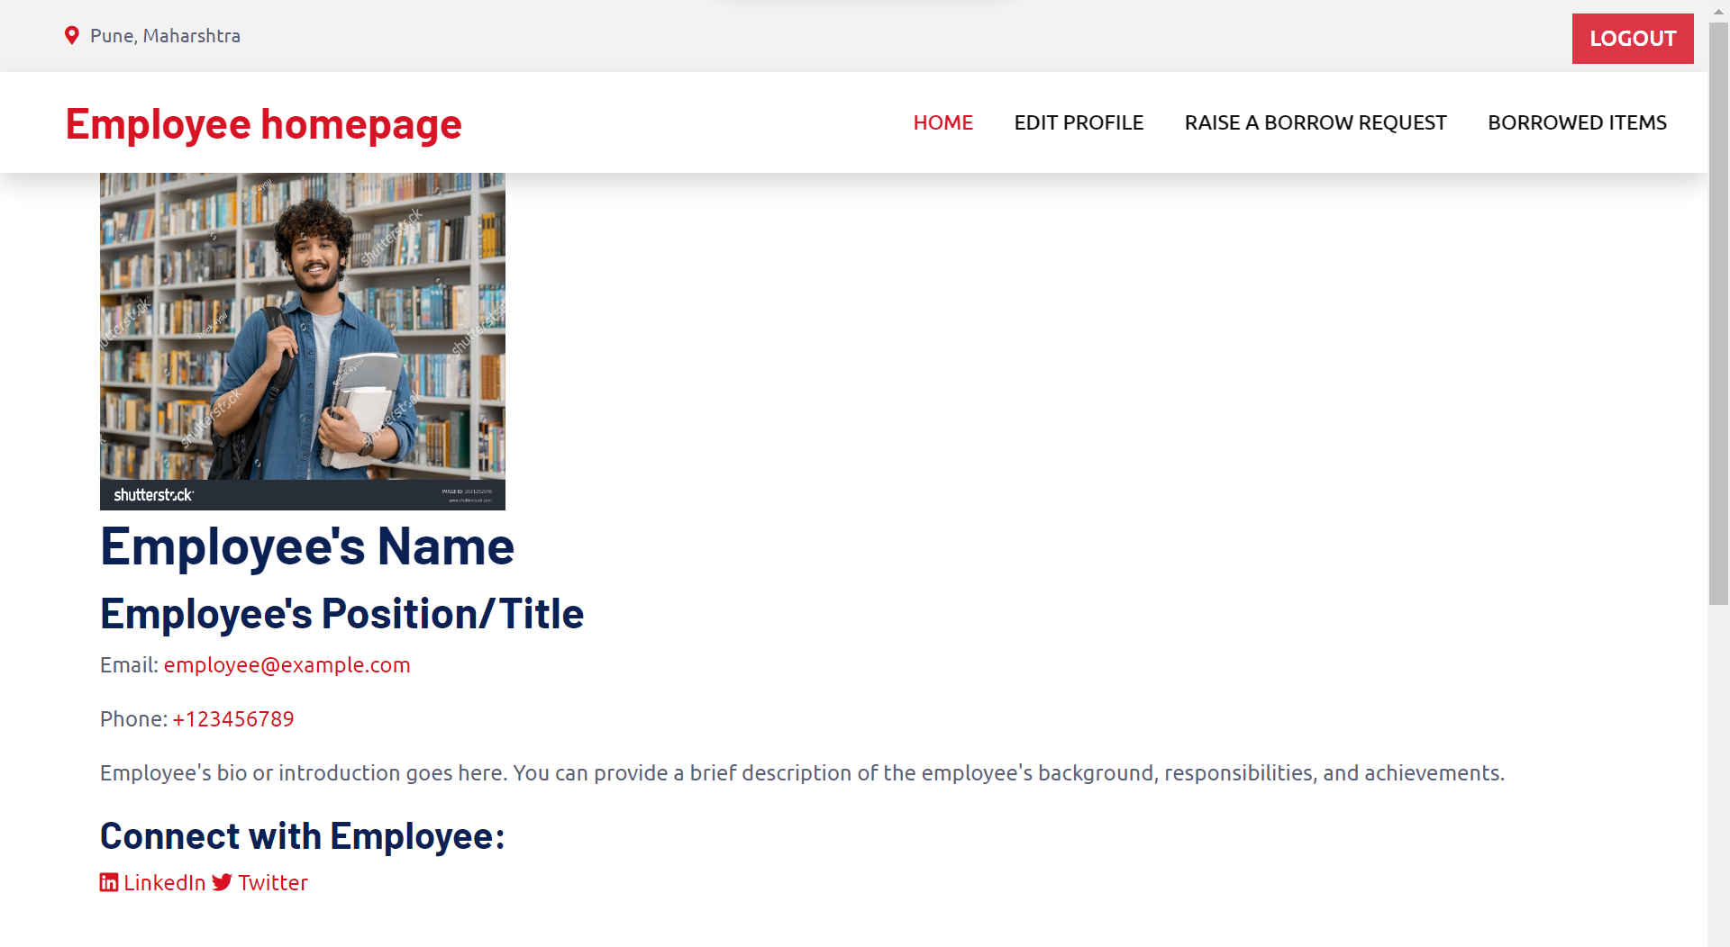
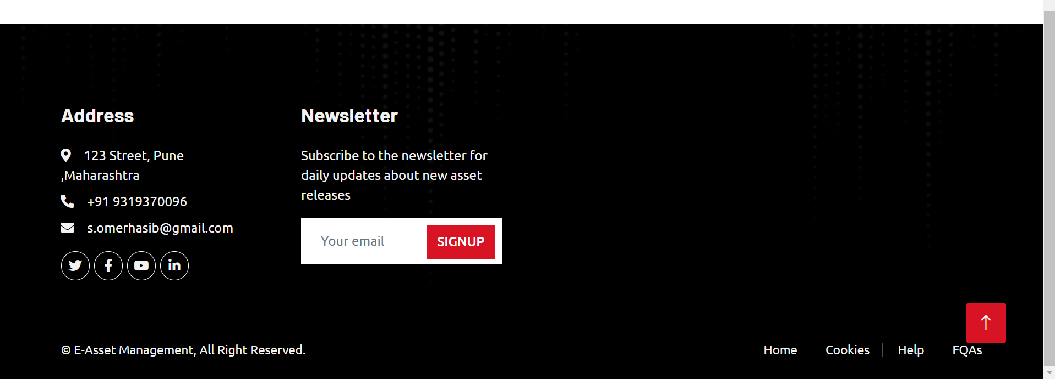
Employee(User) Homepage
Logs out and takes user back to main homepage

Slide 9
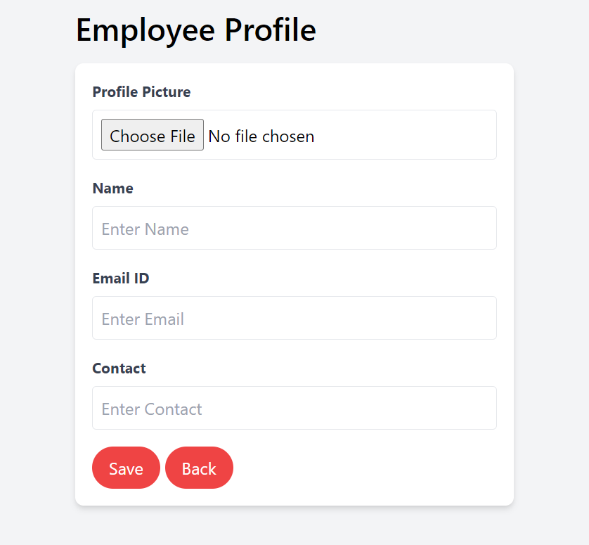
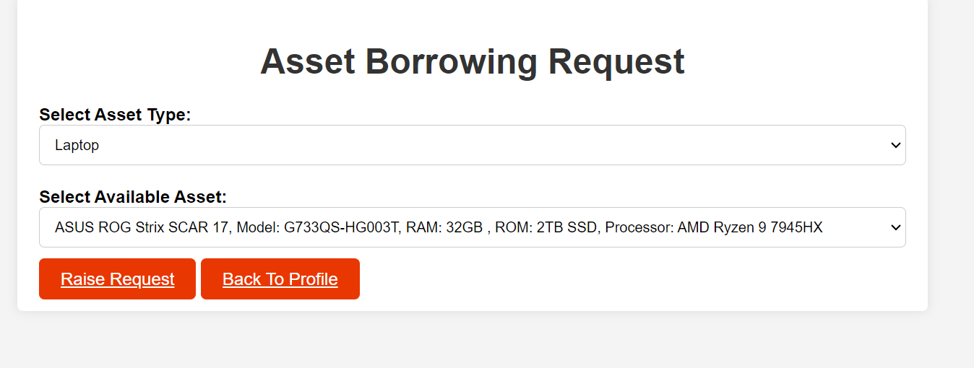
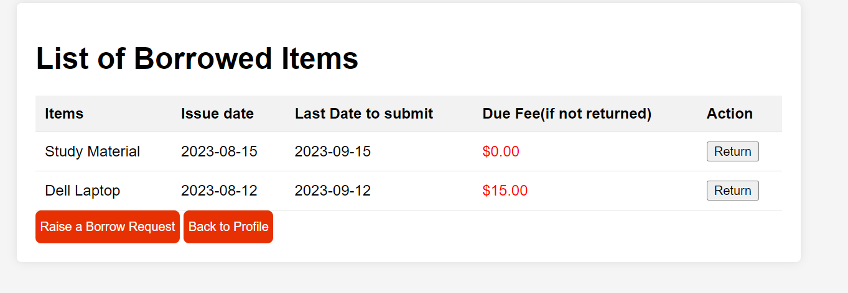
Functions of Employee Homepage

Slide 10
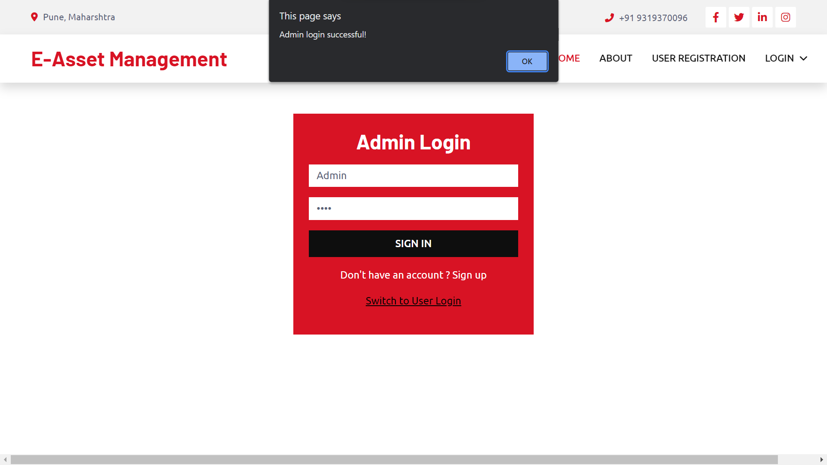
Admin login
Admin login page, only access to one person(admin)
Click ok after signing in to open the admin homepage
Username:Admin
Pass: 1234

Slide 11
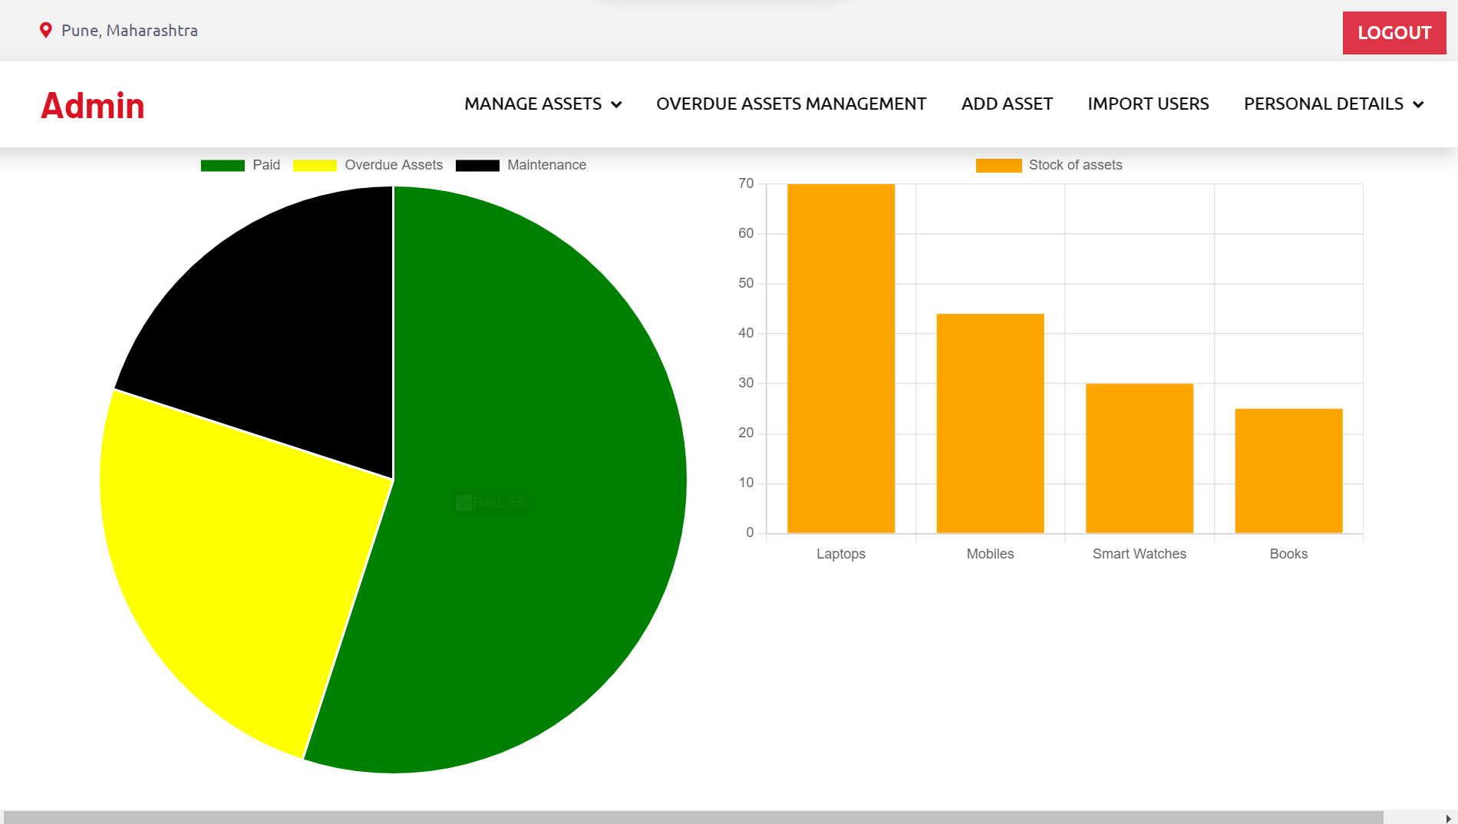
Admin Homepage
Logs out and takes user back to main homepage
Graphs and charts added for analytical purposes

Slide 12
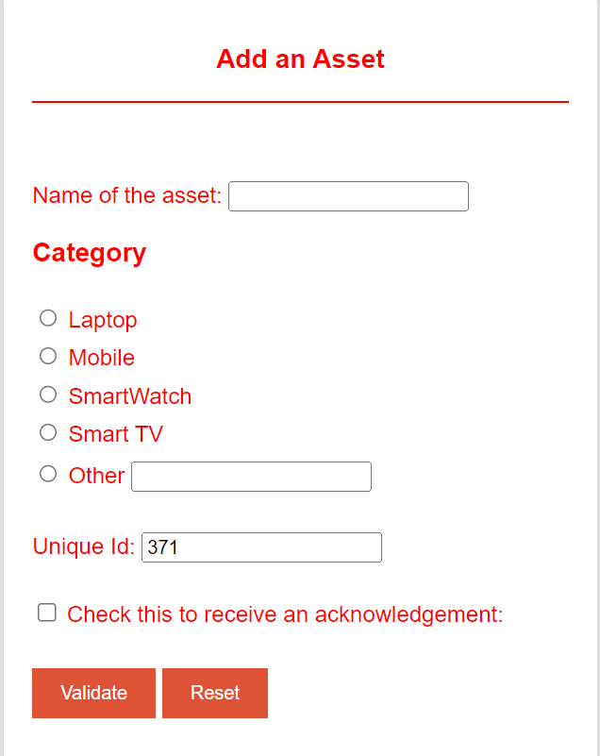
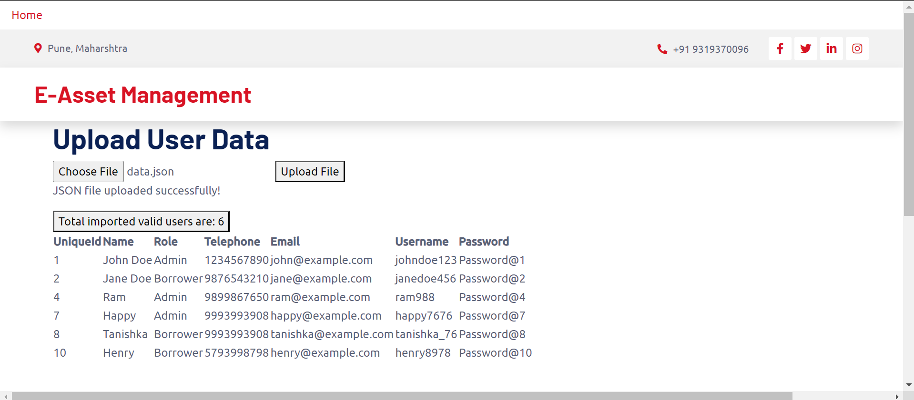
Functionality of Admin homepage
Uploads user data after parsing through JSON
& XML file and passing validation conditions
JSON FILE INCLUDED IN PROJECT

