Slide 1
HIREKAR.COM
It is an E-Marketplace web-application which will connect clients with thousands of Photographers on one single platform.

Slide 2
Why HireKar.com?
Automating the Hiring Process.
Converting the traditional hiring proccess into an automated one.
Wastage of time and effort.
The only way they get clients is through social media,references or work of mouth which requires time and effort.
Not enough options.
You don't have much to start with and no proper way judging the photographer.

Slide 3
Solutions It will Provide.
Providing a Starting Point for the Photographers.
Hirekar simply eliminates all the barrier between the photographer and the client by providing a starting point through this platform.
An opportunity to engage.
You get to know about the photographer to see if he is the right fit for the job.
Elimination the hassle and time.
You get to select the right person for the job without any hassle and Wastage of time.

Slide 4
Tools and Technology to be Used.
ANGULAR
For the Frontend.
NODEJS / EXPRESS
For the Backend.
GITHUB
For the Version-Control.
MONGODB
For the Persistence.
REST API
For Interaction and Fetching Data.

Slide 5
Core Modules
Exif
Exif Data Extraction From the Images.
Dimensions..
Camera Name.
Model...
Dashboard.
Dashboard for the user to Keep track of the activities.
Uploads.
Hits.
Sentiments.
Sentimental Analysis.
Analysis of the Reviews Given by the Audience.
Positive
Negative
Neutral

Slide 6
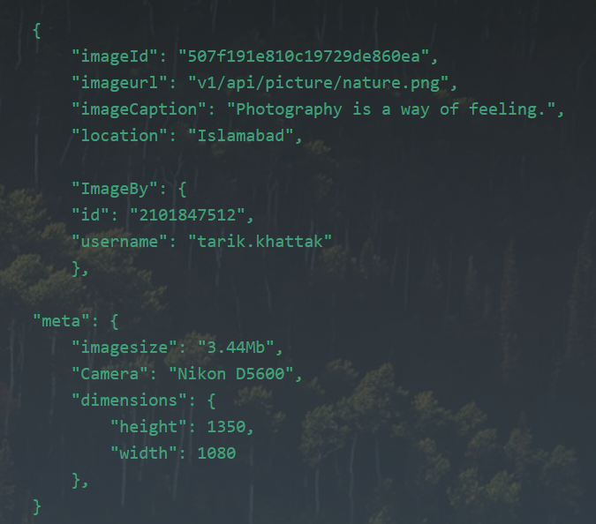
Photo Object and Exif Data Representation.
Exif Data is the meta data associated with the File which is relevent to the photographer.

Slide 7
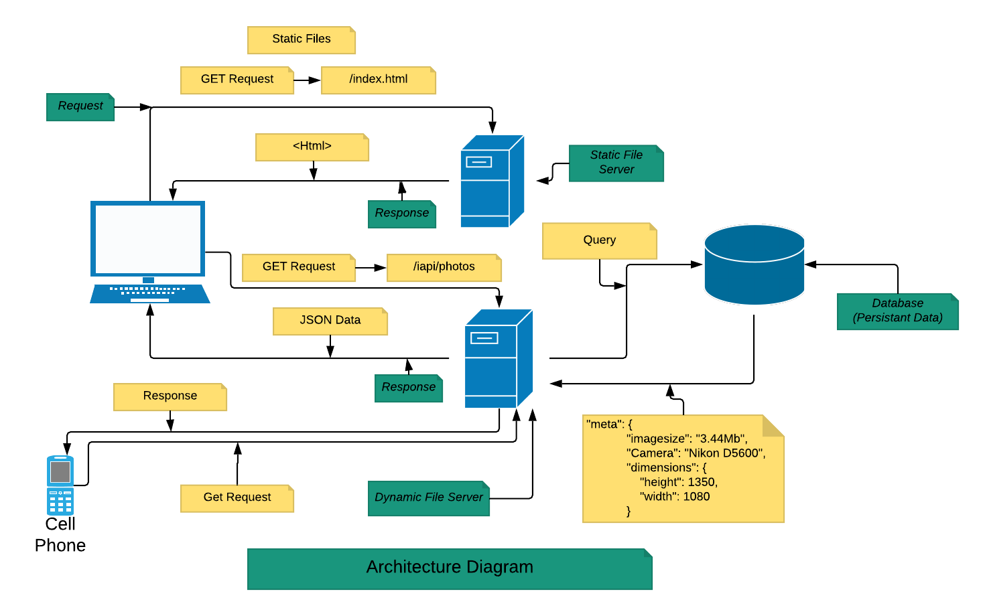
Flow of the system

Slide 8
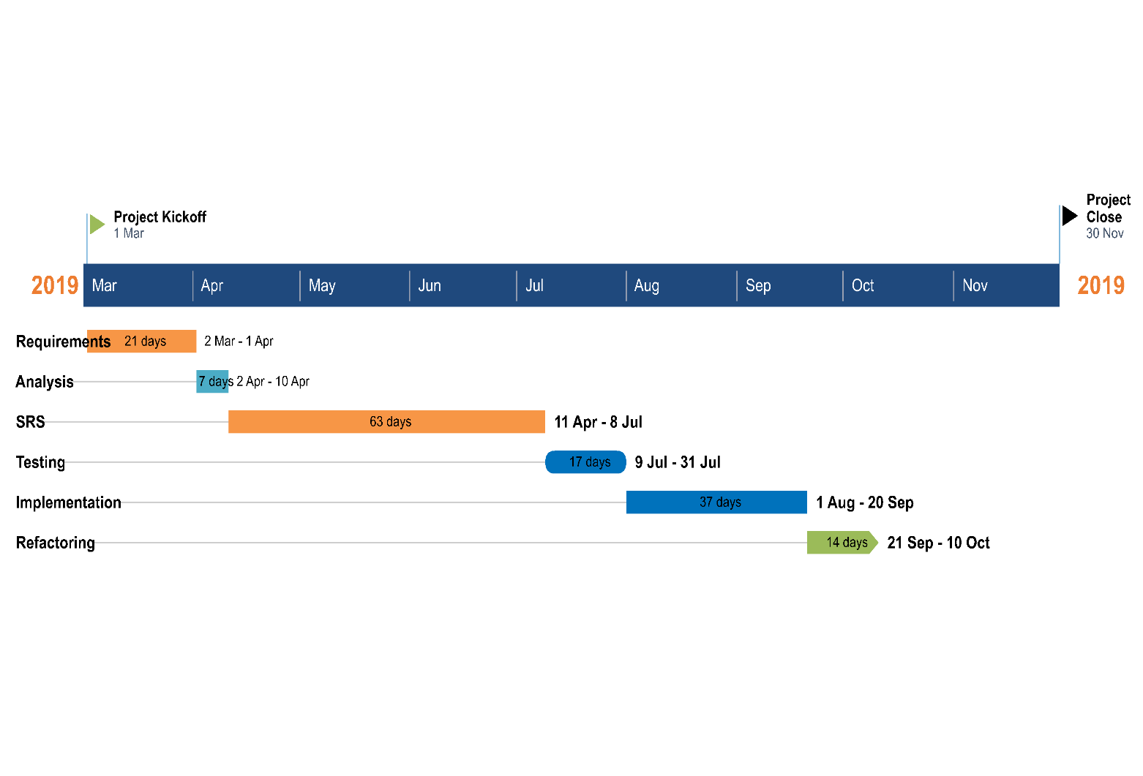
Timeline

