Slide 1
OPTICAL CHARACTER RECOGNITION FOR MARATHI LANGUAGE

Slide 2
PROBLEM DEFINITION
To implement Optical Character recognition software for Marathi language for the identification of printed discrete characters of devnagari script. It should allow us to process an image and then identify the character distinctly. It should also take under consideration various variations and distortion in the characters.

Slide 3
Optical Character Recognition
It is software designed to translate image of handwritten or typewritten text into machine-editable text, or to translate pictures of characters into a standard encoding scheme representing them (e.g. ASCII or Unicode)
Abbreviated as OCR
Steps Involved
  Identification of text and image blocks in the image
  Image Preprocessing Activities
  Feature Extraction
  Character Recognition
  Formatting output

Slide 4
Preprocessing Activities
Binarization
  Image binarization converts an image of up to 256 gray levels to a black and white image.
Noise Removal
  Remove random specks or noise from images
  Introduced during data acquisition
Segmentation
  A field is separated into its individual characters
  Need Segmentation as single character acts as input for recognizing system
  Character separation is carried out by the following steps:
    Plot the histogram of the entire row
    Select the candidate points
    Carry out the split into two sub components

Slide 5
Preprocessing Activities
Framing
  To scale the image size to the specified size
  Scaling Factor = Frame Size ÷ Image Size
  Zooming: If Image size is less than the Frame size
  Algorithms
    Nearest Neighbor Interpolation
    Duplication
  Shrinking: If Image size is greater than the Frame size

Slide 6
Preprocessing Activities
Thinning
  Process of peeling of pixels
  It retains the shape of image
  Removes Redundant pixels
Skew Detection and Correction
  Detecting the inclination in character image and its elimination
  Inclination is introduced during scanning

Slide 7
Feature Extraction
  Features are the salient characteristics of the segmented image
  Different feature extraction methods
    Image Descriptor
    Structural Descriptor
    Mathematical Descriptor

Slide 8
Feature Extraction
  Image Descriptor
    Image is considered as an array with values ‘0’ or ‘1’.
    This entire bitmap is passed to the classifier in the form of an array.
    Every set bit in image represents ‘1’ in the array and reset bits represents ‘0’
    This mechanism is not font invariant
    If the image size is 100*100 then number of inputs to the image will be as high as 10000.
    It is not noise tolerant.
    To reduce the number of input to the system we introduce blocking.
    We divide image into block and count number of set pixels and pass the value.
    It helps to control the number of inputs but still this method is not font invariant.

Slide 9
Feature Extraction
  Structural Descriptor
    Divide the image up into regions of interest
    It considers strokes (vertical or horizontal strokes) and orientation strokes of a character.
    It examines the shape of the character. Shapes are recognized, and then they are coded.
    Describe strokes in the sub part of every region using
    Freeman’s Code
    Freeman chain code is a compact way to represent a contour of an object
    Append All of them to get the chain code
    Chain code is the required feature vector

Slide 10
Feature Extraction
  Mathematical descriptors
    In this method various transform such as Fourier Transform and wavelet Transform can be used
  Wavelet Transform
    Fast Encoding method
    Similar to Fourier Transform
    Adds extra information to FT depending upon the scale
    They give more localized information
    Lack invariance property

Slide 11
Feature Extraction
  Moments
    Zernike moments
      Function of image intensity values
      Based on complex polynomial
      Defined in the interior of unit circle
      Properties of Zernike moments
        Minimum Redundancy
        Rotation invariance
        Robust to noise
    Basis Function and Moment Function

Slide 12
Character Recognition
  Character recognition is a process in which a character is recognized by its features. Features here could be the information about the character image or the information derived from the image.
  The various techniques are as follows:
    Template Matching: The input image is simply ANDed with the sample images of each character.
    Generalized Hausdorff distance: The input image and the model image are considered to be the set of points. Hausdorff distance is calculated from the input image to the sample image.
    Support vector machine: The set of sample data are collected and plotted as sample points on a plane. This plane is divided into hyper planes. The distance between the hyper planes is calculated

Slide 13
Character Recognition
  Artificial Neural network
  An artificial neural network (ANN) or commonly just neural network (NN) is an interconnected group of neurons. ANN has neurons and all those neurons are connected by synapse. Each synapse has some weights associated with it and the identification information about the source and the destination neuron. The weights on each synapse are adjusted using back propagation logic.

Slide 14
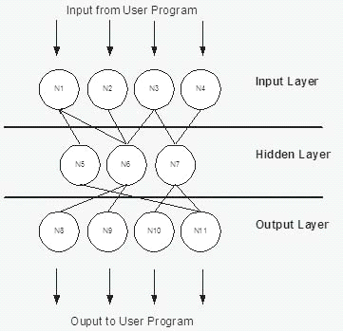
Artificial Neural network

Slide 15
DESIGNING
  Data collection
    samples of Marathi characters
    single discrete character
    stored in .JPEG
  Fonts
    Training set: Shiv01, Shusha, Kruti Dev 010, Kruti Dev 011, Kruti Dev 012, Kruti Dev 013, Kruti Dev 014, Kruti Dev 035, Kruti Dev 060, Kruti Dev 110 and Kruti Dev 111.
    Testing set : Kruti Dev 016, Kruti Dev 26, Kruti Dev 36, Kruti Dev 041 and Kruti Dev 044.

Slide 16
DESIGNING
  Image Pre Processing activities:
    Binarization
    Noise Removal
    Segmentation
    Framming
    Thinning
    Skew Detection
  Feature extraction
  Recognition
    Neural Network

Slide 17
Network Consideration
  The structure of neural network is as follows:
    One input and one output layer
    Two hidden layers
    Learning Rate: 0.3
    Iterations: 10000
    Training Set: 11 fonts
    Testing Set: 5 fonts
    No of neurons in 1st hidden layer: 60
    No of neurons in 2nd hidden layer: 36

Slide 18
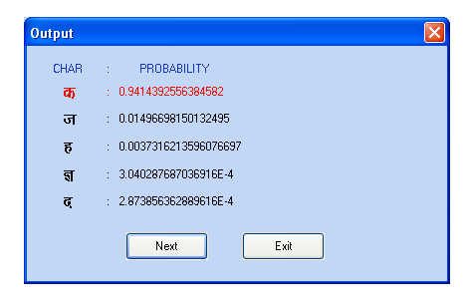
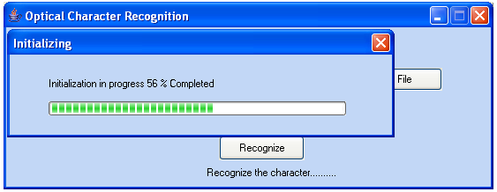
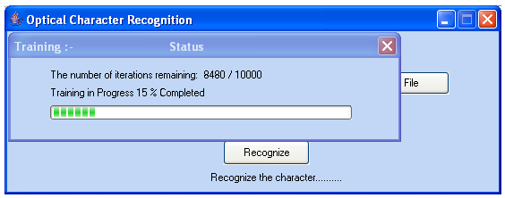
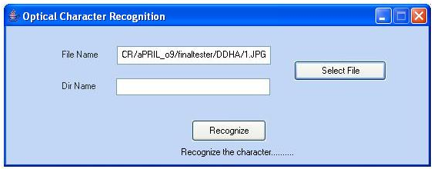
User Interface

Slide 19
THANK YOU !!

