Slide 1
Mock ICT01
Answer Discussion

Slide 2

Question 01
The Turing Test is a method of inquiry in artificial intelligence (AI) for determining whether a computer is capable of thinking like a human being
A : True
B : False

Slide 3

Question 02
Ethical issues related to AI include privacy concerns and the impact on job markets
A : True
B : False

Slide 4
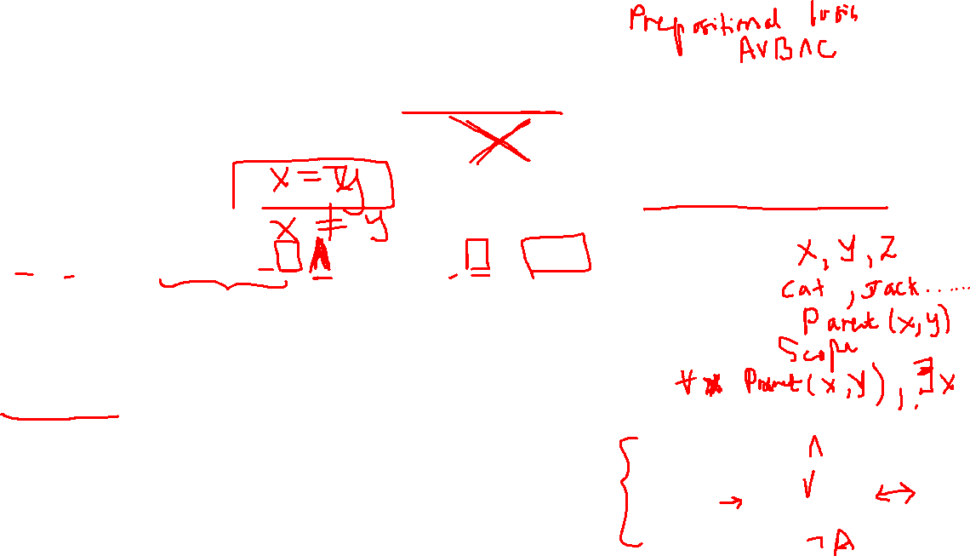
Question 03
If we interpret the predicate Spouse(x,z) as “x is the Spouse of z”, the following FOL formula means “Everyone can be the spouse of any given person.”
∃x ∀ x,y,z Spouse(x,z) ∧ Spouse(y,z) ⇒ x=y
A : True
B : False
FOL/ Predicate Logic
Variables
Constants
Predicates
Quantifiers
Logical Connectives
Conjunction
Disjunction
Implication/biconditional
Negation

Slide 5

Question 05
Move ordering has no effect on Alpha-Beta pruning
A : True
B : False

Slide 6
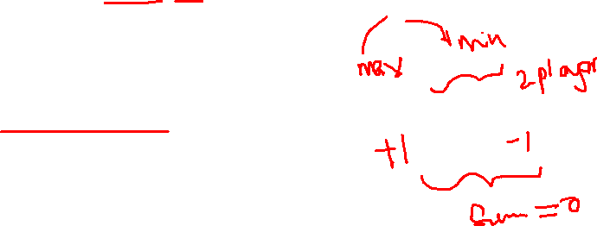
Question 06
The minimax algorithm is only applicable to two-player, zero-sum games
A : True
B : False

Slide 7
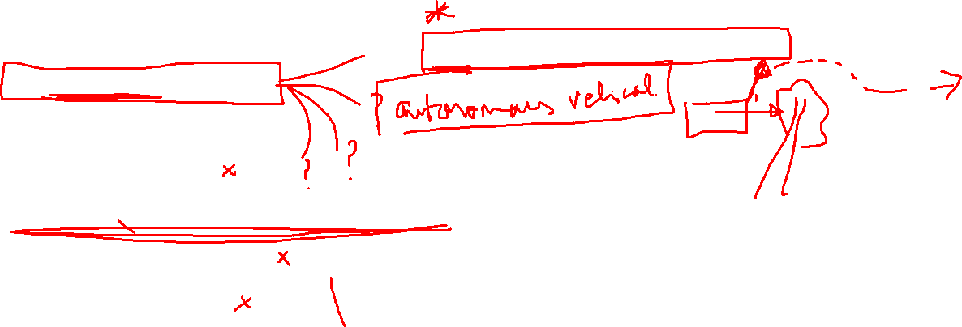
Question 07
Which among the following is not a primary characteristic of an intelligent agent?
Reactivity
Ability to play board games
Proactiveness
Autonomy

Slide 8
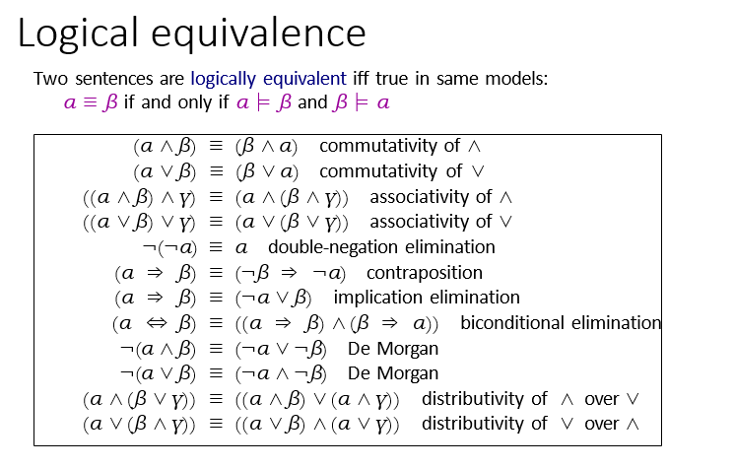
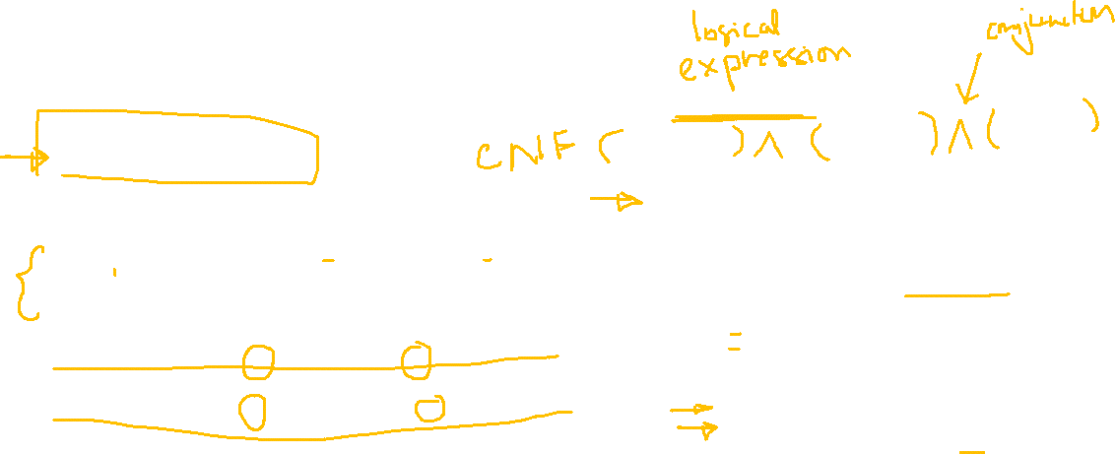
Question 08
What is the CNF form for the following sentence?
(P => P) <=> Q
(P v ¬P v ¬Q) ^ (¬P v Q) ^ (P v Q)
(¬P v ¬Q) ^ (¬P v Q) ^ (P v Q)
(P ^ ¬Q) v (¬P ^ Q) v (P ^ Q)
(P ^ ¬P) v (¬Q ^ ¬P) v (Q ^ P)

Slide 9
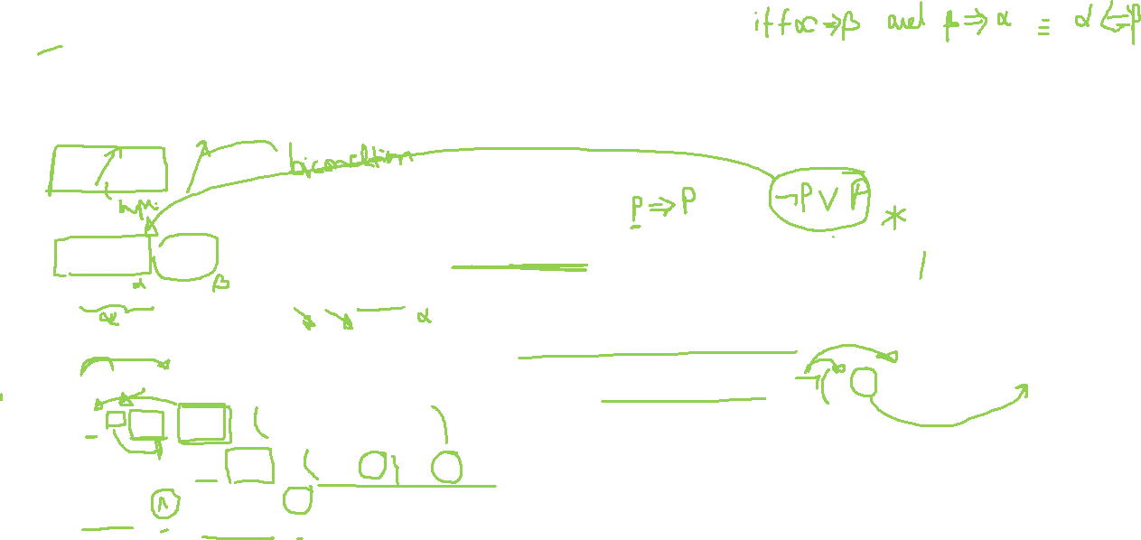
Question 08 (Working)
What is the CNF form for the following sentence?
(P => P) <=> Q
¬P v P <==> Q # implication elimination (α⇒β) ≡ (¬α ∨ β)
(¬P v P => Q) ^ (Q =>¬P v P) #bidirectional elimination (α⇔β) ≡ ((α⇒β) ∧ (β ⇒α))
(¬ (¬P v P) v Q) ^ (¬ Q v (¬P v P)) # implication elimination
(¬ (¬P v P) v Q) ^ ¬ Q v (¬P v P) # Apply de Morgans Law ¬(α ∧ β) ≡ (¬α ∨ ¬β)
((P ^ ¬P) v Q) ^ ¬ Q v (¬P v P) # Apply distributive Law (logical equivalence Table)
(P v Q) ^ (¬P v Q) ^ ¬ Q v (¬P v P)
(P v Q) ^ (¬P v Q) ^ ( ¬ Q v ¬P v P)
( ¬ Q v ¬P v P) ^ (P v Q) ^ (¬P v Q)

Slide 10
Question 08 (Working)
What is the CNF form for the following sentence?
(P => P) <=> Q
¬P v P <==> Q # implication elimination (α⇒β) ≡ (¬α ∨ β)
(¬P v P => Q) ^ (Q =>¬P v P) #bidirectional elimination (α⇔β) ≡ ((α⇒β) ∧ (β ⇒α))
(¬ (¬P v P) v Q) ^ (¬ Q v (¬P v P)) # implication elimination
(¬ (¬P v P) v Q) ^ ¬ Q v (¬P v P) # Apply de Morgans Law ¬(α ∧ β) ≡ (¬α ∨ ¬β)
((P ^ ¬P) v Q) ^ ¬ Q v (¬P v P) # Apply distributive Law (logical equivalence Table)
(P v Q) ^ (¬P v Q) ^ ¬ Q v (¬P v P)
(P v Q) ^ (¬P v Q) ^ ( ¬ Q v ¬P v P)
( ¬ Q v ¬P v P) ^ (P v Q) ^ (¬P v Q)

Slide 11

Question 08
What is the CNF form for the following sentence?
(P => P) <=> Q
(P v ¬P v ¬Q) ^ (¬P v Q) ^ (P v Q)
(¬P v ¬Q) ^ (¬P v Q) ^ (P v Q)
(P ^ ¬Q) v (¬P ^ Q) v (P ^ Q)
(P ^ ¬P) v (¬Q ^ ¬P) v (Q ^ P)
(P v Q) ^ (¬P v Q) ^ ( ¬ Q v ¬P v P)

Slide 12
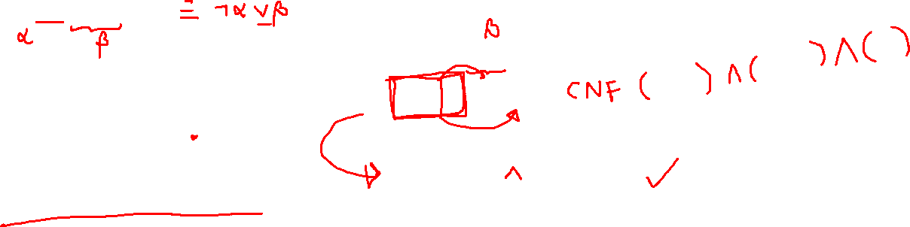
Question 09
The CNF (Clausal) form of A->(B ^C) is
(AvB)^ (¬ AvC)
(¬ Av ¬ B)^ (AvC)
(Av ¬ B)^(Av ¬ C)
(¬ AvB)^(¬ AvC)
The CNF (Clausal) form of A->(B ^C) is
Replace implication
A->(B ^C)
¬ A v (B ^C)
Apply de Morgan’s Law
(¬ A v B) ^ (¬ A v C)

Slide 13
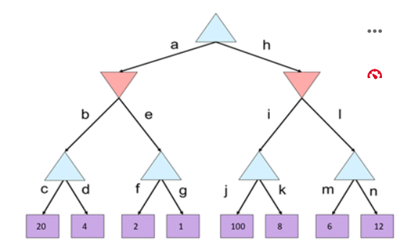

Question 10
The following game tree generated using the MiniMax algorithm. What will be the value in the root node?
100
2
12
20

Slide 14
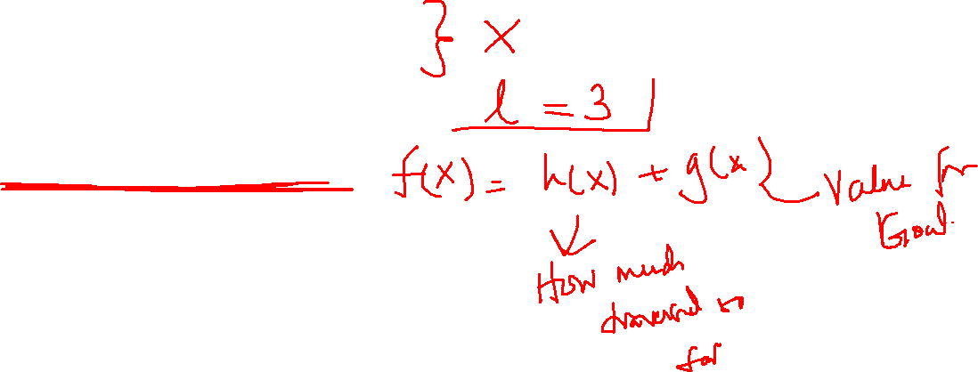
Question 11
Which of the following is an Informed Search technique?
Breadth first search
Depth first search
Depth limited search
A* algorithm

Slide 15
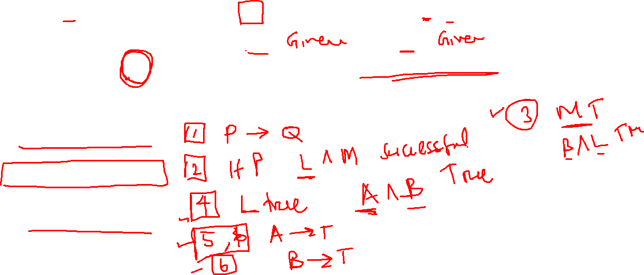
Question 12
A knowledge base has the following rules
1. P->Q 2. L^ M->P 3. B^L->M
4. A^B->L 5. A 6. B
If the query Q has to be tested using backward chaining inference method, what sequence of the rule will be executed.
5,6,4,2,3,1
1,2,4,5,6,3
1, 5,6,2,3,4
5,6,2,3,4,1

Slide 16
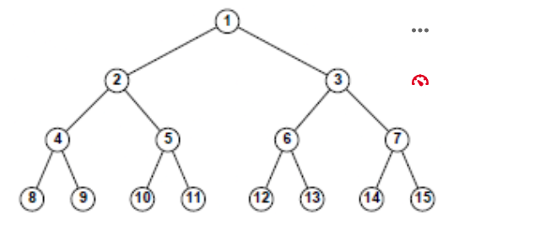
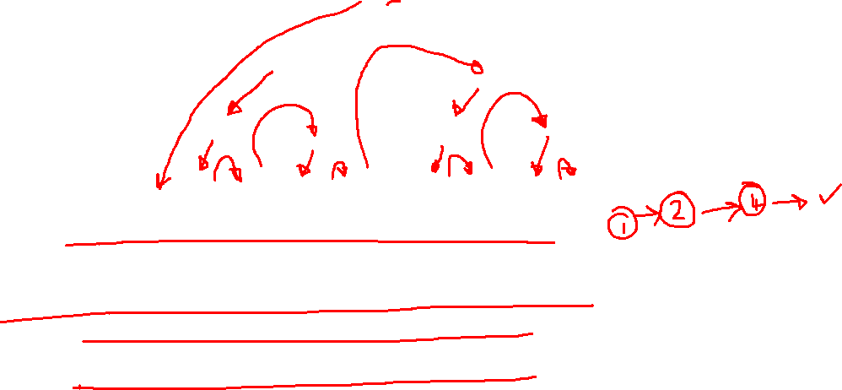
Question 13
What is the sequence of nodes visited during Depth First Search?
1,2,3,4,5,6,7,8,9,10,11,12,13,14,15
1,2,4,8,9,5,10,11,3,6,12,13,7,14,15
1,2,4,9,8,5,11,10,3,6,13,12,7,15,14
13,6,12,13,7,14,15,2,4,8,9,5,10,11

Slide 17
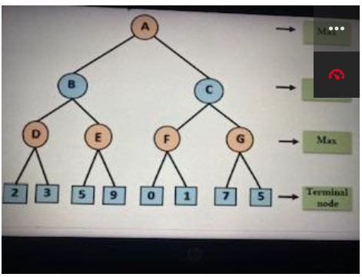

Question 14
IF alpha-beta pruning is used in the following graph, which of the following gives the alpha and beta values of node (E)
2 , 5
3 , 5
5 , 3
3 , 9

Slide 18
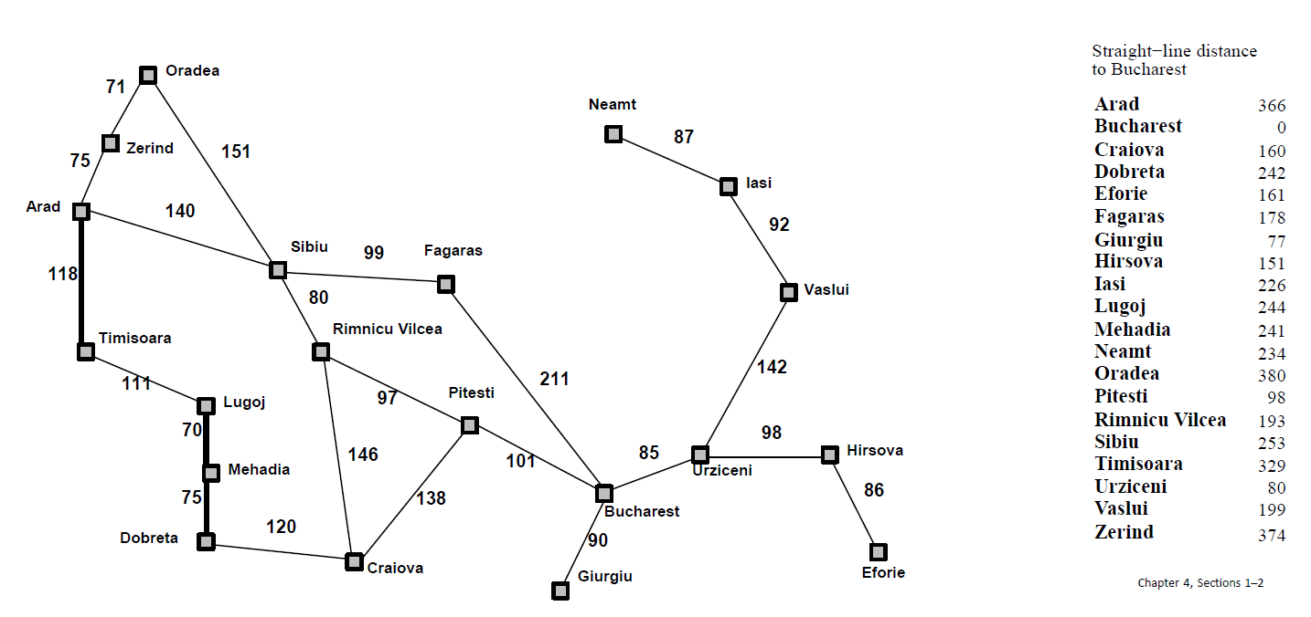
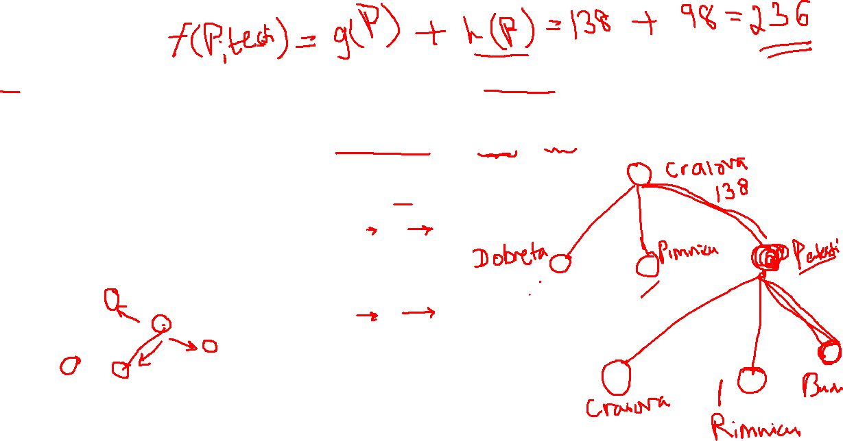
Question 15
A∗ is applied to the problem of getting from Craiova to Bucharest using the straight-line distance heuristic. What is the cost for Pitesti after the application of the evaluation function f(x) = g(x) + h(x) ?

