Slide 1

Goibibo Flight Analysis Dashboard Insights
By Om Gawai

Slide 2
INTRODUCTION
Analysis of flight data from Goibibo, focusing on key metrics.
Insights into average ticket prices and total flight count.
Examination of price variations across airlines, classes, and routes.
Identification of high-demand routes and popular travel patterns.
Seasonal trends in ticket prices, highlighting peak and low-demand periods.
Useful for optimizing Goibibo’s service offerings and marketing strategies.

Slide 3
Key Matrix Overview
1. Average Price: ₹21,000 - indicating the average cost per flight.
Number of Flights: 1,569 - total flights recorded within the date range.

Slide 4
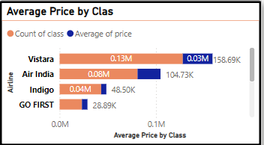
Average Price by Class
Vistara has the highest average price per class.
Air India and Indigo follow, with slightly lower average prices.
Trujet offers the lowest average price per class, making it a budget-friendly option.

Slide 5
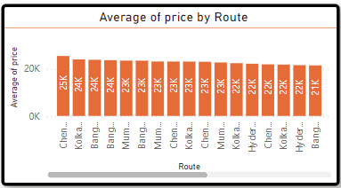
Average Price by Route
The average price varies slightly across routes.
Chennai to Kolkata has the highest average price at approximately ₹25K.
Popular routes like Mumbai to Kolkata and Delhi to Hyderabad show similar price trends.

Slide 6
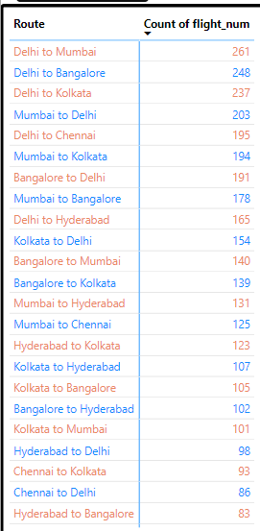
Flight Count by Route
Delhi to Mumbai has the highest number of flights (261).
Delhi to Bangalore and Delhi to Kolkata also have high flight counts.
These routes indicate high travel demand

Slide 7
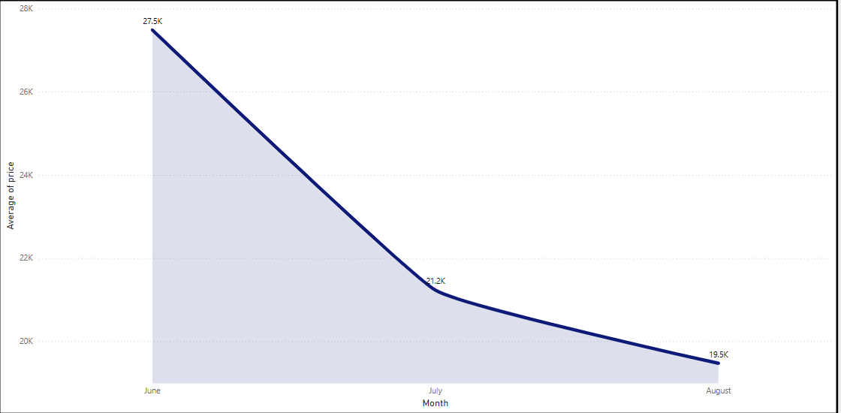
Average Price by Month
June shows the highest average price at around ₹27.5K.
Prices decrease to ₹21.2K in July and ₹19.5K in August.
This trend suggests peak travel demand in early summer.

Slide 8
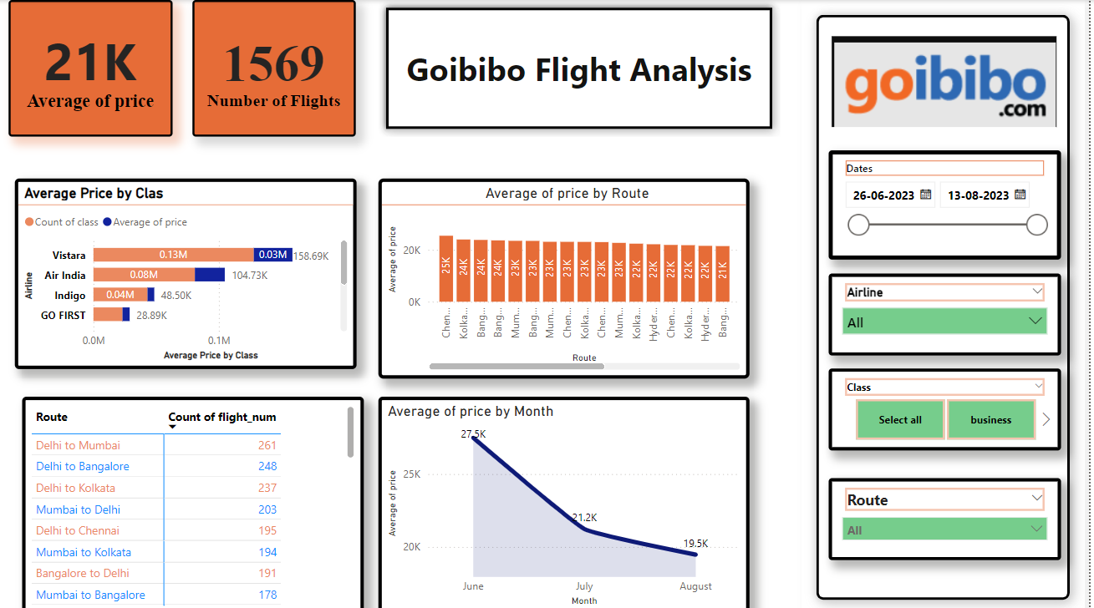

Slide 9
Conclusion
The busiest routes are Delhi to Mumbai and Delhi to Bangalore.
Go First is the most economical option for price-sensitive customers.
Prices tend to peak in June, indicating seasonal demand trends.

