Slide 1


Slide 2
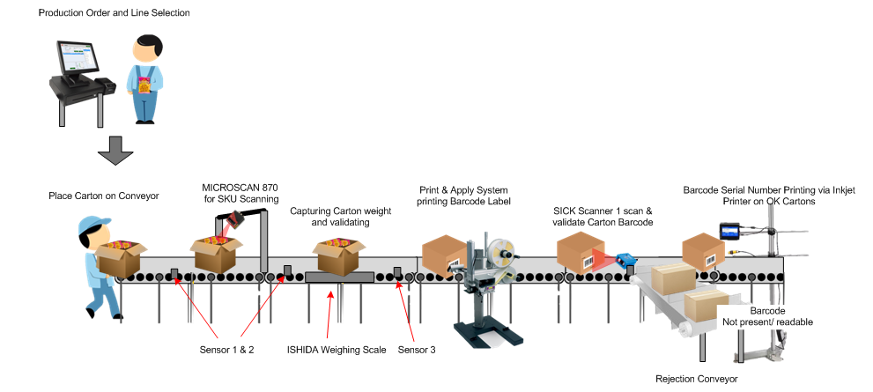

Slide 3

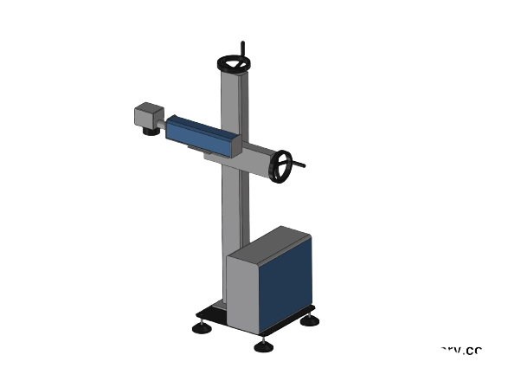
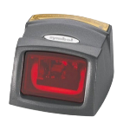



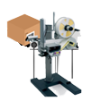
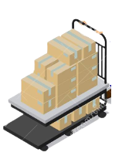



Mono packing Box Machine
Laser Marking
Machine
FMS Scanner
Label Pasting machine on mono boxes
Worker keeping
Item on Conveyor
Mono box that passed and labelled
Scanner to validate Mono box Barcode
User carrying mono boxes in trolley
Non –barcoded items
Non –labelled items

Slide 4





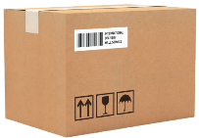


Mono boxes are packed in Carton box
Capturing and validating weight of Carton box
Shipper label Pasting machine on Carton boxes
Carton ready for QC testing and for dispatch
Carton boxes with
shipper address
Rejected boxes,
Carton weight less than tolerance
*Item manually rechecked and repacked

Slide 5
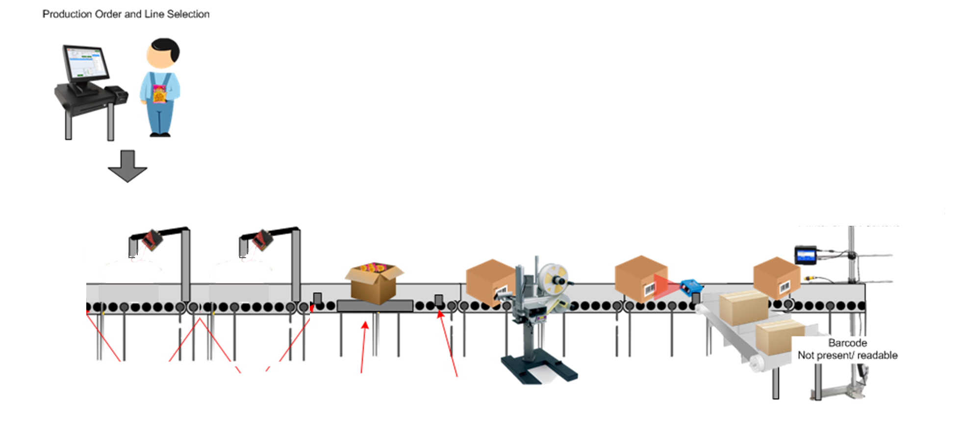
Serial Barcode Generation PC module
Worker carrying Item in trolley to the Conveyor Line

Slide 6
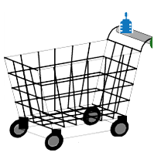


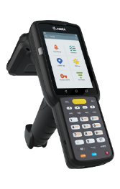
Laser Marking
Machine for QR Code Marking
Packed in Mono box
FMS Scanner
Conveyor Assembly Line
Worker keeping
Item from trolley on the Conveyor Line
User carrying mono boxes in bins
*Map the Line and Bin barcode Label into the system.
Non –barcoded items
*If the Scanner/Conveyor is not working, use the HHT device for manually scanning and printing shipper labels. Schedule these tasks for the end of the day.

Slide 7
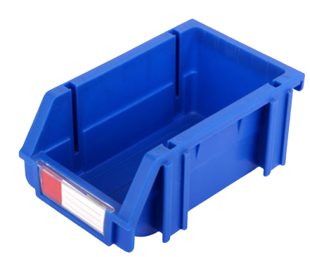
Laser Marking
Machine for QR Code Marking
FMS Scanner
Packed in Mono boxes
Conveyor Assembly Line
Worker keeping
Item from trolley on the Conveyor Line
User carrying mono boxes in bins
*Map the Line and Bin barcode Label into the system.
Non –barcoded items
*If the Scanner/Conveyor is not working, use the HHT device for manually scanning and printing shipper labels. Schedule these tasks for the end of the day.

Slide 8
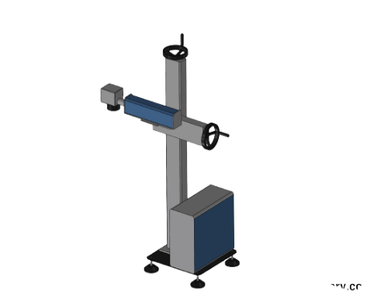





Laser Marking
Machine for QR Code Marking
FMS Scanner
Capturing Weight of Carton box
Print and Apply Shipper Label
Carton ready for QC testing
Packed in Mono boxes
Mono boxes kept in Bin
Mono boxes kept in Carton
*All human interactions process to be completed before laser marking process.
Rejected boxes,
Carton weight less than
tolerance
*Item manually rechecked
and repacked
*Map the Line and Bin barcode Label into the system.
Non –barcoded items
*If the Scanner/Conveyor is not working, use the HHT device for manually scanning and printing shipper labels. Schedule these tasks for the end of the day.
PC application will display Packing Order details and Quantity Count

Slide 10
Mono boxes are carried in bins
Mono boxes are packed in Carton box
Carton boxes are carried in bins

Slide 11
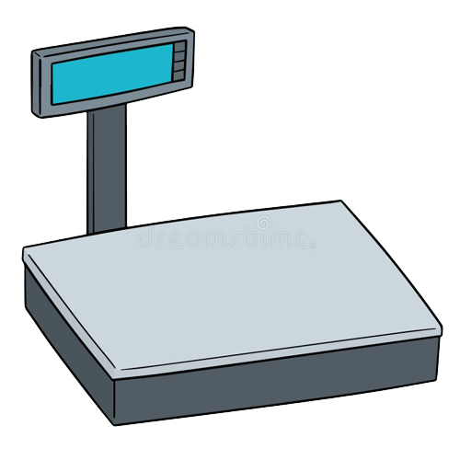
Carton boxes are carried in bins
Capturing and validating weight of Carton box
Rejected boxes,
Carton weight less than
tolerance
*Item manually rechecked
and repacked

Slide 12

Shipper label Pasted on Carton boxes in bins
Carton ready for QC testing and for dispatch
Carton boxes with
shipper address
Shipper Label will be generated in system after counter reaches pack size order Quantity in conveyor process

Slide 13
Mono boxes are packed in Carton box
Capturing and validating weight of Carton box
Shipper label Pasting machine on Carton boxes
Carton ready for QC testing and for dispatch
Carton boxes with
shipper address
Rejected boxes,
Carton weight less than tolerance
*Item manually rechecked and repacked

Slide 14
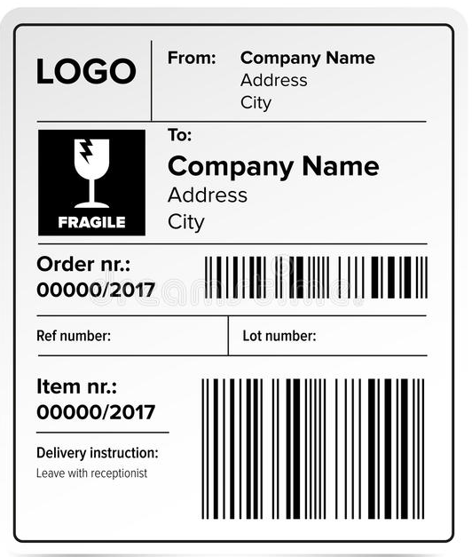

Slide 15
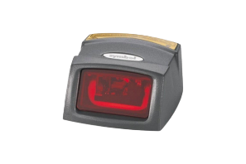


Slide 18
Authorized User
starting the Production line
Worker carrying Item in trolley
Worker going to the Conveyor Line

