Slide 1
Java part one

Slide 2
agenda
Class (and Object)
Method
Fields\Variables (talk about possible types, static, final)
Access modifiers
Arrays
Collections
Enumerators

Slide 3
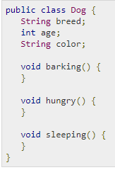
Class
A class is a blueprint from which individual objects are created.

Slide 4
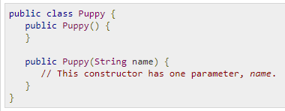
Constructors
When discussing about classes, one of the most important sub topic would be constructors. Every class has a constructor. If we do not explicitly write a constructor for a class, the Java compiler builds a default constructor for that class.
Each time a new object is created, at least one constructor will be invoked.
The main rule of constructors is that they should have the same name as the class.
A class can have more than one constructor.

Slide 5
Object
Objects have states and behaviors.
In Java, the new keyword is used to create new objects.
There are three steps when creating an object from a class:
Declaration − A variable declaration with a variable name with an object type.
Instantiation − The 'new' keyword is used to create the object.
Initialization − The 'new' keyword is followed by a call to a constructor. This call initializes the new object.

Slide 6
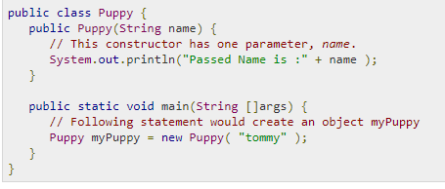
object

Slide 7

Method
A method is basically a behavior. A class can contain many methods. It is in methods where the logics are written, data is manipulated and all the actions are executed.
Methods could be void or non-void, static and non-static

Slide 8
Method
Static method means that method could be called without creating a class instance. Non-static method are depending on Object instances.
“Return” statement returns value from a method. Non void methods MUST have return value.
If method is “void”, return statement just breaks method execution
There will be NO code executed after return statement

Slide 9
Variable
Local variables − Variables defined inside methods, constructors or blocks are called local variables. The variable will be declared and initialized within the method and the variable will be destroyed when the method has completed.
Instance variables − Instance variables are variables within a class but outside any method. These variables are initialized when the class is instantiated. Instance variables can be accessed from inside any method, constructor or blocks of that particular class.
Class variables − Class variables are variables declared within a class, outside any method, with the static keyword.

Slide 10
datatypes
Primitive Data Types:
Byte
Short
Int
Long
Float
Double
Boolean
Char
Reference Datatypes:
Class objects and various type of array variables come under reference datatype.
Default value of any reference variable is null.
A reference variable can be used to refer any object of the declared type or any compatible type.
Example: Animal animal = new Animal("giraffe");

Slide 11
Local variable
Local variables are declared in methods, constructors, or blocks.
Local variables are created when the method, constructor or block is entered and the variable will be destroyed once it exits the method, constructor, or block.
Access modifiers cannot be used for local variables.
Local variables are visible only within the declared method, constructor, or block.
There is no default value for local variables, so local variables should be declared and an initial value should be assigned before the first use.

Slide 12
Instance Variables
Instance variables are declared in a class, but outside a method, constructor or any block.
Instance variables are created when an object is created with the use of the keyword 'new' and destroyed when the object is destroyed.
Instance variables hold values that must be referenced by more than one method, constructor or block.
Access modifiers can be given for instance variables.
The instance variables are visible for all methods, constructors and block in the
Instance variables have default values. For numbers, the default value is 0, for Booleans it is false, and for object references it is null. Values can be assigned during the declaration or within the constructor.
Instance variables can be accessed directly by calling the variable name inside the class.

Slide 13
Class/Static Variables
Class variables also known as static variables are declared with the static keyword in a class..
There would only be one copy of each class variable per class, regardless of how many objects are created from it.
Static variables are rarely used other than being declared as constants. Constants are variables that are declared as public/private, final, and static. Constant variables never change from their initial value.
Static variables are created when the program starts and destroyed when the program stops.
Visibility is similar to instance variables. Default values also.
Static variables can be accessed by calling with the class name ClassName.VariableName.
When declaring class variables as public static final, then variable names (constants) are all in upper case.

Slide 14
Access modifiers
Visible to the package, the default. No modifiers are needed.
Visible to the class only (private).
Visible to the world (public).
Visible to the package and all subclasses (protected).

Slide 15
Arrays
Java provides a data structure, the array, which stores a fixed-size sequential collection of elements of the same type. An array is used to store a collection of data, but it is often more useful to think of an array as a collection of variables of the same type.
Instead of declaring individual variables, such as number0, number1, ..., and number99, you declare one array variable such as numbers and use numbers[0], numbers[1], and ..., numbers[99] to represent individual variables.

Slide 16


arrays
To use an array in a program, you must declare a variable to reference the array, and you must specify the type of array the variable can reference.
Alternatively you can create arrays as follows:
To access element of an array:

Slide 17
Collections
The collections framework was mainly designed:
The framework had to be high-performance. The implementations for the fundamental collections (dynamic arrays, linked lists, trees, and hashtables) were to be highly efficient.
Java provides a set of standard collection classes that implement Collection interfaces.
Java provides a set of standard collection classes:
The most common are
Map<String, String> map = new HashMap();
Set<String> set = new HashSet();
List<String> list = new ArrayList();

Slide 18

Enumerators
An enum type is a special data type that enables for a variable to be a set of predefined constants. The variable must be equal to one of the values that have been predefined for it. Common examples include compass directions (values of NORTH, SOUTH, EAST, and WEST) and the days of the week.

Slide 19
Break

