Slide 1
Java part two

Slide 2
agenda
Operators
Expressions, Statements, and Blocks
If-else
Switch case
For, For-each, While, Do-while
lambda

Slide 3
Operators
Java provides a rich set of operators to manipulate variables. We can divide all the Java operators into the following groups −
Arithmetic Operators
Relational Operators
Bitwise Operators
Logical Operators
Assignment Operators
Misc Operators

Slide 4
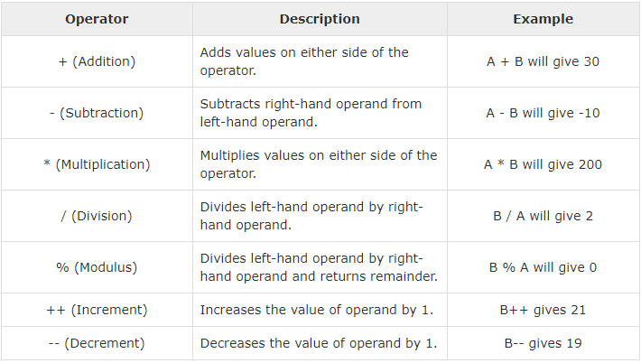
The Arithmetic Operators
variable A holds 10
variable B holds 20

Slide 5
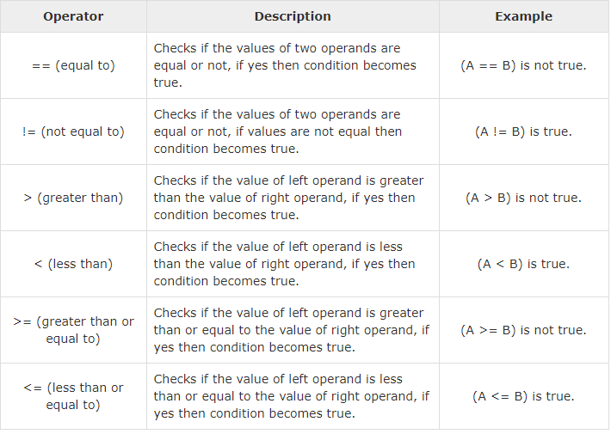
The Relational Operators

Slide 6
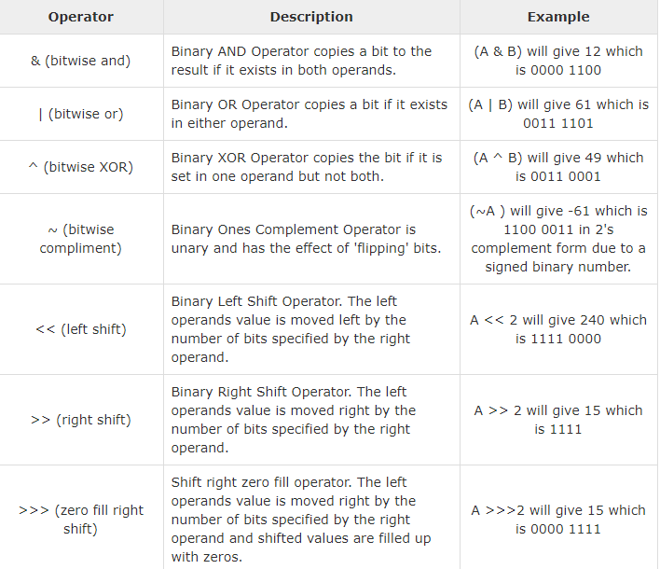
The Bitwise Operators
a = 0011 1100
b = 0000 1101
-----------------
a&b = 0000 1100
a|b = 0011 1101
a^b = 0011 0001
~a = 1100 0011

Slide 7
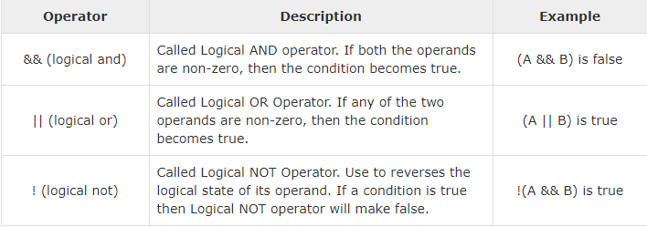
The Logical Operators
A = true
B = false

Slide 8
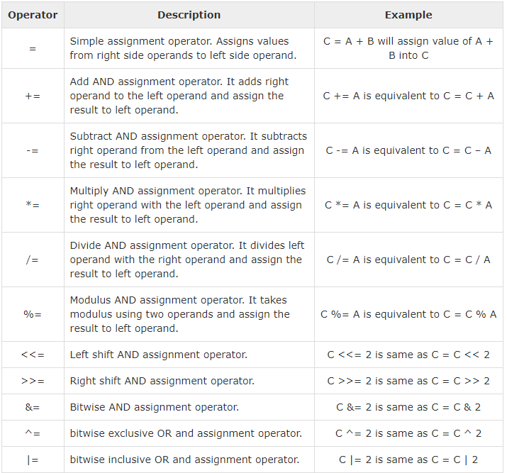
The Assignment Operators

Slide 9
Miscellaneous Operators
Conditional Operator ( ? : )
instanceof Operator

Slide 10
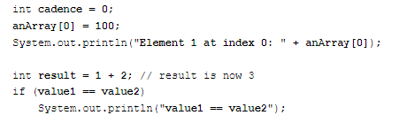
Expressions
An expression is a construct made up of variables, operators, and method invocations, which are constructed according to the syntax of the language, that evaluates to a single value.

Slide 11
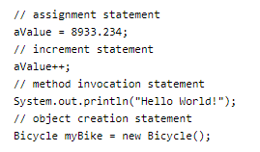
Statements
Statements are roughly equivalent to sentences in natural languages. A statement forms a complete unit of execution. The following types of expressions can be made into a statement by terminating the expression with a semicolon ;.

Slide 12
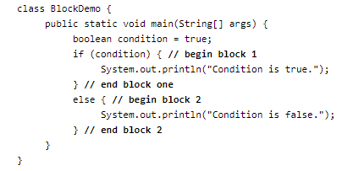
Blocks
A block is a group of zero or more statements between balanced braces and can be used anywhere a single statement is allowed.

Slide 13
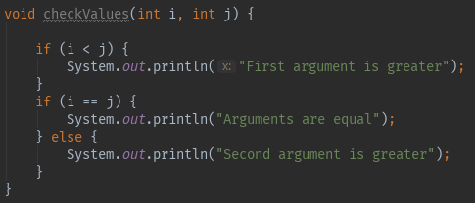
If-else

Slide 14
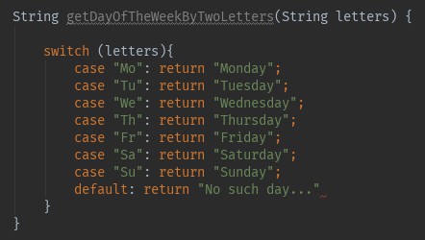
Switch case

Slide 15
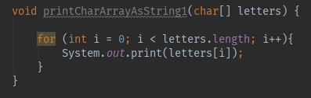
For

Slide 16
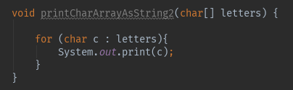
For-each

Slide 17
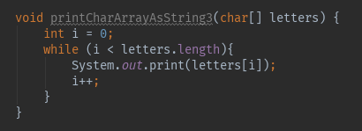
While

Slide 18
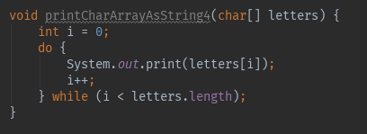
Do-while

Slide 19
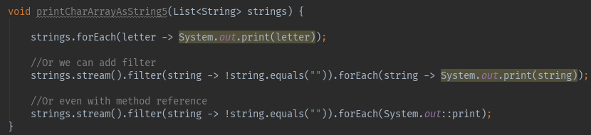
lambda

Slide 20
break

