Slide 1
Java part three

Slide 2
agenda
Strings
Exceptions
Try-catch
This keyword
How to run Java files

Slide 3
strings
Strings, which are widely used in Java programming, are a sequence of characters. In Java programming language, strings are treated as objects.
The Java platform provides the String class to create and manipulate strings.

Slide 4

Strings
Methods used to obtain information about an object are known as accessor methods. One accessor method that you can use with strings is the length() method, which returns the number of characters contained in the string object.

Slide 5

Strings
The String class includes a method for concatenating two strings
Strings are more commonly concatenated with the + operator
Result:

Slide 6

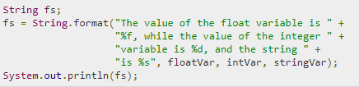
Strings
You have printf() and format() methods to print output with formatted numbers.
Using String's static format() method allows you to create a formatted string that you can reuse, as opposed to a one-time print statement.

Slide 7
strings
char charAt(int index) Returns the character at the specified index.
boolean endsWith(String suffix) Tests if this string ends with the specified suffix.
boolean equals(Object anObject) Compares this string to the specified object.
boolean equalsIgnoreCase(String anotherString) Compares this String to another String, ignoring case considerations.
int indexOf(int ch) Returns the index within this string of the first occurrence of the specified character.
int length() Returns the length of this string.
String replace(char oldChar, char newChar) Returns a new string resulting from replacing all occurrences of oldChar in this string with newChar.

Slide 8
Strings
Notation | Character represented
\n | Newline (0x0a)
\b | Backspace (0x08)
\s | Space (0x20)
\t | tab
\" | Double quote
\' | Single quote
\\ | backslash
\uxxxx | Hexadecimal UNICODE character (xxxx)
Strings in Java has special combination of characters, which won’t be displayed as it is. Instead they transforms to

Slide 9

exceptions
An exception (or exceptional event) is a problem that arises during the execution of a program. When an Exception occurs the normal flow of the program is disrupted and the program/Application terminates abnormally, which is not recommended, therefore, these exceptions are to be handled.
Checked exceptions − A checked exception is an exception that occurs at the compile time, these are also called as compile time exceptions. These exceptions cannot simply be ignored at the time of compilation, the programmer should take care of (handle) these exceptions.

Slide 10

exceptions
Errors − These are not exceptions at all, but problems that arise beyond the control of the user or the programmer. Errors are typically ignored in your code because you can rarely do anything about an error. For example, if a stack overflow occurs, an error will arise. They are also ignored at the time of compilation.

Slide 11
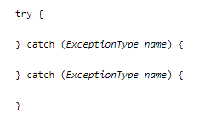
Try\catch
You associate exception handlers with a try block by providing one or more catch blocks directly after the try block. No code can be between the end of the try block and the beginning of the first catch block.

Slide 12

This keyword
Within an instance method or a constructor, this is a reference to the current object — the object whose method or constructor is being called. You can refer to any member of the current object from within an instance method or a constructor by using this.

Slide 13
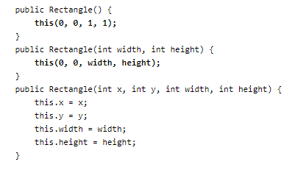
This keyword
From within a constructor, you can also use the this keyword to call another constructor in the same class.

Slide 14
How to run java app
Java application is .jar file.
You can create .jar file from the project using “Build” tab in IDE
To run .jar you have to install Java.
To Run:
Double click on your .jar file (the most primitive way)
But, if you need to pass some arguments and see the output from for Java program, use Command Line, typing here java -jar TheJavaFile.jar

Slide 15
break

