Slide 1
networking

Slide 2
agenda
HTTP and HTTPS
URL and it’s features
HTML
XML

Slide 3
What is http
HTTP (Hypertext Transfer Protocol) is the set of rules for transferring files (text, graphic images, sound, video, and other multimedia files) on the World Wide Web. As soon as a Web user opens their Web browser, the user is indirectly making use of HTTP. HTTP is an application protocol that runs on top of the TCP/IP suite of protocols (the foundation protocols for the Internet).

Slide 4
HTTp vs https
For example, we are going on https://Accenture.com instead of http:// What does it mean?
Instead of HyperText Transfer Protocol (HTTP), this website uses HyperText Transfer Protocol Secure (HTTPS).
Using HTTPS, the computers agree on a "code" between them, and then they scramble the messages using that "code" so that no one in between can read them. This keeps your information safe from hackers.
They use the "code" on a Secure Sockets Layer (SSL), sometimes called Transport Layer Security (TLS) to send the information back and forth.

Slide 5
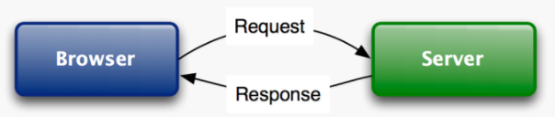
How http works
There are several types of HTTP Requests
For example, when you type a webpage URL in the browser and hit Enter, the browser makes an HTTP GET request
There are lots of HTTP response statuses. Example: if request has gone OK, then response will be with code 200.

Slide 6
URL
A URL (Uniform Resource Locator), as the name suggests, provides a way to locate a resource on the web, the hypertext system that operates over the internet. The URL contains the name of the protocol to be used to access the resource and a resource name. The first part of a URL identifies what protocol to use. The second part identifies the IP address or domain name where the resource is located.
Example: https:// <- protocol Accenture.com <- resource name

Slide 7
URL
URLs have more features than only protocol and name.
Every Url tries to find matching endpoint on Server side – if there’s none, You get response with code 400 – Not Found.
You can define port this way: somewebpage:8080/
You can define pathParams for request, which will be read as parameters. For example, we need to pass parameter with name “product” and value “apple”: somewebpage.com/somePath?product=apple
Applying more than 1 parameter: somewebpage.com/somePath?parameter1=value1&parameter2=value2

Slide 8
What is HTML
HTML is the standard markup language for creating Web pages.
HTML stands for Hyper Text Markup Language
HTML describes the structure of Web pages using markup
HTML elements are the building blocks of HTML pages
HTML elements are represented by tags
HTML tags label pieces of content such as "heading", "paragraph", "table", and so on
Browsers do not display the HTML tags, but use them to render the content of the page

Slide 9
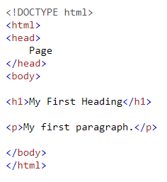
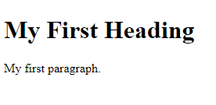
What is HTML
HTML page basic example:
As You can see, HTML consists of 3 usual tags:
<html> - declares html document
<head> - page’s tab name
<body> - page’s content

Slide 10
WHAT is XML
XML is a software- and hardware-independent tool for storing and transporting data.
XML stands for eXtensible Markup Language
XML is a markup language much like HTML
XML was designed to store and transport data
XML was designed to be self-descriptive

Slide 11
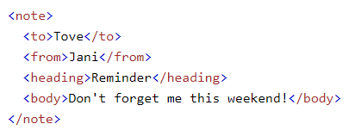
What is xml
XML example:
It has sender information.
It has receiver information
It has a heading
It has a message body.
XML is just information wrapped in tags.

Slide 12
That’s all for today

