Slide 1
Operating Systems

Slide 2
agenda
OS
Kernels
x86, x64 OS
Drivers
Command Line
Tasks (processes)
Batch commands
Batch files
Linux

Slide 3
What is OS
The operating system (OS) is the most important program that runs on a computer – software that manages computer hardware and software resources, provide common services for computer programs.
OS provide a software platform on top of which other programs, called application programs, can run.
Computer operating systems perform basic tasks, such as recognizing input from the keyboard, sending output to the display screen, keeping track of files and directories on the storage drives, and controlling peripheral devices, such as printers.

Slide 4
User Interaction With the OS
As a user, you normally interact with the operating system through a set of commands.
For example, the DOS operating system contains commands such as COPY and RENAME for copying files and changing the names of files, respectively.
The commands are accepted and executed by a part of the operating system called the command processor or command line interpreter.
Graphical user interfaces allow you to enter commands by pointing and clicking at objects that appear on the screen.

Slide 5
Kernels
The kernel is the core of an operating system. It is the software responsible for running programs and providing secure access to the machine's hardware.
Since there are many programs, and resources are limited, the kernel also decides when and how long a program should run. This is called scheduling. Accessing the hardware directly can be very complex, since there are many different hardware designs for the same type of component.

Slide 6
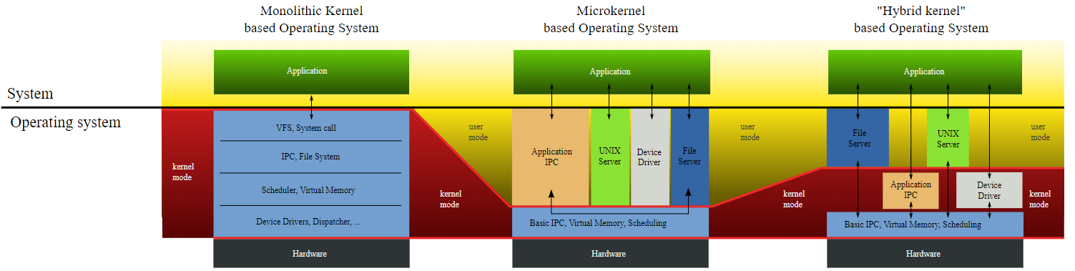
Kernels
Notes:
Windows uses Hybrid Kernel
Linux uses Monolithic Kernel
Monolithic kernel is a single large process running entirely in a single address space. It is a single static binary file. ...
In microkernels, the kernel is broken down into separate processes, known as servers. Some of the servers run in kernel space and some run in user-space.
https://www.youtube.com/watch?v=rg6ww5U-XJ8

Slide 7
X86 vs x64
Technically x86 simply refers to a family of processors and the instruction set they all use. It doesn't actually say anything specific about data sizes. The term x86 started out as a 16-bit instruction set for 16-bit processors (the 8086 and 8088 processors), then was extended to a 32-bit instruction set for 32-bit processors (80386 and 80486), and now has been extended to a 64-bit instruction set for 64-bit processors.

Slide 8
X86 vs x64
Put simply, 32-bit is shorthand for a 32-bit number. This number contains 32 bits (binary digits) which are either 0 or 1. And example could be 10101010101010101010101010101010.
A 32-bit processor is - by definition - capable of dealing with instructions and referencing memory locations of 32-bits.

Slide 9
Why can't 32-bit CPUs use lots of RAM?
Given that each digit in the number can be only 1 or 0, the total number of combinations is 2^32, which is 4,294,967,295. And 4.29 billion memory locations (each storing one byte of data) equate to 4GB, which is why a 32-bit processor can access a maximum of 4GB of memory without some workarounds in software to address more.
4GB isn't really enough these days. It might be fine for basic tasks, but if you want to run multiple programs, have 35 tabs open in various web browsers or open 30 high-resolution photos for editing at once, 4GB isn't going to cut it.

Slide 10
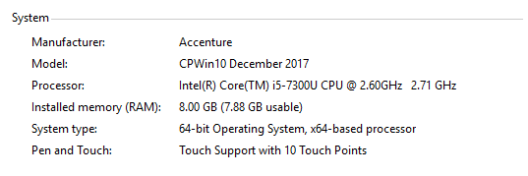

Check your os?
This PC -> Properties to get basic info:
Or You can open Command-Line and type: systeminfo
Try it!

Slide 11
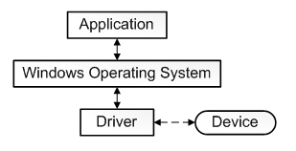
About drivers
It is challenging to give a single precise definition for the term driver. In the most fundamental sense, a driver is a software component that lets the operating system and a device communicate with each other.
For example, suppose an application needs to read some data from a device.
The application calls a function implemented by the OS
The OS calls a function implemented by the driver.
After the driver gets the data from the device
Driver returns the data to the OS
OS returns data to the application.
It looks like that:

Slide 12
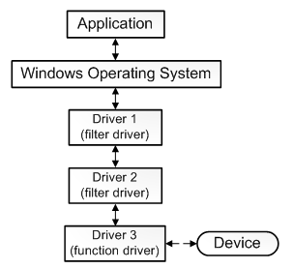
Some driver features
Not all drivers have to be written by the company that designed the device. In many cases, a device is designed according to a published hardware standard. This means that the driver can be written by Microsoft, and the device designer does not have to provide a driver.
Not all drivers communicate directly with a device: The one driver in the stack that communicates directly with the device is called the function driver; the drivers that perform further processing are called filter drivers.
Some filter drivers observes and record information about I/O requests but do not actively participate in them.
Notes:
auxili

Slide 13
what happens when you plug in a new USB device?
In Windows case:
When a USB device is plugged into the system, the USB bus driver is notified. The bus driver sends a standard USB request to the device. With this the device reports its name and type.
With this information, Windows creates an device entry in the system. This the Hardware-ID. The system now tries to find either a generic driver which can handle the device (HID/UVC) or a driver which specifically registered itself to support this Hardware-ID.
To register a driver as the handler for a specific device, you have to install the driver into the system, or you must supply Microsoft with one, which they can provide on their servers.

Slide 14
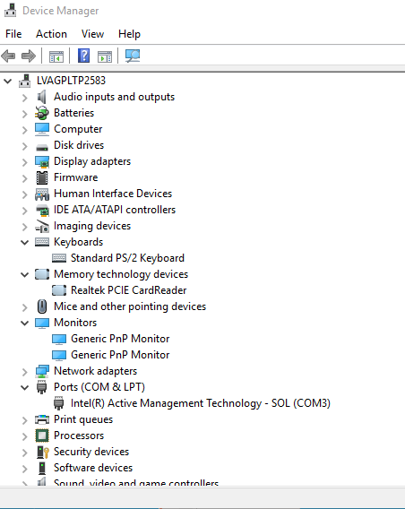
Device manager
Windows has beautiful tool to see, enable\disable devices connected to your PC. This tool calls Device Manager.
Try to go: Control Panel -> Device Manager
Devices are sorted by different types
There You can also Update drivers or look at the properties of certain device, right-clicking them

Slide 15

About Command-line
To run command line You can:
Win+S -> cmd
Win+R-> cmd
Basic syntax:
Current Directory Command Parameters

Slide 16
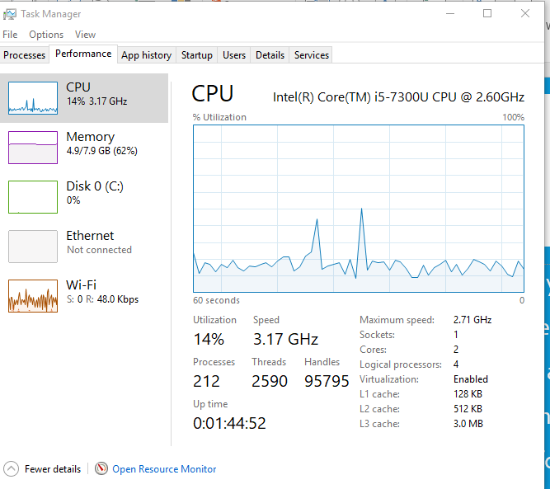
Tasks
In every OS there are many tasks running on background.
To look at them, check memory usage or just kill You can use Task Manager:
CTRL+ALT+DEL -> Task Manager
User Interface of Task Manager is just native – no need of explanation.
Also You can move to Performance tab to see how’s going PC.

Slide 17
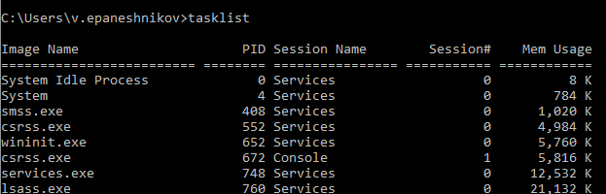
Tasks
Task manager is not the only way to deal with tasks. You can do it via Command Line. Win+R -> cmd
To display processes use tasklist command:
To kill the task find it’s PID And perform command: Taskkill /PID 26356 /F (If command’s PID = 26356)
Notes:
/F Specifies to forcefully terminate the process(es).

Slide 18
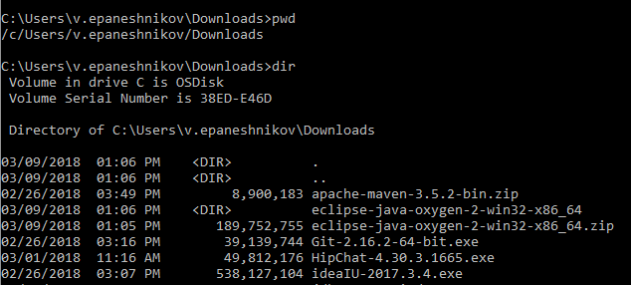
Working with directories via cmd
You can navigate through folders not only via UI, but also, with Command Line.
Open cmd and try it out!
To check where you are use pwd
To check what is inside current directory use dir
Notes:
Pwd can be not working for some

Slide 19
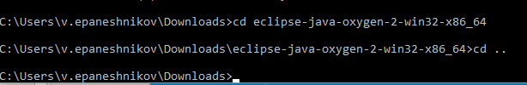

Working with directories via cmd
To move to the folder use cd <foldername>
To move backwards or folder-down use cd ..
You can use “complex paths” to navigate, dividing them with \ :

Slide 20
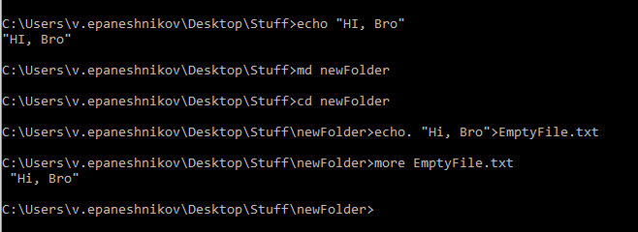
Some basic Batch commands
https://www.tutorialspoint.com/batch_script/batch_script_commands.htm

Slide 21
Scripting (Batch files)
Batch Script is incorporated to automate command sequences which are repetitive in nature. Scripting is a way by which one can alleviate this necessity by automating these command sequences in order to make one’s life at the shell easier and more productive. In most organizations, Batch Script is incorporated in some way or the other to automate stuff.
Typically, to create a batch file, notepad is used. This is the simplest tool for creation of batch files. Next is the execution environment for the batch scripts. On Windows systems, this is done via the command prompt or cmd.exe. All batch files are run in this environment.

Slide 22
Scripting (Batch files)
Simple batch file:
Greets Us
Creates new folder
Creates file inside new folder with Greeting text
Displays what’s inside the file

Slide 23
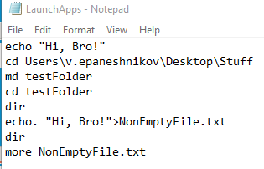
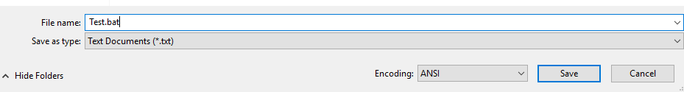
Scripting (Batch files)
1) Writing command via notepad
2) Save file as .bat file
Notes:
Bash (bash) is one of many available (yet the most commonly used) Unix shells. Bash stands for "Bourne Again SHell", and is a replacement/improvement of the original Bourne shell (sh).
Shell scripting is scripting in any shell, whereas Bash scripting is scripting specifically for Bash. In practice, however, "shell script" a

Slide 24
History of Unix
The UNIX operating system was born in the late 1960s. It originally began as a one man project led by Ken Thompson of Bell Labs, and has since grown to become the most widely used operating system. In the time since UNIX was first developed, it has gone through many different generations and even mutations. Some differ substantially from the original version, like Berkeley Software Distribution (BSD) or Linux. Others, still contain major portions that are based on the original source code.
Now UNIX is a trademark. Only systems fully compliant with and certified to the Single UNIX Specification qualify as “UNIX”. Very few operating systems are submitted for compliance with the SUS, although system developers generally aim for compliance with POSIX standards, which form the core of the SUS.
Notes:
The Portable Operating System Interface (POSIX)^{[1]} is a family of standards specified by the IEEE Computer Society for maintaining compatibility between operating systems. POSIX defines the application programming interface (API), along with command line shells and utility interfaces, for software compatibility with variants of Unix and other operating systems.^{[2][3]}

Slide 25
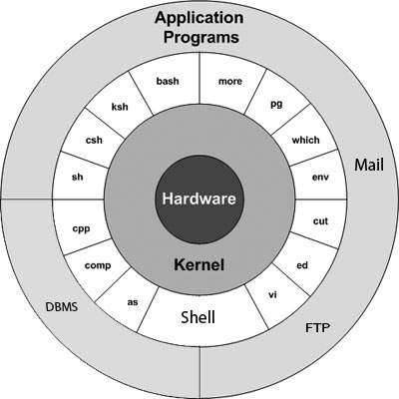
Unix architecture
Hardware – Devices
Kernel – Core of the Unix
Shell – user interface to access an OS services
Applications – a computer program designed to perform a
group of coordinated functions
Notes:
DBMS = database management system
FTP = file transfer protocol
In computing, a shell is a user interface for access to an operating system's services. In general, operating system shells use either a command-line interface (CLI) or graphical user interface (GUI), depending on a computer's role and particular operation. It is named a shell because it is the outermost layer around the operating system kernel.^{[1][2]}

Slide 26
Where unix is used
Unix is everywhere, mainly on servers HP-Unix, IBM-AIX, Linux
Android
macOS

Slide 27
Lesson log
For a now we are aware about:
OS
Kernel
Drivers
Windows Device Manager
CMD
Scripting and Batch files
Unix
Following topics for today – JDK, Git and Eclipse installation, Networking

Slide 28
la fine

