Slide 1
Programming

Slide 2
agenda
What is programming
Programming languages
What is Java

Slide 3
What is Programming
Computer programming - is a process that leads from an original formulation of a computing problem to an executable computer programs. Programming involves activities such as analysis, generating algorithms, verification of requirements and implementation - coding of algorithms in a target programming language.
Source code - is any collection of computer instructions, possibly with comments, written using a human-readable programming language, usually as plain text.

Slide 4
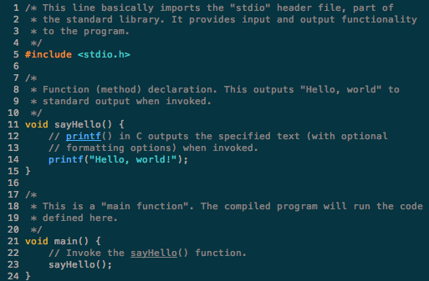
Programming languages
Programming language - is a formal language that specifies a set of instructions that can be used to produce various kinds of output. Programming languages generally consist of instructions for a computer.

Slide 5
Programming languages
Assembly
C/C++
Java, .NET
Python, Perl, PHP
JavaScript

Slide 6

What is Java
Java - is an island of Indonesia. At about 139,000 square kilometers, the island is comparable in size to England. Java was the first place where Indonesian coffee was grown.

Slide 7
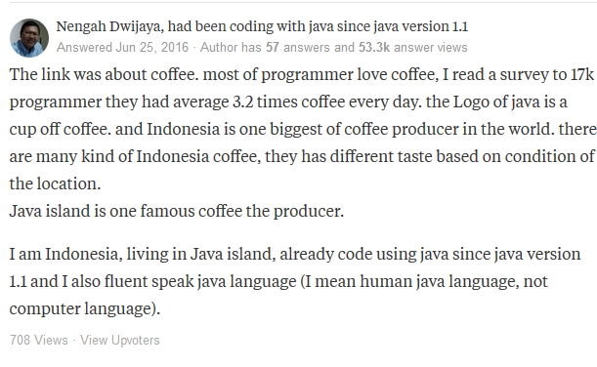
What is java

Slide 8

What is java
Java - is a general-purpose computer-programming language that is concurrent, class-based, object-oriented, and specifically designed to have as few implementation dependencies as possible. It is intended to let application developers "write once, run anywhere" (WORA) - that compiled Java code can run on all platforms that support Java without the need for recompilation.
Java applications are typically compiled to bytecode that can run on any Java virtual machine (JVM).
Java was originally developed by James Gosling at Sun Microsystems (which has since been acquired by Oracle Corporation).

Slide 9
Lesson log
For a now we know about:
Programming
Programming languages
Java programming language

Slide 10
end

