Slide 1
Predicting the Survival of Titanic Passengers
By- Om(4351468) and Prateek(4354555)

Slide 2
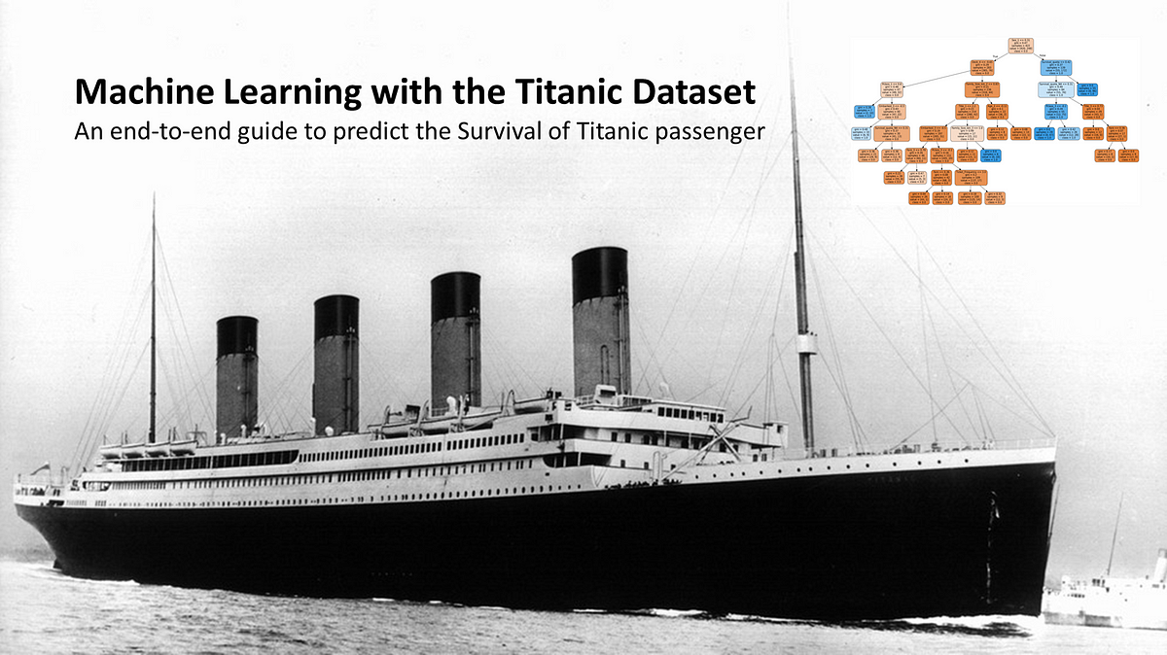
The goal of this project is to create a model that can predict the survival of passengers on the Titanic based on various passenger features. The dataset is divided into a training set and a test set. The training set is used to build and validate the machine learning model, while the test set is used to evaluate its performance on unseen data.
Introduction

Slide 3

Features in the Titanic Survival Dataset
survival (the target variable): Indicates whether the passenger survived or not.
pclass: Ticket class, a proxy for socio-economic status.
sex: Gender of the passenger.
Age: Age in years of the passenger.
sibsp: Number of siblings/spouses aboard the Titanic.
parch: Number of parents/children aboard the Titanic.
ticket: Ticket number.
fare: Passenger fare.
cabin: Cabin number.
embarked: Port of Embarkation.

Slide 4

Understanding Key Features
pclass (Ticket Class): This variable represents the socio-economic status of passengers. 1st class passengers are in the upper class, 2nd class are in the middle class, and 3rd class are in the lower class.
Age: Represents the age of the passenger. Fractions are used if age is less than 1, and an estimated age is denoted in the form of xx.5.
sibsp & parch: These variables indicate the number of family members the passenger had on board. sibsp counts the number of siblings and spouses, while parch counts the number of parents and children.

Slide 5

Preparing the Data for Model Training
Handling missing values: Strategies for dealing with missing values in columns like 'Age', 'Cabin' and 'Embarked'.
Feature Engineering: Creating new variables, such as 'FamilySize' (combining sibsp and parch), 'IsAlone' (whether the passenger is travelling alone), etc.
Encoding Categorical Variables: Converting categorical variables like 'Sex', 'Embarked', 'Pclass' into numeric form for machine learning models.
Scaling Numeric Variables: Normalize or standardize variables like 'Age' and 'Fare' for optimal model performance.

Slide 6

Model Development and Evaluation
Model Selection: Discussion on the choice of machine learning model (like Logistic Regression, Random Forest, etc.).
Model Training: Training the chosen model on the training dataset.
Model Evaluation: Evaluating the model's performance on the test set, measuring accuracy and precision.

Slide 7
Thank You!

