Slide 1

Charging Ahead Without Overloading the Grid
VOLTGRID | EV GRID INTEGRATION STUDY
How smart charging and V2G protect a 2.5 MVA substation at 70% EV adoption
-45%
74x to 0.19x
-25%
peak load vs. uncontrolled charging
transformer aging rate
daily CO₂ with solar + V2G
Notes:
Open with the headline: EV adoption is a transformer problem before it is an energy problem. This study simulates a 2.5 MVA urban-suburban substation (12.47 kV, 13-bus feeder) at 70% EV penetration, using cleaned charging-session data and an IEEE C57.91 thermal model. The three numbers at the bottom are the punchline of the whole deck: smart charging cuts the evening peak by 45%, drops transformer aging from 74x normal to 0.19x, and adding solar plus V2G trims daily carbon emissions by about 25%.

Slide 2




Testing four ways to charge one feeder
3,447
13-bus
2.375 MW
70%
cleaned charging sessions (from 3,500 raw)
12.47 kV radial distribution feeder
transformer limit (2.5 MVA at 0.95 pf)
EV penetration on the feeder
Four charging strategies compared
Uncontrolled
Static TOU tariff
Smart valley filling
Solar + V2G microgrid
Charge at full power the moment a car plugs in
Fixed timers delay charging to cheap night hours
Coordinated schedule fills the load valleys
Valley filling plus 800 kW solar, battery and V2G
Notes:
Setup: 3,500 raw telemetry records were cleaned to 3,447 valid sessions (timestamp inversions removed, missing state-of-charge imputed by user cluster, spikes above 350 kW clamped). The feeder is a 13-bus radial network on a 2.5 MVA transformer, which at 0.95 power factor gives a 2.375 MW limit. We compare four strategies: A uncontrolled, B fixed time-of-use timers, C coordinated smart valley filling that uses each car's dwell-time flexibility, and D the same plus 800 kW of solar, a 400 kW / 1.2 MWh battery and V2G.

Slide 3
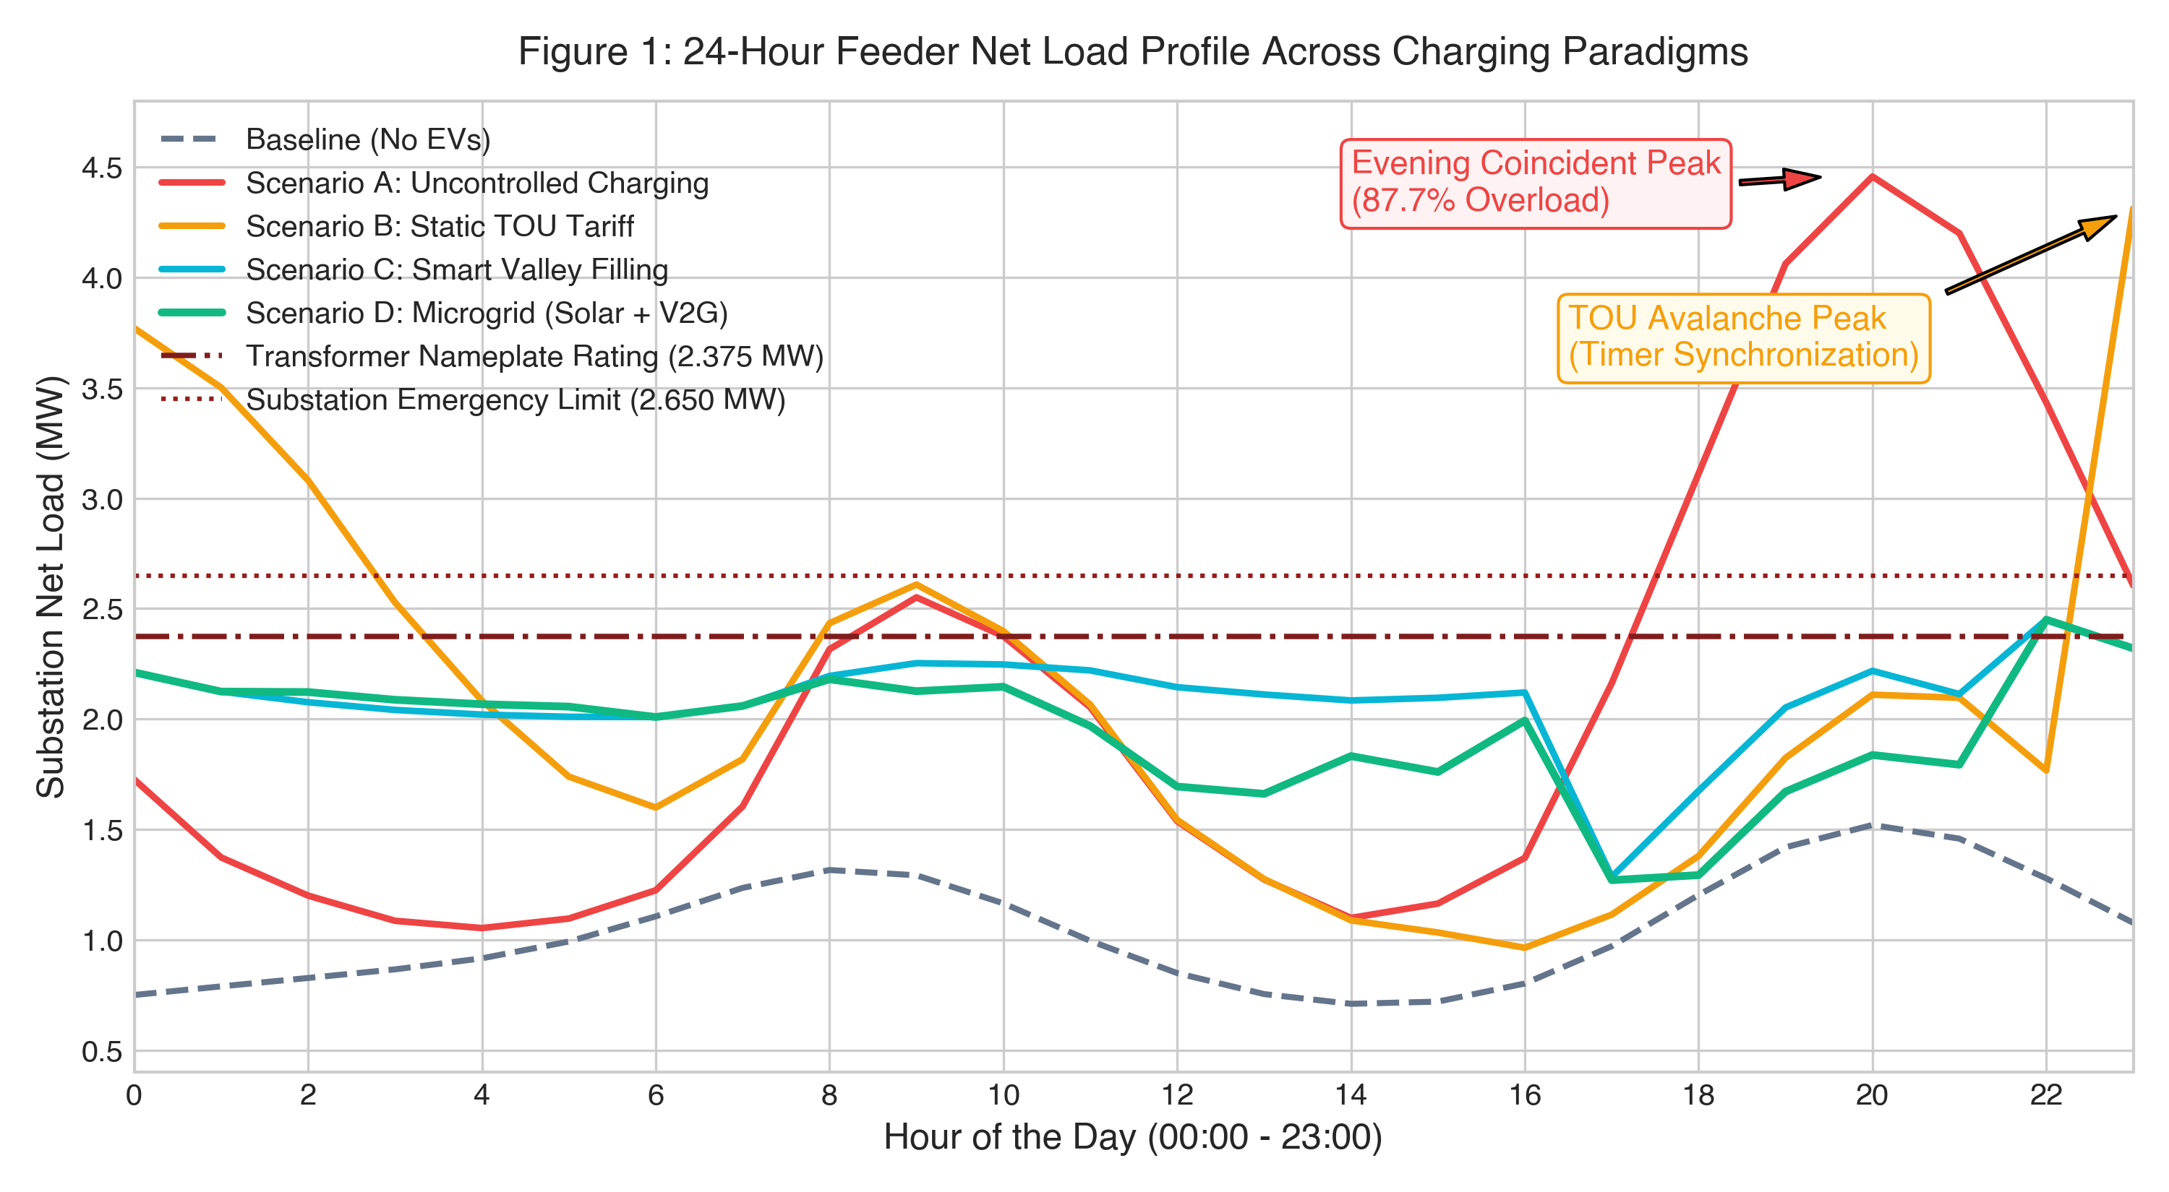
Timers just move the peak
4.46 MW
Uncontrolled: peak at 20:00, 87.7% over the rating
4.31 MW
TOU: timers synchronise and create a new peak at 23:00
2.45 MW
Smart charging: load flattened to just above nameplate
24-hour feeder net load by charging strategy, 70% EV penetration
Notes:
Uncontrolled charging stacks on top of the evening residential peak: 4.46 MW against a 2.375 MW rating, 87.7% overload. The common fix, static time-of-use pricing, backfires: every timer fires at the same moment, creating a 4.31 MW avalanche peak at 23:00 and a high load overnight. Coordinated valley filling uses the fact that most cars sit plugged in far longer than they need to charge, and keeps the feeder at about 2.45 MW, inside the 2.65 MW emergency limit.

Slide 4
Smart charging protects the transformer
74x to 0.19x
insulation aging rate vs. normal (uncontrolled to smart)
-45%
peak load vs. uncontrolled (4.46 to 2.45 MW)
2.13 to 1.17
peak-to-average load ratio
Dashed line: IEEE C57.91 continuous hot-spot limit (110 °C)
Notes:
Thermal modelling follows IEEE C57.91. Uncontrolled charging drives the winding hot spot to 189 C and static TOU to 176 C, far above the 110 C continuous limit. That means insulation ages 74x faster than normal, costing almost 1% of transformer life in a single day. Smart valley filling holds the hot spot at 102 C, under the limit, with an aging factor of 0.19. The lowest hot spot, 97 C, comes from the solar + V2G microgrid. Minimum feeder voltage also improves, from 0.951 pu to 0.973 pu.

Slide 5
Solar and V2G make it sustainable
-24.6%
-29.6%
97 °C
daily CO₂ vs. uncontrolled (14.9 to 11.2 t)
feeder losses (0.85 to 0.60 MWh/day)
peak hot-spot, lowest of all scenarios
Recommendations
1
Replace fixed TOU timers with coordinated, flexibility-aware charging
2
Pair workplace and public chargers with solar PV and battery storage
3
Enable V2G hardware on fleets to shave the evening peak
Residual peak of 2.45 MW is 3.2% above the 2.375 MW nameplate but within the 2.65 MW emergency limit. Source: VoltGrid simulation, 70% EV penetration.
Notes:
Close on the combined microgrid: 800 kW of solar, a 400 kW / 1.2 MWh battery and V2G fleet injection cut daily emissions by about 25% and feeder losses by about 30% versus uncontrolled charging, while running the transformer coolest. Three actions follow: move from fixed timers to coordinated charging, co-locate chargers with solar and storage, and enable V2G on fleets. Be upfront about two caveats: the residual peak is still about 3% over nameplate (under the emergency limit), and plain valley filling emits slightly more CO2 than TOU (12.2 t vs 11.8 t) because it shifts some load into higher-carbon hours, which is why the solar and V2G layer matters.

