Slide 1

Seasonal Agriculture Performance Analysis
Omkar Ashirvad Sawant
Finolex Academy of Management & Technology
AICTE STU ID : STU68f8552feaaca1761105199

Slide 2

PROBLEM STATEMENT
Agricultural activities are influenced by seasonal variations in environmental conditions, farming practices, resource availability and market conditions. As a result, agricultural performance may differ from one season to another. However, raw agricultural data does not clearly explain how agricultural performance changes across seasons or what patterns can be observed in different seasonal conditions. The problem is to analyze the given agricultural dataset and investigate seasonal differences in agricultural performance by identifying meaningful patterns, trends, relationships and variations within the available data.

Slide 3
Project Description
Dataset: 4,000 farm-level records covering 8 states, 10 districts, 8 crops and 3 seasons.
Workflow: data understanding → quality checks → cleaning → exploratory analysis → seasonal comparison → environmental/resource analysis → crop/state/irrigation cuts → statistical testing.
Key measures: yield, production, cost, revenue, profit, profit margin, water use, water efficiency and disease/pest risk.
Statistical methods: Pearson/Spearman correlation, one-way ANOVA, Bonferroni-corrected Welch tests and crop-controlled two-way ANOVA with interaction.
Goal: convert raw agricultural records into evidence-based seasonal planning recommendations.

Slide 4

WHO ARE THE END USERS?
Farmers and farm managers — seasonal crop and irrigation planning.
Agricultural advisors / extension teams — identify high-risk seasons and targeted interventions.
Agribusiness and procurement teams — understand crop, region and season profitability.
Water-resource planners — compare water use and water efficiency across seasons and irrigation methods.
Researchers and policymakers — use evidence on seasonal, regional and crop-level variation for planning.

Slide 5

Technology Used
Python — primary analysis language.
Jupyter Notebook — end-to-end project documentation and reproducible analysis.
Pandas & NumPy — data loading, cleaning, transformation and aggregation.
Matplotlib & Seaborn — statistical and analytical visualizations.
SciPy — correlation and statistical testing.
Statsmodels — ANOVA and linear-model based analysis.
GitHub — project/version-control repository

Slide 6
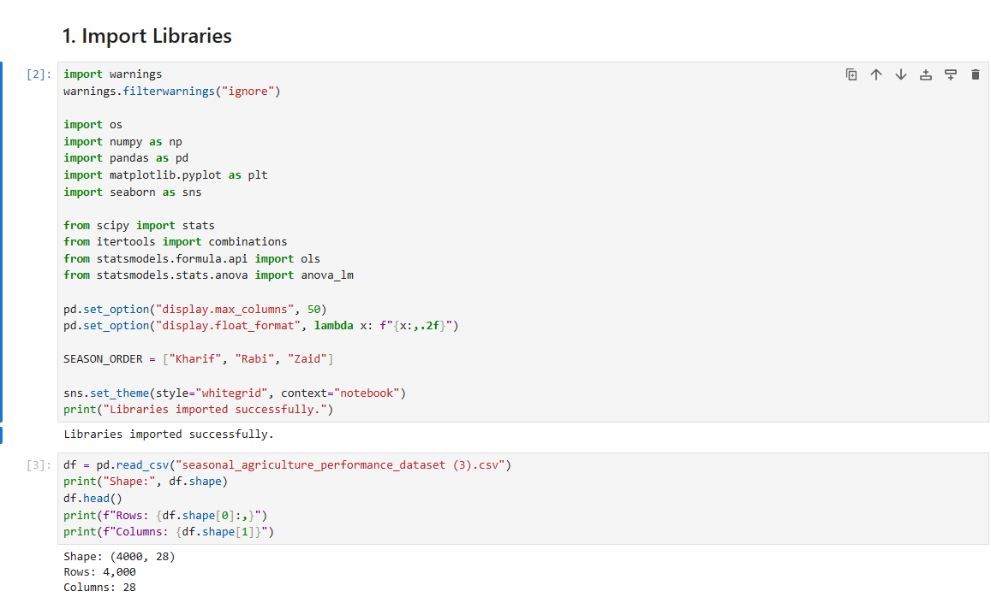
RESULTS

Slide 7
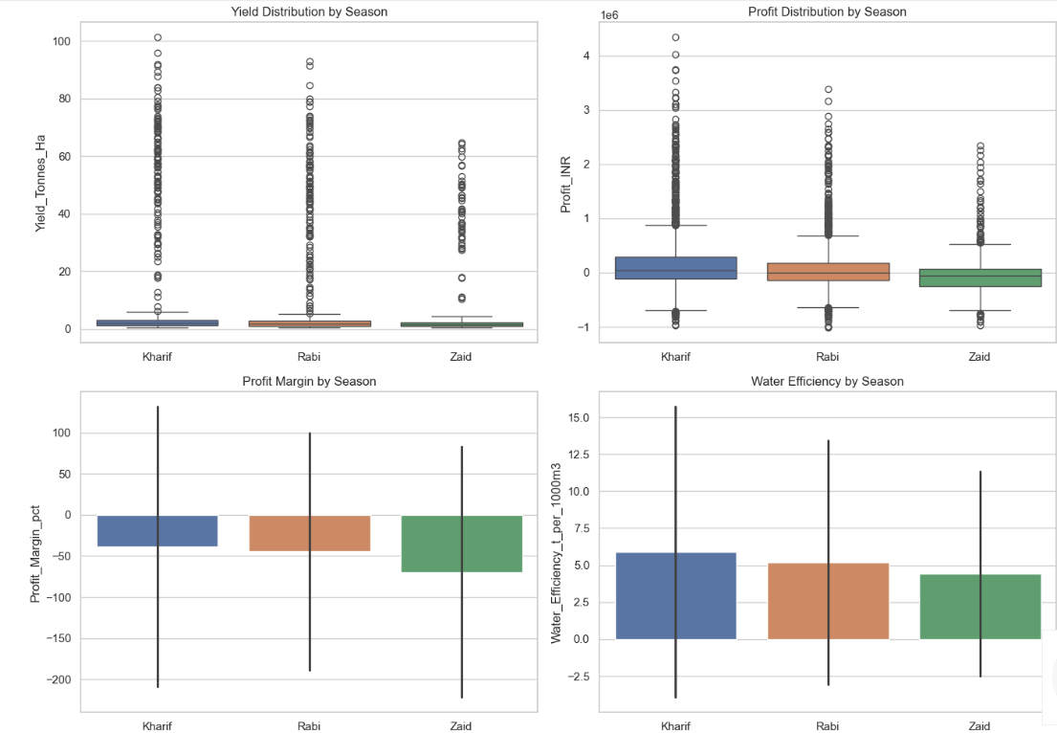
RESULTS

Slide 8
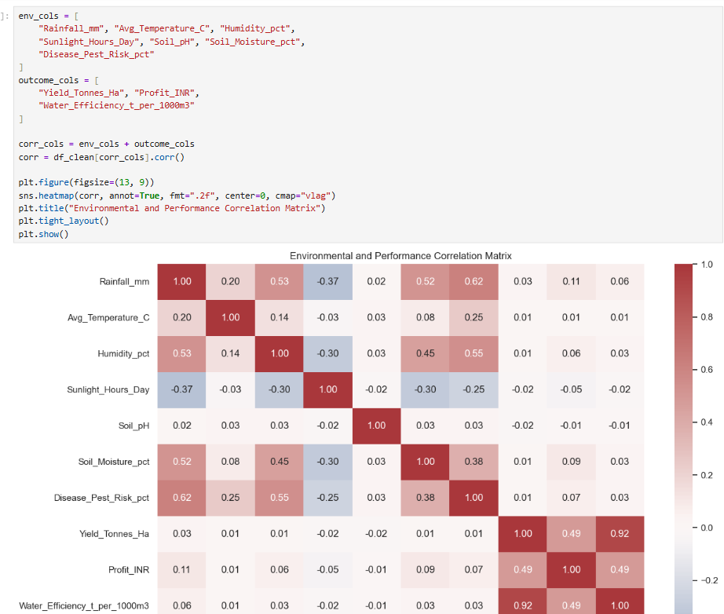
RESULTS

Slide 9
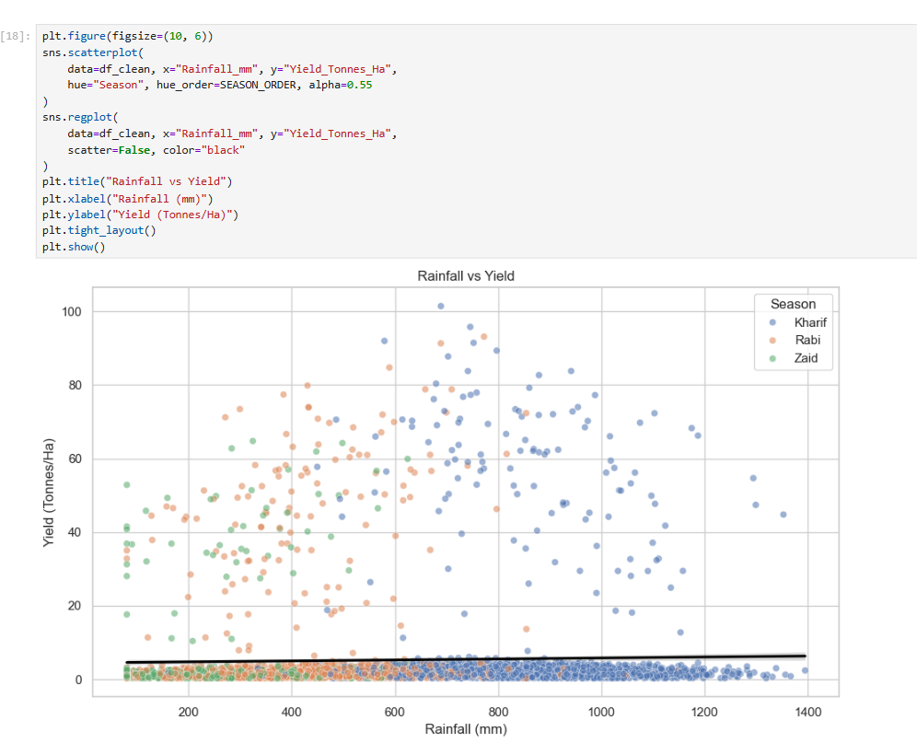
RESULTS

Slide 10
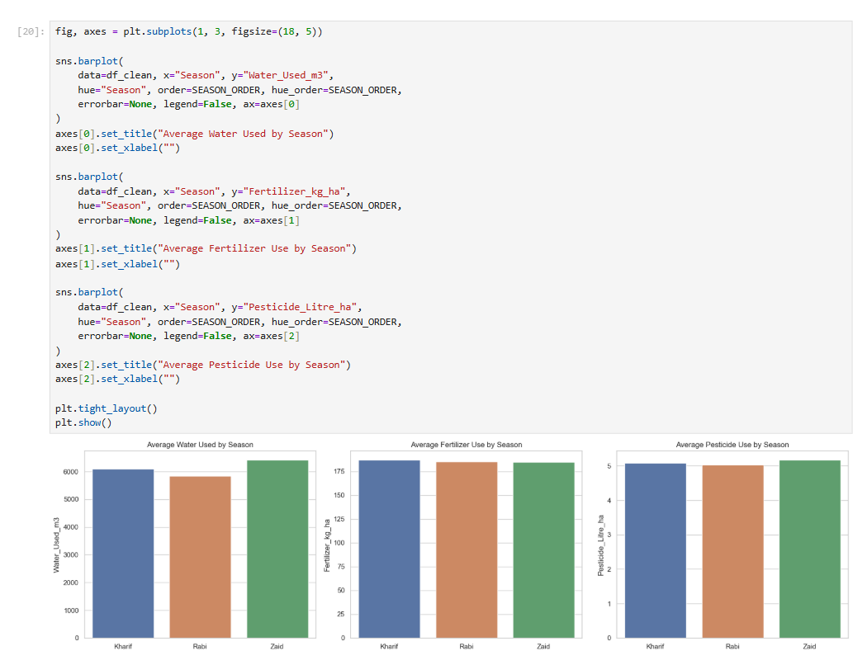
RESULTS

Slide 11
Future scope
Build an interactive dashboard in Power BI for Season × Crop × State exploration.
Extend the model with multi-year or time-series data to separate seasonal effects from year-to-year variation.
Add market-price forecasting and scenario analysis for crop planning.
Develop predictive models for yield, profit and loss risk using environmental and input variables.
Evaluate irrigation methods with stronger controls for crop, state, soil and farm characteristics.
Add geospatial analysis to identify regional hotspots for water stress, pest risk and profitability.

Slide 12
GitHub Link
https://github.com/OmiSaw2072/Seasonal-Agriculture-Performance-Analysis.git

Slide 13
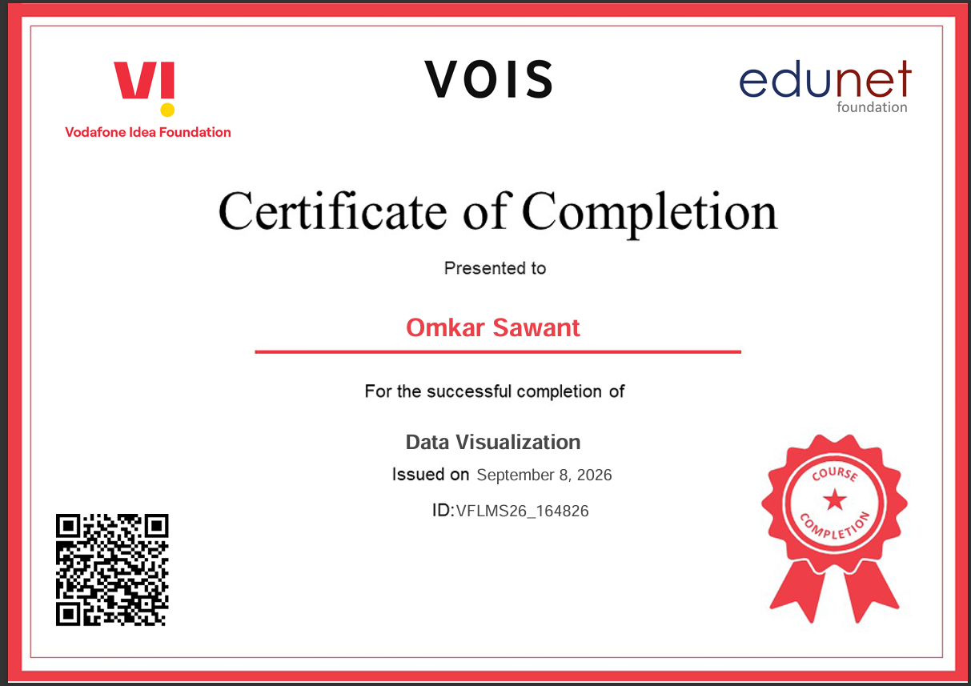
VOIS Course completion certificate - Course name- Data Visualization

Slide 14
Thank you
.

