Slide 1
Metro Bike Share Data
Presented by :
Omkar Khade

Slide 2
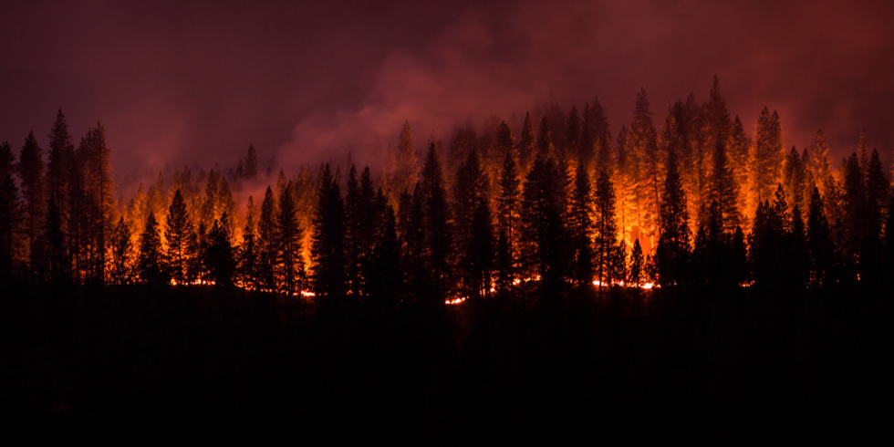
Why did we do it? Why we decided to take on that topic?
Because it is really important to know the
location of vehicles in emergency.
Name of your Project

Slide 3
Data Collection
"The Metro Bike Share system makes bikes available 24/7, 365 days a year in Downtown LA, Central LA, Port of LA and the Westside. Metro Bike Share offers convenient round-the-clock access to a fleet of bicycles for short trips. Metro Bike Share is one of LA Metro's multiple public transportation options for Angelenos and visitors to get around." -https://bikeshare.metro.net/about/
Datset obtained from:
https://www.kaggle.com/cityofLA/los-angeles-metro-bike-share-trip-data

Slide 4
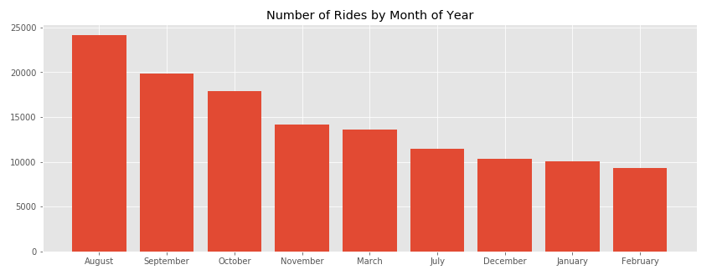
Visualization

Slide 5
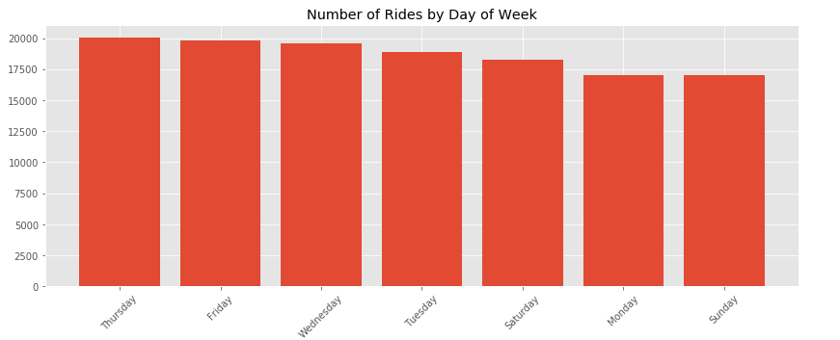

Slide 6
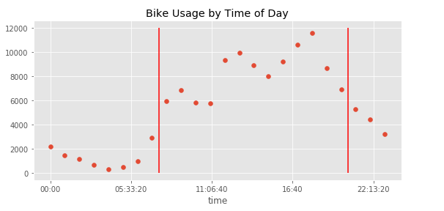

Slide 7
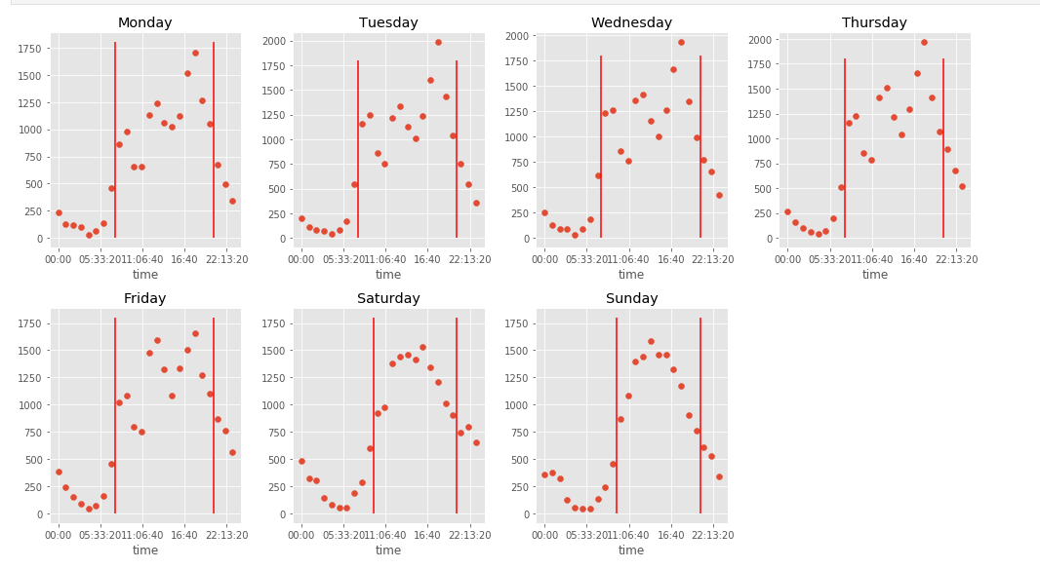

Slide 8
What we learned? What can be next?
Current dataset covers 9 months, updated data lengthening the timescale will allow for year on year factors to be accounted for.
Time is binned by hour in this exercise, more detailed usage of time series data may improve accuracy.
Tune Classification models based on business case for maximizing accuracy in relation to a particular Membership Type with the goal of guiding membership in that direction.

Slide 9
Reference
https://bikeshare.metro.net/

Slide 10
Thank you

