Slide 1


PART 1
Monitoring Asterisk with Prometheus
Introduction & Installation
Omid Mohajerani

Slide 2



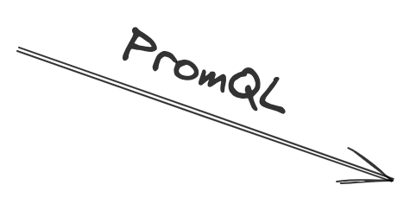





Notes:
Prometheus is a simple powerful metric toolkit that can be used to get information on what your telephony apps are doing and how healthy they are.
Prometheus uses a pull model,
so you need to expose metic from your systems and then Prometheus will go and fetch them every minute or every 30 seconds or whatever you configure
Those systems to monitor could be Linux or Windows Servers providing metrics on CPU, Memory or Disk use, or they could be applications such as Asterisks or FreeSWITCH providing metrics on uptime, number of calls, and number of online sip endpoints.
Prometheus stores metrics in a time series database so all the metrics are recorded with a timestamp.
Saving metrics in time series is all taken care of in the Prometheus server, so the systems you are monitoring just explore the current set of metrics, Prometheus adds the timestamps when it fetches the data and stores it.
Prometheus has its query language and there is an HTTP API running on the Prometheus server which lets you run those queries.

Slide 3
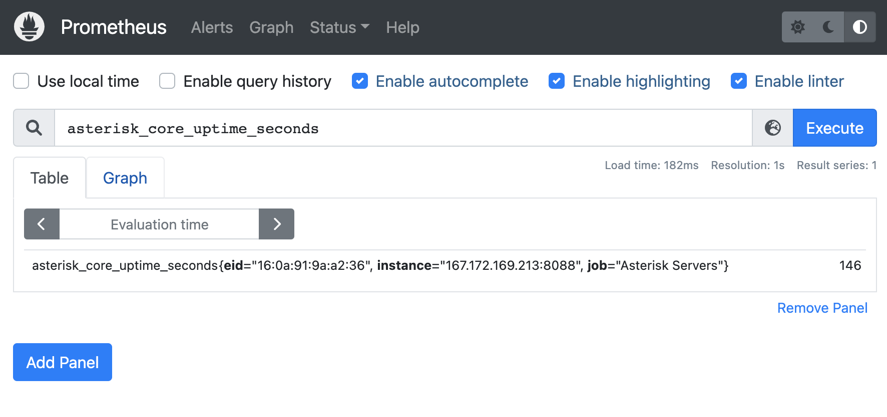
Notes:
There is also a simple WEBUI running on the server, which is for basic administrative tasks.
you can use it to view the server configuration and check that Prometheus can reach the servers that it's configured to monitor

Slide 4
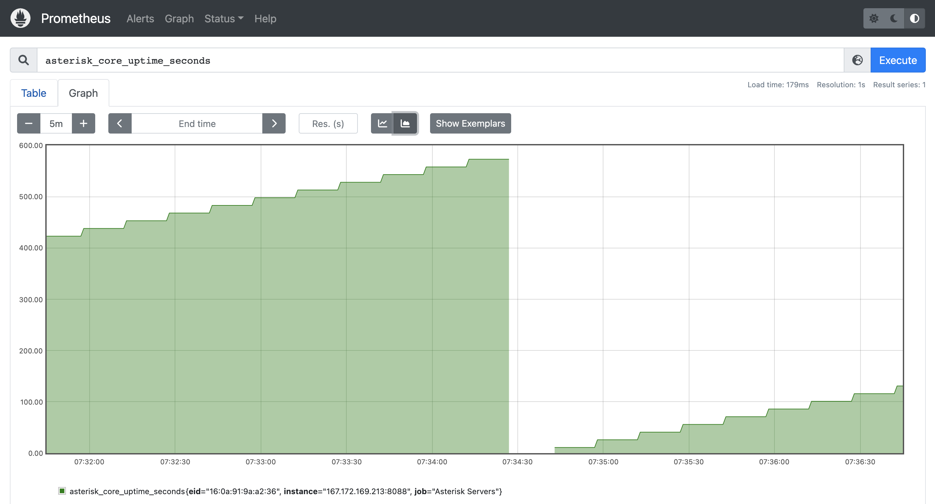
Notes:
you can also run queries with the UI and see the current value of the metric or have them in the graph.

Slide 5
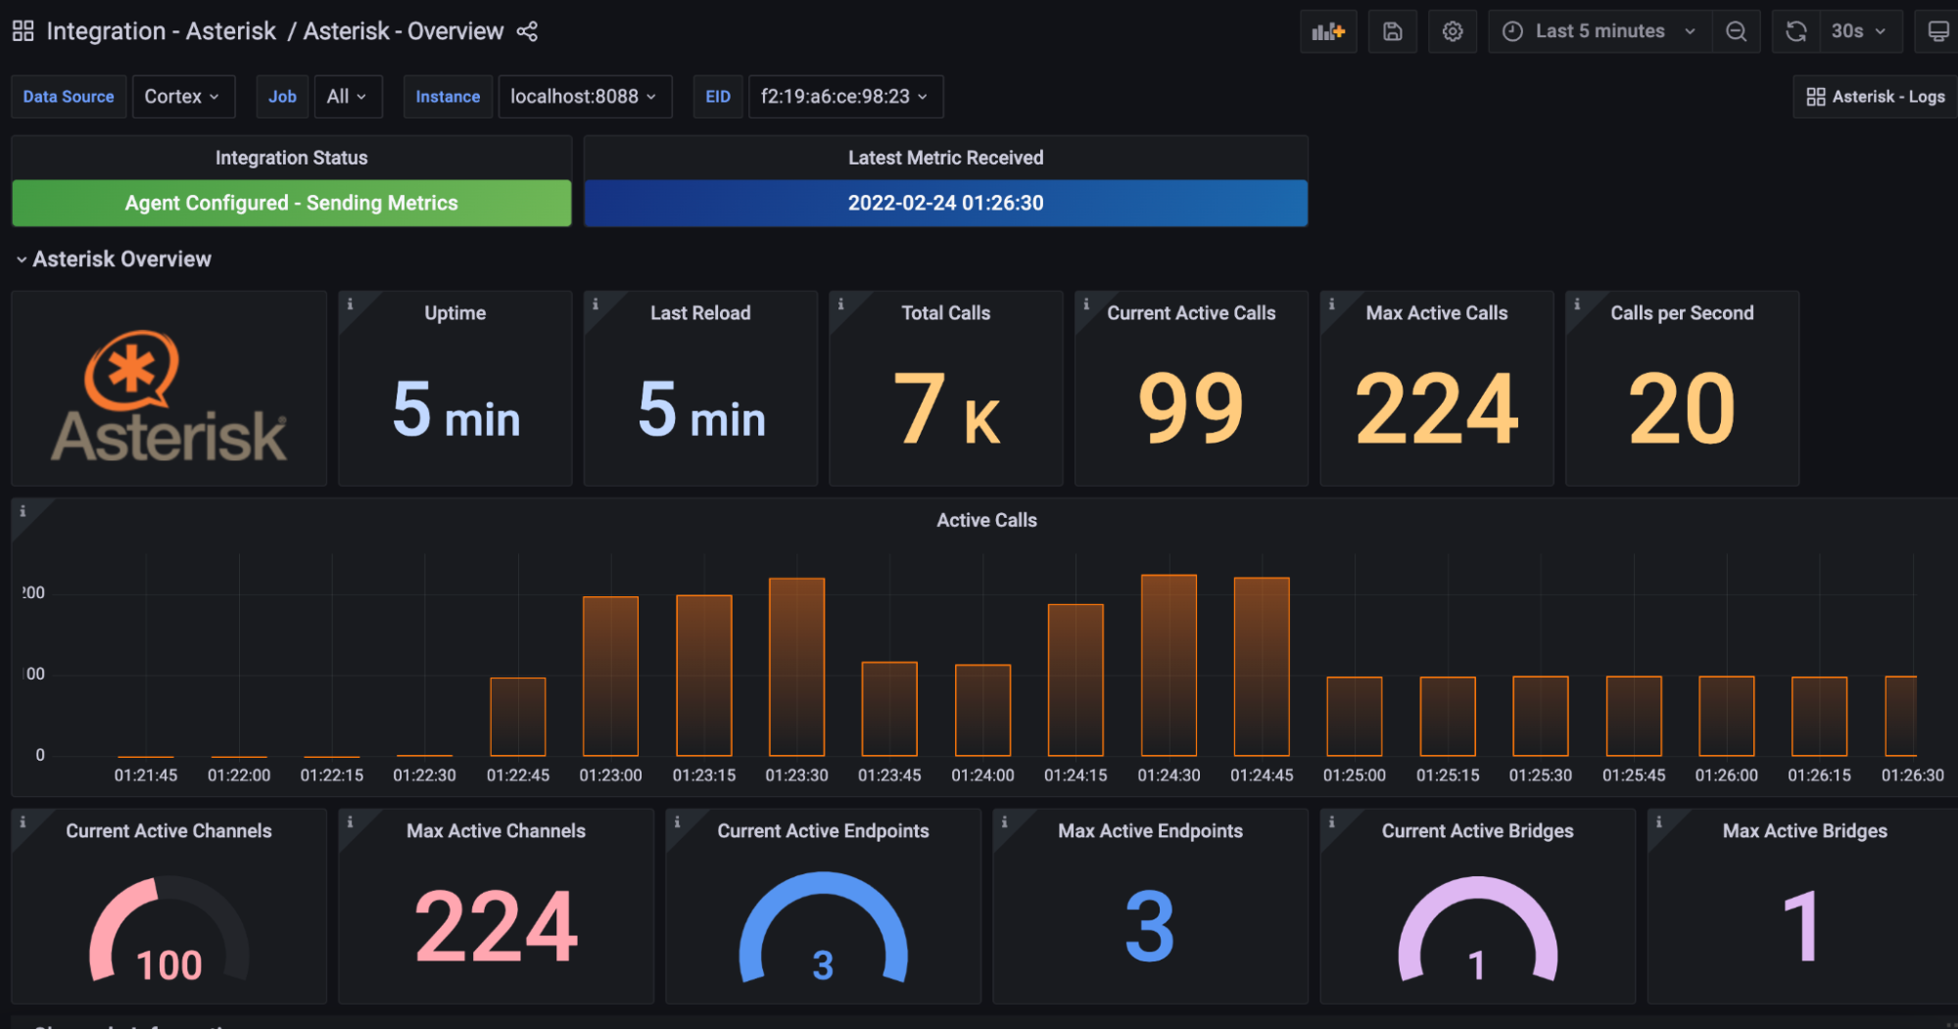
Notes:
But Prometheus UI isn't a fully featured dashboard. For Dashboard, we usually use a separate software which connects to the Prometheus API to get the data to visualize. Yes, I'm referring to Garafan and we will talk about it later in this channel.

Slide 6
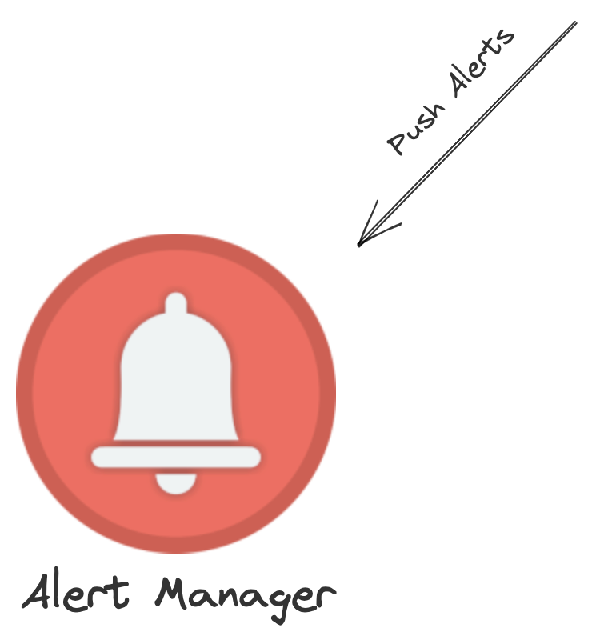
Notes:
Prometheus has a really advanced alerting system as well. We can register alerts in the Prometheus server using rules and when the rules trigger, Prometheus take action on the alerts, sends SMS or emails, creates tickets or even can make a call and play the error message using text-to-speech.
So now that you are more familiar with this tool let's stat by installing the Prometheus on Debian Server

