Slide 1


PART 2
Monitoring Asterisk with Prometheus
Client LIBRARY vs NODE EXPORTER
Omid Mohajerani

Slide 2

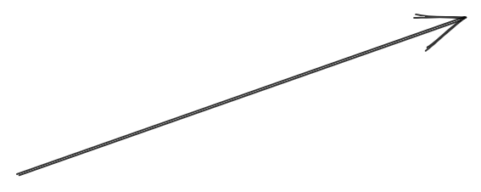
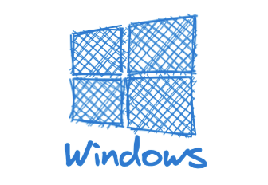
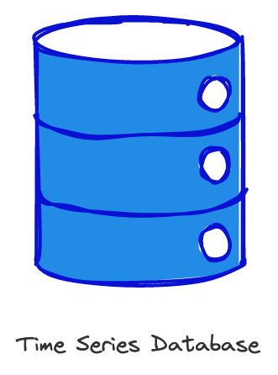
Notes:
The Prometheus server is a really powerful system but what makes Prometheus different to other monitoring solutions is how it fetches metrics from the systems.
Any system that you want to monitor needs to run an exporter which provides all its metrics via HTTP. The Prometheus Sever grabs the metrics from the HTTP every 30 seconds or whatever it's configured and stores them in a Time Series database. It's not important for Prometheus what system it's connecting to fetch metrics or what they mean. The job of the exporter is to provide metrics in standard Prometheus format. even though the content of metrics in each system or application is different, the process of exporting and collecting metrics is the same.

Slide 3
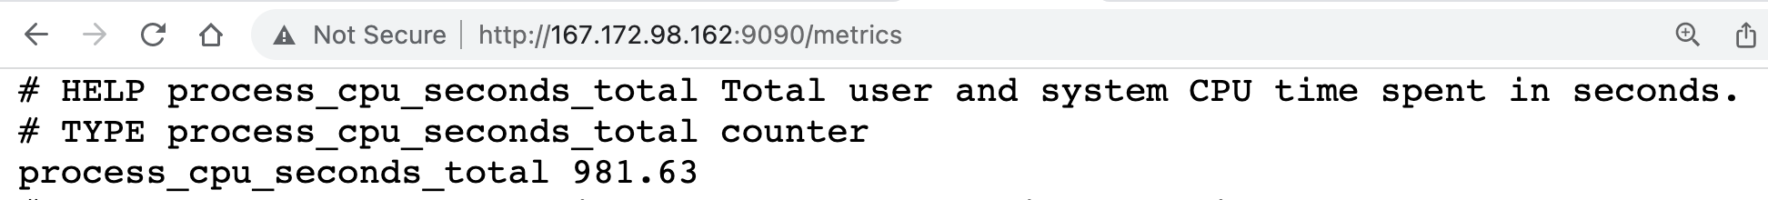
METRIC SAMPLE
Notes:
for example on a Linux server, we can run an exporter process using a tool called the Node Exporter, which is a part of the Prometheus ecosystem. That exporter provides metrics via the HTTP protocol,
Here is an example output from a Linux Node Exporter.
Prometheus format is a simple text format where every metric has a name , a value and it can have a description which includes the type and explanation of that metric.
Metric can have a label as well, for example total number of connection for http protocol is exposed in this metric.

Slide 4
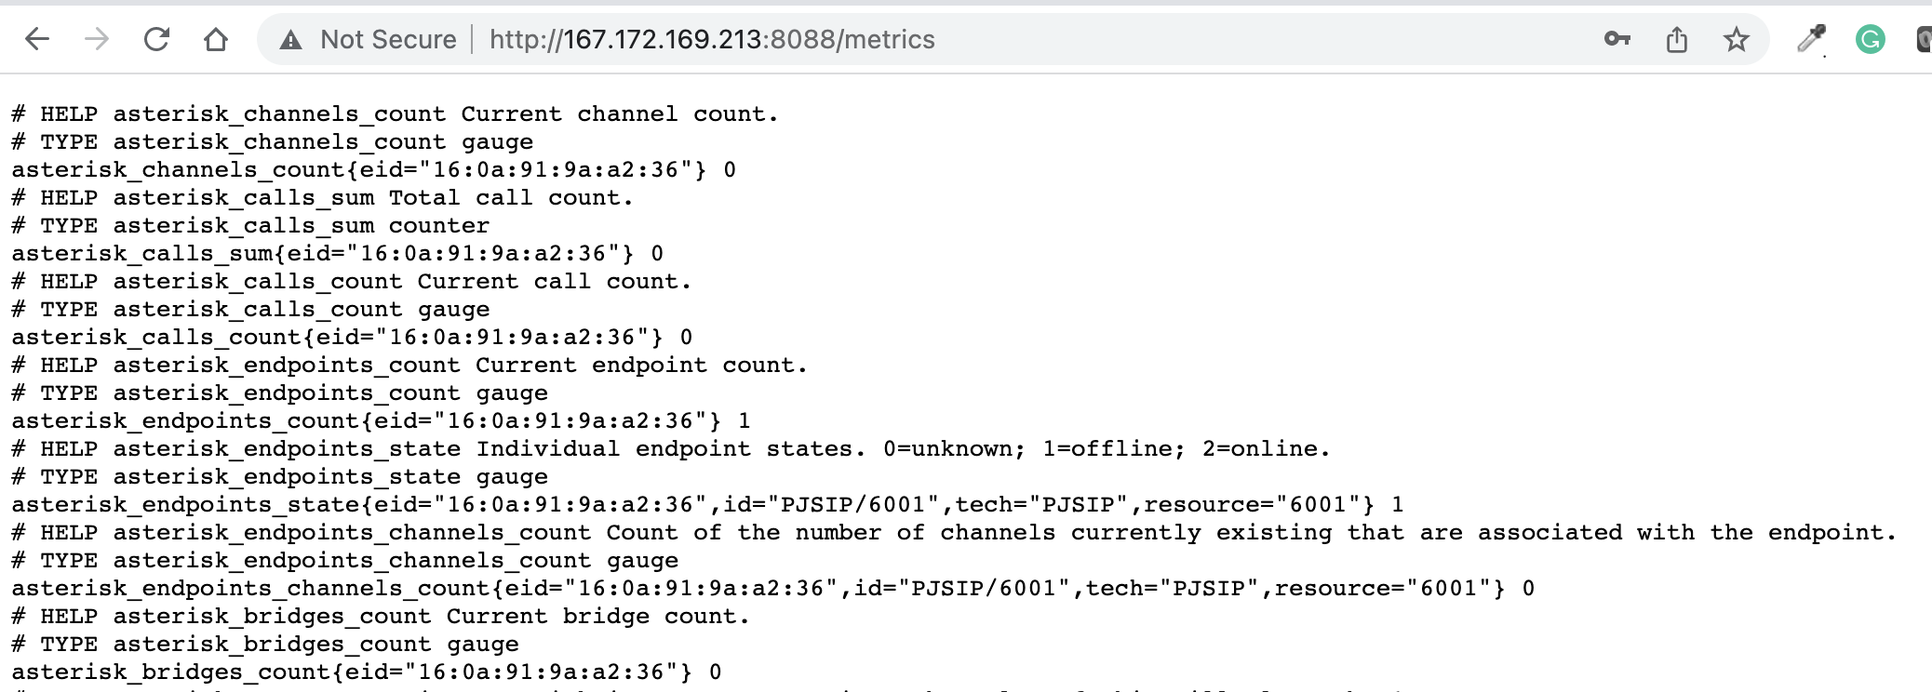
METRIC SAMPLE
Notes:
My Linux Server is running the asterisk application and asterisk also exports Prometheus metrics. Asterisk developers added Prometheus support in the code using Prometheus client libraries. All major programming languages have Prometheus client libraries, which developers can use in their apps. Here is a sample of metrics that asterisk application provides . Metrics such as number of channels , number of calls , number sip endpoints and so on.

Slide 5
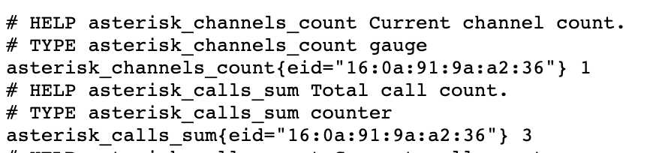
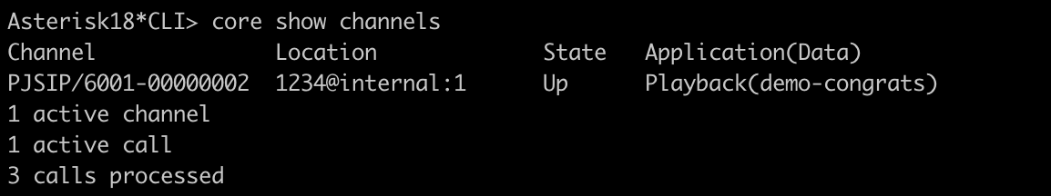
METRIC SAMPLE
Notes:
You can verify these metrics by running asterisk commands . For example here I tested number of channels in asterisk by running ”core show channels” in the asterisk console .

Slide 6








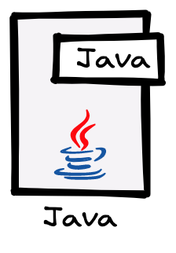


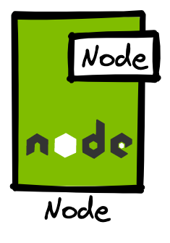
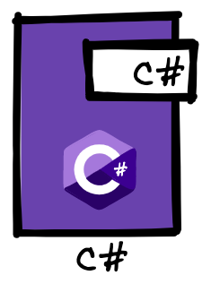
Notes:
So by using Prometheus we will have metrics about hardware, the operating system that our telephony systems run on and the asterisk application itself, all in the same format.
The whole Prometheus monitoring system is built on a single server and there are a whole bunch of exporters for linux , Windows , Databases. WebServers, Cloud Platfroms or even for applications such as elasticearch , asterisk or FreeSWITCH. Prmethues also have client libraries in different languages such as jave , python , Go . Node and Dot net .

Slide 7
Notes:
Now that we know more about how Prometheus metrics works, let's install Node exporter on our Linux Server and view operating system metrics in our Prometheus Server. By end of this lab, we will also have an idea of where the Prometheus configuration files are located and how to work with them. In the next video in this series, we will dig into the asterisk Prometheus configuration to monitor our asterisk.

