Slide 1

Features and Architecture

Slide 2
Agenda
Introduction
Architecture
Features
License costing

Slide 3
What is VoIPmonitor?
VoIPmonitor is open source network packet sniffer with commercial frontend for SIP RTP RTCP SKINNY(SCCP) MGCP WebRTC VoIP protocols running on linux.
VoIPmonitor is designed to analyze quality of VoIP call based on network parameters - delay variation and packet loss according to ITU-T G.107 E-model which predicts quality on MOS scale.
Calls with all relevant statistics are saved to MySQL database.
Optionally each call can be saved to pcap file with either only SIP protocol or SIP/RTP/RTCP/T.38/udptl protocols.
VoIPmonitor can also decode speech and play it over the commercial WEB GUI or save it to disk as WAV.
Supported codecs are G.711 alaw/ulaw and commercial plugins supports G.726 G.722 G.729a G.723 iLBC Speex GSM Silk iSAC OPUS AMR.
VoIPmonitor is also able to convert T.38 FAX to PDF.

Slide 4
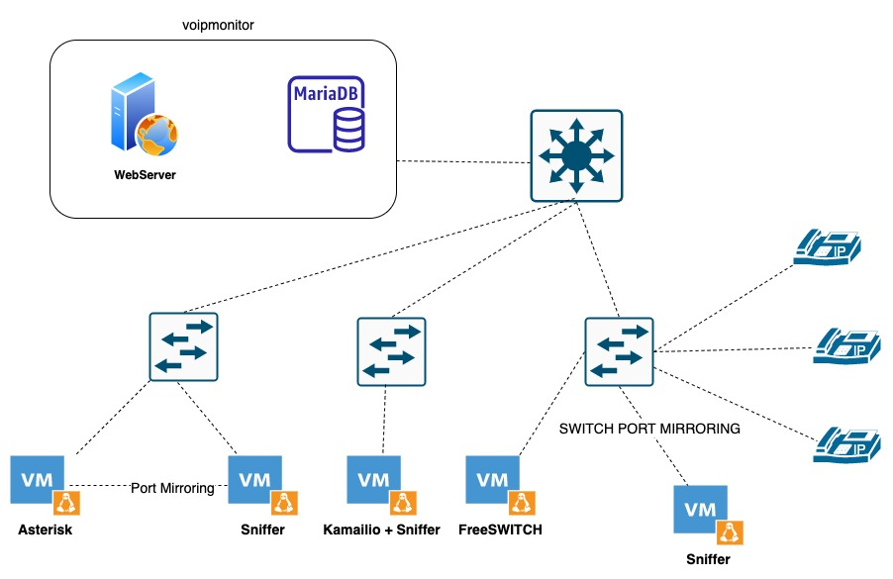
Architecture

Slide 5
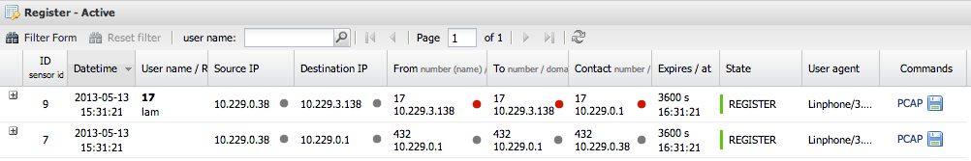
Main Features
Supported protocols: SIP RTP RTCP SKINNY(SCCP) MGCP SS7 SCTP WebRTC TCP SSL TLS
Supported transports: UDP TCP

Slide 6
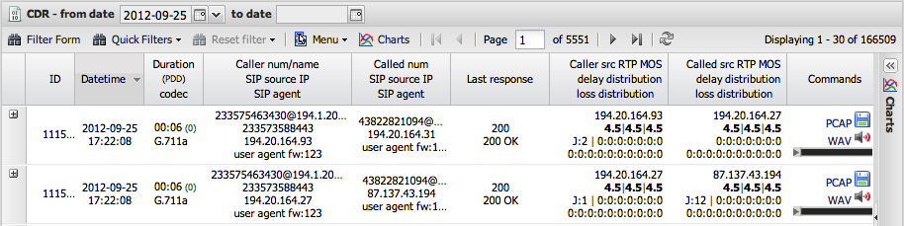
Main Features
Output: CDR, full SIP/RTP pcap, WAV OGG audio, T.38 PDF FAX

Slide 7
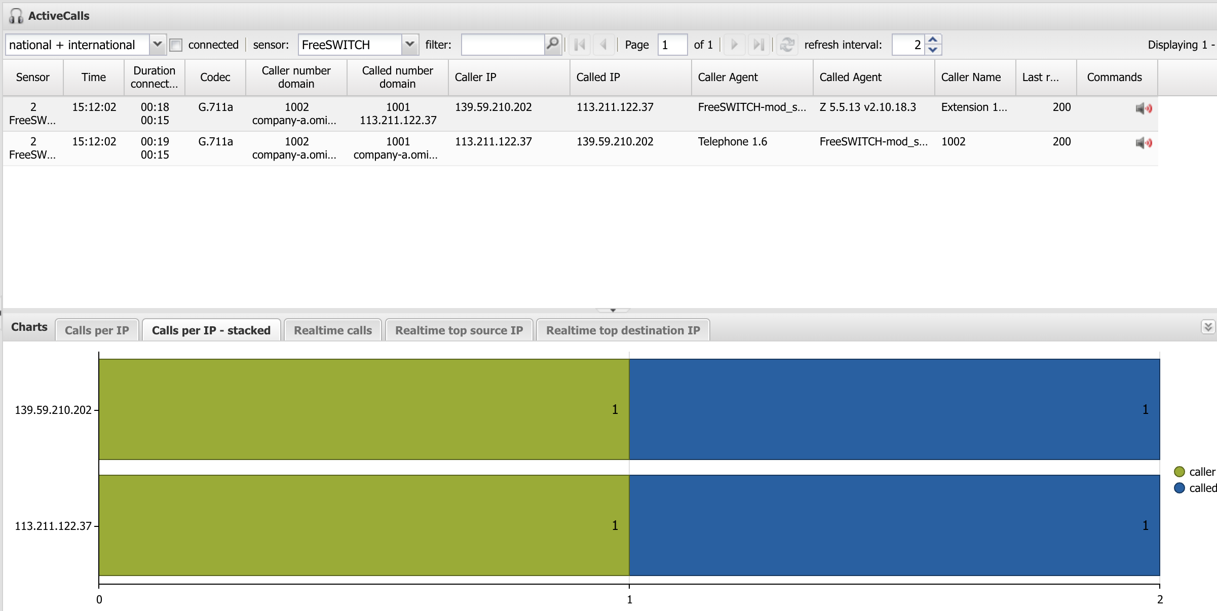
Main Features
Active Calls and Call Spy

Slide 8
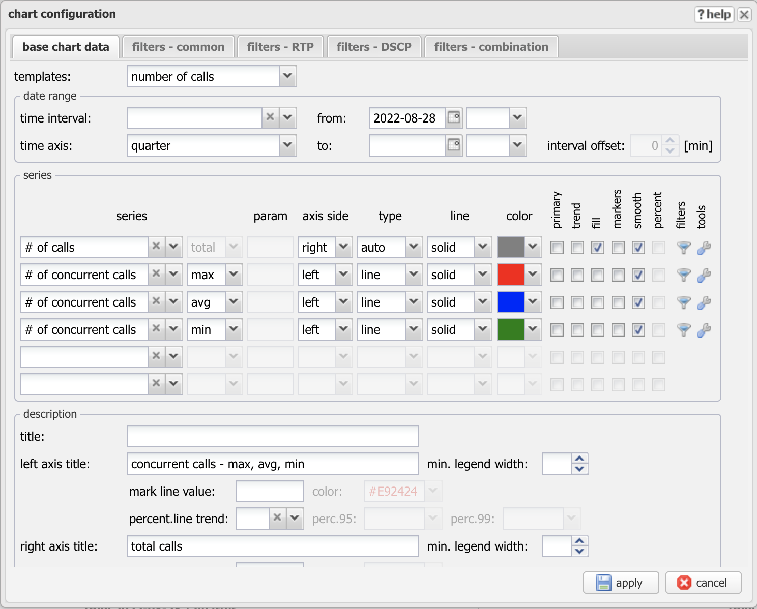
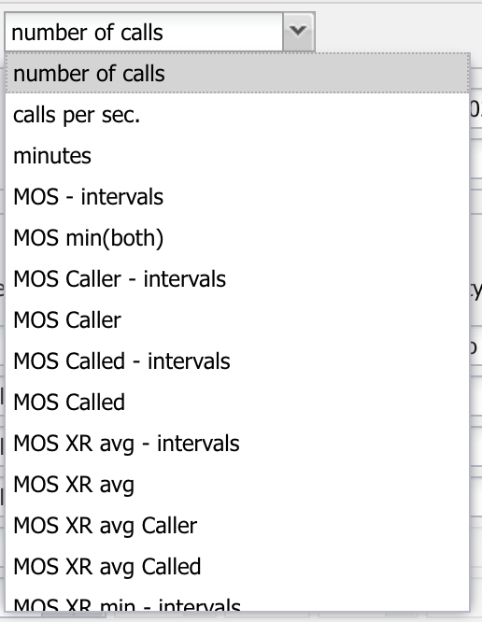
Main Features
Comprehensive statistics / charts / dashboards

Slide 9
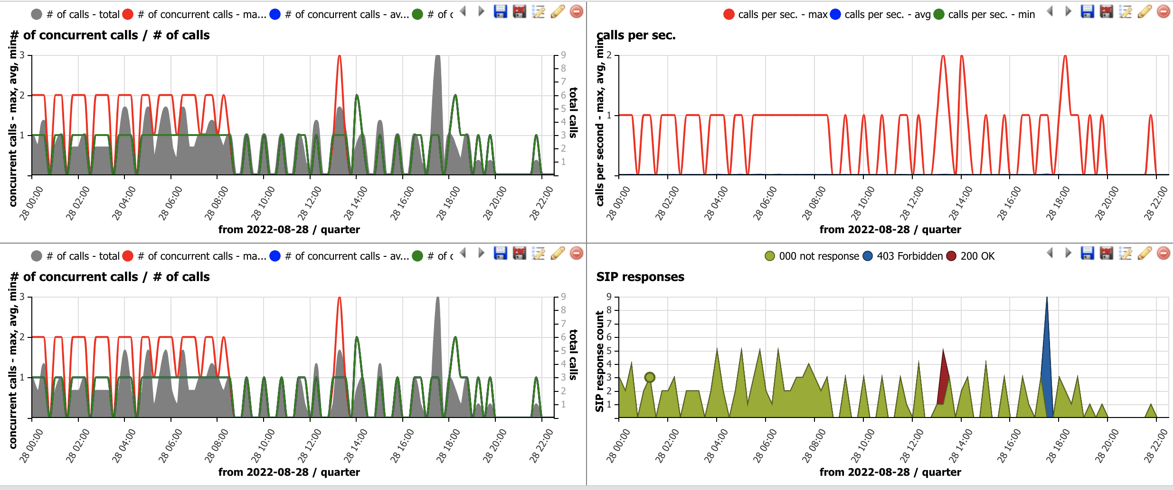
Main Features
Comprehensive statistics / charts / dashboards
https://www.voipmonitor.org/doc/Charts

Slide 10
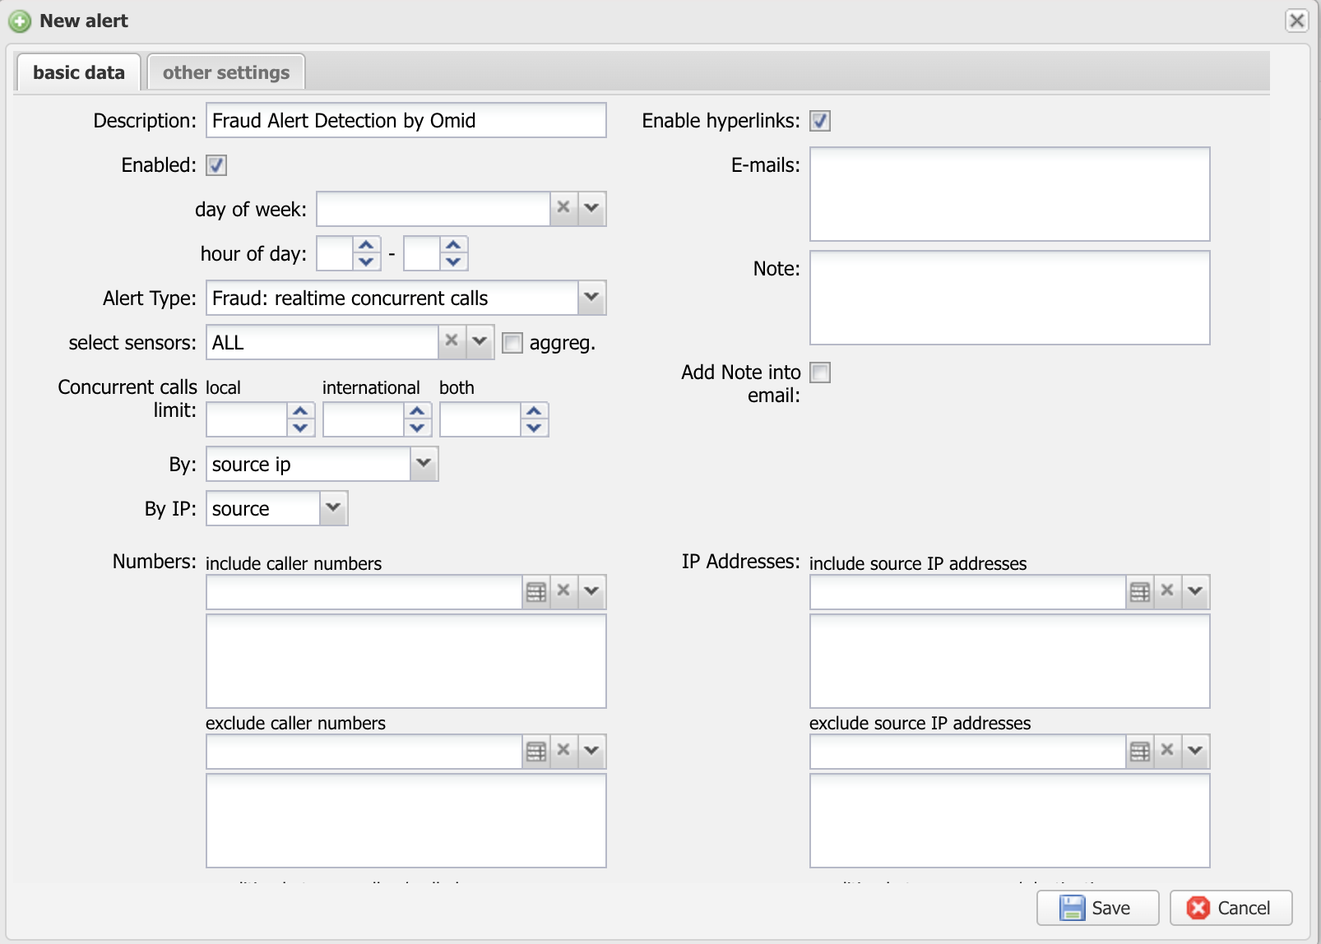
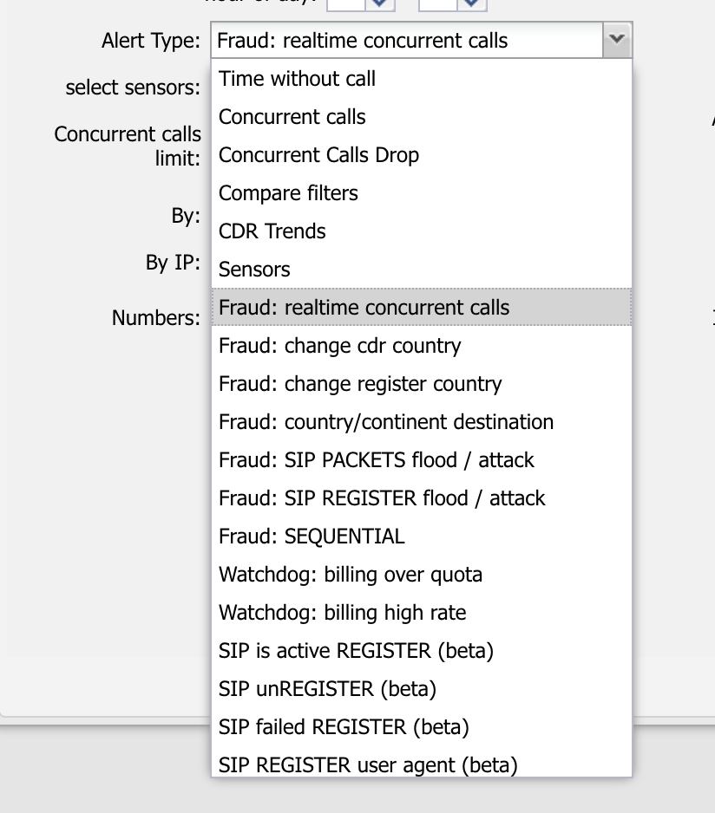
Main Features
Alerting & Antifraud
Notes:
Alerts&Reports contains tools to generate email alerts based on QoS parameters or SIP error conditions. It can also generate daily report or generate ad hoc reports. All generated alerts and reports are saved in history.

Slide 11
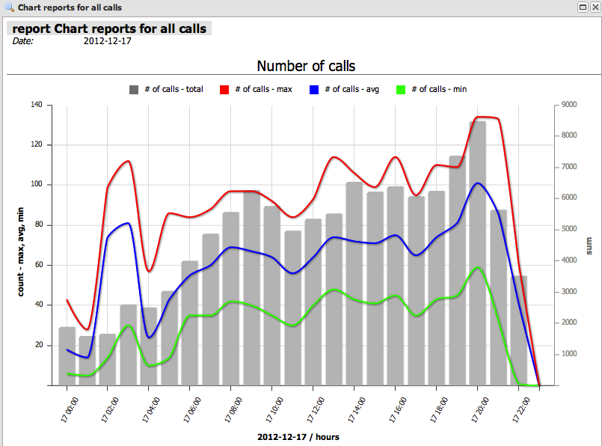
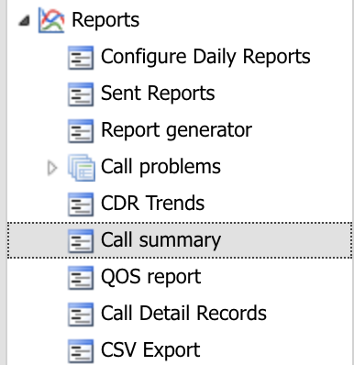
Main Features
Reports

Slide 12
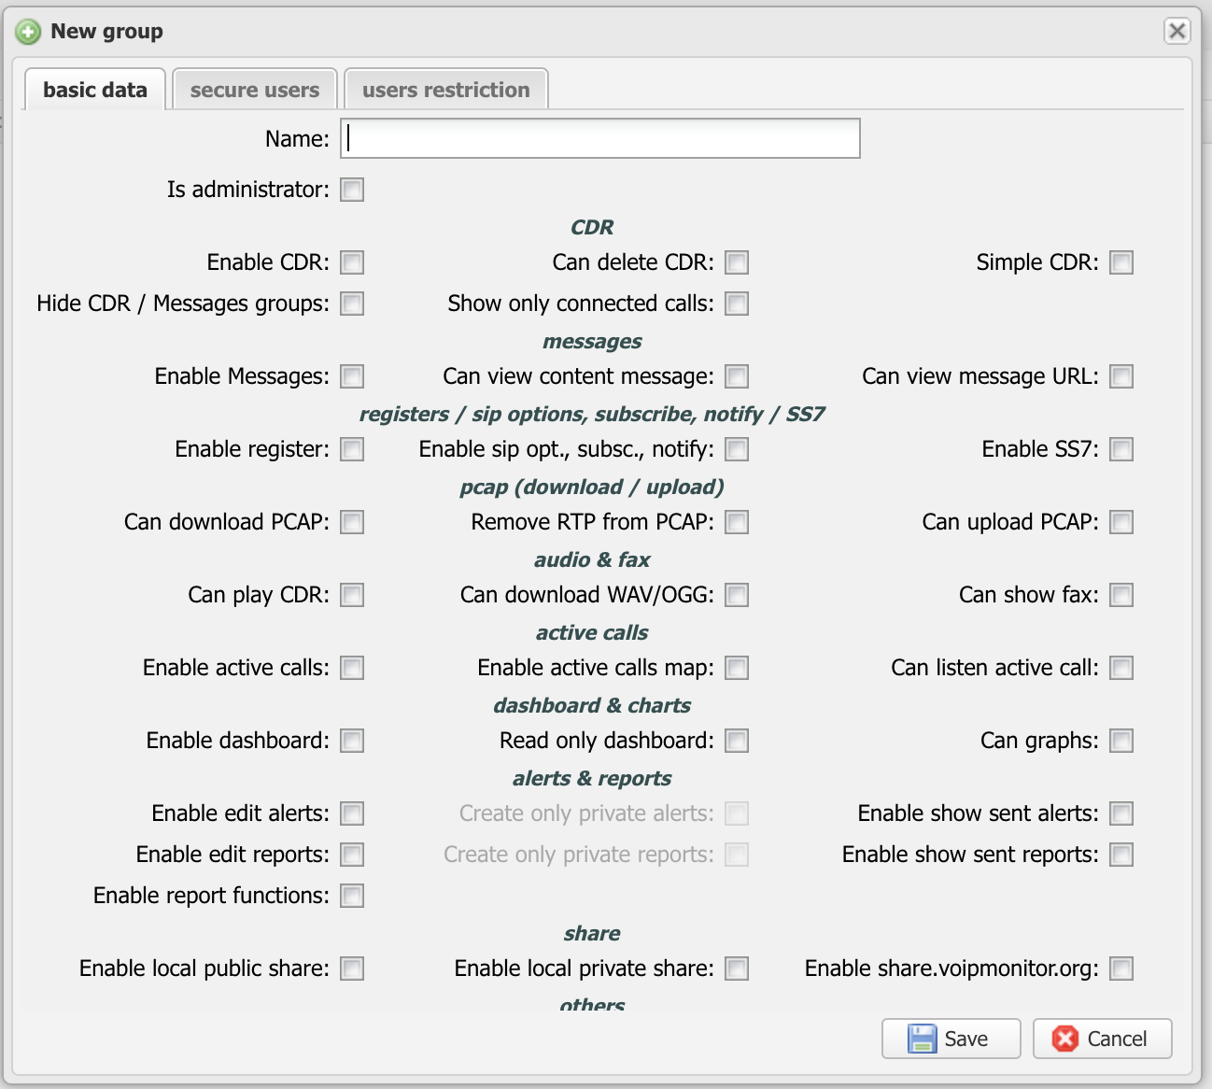
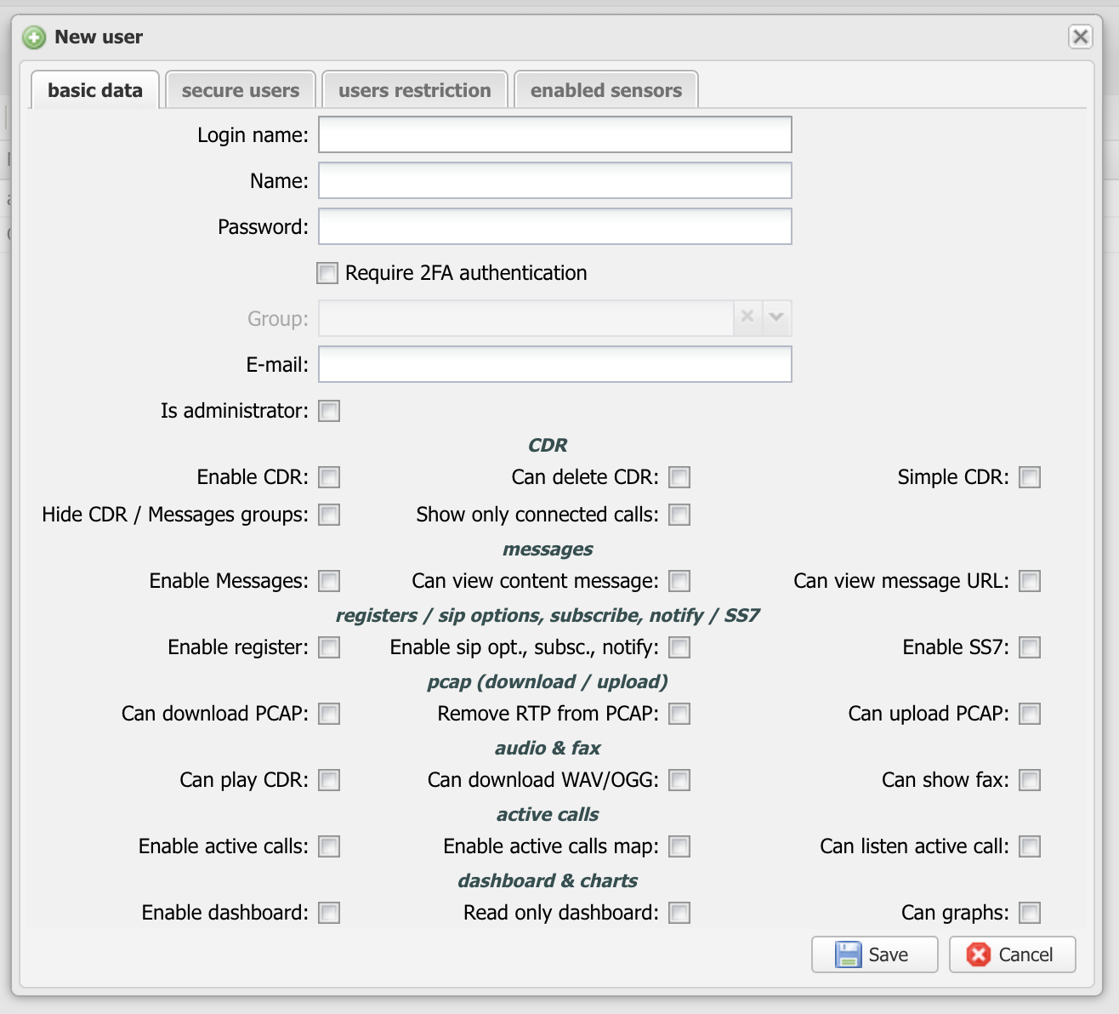
Main Features
Multi-user Multi-role access

Slide 13
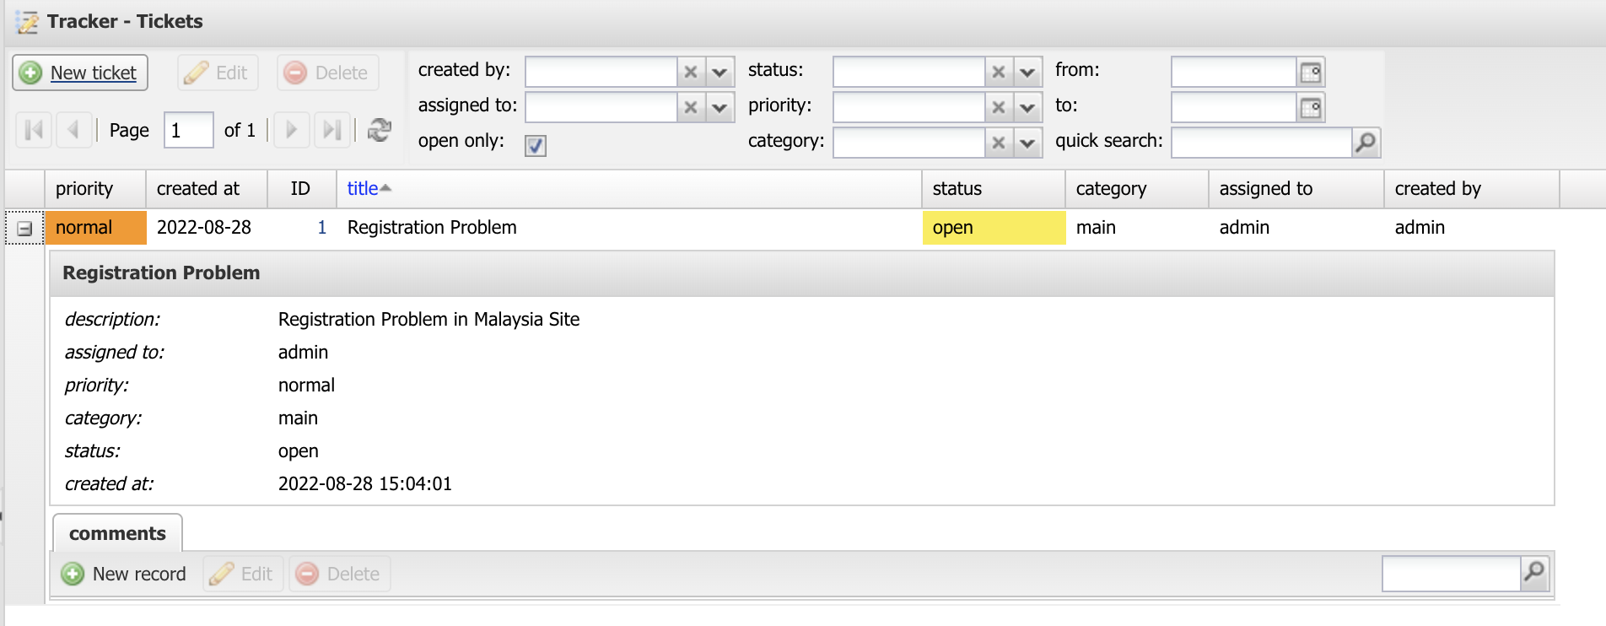
Main Features
Issue Tracker

Slide 14
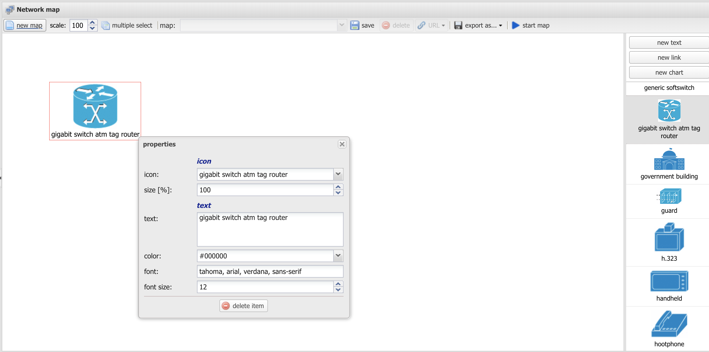
Main Features
network Map

Slide 15
Compatibility
VoIPmonitor is a passive analyser which can decode any software and hardware based SIP
VoIPmonitor is tested and used to monitor all major opensource SIP platforms (Kamailio Opensips Freeswitch Asterisk SipXecs OpenUC)
VoIPmonitor is tested and used by major proprietar SIP PBX/SBC
VoIPmonitor can run on any hardware running linux including all virtual and cloud platforms
VoIPmonitor sniffer can run directly on the linux SIP host or as a dedicated virtual or physical hardware listening to mirrored packets (Switch mirroring / TAP)

Slide 16


License Cost

